Slide 1


ECON104 TUTORIAL TEST
Wednesday 18th March
4 - 5pm Rehua 002
Notes:
Introduce
Ourselves
The Club
Thank for coming
Explain
Thank for submitting
Why we are going these

Slide 2
SIGN UP FOR FREE
Website: www.ucinvestmentsociety.com
STAY UPDATED FOR EVENTS
Facebook Page: The Investment Society
Instagram: the_investmentsociety
QUESTIONS AND FEEDBACK
Email: sbu125@uclive.ac.nz

Slide 3
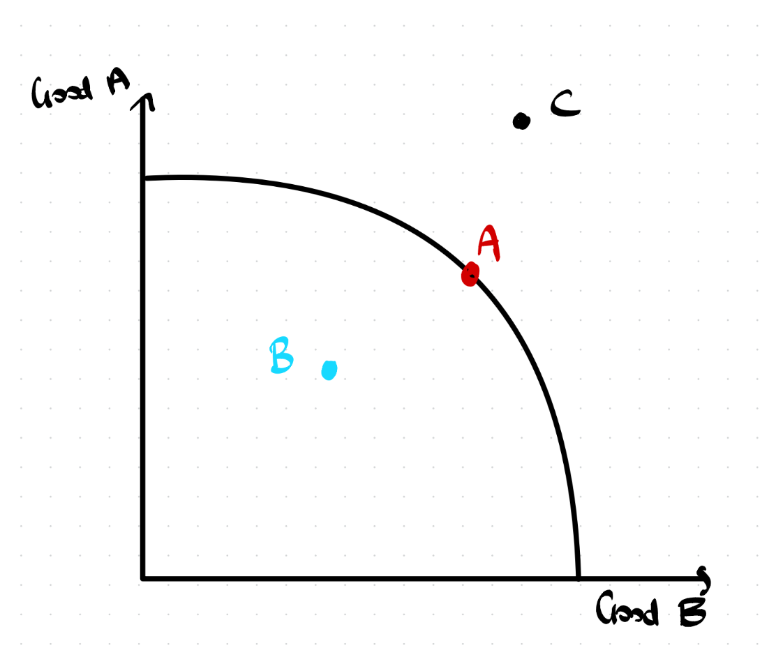
Production Possibility Frontier
PPF Model -> firms ability to produce two different goods
Assumptions:
No change in technology
No change in level of resources
Point A - this shows point of maximum efficiency where firm has maximised their resources to full potential
Point B - point inside the frontier shows inefficient allocation of resources sometimes referred to as an unemployment of resources
Point C - point outside the frontier is unachievable unless our assumptions are broken

Slide 4
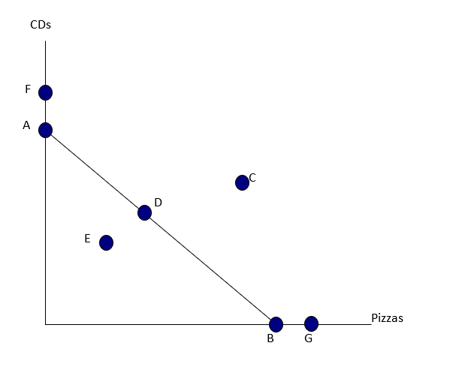
Production Possibilities Example Questions
On the production possibilities graph shown, which point represents the maximum possible production of pizzas given current resources and technology?
G.
B.
C.
D.
The most production efficient use of existing resources is represented by point
E.
D.
C.
G.

Slide 5
Production Possibilities Example Questions
On the production possibilities graph shown, which point represents the maximum possible production of pizzas given current resources and technology?
G.
B.
C.
D.
The most production efficient use of existing resources is represented by point
E.
D.
C.
G.

Slide 6
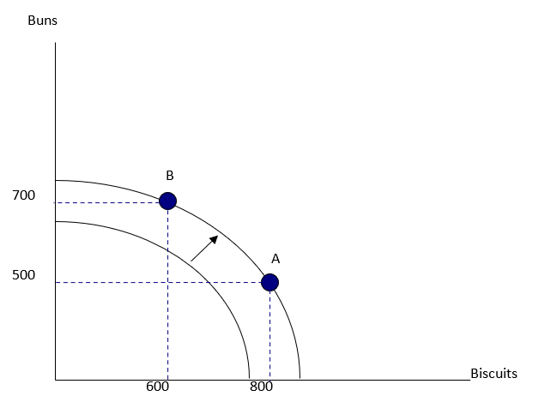
Production Possibilities Example Questions
In the production possibilities graph shown, what is the opportunity cost of the movement from point B to point A?
200 biscuits.
200 buns.
800 biscuits.
500 buns.
In the production possibilities graph shown, which of the following is the most likely cause of the outward shift of the production possibilities frontier?
The destruction of economic resources because of war.
Better technology in the production of buns and biscuits.
A decrease in society’s preference for buns and biscuits.
An increase in society’s preference for buns and biscuits.

Slide 7
Production Possibilities Example Questions
In the production possibilities graph shown, what is the opportunity cost of the movement from point B to point A?
200 biscuits.
200 buns.
800 biscuits.
500 buns.
In the production possibilities graph shown, which of the following is the most likely cause of the outward shift of the production possibilities frontier?
The destruction of economic resources because of war.
Better technology in the production of buns and biscuits.
A decrease in society’s preference for buns and biscuits.
An increase in society’s preference for buns and biscuits.
Notes:
Opportunity cost = Next best alternative forgone when a decision is made

Slide 8
Advantages Example Questions
Comparative advantage is based on
Absolute labour productivity.
Relative labour costs.
Relative opportunity costs.
Dollar price.
Absolute advantage is found by
Comparing relative opportunity cost.
Calculating the comparative advantage.
Comparing productivity of one nation to that of another.
None of the above is correct.

Slide 9
Advantages Example Questions
Comparative advantage is based on
Absolute labour productivity.
Relative labour costs.
Relative opportunity costs.
Dollar price.
Absolute advantage is found by
Comparing relative opportunity cost.
Calculating the comparative advantage.
Comparing productivity of one nation to that of another.
None of the above is correct.

Slide 10
Trade Example Questions
Economists say that free trade is beneficial because
Goods are cheaper for consumers.
Producers export more.
Total surplus in the market will be increased.
Employment will be increased.
Assume India trades one T.V. with China in return for two toys. The opportunity cost of producing one T.V. in India must be
Greater than two toys.
Less than two toys.
Measured in dollars.
All of the above.

Slide 11
Trade Example Questions
Economists say that free trade is beneficial because
Goods are cheaper for consumers.
Producers export more.
Total surplus in the market will be increased.
Employment will be increased.
Assume India trades one T.V. with China in return for two toys. The opportunity cost of producing one T.V. in India must be
Greater than two toys.
Less than two toys.
Measured in dollars.
All of the above.

Slide 12
Comparative Advantage Question
Given the table below determine the opportunity cost of producing one Laptop for both Firm Alpha and Firm Beta?
Which firm has the comparative advantage in producing laptops, explain why?
For trade to be mutually beneficial for both firms what is the range of prices (in terms of ipads) that could be established for one laptop?
Firm | Laptops | Ipads
Alpha | 100 | 200
Beta | 100 | 500

Slide 13
Firm Alpha: Produce 100 Laptops, Alpha gives up 200 Ipads. Therefore 1 Laptop = 2 Ipads
Firm Beta: Produce 100 Laptops, Beta gives up 500 Ipads. Therefore 1 Laptop = 5 Ipads
Firm Alpha has the Comparative advantage in Laptops because its opportunity cost of 2 Ipads is lower than Alpha’s.
For trade to occur, price of a good must fall between the two firm's opportunity costs.
Firm Alpha will only trade if they receive more than 2 Ipads as that is what it costs them to produce it themselves.
Firm Beta will only trade if they pay less than 5 Ipads, as they could produce it themselves for that cost.
Overall the mutually beneficial price for the two firms falls between 2 and 5 Ipads per Laptop.
E.g. if the price is 4 Ipads for 1 Laptop
Alpha: trade 1 laptop receive 4 Ipads exceeds current rate of 2 Ipads
Beta: trade 4 Ipads receive 1 Laptop saves one additional Ipad being sacrificed

Slide 14
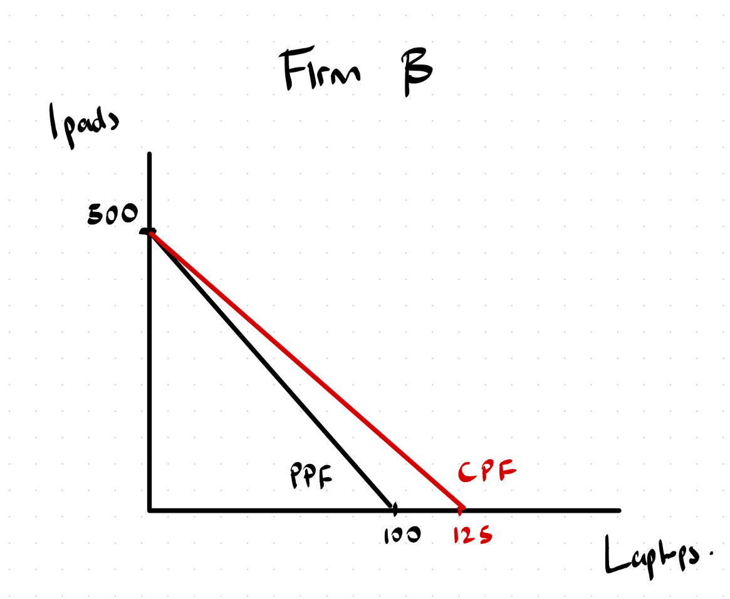
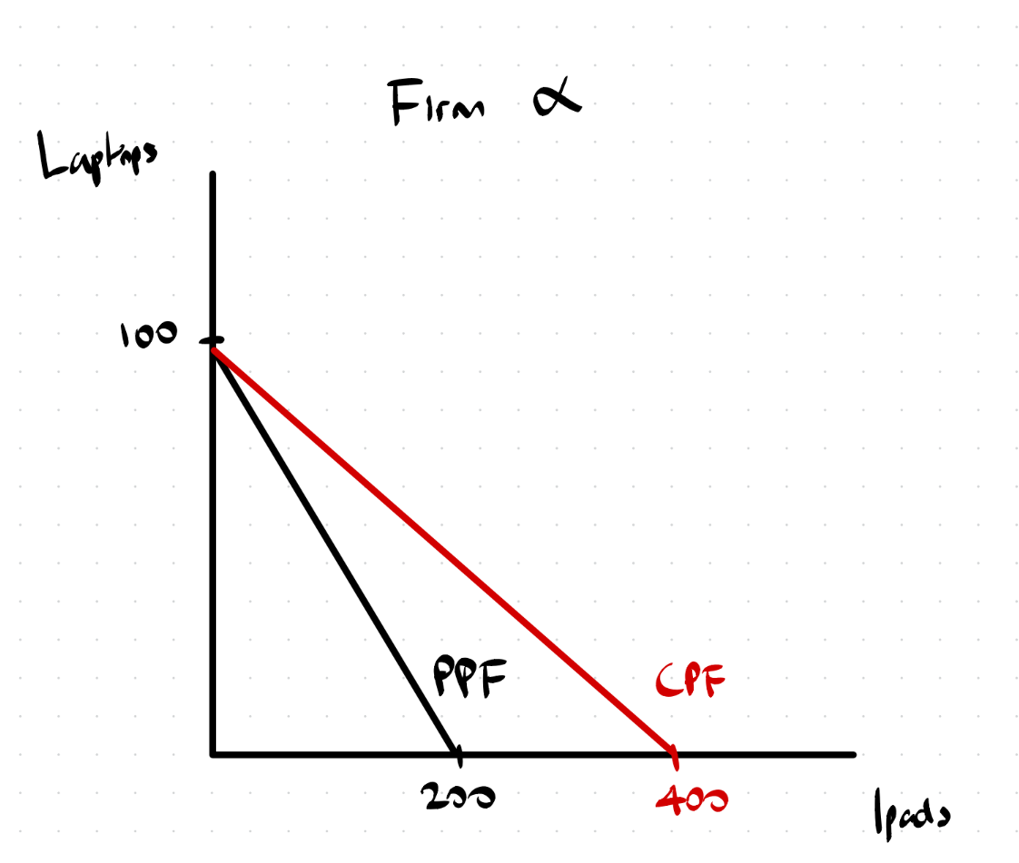
Visual Representation:

Slide 15
Elasticity
Elasticity of Demand measures responsiveness of quantity demand to a given change in price
Goods tend to either be Inelastic PED < 1 or Elastic PED > 1 with a scarce goods that fall in the grey areas i.e. PED = 1
Inelastic Nature - Necessities, small number of firms or close substitutes, small % of income spent on the good, sometimes not for all these goods they are addictive in nature
Elastic Nature - opposite- luxury, large number of firms, higher % of income
Formula: (△Qd / △P) * (P / Qd) or (△Qd * P) / (△P * Qd)
Elasticity of Supply measures responsiveness of quantity supplied in regards to a given change in price
Tend to measure this responsiveness through time as that is the greatest factor that determines a firm’s ability to change quantity supply
Short term = inelastic as harder to change stock levels, long term = elastic as time to adjust to the market
Formula same as above replace Qd with Qs

Slide 16
PED/ PES | Coefficient | Proportional Relationship between P and Qd/ Qs
Perfectly Elastic | Infinite | Infinite change in Qd when P changes
Elastic | > 1 | Qd more than proportional to change in P
Inelastic | < 1 | Qd less than proportional to change in P
Unitary | 1 | Exact proportional relationship
Perfectly Inelastic | 0 | No change occurs when P changes
Cross Price Elasticity: Substitute Complementary CPED = (% change Qd Good A) (% change in P Good B) | Sub = Positive Comp = Negative | Sub positive because as P of Good A increase, Qd of Good B increase as more affordable Comp negative as P of Good A increase, Qs of Good B decrease as these goods benefit each other
Income (YED) Necessity Luxury Inferior YED = % change Qd % change in Income | Necessity = 0 < x < 1 Luxury > 1 Inferior < 0 | Income changes are like our price changes
Notes:
CPED =

Slide 17
Elasticity Example Questions
Price elasticity of demand measures
How much the price of a good changes when there is a change in the quantity demanded.
How much the quantity demanded responds to a change in the price.
How much the price of a good changes when there is a change in the number of buyers.
How much the demand shifts for a given change in the price of the good.
Which of the following statements is NOT correct?
If buyers are relatively responsive to a change in price, demand is said to be elastic.
If buyers are relatively unresponsive to a change in price, demand is said to be inelastic.
If buyers have no good substitutes for a good, the demand for the good will tend to be inelastic.
If buyers consider the good a luxury good, the demand for the good will tend to be inelastic.

Slide 18
Elasticity Example Questions
Price elasticity of demand measures
How much the price of a good changes when there is a change in the quantity demanded.
How much the quantity demanded responds to a change in the price.
How much the price of a good changes when there is a change in the number of buyers.
How much the demand shifts for a given change in the price of the good.
Which of the following statements is NOT correct?
If buyers are relatively responsive to a change in price, demand is said to be elastic.
If buyers are relatively unresponsive to a change in price, demand is said to be inelastic.
If buyers have no good substitutes for a good, the demand for the good will tend to be inelastic.
If buyers consider the good a luxury good, the demand for the good will tend to be inelastic.

Slide 19
Elasticity Example Questions
Demand is said to be elastic
If the price of the good responds only slightly to changes in the quantity demanded.
If the demand shifts only slightly when the price of the good changes.
If buyers respond substantially to changes in the price of the good.
If the quantity demanded changes only slightly when the price of the good changes.
Income elasticity of demand measures how
The quantity demanded changes as consumer income changes.
Consumer purchasing power is affected by a change in the price of a good.
The price of a good is affected when there is a change in consumer income.
Many units of a good a consumer can buy given a certain income level.

Slide 20
Elasticity Example Questions
Demand is said to be elastic
If the price of the good responds only slightly to changes in the quantity demanded.
If the demand shifts only slightly when the price of the good changes.
If buyers respond substantially to changes in the price of the good.
If the quantity demanded changes only slightly when the price of the good changes.
Income elasticity of demand measures how
The quantity demanded changes as consumer income changes.
Consumer purchasing power is affected by a change in the price of a good.
The price of a good is affected when there is a change in consumer income.
Many units of a good a consumer can buy given a certain income level.

Slide 21
Elasticity Example Questions
Canterbury University has decided to raise the price on parking permits to increase revenue. If the buyers of parking permits respond substantially to an increase in price, then
The planned price increase would not enhance revenue.
The planned price increase would enhance revenue.
Canterbury University should increase the price of parking permits a lot.
The price elasticity of demand for parking permits is inelastic.
If the price of wheat rises, incentives are created for
People to buy less wheat.
Farmers to grow more wheat.
Government to lower the price of wheat.
1 and 2.

Slide 22
Elasticity Example Questions
Canterbury University has decided to raise the price on parking permits to increase revenue. If the buyers of parking permits respond substantially to an increase in price, then
The planned price increase would not enhance revenue.
The planned price increase would enhance revenue.
Canterbury University should increase the price of parking permits a lot.
The price elasticity of demand for parking permits is inelastic.
If the price of wheat rises, incentives are created for
People to buy less wheat.
Farmers to grow more wheat.
Government to lower the price of wheat.
1 and 2.

Slide 23
Supply and Demand Diagrams and Long Answer Section

Slide 24
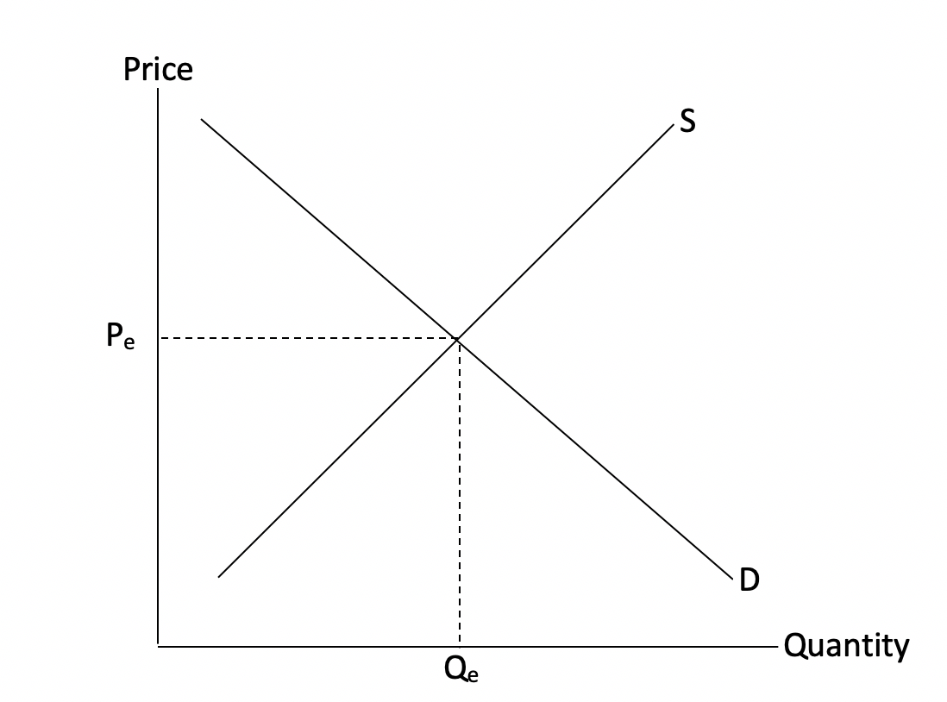
Demand and Supply Example Questions
If a government wants to help local producers of shoes, they could impose a minimum price above the current equilibrium price. In your answer booklet, draw a diagram showing the effect on the NZ shoe market of imposing a minimum price above the equilibrium price (assume there are no exports or imports in the market).

Slide 25
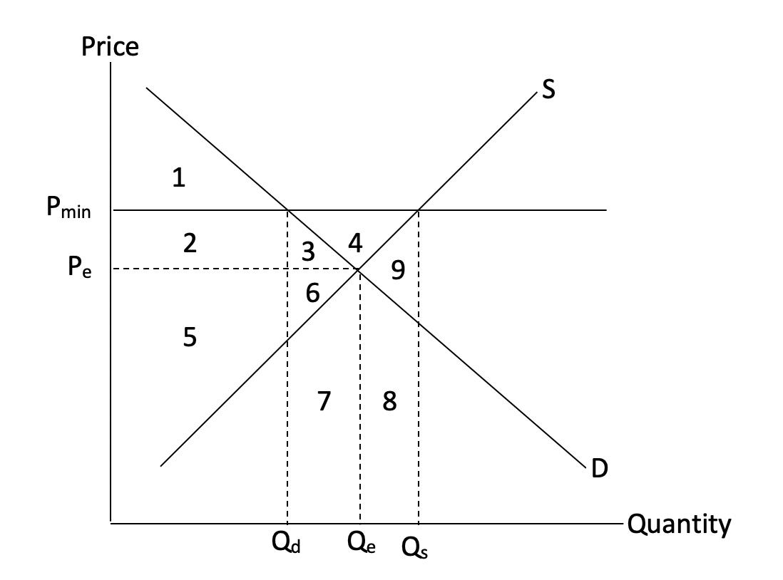
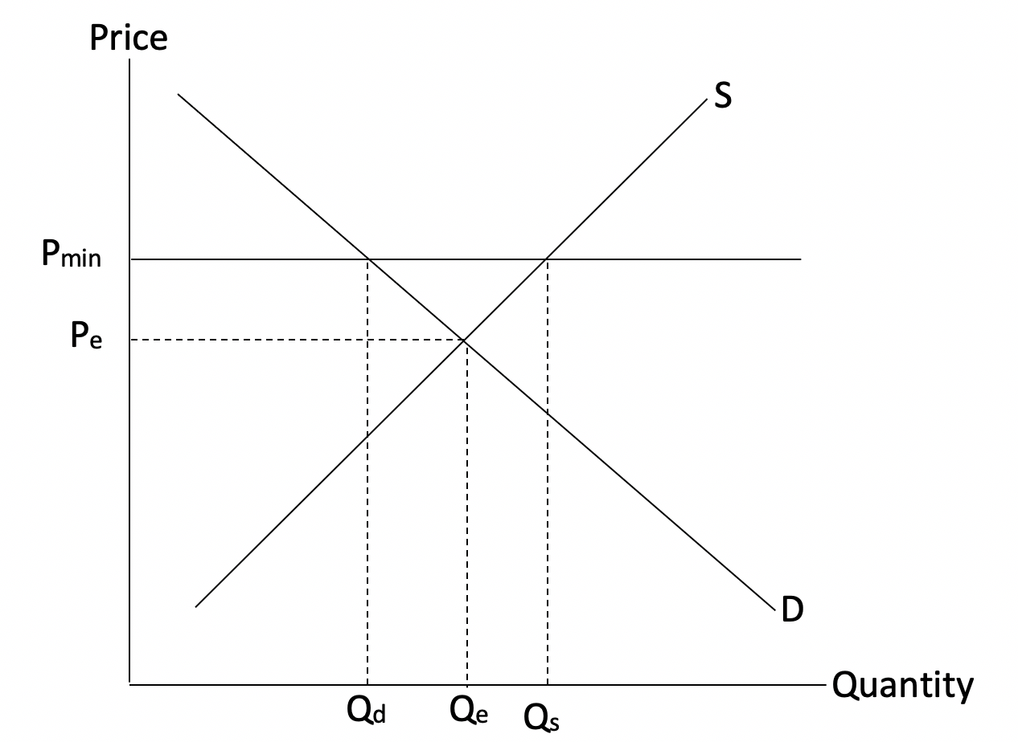
Demand and Supply Example Questions
If a government wants to help local producers of shoes, they could impose a minimum price above the current equilibrium price. In your answer booklet, draw a diagram showing the effect on the NZ shoe market of imposing a minimum price above the equilibrium price (assume there are no exports or imports in the market).
Don’t Forget:
Axis Labelled (Price and Quantity)
Supply and Demand Curves labelled
P_{e}, Q_{e} labelled
P_{min}, Q_{d}, Q_{s} Labelled
Or if there are moves of a curve, label fully

Slide 26
Demand and Supply Example Questions
Label the areas in your previous diagram, and copy and complete the table below into your answer booklet.
 | Equilibrium | With Minimum Price
Consumer Price
Quantity Traded
Consumer Surplus
Producer Surplus
Cost of Govt. Purchases | ----
Total Surplus
Change in Surplus | ----
Notes:
CS = difference between the price a consumer is willing to pay and what they actually pay

Slide 27
Demand and Supply Example Questions
Label the areas in your previous diagram, and copy and complete the table below into your answer booklet.
 | Equilibrium | With Minimum Price
Consumer Price | P_{e} | P_{min}
Quantity Traded | Q_{e} | Q_{d}
Consumer Surplus | 1,2,3 | 1
Producer Surplus | 5,6 | 2,3,4,5,6
Cost of Govt. Purchases | ---- | 3,4,6,7,8,9
Total Surplus | 1,2,3,5,6 | 1,2,5,-7,-8,-9
Change in Surplus | ---- | 3,6,7,8,9
Notes:
Important to note that the government will not always buy the excess supply hence if it doesn’t specify then we must be cautious about this fact

Slide 28
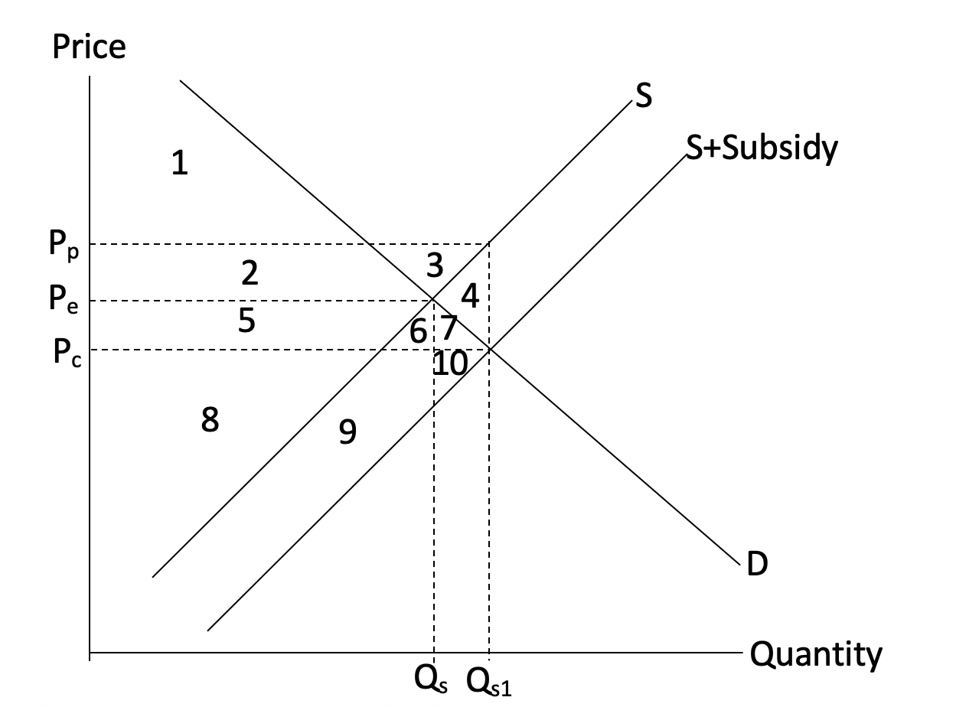
Demand and Supply (Subsidy) Example Questions
An alternative policy to a minimum price the government could impose is a subsidy. The diagram below shows the imposition of a subsidy on the show market in NZ.
Complete the table using the information shown in the diagram
 | Equilibrium | With Subsidy
Consumer Price
Quantity Traded
Consumer Surplus
Producer Surplus
Govt. Cost of Subsidy | ----
Total Surplus
Change in Surplus | ----

Slide 29
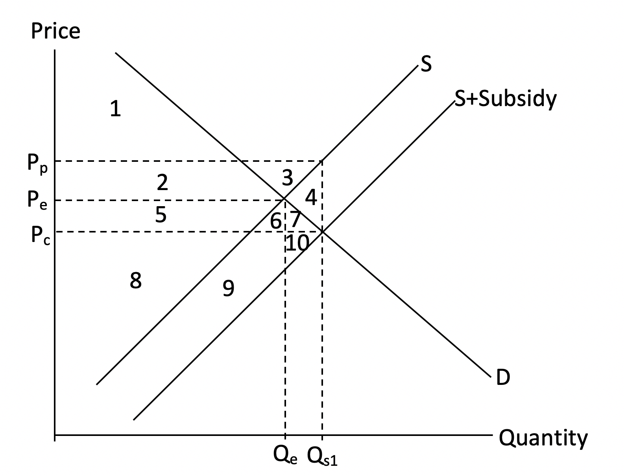
Demand and Supply (Subsidy) Example Questions
An alternative policy to a minimum price the government could impose is a subsidy. The diagram below shows the imposition of a subsidy on the show market in NZ.
Complete the table using the information shown in the diagram
 | Equilibrium | With Subsidy
Consumer Price | P_{e} | P_{c}
Quantity Traded | Q_{e} | Q_{s1}
Consumer Surplus | 1,2 | 1,2,5,6,7
Producer Surplus | 5,8 | 2,3,5,8
Govt. Cost of Subsidy | ---- | 2,3,4,5,6,7
Total Surplus | 1,2,5,8 | 1,2,5,8,-4
Change in Surplus | ---- | 4

Slide 30
Demand and Supply (Subsidy) Example Questions
What do the following areas represent?
Area 5 after the subsidy
Area 9 after the subsidy
Area 2 before the subsidy

Slide 31
Demand and Supply (Subsidy) Example Questions
What do the following areas represent?
Area 5 after the subsidy
Producer Surplus, Consumer Surplus and cost of the Subsidy to the Government
Area 9 after the subsidy
Nothing
Area 2 before the subsidy
Consumer Surplus

Slide 32
NOTE: You may also get asked about a Tax instead of a Subsidy where the supply curve becomes S + Tax and is left of the original Supply curve. Here the government will receive an income instead of the expense the subsidy incurs. Consumer and Producer surpluses are smaller and do not overlap like in the subsidy example.
You must know what each part of the Demand and Supply graph represents in terms of surpluses and government cost/income.
Demand and Supply (Tariff) Example Question
An import tariff is another example of a government policy. In a few sentence, explain how a tariff works and why one would be implemented. As part of your answer explain who wins from a tariff, who loses from a tariff, and why.

Slide 33
Demand and Supply (Tariff) Example Question
An import tariff is another example of a government policy. In a few sentence, explain how a tariff works and why one would be implemented. As part of your answer explain who wins from a tariff, who loses from a tariff, and why.
A tariff raises the price of imports as it is a tax on imports aimed at increasing domestic producer profits by helping domestic firms compete with cheaper imports.
Consumers lose from a tariff as prices are higher for them.
Producers and government gain due to increased tax revenue for the government and increased profits/revenue for local producers.

Slide 34
Supply and Demand Functions Example Question
Assume the supply and demand functions for a pair of socks are as follows:
Qd = 12 – P
Qs = 2P - 6
Assuming price is in dollars calculate the equilibrium price and quantity for a pair of socks.
Using the demand function Qd = 12 – P calculate the price elasticity of demand at a price of $5.
What type of price elasticity of demand exists at a price of $5 according to your answer in (ii) above, and what should the firm do to price to increase their revenue?

Slide 35
Supply and Demand Functions Example Question
Assume the supply and demand functions for a pair of socks are as follows:
Qd = 12 – P
Qs = 2P - 6
Assuming price is in dollars calculate the equilibrium price and quantity for a pair of socks.
Q_{d} = Q_{s}
12 – P = 2P – 6
18 = 3P
P = 18/3
P = 6
Q_{d} = 12 – P
Q_{d} = 12 – 6
Q = 6

Slide 36
Supply and Demand Functions Example Question
Assume the supply and demand functions for a pair of socks are as follows:
Qd = 12 – P
Qs = 2P - 6
Using the demand function Qd = 12 – P calculate the price elasticity of demand at a price of $5.
Q_{d} = 12 – 5 = 7
1 x 5/7 = 0.71
3. What type of price elasticity of demand exists at a price of $5 according to your answer in (ii) above, and what should the firm do to price to increase their revenue?
Inelastic as our answer above is less than 1, Increase price to increase revenue as the price is inelastic.

Slide 37
Supply and Demand Changes Example Question
For each of the following state whether the supply or demand
curve for woollen socks will shift, and whether it is an increase
or a decrease.
A mystery disease affecting sheep results in the price of wool rising.
Woollen socks are found to be linked to skin disease.
The price of cotton socks falls.

Slide 38
Supply and Demand Changes Example Question
For each of the following state whether the supply or demand
curve for woollen socks will shift, and whether it is an increase
or a decrease.
A mystery disease affecting sheep results in the price of wool rising.
Supply will decrease as the cost of production (Wool) has increased
b. Woollen socks are found to be linked to skin disease.
Demand will decrease as people will choose to by other types of socks, put off by this disease
The price of cotton socks falls.
Demand will decrease as cotton socks are a substitute for woollen socks which are now cheaper making woollen socks relatively more expensive

Slide 39
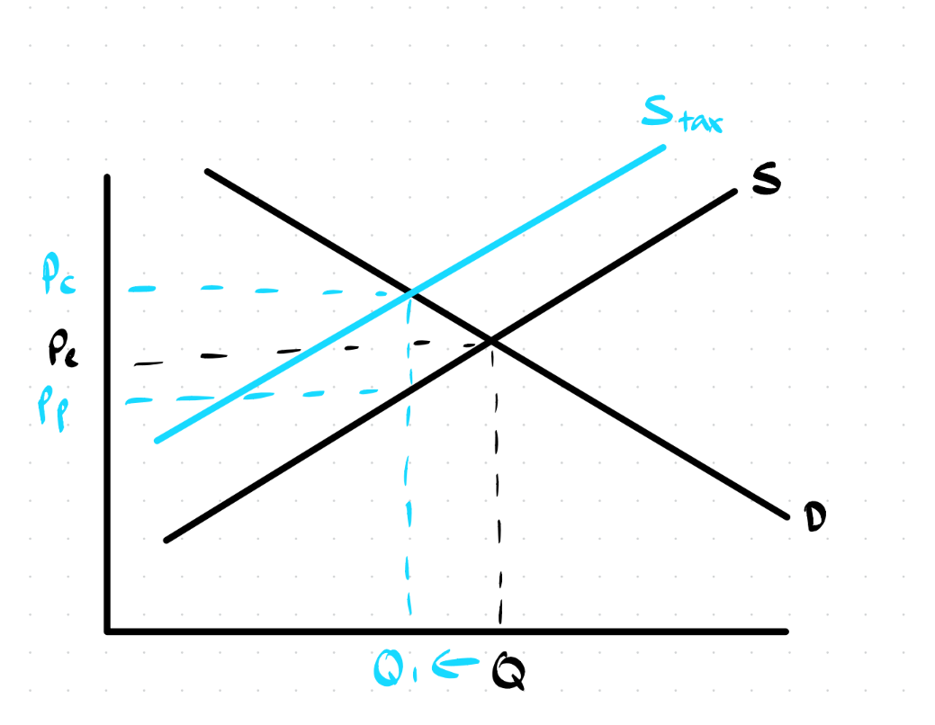
Demand and Supply Function Question
Qd = 10 - 2P
Qs = 4P - 2
Tax = 0.20 per unit
Goal is to calculate the tax burden on consumers and producers to evaluate who assumes more of the tax?

Slide 40
Step 1: Calculate Original Equilibrium
Set Qd = Qs therefore 10 - 2P = 4P- 2 rearrange our equation to get 6P = 12 so price = 2 and therefore Qe = 6
Step 2: Adjust our Qs function for Qs1 = 4(P-0.20) -2 -> 4P- 2.8
Step 3: Find new Equilibrium
10 - 2P = 4P-2.8 so 6P =12.8 P = 2.13 which is the price consumers pay Pc
Qtax = 5.74
Step 4: Calculate Pp
Pp = 2.13 - 0.20 = 1.93
Final step: Evaluate changes in prices for consumers and producers
Consumers: Pc - Pe = 2.13- 2.00 = 0.13 an additional cost of 13 cents
Producers: Pp - Pe = 1.93 -2.00 = - 0.07 a lose of 7 cents
Consumers worse off

Slide 41
Stay Updated for Events
Sign Up for Free!
Slides will go up on our website
Website: www.ucinvestmentsociety.com
Facebook Page: The Investment Society
Instagram: the_investmentsociety

Slide 42
Thank You and Good Luck!
Presented by The Investment Society

