Slide 1

ECON 208 TUTORIAL MID TERM TEST
Monday 23rd March 5-6pm in F1
Notes:
Introduce
Ourselves
The Club
Thank for coming
Explain
Thank for submitting
Why we are going these

Slide 2

@the_investmentsociety

Slide 3
Format
Section A: 15 multichoice (30 marks)
Section B: 5 short answers (8 marks each)
Section C: 2 long answer (15 marks each)
One question will be from a problem set
One long answer will be a Cobb Douglas function

Slide 4
Section A
Practice past papers
Find Quizlets

Slide 5
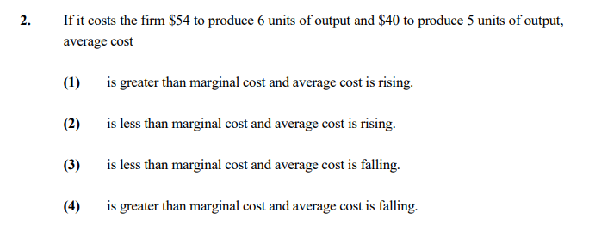
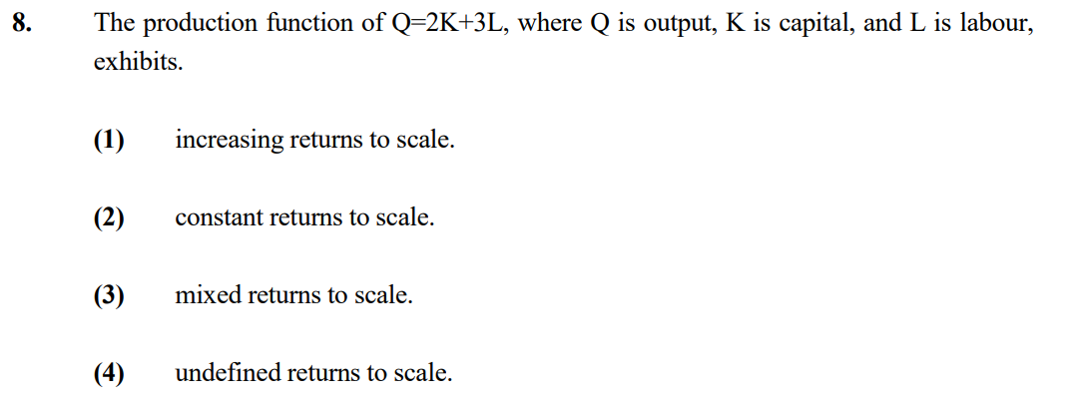
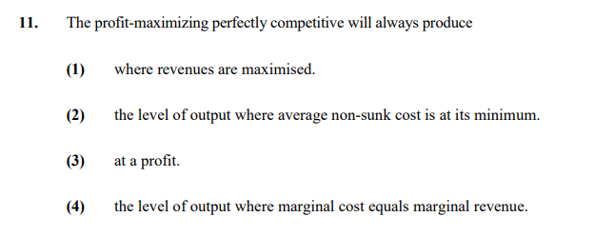
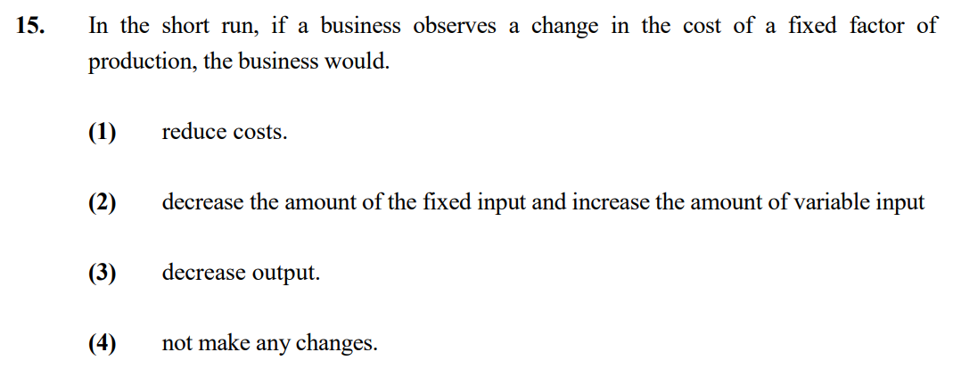
2021 Questions

Slide 6
2021 Answers
Notes:
2)
What is average cost for each $8 for 5 units, $9 for 6 units, ac rising, marginal cost is $14, so less than MC
8)
Because there is no exponent, or the exponent is effectively 1 means that scales at constant rate, double capital, double output

Slide 7
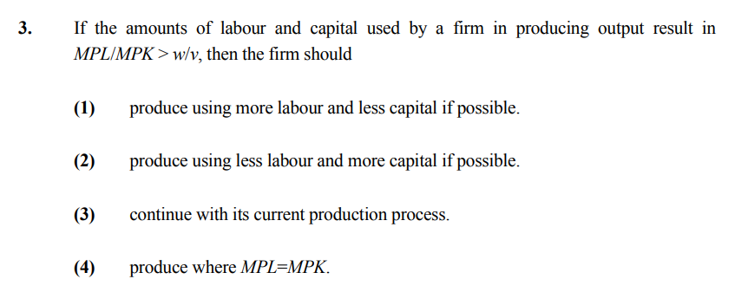
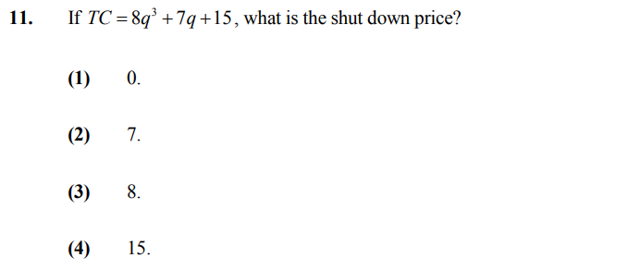
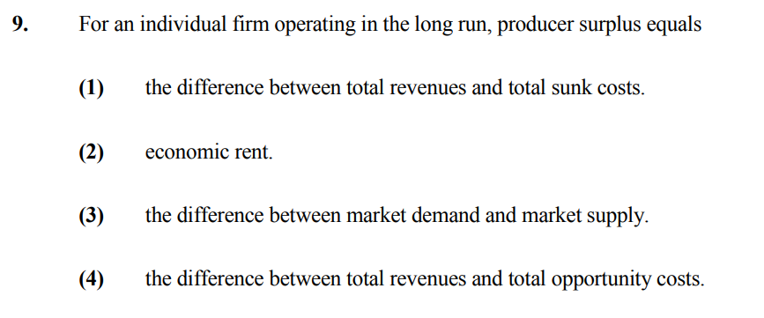
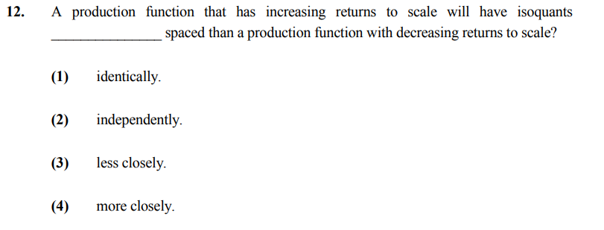
2020 Questions

Slide 8
2020 Answers

Slide 9
Section B: Short Answers
One question will be from the problem sets
Most of this section is pulled from your notes

Slide 10
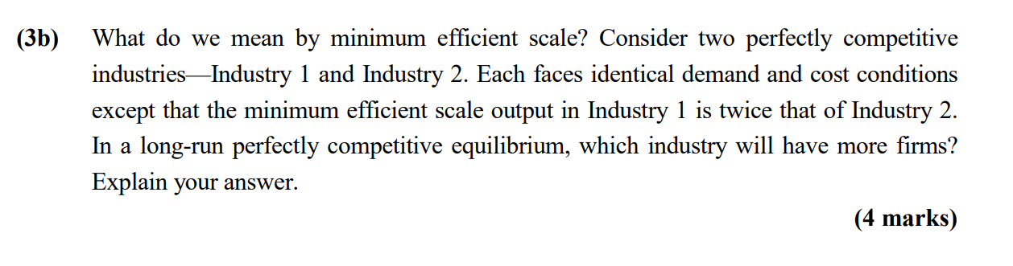
2021 Question
What is minimum efficient scale?
It is the level of output that minimises long run average cost
In a perfectly competitive market each firm must produce at this scale
Which industry has more firms?
If the industries are identical, the industry which has the higher minimum efficient scale has less firms
This is because to produce the same output in each industry there can only afford to be less firms
Therefore industry 1 has less firms

Slide 11
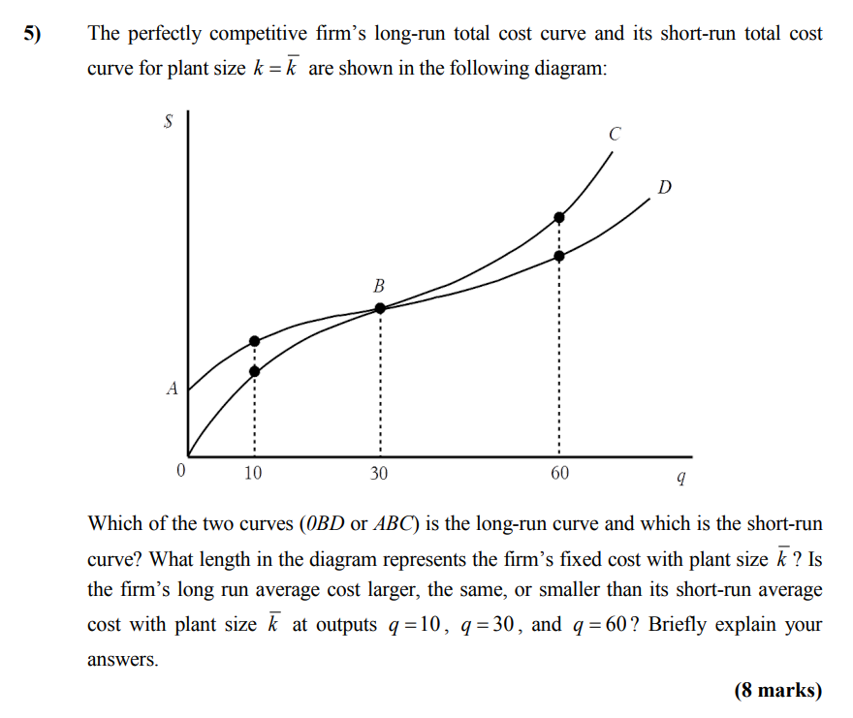
2020 Question
Which is short run and long run?
Short run curve is less efficient as includes fixed costs from fixed factors
Long run cost curve minimises cost as has a more efficient use of inputs
Therefore the short run curve should not go below the long run curve
Long run = OBD
Short run = ABC
Fixed costs
Are the difference between long and short run costs
Therefore 0A
Average costs
At Q=10 and Q=60 short run larger as TC higher
At q = 30 the same as TC the same

Slide 12
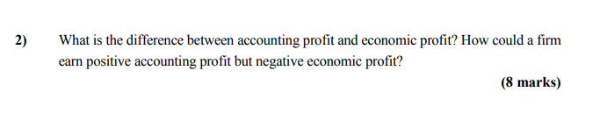
2019 Question
Accounting profit
Includes just accounting costs which measures the historical expenses incurred to the firm
Economic profit
Includes accounting cost and economic cost
Economic costs are the opportunity cost of the resources used by the firm
Why could one be positive and other negative?
This may occur if the opportunity cost of the resource used is higher than the accounting cost
For example: if the resource cost $1m but could have been sold for $2m, then the accounting profit may be $2m higher than economic profit, given the opportunity cost

Slide 13
Section C: Long Answers
One question will be a Cobb Douglas production function

Slide 14
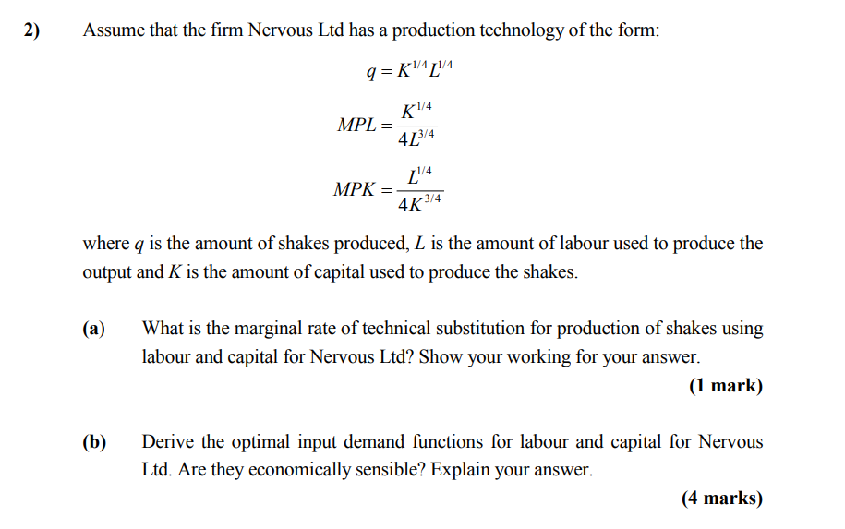
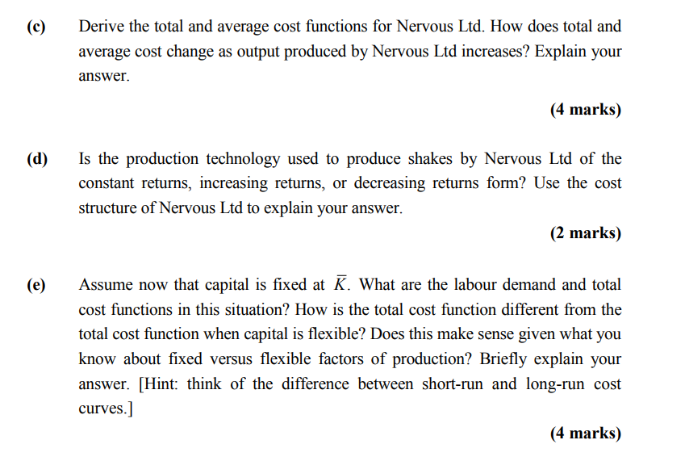
2020 Question
Notes:
For E
Doing what we did for C, but only for Ld, K just stays fixed
Re arrange quantity formula so get Ld =
Sub into TC function of TC = rK + WL
Now only have K these cancel
- Get the outcome that TC increases faster show by the 2* multiplier , now more effeicnet as can’t adjust capital

Slide 15
Cobb Douglas Process
1. Find the MRTS by going –MPL/MPK
2. Find functions for optimal choice of labour (Ld) and capital (Kd)
Rearrange optimality condition of (K/L) = (w/r) to get K =
Substitute this into the given production function of q=
Rearrange this to get in the form of Ld = ….
Substitute the Ld into the formula we found in first bullet point to get Kd=
3. Find the total cost and average cost
Using the TC formula of TC = rK + wL, substitute in for K and L
Average cost is just TC divided by quantity
4. Determine the type of returns
Look at how TC is changing with output, look for an exponent on q
If exponent > 1, then decreasing as cost is increasing at a faster rate that quantity

Slide 16
General Tips
Write neatly and concisely
Bullet points are fine – don’t need paragraphs
Add intercepts on graphs
Know why curves slope the way they do
Do the past papers!
Learn your notes
”Prepare a cheat sheet”
Practice problem sets!

