Slide 1

FINC 201 TUTORIAL TUESDAY 21th APRIL
5-6pm in F1
Notes:
Introduce
Ourselves
The Club
Thank for coming
Explain
Thank for submitting
Why we are going these

Slide 2

SIGN UP FOR FREE
STAY UPDATED
Instagram: the_investmentsociety
QUESTIONS AND FEEDBACK
Email: ipi17@uclive.ac.nz

Slide 3

OVERVIEW
Week 1: Introduction and Financial Statements and Analysis
Week 2: Time Value of Money
Week 3: Bonds
Week 4:Stocks
Week 5: NPV and other Investment Profitability Criteria

Slide 4
Tips
Write down the formulas and enter the correct numbers before using a financial calculator
If using a financial calculator, state what you are doing and the variables you have inputted eg. N= ____ , I/Y = ____ etc…
If you do not have a financial calculator, you must rearrange and solve mathematically

Slide 5
Time Value of Money

Slide 6
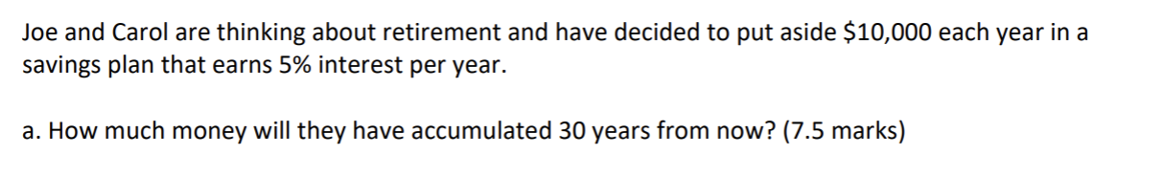
Question 1

Slide 7


Question 1
PMT | $10,000
r | 5%
n | 30
FV | ?
0
30
$FV=PMT × \frac{(({1+r)}^{n}−1)\text{1}}{r}$)
$$FV=\$664,388$$

Slide 8
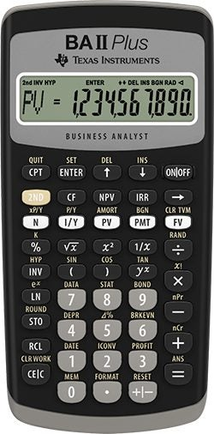
Question 1
Press 30 → N
Press 5 → I/Y
Press 0 → PV
Press 10000 +/− → PMT
Press CPT → FV
PMT | $10,000
r | 5%
n | 30
FV | ?

Slide 9
Question 2

Slide 10


Question 2
FV | $800,000
r | 5%
n | 30
PMT | ?
0
30
$800,000
$FV=PMT × \frac{(({1+r)}^{n}−1)\text{1}}{r}$)
$$PMT=\$12,041$$

Slide 11
Question 2
Press 30 → N
Press 5 → I/Y
Press 0 → PV
Press 800,000 → FV
Press CPT → PMT
FV | $800,000
r | 5%
n | 30
PMT | ?

Slide 12
Notes
Value of a dollar depends on when it is received, a dollar today is worth more than a dollar tomorrow
When there is opportunity to invest today at a positive rate, money has time value with no inflation
Cash flows need to be compared at the same point in time

Slide 13
Bonds

Slide 14
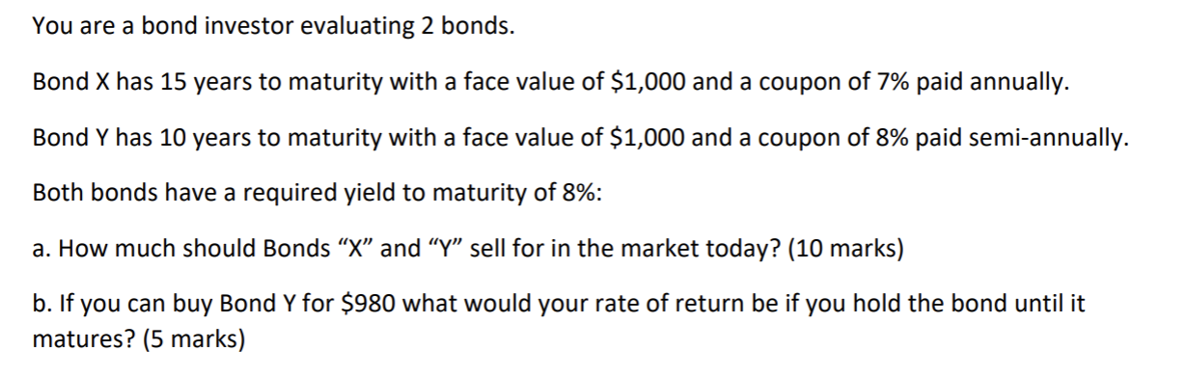
Question 3

Slide 15

Question 3
Bond X
$$PV= \frac{C}{(1+r)}+\frac{C}{{(1+r)}^{2}}+ …+ \frac{C+FV}{{(1+r)}^{n}}$$
n | 15
FV | $1000
C | $70
r | 8%
$$PV=\$914.40$$

Slide 16

Question 3
If the coupon rate is equal to the yield to maturity, the bond should sell at face value
Bond Y
n | 20
FV | $1000
C | $40
r | 8%
$$PV=\$1000$$

Slide 17




Question 3
n | 20
FV | $1000
C | $40
PV | $980
r | ?
$$PV= \frac{C}{(1+r)}+\frac{C}{{(1+r)}^{2}}+ …+ \frac{C+FV}{{(1+r)}^{n}}$$
$$r=4.15\% for 6 months$$
$$r=8.30\%$$

Slide 18
Question 3
n | 20
FV | $1000
C | $40
PV | $980
r | ?
Press 20 → N Press 980 → +/- → PV Press 40 → PMT Press 1000 → FV
Press CPT → I/Y

Slide 19
Notes
A premium bond sells above par value, at maturity you receive less than you paid — an embedded capital loss
A discount bond sells below par value, at maturity you receive more than you paid — an embedded capital gain
When interest rates fall, old bonds with higher coupons become attractive, so prices rise
When interest rates rise, old bonds with lower coupons become unattractive, so prices fall
Coupons are fixed, so price must adjust to reflect changes in market rates

Slide 20
Stocks

Slide 21
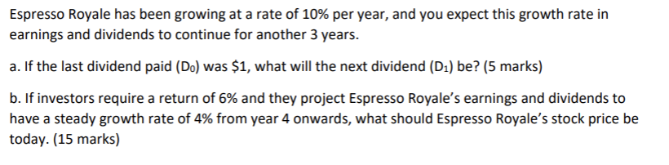
Question 4

Slide 22


Question 4
Bond X
D₀ | $1
g | 10%
D₁ | ?
$$D1=D0 × (1+g)$$
$$D1=\$1.10$$

Slide 23

Question 4
1. Work out dividends D₁ to D₃
D₁ | $1.10
D₂ | $1.21
D₃ | $1.331
$$D1=D0 × (1+g)$$

Slide 24



Question 4
2. Work out P₃
D₁ | $1.10
D₂ | $1.21
D₃ | $1.331
$$P3=\frac{D4}{r −g}$$
$$P3=\$69.21$$
$$D4=D3 × (1+g)$$

Slide 25


Question 4
3. Discount
D₁ | $1.10
D₂ | $1.21
D₃ | $1.331
P₃ | $69.21
$$P0=\frac{D1}{1+r}+\frac{D2}{({1+r)}^{2} }+\frac{D3+P3}{{(1+r)}^{3}}$$
$$P0=\$61.34$$

Slide 26
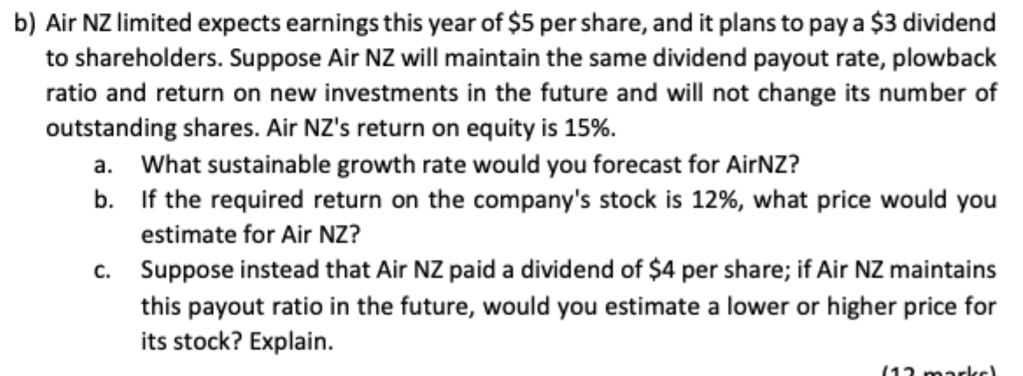
Question 5

Slide 27


Question 5
ROE | 15%
plowback | 40%
$$g=ROE × plowback$$
$$g=6\%$$

Slide 28


Question 5
D₁ | $3.18
r | 12%
g | 6%
$$P0=\frac{D1}{r −g}$$
$$P0=\$ 53$$

Slide 29
Question 5
If the dividend increases, the plowback ratio will fall. We would expect that the growth rate will fall and the price will fall.

Slide 30
NPV and Investment Criteria

Slide 31
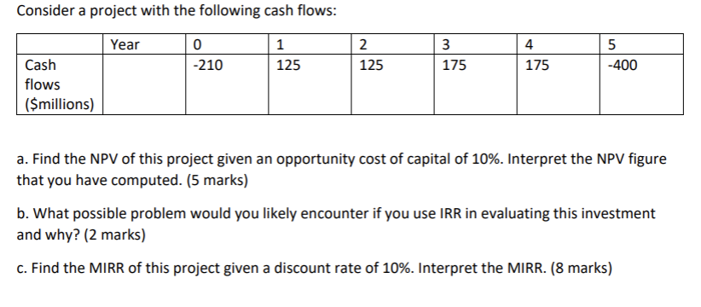
Question 6

Slide 32


Question 6
If
Accept the project when
NPV > 0 , investment earns return greater than the cost of capital
$$NPV=CF0+\frac{CF1}{1+r}+…+\frac{CFn}{{(1+r)}^{n}}$$
$$NPV=\$9.58 million$$

Slide 33
Question 6
CF₀ | -210
CF₁ | 125
CF₂ | 125
CF₃ | 175
CF₄ | 175
CF₅ | -400
r | 10%
Press CF → 2nd CLR WORK
CF0 = 210 +/− ENTER ↓
C01 = 125 ENTER ↓, F01 = 1 ENTER ↓
C02 = 125 ENTER ↓, F02 = 1 ENTER ↓
C03 = 175 ENTER ↓, F03 = 1 ENTER ↓
C04 = 175 ENTER ↓, F04 = 1 ENTER ↓
C05 = 400 +/− ENTER ↓, F05 = 1 ENTER ↓
Press NPV → I = 10 ENTER ↓ → CPT

Slide 34
Question 7
If there is more than one sign change, you will incur multiple IRR

Slide 35


Question 7
1. Find the PV of cash outflows and FV of cash inflows
$$PV0=−458.369$$
$$FV5=753.638$$

Slide 36


Question 7
2. Find rate where PV cash outflows grows to equal FV cash inflows
$PV0 {(1+MIRR)}^{n}=FV$_{n}
$$MIRR=10.45\%$$
Assuming CF are reinvested at 10%, the investment of 458.369 earns a return of 10.45%
Notes:
N=5, PV = -458.369, PMT= 0, FV = 753.638, Compute I/Y

Slide 37
Question 7
PV | -458.369
FV | 753.638
n | 5
PMT | 0
I/Y | ?
Press 5 → N
Press 458.369 +/− → PV
Press 0 → PMT
Press 753.638 → FV
Press CPT → I/Y

