Slide 1


ECON104 Term
Test 2 Tutorial
Monday 4th May
4 - 5pm F1
Notes:
Introduce
Ourselves
The Club
Thank for coming
Explain
Thank for submitting
Why we are going these

Slide 2
SIGN UP FOR FREE
Website: www.ucinvestmentsociety.com
STAY UPDATED FOR EVENTS
Facebook Page: The Investment Society
Instagram: the_investmentsociety
QUESTIONS AND FEEDBACK
Email: cco115

Slide 3

Term Test INFORMATION
Term One Content:
Indifference Curves and Budget Lines
Imperfect Information, Public Goods
Term Two Content:
Externalities
Labour Market
Notes:
Structure the IC and BL content at the start as that’s the initial content and end on the Labour Market stuff

Slide 4
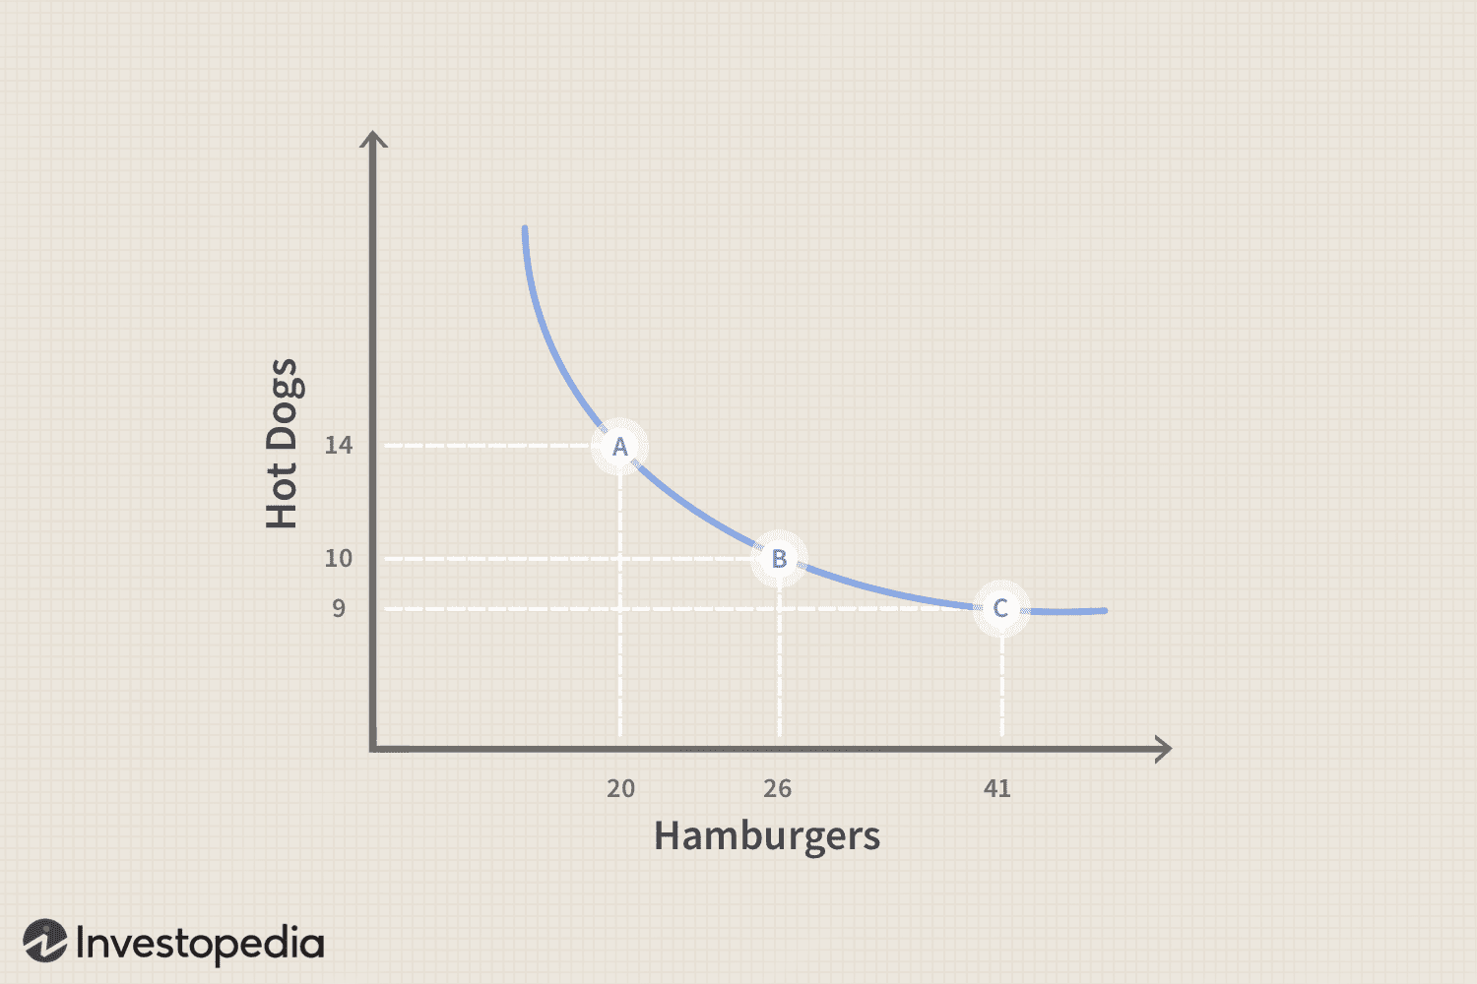
Indifference Curves
Indifference Curve: All combinations of two goods that give a consumer the same level of utility.
Properties
Downward Sloping – to maintain equal utility, when getting more of one good must trade off less of another
Higher Curves = higher utility - Curve further from origin represents a preferred bundle
Never intersect – If intersection occurred the prior statement would contradict
Convex to the origin – Diminishing marginal rate of substitution meaning as you consume more of one good, you’re willing to give us less of the other to get even more of it.
Notes:
As all points on this curve/ boundary are equal the consumer would be indifferent between any point on the same curve
We expect this trade off as we have fixed things such as time and money therefore cannot just increase one good without expecting to decrease another.
The higher curve at any point on this indifference curve will produce more utility than the other curve- else the indifferent curve is not true – i.e. indifference curves cannot cross
As said we must have the whole curve above the lower curve otherwise the utility wouldn’t be equal along that higher curve
As you get more of another good produces less utility as you are already consuming that good therefore the trade off is stricter where you are less willing to trade the other good, hence this slope
The MRS is the slope of the curve at any point

Slide 5
Budget Lines
Budget line: Shows all combinations of two goods a consumer can purchase if they spend their entire income. Determined by income and prices not preferences.
Properties
Downward sloping – buying more of Good X means buying less of Good Y- substitution effect as fixed income
Linear – prices are constant therefore the trade-off will be constant
Points on the line – any point along the line shows maximised income, inside the curve is still affordable but has unspent income, outside is unaffordable
Slope = -Px/Py our price ratio which shows how many units of Y the market requires to give up for one more unit of X
The optimal bundle for a consumer is where the slope of the budget line is equal to the slope of the Indifference Curve: MRS = Px / Py
Notes:
X = M/ Px i.e. income over price of good X, same applies for Y intercept
Shifts of the Budget line:
If Income increases – Parallel shift outwards vice versa- causes slope to be unchanged but intercepts move proportionally
Price of X changes – causes the X-int to move, therefore higher price = less of good X able to be purchased so int moves inward whilst income and Py are unchanged
Price of Y change – opposite effect of X
Both prices change at same rate can resemble a income shift without income changing

Slide 6
Budget Lines and Indifference Curves Example Questions
In the consumer behaviour model, a utility maximising consumer consuming two normal goods will
  Consume on the highest indifference curve possible.
  Consume where the slope of the budget line equals the slope of the indifference curve.
  Consume where the utility per dollar spent is the same across both goods.
  Meet all of the above criteria.
Suppose the price of pizza is $10, the price of cola is $1, and the consumer’s income is $50. In addition, suppose the consumer’s budget constraint measures pizza on the horizontal axis and cola on the vertical axis. If the price of cola doubles to $2, then the
  Budget constraint intersects the vertical axis at 100 colas.
  Budget constraint shifts inward in a parallel fashion.
  Budget constraint intersects the vertical axis at 25 colas.
  Slope of the budget constraint rises to -2.
Notes:
4)
3)

Slide 7
Budget Lines and Indifference Curves Example Questions
In the consumer behaviour model, a utility maximising consumer consuming two normal goods will
  Consume on the highest indifference curve possible.
  Consume where the slope of the budget line equals the slope of the indifference curve.
  Consume where the utility per dollar spent is the same across both goods.
  Meet all of the above criteria.
Suppose the price of pizza is $10, the price of cola is $1, and the consumer’s income is $50. In addition, suppose the consumer’s budget constraint measures pizza on the horizontal axis and cola on the vertical axis. If the price of cola doubles to $2, then the
  Budget constraint intersects the vertical axis at 100 colas.
  Budget constraint shifts inward in a parallel fashion.
  Budget constraint intersects the vertical axis at 25 colas.
  Slope of the budget constraint rises to -2.

Slide 8
Budget Lines and Indifference Curves Example Questions
A budget constraint
  Shows the purchases made by consumers.
  Shows the consumption bundles that a consumer can afford.
  Shows the prices that a consumer chooses to pay for products he consumes.
  Represents the consumption bundles that give a consumer equal satisfaction.
A decrease in a consumers income
  Decreases the slope of the consumers budget constraint.
  Has no effect on the slope of the consumers budget constraint.
  Increases the slope of the consumers budget constraint.
  Has no effect on the consumers budget constraint.
As one moves down a typical indifference curve, the marginal rate of substitution
  Decreases.
  Will switch from positive to negative.
  Is constant.
  Increases.
Notes:
2)
2)
1)- This is because as we explained increasing demand for another good will mean willing to give up less of other good hence the MRS will decrease as the trade off isn’t as much

Slide 9
Budget Lines and Indifference Curves Example Questions
A budget constraint
  Shows the purchases made by consumers.
  Shows the consumption bundles that a consumer can afford.
  Shows the prices that a consumer chooses to pay for products he consumes.
  Represents the consumption bundles that give a consumer equal satisfaction.
A decrease in a consumers income
  Decreases the slope of the consumers budget constraint.
  Has no effect on the slope of the consumers budget constraint.
  Increases the slope of the consumers budget constraint.
  Has no effect on the consumers budget constraint.
As one moves down a typical indifference curve, the marginal rate of substitution
  Decreases.
  Will switch from positive to negative.
  Is constant.
  Increases.

Slide 10
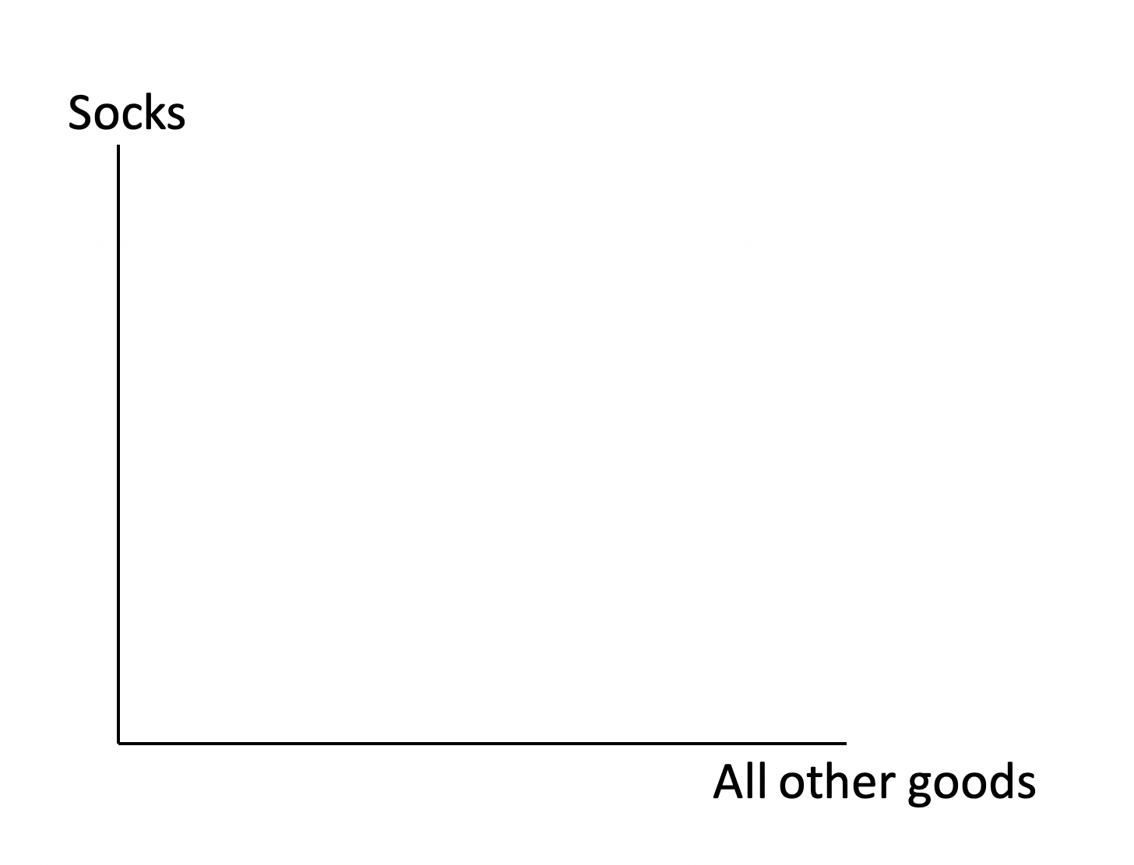
Utility Example Question
Show a utility maximizing consumer consuming a combination of socks and all other goods, on the axis below
Notes:
Constructing an indifference curve remember to follow the conditions
Indifference curve downward sloping and convex to origin
Budget Line straight line where points of intersection on axis are the intercepts
Label the axis
And ensure there is a singular point of intersection between I and BL

Slide 11
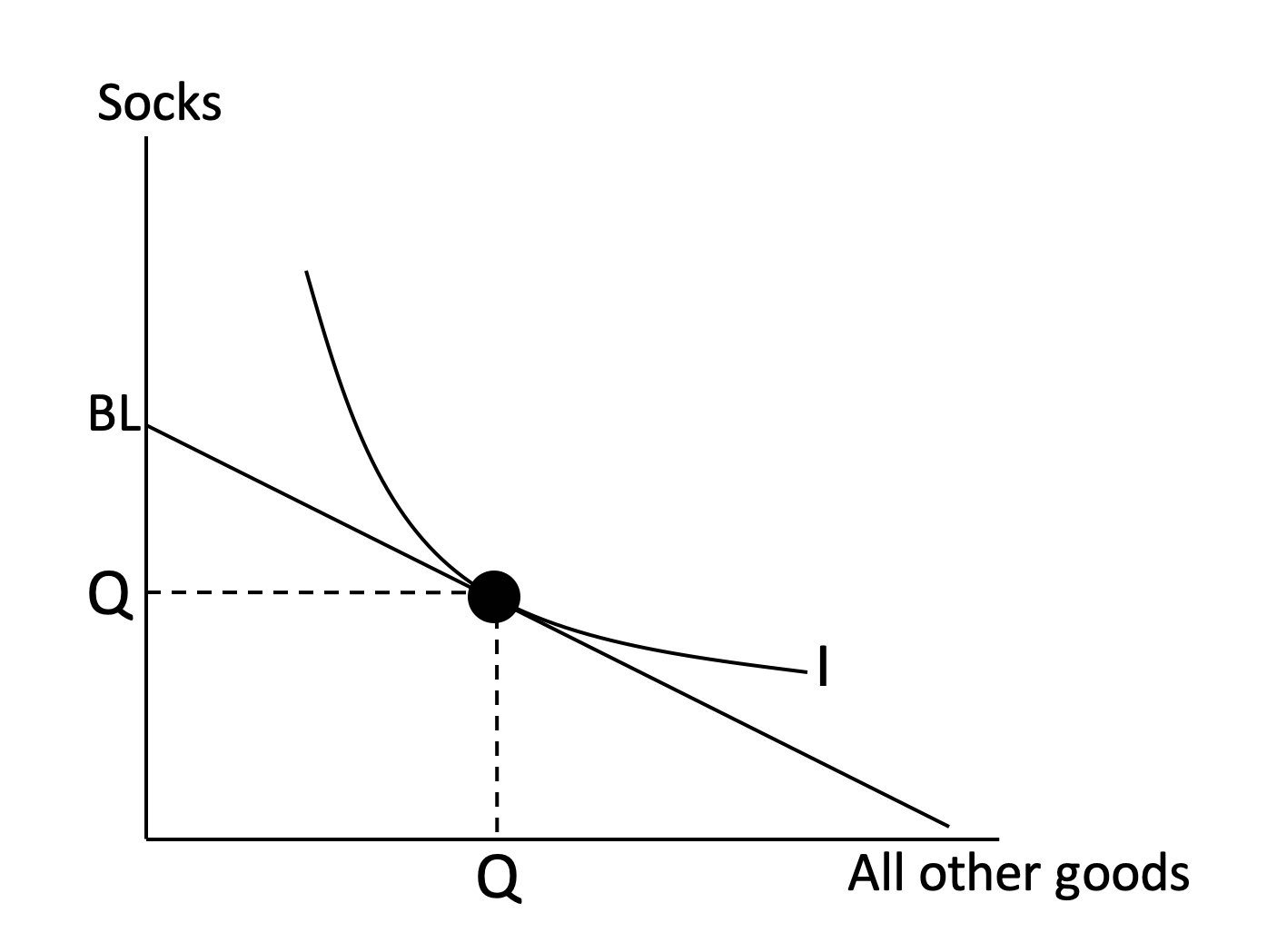
Utility Example Question
Show a utility maximizing consumer consuming a combination of socks and all other goods, on the axis below
Remember to:
Label Axis
Label Budget Line and Indifference Curve
Label Quantity on axis
Utility maximizing occurs at point of tangency between Budget Line and Indifference curve

Slide 12
Utility Example Question
Show the effect on your diagram of a price decrease for socks. Be sure to show and explain the income and substitution effects.
Notes:
A-> B is the substitution effect, effectively what would the consumer choose if we changed the price ratio but held utility constant.
Point B is obtained by drawing a hypothetical budget line the red line which has a flatter slope parallel to the new BL1- still on same indifference curve but higher up on the sock side due to cheaper pricing.
B -> C is the income effect where as the price falls the consumer effectively has more purchasing power, which is resembled by the move from B to C reaching a higher indifference curve as the new budget line has increased so we have a outward shift of a new indifference curve where the intersection of those is point C our new utility maximising bundle

Slide 13
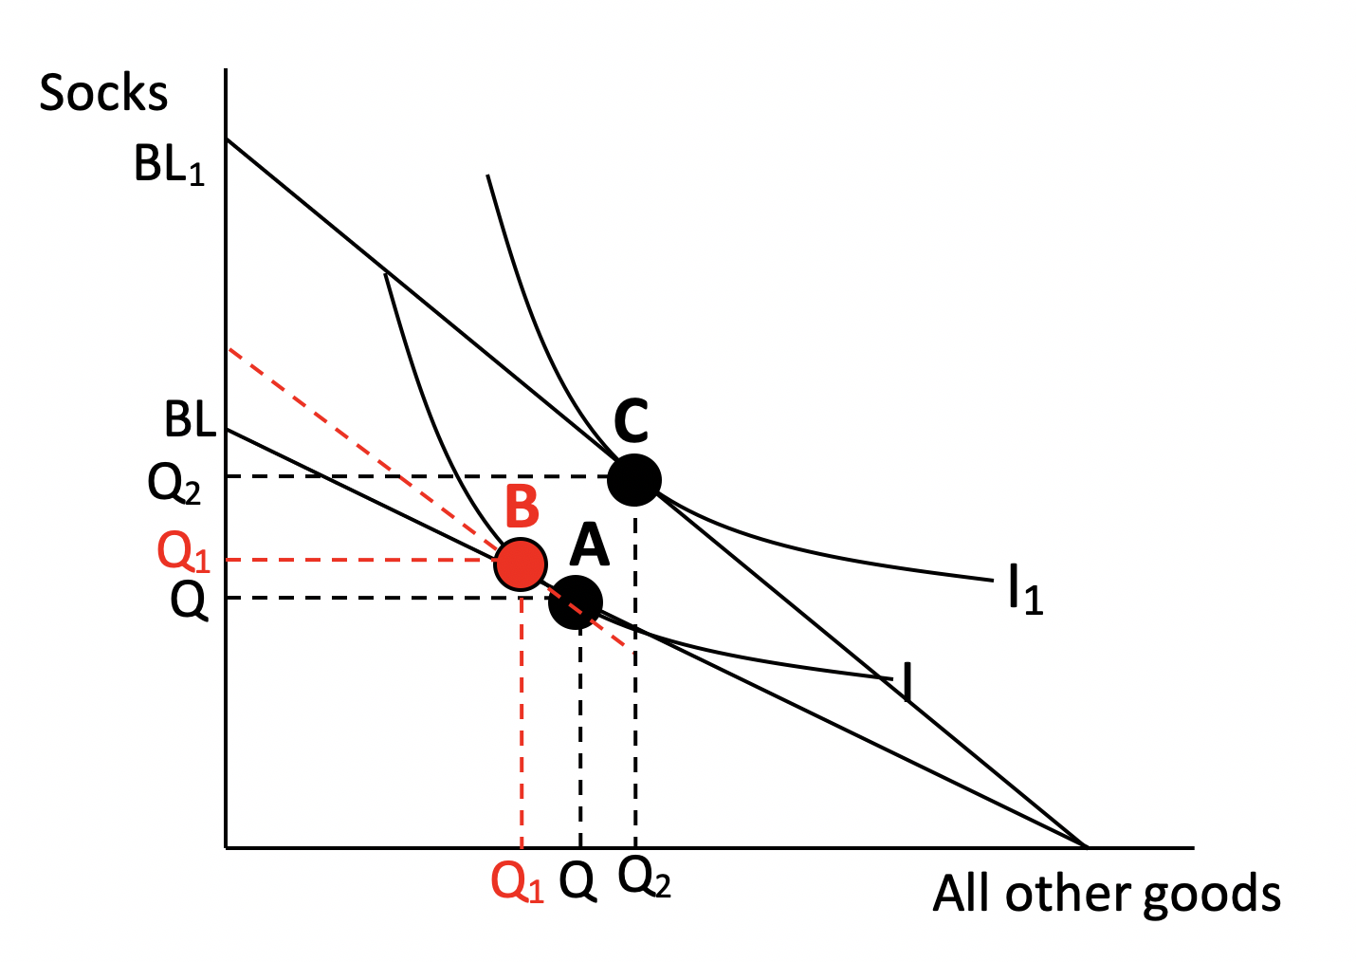
Utility Example Question
Show the effect on your diagram of a price decrease for socks. Be sure to show and explain the income and substitution effects.
A to B is the substitution effect which is the movement around the existing indifference curve as a result of a change in relative prices.
B to C is the income effect which is a shift to a higher indifference curve due to increased purchasing power
Notes:
A-> B is the substitution effect, effectively what would the consumer choose if we changed the price ratio but held utility constant.
Point B is obtained by drawing a hypothetical budget line the red line which has a flatter slope parallel to the new BL1- still on same indifference curve but higher up on the sock side due to cheaper pricing.
B -> C is the income effect where as the price falls the consumer effectively has more purchasing power, which is resembled by the move from B to C reaching a higher indifference curve as the new budget line has increased so we have a outward shift of a new indifference curve where the intersection of those is point C our new utility maximising bundle

Slide 14
Imperfect information
Key ideas
Asymmetric information: When the buyer/seller knows more than the other party (Hidden Information
Adverse selection: As a result of asymmetric information, you end up trading with parties you don’t want to
Moral hazard: In the insurance industry, people changing their behaviour once insured (Hidden action)
Example question
An example of moral hazard in the insurance industry would be?
Two parties colluding to form a cartel
Insurance companies dealing with the wrong type of people
People lying on policy forms
People who have car insurance driving faster
Notes:
The first topic is imperfect information, this will most likely come in multichoice format, as they are quite a small part of the content.
- Helps understanding them in context of examples
Asymmetric information: Example: of buying a car from a second-hand dealer, and you aren’t aware of the condition of the car, allows the seller to take advantage of you
Adverse selection: Example of health insurance, people who genetically are more predisposed to medical conditions are going to take the insurance as it is good value for them, whereas those who are low risk will not, this leads to the insurance company, insuring a bunch of people who are high risk, not what they want and the reason they ask questions before you can get a policy from them
Moral hazard: Example when someone get’s car insurance they no longer feel like they bare the full cost, so may drive more dangerously, this is the reason insurance companies make you pay an excess or no claims bonus.

Slide 15
Example:
A tech company launches a comprehensive "no questions asked" replacement warranty for a new smartphone. Within a month, they notice a massive spike in users accidentally dropping their phones in swimming pools.
This is a primary example of:
Free-Rider Problem
Adverse Selection
Moral Hazard
Asymmetric Information
Notes:
Answer C
Explanation:
Risky behaviour – dropping phone occurs after transaction, because user no longer bears cost of broken device as the insurance now bears it.
To fix this the company must introduce an excess fee for replacement, else exploitation of this will pursue.

Slide 16
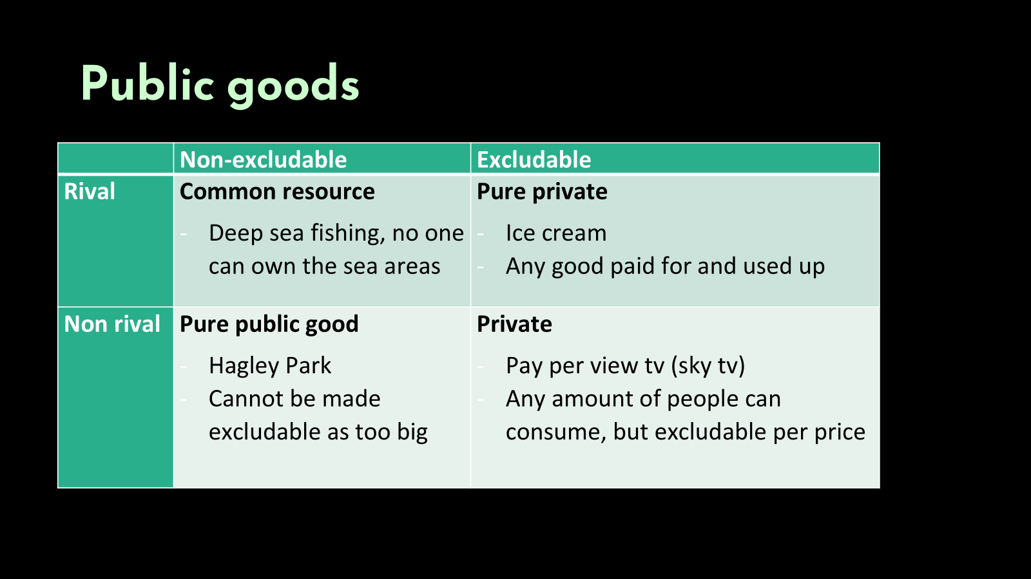
Notes:
These questions mostly come in multichoice form again as still a small part of the content.
Basically, all you need to know is this table: as likely may ask you to classify something as one of these categories
Rival vs non rival : means that if one person is consuming it, then it means another person can’t
Excludable vs non: basically, whether you can stop someone from consuming it, either through price or other measures
Free rider effect: non-excludable goods, when people can get away with not paying for the good but still getting value from it, coming at the cost of others that may use it, or provide it.
- Example people fishing more than they should

Slide 17
Example:
A local council provides a free, open-access outdoor Wi-Fi network in the city centre. At 6:00 AM, the network is incredibly fast for the few early birds using it. By 12:00 PM, hundreds of workers log on, causing speeds to crawl to a halt for everyone.
At 12:00 PM, the Wi-Fi network transitions from behaving as a __ to a
___.
Public Good -> Private Good
Public Good -> Common Resource
Private -> Common Resource
Common Resource -> Public Good
Notes:
Answer b) Here at 6am it is non-rival and non-excludable therefore a Public Good as everyone has access to it and no one is stopping the consumption for others to use it
At 12pm it remains non-excludable where anyone can log on however it becomes rival where one persons heavy downloading slows down another’s. This turns the good into a common resource and therefore suffers for the tragedy of commons.

Slide 18
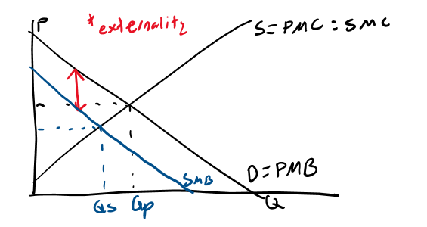
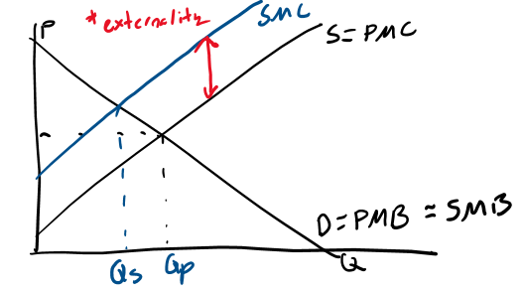
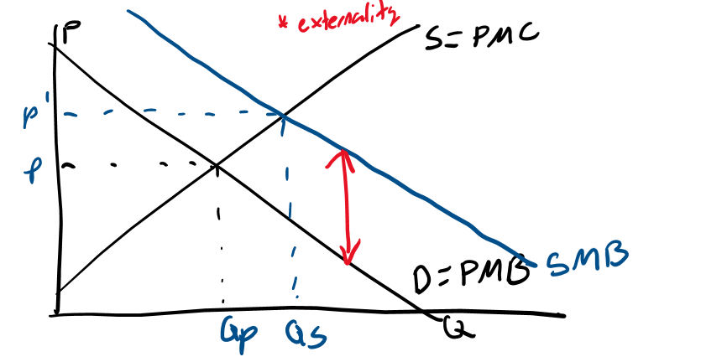
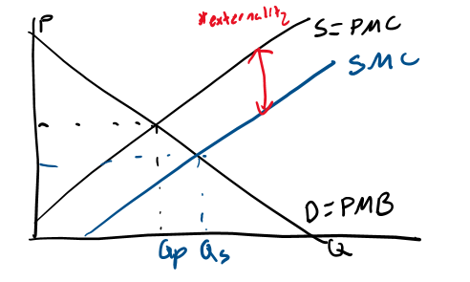
EXTERNALITIES
Negative, Consumption
Negative, Production
Positive, Consumption
Positive, Production
Notes:
Externalities, will likely make up a decent part of short answer questions,
Fundamental idea of externalities being the “spill over costs and benefits that is not part of the original transaction” and that these externalities can be either positive or negative, and either effect consumption or production.
Essentially there is a different curve than what is represented in the market, this is shown by either the social marginal benefit or marginal cost curves (in blue).
We want the market to be operating at these curves, so a simple logic test if you are trying to work out where the social marginal benefit or cost curve goes is, do you think we would want the consumption for this product to increase or decrease.
For example, for something like cigarettes, first work out, does the externality (the effects), come from producing or consuming the product, then work out are the effects, good or bad, then finally do you think society would prefer the consumption for this product to increase or decrease?.... So we will be putting the social marginal benefit curve, left of the private marginal benefit as this is the location where consumption would decrease.

Slide 19
Consumption Externalities
Negative Consumption = SMB < PMB therefore as we see the market overconsumes, which this product will provide a negative impact on a third party.
Positive Consumption is the opposite where consumption provides unintended benefits to third parties however as the SMB > PMB, the good is under-consumed as consumers only consider personal gains rather than total benefit to society
Notes:
Here externalities are on the demand side, and are a case of overconsumption (negative) or underconsumption (positive)
The negative consumption situations could be such as cigarette smoke, alcohol abuse, traffic congestion where the market fails because the price mechanism fails to reflect the true social cost
Solutions: To correct this, Governments can intervene with taxes, regulations or legislation to discourage consumption
Positive externalities of consumption could be such as education or vaccines which provides private benefits for those of higher income whilst benefiting society as a whole less viruses and more skilled workforce
However the good is under-consumed because the price doesn’t reflect the added external benefits.
Solution could be the Government provides subsidies for education or vaccines to increase consumption to increase to reach social optimum

Slide 20
Production Externalities
Negative Production = SMC > PMC therefore as we see there is an overproduction, which this product will provide a negative impact on a third party which isn’t internalised but imposed on society.
Positive Production is the opposite where a firms manufacturing process creates unintended benefits for third parties. The SMC < PMC which causes the firm to underproduce the good. As the firm only considers their private costs they produce lower quantity than socially optimal.
Notes:
Here externalities are on the supply side, and are either a case of overproduction (negative) or underproduction (positive)
The negative externalities could be situations such as … air water pollution, industrial waste, noise pollution – the production process forms harmful byproducts -> damage surrounding communities or ecosystems
Solutions: Government Intervention such as taxes or regulations which forces companies to internalise these costs and therefore increase PMC and reduce SMC where they equal each other at a social optimal quantity
The positive externalities could be situations such as … Beekeeping where producers bees pollinate farmers crops boosting harvest at 0 cost, or companies R&D leads to firms becoming more efficient
The effects are positive however not maximised as private firms operate for their own benefits (PMC) which are less than the social optimal benefits
Solution: Government often uses subsidies to increase social optimum level.

Slide 21
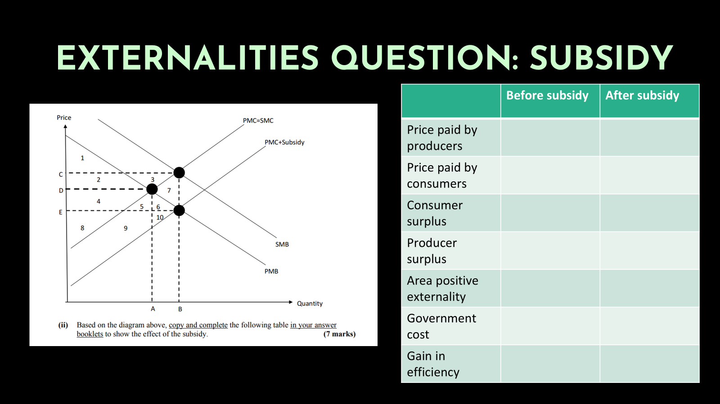
Note: should say price received by producers
 | Before subsidy | After subsidy
Price paid by producers
Price paid by consumers
Consumer surplus
Producer surplus
Area positive externality
Government cost
Gain in efficiency
Notes:
So what we have got here is a Positive externality of consumption: we get that as we can see that SMB is greater than PMB
But the subsidy is done on the supply side, as we can’t really apply a subsidy to the demand curve, so this shifts the supply curve right the same distance of the externality (which still works)
- Works as moves to the same quantity as if we operated at PMB
So give this one a go
Initially operating at point PMB = PMC so A, D therefore price = D for both consumers and producers
Therefore CS = 1,2 and PS = 4,8 whilst area of positive externality = 5,9 as bounded by quantity produced (A), Govt cost none before and same with gain in efficiency
After subsidy is imposed: We now operate at two different prices, the quantity is now B but the price received is C and price paid E as the subsidy covers the difference
Therefore CS = 1,2,4,5,6 as bounded by PMB curve but lower bound is the E as price paid, PS = 2,3,4,8 as bounded by PMC but now upper bound is C
Pos Ext = 5,6,7,9,10 as quantity increased allowing these additional areas to be experienced, Govt cost = rectangle = 2,3,4,5,6,7 (negatives)
Therefore to calculate our gain in efficiency we look at changes CS: 4,5,6 gain PS: 2,3 gain Ext: 6,7,10 gain , Govt Cost: -(2,3,4,5,6,7)
These cancel so that we are left with 6 and 10 as our gain in efficiency as a result of the subsidy

Slide 22
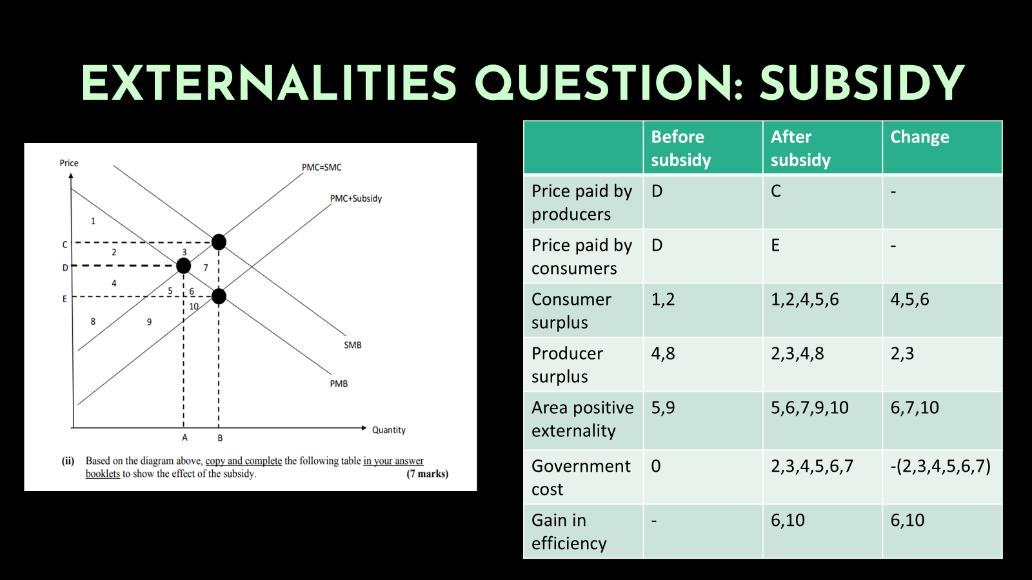
Notes:
Remember what producer and consumer surplus areas are…

Slide 23
Externalities Question
A steel manufacturing plant operates in a competitive market and produces steel for commercial sale. As a by-product of production, the plant releases pollution into a nearby river, damaging the local fishing industry and reducing water quality for surrounding communities.
(a) Draw a supply and demand diagram for the steel market. On your diagram show:
The demand curve (representing marginal social benefit)
The MPC curve (the private supply curve)
The MSC curve
The free market (private) equilibrium quantity and price (Qm, Pm)
The socially optimal quantity and price (Qs, Ps)

Slide 24
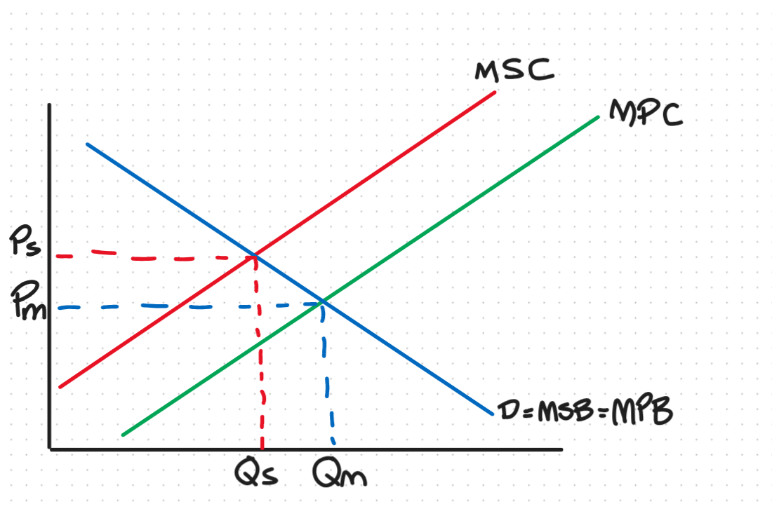
Externalities Question
As we have a steel production firm releasing effluents into the environment we have a negative production externality.
We can identify that the externality will be on the production side so between the supply curves.
Here the quantity expected by the social market Qs will be less than what is produced by the private market Qm
Therefore MPC is to the right of MSC and the gap between supply curves is the total spillover costs of the pollution created by the steel manufacturing plant.

Slide 25
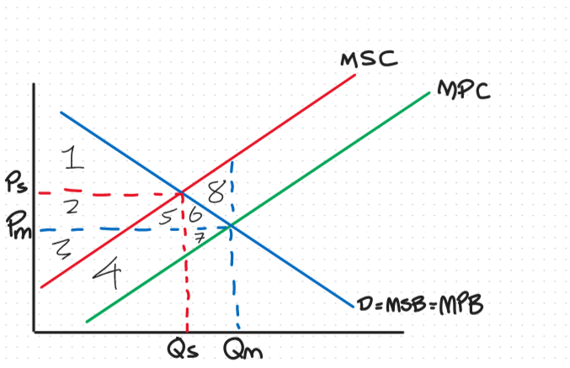
(c) Using your diagram, explain why the free market overproduces steel relative to the socially optimal level. In your answer refer to the wedge between MPC and MSC, and identify the area on your diagram that represents the deadweight welfare loss from the externality.
Notes:
Here the free market equilibrium occurs where MPC meets demand at Qm. However the steel producer only considers their own private costs ignoring the external costs imposed on third parties (pollution damaging the fishing industry and local communities. Therefore the market price is too low and output is too high relative to what is socially efficient.
Looking at our graph here can note that I have drawn a the Qm line up to intersect MSC this outlines the total area of spillover cost: 4, 5, 6, 7, 8. To calculate the area of deadweight loss we must consider which costs are internalised by the steel manufacturer and buyers first. Here the CS = 1, 2, 5, 6 at equilibrium Qm, Pm and PS = 3, 4 therefore only area not internalised in the private market of CS and PS is area 8 our deadweight loss
- Common theme where the deadweight loss is this triangle above the demand curve
Question how can we remove this deadweight loss? – Tax that brings our MPC to equal our MSC where MSC = MPC + tax

Slide 26
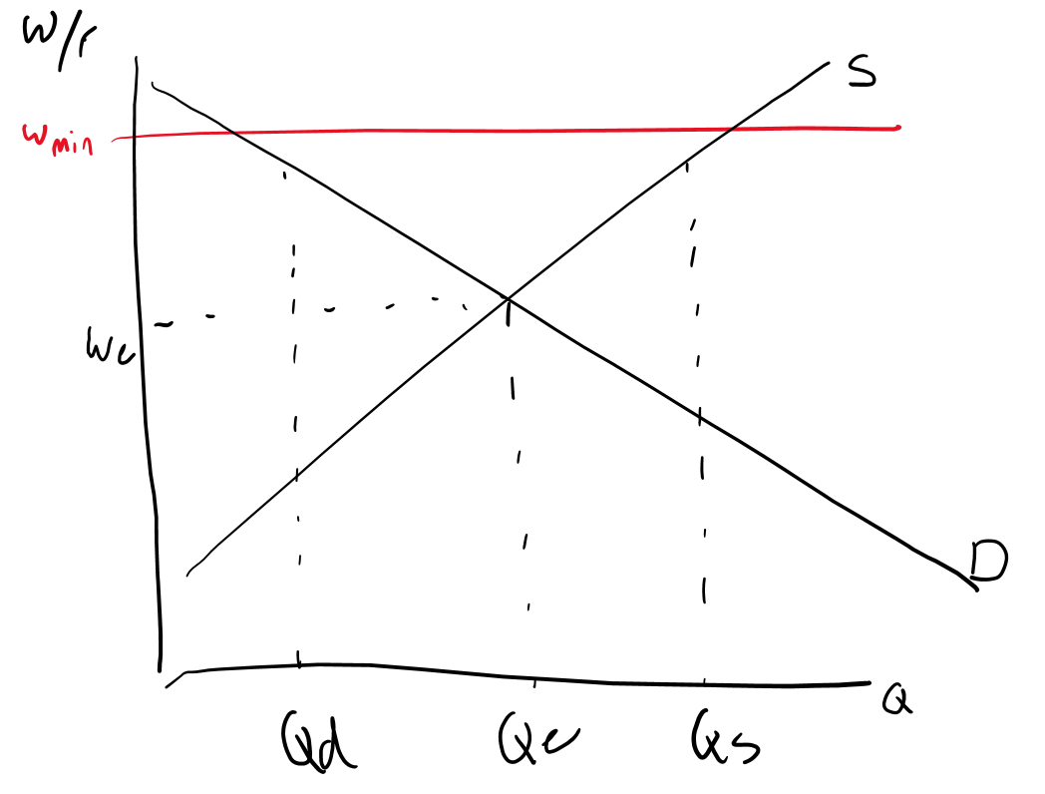
Labour market
Supply of labour:
It is supplied by households
Curve is shifted by anything that changes the number of workers available
Demand for labour
Demand comes from firms
Curve is shifted by anything that affects the value of the marginal product of labour
Firms will hire workers as long as the value they provide is greater than the wage rate
Question: Minimum wage is implemented in this labour market, explain whether workers are better or worse off as a result of this?
Notes:
Labour market is fundamentally the same as what was covered in term 1 with normal supply and demand, with the exception that it is now consumers supplying the labour, and producers the ones that are demanding it.
Shifting the supply curve is guided basically by anything that shifts the numbers of workers available: such as immigration
Shifting the demand curve: a little bit more complicated, it is anything that changes the value of the marginal product of workers – which essentially you can imagine to mean anything that changes the value of the workers for the organisation, workers will be hired as long as this value is greater than wage rate, so anything like changes in technology, or changes in demand for product can affect this.
Common question comes in the form of minimum wage and the effect of this
Run through this question

Slide 27
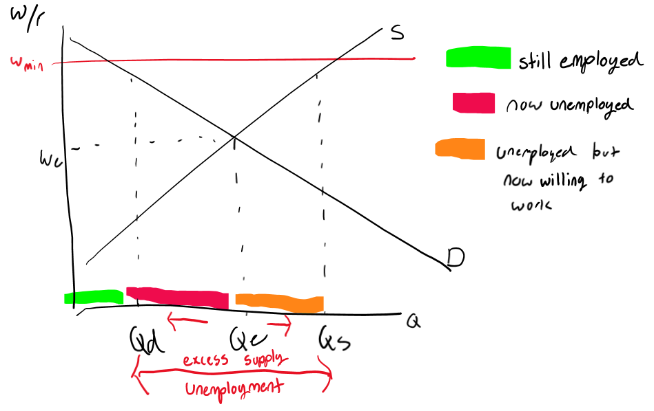
Labour market exam question
Notes:
So we have three key categories of workers in this market.
Those still employed: better off
Those who were employed now unemployed, worse off
Those who weren’t in job market but no are: ambiguous
Overall can go either way in terms of whether people better or worse off, all depends on elasticity of demand
- If elastic: larger increase in unemployment overall worse off (more horizontal curve)
- If inelastic: lesser increase in unemployment, might be better off

Slide 28
Stay Updated for Events
Sign Up for Free!
Website: www.theinvestmentsociety.org
These slides are available on our Website
Facebook Page: The Investment Society
Instagram: the_investmentsociety

Slide 29
Thank You and Good Luck!
Presented by The Investment Society

