Slide 1

FINC 203 TUTORIAL
THURSDAY 30th APRIL
4-5pm in F1
Notes:
Introduce
Ourselves
The Club
Thank for coming
Explain
Thank for submitting
Why we are going these

Slide 2

SIGN UP FOR FREE
STAY UPDATED
Instagram: the_investmentsociety
QUESTIONS AND FEEDBACK
Email: ipi17@uclive.ac.nz

Slide 3
Financial Markets
Financial markets are where financial institutions operate:
Money market
Capital market
Financial institutions are companies that provide financial services to the economy:
Commercial banks
Credit unions
Insurance companies

Slide 4
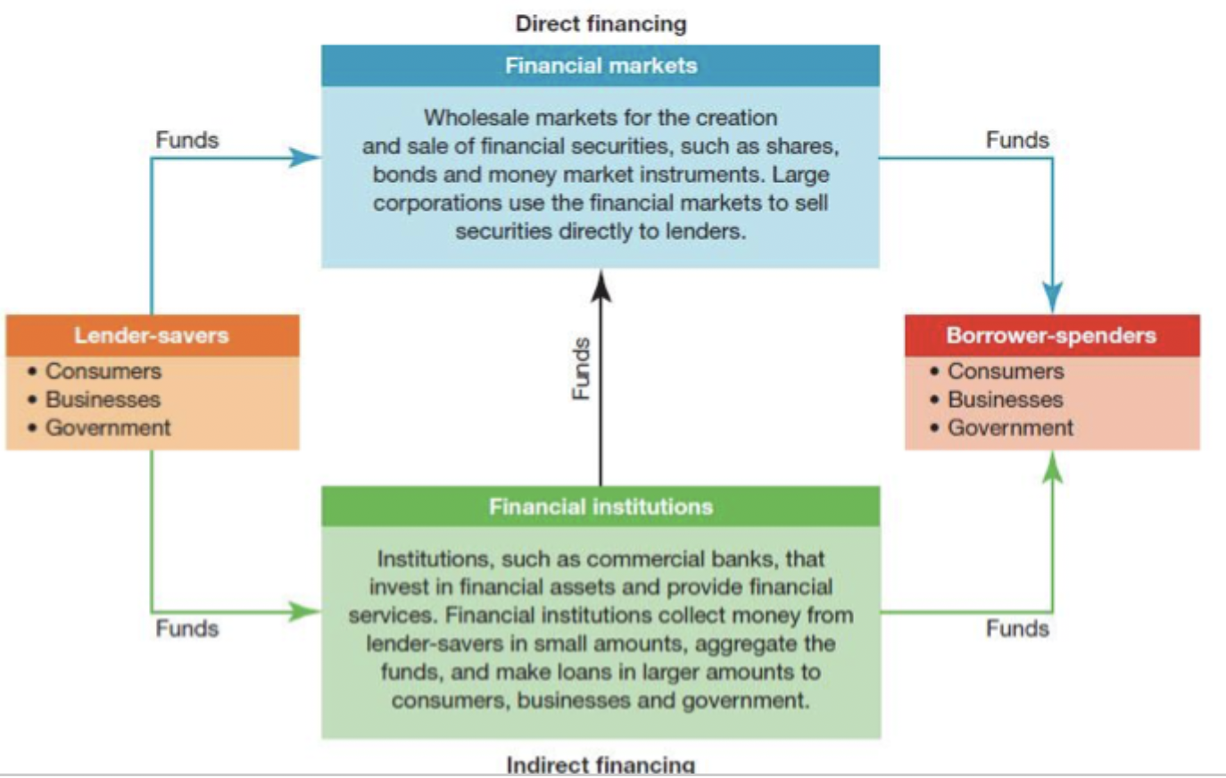
Funds Flow
Lender-Savers = SSU
Excess money they don’t require
Households
Some firms, governments
Term deposit
Borrower-Spenders = DSU
Require money
Firms, governments
Mortgage

Slide 5
Funds Flow
Direct Financing
- SSU and DSU deal directly
DSU sell securities to SSU
Typical minimum transaction size is $1 m, financial institutions are major buyers
Provides lowest transaction costs possible
Indirect Financing
Uses an intermediary

Slide 6
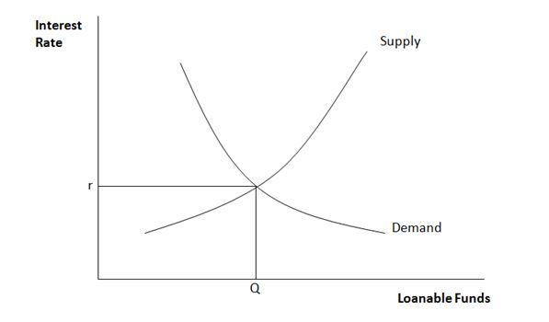
How are interest rates determined?
Business want to rent (borrow) money to buy capital to produce and sell more - invest
People that want to save will want to rent out the surplus money they have.
Interest performs allocative role in economies
Interest rates are set by the interaction of supply and demand of money (loanable funds)
Level of interest rates stems from individuals' time preference for consumption and production opportunities facing entrepreneurs and investors
Notes:
The higher return on investment, more likely producers are to undertake a particular investment project - more willing to pay a high fee (higher interest rate).
The higher fee (interest rate), the more willing they will be to rent out the money.

Slide 7
Types of Bonds
Treasury bonds
Issued by government, low credit risk
Treasury indexed bonds
- Principal changes to reflect inflation
Municipal bonds
Tax exempt
General obligation (backed by issuers without assets pledged as security) or revenue (backed by cash flow of project)
Corporate
Secured: underlying asset/collateral attached to the bond
Unsecured: no collateral attached to the bond

Slide 8
Markets for Securities
- Primary market: companies sell shares for the first time in order to raise money (IPO)
- Second market: outstanding shares are bought and sold among investors
- Broker markets: broker brings buyers and sellers together in order to earn commission
- Dealer market: buy and sell securities (profit is the difference between bid and ask spread)

Slide 9
Types of Orders
Market orders: execute trade at the current market price
Limit order: execute the trade at a given price limit
Buy limit order: an order to buy at a designated price or a lower price
Sell limit order: an order to sell at the designated or a higher price
Stop loss order: order to sell when the price drops below a certain level, becomes a market order when the price on the market drops below a certain level

Slide 10
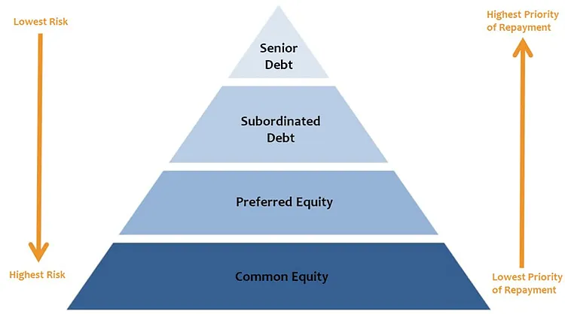
Ranking of Debt
Senior debt
  Usually backed by collateral
  Offers lower interest rates
Subordinated debt
  Unsecured
  Offers higher interest rates
Preferred shares
  No voting rights
  Fixed dividend
Common shares
  Not guaranteed dividends

Slide 11
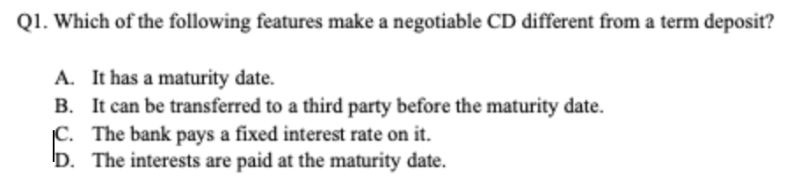
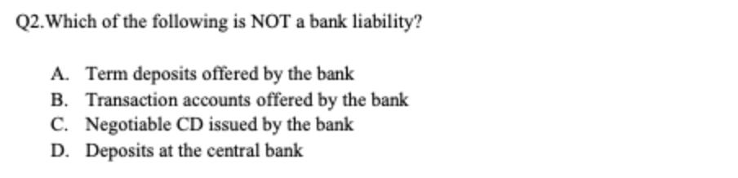

Slide 12
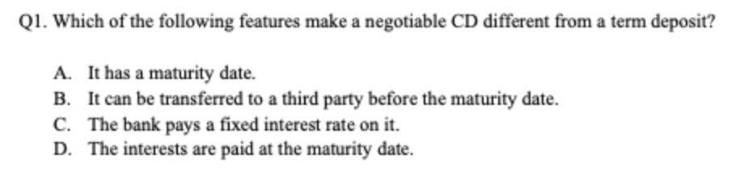
Term deposits lock away your money for a set period at a fixed interest rate, CDs are usually negotiable and tradeable
Banks hold deposits at the central bank for reserve requirements, settlement purposes and as a safe, liquid store of funds

Slide 13
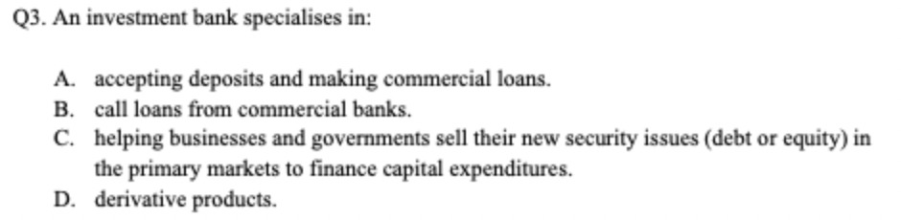

Slide 14
Investment banks specialize in helping companies sell new debt or equity
Origination: process of preparing security issue for sale
Underwriting: guarantees company will raise funds it expects from new issue
Standby underwriting is most common where the investment bank agrees to purchase leftover shares
Primary market: companies initially sell new debt or equity (IPO)
Secondary market: where owners of securities can sell them to other investors

Slide 15
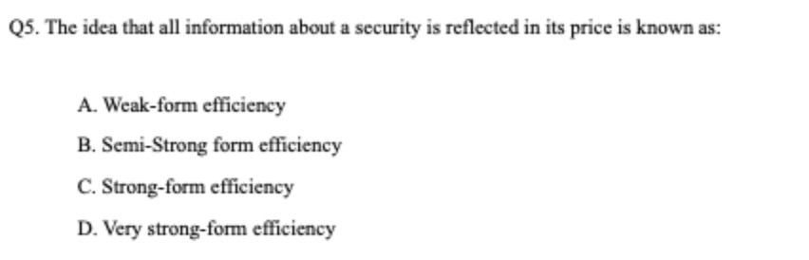

Slide 16
Weak: all information about security contained in past prices is reflected in current prices but there is public and private information that is not
Semi-strong: only that all public information available to investors is reflected in security prices
Strong: all information about a security is reflected in its price

Slide 17
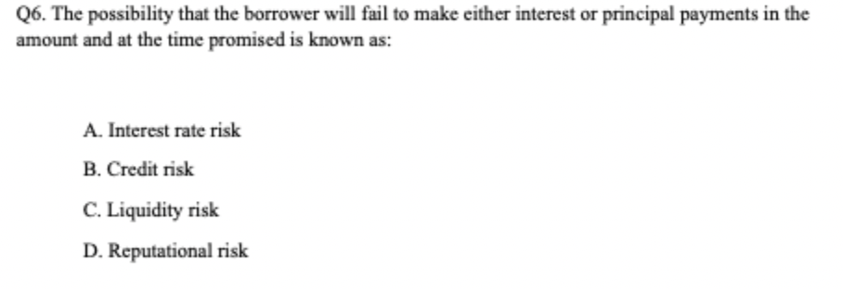

Slide 18
Types of risks:
Credit
Liquidity
Foreign exchange
Political
Reputational
Environmental
Operational
Contagion
Notes:
Credit - borrower fails to make either interest or principal repayments in the amount and at the time promised
Liquidity - financial institution unable to generate sufficient cash inflow to meet required cash outflows
Foreign exchange - fluctuation in earnings or value of a financial institution that arises from changes in exchange rates
Political - fluctuation in value of financial institution resulting from actions of local/foreign governments
Reputational - negative publicity regarding an institution's business practices to cause a decline in customer base, costly litigation or revenue reduction
Environmental - climate change and environmental litigation
Operational - complexity and scale of large business create a risk of loss due to failure or inadequacy of internal systems, people and processes that should ensure effective and efficient operation of financial institution
Contagion - financial difficulties in one organization spreading to others due to complex interrelationships between institutions and the nature of the exchange settlement systems

Slide 19
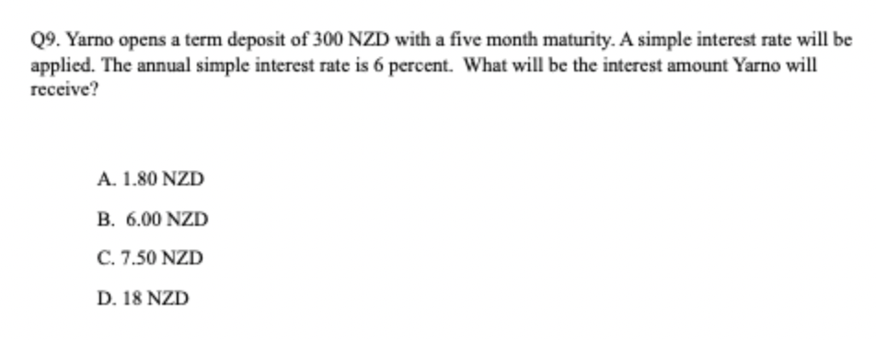
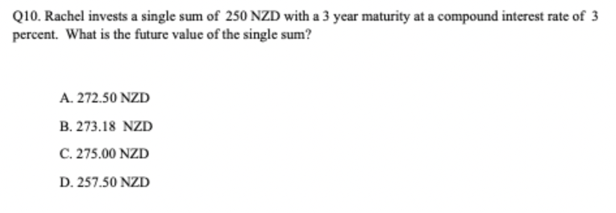

Slide 20


Simple interest:
$0.06 ×\frac{5}{12}$= 0.025
$$0.025 × 300=7.5$$
Compound interest:
$$FV=PV{(1+r)}^{n}$$
$$FV=250 × {(1.03)}^{3}$$
FV = $273.18

Slide 21
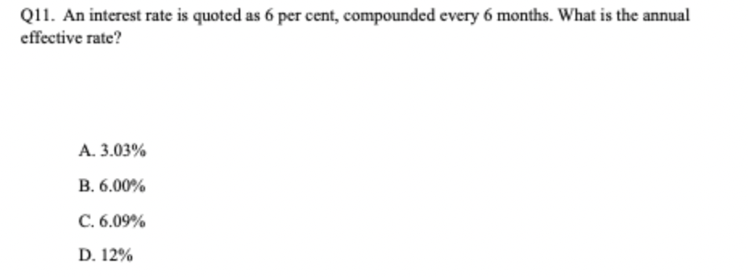

Slide 22

EAR:
$$EAR={(1+\frac{r}{n}\text{)}}^{n}−1$$
$$EAR={(1+\frac{0.06}{2}\text{)}}^{2}−1$$
EAR = 6.09%

Slide 23
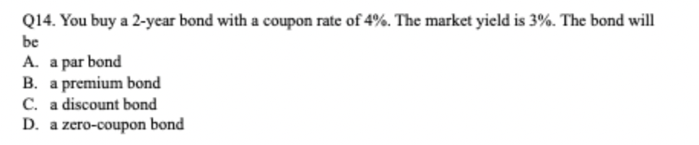

Slide 24

The bond price will increase $≈\$547.62$
Premium: Coupon > YTM
Par: Coupon = YTM
Discount: Coupon < YTM
Notes:
Q26. % ΔPrice ≈ −Duration × (Δr / (1 + r))
Given:
Price = $500
Duration = 5 years
Rate drops from 5% → 3%, so Δr = −0.02
Calculation:
% ΔPrice ≈ −5 × (−0.02 / 1.05) ≈ −5 × (−0.01905) ≈ +9.524%
New Price:
$500 × (1 + 0.09524) = $500 × 1.09524 ≈ $547.62
Q14. Premium: bond pays more than the market demands, so buyers compete for it and bid the price up.
Par: bond pays exactly what the market demands, so no adjustment is needed.
Discount: bond pays less than the market demands, so nobody wants it at full price

Slide 25
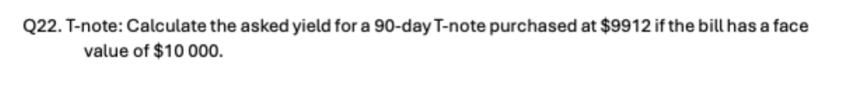
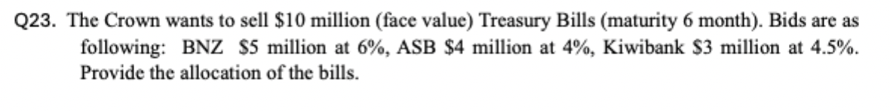

Slide 26



F = $10,000
P = $9,912
T = 90
$$F=P(1+y\frac{n}{365})$$
$$y=3.60\%$$
$$10000=9912(1+y\frac{90}{365})$$
ASB, $4M at 4%
Kiwibank, $3M at 4.5%
BNZ, $3M at 6%

Slide 27
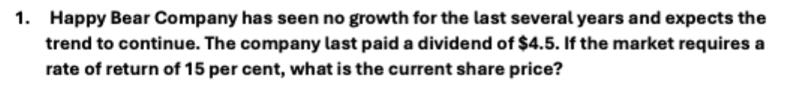
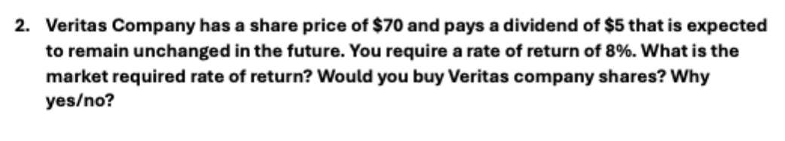

Slide 28






G = 0%
R = 15%
D0 = $4.5
$$P0=\frac{D}{r }$$
$$P0=\frac{4.5}{0.15}$$
$$P0=\$30$$
$$P0=\frac{D}{r }$$
$$P0=\frac{5}{0.08}$$
$$P0=\$62.50$$
$70 > $62.5, the share is overvalued

Slide 29
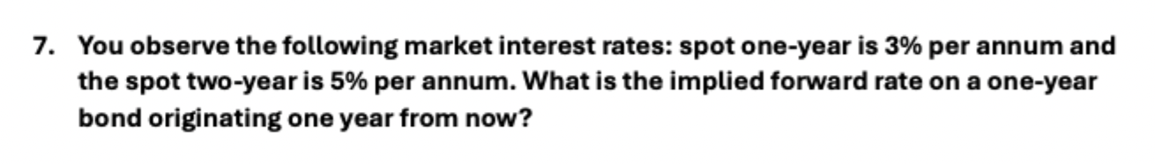
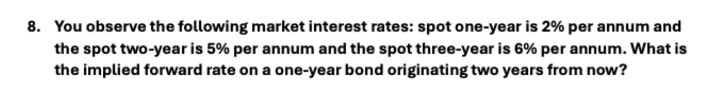

Slide 30
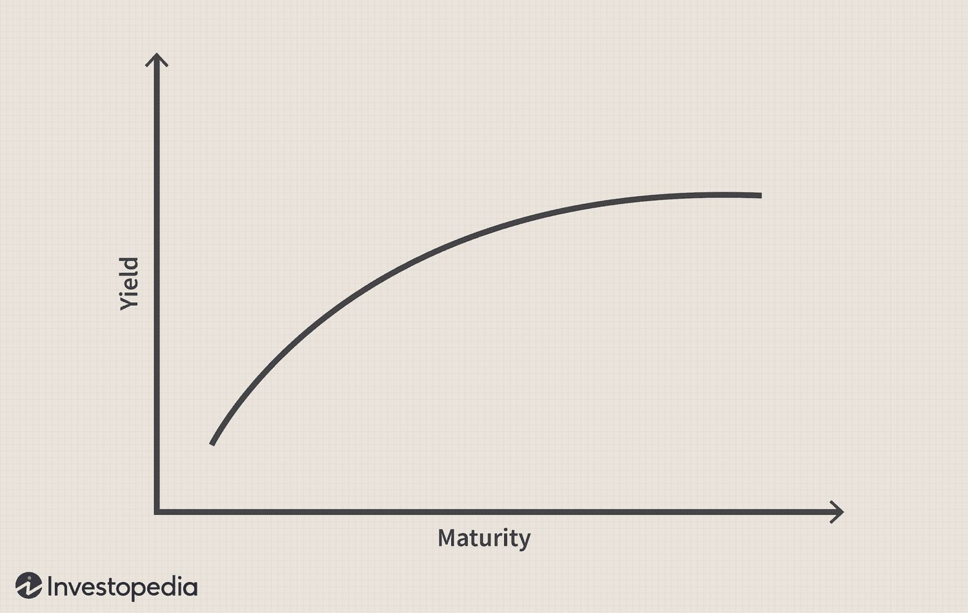
Yield curve plots interest rates across different maturities – shows what investors demand for different lengths of time
(1
Upward sloping – liquidity preference
Flattening - expectations
No arbitrage condition must hold – 7.04%
(1
No arbitrage condition must hold – 8.03%
(1
Notes:
Using the no-arbitrage forward rate formula:
$$\left((1+s_{2}{\left.)\right.}^{2}=\left(1+s_{1}{\left.)\right.}^{1}×\left(1+f_{1,2}{\left.)\right.}^{1}\right.\right.\right.$$
Where:
s₁ = 3% (spot one-year rate)
s₂ = 5% (spot two-year rate)
f₁,₂ = ? (implied forward rate, year 1→2)

Slide 31
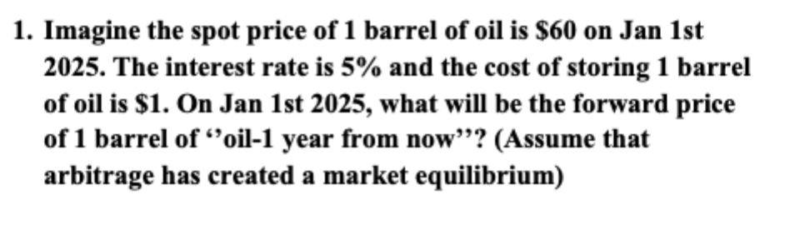

Slide 32


Need no arbitrage profit to exist - forward price must be equal to the spot price and all carrying costs, otherwise riskless profit can be made
$F=S\left(1+r\right)+U$F
$$F=\$64$$

Slide 33
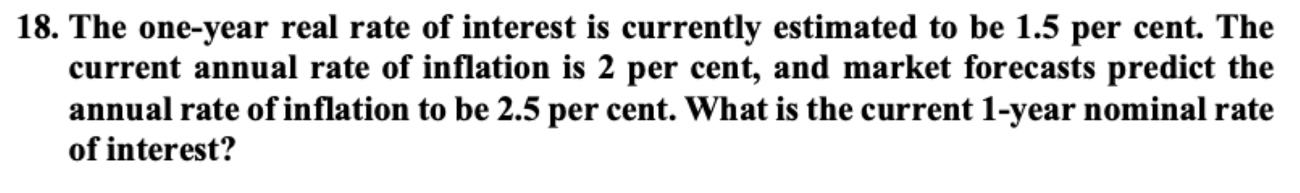

Slide 34

Fisher equation:
(1+ nominal) = (1 + real)(1+ inflation)
Nominal = 4.04%
Fisher approximation:
Nominal $≈$ real + inflation
Nominal $≈$4.00%

Slide 35
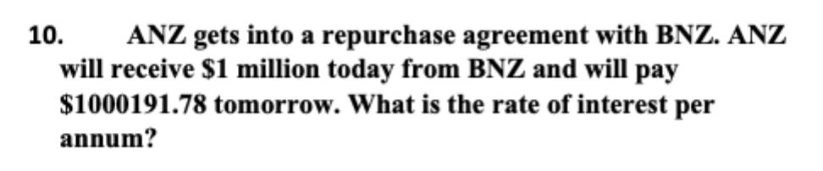

Slide 36

Repo is a collateralized overnight loan:
$\frac{1000191.78−1000000}{1000000}$= 0.000191
0.00019178 * 365 = 7.00%

Slide 37
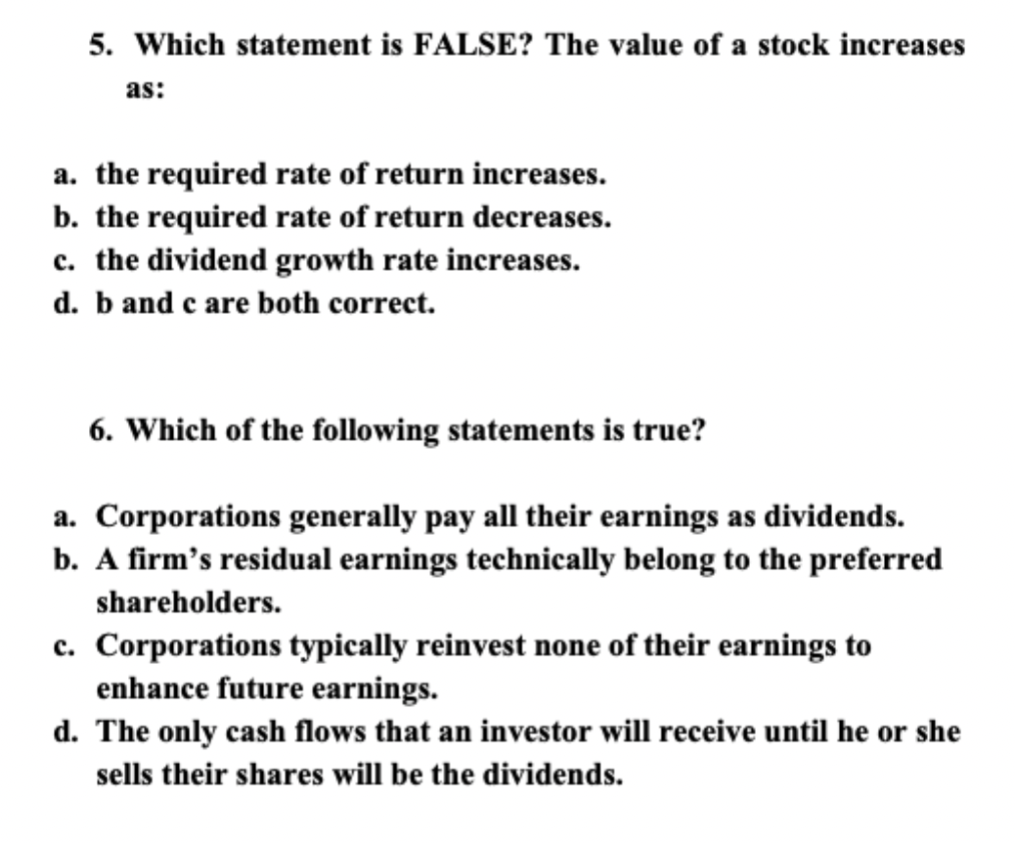

Slide 38

$$P0=\frac{D1}{r −g}$$
1. Firms retain a portion for reinvestment
2. Residual earnings belong to ordinary/common shareholders
3. Most corporations reinvest a portion of earnings (plowback/retention ratio) for growth

Slide 40
1. Counterparty to every trade
- Neither party has credit exposure
- Eliminates counterparty risk
2. Marking to market
- Settles positions at end of each day
3. Margin management
4. Guarantees contract

Slide 41
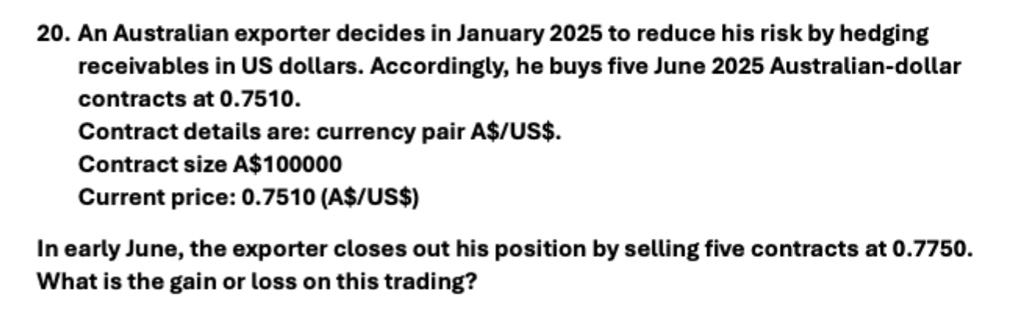

Slide 42
Gain/loss = (Exit – entry) * contract size * no. of contracts
Gain/loss = (0.775 – 0.751) * 100,000 * 5
Gain = $12,000 USD

