Slide 1

ECON 208 TUTORIAL
TUESDAY 2ND JUNE
F1
Notes:
Introduce
Ourselves
The Club
Thank for coming
Explain
Thank for submitting
Why we are going these

Slide 2
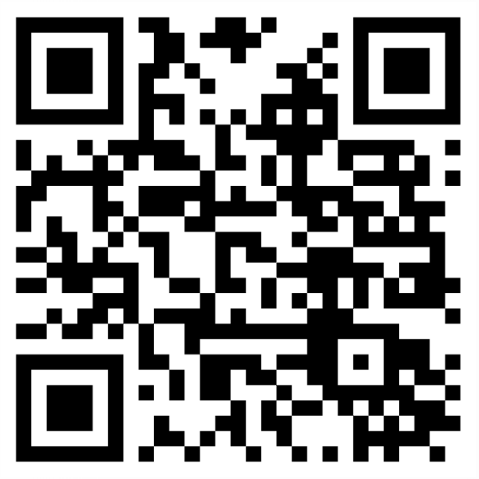
SIGN UP FOR FREE
STAY UPDATED
Instagram: the_investmentsociety
QUESTIONS AND FEEDBACK
Email: ipi17@uclive.ac.nz

Slide 3
Format
Section A: 15 multichoice (30 marks)
Section B: 5 short answers (8 marks each)
Section C: 2 long answer (15 marks each)
One question will be from a problem set

Slide 4
Section A

Slide 5
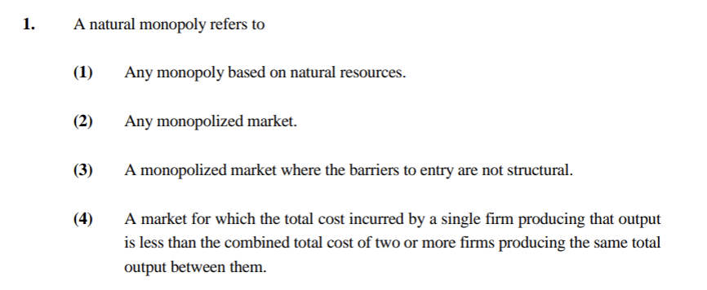
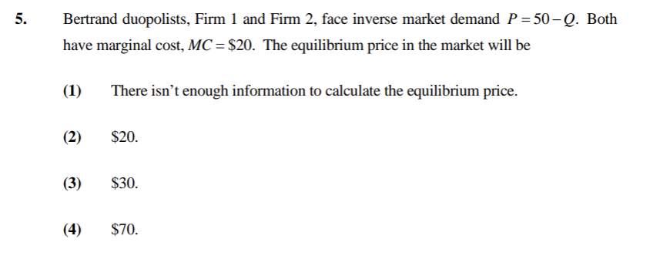
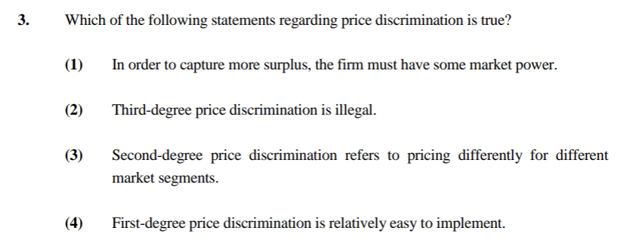
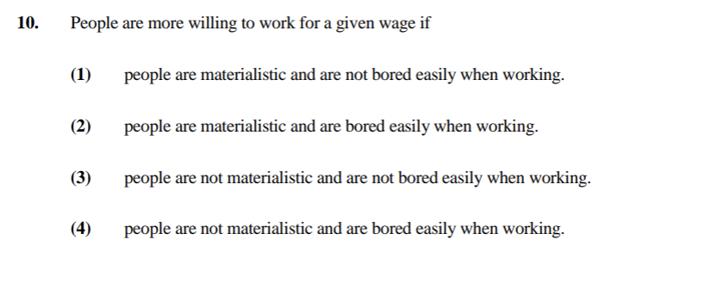

Slide 7
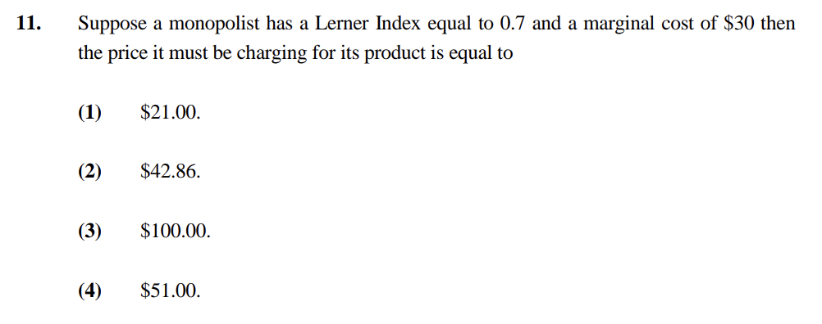
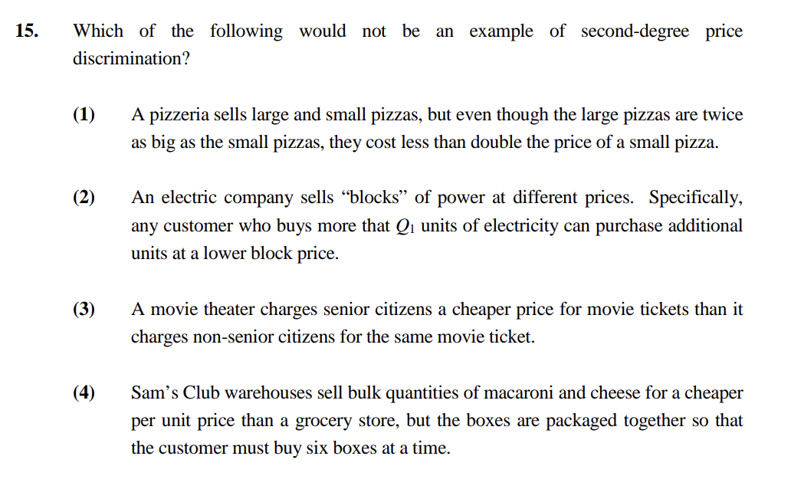
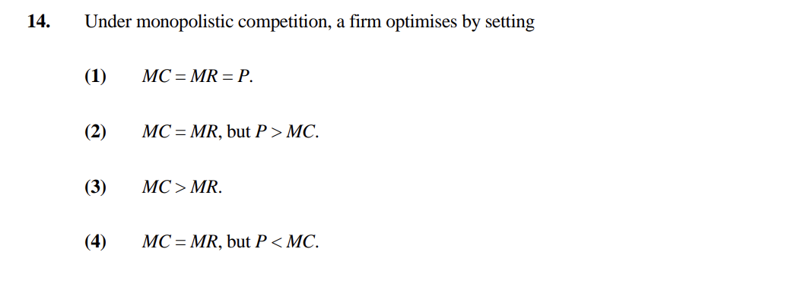

Slide 9
Section B

Slide 10
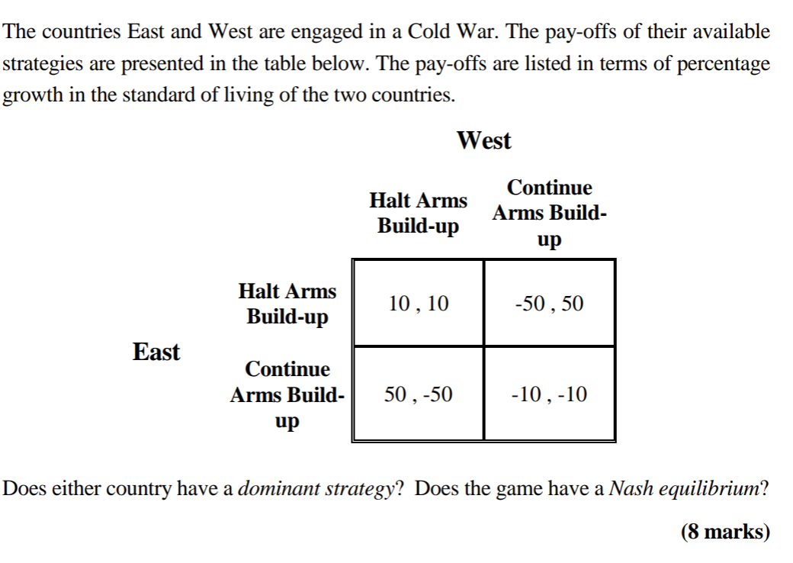

Slide 11
Dominant strategy is optimal regardless of the rival strategy. Both countries can do better by choosing continue arms build-up regardless of what the other country chooses.
Dominant strategy = continue arms build up
Nash equilibrium occurs when no player has an incentive to change their strategy given the strategy of the other player.
(Continue arms build-up, Continue arms build-up)

Slide 12
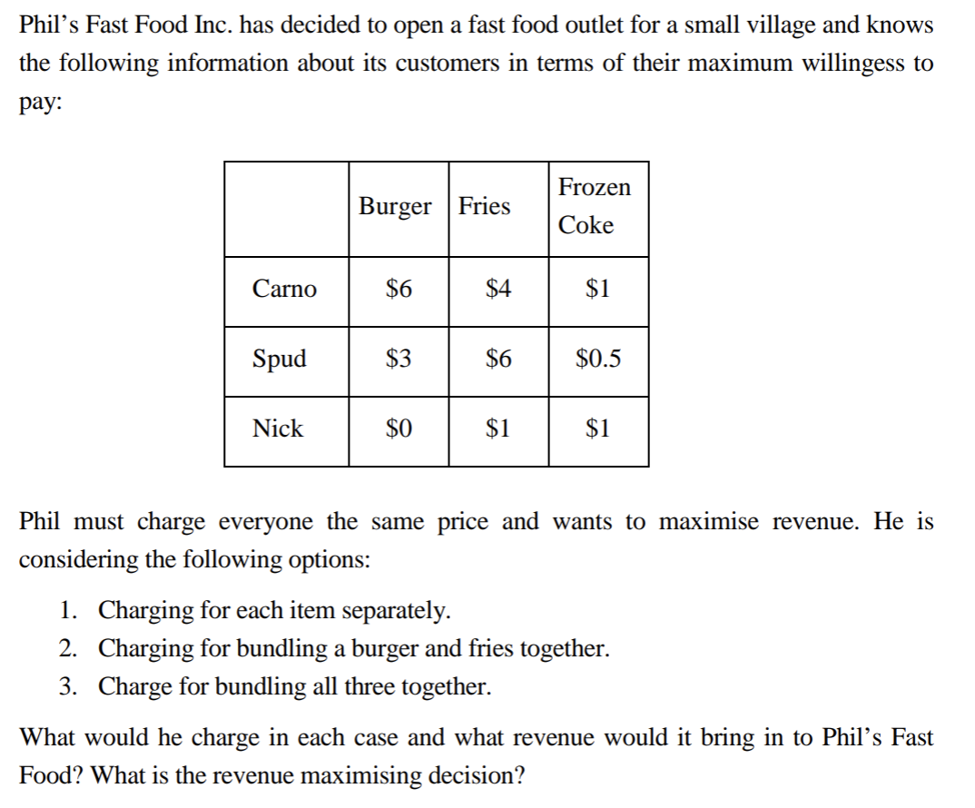

Slide 13
Burger = $3
Fries = $4
Frozen Coke = $1
Want to find the price that attracts the most total revenue for each item
Total revenue
= 3*2 + 4*2 + 1*2
= $16

Slide 14
 | Burger | Fries | WTP
Carno | 6 | 4 | 10
Spud | 3 | 6 | 9
Nick | 0 | 1 | 1
Want to find the bundle price that attracts the most total revenue
At $10, $10
At $9, $18
At $1, $3
Therefore, charge $9 for burger and fries bundle

Slide 15
 | Burger | Fries | Coke | WTP
Carno | 6 | 4 | 1 | 11
Spud | 3 | 6 | 0.5 | 9.5
Nick | 0 | 1 | 1 | 2
Want to find the bundle price that attracts the most total revenue
At $11, $1
At $9.5, $19
At $2, $6
Therefore, charge $9.5 for burger, fries and frozen cokebundle

Slide 16
$9 for burger and fries
$1 for frozen coke
Nick only buys a frozen coke, Spud only buys burger and fries
Total revenue
= 9*2 + 1*2
= $20

Slide 17
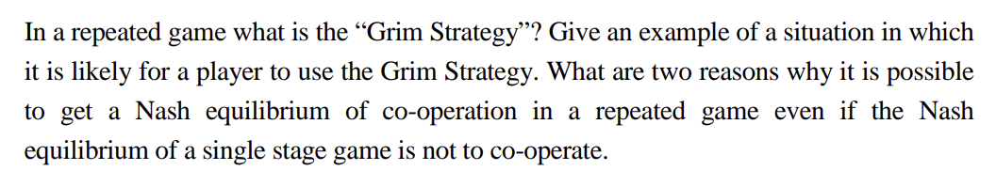

Slide 18
‘Tit for tat’ strategy where if someone cheats, then they will be punished with the harshest punishment possible
Likely to occur in situations involving wars, cartels, etc.
Cooperation occurs when:
Indefinite length game
Cheating gain
Punishment cost
Notes:
Co-operation is likely to occur in a repeated strategic situation when the following conditions
are present:
1. Indefinite Length Game — a large enough chance that firms will not go bankrupt in
any given year.
2. Cheating Gain — the one year gain from cheating on an agreement and advertising is
not too big.
3. Punishment Cost — the future loss of profits from increased advertising expenditures
is large enough to act as a credible punishment.

Slide 19
Section C

Slide 20
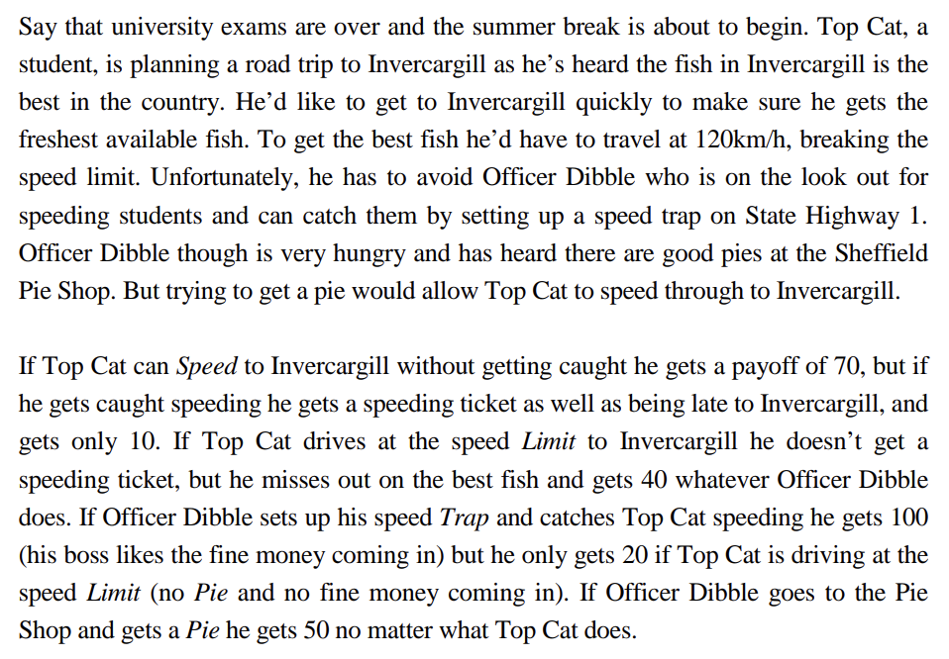

Slide 21
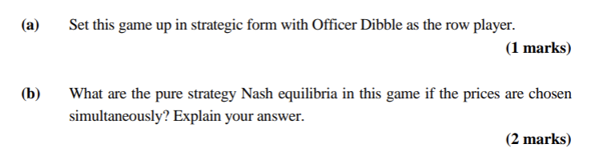

Slide 22
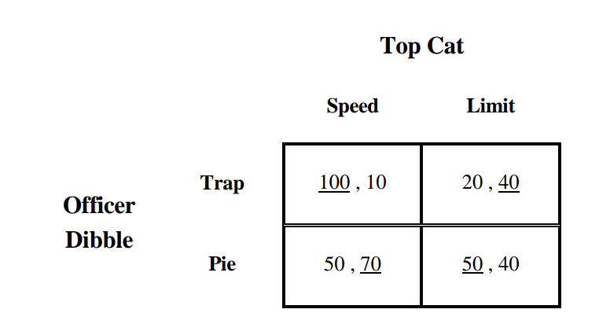
No pure strategy equilibria – discoordination game

Slide 23
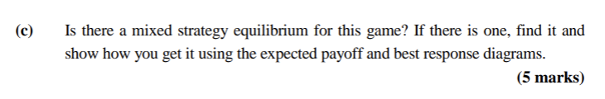

Slide 24
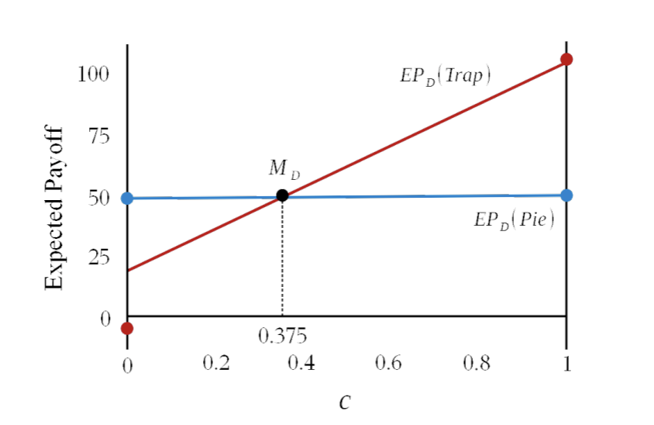
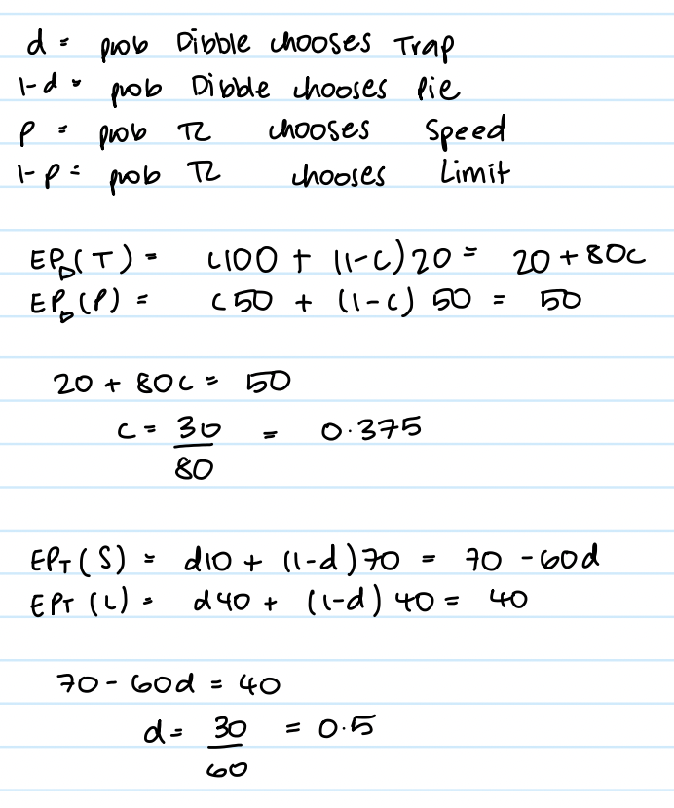
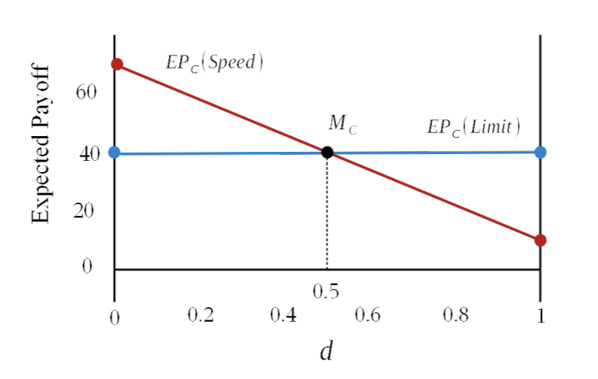

Slide 25
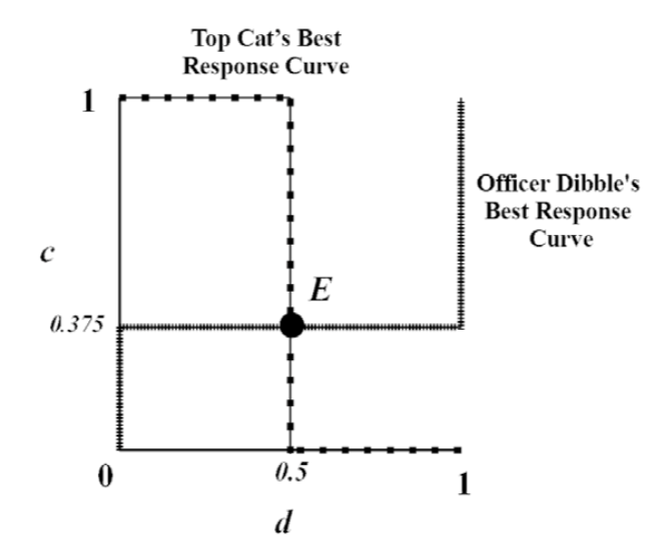
Notes:
If there is a high enough chance that Top Cat chooses Speed then Officer Dibble should set a
Trap to catch him. This is because 100 > 50. On the the hand it is not worth setting a Trap if
there isn’t much chance of catching Top Cat speeding as there is always that Pie waiting. If there is a high enough chance that Office Dibble chooses Trap then Top Cat should drive to
the Limit to avoid the speeding ticket. This is because 70 > 10. On the the hand it is not worth
driving slowly if there isn’t much chance of being caught speeding.

Slide 26
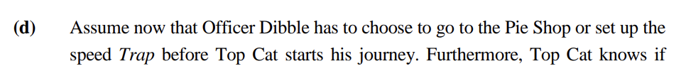
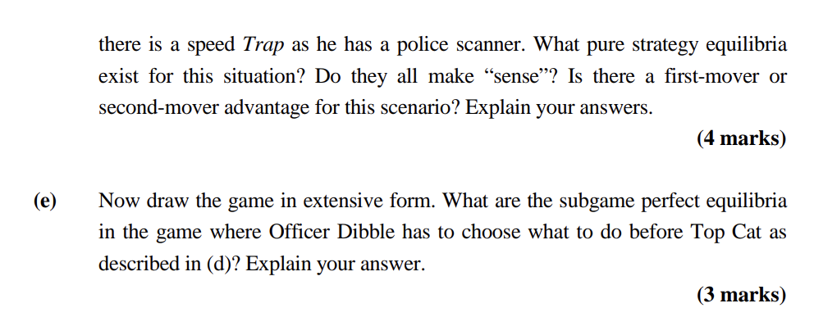

Slide 27
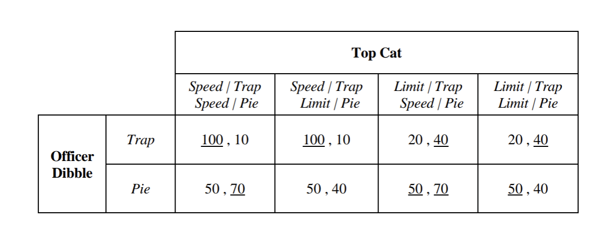
Notes:
There is 1 Nash equilibria. This equilibrium makes sense. If Top Cat knows where Officer
Dibble is going to be then Top Cat can choose the appropriate response, in effect to be where
Officer Dibble is not i.e. Speed if Officer Dibble is absent getting a Pie, and Limit if Officer
Dibble is present with his Trap. In this case there is definitely a second-mover advantage.

Slide 28
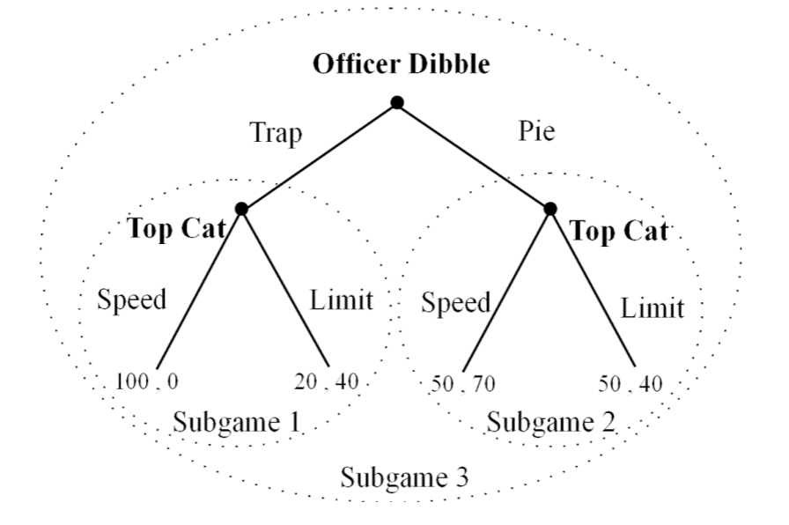

Slide 29
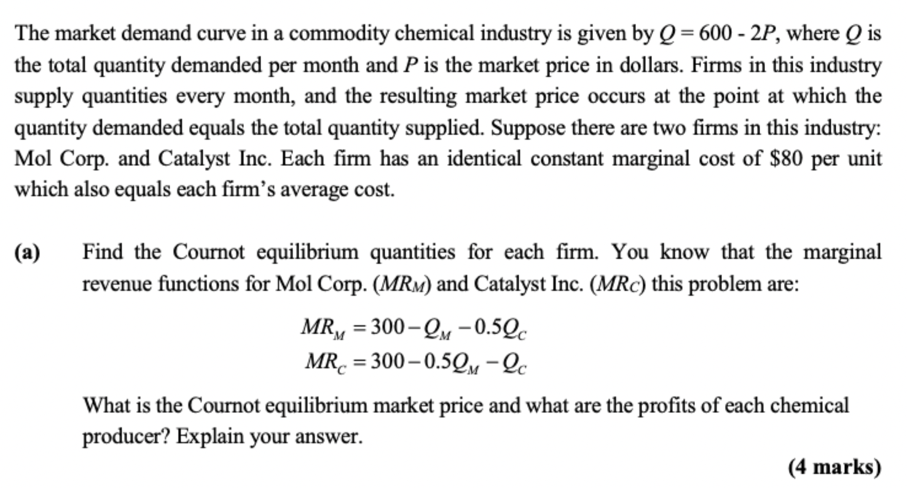

Slide 30
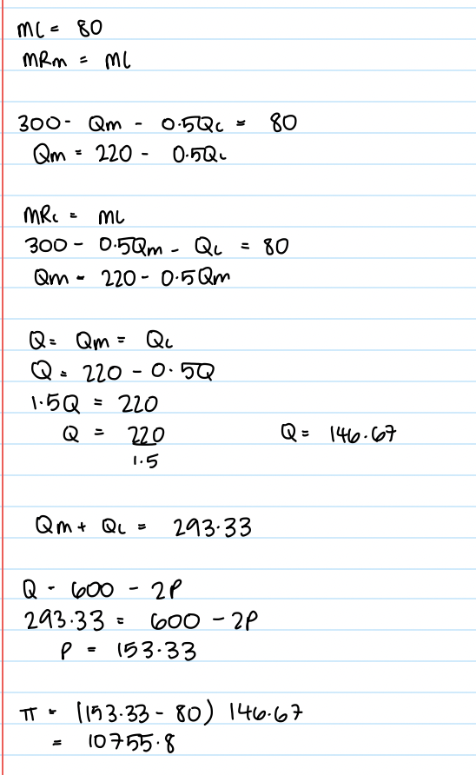

Slide 31
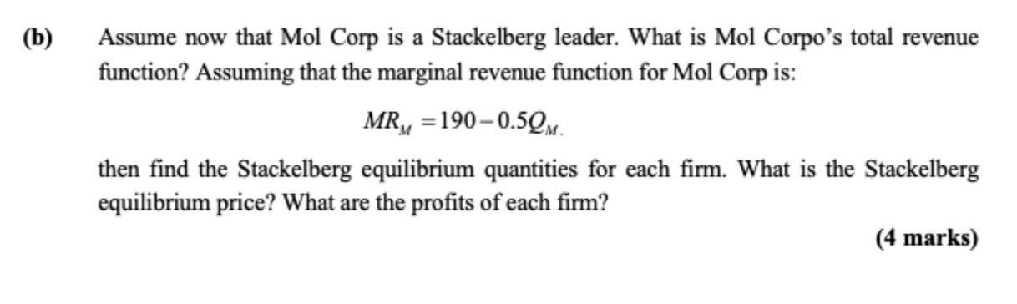

Slide 32
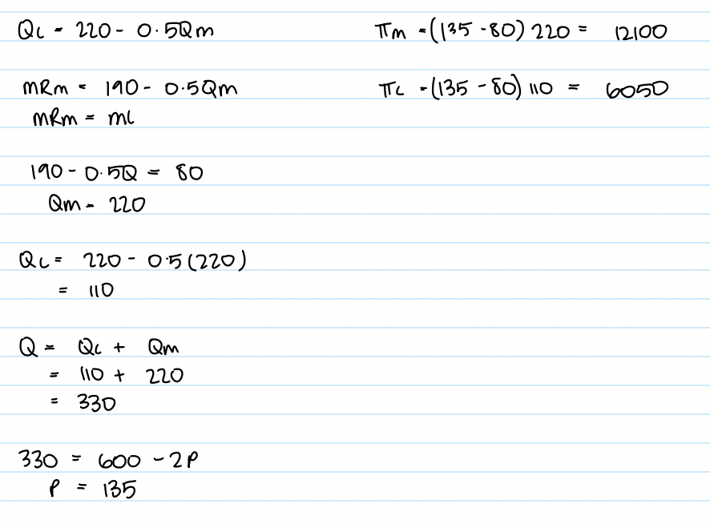

Slide 33
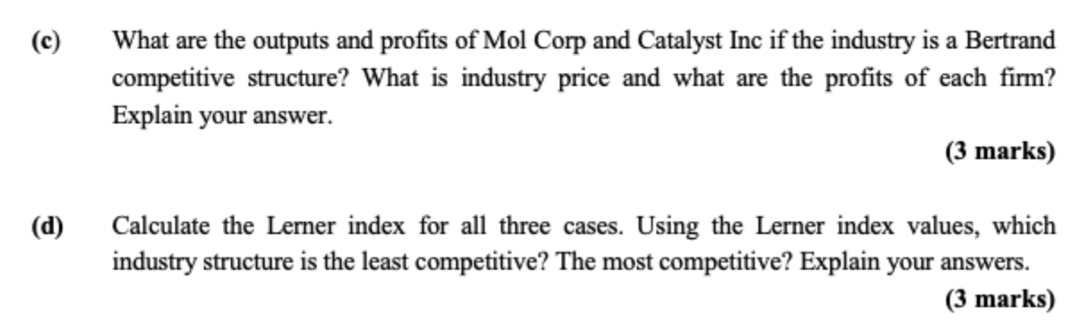

Slide 34
