Slide 1

FINC 201 TUTORIAL
TUESDAY 2ND JUNE

Slide 2

SIGN UP FOR FREE
STAY UPDATED
Instagram: the_investmentsociety
QUESTIONS AND FEEDBACK
Email: ipi17@uclive.ac.nz

Slide 3
Discounting Cash Flows
1. Only discount CF, not profits
2. Discount incremental CF
Incremental CF = CF with project – CF without project
3. Discount nominal (real) CF by nominal (real) cost of capital
4. Separate investment and financing decisions
Notes:
For incremental CF:
Include all indirect effects
Forget sunk costs
Include opportunity cost
Recognize investment in WC
Remember terminal CV
Watch for allocated overhead costs
If CF still exists when the project doesn’t exist, don’t include it
Separate investing and financing decisions by viewing all projects as equity financned

Slide 4
Cash Flows
Includes:
Capital investment
Operating CF
Changes in working capital
After tax salvage value = salvage value – tax*(salvage - book value)
Operating CF/CFAT = revenue – expenses (only cash) - taxes
Notes:
Depreciation is a non-cash expense

Slide 5
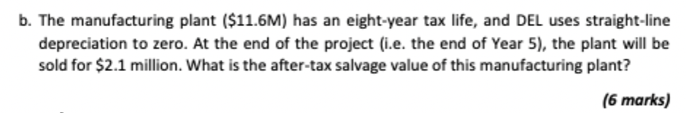

Slide 6
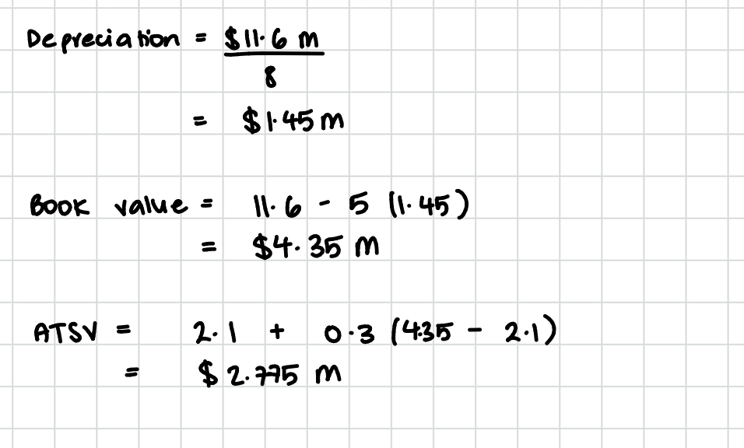

Slide 7
Discounted Cash Flow Analysis Example
McGilla Golf has decided to sell a new line of golf clubs. The clubs will sell for $840 per set and have a variable cost of $440 per set. The company has spent $154,000 for a marketing study that determined the company will sell 58,000 sets per year for seven years. The marketing study also determined that the company will lose sales of 9,900 sets of its high-priced clubs. The high- priced clubs sell at $1,140 and have variable costs of $740. The company will also increase sales of its cheap clubs by 11,400 sets. The cheap clubs sell for $480 and have variable costs of $250 per set. The fixed costs each year will be $9,140,000. The company has also spent $1,150,000 on research and development for the new clubs. The plant and equipment required will cost $28,980,000 and will be depreciated on a straight-line basis. The new clubs will also require an increase in net working capital of $1,340,000 that will be returned at the end of the project. The tax rate is 38 percent, and the cost of capital is 10 percent.

Slide 8
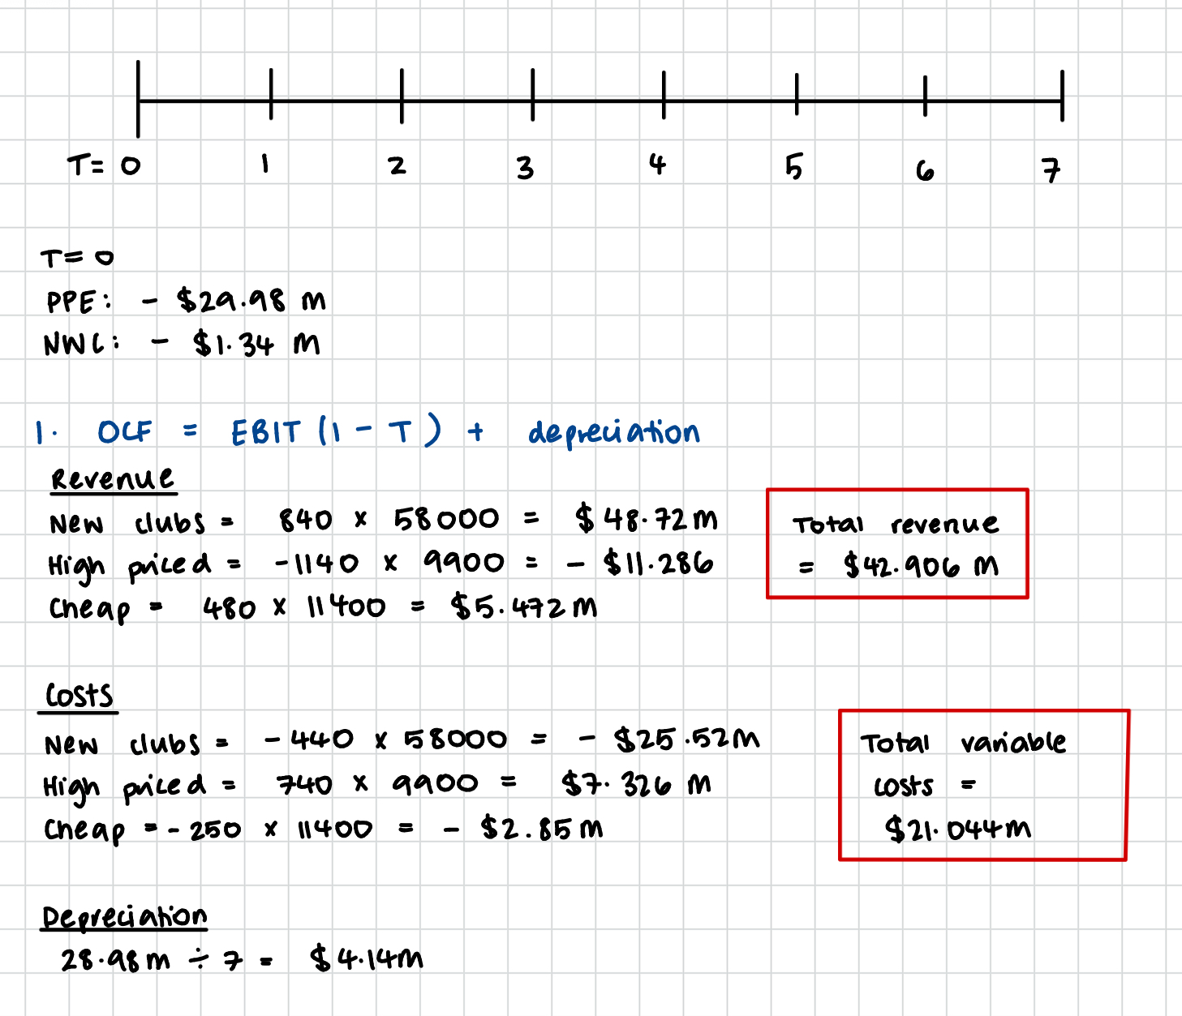

Slide 9
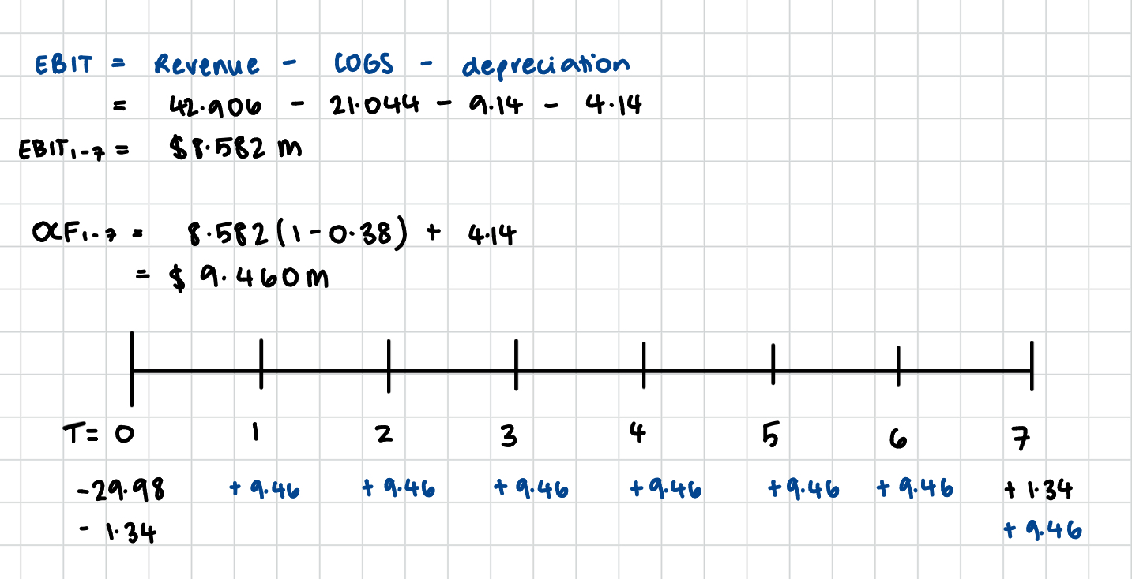
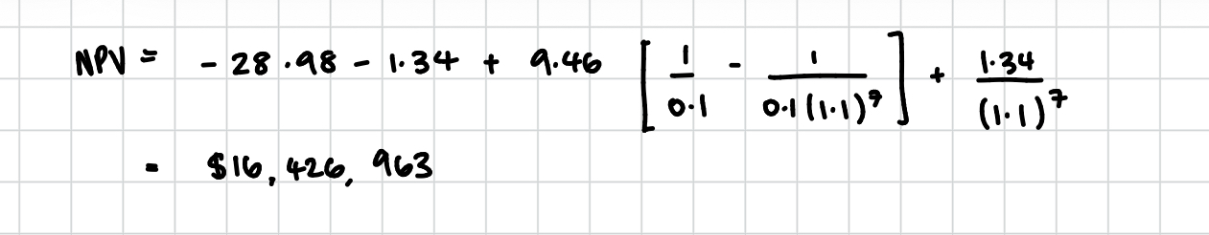

Slide 10
Risk and Return
Cost of capital is the rate of return expected to earn if invested in equally risky securities (opportunity cost)
Market index tracks the investment performance of the overall market
Dow Jones is the index of performance of portfolio of 30 blue chip stocks
S&P500 is the index of performance of portfolio of 500 large US stocks
NZX is national stock exchange and publicly owned company
Return = profit / investment
Annual return = (Pt+1 - Pt)/Pt

Slide 11
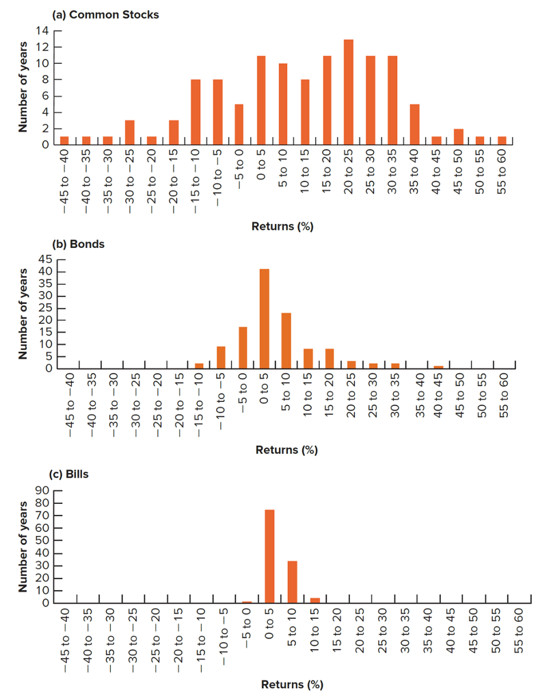
Measuring Risk
Opportunity cost of safe projects must be rate offered by safe Treasury bulls
Opportunity cost for average risk projects must be expected return on market portfolio
Need measure of how far returns may differ from the average
Variance
Standard deviation

Slide 12
Higher risk, higher return
Expected return is a function of risk
Assume all investors rational and risk averse, always choose to invest in portfolios rather than single assets = diversification
Diversification works as prices of stocks don’t move exactly together = correlation
Market/systematic/undiversifiable risk
Firm specific/unique/unsystematic/diversifiable risk
CAPM:
Er = rf + B(rm –rf)
Notes:
Market risk: part of security’s risk that can’t be eliminated through diversification as it is associated with economic or market factors that systematically affect most firms
Firm specific: Part of a security's risk associated with random outcomes generated by events, behaviors, specific to the firm

Slide 13
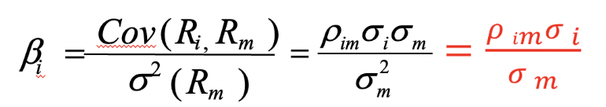
Beta
Beta is a measure of non-diversifiable risk
Measure of asset’s return sensitivity to changes in the market return
Market portfolio, beta = 1
Measured by regressing returns of market portfolio against returns of an individual asset

Slide 14
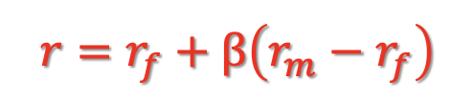
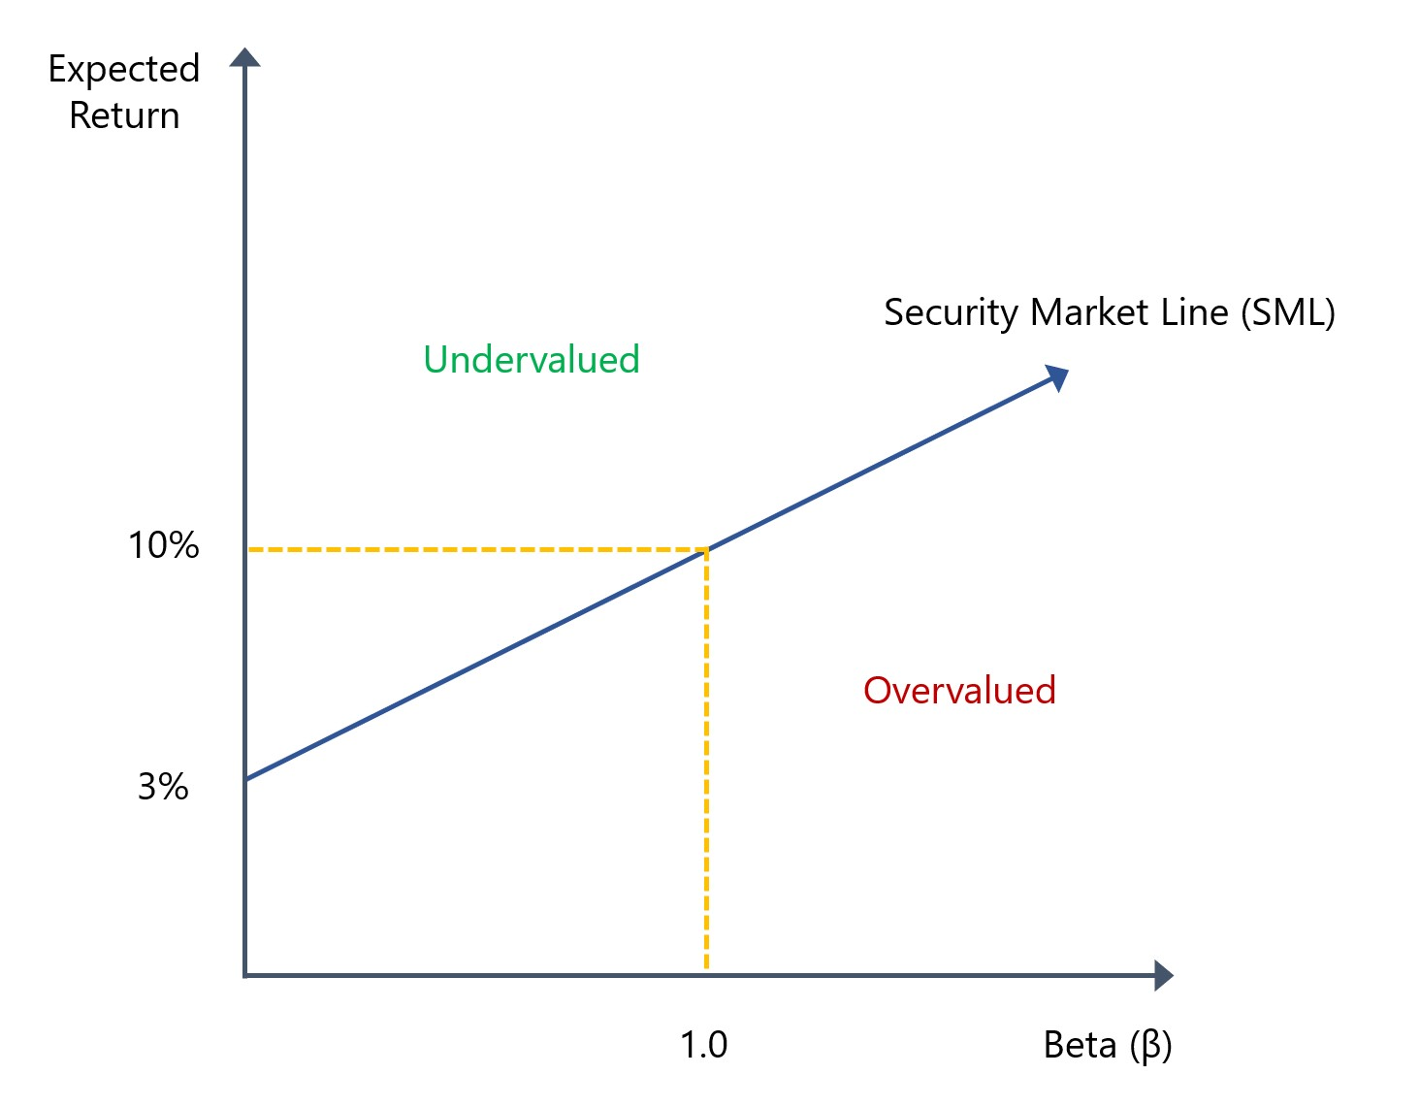
Capital Asset Pricing Model
SML is graphical representation of CAPM

Slide 15
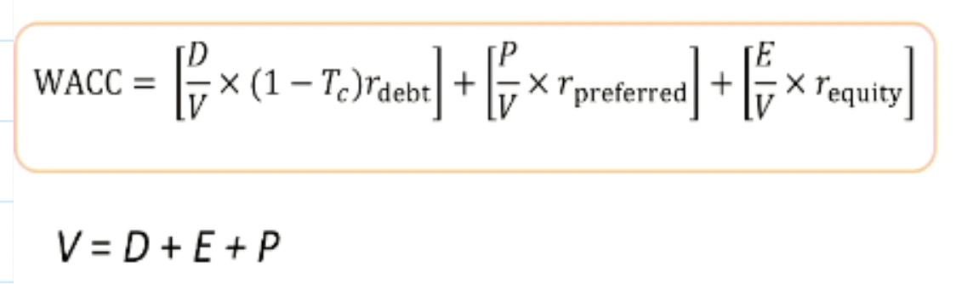
Weighted Average Cost of Capital (WACC)
Companies finance long term activities via long term debt, preferred stock or common equity
Company management need a way to calculate overall cost of a company’s capital as a benchmark for new investment opportunities and to value to company as a whole

Slide 16
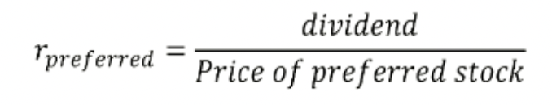
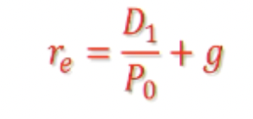
Working out r
Debt
YTM often used
Preferred stock
Common equity
CAPM
Dividend discount model
Notes:
Only use DDM if company pays dividends with constant growth rate

Slide 17
Working out weights
Use market value
E = # outstanding common shares * price per common share
P = # outstanding preferred shares * price per preferred share
D = # outstanding bonds * bond price
V = E + P + D
Notes:
MV represents the opportunity cost whilst BV does not

Slide 18
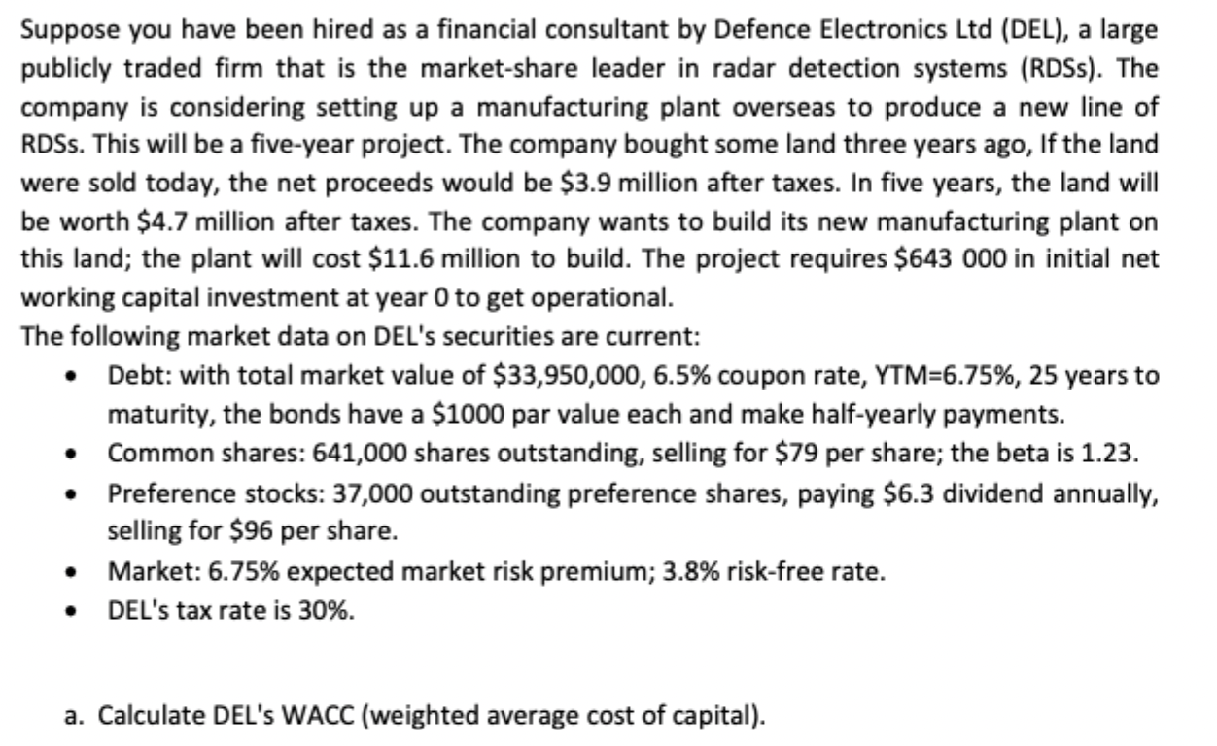

Slide 19
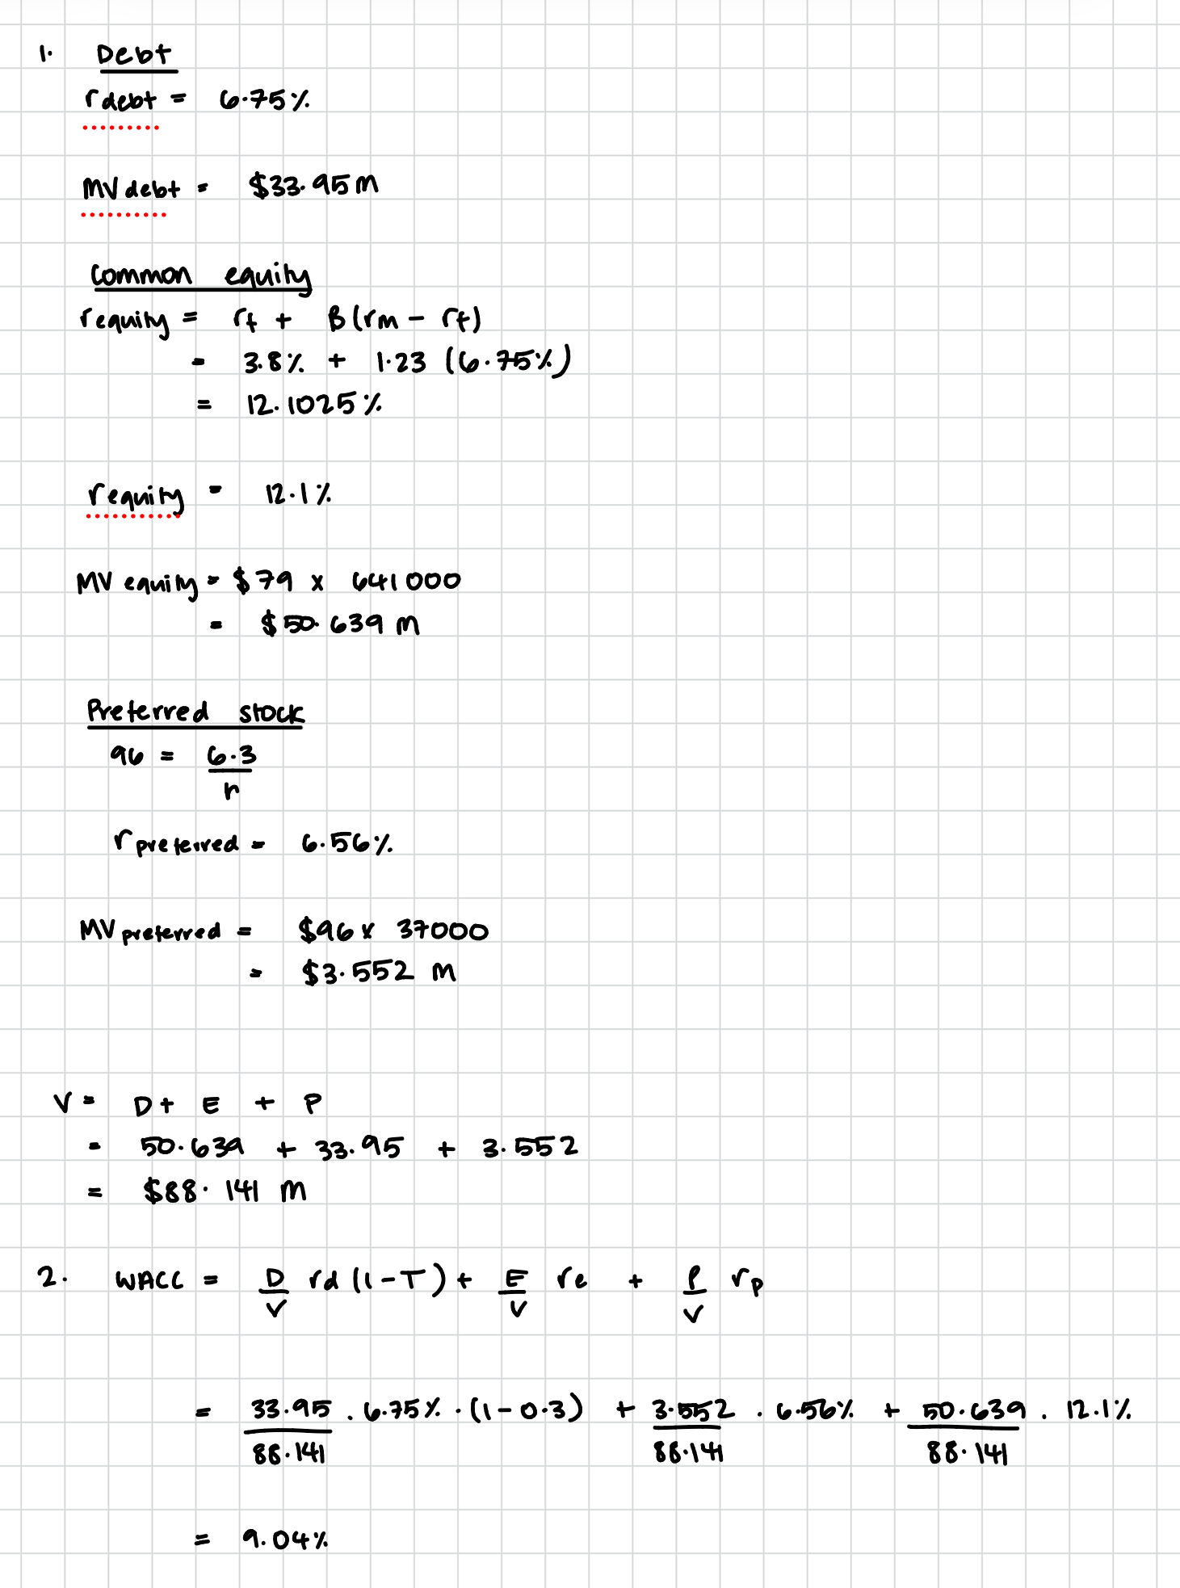

Slide 21

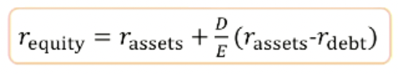
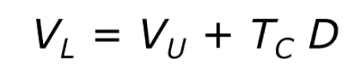
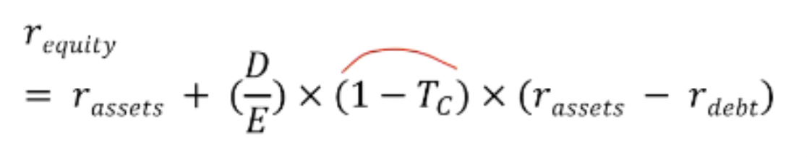
Modigliani and Miller
No tax
1. Firm value is not affected by leverage
2. Leverage increases risk and return to stockholders
With tax
1. Firm value increases with leverage
2. Some of the increases in equity risk and return is offset by the interest tax shield
Notes:
No Tax — Proposition 1
A firm's value depends on its assets and earnings, not how it is financed
Mixing debt and equity in different proportions does not change the total value
Investors can replicate any capital structure themselves, so the firm adds no value by doing it for them
Like cutting a pizza into more slices — the total amount never changes
No Tax — Proposition 2
Taking on more debt shifts more risk onto equity holders, who have a junior claim on cash flows
To compensate, equity holders demand a higher return as leverage increases
The cost of equity rises in direct proportion to the debt-to-equity ratio
The benefit of cheaper debt is exactly cancelled out by the rising cost of equity
The overall cost of capital therefore stays constant
With Tax — Proposition 1
Interest payments are tax-deductible, creating an "interest tax shield"
The tax shield increases the total after-tax cash flows available to all investors
Firm value = value of an unlevered firm + present value of the tax shield
In theory, firms should borrow as much as possible to maximise this benefit
With Tax — Proposition 2
Equity holders still face greater risk and demand higher returns as leverage rises
However, the government effectively shares part of the cost of debt via the tax deduction
The cost of equity does not rise as steeply as in the no-tax case
As a result, the WACC falls as debt is added, reflecting the net gain from the tax shield

Slide 22
MM, Inc., a prominent consumer products firm, is debating whether or not to convert its all-equity capital structure to one that is 35% debt. Currently, there are 6,000 shares outstanding, and the price per share is $58. EBIT is expected to remain at $39,600 per year forever. The interest rate on new debt is 7%, there are no taxes, and M&M assumptions hold.
a) Ms. Brown, a shareholder of the firm, owns 100 shares of stock. What is her cash flow under the current capital structure, assuming the firm has a dividend payout ratio of 100%?

Slide 23
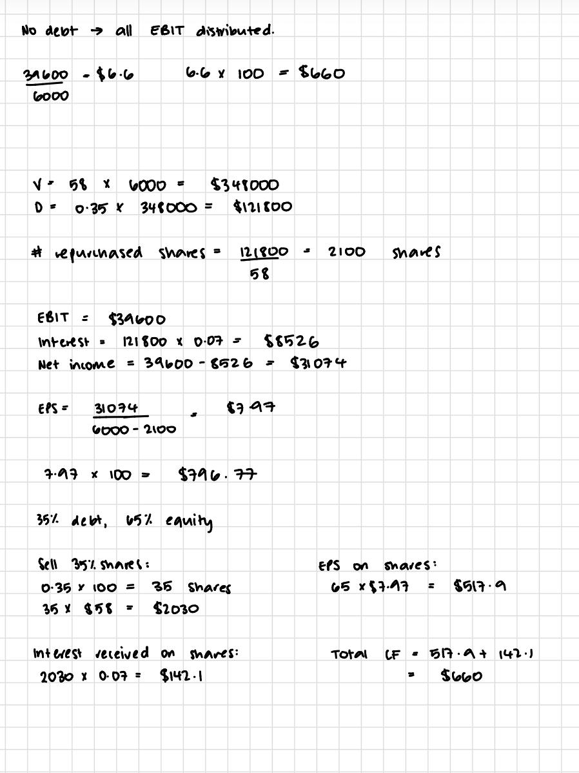

Slide 24
b) What will Ms. Brown's cash flow be under the proposed capital structure of the firm? Assume that she keeps all 100 of her shares.

Slide 26
c) Suppose the company does convert, but Ms. Brown prefers the current all-equity capital structure. Show how she could unlever her shares of stock to recreate the original capital structure.

Slide 27
Using homemade leverage,

Slide 28
Payout Policy
Cash dividend
Stock dividends and splits
Share repurchases (buybacks)
In a perfect world, stock price should fall by the amount of the dividend on the ex-dividend date
Unless dividend or split conveys information, stock price should fall to keep the investor’s wealth unchanged

Slide 29
Apex Innovations, a leading technology firm, is considering whether to shift its current capital structure with debt-to-equity ratio of 0.2 to an all-equity structure. Currently, the company has 40,000 shares outstanding, each share is priced at $100. If they decide to restructure, the firm plans to issue new shares to raise the necessary funds to pay off the debt. Expected EBIT is projected to remain at $200,000 annually indefinitely. The interest rate on the debt is 4%, and there are no taxes, assuming Modigliani and Miller's (M&M) framework holds.
a) Mr. Anderson, a shareholder of the firm, owns 200 shares of stock. What is his cash flow under the current capital structure, assuming the firm pays out 100% of its earnings as dividends?

Slide 30
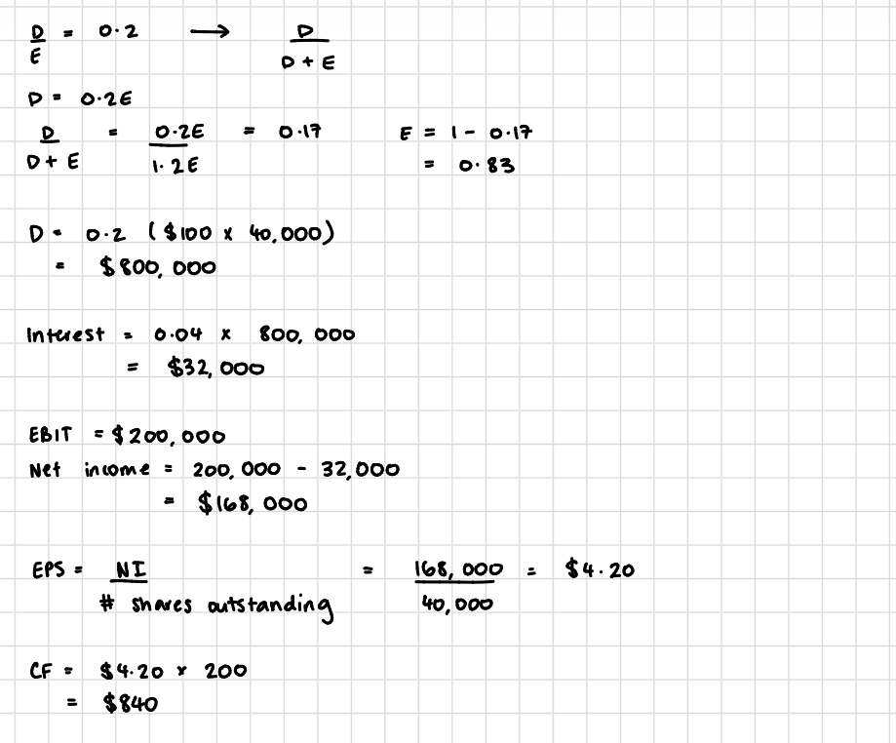

Slide 31
b) What will Mr. Anderson's cash flow be if the company adopts the new all-equity capital structure, he has 200 shares?

Slide 32
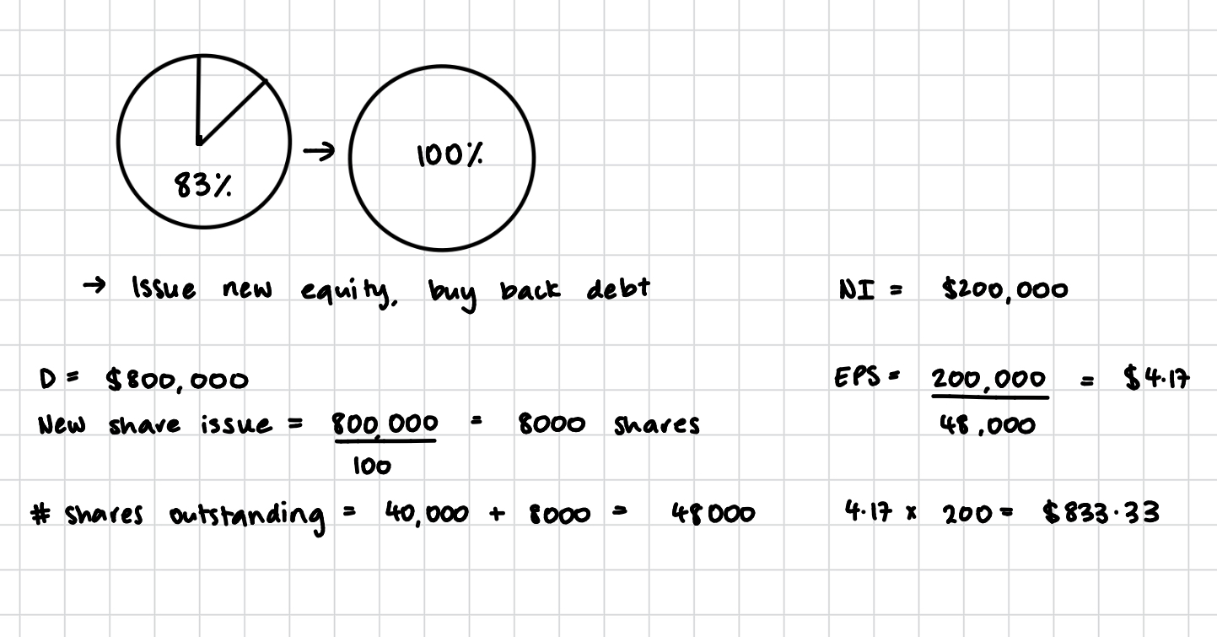

Slide 33
c) If Mr. Anderson prefers the current capital structure with debt-to-equity ratio of 0.2, and the firm switches to all-equity, explain how he can re-lever his shares to replicate the debt-to-equity ratio of 0.2.

Slide 34
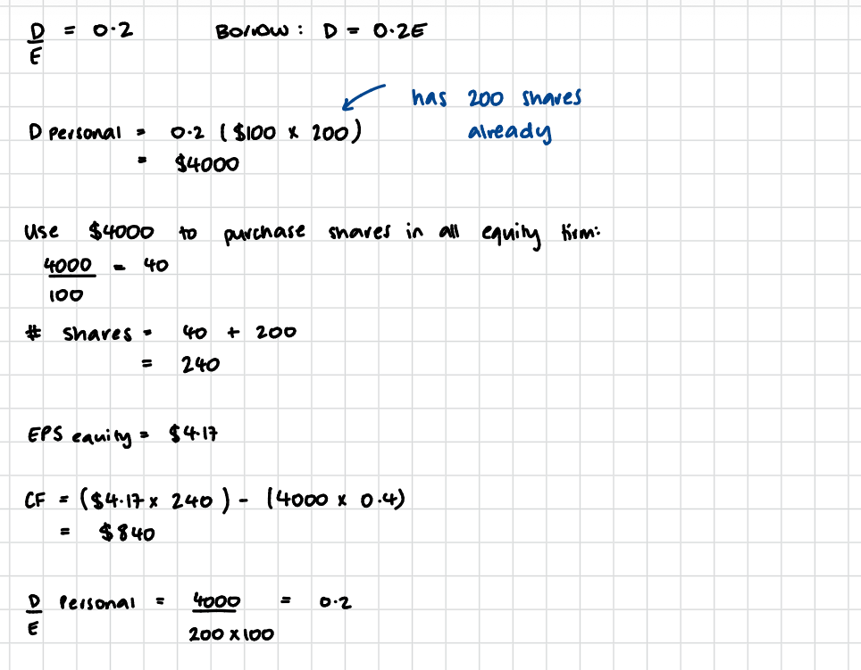

Slide 35
Dividend Policy
Dividends are usually smooth, managers reluctant to alter them
Signaling theory: investors may regard changes in dividends as managements’ earnings forecast
Types of payments:
Constant (percent or amount)
Residual (earnings less retained earnings needed to finance optimal capital budget)
Distributions = Net income – (target equity ratio * total capital budget)

Slide 36
Dividend Theory
Irrelevance
Indifferent between dividends and capital gains
Want cash then sell stock, if don’t want cash then use dividends to buy stock
Supported by MM
Based on unrealistic assumptions (no taxes or brokerage costs)

Slide 37
Increases Value
Relevance – information content (signaling)
Regard changes in dividend as signals of earnings forecasts
Management hate to cut dividends, won’t raise dividends unless sustainable
Stock price increase at time of dividend increase could reflect higher future EPS, not desire for dividends
Bird in the hand
Dividends less risky than potential future capital gains
Investors should value high payout firms more highly

Slide 38
Decreases Value
Tax preference
Companies can covert dividends to capital gains by shifting dividend policies
If dividends taxes more than capital gains, tax paying investors should value the firm more favorably
Total cash flow retained by the firm/held by shareholders will be higher than if dividends are paid

Slide 39
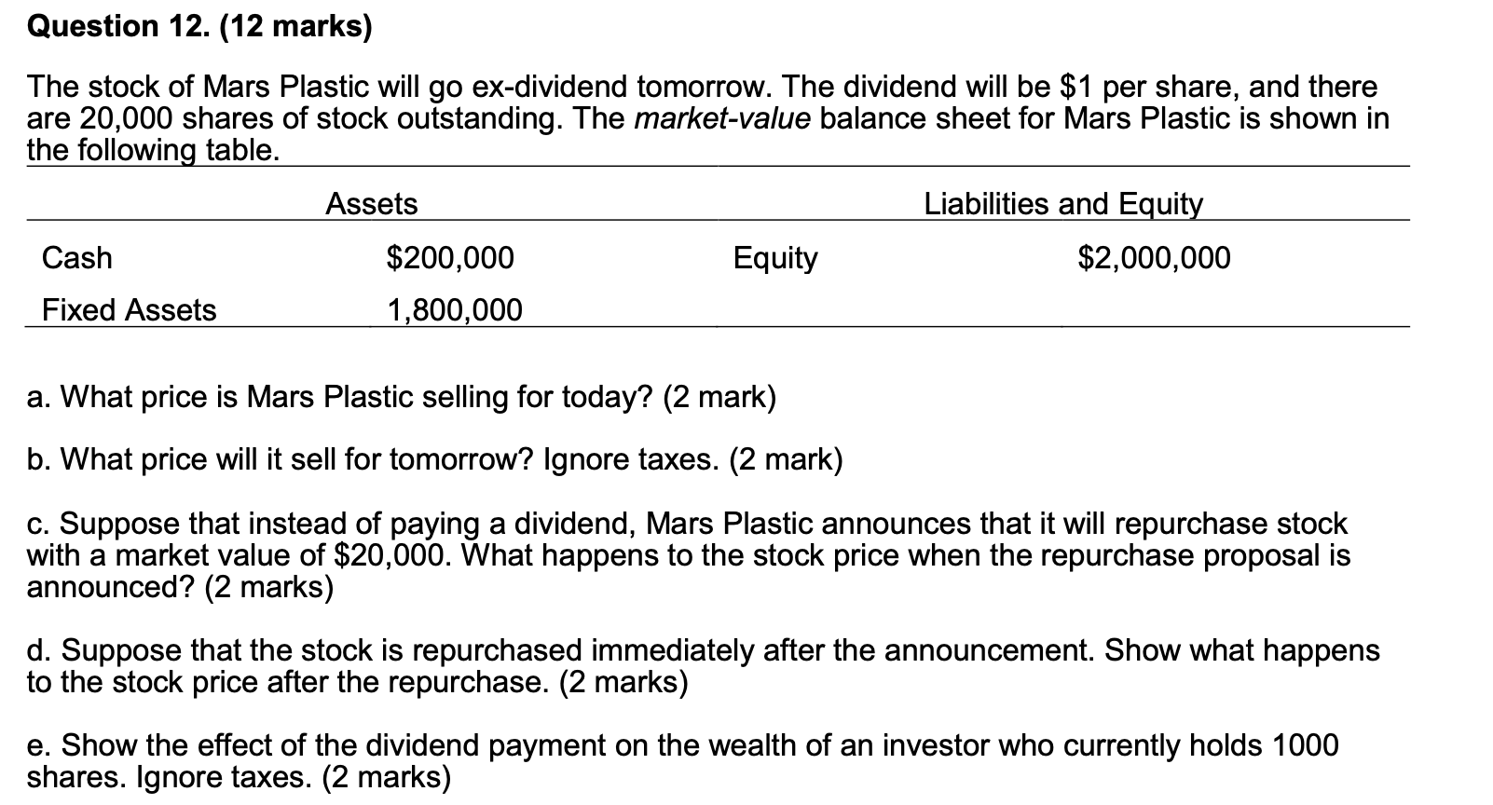

Slide 40
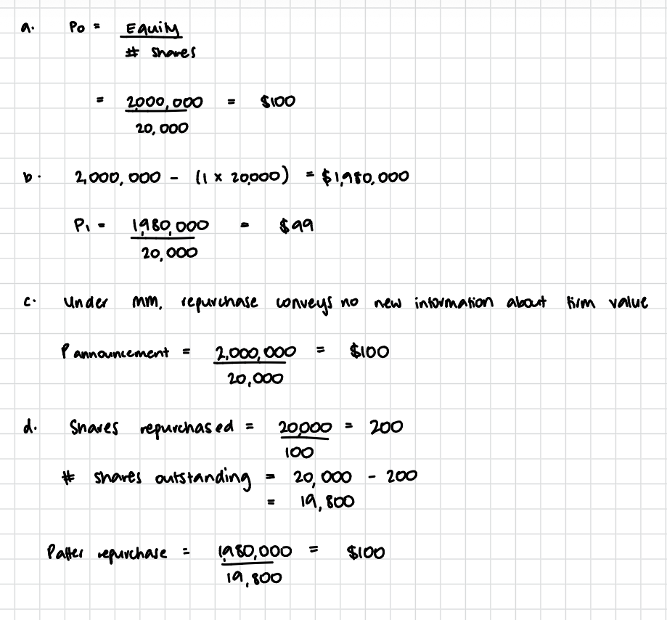

Slide 41
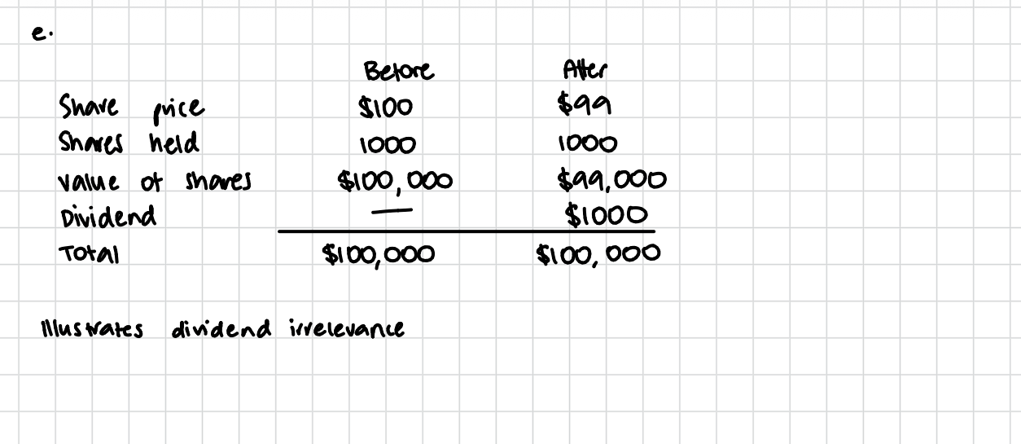

Slide 42
Financial Planning
Goal of a firm = maximize shareholders wealth by investing in fixed assets, having a good capital structure and payout policy of the firm
Financial plans: establish a firm’s financial goal, provide benchmark for evaluating performance
Long term = plans that > 12 months
Short term = plans for next 12 months (working capital)

Slide 43
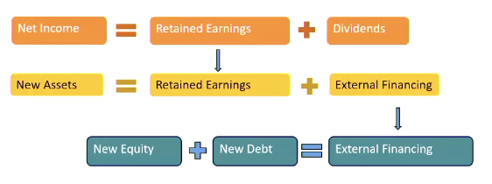
Long Term
Pro forma = projected or forecasted financial statements
Percentage of sales model = planning model in which sales forecasts are driving variable, other variables are in proportion to sales
Balancing item (plug) = variable that adjusts to maintain consistency of financial plan

Slide 44
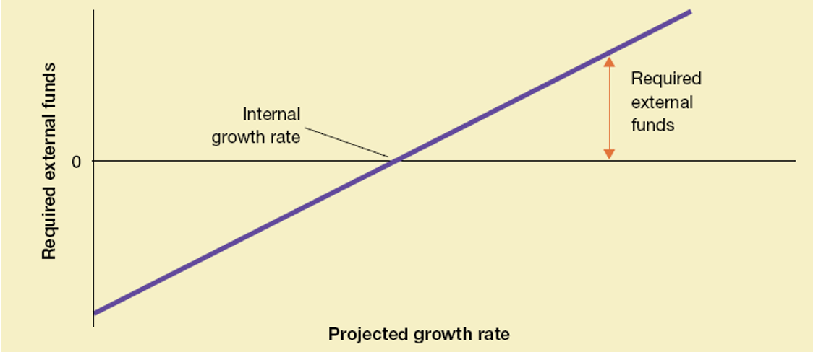
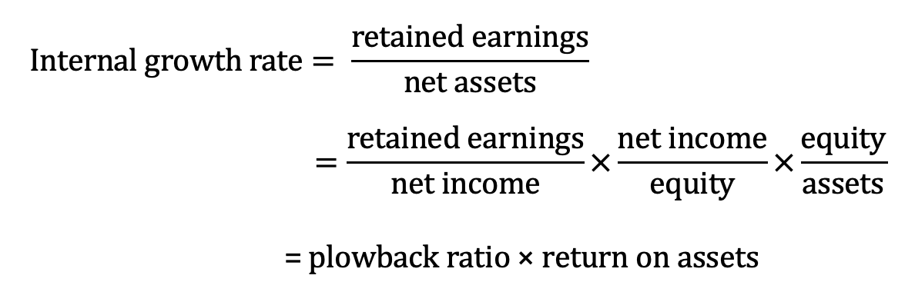
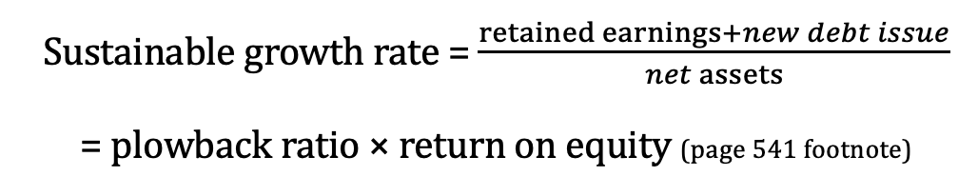
Growth
With low growth, internal financing may exceed required investment
With high growth, internal financing will not be enough and will have to go to capital market
Required external financing = growth rate*initial net assets – retained earnings
Notes:
Internal growth rate: maximum rate of growth without requiring external financing
Sustainable growth rate: rate at which the firm can grow without changing its leverage ratio, or issuing new equity
Internal growth rate will be less than sustainable growth rate, possible for ROA = ROE for all equity firm
Firm can increase their growth rate by:
Selling new shares of stock
Increase reliance on debt
Reduce dividend payout ratio
Increase profit margins

Slide 45
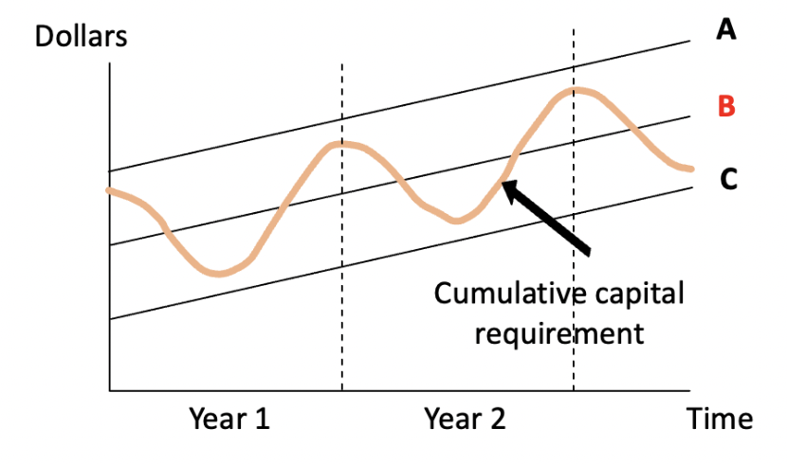
Short Term
Focuses on management of a firm’s current assets and current liabilities
Cash and marketable securities
Accounts receivable
Inventory
Accounts payable
Short term loans
Net working capital = current assets – current liabilities
Notes:
No convincing theoretical analysis on when long term financing is better, but there are some observations:
Matching maturities - financing long lived assets with long term borrowing and equity, short term assets by short term debt
Permanent working capital requirement - permanent investment in NWC, which is financed from long term sources
Maintaining liquidity - the more the current assets, the greater the liquidity (cash, marketable securities) and some firms choose to have more liquidity than others
A: Cash surplus -> short term lenders
C: Cash deficit -> permanent short term borrower
B: Short term lenders and short term borrowers

Slide 46
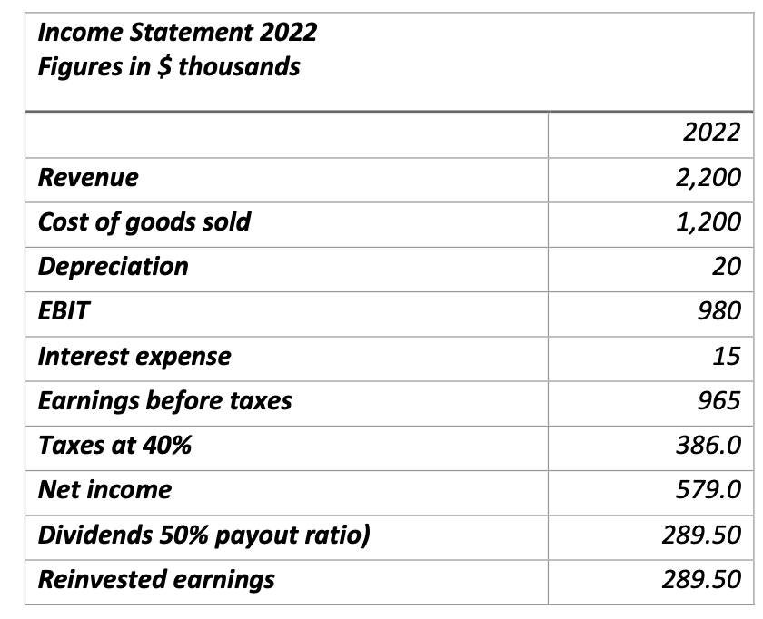
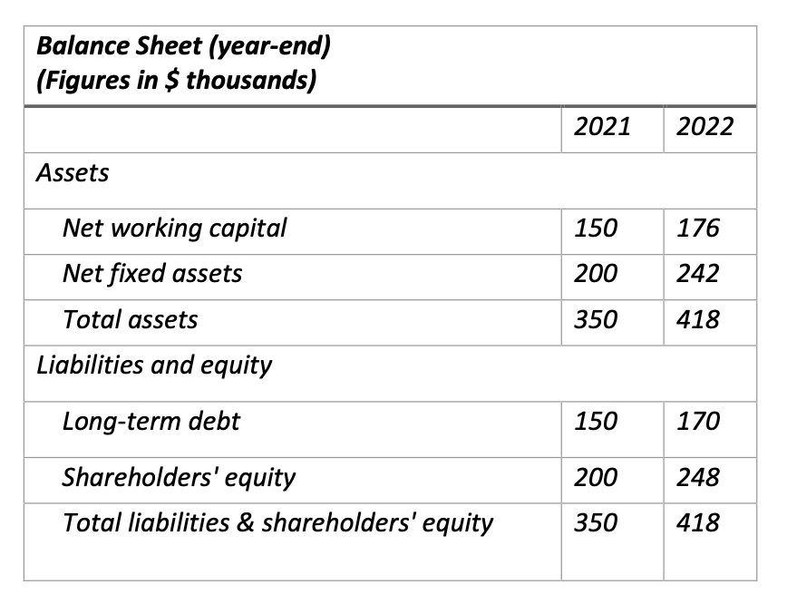
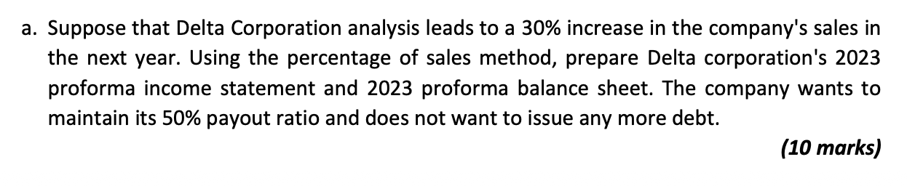

Slide 47
