Slide 1

ECON104 TUTORIAL
Final Exam
Tuesday 2nd of June
10-11 am in F1
Notes:
Introduce
Myself, my name
Thank for coming
Plan for today: go for about an hour, try cover as much as I can with some example questions

Slide 2

FINAL EXAM INFORMATION (2025)
Term Two Content
20 marks multichoice
40 marks short answer
Notes:
Discuss the breakdown of the marks for the exam.
No term 1 content – multichoice
- Best things that you guys can do is go through your weekly tutorials and practice them again, and maybe also go through those multichoice questions in your term test paper, if you need extra help with the multi choice maybe ask chat to ask for some similar content based on the topics (but beware as sometimes it generates unnecessary questions that are out of this papers depth)
- Also, my tips for the multichoice questions, especially with supply and demand, are to draw the graphs out next to the question, as some of them do try to trick you
- For example, you may get asked a question like, what is the effect of a minimum price policy at a price below the equilibrium price….. This is a trick question as it has no effect on the price as the market price will just return to the equilibrium price
- Also generally can eliminate some of the multichoice answers, likely just between two of them, so cross out the ones you think it isn’t
So, for this tutorial, I am just going to run through the content for term 2, try summarise it as well as possible and give some tips that should help you guys.
I will hopefully also leave a bit of time at the end to run through any questions you might have from past papers.

Slide 3
OVERVIEW – TERM 2
Cost Curves
  Profit levels
Market Structures / Marginal Analysis
  Perfect Competition
  Monopolies
Game Theory
Price discrimination

Slide 4
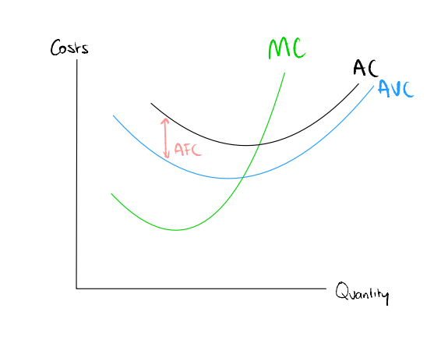
Economic costs
Marginal cost curve: the cost to produce one extra unit
Average cost curve: total cost/quantity
Average variable cost curve: total variable costs/quantity
An increase in fixed costs only increases AC
An increase in variable costs increase, AC, AVC and MC
Notes:
There are 3 main cost curve types of you need to know and how they behave
- Marginal cost curve :
- Average cost curve
- Average variable cost curve
They all initially decrease then increase …..
Because initially workers can become more efficient through specialisation and division of labour, this decrease costs
But as more workers get added, they have less of the fixed factor to work with, so become less efficient as the cost per worker is fixed
Example of making clothes sewing machine
Finally in terms of changes of costs
An increase in fixed costs only increases AC
An increase in variable costs increase, AC, AVC and MC

Slide 5
Economic costs
Question:
Why does MC intersect AC and AVC at their minimum points?
Notes:
To explain this in a cricket sense – if we treat it like a batting average, if your next innings score (marginal cost) is below your current average your average will fall
If its above it will rise. So MC works the same way, when the cost of producing one more unit is below the average it pulls the average down, when it’s above it pulls it up, the only point when average stops falling and starts rising is where MC = AC or AVC, that’s our minimum.

Slide 6
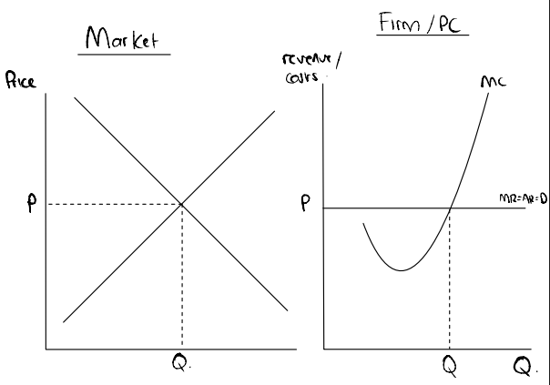
Perfect competition
Characteristics
Many sellers (lots of small firms)
Many buyers (able to sell all of your product)
Homogeneous products (all identical)
Perfect information (both buyers and sellers know everything, no competitive advantage)
No barriers to entry/exit (can move into and out of the market with ease)
Why is the location where marginal revenue is equal to marginal cost the profit maximising location?
Notes:
Perfect comp and monopoly are likely large parts of this exam so will be important to understand
Perfect competition characteristics: go through them
This leads to revenue curve..
Revenue curve:
- Horizontal revenue curve = AR = AR = D
- This is because, price taker and cannot influence market price
- If they tried selling above or below this price…
Marginal cost curve, standard
Profit maximising point will be at where MR = MC…. Ask the question does anyone why?
- We consider what is the case when we are not at this location
- If at higher quantity earning a marginal loss : so should decrease output
- If at a lower quantity earning a marginal profit : so should increase output

Slide 7
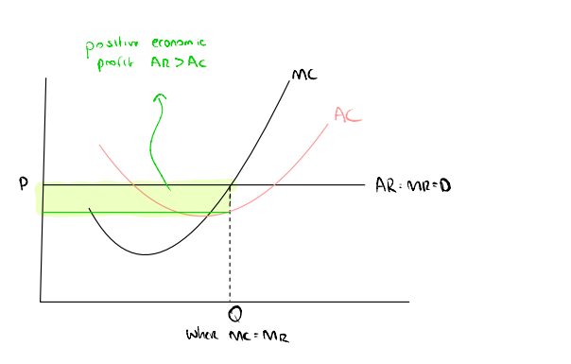
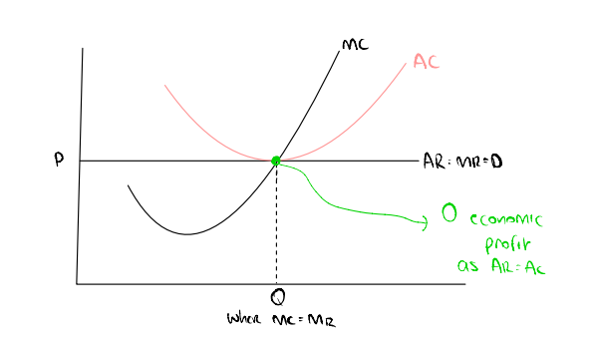
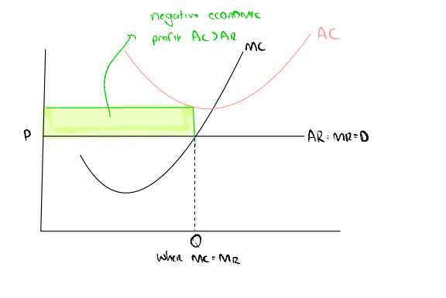
Perfect competition – profits
Notes:
This may come in the form of drawing at a certain profit level on the diagram, or shading it in, I’ve got a few steps that help with this.
To work out what type of profit
Work out where the profit maximising quantity is: MC = MR
Work out where this intersects the average cost curve:
Draw from the cost curve a horizontal line to the vertical axis
Then shade in the profit/loss (above AR=MR=D curve then profit else loss)

Slide 8
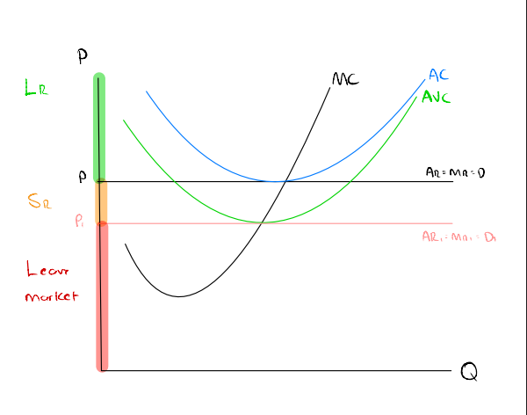
Breakeven/shutdown points
At any price above P, firm is making economic profit so should stay in market both short and long term.
Breakeven point: AC = AR
At any price between P1 and P, firm is covering all of their variable costs with some revenue left over to cover their fixed costs. So should stay in the market short term to pay off fixed costs, but as still making negative economic profit will leave market in the long term.
Shutdown point: AVC = AR
At any price below P1 the firm should leave the market as they will not being covering all their variable costs or any of their fixed costs, so would be better off leaving the market immediately and paying their fixed costs.
Notes:
This breaks down the types of profit a bit more, elaborating on simply just the positive, negative or zero economic profit scenarios.
We have got our Shutdown point where AVC = AR red line and breakeven where AC = AR, black line
Breaks up graph into 3 zones
Imagine it like you are running a pizza store, lets say your fixed costs are your rent as locked into a contract, variables costs are ingredients and price of pizzas is revenue.
If you are selling at a price less than what is costs you to make the pizzas you should shut down everything, you are making a loss each time you sell this pizza
If you are selling a price more than this average variable costs, but less than average cost, stay in business short run, because you are covering your pizza costs and paying off a bit of your rent (remember still have to pay rent no matter whether you are open or not.
And if it’s above average costs, no problem you are making profit

Slide 9
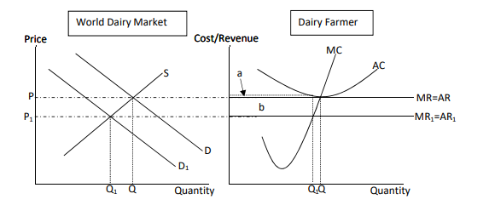

Perfect competition return to zero economic profit
What is the type of profit being earnt?
What will happen to these firms that are earning these economic losses?
What does this do to the supply in the market?
What effect does this have on the market price?
What does this do to the individual firms MR and AR curve?
Is the firm still at profit maximising quantity?
Notes:
An important thing to remember is that in perfect competition a firm can only earn zero economic profit. Let’s go through this exam question to understand this.
This question is slightly adapted, but still relevant, so what you need to know is currently the market is operating at P1, Q1, this is as a result of a decrease in demand for Dairy.
What is the type of profit being earnt? – subnormal/economic loss as price (AR) is now less than average cost
What will happen to these firms that are earning these economic losses? – they leave the market
What does this do to the supply in the market? – it decrease it, shifting supply curve left
What effect does this have on the market price? – it will increase it
What does this do to the individual firms MR and AR curve? – Moves it up as a price taker
Is the firm still at profit maximising quantity? – No, now MR > MC at q1, so should increase quantity
They do this until zero economic profit is earnt back at Q and no firms leaving/entering the market again
Quite a lengthy question, likely will be split up into smaller questions for you, but an understanding of this will make the questions in the test really easy for you

Slide 10
This question is slightly adapted, but still relevant, so what you need to know is currently the market is operating at P1, Q1, this is because of a decrease in demand for Dairy.
What is the type of profit being earnt? – subnormal/economic loss as price (AR) is now less than average cost
What will happen to these firms that are earning these economic losses? – they leave the market
What does this do to the supply in the market? – it decrease it, shifting supply curve left
What effect does this have on the market price? – it will increase it
What does this do to the individual firms MR and AR curve? – Moves it up as a price taker
Is the firm still at profit maximising quantity? – No, now MR > MC at q1, so should increase quantity
They do this until zero economic profit is earnt back at Q and no firms leaving/entering the market again

Slide 11
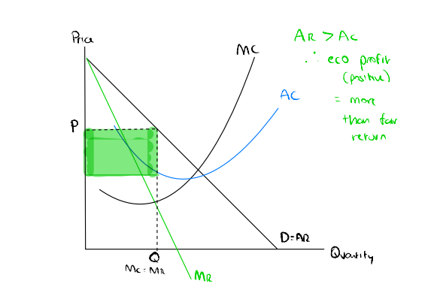
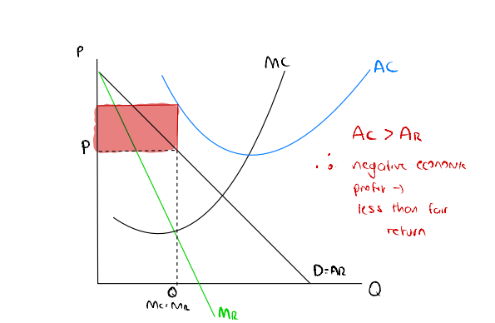
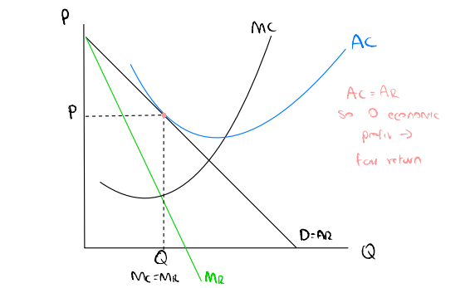
Monopoly
Characteristics
One seller
No or few close substitutes
High barriers to entry for other firms
Able to dictate either price or quantity
Key notes:
- Different MR and AR curves, both downward sloping
- MR will intersect halfway of AR
- Due to high barriers to entry, can maintain any type of profit in both short and long run
- Can work out profit maximising quantity the same way as perfect competition (MR = MC)
Notes:
A monopoly is on the opposite side of the spectrum to perfect competition. It faces a downwards sloping demand/average revenue curve as it can only sell to what the market is willing to buy (like a typical demand curve, as the monopoly can either control price or quantity not both at the same time)
- The cost curves are the same as perfect competition and we can find the profit maximising level, the same way where MR = MC
- Big thing that is different to what the perfect competition, is that the marginal revenue curve and average revenue curve are different to each other, marginal revenue curve intersects half way of the intersection of the average revenue curve
- So when working out profit, use the marginal revenue curve to work out the location, but then use then extend up to the average revenue curve for the price
- Will earn same profit in long and short run

Slide 12
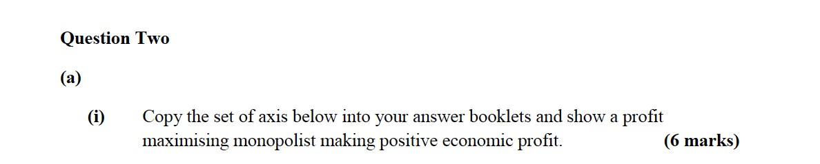
QUESTION
Notes:
*depends on time if past 45 don’t do it
Okay, this is a question from a past paper, I’ll give you guys a minute to do it, then I can show you the answer and explain it

Slide 13
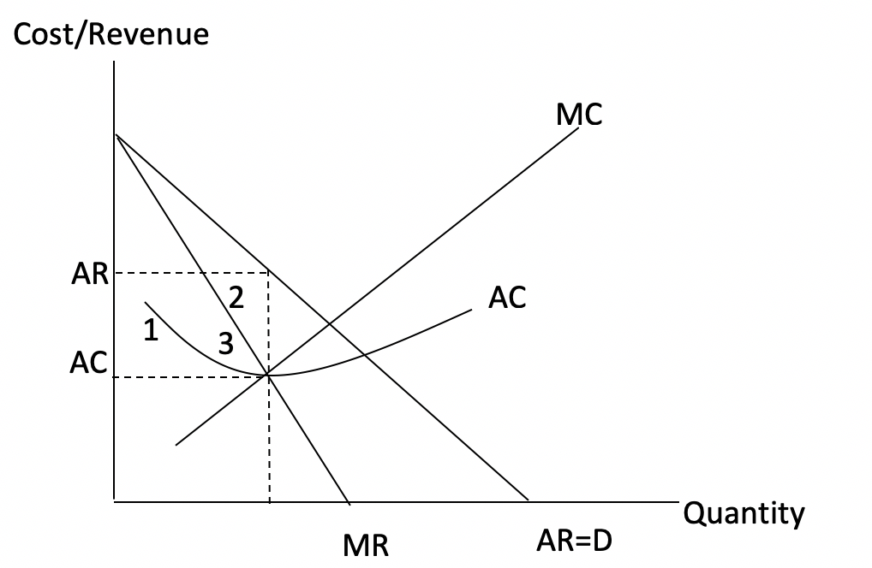
QUESTION
Mark Breakdown
- AR drawn and labelled correctly (1/2 mark)
- MR drawn and labelled correctly (1/2 mark)
- MR x-axis intercept halfway between origin and AR curve intercept (1/2 mark)
- AC drawn and labelled correctly (1/2 mark)
- MC drawn and labelled correctly (1/2 mark)
- MC cuts AC at its lowest point (1/2 mark)
- AR at Q correctly identified on vertical axis (1/2 mark)
- AC at Q correctly identified on vertical axis (1/2 mark)
- Positive economic profit of areas 1, 2 and 3 correctly identified (1 mark) and labelled (1 mark)
Notes:
*maybe do on document camera if possible
First step you need to draw the axis
Then lets draw the revenue curves: remember MR intersects half of what AR does
Then we need to draw the marginal cost curve, does not really matter where you put it as long as it goes up
The average cost curve is the important one here, you have to make sure it in intersects the marginal cost curve at lowest point, so I usually draw two tails either side of it, then as long as you have it so that when we draw a line up from where MR intersects MC it hits the AC curve before AR curve, it’s allgood

Slide 14
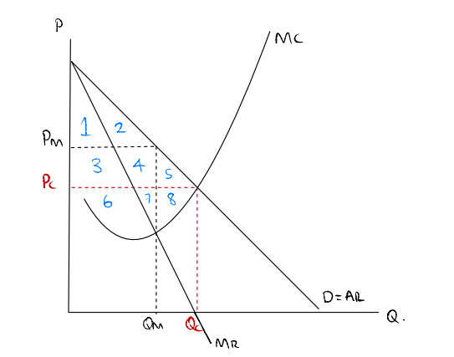
Comparing Monopoly to PC
 | Competitive | Monopoly
Price | Pc
Quantity | Qc
CS
PS
Total surplus
Deadweight loss
Notes:
This is another question they may ask in the exam about using a table to compare between an efficient market (may get mentioned as perfect competition) and a monopoly,
Goes through comparison of prices and quantities and deadweight loss of both different types of markets
One thing to note is that I know that there is no horizontal margin revenue curve in this, we are able to just assume that for the perfectly competitive market it operates at where MC = AR (as this is where demand = supply)
So lets fill this table out, work out which is the most efficient, I’ll give you guys a couple mins to go through this
Note the PC will operate where Market Supply (MC) = Market Demand (AR) whilst the Monopoly operates at profit maximising Mc= Mr
Using our relevant curves as AR = D and MC = S we can find the CS and PS and hence our DWL

Slide 15
Monopoly compared to Perfect competition
 | Competitive | Monopoly | Change
Price | Pc | Pm
Quantity | Qc | Qm
CS | 1,2,3,4,5 | 1,2 | -(3,4,5)
PS | 6,7,8 | 3,4,6,7 | 3,4 (-8)
Total surplus | 1,2,3,4,5,6,7,8 | 1,2,3,4,6,7 | -(5,8)
Deadweight loss |  | 5,8
Notes:
Remember consumer surplus area above the price below the demand curve (AR)
Producer surplus area below the price above the supply curve (MC)

Slide 16
Comments on Other Markets
Oligopoly- Several large firms
Duopoly – two sellers (a special case of oligopoly market)
Monopolistic Competition – Large market of small firms that sell slightly differentiated product
Notes:
Oligopoly – market dominated by small number of large firms: key is interdependence, each firms decision on price and output directly affect the others, so firms must consider rivals reactions before acting – leads onto game theory. There are also high barriers to entry to keep new comps out, products can be homogenous or differentiated. Firms are often tempted to collude to act like a monopolist but there are rules and regulations for collusion.
Duopoly – effectively same conditions but interdependence more direct
Monopolistic Competition – Many firms like a PC but each sells a differentiated product, so each firm has a small amount of market power and faces downward sloping demand curve (rather than being a price taker), Low barriers means in long run- economic profit is competed away just like PC. A way for them to differentiate could be via marketing i.e. their brand image

Slide 17
Game theory
Dominant strategy: where a player will do this option regardless of what the other player does
Nash equilibrium: Where neither person has an incentive to change their behaviour given the actions of the other
Notes:
Game theory is all about the idea of what is the best thing for you to do based on the other group/person decision
2 key things to understand
Dominant strategy
Nash equilbrium

Slide 18
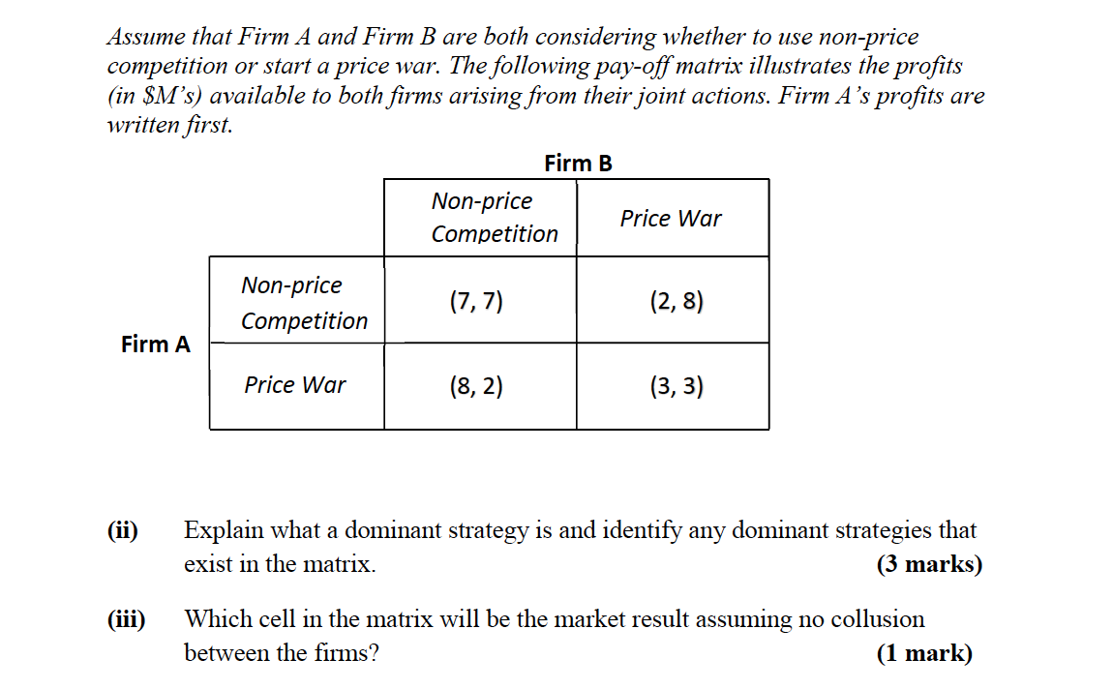
GAME THEORY QUESTION
Notes:
Note that the first number in the bracket will always be the first person (person on the left). I want to give you guys a minute to go through this one first then I’ll go through it with you.
Pretty much the same process for all these questions, so can always start with this
- I like to underline each of the values as I go along
- So starting with firm A, if firm B does non price competition, they are better off price war (8 > 7), then if B does price war they are still better off doing price war (3 > 2). So dominant strategy
- Then firm B, if firm A does a non price, they are better of price war (8>7) and if price war still better off as 3 > 2 so same strategy, end up at nash equilibrium of 3, 3

Slide 19
GAME THEORY QUESTION
A dominant strategy is one a firm plays regardless of the actions of the other player. Firm A has a dominant strategy of price war. Firm B has a dominant strategy of price war.

Slide 20
GAME THEORY QUESTION

Slide 21
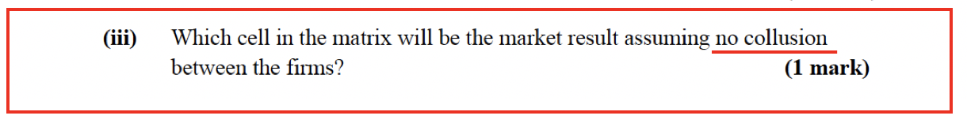
GAME THEORY QUESTION
(price war, price war) or (3,3) or bottom right cell
Notes:
If collusion was possible what square could they end up in?
square (7,7) both are better off.

Slide 22
GAME THEORY QUESTION
Firms A and B independently choose to Invest in R&D or Not Invest. Payoffs shown as (Firm A, Firm B):
Q1. Does Firm A have a dominant strategy? Show your reasoning.
Q2. Does Firm B have a dominant strategy? Show your reasoning.
Q3. What is the Nash equilibrium? Explain why.
Q4. Is the Nash equilibrium the jointly optimal outcome? What does this tell us?
Q5. Firms have competed for many years. How might this change their behaviour?
 | B: Invest | B: Don’t Invest
A: Invest | (4,4) | (7,2)
A: Don’t Invest | (2,7) | (5,5)
Notes:
If B invests they will also Invest as 4>2 and then if B doesn’t invest they will invest 7>5 so yes dominant strategy of invest
If A invests they will invest as 4 > 2 and then if A doesn’t they will invest as 7>5
Nash equilibrium is (4,4) as both have dominant strategies
Not jointly optimal as Don’t, Don’t a better outcome for both as get higher payoffs of 5,5
Initially you take investing as it’s the rational move no further consequences. When firms compete repeatedly over many years the dynamic shifts over time, now every decision has a shadow over the future. If Firm A defects today, invests when B doesn’t, B can punish A next round by investing, and they can keep doing that indefinitely.
Suddenly the short-term gain from defecting has to be weighed against potentially years of being stuck in the bad (4,4) equilibrium instead of the good one (5,5).
A strategy is tit-for-tat where do exactly what your opponent did last round.

Slide 23
GAME THEORY QUESTION — ANSWERS (1)
Q1. Firm A dominant strategy: Invest
If B invests: A gets 4 (invest) vs 2 (don't) → invest. If B doesn't: A gets 7 (invest) vs 5 (don't) → invest. Invest is better regardless of B's choice.
Q2. Firm B dominant strategy: Invest
Same logic by symmetry. Invest is dominant regardless of A.
Q3. Nash equilibrium: (Invest, Invest) → (4, 4)
Neither firm wants to deviate unilaterally. If A invests, B's best response is invest (4 > 2), and vice versa. So neither has an incentive to change given the other's action.

Slide 24
GAME THEORY QUESTION — ANSWERS (2)
Q4. Nash equilibrium is NOT jointly optimal
(Don't, Don't) → (5, 5) gives both firms higher payoffs. This is a prisoner's dilemma: individual rationality leads both firms to invest, leaving them collectively worse off than if they'd cooperated. The Nash equilibrium is stable but not efficient.
Q5. Repeated games enable cooperation
In a repeated game, firms can adopt tit-for-tat strategies — cooperate until the other defects, then punish. The threat of future punishment makes defection less attractive, so (Don't, Don't) can be sustained over time. This is why cartels and informal collusion emerge in long-run oligopolies.

Slide 25
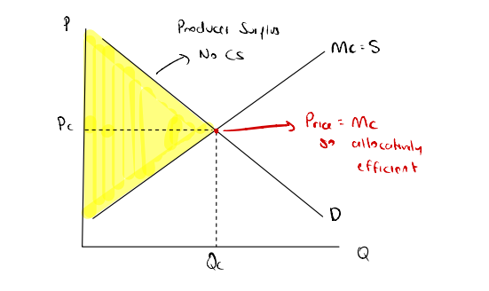
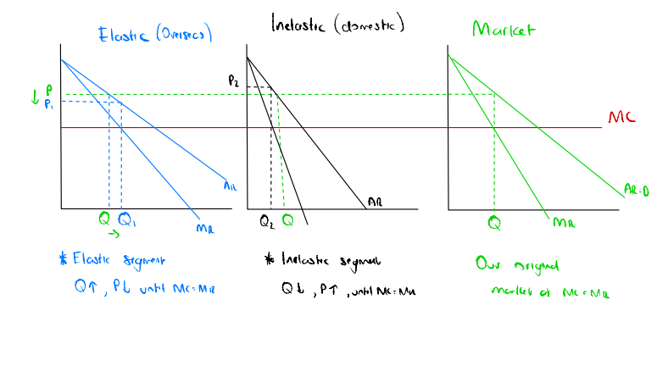
Price discrimination
First degree: each person is charged their reservation price
Second degree: discounts given based on bulk purchasing
Third degree: market is segmented and charged based on elasticity
Notes:
**could be skipped**
3 main types of price discrimination that are relevant to know, likely to be briefly covered
In the first one – essentially there is no consumer surplus, as each person pays the max they would be willing to
Second one: basically, as you buy more you get discounts
Third one: most complex, able to segment market, based on the elasticity, for example haircuts, guys and girls are charged different prices, allows for profits to be maximised for the producers

Slide 26
What conditions must hold for third degree price discrimination to work?
Notes:
Three things need to be true simultaneously.
First, the firm needs market power, a price taker can't set different prices because competition forces one price.
Second, the firm must be able to segment customers by their willingness to pay (e.g. age, location, time of purchase).
Third, resale must be impossible or impractical — if a student could buy a cheap ticket and sell it to a full-fare passenger, the pricing structure collapses immediately.

Slide 27
Three things need to be true simultaneously.
First, the firm needs market power, a price taker can't set different prices because competition forces one price.
Second, the firm must be able to segment customers by their willingness to pay (e.g. age, location, time of purchase).
Third, resale must be impossible or impractical — if a student could buy a cheap ticket and sell it to a full-fare passenger, the pricing structure collapses immediately.

Slide 28
QUESTIONS?
Notes:
I am happy to answer any questions, I can also hang around outside afterwards and help as well

Slide 29
STAY UPDATED FOR EVENTS
SIGN UP FOR FREE!
Facebook Page: The Investment Society
Instagram: the_investmentsociety
QUESTIONS AND FEEDBACK
Email: sbu110@uclive.ac.nz
Notes:
The Club – we are the investment society, we run many different investment related events along with these tutorials, ranging from panels with employers to social events, so would highly suggest joining the club if this sounds interesting to you (membership is free), or at least follow our Instagram so you can stay up to date with what events we have coming up next year.
Share the Instagram

Slide 30
THANK YOU AND GOOD LUCK!

