Slide 1

ECON 105 TUTORIAL
FINAL EXAM
Tuesday June 2nd
9 - 10am in F1
Notes:
Introduce
Ourselves
The Club
Thank for coming
Explain
Thank for submitting
Why we are going these

Slide 2

OVERVIEW + Mark Breakdown
Economic History (5)
National Accounts, BOP (5)
Foreign Exchange (5)
Labour Market (10)
Money and Inflation (15)
AD/AS Model (25)
OCR news release and Economic Growth (30)
Government and Taxes (5)
Notes:
Focusing more on the later content that wasn’t covered in the mid term however briefly touch up on some things

Slide 3
WAYS TO PRACTICE MULTI-CHOICE QUESTIONS
Weekly quizzes – all quizzes have re-opened until the day before the exam, you cannot make your grade worse by attempting them
Past exams
Past term tests
Input the range of Questions to any AI to give you another selection of possible questions.
Economic history can ONLY be multichoice however broad range

Slide 4
PRICES, MEASUREMENT, BOP

Slide 5
Core Formulas
CA = X-M+NFI | Current Account balance determinant by outflows and inflows between countries
Srow = -CA | Rest of world savings is negative of NZ’s current account
GDP = C+G+I+(X-M) | GDP measured by our 4 main sectors
NDI = GDP + NFI | National disposable income measured by GDP and net foreign income
SG = T-G | Government savings are tax revenue subtract whatever the government spending was
Sp = Yd - C - T | Private savings are the amount of disposable income left over by households and businesses after accounting for expenditure and taxation.
I = Sp + Sg + Srow | Investment represents amount spent on capital goods, infrastructure and business expansion

Slide 6
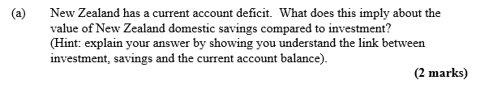
BOP EXAMPLE QUESTION
From 2015 S2 Exam
Notes:
CAB = - ROW Savings
I = S_{P} + S_{G} + ROW Savings
I = S_{NZ} + ROW Savings
If the CAB is negative (deficit) then ROW Savings must be positive and NZ is borrowing money to fund investment.
Domestic savings must be lower than investment.

Slide 7
BOP EXAMPLE QUESTION
CAB = - ROW Savings
I = S_{P} + S_{G} + ROW Savings
I = S_{NZ} + ROW Savings
If the CAB is negative (deficit) then ROW Savings must be positive and NZ is borrowing money to fund investment.
Domestic savings must be lower than investment.
Notes:
The key association is that the current account balance = negative rest of world savings.

Slide 8
FOREIGN EXCHANGE

Slide 9
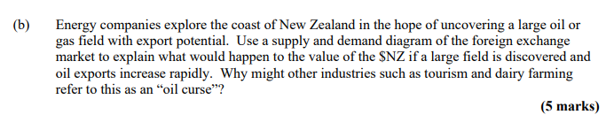
FOREIGN EXCHANGE EXAMPLE QUESTION
From 2018 S2 Exam
Notes:
Here if oil exports rise then the purchase of oil on global markets increases where transactions occur in NZD
Greater transactions in NZD means foreigners have to trade their currency for NZD therefore demand for NZD rises
As the Demand for NZD increases, the exchange rate increases so NZD appreciates
For other industries the cost of their exports will now rise as the appreciation of the NZD causes foreigners to lose purchasing power and in turn reduce global demand for other industry goods.

Slide 10
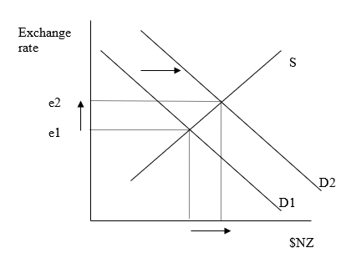

FOREIGN EXCHANGE EXAMPLE QUESTION
PART 1: Use a supply and demand diagram to explain
To buy NZ goods (exports):
Foreigners must first change their foreign currency into $NZ.
An increase in the demand for NZ oil will increase the demand for $NZD.
On our NZ money market market diagram, demand will shift out from D1 to D2.
The quantity of $NZD will increase and the exchange rate will increase.

Slide 11
FOREIGN EXCHANGE EXAMPLE QUESTION
PART 2: Why do other industries refer to this as an ‘oil curse’?
The increase in the exchange rate (value of $NZ rise) makes other exports such as tourism and milk more expensive to overseas customers. These industries are therefore less competitive compared to overseas goods so might suffer.

Slide 12
LABOUR MARKET

Slide 13
Labour Market Details
Important to understand Minimum Wages and the effects on different groups
Have a timeline of the different reforms that occurred especially after 1991 as common multi choice questions
Understand the differences in unemployment – Frictional, Structural, Cyclical
What are efficiency wages and why do firms pay them
What defines someone as Unemployed- Official and Job Seeker definitions
The participation rate, unemployment rate, underemployed definitions

Slide 14
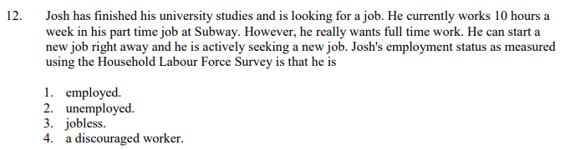
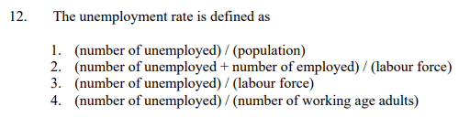
LABOUR MARKET
Likely to be in the multi-choice section
Notes:
Q2: 1 since he as part time work – If jobseeker would be 2 key point
Q2: 3 as include everyone whose employed or unemployed = Labour force not those who opt out otherwise participation raete

Slide 15
MONEY AND INFLATION

Slide 16
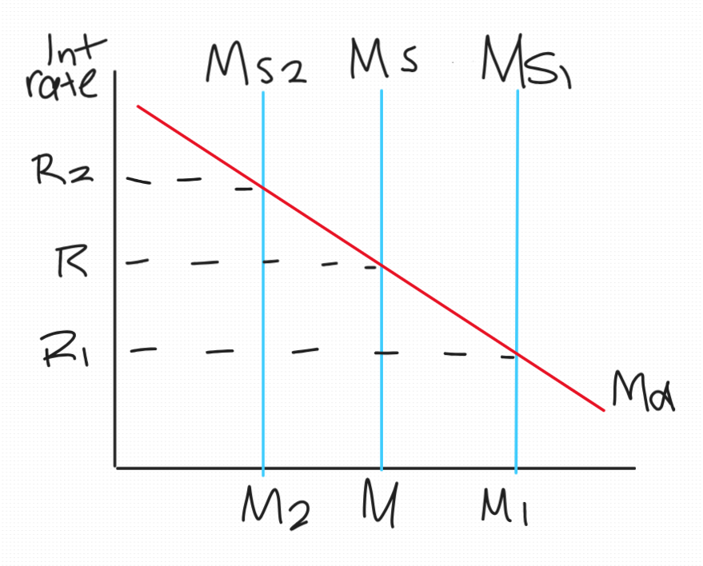
Money
Money Market
2 Motives for Demand (Md) -> Settle transactions or for speculation
Shifts in Demand -> Price level or Real GDP increasing causes Md to increase
Supply (Ms) -> Fixed vertical curves as the central bank policy doesn’t fluctuate with interest rates
2 Scenarios:
Tightening Monetary Policy - Higher Interest Rates and less Ms
M -> M2
Loosening Monetary Policy - Lower Interest Rates and increased Ms
M -> M1

Slide 17
Inflation
Core Formulas:
V = PL . Y / M
V= how fast money is circulating the economy to generate a given level of GDP
PL = Price Level, Y = Real GDP, M = Money Supply
%▲ M + %▲ V = %▲ PL + %▲ Y
Idea is that if we assume changes in Velocity of circulation is constant then changes in Price Level can be modelled by the difference in changes in money supply and real GDP
If ▲ Ms > ▲ Y, then Inflation occurs

Slide 18
Q1. Using the quantity theory of money (MV = PY), if money supply grows at 8% and real GDP grows at 3%, what happens to the price level? State your assumption.
Q2. What are the two motives for holding money? How does an increase in real GDP affect money demand, and what happens to the interest rate if money supply is held constant?
Notes:
Q1. Assuming velocity (V) is constant: %ΔPL = %ΔM − %ΔY = 8% − 3% = 5% inflation.
Extra money supply outpaces real output growth, so prices rise to absorb the difference.
Q2. The two motives are transactions (need money to buy things) and speculation (hold money instead of assets when returns are uncertain).
A rise in real GDP means more transactions are happening, so money demand shifts right. Like normal demand
With fixed money supply, this excess demand pushes the interest rate up — people compete for the same pool of money.

Slide 19
Q1. Assuming velocity (V) is constant: %ΔPL = %ΔM − %ΔY = 8% − 3% = 5% inflation.
Extra money supply outpaces real output growth, so prices rise to absorb the difference.
Q2. The two motives are transactions (need money to buy things) and speculation (hold money instead of assets when returns are uncertain).
A rise in real GDP means more transactions are happening, so money demand shifts right. Like normal demand
With fixed money supply, this excess demand pushes the interest rate up, people compete for the same pool of money.

Slide 20
AD/AS, MONETARY POLICY, INFLATION & UNEMPLOYMENT TRADE-OFF

Slide 21
AD/AS MODEL
AD shifts if C,I,G,X or M change
SAS shifts if wages or input costs change
LRAS shifts if the economy’s productivity changes with an increase in the quantity of scarce resources, such as inward migration or organic population growth, or improvements in the quality of resources, such as through better education and training
Label the axes PL and Y
Notes:
Draw AD/AS Diagram with LAS

Slide 22
MONETARY POLICY
RBNZ uses the Official Cash Rate (OCR) as a tool for Monetary Policy
  Tightening MP – Raising the OCR
  Loosening MP – Lowering the OCR
Inflation can be influenced through 3 mechanisms
  Interest rate
  Exchange rate
  Inflation expectations

Slide 23
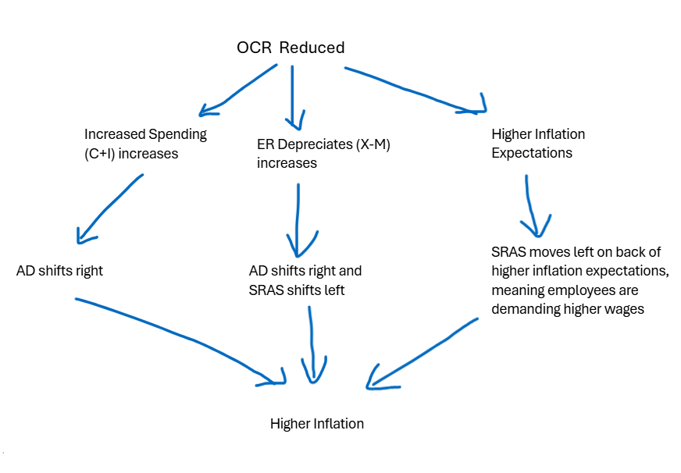
Notes:
Effect of a Loose Monetary Policy how we can split the effects into the three different sections
Interest rates impact consumers and businesses as the opportunity cost to save increases as it becomes less profitable to keep money aside due to the reduced return so we expect business spending (I) and consumer spending (C) to increase as cost of borrowing is less. Therefore AD increases
Lower interest rates detracts foreign investment and encourages domestic investment overseas - causing on the forex market the NZD to depreciate and in turn by valuing our exports and imports, it becomes more expensive to buy and cheaper for overseas to buy our goods so (X-M) increases, however have to consider both sides AD will increase, but SRAS will decrease due to higher input costs through import pricing rising, the overall effect is a rising price level as both shifts create this
Finally inflation expectation - the expectation that inflation will occur under a loose policy as growth is being stimulated therefore workers negotiate higher wages to accommodate this expected increase in cost of living however in turn this is actually just pricing in the anticipated inflation as workers input costs rise so price levels rise (inflation). This is caused by SRAS decreasing.
Overall the general direction is higher inflation as all impacts cause price levels to rise, where the AD curve increases and SRAS decreases, we are only concerned majorly about price level but for real GDP harder to say but tend to rely on the fact that AD shifts should exceed SRAS creating some growth in the economy as the policy intends.

Slide 24
MONETARY POLICY
  C and I
  Lower interest rate
  = less costly to borrow so borrowers have more disposable income, less incentive to save money consumers have more to spend
  = firms have more incentive to borrow and invest
    C and I increase
    AD shifts right
Notes:
Draw diagram showing this

Slide 25
MONETARY POLICY
2. X and M
  Lower interest rates lead to a lower exchange rate (less demand for NZD)
  = increases demand for NZ goods
  = makes inputs more expensive, raw material imports more expensive
    X rises and M falls (X-M) rises
    AD shifts right
    Inputs fall
    SAS shifts left but less than AD shifts
Notes:
Draw the diagram showing this

Slide 26
MONETARY POLICY
3. INFLATION EXPECTATIONS. PEOPLE MAKE DECISIONS BASED ON WHAT THEY EXPECT PRICES WILL BE IN THE FUTURE
HIGH INFLATION EXPECTATIONS
= WORKERS DEMAND WAGE INCREASES
  HIGHER WAGES
  SAS SHIFTS LEFT

Slide 27
RBNZ NEWS RELEASE
Big Picture:
NZ’s economy has been weak but beginning to recover
RBNZ has been cutting interest rates to stimulate growth
Inflation at top of their target band but expected to naturally fall
The Economy
Growth stalled mid 2025 due to global uncertainty and cautious households
Significant spare capacity, businesses aren’t operating at full potential and unemployment has risen
Early signs of recovery are now emerging heading into late 2025
Inflation
Currently sitting at the top of the target band but driven by temporary factors
Underlying inflation pressures are actually easing
Expected to return to 2% midpoint by mid 2026
Interest Rates
RBNZ cut OCR to support recovery
Lower rates = cheaper borrowing = increased C = economy picks up
Concern is not enough inflation / growth not too much
Notes:
At the moment economy has too much slack right now - core problem
Global factors are influencing NZ but effects are modest
RBNZ is trying to balance inflation getting inflation back to 2% without causing unnecessary harm to jobs and growth

Slide 28
RBNZ NEWS RELEASE
The exchange rate has fallen, supporting exporters' incomes" and "the New Zealand dollar Trade Weighted Index has depreciated since August
Draw and explain the effect of the exchange rate depreciation on the NZ economy using ADAS
Notes:
Draw AD shift to left
Decrease inflation
Decrease growth

Slide 29
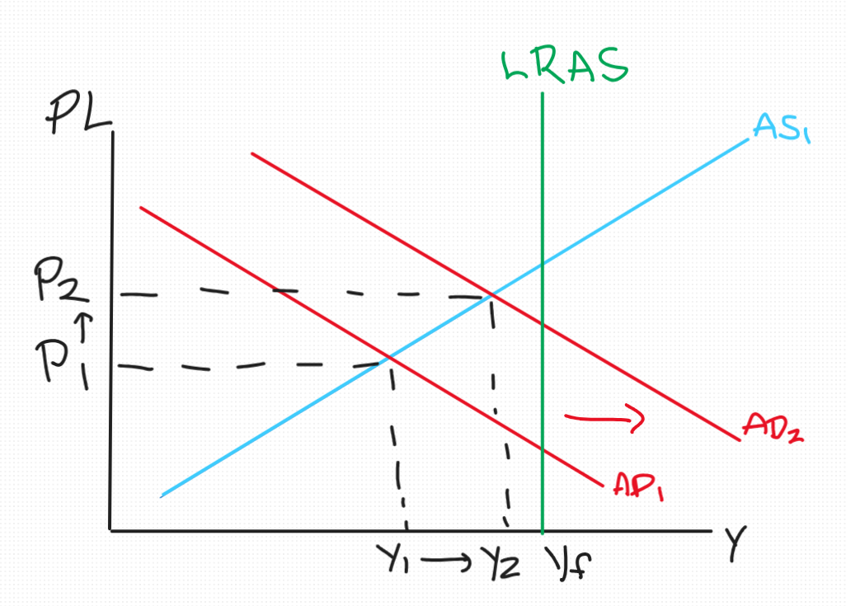
Exchange rate:
AD shifts right because a cheaper NZD boosts export demand. Overseas market has greater purchasing power of our goods so exports relatively cheaper, whilst imports becoming relatively more expensive. (X-M) increases causing AD to increase.
Output moves closer to Yf and the price level rises from P₁ to P₂. Note Y₂ is still at or just reaching Yf, consistent with the RBNZ view that the economy is recovering toward potential.

Slide 30
RBNZ NEWS RELEASE
Why did the RBNZ cut rates even though inflation is at the top of the band?
Some Ideas:
What does cutting rates / OCR mean?
How does this influence higher Inflation
Is there a short term outcome where the tradeoff for higher inflation can result in a strong economic outcome for NZ?
Notes:
The 3% inflation is temporary, it is being driven by one-off cost factors, not persistent demand pressure
There is significant spare capacity in the economy — unemployment is up, firms are underutilising resources, and the economy is operating below potential output
With output below potential, inflation will naturally fall back toward 2% without needing tight policy
The bigger risk is that the economy stays too weak for too long, causing inflation to undershoot the target rather than overshoot it
In ADAS terms — the economy is at Y₁ below Yp, so cutting rates to shift AD right helps close the gap and stabilise inflation near the midpoint

Slide 31
Overview of Cutting Rates despite Inflation
The economy is currently operating below full capacity
Inflation despite being at the top of the band is not occurring as what we expect.
The reason for Inflation is lagged Covid effects, not the rising demand and consumption of goods
Therefore we have to prioritise an underperforming economy over rising inflation
Once the economy is near full employment then inflation will fall back within the guided target on its own.
Overall the government want to prioritise maximising employment as if the output gap remained then there would be the issue of inflation undershooting its target

Slide 32
ECONOMIC GROWTH, INCOME & POVERTY

Slide 33
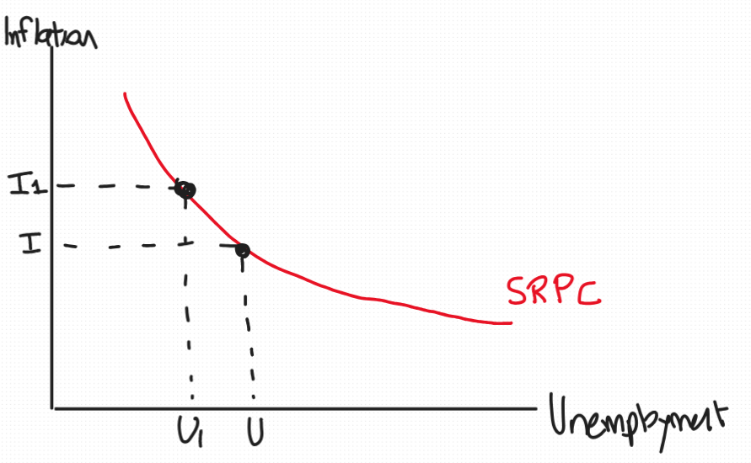
Trade off: Inflation and Growth
When we think about Inflation and Growth Government Policies there is often a trade off involved:
As previously discussed the Government’s decision to cut rates despite strong inflation demonstrates these trade offs.
We can model this via a Phillips Curve as modelled on the right
The SRPC shows there are two outcomes can have strong growth (low unemployment) but high inflation, or low inflation but low growth (high unemployment).

Slide 34
Using the Phillips Curve, illustrate the RBNZ's expected path for the NZ economy from late 2025 to mid-2026. What trade-off is the RBNZ trying to manage?

Slide 35
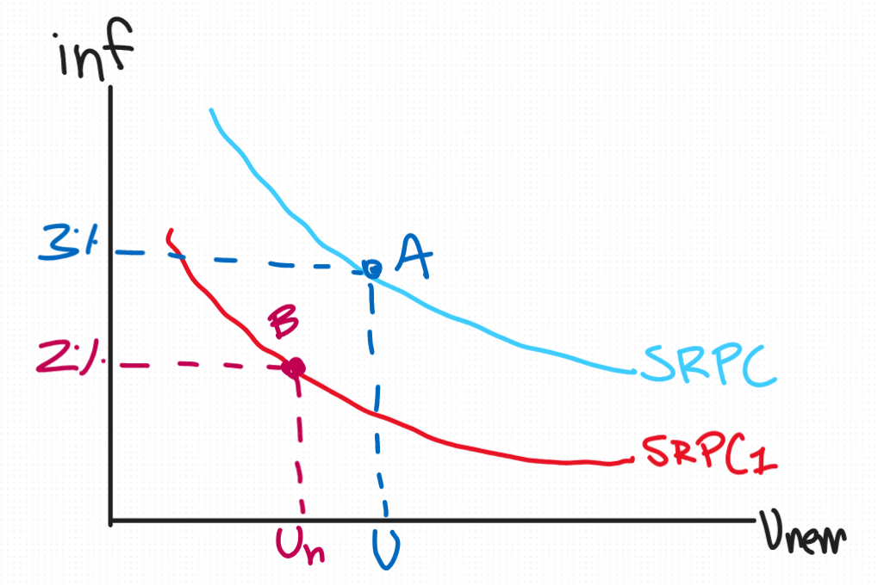
The SRPC will shift downwards, because inflation expectations fall.
Due to the OCR cuts, the boost in AD causes greater demand and growth in the economy in turn bringing unemployment toward the natural rate (Un).
Here we can see that due to these two factors, we transition from a higher SRPC point A to a lower one point B due to the lower inflation expectations.
We end at a point where inflation is around the midpoint at 2% and unemployment is at the natural rate around 3%.
Notes:
The first step is that the SRPC itself shifts downward. This happens because inflation expectations fall. Currently expectations are elevated, which is why SRPC₁ sits higher. As the temporary cost pressures (petrol, energy, council rates) dissipate and people see inflation returning toward 2%, their expectations adjust downward and the whole curve drops to SRPC₂.
The second step is that the OCR cuts boost AD, which brings unemployment down toward the natural rate u*. So the economy moves along the new lower SRPC₂ toward point B.
The end result is that NZ reaches 2% inflation at u* — the best of both outcomes. Inflation falls not because unemployment was deliberately pushed up, but because the curve itself shifted. This is exactly what the RBNZ means when it says inflation will return to 2% by mid-2026 while the labour market also recovers.
The key phrase from the release that supports this is that "household inflation expectations have fallen" — that is the mechanism driving the SRPC downward.

Slide 36
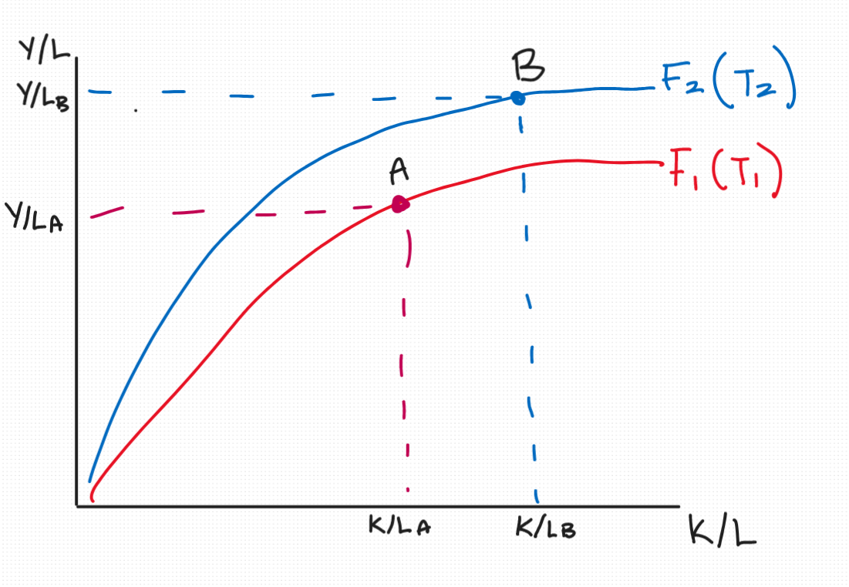
Growth Model
We can compare countries using this model where our two factors measured are capital per labour (K/L) and output per labour (Y/L).
Effectively we view how much output a worker produces based on a given amount of capital they can work with.
The relationship is diminishing, i.e. the rate at which you generate more output given additional capital slows down as there is a limit to the efficiency of a worker where no capital will further improve their performance.
Comparisons:
A - Lower output and capital however a faster rate at which they can generate output.
B - On a higher growth curve could be due to a more efficient use of capital.
A can move from F1 to F2 if they improve education, skills, innovation.

Slide 37
Q1. What is the difference between moving along the production function versus shifting it upward? What kinds of changes cause each?
Notes:
Q3. Moving along the curve means more capital per worker (K/L increases) but with diminishing returns, e.g. buying more machines for the same workforce.
Shifting the curve upward means getting more output from the same capital, driven by things like better education, technology, or innovation.
The first is accumulation; the second is productivity.

Slide 38
Q1. Moving along the curve means more capital per worker (K/L increases) but with diminishing returns, e.g. buying more machines for the same workforce.
Shifting the curve upward means getting more output from the same capital, driven by things like better education, technology, or innovation.
The first is accumulation; the second is productivity.

Slide 39
GOVERNMENT & TAX
Notes:
Worth 10 marks

Slide 40
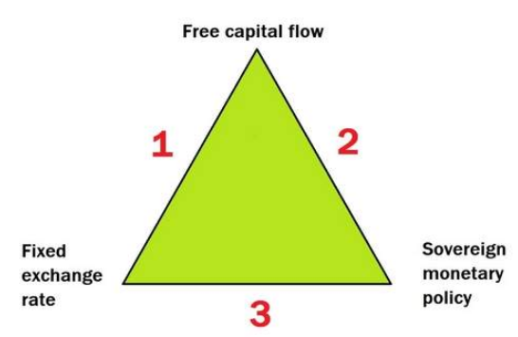
GOVERNMENT AND TAX
Fiscal policy
Taxes
The Impossible Trinity
The GFC and Great Depression
Some marks are likely to be multi-choice
Notes:
Examples of questions for exam:
Why was deflation such as that seen in The Great Depression such a significant problem?
Why was a belief that house prices would continue to rise was an important contributor to the 2008 Global Financial Crisis?
Impossible trinity is that a country can only have 2 of the parts in the diagram at any one time.
Free financial flows
Independent Monetary Policy
Fixed Er
Cannot have a fixed Er as seen in the past, therefore if the RBNZ raises interest rates (Monetary Policy) money will flow in from overseas as NZ more attractive, so free financial flows increases. As a result free financial flows drives up the Er as higher demand and reduced supply of NZD. But if the RBNZ tries to prevent rise in Er would have to sell off stored NZD to depreciate and therefore increases Money Supply and lowering interest rates again. So a cycle.
Taxation:
Vertical Equity - people with different abilities to pay should be traded differently. What we have at the moment ~ progressive taxation system
Horizontal Equity - people in similar economic circumstances treated same- i.e. income doesn’t affect your taxation
Consequences:
Fiscal drag = occurs when tax rates are progressive but due to inflation, as nominal wages increase (wages increase due to inflation), workers will move up tax brackets however be effectively earning the same amount i.e. take home income is less now due to the higher tax bracket.
Effective Rate

Slide 41
Q1. Explain fiscal drag. Why does it reduce real wages even when nominal wages rise with inflation? What are two policy solutions?
Q2. A worker earns $35,000. Using a progressive tax structure ($0-$20k taxed at 20%, $20,001-$40k at 33%), calculate their total tax bill and effective tax rate.
Q3. Short answer: Explain one argument for and one argument against progressive taxation.
Notes:
Q1. Fiscal drag: inflation pushes nominal wages up, dragging workers into higher tax brackets even though their real purchasing power hasn't changed. Result: real after-tax income falls. Two fixes: (1) index tax brackets to inflation, or (2) reduce the progressivity of the scale.
Q2. Tax on first $20,000: 20% × $20,000 = $4,000. Tax on next $15,000: 33% × $15,000 = $4,950. Total tax = $8,950. Effective rate = $8,950 / $35,000 = 25.6%.
Q3. For: redistributes income from high to low earners, reducing inequality and funding public services those on lower incomes rely on most.
Against: reduces incentive to earn more at higher income levels, potentially discouraging work, investment, or causing high earners to shift income offshore.

Slide 42
Q1. Fiscal drag: inflation pushes nominal wages up, dragging workers into higher tax brackets even though their real purchasing power hasn't changed. Result: real after-tax income falls. Two fixes: (1) index tax brackets to inflation, or (2) reduce the progressivity of the scale.
Q2. Tax on first $20,000: 20% × $20,000 = $4,000. Tax on next $15,000: 33% × $15,000 = $4,950. Total tax = $8,950. Effective rate = $8,950 / $35,000 = 25.6%.
Q3. For: redistributes income from high to low earners, reducing inequality and funding public services those on lower incomes rely on most.
Against: reduces incentive to earn more at higher income levels, potentially discouraging work, investment, or causing high earners to shift income offshore.

Slide 43
STAY UPDATED FOR EVENTS
SIGN UP FOR FREE!
Facebook Page: The Investment Society
Instagram: the_investmentsociety
QUESTIONS AND FEEDBACK
Email: tutorials@ucinvestmentsociety.com

