Slide 1

ECON207 Mid Term Tutorial
Friday 14th August – F1
THE INVESTMENT SOCIETY

Slide 2
TUTORIAL ROADMAP
What We'll Cover
01
Constrained Optimization & Rational Choice
02
Indifference Curves, MRS & Well-Behaved Preferences
03
The Budget Line & the Best Affordable Bundle
04
Utility Functions: Cobb-Douglas, Substitutes & Complements
05
Income & Price Changes — Substitution vs Income Effects
06
Compensating Variation & Practice Questions

Slide 3
CONCEPT OVERVIEW
Constrained Optimization & Rational Choice
Economists assume people practice constrained optimization.
For households, constrained optimization = rational choice theory
Rational households ask two questions:
1
2
What bundles do I prefer?
Which bundles can I afford?
Described by indifference curves
Described by the budget line
Together these determine the household's Best Affordable Bundle (BAB)

Slide 4
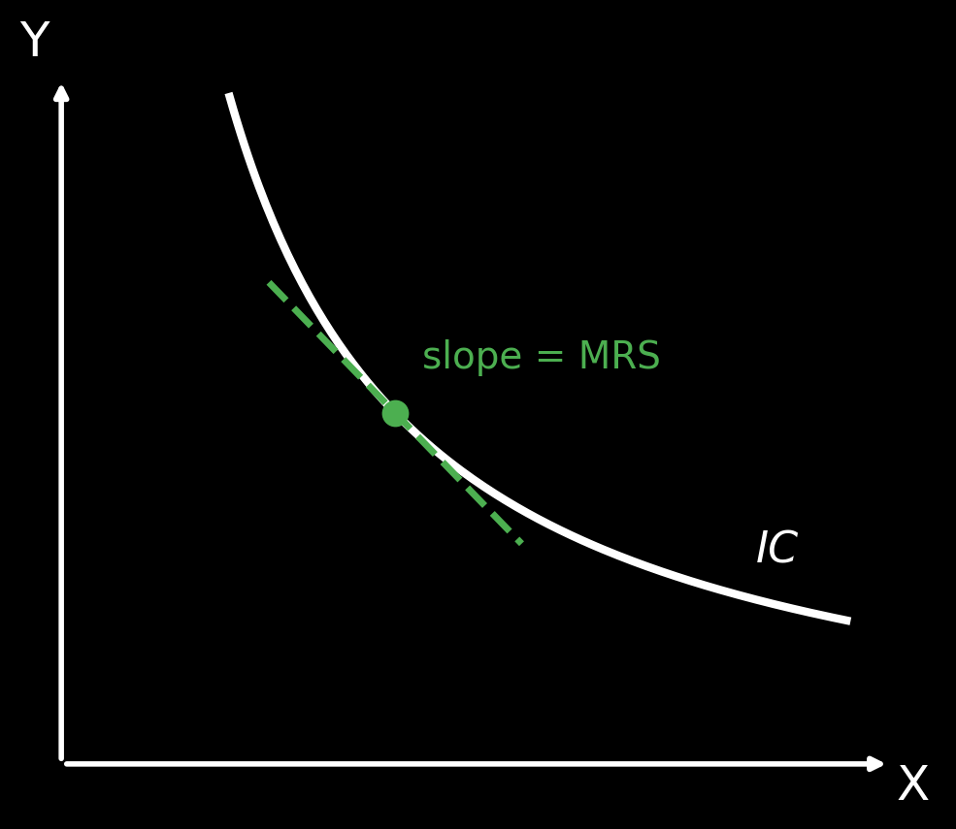
CONCEPT OVERVIEW
Indifference Curves & MRS
If two bundles give a consumer the same satisfaction, the consumer is indifferent between them
An indifference curve (IC) shows every bundle that provides the same level of satisfaction
Marginal Rate of Substitution (MRS):
  rate at which a consumer is willing to give up Y to get another unit of X
  the slope at any point on the IC shows the MRS
MRS changes along the curve — as the ratio of goods consumed changes, so does willingness to substitute
A convex IC means a consumer prefers a balanced bundle to an extreme one — the 50/50 average sits on a higher IC

Slide 5
CONCEPT OVERVIEW
Well-Behaved (Convex) Preferences
We know a consumer prefers bundles on a higher IC, but not by how much — it isn't a linear measurement. Four axioms define well-behaved preferences:
Completeness
Transitivity
All households can rank possible bundles — even if they rank them as equal
Household preferences are consistent at a given point in time
Non-satiation
Convexity
More is preferred to less, if unused goods can be freely disposed of
Diminishing MRS as you move down the indifference curve
Goods on the axis must be things we want more of — not economic “bads.”

Slide 6

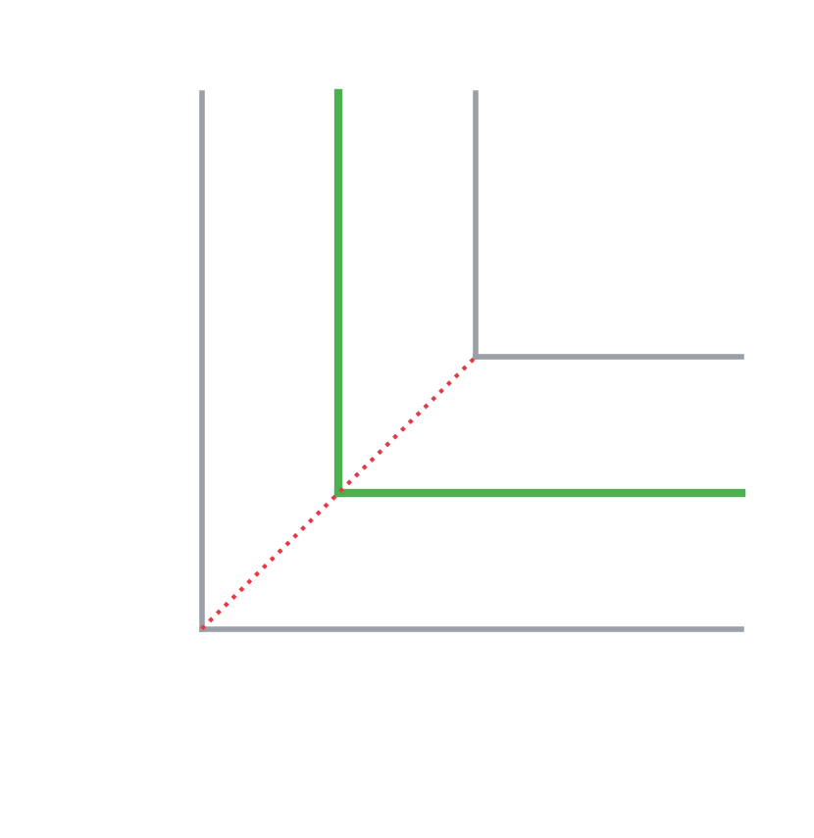
CONCEPT OVERVIEW
Special Preference Types
Indifference curves can't cross — this would violate transitivity
Indifference curves can't slope upward — this would violate non-satiation
Perfect substitutes:
  straight-line ICs — satisfy convexity only
Perfect complements:
  L-shaped ICs — satisfy non-satiation & convexity
For substitutes & complements, the IC is no longer strictly convex — the consumer may prefer all of one good and none of the other: a corner solution
Perfect Substitutes
Perfect Complements

Slide 7
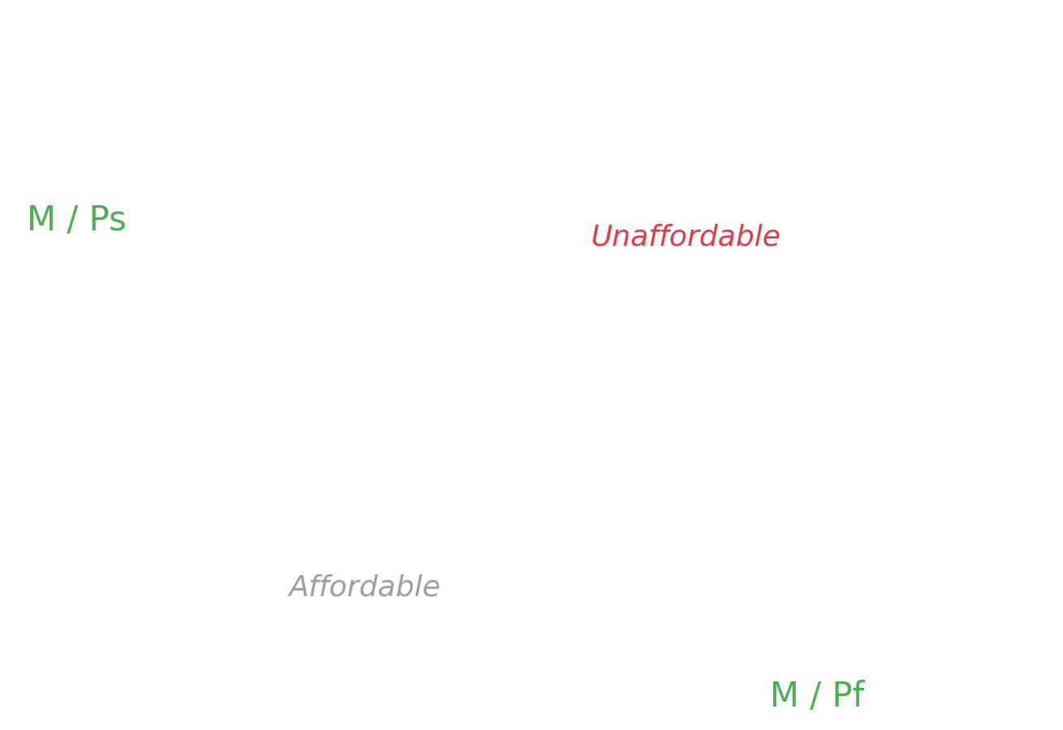
CONCEPT OVERVIEW
The Budget Line / Constraint
The budget line (BL) represents affordability — NOT preferences
Outside the BL: unaffordable
Inside the BL: not all income is spent
On the BL: all income is spent
If Moana spends all her income on shelter: Q = M / Ps
If Moana spends all her income on food: Q = M / Pf
Slope of BL = Px / Py (quantity, not price, is on the axis)

Slide 8
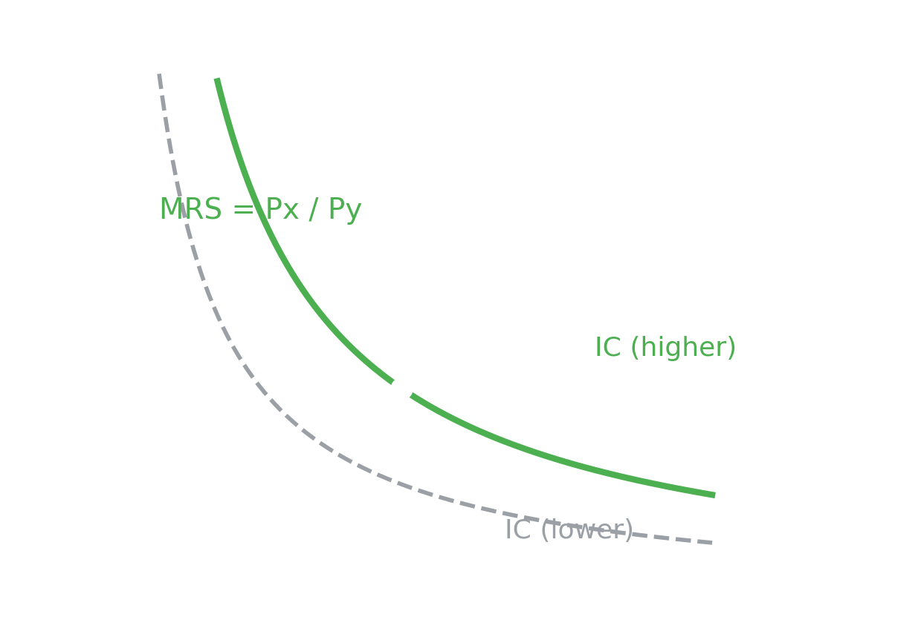
CONCEPT OVERVIEW
Best Affordable Bundle — Tangency Condition
A utility-maximizing consumer picks the bundle where the IC is tangent to the BL
Slope of BL = Slope of IC, and the bundle must sit on the BL (or income isn't fully spent)
At tangency: MRS = Px / Py
Worked Example
Assume MRS = 4, Px / Py = 2
Sam is willing to ‘pay’ 4 ham for an egg, but only has to pay 2 ham for an egg
Since MRS > Px/Py, Sam keeps buying more eggs, moving down the BL onto a higher IC
This continues until MRS = Px / Py = 2 (the BL has a constant slope)

Slide 9
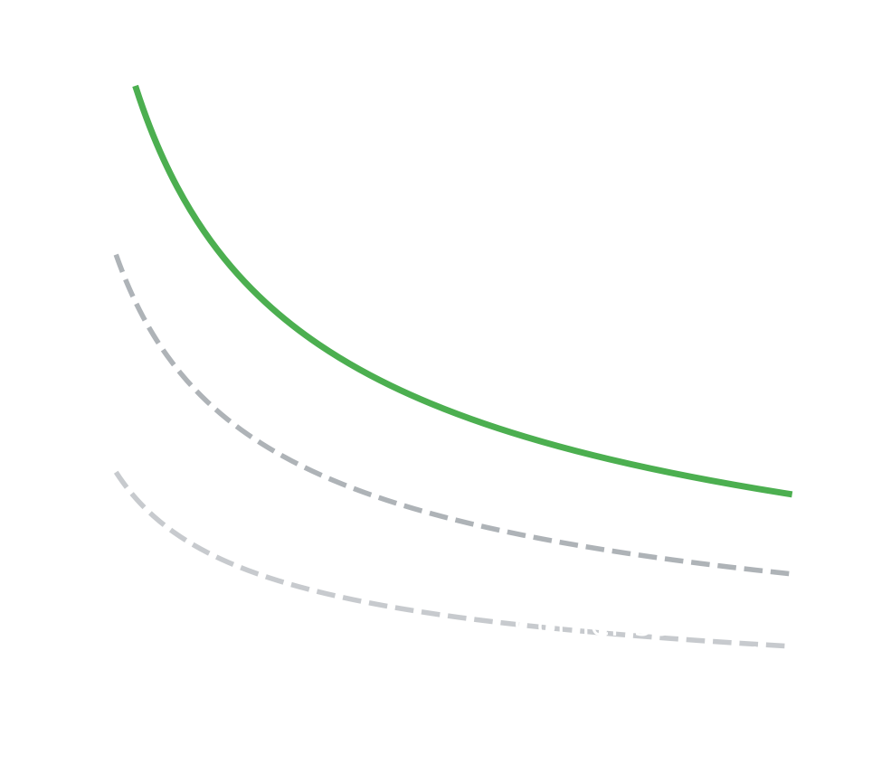
CONCEPT OVERVIEW
Corner Solutions
Sometimes a household ends up consuming Q = 0 of one good — a corner solution
This happens when MRS is always > Px/Py, or always < Px/Py — the point of tangency is never reached
If IC is flatter than BL everywhere → corner solution of all Y
If IC is steeper than BL everywhere → corner solution of all X
This won't happen with strictly well-behaved preferences — the BAB is either an interior tangency, or a corner solution, depending on the consumer's preferences

Slide 10
CONCEPT OVERVIEW
Utility Functions & MRS via Calculus
U(X,Y) is a function of consumption of goods X and Y, assuming self-regarding preferences
Cobb-Douglas function: U(X,Y) = √(XY)
  Convex, well-behaved, can rank all bundles, diminishing MRS → gives an interior (tangency) solution
Monotonic transformation:
  any variation of a utility function that preserves the rank ordering of bundles, e.g. U = 10√(XY) still ranks bundles the same way
Finding the tangency condition
MRS tells you how much Y a consumer is willing to give up for another X = slope of the IC
Take the partial derivatives of U(X,Y) (the Power Rule) to find MUx and MUy
MRS = MUx / MUy
Set MRS = Px / Py to find the point of tangency
Substitute the resulting Y/X ratio into the budget constraint to solve for the BAB

Slide 11
WORKED EXAMPLE
Perfect Substitutes
Apple juice (A): price = $0.06 Grape juice (G): price = $0.05 Income = $1.20
1. Compare MRS to relative prices
2. Compare marginal utility per dollar
3. Compare total utility at each corner
MRS = 1.33 (constant, straight-line IC)
Px / Py = 0.06 / 0.05 = 1.2
1.33 > 1.2 → willing to give up more grape juice than needed → keeps substituting into apple juice
MUa / Pa > MUg / Pg
More utility per dollar spent on apple juice
→ confirms a corner solution of all apple juice
All apple juice: 20 units → utility = 80
All grape juice: 24 units → utility = 72
80 > 72 → corner solution of all apple juice
You don't need a 1:1 ratio to be perfect substitutes — the ratio just has to stay constant, no matter the quantity consumed.

Slide 12
WORKED EXAMPLE
Perfect Complements
You must consume 2 bags of popcorn per movie ticket to maximize utility. Income = $30, P(movie) = $10, P(popcorn) = $2.50
Utility function: U = min(2M, C) — utility is the smaller of the two, weighted by the fixed ratio
Extra units of one good beyond the fixed ratio are wasted expenditure — e.g. 3 popcorn with 1 movie wastes 1 bag
To have balanced utility, consume 2 bags of popcorn for every movie ticket: C = 2M
Result
Bundle = (2, 4)
2 movies and 4 bags of popcorn — quantity of popcorn consumed is always twice the quantity of movie tickets consumed.
Solving the budget constraint
10M + 2.50(2M) = 30 → 15M = 30 → M = 2
C = 2M = 4

Slide 13
WORKED EXAMPLE
Cobb-Douglas Preferences
Li has well-behaved preferences U(X,Y) = √(XY), Px = $4, Py = $1, M = $40
Convexity → MRS is falling as you move along the IC. The BAB is an interior solution: some combination of both goods
The BAB is the point of tangency between the IC and BL — Slope of IC = Slope of BL
Result
BAB = (5, 20)
Li buys 5 units of X and 20 units of Y — spending $20 on each good, exactly exhausting her $40 budget.
Step 1 — MRS
MUx = 0.5(Y/X)^0.5, MUy = 0.5(X/Y)^0.5
MRS = MUx / MUy = Y / X
Step 2 — Tangency
A monotonic transform of U (e.g. U = 10√(XY)) would give the exact same BAB.
Set MRS = Px / Py:
Y / X = 4 / 1 = 4 → Y = 4X
Step 3 — Substitute into BL
4X + 1(4X) = 40 → 8X = 40 → X = 5, Y = 20

Slide 14
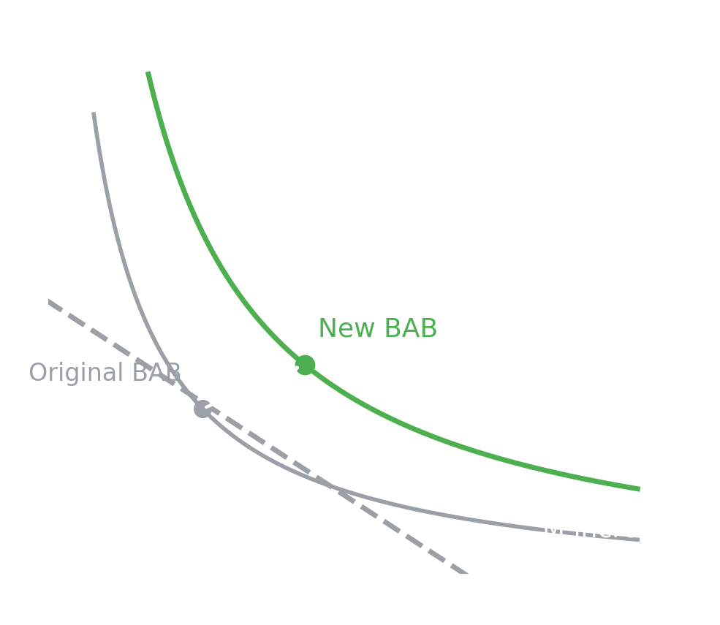
CONCEPT OVERVIEW
Changes in Income
When M increases: BL shifts outward, parallel — the slope doesn't change since prices haven't changed
The consumer can now reach a BAB on a higher IC
A decrease in M is the exact opposite: BL shifts left, consumer lands on a lower IC
Normal good:
  consumption moves with income
Inferior good:
  as M increases, consumption decreases; as M decreases, consumption increases

Slide 15
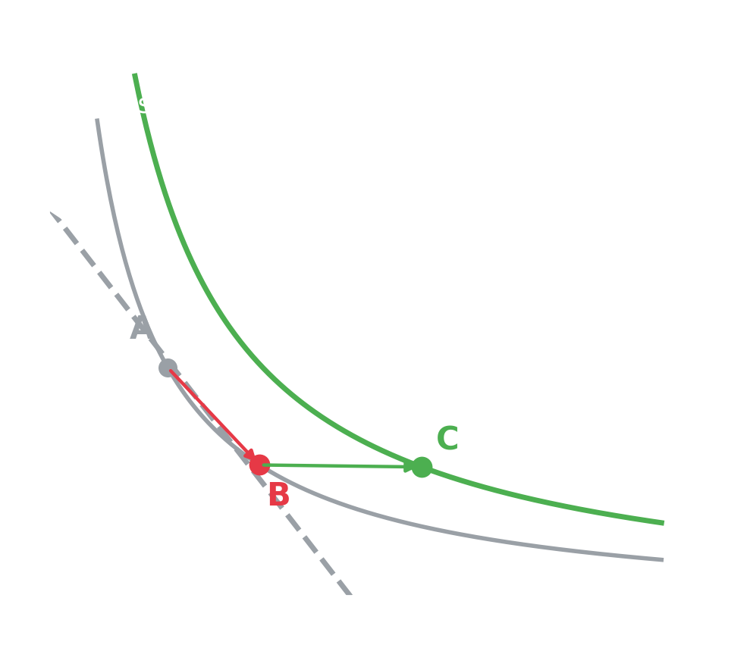
CONCEPT OVERVIEW
Changes in Price — Substitution & Income Effects
A fall in Px lets the consumer buy more X with the same income — the BAB moves in two distinct steps:
1. Substitution Effect (A → B)
As Px falls, the consumer substitutes into the now-cheaper good X and away from Y
Moves along the ORIGINAL IC to a bundle with more X, less Y
Uses a line parallel to the new BL (reflecting new relative prices)
2. Income Effect (B → C)
As Px falls, real income (purchasing power) rises
The consumer moves to a new point of tangency on a HIGHER IC
Reflects being able to afford more of everything, not just the cheaper good

Slide 16
CONCEPT OVERVIEW
Inferior & Giffen Goods
For an inferior good, when Px rises: real income falls, and the income effect increases consumption of X (opposite direction to a normal good)
This increase (from the income effect) doesn't go all the way back past the original quantity — substitution effect still dominates income effect for good X
Giffen Goods — the extreme case
An extreme example of an inferior good
As real income decreases, consumers buy MORE of the good — usually because they can only afford one staple (Giffen) good as real income falls
Same logic as an inferior good, except here the income effect is GREATER than the substitution effect
Net result: Px increases and Qd increases — an upward-sloping demand curve

Slide 17
CONCEPT OVERVIEW
Compensating Variation & the Lump Sum Principle
Compensating Variation
Lump Sum Principle
The concept revolves around the idea of fairness
If a price increases (e.g. as the result of a tax), the government could compensate certain groups (e.g. low-income households) by giving them cash
A deadweight loss (DWL) is generated whether the government puts a tax on goods, or taxes incomes directly
Generally, DWL is lower with a tax on income than with a tax on a specific good

Slide 18
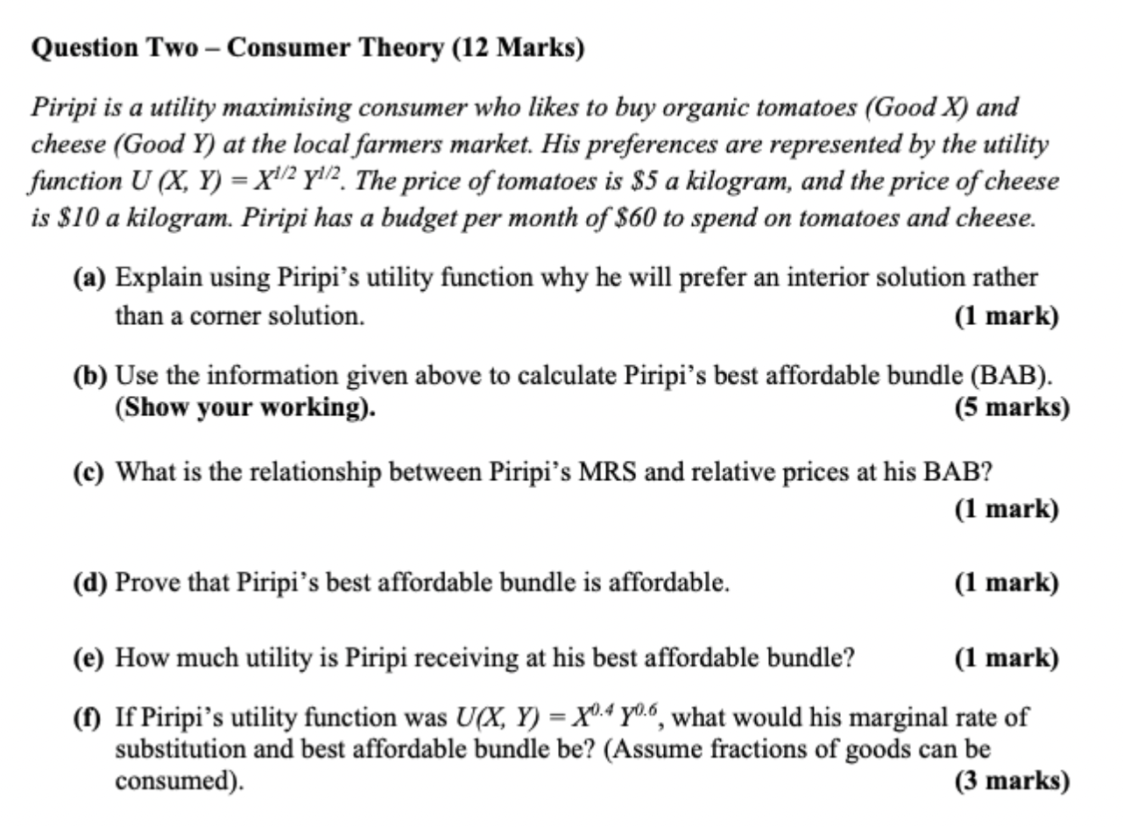
PAST TEST PRACTICE, 2024
Consumer Theory

Slide 19
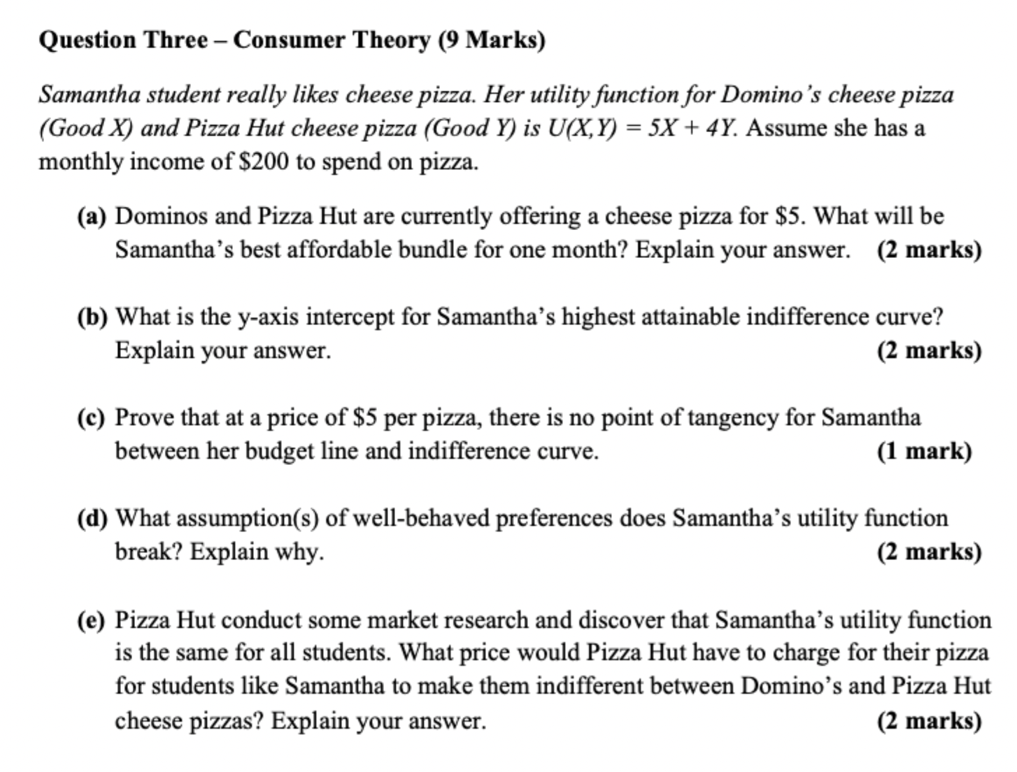
PAST TEST PRACTICE, 2024
Consumer Theory

Slide 20
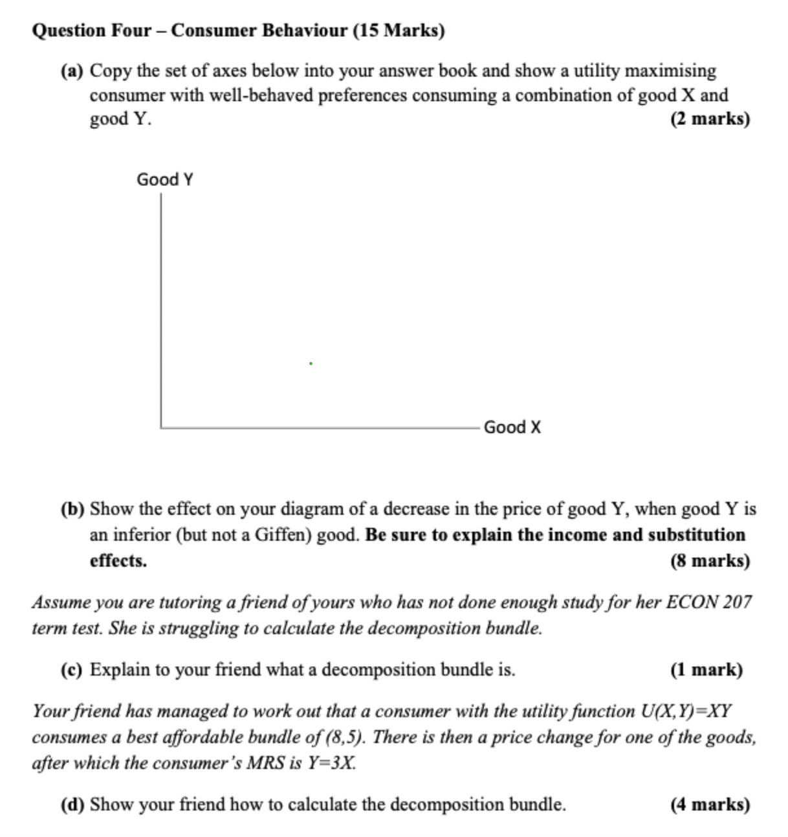
PAST TEST PRACTICE, 2024
Consumer Behaviour

Slide 21
PRACTICE
Quickfire Practice Questions
Q1
If MRS = 5 and Px/Py = 3, will the consumer increase or decrease consumption of X?
Increase — MRS > Px/Py means the consumer is willing to give up more Y than they have to, so they keep buying X.
Q2
What condition defines the Best Affordable Bundle at an interior solution?
Tangency: MRS = Px/Py — the slope of the IC equals the slope of the budget line.
Q3
A fall in Px moves the consumer along the original IC in which effect?
The substitution effect (A→B); the move to a new, higher IC is the income effect (B→C).
Q4
For a Giffen good, does Qd rise or fall when Px rises?
Rises — the income effect outweighs the substitution effect, giving an upward-sloping demand curve.
Q5
Which axiom is violated if two indifference curves cross?
Transitivity.

Slide 22
KEY TAKEAWAYS
Summary & Core Equations
Tangency (interior BAB)
MRS = Px / Py
Budget line
Qy = M/Py − (Px/Py)·Qx
Corner solution
MRS always > or always < Px/Py
Cobb-Douglas MRS
MRS = MUx / MUy
Thank you — questions welcome.

