Slide 1

FINC201 Mid Term Tutorial
Wednesday 19th August, 1-2pm in F1

Slide 2
ROADMAP
What We're Covering Today
Foundations of Finance
Measuring Performance
1
5
Corporations & Markets
Ratios: Leverage & Liquidity
2
6
The Agency Problem
Time Value of Money
3
7
Financial Statements
Inflation & Amortization
4
8
THE INVESTMENT SOCIETY · FINANCE TUTORIAL
2

Slide 3
MODULE 1 · FOUNDATIONS
What Is Finance?
The Big Picture
Managerial Finance
The art and science of managing money.
Concerned with the transfer of money among individuals, businesses and governments — through processes, institutions, markets and instruments.
Macro level: financial institutions & markets within a country and globally.
Micro level: financial planning, asset management, and fund raising for firms.
The duties of the financial manager in a business firm — managing the financial affairs of the entity:
Planning
Extending credit to customers
Evaluating proposed large expenditures
Raising money to fund operations
THE INVESTMENT SOCIETY · FINANCE TUTORIAL
3

Slide 4
MODULE 1 · FOUNDATIONS
Types of Business Organizations
1
2
3
Sole Proprietorship
Partnership
Corporation
Personal taxes on income. Owner personally liable for business debts.
Two or more people share the business. Personal taxes; liable for debt obligations.
Corporate tax on profit (28% in NZ) + personal tax on dividends. Protected by limited liability.
Corporation: a separate legal entity owned by shareholders. Shareholders don't directly own real assets — they hold indirect ownership via financial assets (shares).
Note: NZ's dividend imputation system eliminates double taxation of cash payouts from a corporation to its shareholders.
THE INVESTMENT SOCIETY · FINANCE TUTORIAL
4

Slide 5
MODULE 1 · FOUNDATIONS
The Corporation & Its Goal
Real Assets
Limited Liability
Used to produce goods and services (plant, machinery, brand names, patents).
Owners of a corporation are not personally liable for its obligations.
The Goal of the Firm
Maximize
Financial Assets
A financial claim to the income generated by the firm's real assets (e.g. shares).
Shareholder Wealth
This is the central goal of financial management.
THE INVESTMENT SOCIETY · FINANCE TUTORIAL
5

Slide 6
MODULE 1 · FOUNDATIONS
Investment vs. Financing Decisions
Financial managers face two broad questions:
?
What investments should
the corporation make?
?
How should it pay for
these investments?
Investment Decision
Decision to invest in tangible or intangible assets — the capital budgeting (CAPEX) decision.
Financing Decision
Decision on the sources and amounts of financing — the capital structure (mix of long-term debt & equity).
Example
Intel spends $7B to develop a new microprocessor.
Avon spends $200M to launch cosmetics in Europe.
Example
BMW borrows $350M from a bank.
A firm issues new shares or bonds to the market.
THE INVESTMENT SOCIETY · FINANCE TUTORIAL
6

Slide 7
MODULE 1 · FOUNDATIONS
The Firm & Financial Markets
To fund a $2M equipment purchase, a firm chooses between internal financing (retained earnings) or external financing (bank loan, new debt, bonds, stock).
Primary Market
Secondary Market
Money Market
Capital Market
Sale of new securities by corporations.
Previously issued securities traded among investors.
Short-term marketable securities.
Long-term securities (bonds, stocks).
Key Securities Traded in the Capital Market
Bonds
Common Stock
Preferred Stock
Hybrid Securities
Long-term debt instruments used to raise large sums from diverse lenders.
Units of ownership interest (equity) in a corporation.
Special ownership form with features of both a bond and common stock.
Instruments blending debt and equity characteristics.
Interest payments are tax deductible.
THE INVESTMENT SOCIETY · FINANCE TUTORIAL
7

Slide 8
MODULE 1 · FOUNDATIONS
The Agency Problem
Managers are agents for stockholders — and may be tempted to act in their own interests rather than maximizing shareholder value.
Do Shareholders Control
Managerial Behavior?
Shareholders vote for the board of directors, who in turn hire the management team.
Public shareholders can't manage the corporation directly — they elect a board of directors, who appoint and monitor top managers. This separation gives stability, but opens the door to conflicts.
1
Managerial contracts are carefully constructed — managers rewarded with shares, aligning incentives.
Conflicts of Interest
2
A market for managerial talent exists — poor managers can be replaced.
• Shareholders vs. Managers
• Managers vs. Employees
• Debtholders vs. Shareholders / different equity classes
3
Managers who fail to maximize share price risk a hostile takeover.
THE INVESTMENT SOCIETY · FINANCE TUTORIAL
8

Slide 9
MODULE 2 · FINANCIAL STATEMENTS
Why Do We Need Financial Statements?
Formal records of the financial activities and position of a business — used by investors, market analysts, and creditors to evaluate financial health and earnings potential.
Players who monitor a corporation's progress:
Shareholders
Lenders (Bondholders)
Directors
Management
Employees
The corporation prepares regular financial accounts and arranges for an independent auditor.
Balance Sheet
Income Statement
Statement of Cash Flows
Value of a firm's assets & liabilities at a point in time.
Revenue, expenses & net income over a period.
Cash receipts & payments over a period.
THE INVESTMENT SOCIETY · FINANCE TUTORIAL
9

Slide 10
MODULE 2 · FINANCIAL STATEMENTS
The Balance Sheet
Total Assets = Total Liabilities + Shareholders' Equity
Liquidity
Shareholders' Equity
Current assets: convertible to cash in less than a year without losing value.
Liquidity: how fast & easily an asset can be sold in the financial market.
Most liquid asset: cash, followed by marketable securities (e.g. government short-term bonds).
Issued shares
Shares that have been issued by the company.
Outstanding shares
Issued shares currently held by investors.
Treasury stock
Repurchased shares held by the company = Issued − Outstanding.
Example: ABC is authorized for 2M shares, issues 1M at IPO, then repurchases 200k → 800,000 shares remain outstanding.
THE INVESTMENT SOCIETY · FINANCE TUTORIAL
10

Slide 11
MODULE 2 · FINANCIAL STATEMENTS
Market Value vs. Book Value
Book Value
Market Value
• Backward-looking
• Determined by IFRS
• Assets: purchase price less depreciation
• Equity: capital raised from shareholders historically
• Forward-looking
• Determined by current market prices
• Assets: value if resold in the market
• Equity: value of future dividends shareholders expect
MV of Equity = Market Price per Share × Number of Shares Outstanding
THE INVESTMENT SOCIETY · FINANCE TUTORIAL
11

Slide 12
MODULE 2 · FINANCIAL STATEMENTS
Income Statement: Income ≠ Cash Flow
The income statement shows revenue, expenses & net income over a period. Two reasons income and cash are not the same:
1
Depreciation
2
Accrual Accounting
Allocates the cost of a tangible asset over its useful life — a non-cash expense.
Records revenues and expenses when they are incurred, regardless of when cash is actually exchanged.
Example: pay $10,000 for machinery
Finance: negative cash flow the day it's bought.
Accounting: depreciated ~$1,000/year for 10 years, treated as an annual expense.
Note: interest expense is tax deductible.
THE INVESTMENT SOCIETY · FINANCE TUTORIAL
12

Slide 13
MODULE 2 · FINANCIAL STATEMENTS
Statement of Cash Flows
Shows the firm's cash receipts and payments over a period, organized into three activities. Change in cash balance = Sources of cash − Uses of cash.
Operating Activities
Investing Activities
Financing Activities
Revenues, operating expenses, and day-to-day business.
Sale or purchase of long-term assets.
Issuing shares, raising or repaying debt.
Cash inflows (+) and cash outflows (−) are netted across all three activities.
Depreciation is a non-cash expense, so it is added back. Net working capital = current assets − current liabilities.
THE INVESTMENT SOCIETY · FINANCE TUTORIAL
13

Slide 14
MODULE 2 · FINANCIAL STATEMENTS
Taxes
Marginal Tax Rate
Average Tax Rate
28%
The tax paid on each extra dollar of income earned.
Total tax bill divided by total income.
NZ Corporate Tax Rate
Companies pay tax on their income — a major factor in financial decisions.
From 1 April 2025, NZ tax settings are changing slightly — check the current thresholds before the test.
THE INVESTMENT SOCIETY · FINANCE TUTORIAL
14

Slide 15
MODULE 3 · MEASURING PERFORMANCE
Market Value Added & Economic Value Added
How much value has a company added for its shareholders?
Market Value Added (MVA)
Economic Value Added (EVA)
MVA = Market Cap − Book Value of Equity
Used when market values aren't observable (private companies, divisions of larger firms) — net income minus a charge for the cost of capital employed.
Market Capitalization
= Share price × Number of shares outstanding
Market-to-Book Ratio
= Market value of equity / Book value of equity — use alongside other fundamentals to interpret correctly.
EVA = After-tax Operating Income − (Cost of Capital × Total Capitalization)
After-tax operating income
= (1 − tax rate) × interest expense + net income
Total capitalization
= Long-term debt + Shareholders' equity
THE INVESTMENT SOCIETY · FINANCE TUTORIAL
15

Slide 16
MODULE 3 · MEASURING PERFORMANCE
Profitability & Financial Leverage
Accounting Rate of Return
Measuring Financial Leverage
Profit per dollar of assets — used to compare managers of small vs. large firms.
Debt increases returns to shareholders in good times, and reduces them in bad times — this creates financial leverage.
• Return on Capital (ROC)
• Return on Assets (ROA)
• Return on Equity (ROE) — higher is better
Long-Term Debt Ratio
Example: 0.94 → every $0.94 of long-term capital is debt. A highly levered firm (94% debt is a lot).
Payout Priority in Bankruptcy
Debtholders → Preferred equity holders → Common equity holders
Times Interest Earned
Extent to which interest obligations are covered by earnings. Banks prefer this ratio high, with room to spare. Add back depreciation (non-cash) to increase it.
More debt in the capital structure = more risk, and a lower probability of full repayment if the firm goes bankrupt.
THE INVESTMENT SOCIETY · FINANCE TUTORIAL
16

Slide 17
MODULE 3 · MEASURING PERFORMANCE
Liquidity & Interpreting Ratios
Measuring Liquidity
Interpreting Financial Ratios
If extending credit or making a short-term loan, you care about more than leverage — you want to know if the borrower can get cash to repay you. Liquid assets convert to cash quickly and cheaply.
Some ratios have a natural benchmark. Others vary from year to year and industry to industry — there's no single right level.
When assessing company performance, managers:
Current Ratio Target
Look at how ratios have changed over time
Should be at least greater than 1.
Compare against companies in the same line of business
Credit analysts and bankers watch several liquidity measures before extending credit.
THE INVESTMENT SOCIETY · FINANCE TUTORIAL
17

Slide 18
MODULE 4 · TIME VALUE OF MONEY
The Time Value of Money
A dollar today is worth more than a dollar in the future.
Why? Investment opportunities. The most important concept in finance — used in nearly every financial decision.
Future Value (FV)
Cash Flow Timelines
The amount to which an investment will grow after earning interest.
A useful tool to illustrate the relationship between PV, FV, and cash flows over time (C = cash flow, R% = interest rate).
Compound interest: interest earned on interest.
Simple interest: interest earned only on the original investment.
Multiple cash flows:
FV = compound each cash flow to a chosen future point, then sum.
PV = sum of present values of all cash flows, each discounted to a chosen point.
THE INVESTMENT SOCIETY · FINANCE TUTORIAL
18

Slide 19
MODULE 4 · TIME VALUE OF MONEY
Perpetuities & Annuities
Perpetuity
FV of Annuity
An evenly spaced stream of level cash flows that never ends.
1. Find PV of the annuity, then take it forward to the future.
2. Or apply the FV of annuity formula directly.
PV = C / R
Growing Stream of Cash Flows
C = cash payment · R = discount rate
Adds a growth rate (G) to the standard annuity/perpetuity formulas to value cash flows that increase each period.
Annuity
An equally spaced stream of level cash flows with a finite maturity (T years).
Applications: valuing payment streams, finding the implied interest rate for an annuity, and calculating periodic payments.
Ordinary annuity: payments at period end.
Annuity due: payments at period start (one extra period of interest).
THE INVESTMENT SOCIETY · FINANCE TUTORIAL
19

Slide 20
MODULE 4 · TIME VALUE OF MONEY
Compounding: APR vs. EAR
Annual Percentage Rate (APR)
Effective Annual Rate (EAR)
Periodic rates annualized by multiplying by the number of compounding periods per year. The rate stated in contracts, quoted by banks and brokers.
The annual rate actually being earned, considering compounding — used to compare opportunities with different compounding frequencies.
APR does not take compounding into account.
EAR = (1 + R/M)^M − 1
Periodic Interest Rate
R = APR · M = compounding periods per year
R_per = APR / m
Can EAR ever equal APR?
Yes — only with annual compounding (m = 1). If m > 1, EAR is always greater than APR.
Amount of interest charged each period; m = compounding periods/year (4 = quarterly, 12 = monthly, 365 = daily).
THE INVESTMENT SOCIETY · FINANCE TUTORIAL
20

Slide 21
MODULE 4 · TIME VALUE OF MONEY
Amortization & Inflation
Loan Amortization
Nominal vs. Real Interest Rates
Paying down debt over time in regular installments of interest and principal.
Nominal rate: the quoted rate before inflation.
Real rate: adjusts for inflation — the real return on a bond or loan.
An amortization schedule is a complete table of periodic loan payments, showing the split between principal and interest until the loan is paid off at term end.
Worked Example
Nominal rate 6%, inflation 2% → real rate ≈ 3.9%
$100 buys 100 loaves at $1/loaf.
Grows to $106; bread now $1.02/loaf.
106 / 1.02 = 103.92 loaves.
A 3.9% real return means you can buy 3.9% more bread.
Widely used for: home mortgages, auto loans, business loans, and retirement plans.
Discounting/compounding rule: current-dollar cash flows use the nominal rate; real cash flows use the real rate. Always be consistent.
THE INVESTMENT SOCIETY · FINANCE TUTORIAL
21

Slide 22
BEFORE YOU GO
Key Takeaways for the Test
✓
Goal of the firm
✓
Market vs. Book Value
Maximize shareholder wealth — every decision ties back to this.
Finance cares about market value and the timing of cash flows.
✓
Balance sheet identity
✓
Time value of money
Assets = Liabilities + Shareholders' Equity — know it cold.
A dollar today > a dollar tomorrow. Practice PV/FV, annuities & perpetuities.
✓
Cash ≠ Income
✓
APR vs. EAR
Depreciation and accrual accounting drive the wedge — expect a question on this.
EAR > APR whenever compounding occurs more than once a year.
THE INVESTMENT SOCIETY · FINANCE TUTORIAL
22

Slide 23
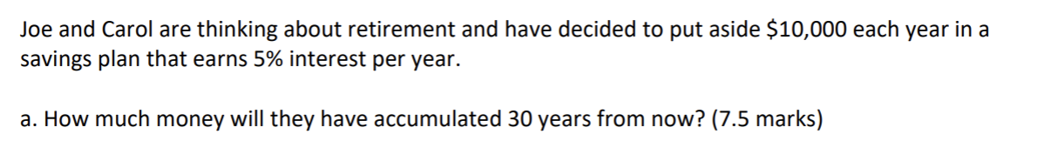

Slide 24
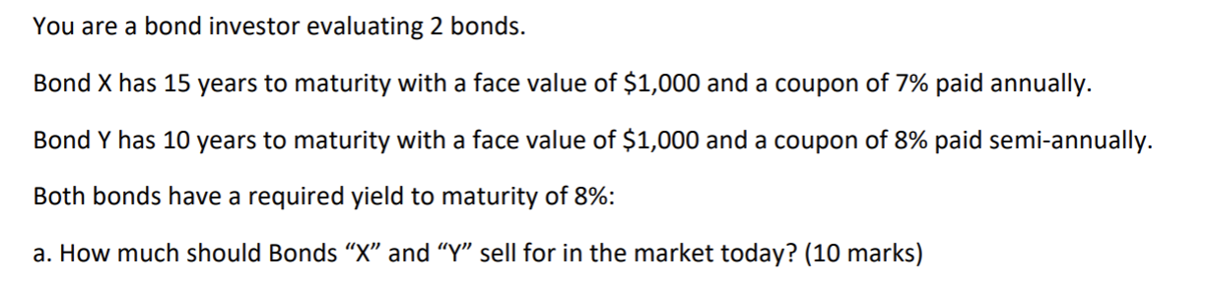

Slide 25
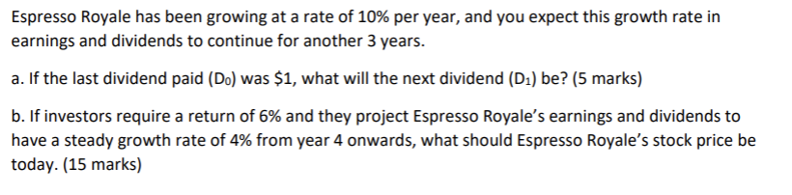

Slide 26
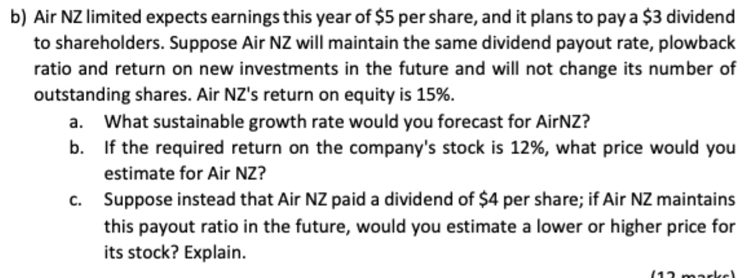

Slide 27
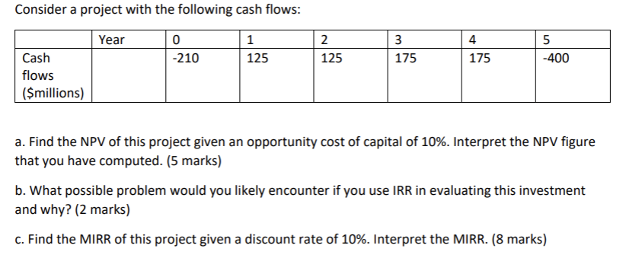

Slide 28
Good Luck!

