Slide 1

ECON206 TUTORIAL
Monday 7th September
2-3pm in F1

Slide 2
SIGN UP FOR FREE
STAY UPDATED
Instagram: the_investmentsociety
QUESTIONS AND FEEDBACK
Email: ipi17@uclive.ac.nz

Slide 3
INFORMATION
Structure
Coverage: Week 1 to Week 5
Lectures: 1 - 15
Quizzes: 1 - 4
Problem Sets: 1 – 5
Section A - 15 multiple choice (30 marks)
Section B - 5 short-answer (40 marks) [8 marks each]
Section C - 2 multiple-part long-answer (30 marks)
One of the written questions in Section B is taken from a problem set.
One of the 15 mark questions will be on calculating GDP (Section C)

Slide 4
SECTION 1 · NATIONAL INCOME & BOP
GDP & National Income Accounting
• GDP: market value of all final goods & services produced in an economy over a given period
• GDP = C + G + I + EX − IM
• Three equivalent approaches:
– Product → sum of value added at each stage
– Expenditure → C + G + I + EX − IM
– Income → after-tax wages + profits + household interest income + taxes paid by firms & households
• Final goods (bought by end user) vs Intermediate goods (used to produce other goods)

Slide 5
Real GDP & Limitations of GDP
• Real GDP: value of output using base-period (constant) prices — isolates changes in quantity from changes in price
• Real GDP per capita = Real GDP / Total Population
• GDP does NOT capture:
– 1. Externalities
– 2. Leisure (working more raises GDP even if welfare falls)
– 3. Social attributes / distribution of income

Slide 6
Balance of Payments — Current Account
• BOP: record of market transactions between a country and the rest of the world (ROW)
• Current Account (CA): goods, services, income & transfers
• CA = (EX + Primary Income) − (IM + Primary Payments) + Net Secondary Transfers
– Primary income/payments: from FDI — wages, interest, dividends, rent
– Secondary income/payments: given but nothing received in return — superannuation, foreign aid, tax transfers
• Equivalently: CA = (EX − IM) + NFI

Slide 7
Financial Account, GNI & the CA–Savings Link
• Financial Account (FA): transactions involving a change in ownership of assets
• BOP = CA + FA → CA = −FA
• GNI = GDP + NFI = C + G + I + CA
• CA = GNI − (C + G + I) = S − I
• CA < 0 (deficit): spending > income; S < I; funded by borrowing from / selling assets to ROW
• CA > 0 (surplus): S > I; NZ is lending to / acquiring assets in ROW

Slide 8
SECTION 2 · PRICES & UNEMPLOYMENT
Prices — CPI, Inflation & the GDP Deflator
• Inflation rate = (Pt − Pt−1) / Pt−1 × 100
• CPI: cost of a fixed basket of domestic consumer goods & services over time
• GDP Deflator = (Nominal GDP / Real GDP) × 100 — covers ALL goods (C, G, I, EX, IM), not just consumer items
• CPI limitations:
– Substitution bias — overstates cost of living as weights don't adjust
– Misses new goods entering the basket
– Doesn't account for quality improvements

Slide 9
Unemployment & the Labour Force
• WAP: civilians aged 15 and above
• "Unemployed" (HLFS test): no job, actively looked in last 4 weeks, could start within 4 weeks
• LF = Employed + Unemployed
• UR = Unemployed / LF
• Participation rate = LF / WAP × 100
• Limitations: excludes underemployed & discouraged workers; includes those with unrealistic wage expectations

Slide 10
Natural Rate of Unemployment (NRU)
• NRU: the long-run UR when the labour market is in equilibrium
• s = separation rate (employed → unemployed) f = job-finding rate (unemployed → employed)
• Equilibrium: flows in = flows out → fu = s(LF − u)
• NRU = u / LF = s / (f + s)
• Frictions: costly job search, time to create jobs, matching workers to jobs — s and f shift with factors like immigration

Slide 11
SECTION 3 · GROWTH & BUSINESS CYCLES
Economic Growth & the Business Cycle
• Economic growth: long-run (10+ yr) increase in real GDP per capita
• Average annual growth: g = (Xт / X₀)^(1/T) − 1
• Business cycle: periodic but irregular ups & downs in aggregate variables — Expansion → Peak → Contraction → Trough
Recession: output falls for 2 consecutive quarters
Depression: a severe, prolonged trough
• Output gap = Actual output − Potential output
– Positive gap → expansionary | Negative gap → contractionary

Slide 12
SECTION 4 · CONSUMPTION & SAVING
The Life-Cycle Hypothesis
Households smooth consumption over their lifetime (diminishing marginal benefit of consumption)
Borrowing constraint: can't borrow against future income without collateral
Other drivers: student debt, mortgages, bequests, precautionary saving, government transfers

Slide 13
Lifetime Resources & the Intertemporal Budget Constraint
• Lifetime resources = Starting Wealth + (Years to Retirement × Expected Earnings)
• Smooth consumption C = Lifetime resources / Years left to live
• Period 1: C1 + S = Y1 Period 2: C2 = Y2 + S(1+r)
• Combine: C1 + C2/(1+r) = Y1 + Y2/(1+r) (PV of lifetime consumption = PV of lifetime income)
• Slope of the intertemporal BL = −(1+r) — r is the price of transferring consumption across time

Slide 14
Optimal Intertemporal Choice & Interest Rate Effects
• Optimum: BL tangent to IC → MRS = ΔC2/ΔC1 = −(1+r)
• Effect of r ↑ for a SAVER:
– Substitution effect — current consumption becomes more expensive (higher opportunity cost) → C1 ↓, C2 ↑
– Income effect — more overall resources available → C1 ↑, C2 ↑ (normal goods)
• Net effect: C2 unambiguously ↑; C1 ambiguous — substitution effect usually dominates → C1 ↓

Slide 15
SECTION 5 · INVESTMENT & CAPITAL
Investment
• Investment: spending on goods/services produced now but used to produce future output
• Types: Business fixed · Inventory · Residential · Human capital · Knowledge (R&D)
• Gross Investment = total spending on investment goods (part of GDP)
• Net Investment = Gross I − Depreciation = change in capital stock
• Net I < 0 → capital stock is shrinking

Slide 16
Optimal Business Fixed Investment
MB of capital = MPK (marginal product of capital) — diminishes as K rises
MC of capital ("user cost") = (Pk/P)(r + d) — flat, firms are "price takers"
Firms invest until MPK = MC → determines optimal capital stock K*
r ↑ → MC ↑ → K* falls → demand for loanable funds ↓ | r ↓ → opposite
MC, MB
MC (user cost)
MPK
K*
Capital (K)

Slide 17
SECTION 6 · THE HOUSING MARKET
The Housing Market
• Demand for housing: downward-sloping in the real house price (Ph/P) — driven by household formation & immigration
• Supply of existing housing: fixed at a point in time (inelastic)
• Supply of new housing: upward-sloping — higher Ph/P needed to cover rising land, labour & material costs
• Long-run equilibrium: Ph/P such that new investment = depreciation (Net I = 0) — stock is stable
• r ↑ → demand ↓ → Ph/P ↓ Immigration ↑ → demand ↑ → Ph/P ↑ (until new supply catches up)

Slide 18
SECTION 7 · LOANABLE FUNDS & EXCHANGE RATES
Loanable Funds & the Open Economy
• CA + FA = 0 → CA = −FA = S − I
• Uses of savings: Investment (business fixed + housing) & the Current Account (lending to ROW)
• Demand for loanable funds: from BFI and housing investment — both rise as r falls
• Supply of loanable funds: private saving + government saving
• Small open economy: takes the world interest rate rw as given — if S = I at rw, then CA = 0; if I > S, CA < 0 (borrow from ROW, FA > 0)

Slide 19
Exchange Rates
• Nominal XR (e): units of foreign currency per 1 unit of domestic currency
– Appreciation: e ↑ (more forex per NZD) Depreciation: e ↓ (less forex per NZD)
• Real XR: er = e × P / Pf — number of foreign goods that trade for one domestic good
• Depreciation (e ↓) → imports more expensive, exports more competitive → CA ↑
• Trade protection (tariffs/subsidies) shifts CA but not FA → equilibrium er adjusts to rebalance the BOP

Slide 20
SECTION 8 · MONEY, BANKING & PARITY CONDITIONS
Money & Banking
• Money: any generally accepted medium of exchange, store of value & unit of account
• Without money: barter (needs a coincidence of wants) or credit (needs trust/enforcement)
• Monetary Base (MB) = currency + bank reserves M1 = currency held by public + demand deposits
• Fractional reserve banking creates money via the money multiplier:
• mm = (1 + cu) / (rr + cu) M = mm × MB
– rr = reserve ratio, cu = currency-drain ratio — the central bank controls MB, not these behavioural ratios

Slide 21
Money Demand, Inflation & Parity Conditions
• Money demand: transactions motive (∝ P×Y) + asset motive (trade-off vs return/liquidity of other assets)
• Equilibrium: M = L(R) × PY → %ΔM = %ΔL(R) + inflation + real growth
• Sustained money supply growth ⇒ inflation
• Interest Rate Parity: (1+R$) = e(1+Rf)/eᶠ — no arbitrage across currencies
• Purchasing Power Parity (Law of One Price): Pₑ = Pf — before transport costs, taxes & trade barriers

Slide 22
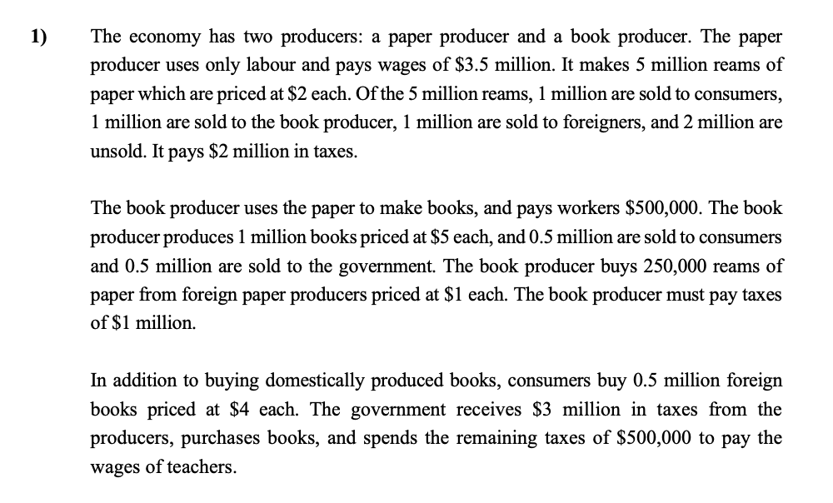
Questions

Slide 23
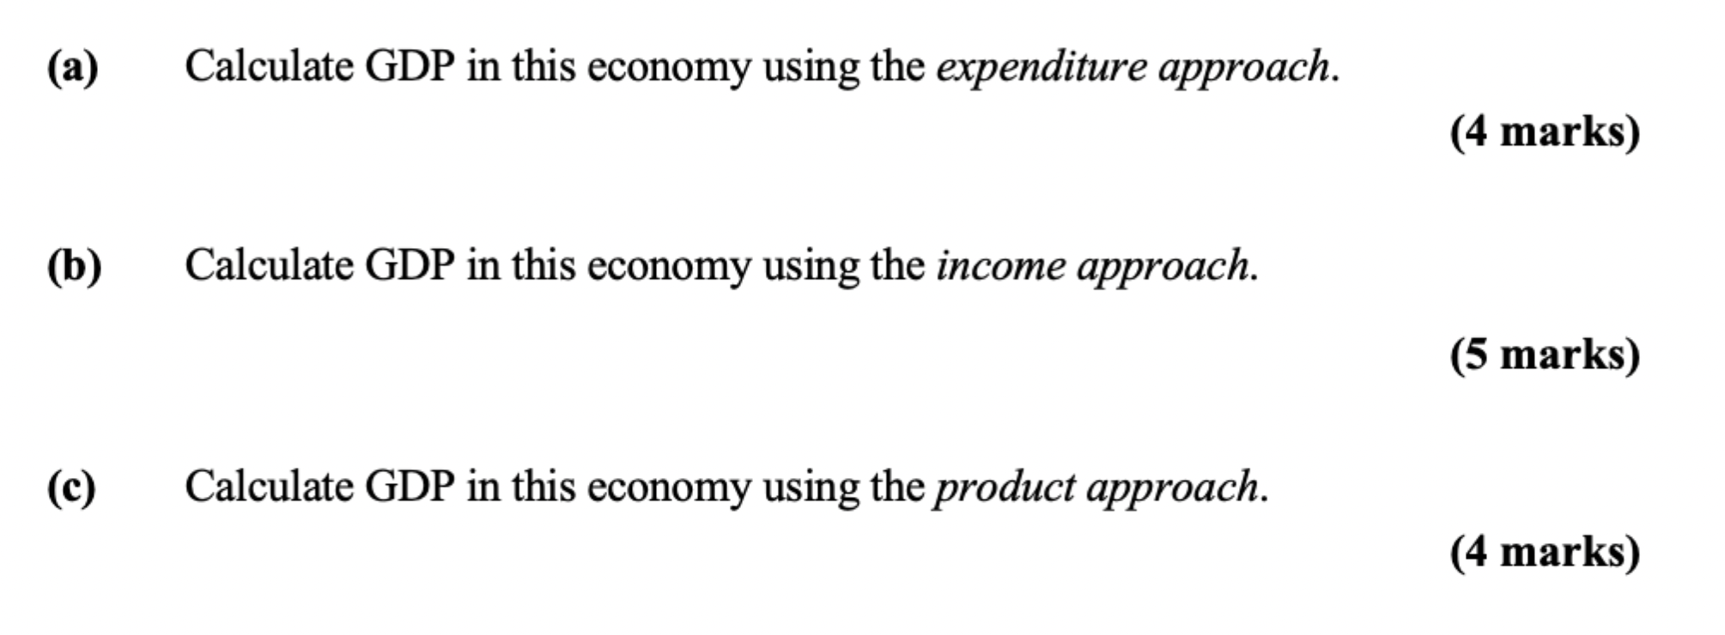
Questions

Slide 24
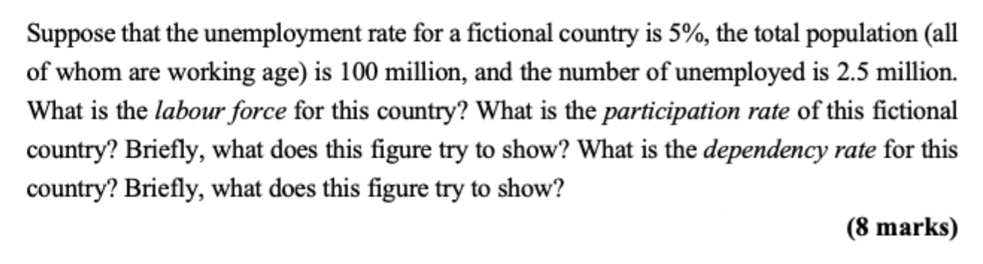
Questions

Slide 25
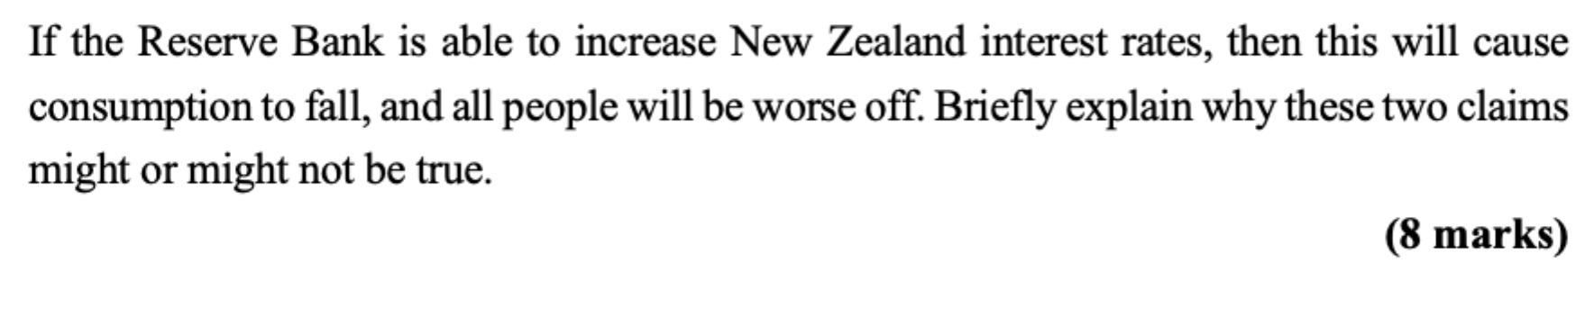
Questions

Slide 26
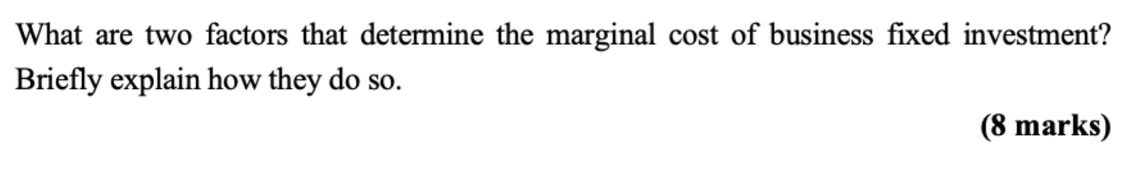
Questions

Slide 27
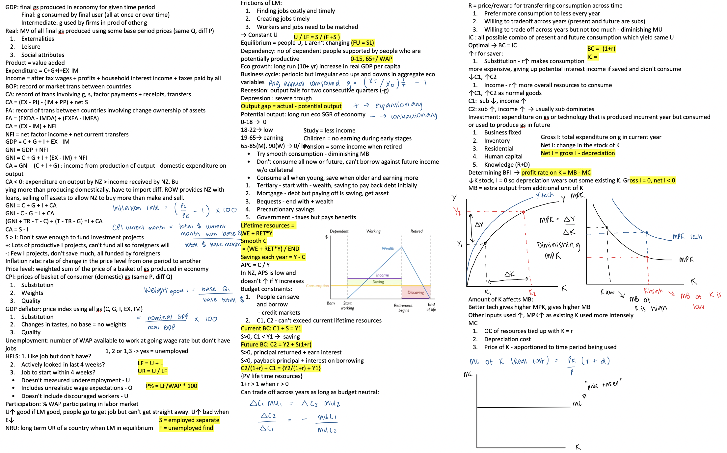

Slide 28
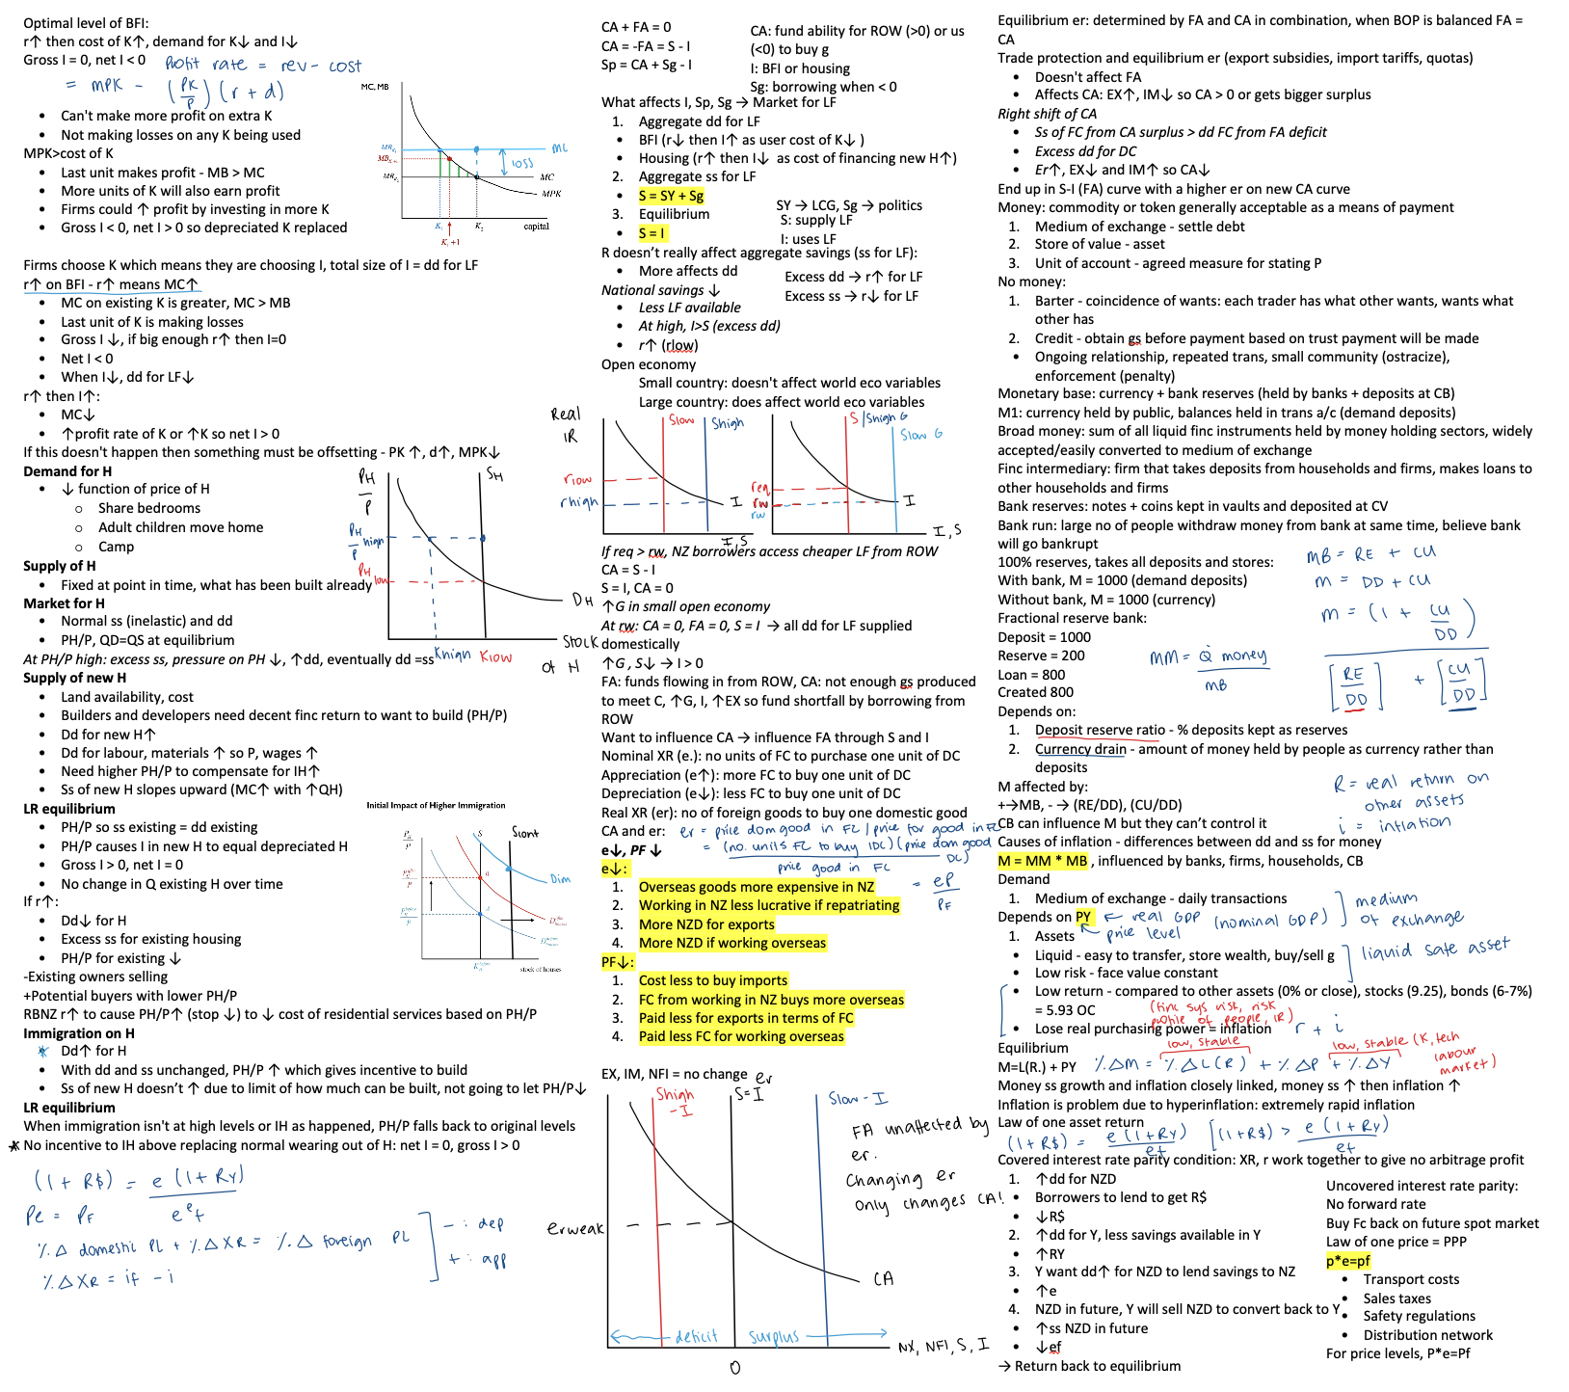

Slide 29
THANK YOU
Questions?

