Slide 1

ECON 105
TERM TEST Tutorial
Monday 7th September
2 - 3pm in A9
Notes:
Introduce
Ourselves
The Club
Thank for coming
Explain
Thank for submitting
Why we are going these

Slide 2
SIGN UP FOR FREE
Website: www.theinvestmentsociety.org
STAY UPDATED FOR EVENTS
Facebook Page: The Investment Society
Instagram: the_investmentsociety
QUESTIONS AND FEEDBACK
Email: sbu110@uclive.ac.nz

Slide 3

Overview
Multi Choice – where to look, how to practice
Supply and demand
Economic History
National Accounts, BOP
Foreign Exchange
Labour Market
Notes:
These tutorials won’t be recorded on ECHO, but we are happy to release these tutorial slides if you think that will be helpful.
We received quite a few submissions asking about …. (we have included this in the handout, and recommend going back over the lecture slides and tutorial questions, but we aren’t specifically covering it in this tutorial session)

Slide 4
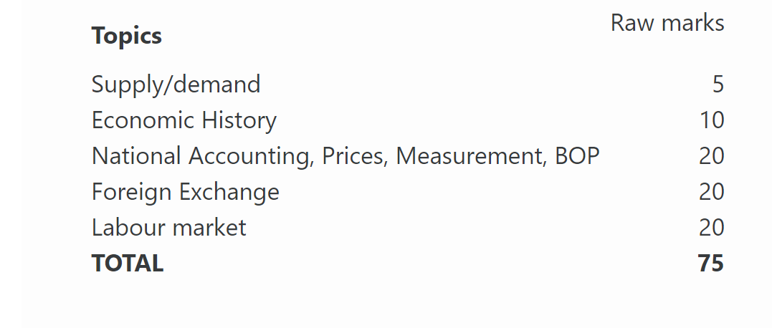

The breakdown of exam marks

Slide 5
Ways to practice multi-choice questions
Term Test Multiple Choice
Weekly quizzes
Past term tests
Multichoice is 25 marks of 75 total
Notes:
- Won't go over supply and demand that much as it is probably the most straight forward topic.
- Happy to take questions if anyone has any specific ones

Slide 6
Economic History
Which historians are associated with the following concepts?
Invisible hand
Communism
Fiscal Policy
Monetarism
Promotion of trade for mutual benefit
Populations self-correcting
Accumulation of wealth through high tariffs
Notes:
Adam Smith- Idea of Absolute Advantage where however produced the most should produce which led to specialisation, also the idea of the invisible hand which is the positive externalities that result from prioritising wealth
Karl Marx - state essentially protects private property upholding capitalist exploitation of the working class
Keynes - Free markets not always self correcting therefore govt should have active role especially fiscal policy i.e. spending more and taxing less depending on economic cycle
Friedman- Strong advocate for free markets where Govt limited role in economy and should only control through monetary supply = monetarism
Ricardo - Comparative advantage - instead of who produced outright the most consider opportunity cost and what a nation would be best off producing irrespective of volume.
Malthus - believed always checks that maintain our population from growing too fast especially a strong disbeliever in technological advancements in agricultural growth
Mercantilism- group that believed that wealth was about how much gold/ silver one had not land and promoted high tariffs to restrict trade

Slide 7
Economic History
Which historians are associated with the following concepts?
Invisible hand – Adam Smith
Communism – Karl Marx
Fiscal Policy – John Keynes
Monetarism – Milton Friedman
Promotion of trade for mutual benefit – David Ricardo
Populations self-correcting – Thomas Malthus
Accumulation of wealth through high tariffs - Mercantilists
Notes:
Adam Smith- Idea of Absolute Advantage where however produced the most should produce which led to specialisation, also the idea of the invisible hand which is the positive externalities that result from prioritising wealth
Karl Marx - state essentially protects private property upholding capitalist exploitation of the working class
Keynes - Free markets not always self correcting therefore govt should have active role especially fiscal policy i.e. spending more and taxing less depending on economic cycle
Friedman- Strong advocate for free markets where Govt limited role in economy and should only control through monetary supply = monetarism
Ricardo - Comparative advantage - instead of who produced outright the most consider opportunity cost and what a nation would be best off producing irrespective of volume.
Malthus - believed always checks that maintain our population from growing too fast especially a strong disbeliever in technological advancements in agricultural growth
Mercantilism- group that believed that wealth was about how much gold/ silver one had not land and promoted high tariffs to restrict trade

Slide 8
Economic History
The Mercantilist school of thought emerges around the 17th century. How did they view trade between countries?
What did they see as the overall objective of trade? Which economic thinker attacked the mercantilists?
How did his view on trade differ from the mercantilists?
Mercantilists saw trade as zero-sum. World wealth was assumed fixed and identified with bullion (gold and silver), so one nation's gain was another's loss and national power came from out-trading rivals.
The objective was therefore a persistent trade surplus: maximise exports, minimise imports. Governments used tariffs, export subsidies and navigation laws, and colonies were held as suppliers of cheap raw materials and captive markets for home-made manufactures.
Adam Smith attacked this, later extended by Ricardo. Smith argued wealth is not bullion but what a nation produces and consumes. If countries specialise according to advantage and trade, the division of labour raises output and living standards on both sides - trade is positive-sum, not a contest with a winner and a loser. Ricardo went further: gains exist even when one country is absolutely better at everything, because what matters is comparative advantage. Ricardo's target was the Corn Laws, mercantilist protection for English landowners.
Notes:
Frame first: zero-sum. Fixed world wealth = bullion. One winner, one loser.
Objective in one line: run a surplus — max exports, min imports. Tools: tariffs, subsidies, navigation laws, colonies (raw materials in, manufactures out).
Names and dates: Smith 1723–1790, Wealth of Nations 1776. Ricardo 1772–1823, Corn Laws 1815.
Smith's two hits: (i) wealth = output, not gold; (ii) specialisation + division of labour → both sides gain.
Land the contrast explicitly: zero-sum vs positive-sum. That's the mark.
If time: Ricardo extends absolute → comparative advantage. Gains exist even when one country is better at everything.
Don't drift into the invisible hand or the fall of Rome — no marks there.

Slide 9
Economic History
At the time of the Great Depression, what was the orthodox policy response? What type of policy response did Keynes suggest instead? Although not part of Keynes's intention, explain how the level of involvement by government in the economy then changed. Give one example of a high level of government intervention.
The orthodox response was contractionary: stay on the gold standard, balance the budget, cut wages and prices to restore competitiveness, and raise tariffs. Because gold fixed the exchange rate, all adjustment had to fall on domestic wages and prices. Tariffs collapsed world trade and deepened the slump — NZ GDP fell roughly 17% between 1929 and 1931.
Keynes rejected this. He argued wages were sticky downwards, so the classical self-correction never arrived; the problem was deficient aggregate demand. His answer was fiscal, demand-side policy: government spending financed by deficits, working through the multiplier, since each round of spending becomes someone's income and is partly respent.
What followed went well beyond what Keynes intended. Demand management became post-war orthodoxy, but governments took on permanent, structural control - welfare states, nationalised industries, import licensing and exchange controls. Keynes wanted counter-cyclical stimulus, not a permanently directed economy.
An extreme example is the USSR (1922–1991): state ownership of all land, industry and resources, administratively fixed prices and central planning, which produced chronic inefficiency and eventual collapse. (NZ's own "Fortress New Zealand" import licensing regime is a milder domestic example if you'd rather use it.)
Notes:
Three orthodox planks: gold standard, balanced budgets, wage/price cuts (+ tariffs).
Mechanism sentence: gold fixes the exchange rate, so all adjustment falls on domestic wages and prices. Say this — it shows you understand why it was contractionary.
Evidence: NZ GDP −17%, 1929–31.
Keynes: wages sticky downwards → no self-correction → problem is deficient aggregate demand → fiscal stimulus via the multiplier.
The "not his intention" pivot: demand management became orthodoxy, but governments went further — welfare states, nationalisation, import licensing, exchange controls. Keynes wanted counter-cyclical spending, not permanent direction of the economy.
Example: USSR 1922–91, state ownership, fixed prices, central planning. (NZ's "Fortress New Zealand" import licensing if you'd rather stay domestic.)
Watch the date: Keynes 1883–1946 — your draft has "196".

Slide 10
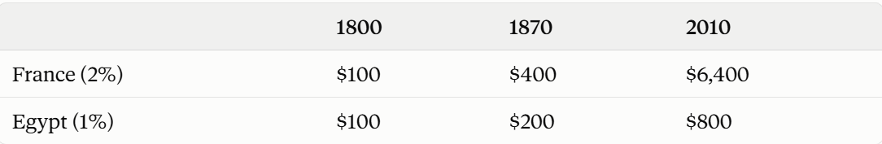
Economic History
Small differences in growth rates don't matter all that much over a short period but matter much more over the longer term. Suppose that in 1800 France and Egypt have the same income per person (say $100) but from 1800 to 2010 France grows at an average rate of 2% per annum while Egypt grows at an average rate of 1%. Show how time makes a significant difference by comparing annual income for each country in 1870 and in 2010. (Hint: you can easily use the rule of 70 here).
Rule of 70: doubling time ≈ 70 ÷ growth rate.
France at 2%: doubles every 35 years
Egypt at 1%: doubles every 70 years
1870 (70 years on): France has doubled twice → $100 → $200 → $400. Egypt has doubled once → $200.
2010 (210 years on): France doubles 210/35 = 6 times → $100 × 2⁶ = $6,400. Egypt doubles 210/70 = 3 times → $100 × 2³ = $800.
After 70 years France is only twice as rich as Egypt - noticeable but not dramatic. After 210 years it is eight times richer, from a gap of just one percentage point a year. This compounding is why Maddison's estimates show broadly similar incomes worldwide before 1800 and a sharply divided rich–poor world after it: sustained small differences in growth rates, not a single event, produced the Great Divergence.
Notes:
State the rule before using it: doubling time ≈ 70 ÷ growth rate.
Doubling times: France 35 yrs, Egypt 70 yrs.
Count doublings, then multiply — don't add. This is where you lost it last time.
1870 (70 yrs): France 2 doublings → $400; Egypt 1 → $200. Ratio 2:1.
2010 (210 yrs): France 210/35 = 6 → 100 × 2⁶ = $6,400; Egypt 210/70 = 3 → 100 × 2³ = $800. Ratio 8:1.
Answer both years — the question names 1870 and 2010, and the comparison of the two ratios is the argument.
Closing line: one percentage point compounds into an 8× gap. Cite Maddison — similar incomes worldwide pre-1800, divided world after. Great Divergence.
Sanity check under exam pressure: 2⁶ = 64, 2³ = 8. If your answer isn't $100 × those, you've added somewhere.

Slide 11
Balance of Payments
Three main accounts - Current Account, Capital Account and Financial Account which sum to 0
We look at the Current Account as easiest to track which consists of the inflows and outflows of money.
CA = X - M + NFI
X = exports, M= imports, N = Net Foreign Income
Notes:
NFI- primary/ secondary sectors income that either earned overseas coming into NZ (inflow) or vice versa (outflow)
NZ- has a persistent current account deficit as we are borrowers due to the large foreign investment that occurred throughout the 20th century in NZ, hence large percentage of profits of businesses flow out of the country leading to a large -NFI.

Slide 12
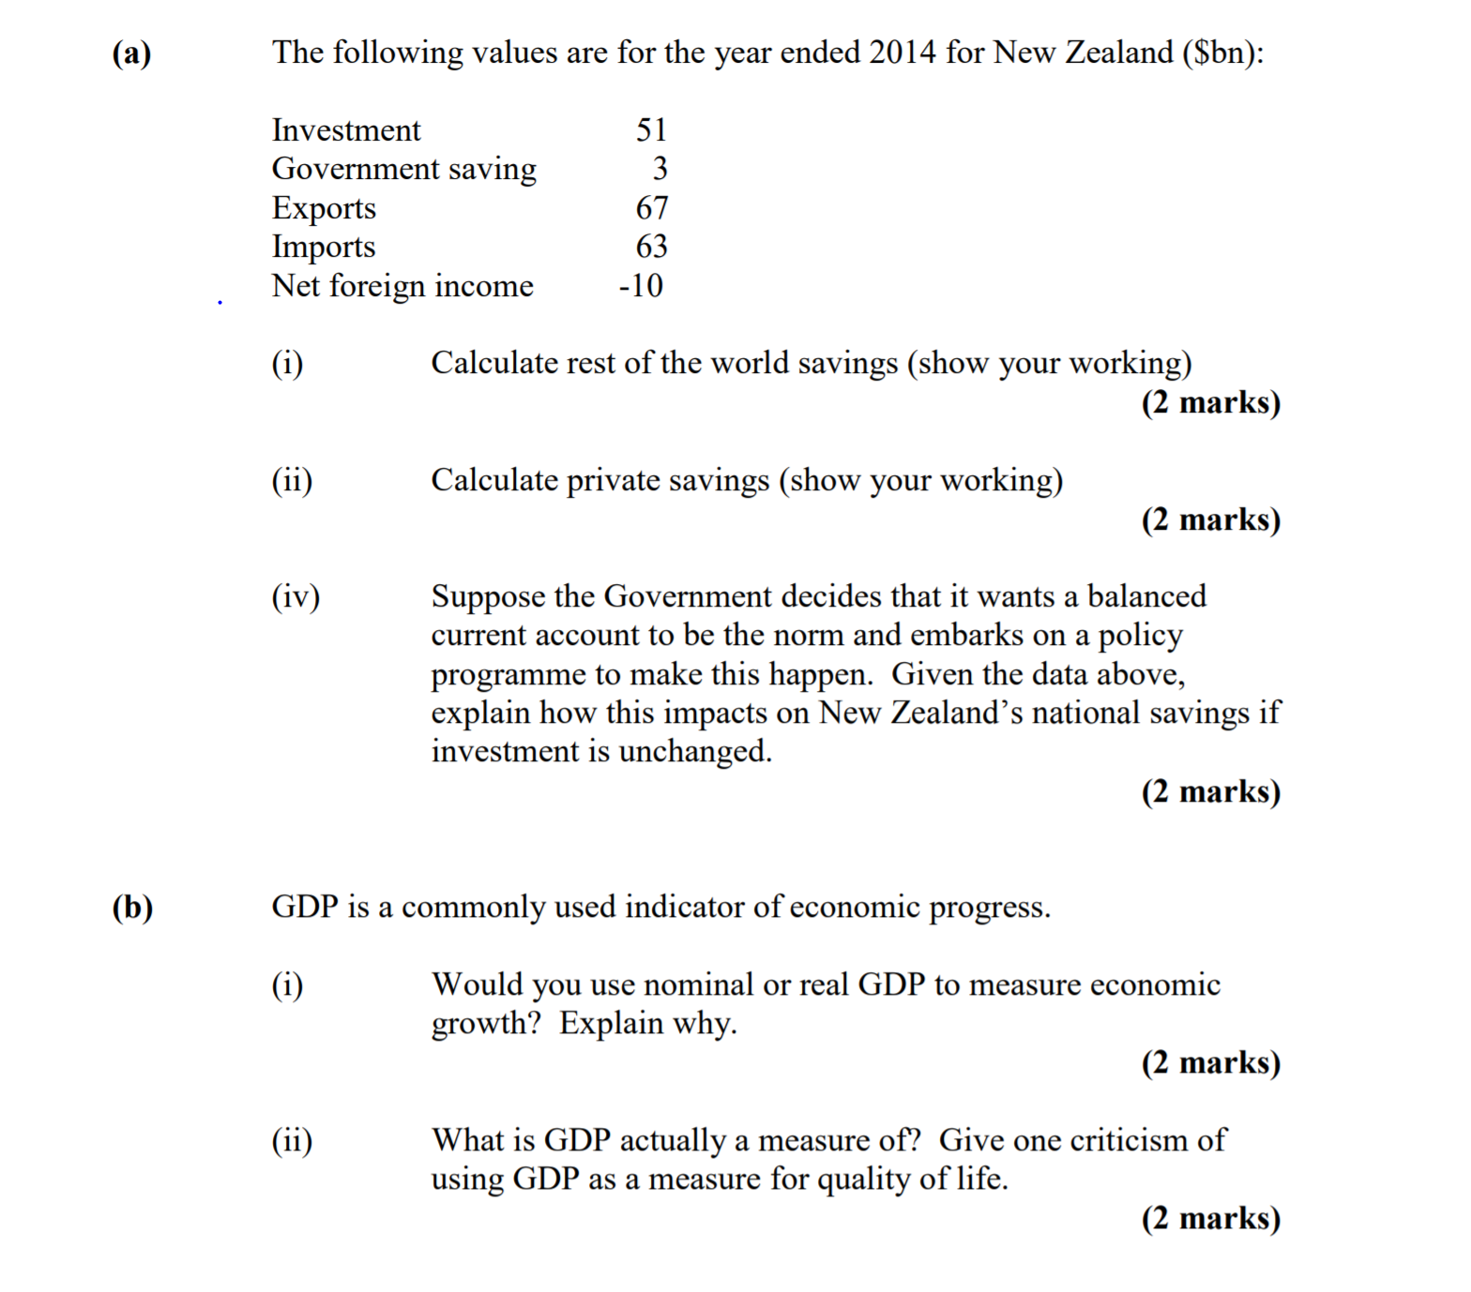
Balance of Payments
Notes:
(i) From our CA equation CA = X-M+NFI we also know that if our current account is negative then money in < money out so the rest of the world is saving
Therefore Srow = -CA or -(X-M+NFI), Srow = M-X-NFI, Srow = 63-67-(-10) = 6 billion savings for rest of the world

Slide 13
Balance of Payments
Part (i)
1 S_{row} = M – X – NFI (or is the negative of the CAB = X – M + NFI)
1 S_{row} = 63 – 67 – (-10) = 6

Slide 14
Balance of Payments
Part (ii)
1 I = S_{p} + S_{g} + S_{row}
51 = S_{p} + 3 + 6
1 S_{p} = 42
Notes:
(ii) Also we know that from rearranging our formulas to get I = Sp+Sg+Srow instead of calculating Sp = yd-C-T as don’t know taxes, we can use what we already know from (i) Srow = 6, Sg = 3 as given in the question, and I = 51 therefore 51 = Sp+6+3, Sp =51-9= 42 billion in savings for private firms

Slide 15
Balance of Payments
Part (iii)
1 If the current account is balanced then S_{row} falls
1 in order for I to remain unchanged then national savings must rise
Notes:
(iii) If CA to become balanced when it’s currently in deficit of 6 million, then need Srow = -CA to fall and reach 0. To do this without changing Investments- S-I = CA, CA increases then national savings (S) must increase. For national savings to increase we could look at either increasing taxes, reducing Government spending from a government savings point of view, in the private savings sector we could look at increase national disposable income or reducing consumption spending which could be achieved by increasing the interest rate to encourage savings.

Slide 16
Inflation Terms
Nominal Values = observed values at a point in time, changes in nominal prices either to do with price, quantity or both.
Real Values = prices don’t change choose some point in time, therefore changes in real prices only caused by change in quantity.
CPI - Way we measure inflation by indexing values by comparing current values to a base period
TOT- Terms of trade measures how much a country can buy from the rest of the world based on what they have to sell to the rest of the world. It’s the ratio of export prices to import prices
Seasonality- Recurring trends and patterns that happen based on numerous reasons across the year. Seasonal adjustment factors these out by removing the noise and finding the true irregular parts to this consistent pattern.
Notes:
Convert Nom- Real: Real value = Nom Value/ Price Index *100
CPI- Strengths: easy to compile and time efficient only pull prices from current period, Weaknesses: Overstates inflation as consumer substitution effect not considered therefore goods aren’t taken out the basket as soon as they become out of fashion allowing a lag effect/ delay.
TOT- if export prices increase proportionally then we are able to sell same goods for high value hence now able to buy more goods overseas as our export prices increased proportionally to import prices.
Seasonality- our seasonal adjustment would tell us that if there is an increase in the trend either means the expected increase was larger than usual, or expected decrease smaller than usual vice versa.

Slide 17
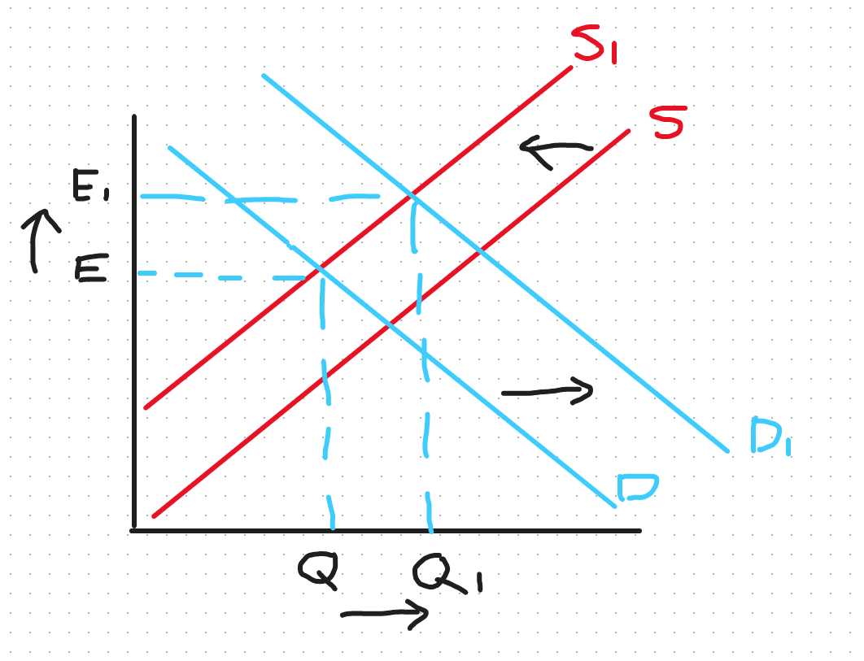
Foreign Exchange
Demand Side Factors - demand of NZD
Exports
Domestic Interest rates
Tourism into NZ
Foreign Investment in NZ
Supply Side Factors - supply of NZD
Imports
Overseas Interest rates
NZ citizens travelling
Investment opportunities overseas
Interest Rates in NZ Rise:
DNZ increase as foreign investors attracted, SNZ decreases as less NZ locals move NZD overseas for better interest rates, therefore both shifts cause Appreciation (higher value) of NZD

Slide 18
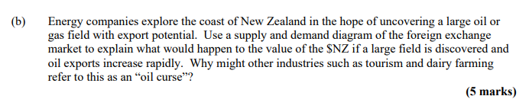

Foreign Exchange Example Question
From 2018 S2 Exam

Slide 19
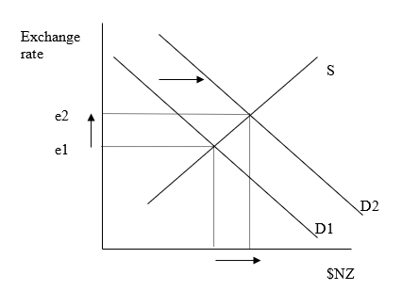
Foreign Exchange Example Question
PART 1: Use a supply and demand diagram to explain
To buy NZ goods (exports), foreigners must first change their foreign currency into $NZ.
Therefore, an increase in the demand for NZ oil will increase the demand for $NZ.
On our NZ money market diagram we will see this as a rightward shift of the demand for $NZ from D1 to D2. This will cause the quantity of $NZ to increase AND the exchange rate to increase from e1 to e2.
Notes:
If NZ discover oil this becomes a resource which we can sell on the overseas market
Other countries will demand oil especially as it is highly demanded therefore we will see an increase in demand for exports
For foreign countries to buy our exports they must exchange foreign currency for NZD hence this will cause an increase in demand for NZD
As demand shifts right on the Forex market for the NZD it will cause the quantity traded of NZD to increase and also the Exchange rate to increase hence an appreciation of the NZD

Slide 20
Foreign Exchange Example Question
Part 2: Exporters prefer a lower exchange rate, as it makes exports relatively cheaper. The oil curse refers to an appreciation of the currency that makes other industries relatively more expensive and less competitive.
Notes:
Due to the appreciation of the NZD caused by oil exports this positions NZD at a higher premium now
In relative terms it costs more of foreign currency to buy the same amount of NZD as before hence exports becoming relatively more expensive.
As we understand by law of demand as a good becomes more expensive the demand for said good will decrease therefore our exports from other industries may appear less competitive on global markets

Slide 21
Purchasing Power Parity
Eppp = Price in Foreign currency / Price in Domestic currency
If the Er < Eppp then our currency is undervalued
If the Er > Eppp then our currency is overvalued
Arbitrage can occur if prices not set correctly
Basket of Goods costs 120 NZD, 80 USD, Calculate Eppp (NZD per USD)?
If Er was 1 USD = 1.40 NZD is NZD undervalued or overvalued? Explain how the Exchange rate would adjust to this difference?
Notes:
Eppp = 120 / 80 = 1.5 NZD per USD
Eppp = 1.5 vs Er = 1.4 so the USD is Er < Eppp = undervalued however we are focused on the NZD which will be overvalued.
The market will respond as if the NZD is overvalued means NZ goods are relatively expensive and foreign goods relatively cheaper. Therefore NZ consumers will start buying more imports as they are cheaper, whilst foreign consumers buy fewer NZ exports as more expensive. This creates higher demand for the foreign currency (USD) and lower demand for the NZD causing the NZD to depreciate and USD to appreciate until they are fairly valued where Eppp = Er.

Slide 22
Forward and Spot Rates
Spot Rate = Todays exchange rate
Forward Rate = Forward contract rate locked in to exchange later on
Useful Formula:
Fr = Sr( 1 + Rf )
(1 + Rd)
Sr = spot rate, Rf = foreign interest rate, Rd = domestic interest rate

Slide 23
Example:
NZ Int rates = 5% p.a
AUS Int rates = 7% p.a
Want to Invest $1000 NZD when current ER = 1 NZD : 0.82 AUD
What would the different outcomes be if the forward rate in a years time was the same as the spot rate?
What should the forward rate be to avoid people making riskless profit?
Notes:
If invest 1000 in nz bank -> 1000*1.05= 1050 NZD
If invest 1000 in Aus bank converting it to AUD -> 1000*0.82 = 820 * 1.07 = 877.4 convert back = 877.4 * (1/0.82) = 1070 NZD
So if the forward rate same there is a 20 NZD discrepancy
Now if we look at what the forward rate should be can use our formula FR = Sr*(1+Rf)/(1+RD) where Rf= foreign int rate, Rd = dom int rate
Therefore FR= 0.82*(1+0.07)/(1+0.05) = 0.8356 ~ 0.836.
This FR makes it more expensive to trade AUD currency back to NZD currency in a years time which accounts for the banks interest rate difference.

Slide 24
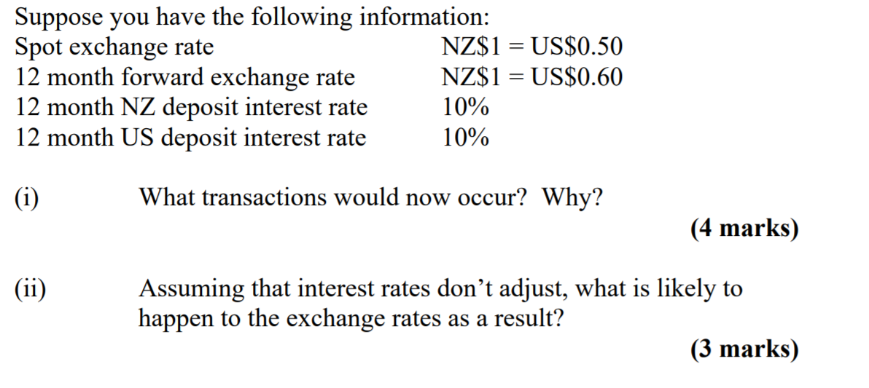
Foreign exchange
Notes:
(i) What happens is as the interest rates in NZ and US are the same there is no interest arbitrage transaction therefore no incentive for investors to take money out from NZ to US vice versa. However if we look at the spot and forward rates we notice that there is an opportunity for risk free profits. If investors swap USD for NZD on the spot market for 0.50: 1 then they can lock in a forward exchange rate of 1 : 0.60 which say they invested $1000 USD they would then have $2000 NZD which can be exchanged for $1200 USD on the forward 12 month rate compared to either interest rates beats it by $100 without investing any money

Slide 25
Foreign Exchange
Part (i)
1 recognising that interest rates are essentially irrelevant or using them to correctly calculate a covered interest arbitrage transaction
1 holders of $US will buy $NZ on the spot market
1 and sell on the forward market
1 because they can make a riskless profit
Example answer
There is no interest rate advantage to holding either $NZ or $US so holders of $US would convert US$0.50 to NZ$1 at the spot rate and then contract to convert those $NZ’s back to $US’s at the forward rate and receive US$0.60. They will do this in order to make the riskless profit.

Slide 26
Foreign Exchange
Part (ii)
1 the spot rate value of the $NZ will rise
1 the forward rate will fall
1 until the riskless profit is removed / until they are equal.
Award the first mark if the student simply states that the value of the $NZ will rise.
Example answer
The spot rate is likely to rise and the forward rate is likely to fall until they remove the riskless profit (i.e. become equal in fact).
Notes:
(ii) If interest rates don’t adjust we will see that there is more demand for the NZD on the spot market and therefore more supply of USD on the forward market. This causes an appreciation of the NZD on the spot market, and a depreciation of the USD on the spot market. So overall the spot rate of the NZD will rise so more USD required to buy 1 NZD.
Then we look 12 months into the future in the forward market where there is increased supply of the NZD, and increased demand for USD so other way round where NZD depreciates and USD appreciates so the NZD falls against the USD on the forward market.
This will occur until the riskless profit is removed i.e. the price of buying 1 NZD with USD will rise in the spot market and the return of USD from 1 NZD will fall in the forward market - both effects reduce the ability to gain riskless profits, and will converge towards a value where they are equal.

Slide 27
Labour markets
What characteristics make a person unemployed?
Not currently in paid employment
Searching for work (in the last 4 weeks)
Willing to work
What do we use to measure unemployment?
Household labour force survey, published by StatsNZ
Notes:
Other terms:
Underutilised = not working as much as they would like i.e. part time worker
Underemployed = part-timers who want to and are available to work more hours
Available potential job seekers = not actively seeking but available and wanting a job
Officially unemployed = actively seeking and available whilst no form of work

Slide 28
Unemployment
Unemployment rate = Number unemployed / labour force
Main Influences:
Job Creation
Growth of Labour Force
Factors of Labour Force:
Population growth
Immigration
School leaving age
Participation rate
Notes:
Unemployment rate = number unemployed / labour force (employed + unemployed ages 15-64)
Main influences
Job creation and growth of labour force
If growth of labour force exceeds job creation you will see the unemployment rate rise as more people actively seeking working but cannot find any
Participation rate: proportion of working age pop that is in the labour force who of age is seeking work/ has work

Slide 29
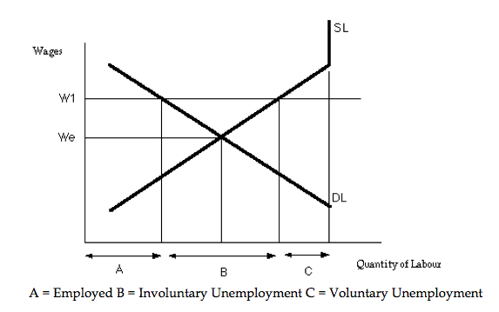
Minimum Wages
Minimum wage is a policy that has unequal effects.
If above equilibrium creates surplus of labour leading to unemployment
Short run: increase in min wage increases labour income and lower portion become unemployed.
Long run: As firms adjust to the higher input costs of labour increases unemployment due to the longer time to respond to this higher wage price.
Notes:
Surplus of labour - causes unemployment because quantity supplied of labour increases due to higher wages whilst quantity demanded of labour decreases due to higher cost. As a result there are winners and losers - Winners are those who keep their jobs and enjoy the higher wages, the losers are those who had jobs originally before the policy but now are unemployed due to higher labour costs (could also include those seeking employment cannot enter market either). This effect however is delayed as we believe the effects are all positive with no one becoming unemployed however the true figures are masked in long term figures which are firms taking time to adjust to the new market wage price settings.

Slide 30
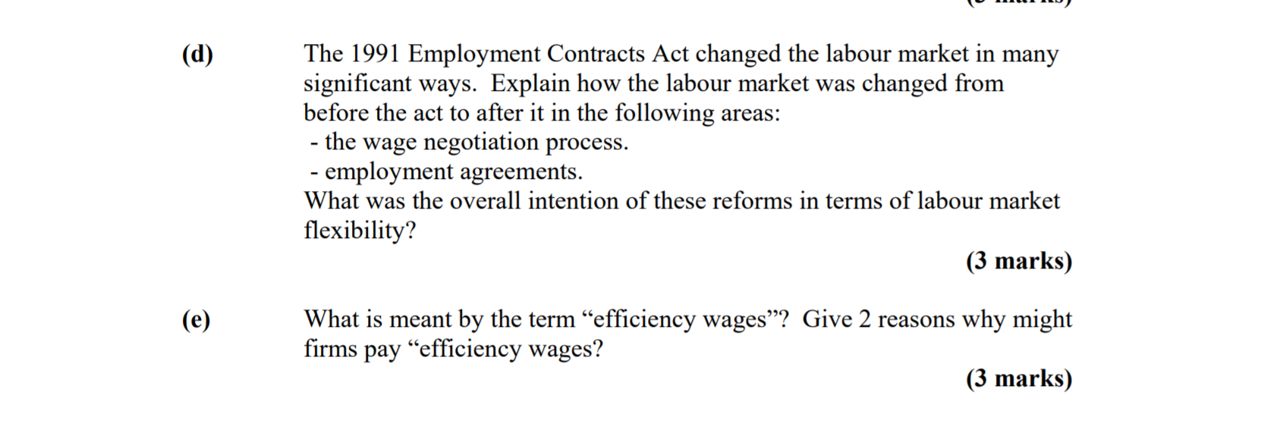
Labour markets

Slide 31
Labour markets
Part (d) 3 marks
1 the wage negotiation process moved from being centralised to decentralised (or could say shifted from being between govt., employer groups and unions to being between employees and employers).
1 employment agreements shifted from being task based, industry wide to being between location or workplace based.
1 to increase flexibility.
Notes:
Work place bargaining replaced national level i.e. employees could negotiate their wages at a firm level (employee to employer) compared to negotiating at a government level
Employees went on individual contracts, and had the option to join a union rather than it being compulsory
Overall these reforms to the labour market meant employees had greater flexibility as there was less generalisation across industries meaning i.e. wages employees could sit across a spectrum rather than one wage or the other. Flexibility = less unemployment with the cost of less protection for existing workers.

Slide 32
Labour markets
Part (e) 3 marks
1 efficiency wages are where firms choose to pay over the equilibrium wage
2 1 mark for each reason: e.g.
- to reduce worker turnover
- to attract better applicants
- to improve worker effort
Notes:
Efficiency wages - when firms choose to pay over the equilibrium / market rate.
Examples:
To improve worker health
Reduce worker turnover as recruitment costs time and money
Improve worker effort - if paid more have greater incentive to provide for the company and add value
Attract better applicants - it isn’t only the employees fighting for a role but the employer fighting for the employee

Slide 33
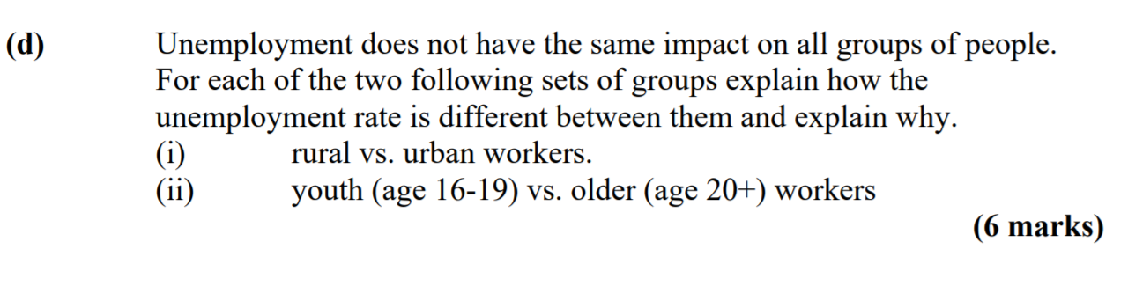
Labour markets

Slide 34
Labour markets
1 rural generally have a higher unemployment rate than urban
2 plausible reason – e.g. there are fewer opportunities in rural areas than urban, changing occupations is harder, re-training is less available.
(marks were awarded for plausible arguments for urban being higher, e.g. rural communities may have more secure jobs, people move out of choice to rural areas for work they definitely get)
1 youth have a higher unemployment rate than older workers
2 plausible reason – e.g. young workers will be less skilled; have less work history to use; etc.
(some students argued that the older have a higher rate as more youth are in school – 1 mark.)
Notes:
Rural vs Urban : could have the argument either way
Urban higher: better measurement of unemployment due to access to data hence could report higher figures, more competition in urban areas for jobs
Rural higher: fewer opportunities in these areas, less access to job search networks and information
Could say something like urban areas have higher measured unemployment due to active job search, whislt rural areas often have lower reported unemployment but higher underemployment, leading to hidden labour market inefficiencies and income disparities.
Youth vs Older:
Youth higher rates because experience gap, job turnover (youth are more frictionally unemployed), education transitions moving between school and work creates temp unemployment, min wage effects- youth could be marginilised out due to a high min wage as would prefer to employ the more productive experienced candidate.

Slide 35
Final advice
Don’t rewatch lectures- you won’t remember anything
If you have a free 15 minutes, use it to do Multi choice practice as I found these the most spontaneous
Past term tests are the best way to practice
All the history questions are online
Questions often repeat themselves
Order your notes as this will help find information faster than causing stress of finding the specific bit

Slide 36
SIGN UP FOR FREE
Website: www.theinvestmentsociety.org
STAY UPDATED FOR EVENTS
Facebook Page: The Investment Society
Instagram: the_investmentsociety
QUESTIONS AND FEEDBACK
Email: sbu110@uclive.ac.nz

