Slide 1
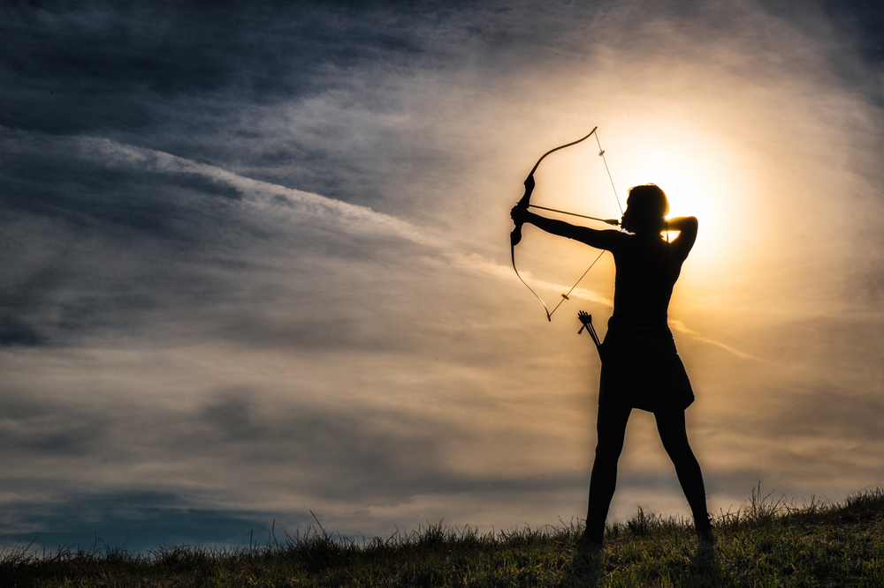
Ladies Archery Day
June 20, 2026
Hosted by:
Norwich Archery Club
110 Wawecus Hill Road, Bozrah, CT 06334
Event: 10:00 am – 2:00 pm Rain or Shine
Pre-Registration: $40.00 includes lunch
This event is for beginners through experienced archers.
All equipment will be supplied, or bring your own equipment
Included in this event is CT DEEP instruction, equipment, and archery games.
Young ladies aged 12 and up are welcomed with an adult.
This is a rain or shine event(in case of rain, we have an indoor facility).
$40.00 registration in cash, check, or money order - *sorry, no credit cards
Registration forms available at: norwicharcheryclub.com or Norwich Archery Club Facebook page.
Contact Alycia Clemons for more information
Cell: 860-460-2535 or 1alycia4nac@gmail.com

