Slide 1
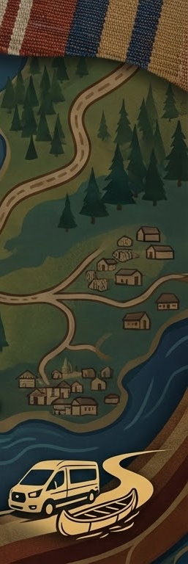




Building Better Paths: Community Transit for First Nations
Hosts:
Asennaienton Frank Horn of Indigi-Solutions and Luke Mellor of Pantonium
Goal: Increase knowledge, awareness, and confidence in low emission transportation in Indigenous communities
Notes:
Theme, infrastructure for communities specifical transit and people transportation.
Also intro three partners and do housekeeping. q&a, handraiseing, recording will be shared afterwards and hosted.
As part of this project we engaged with over 140 first nation communities and their stakeholders

Slide 2
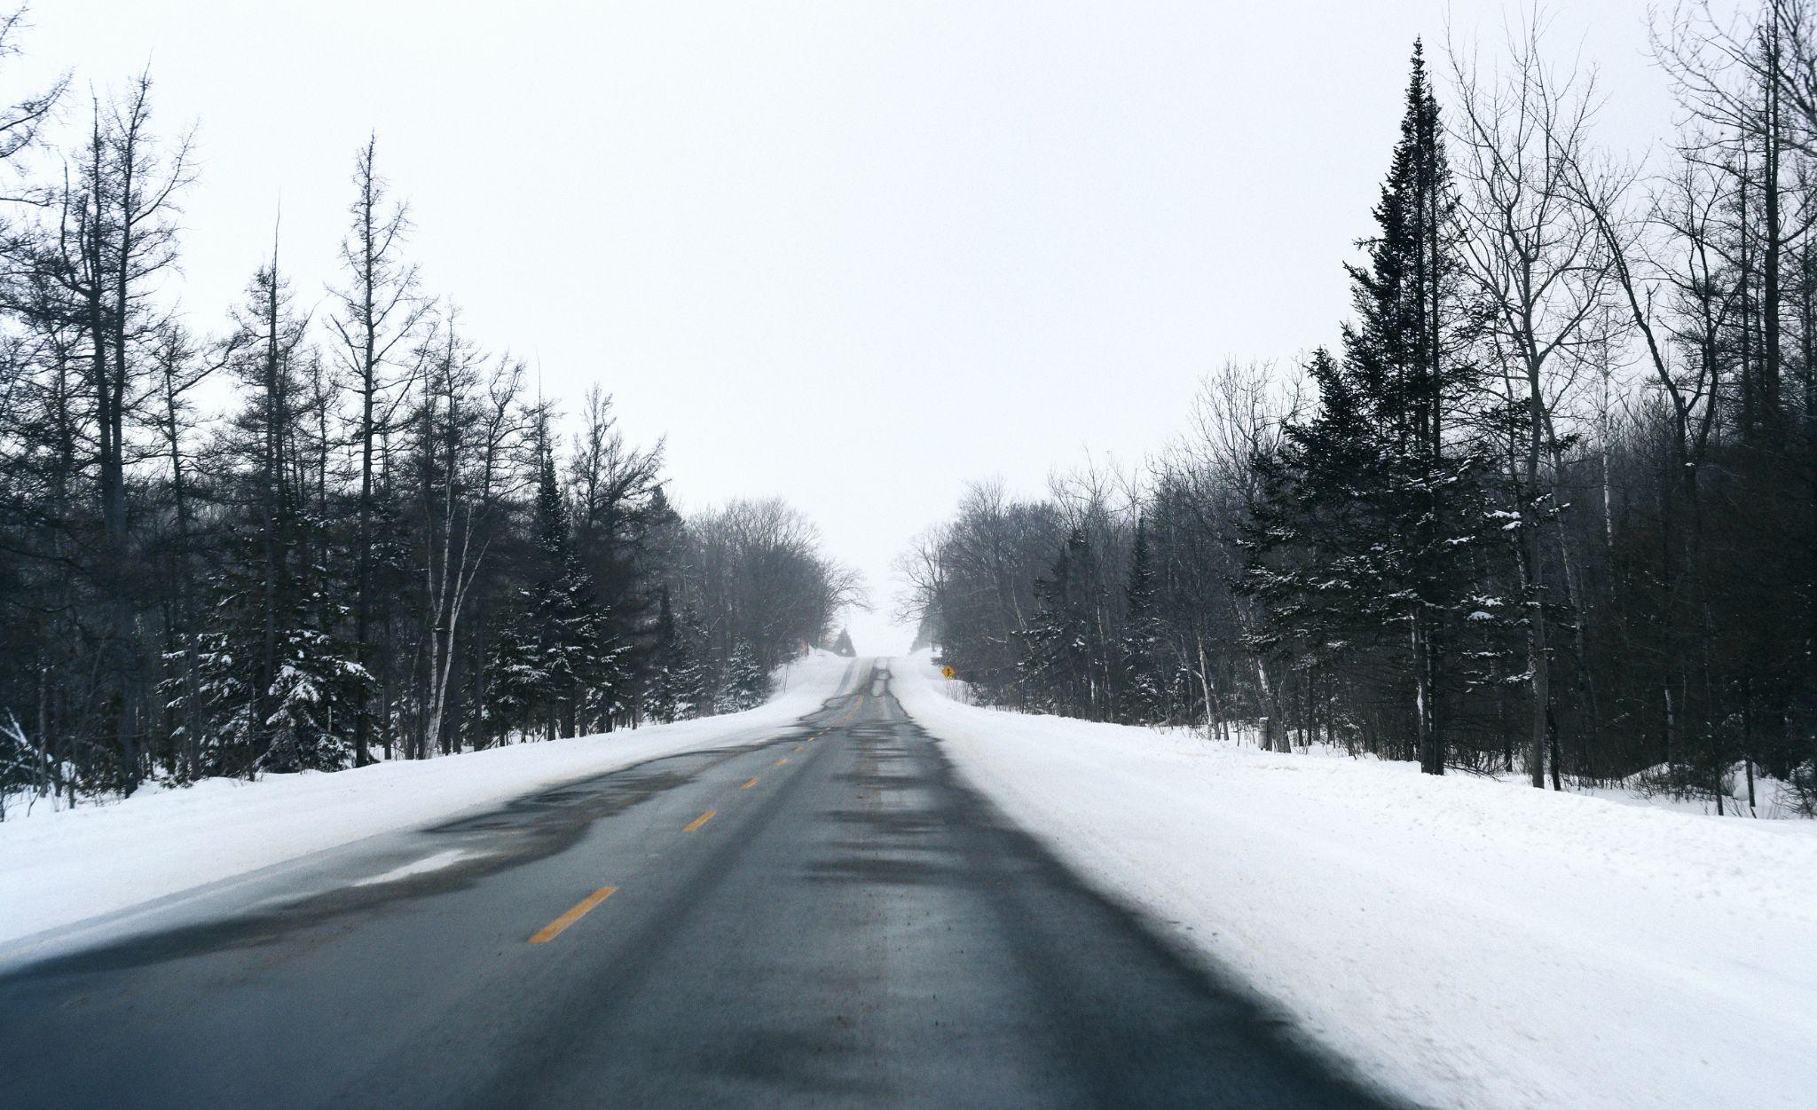
What is the difference a ride makes?
Notes:
Is there a solution to this… human issue before the technical details

Slide 3
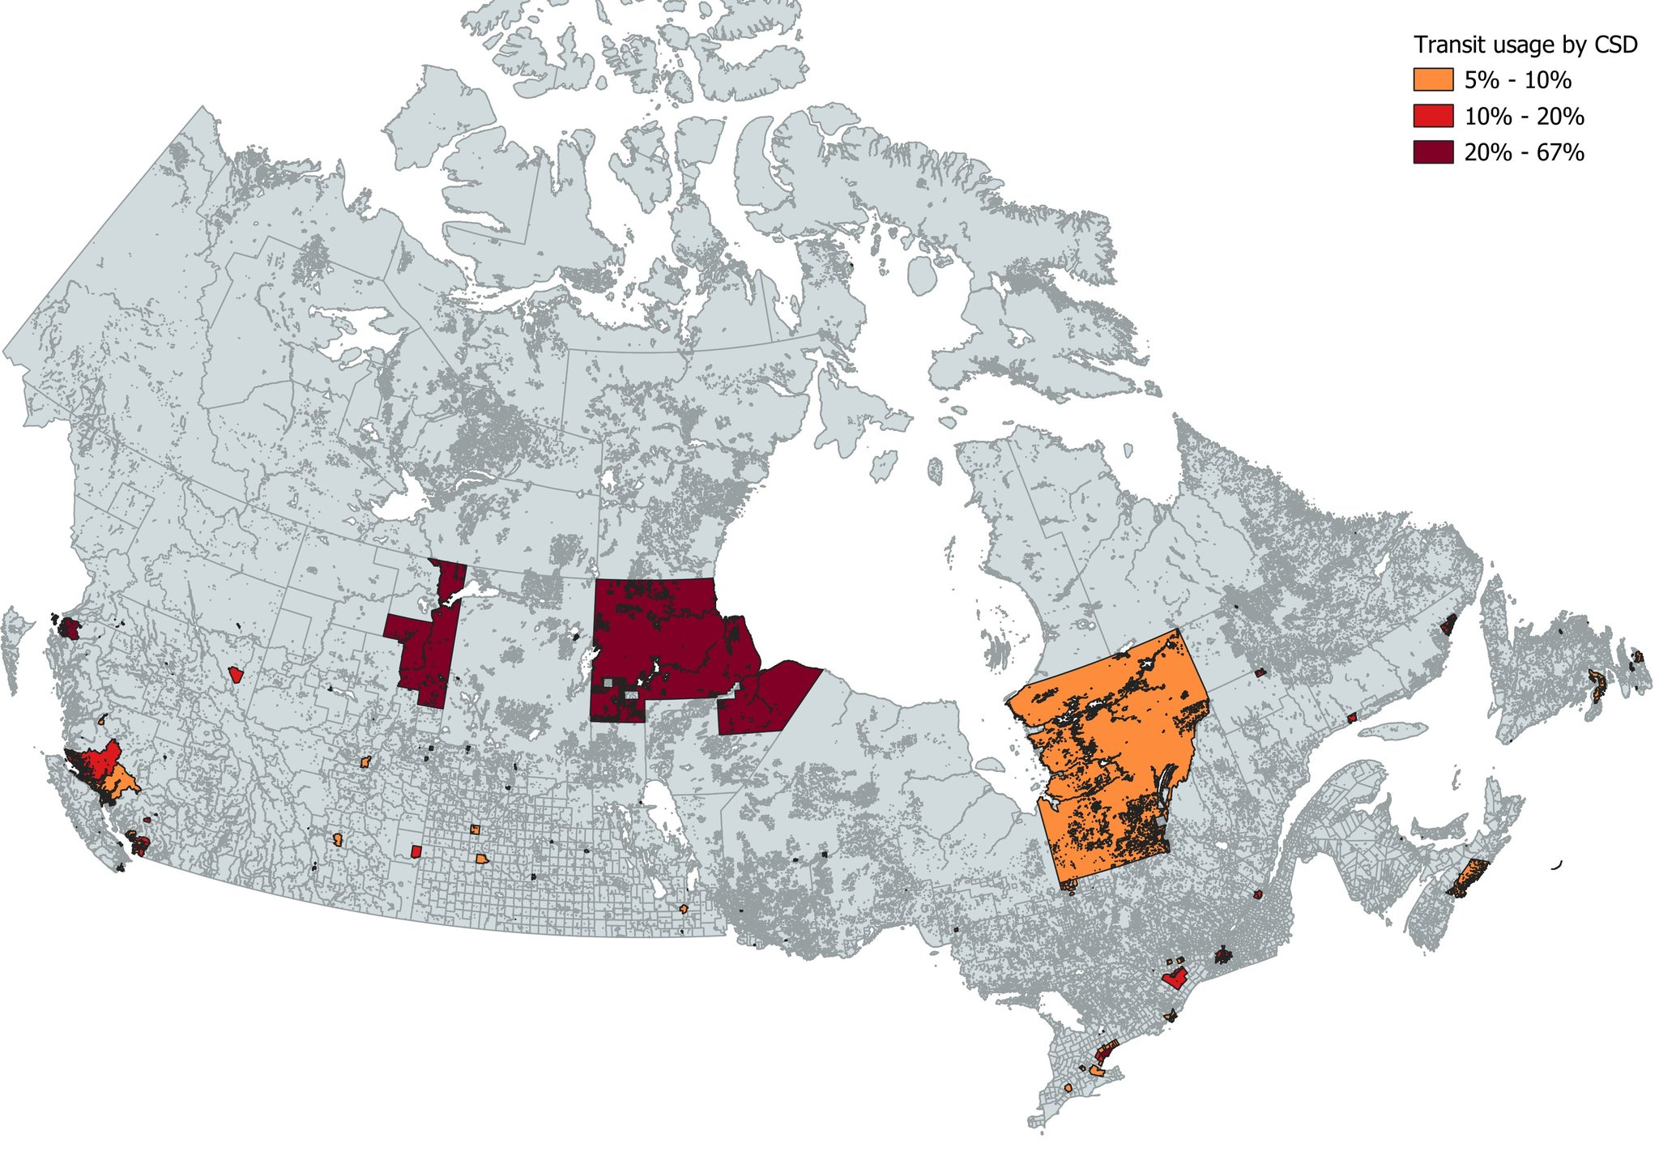
Increase Indigenous Transit Access Across Ontario
Notes:
Goal is to paint this map, there is a reason why communities invest in transit, they see it as an asset that returns at least 2$ to every 1$ invested

Slide 4
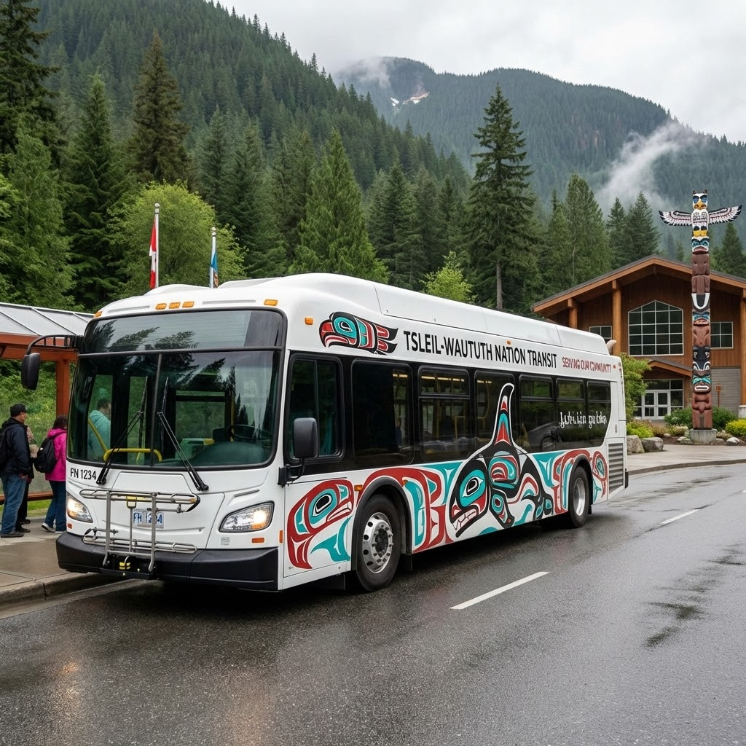
What could this look like for a First Nation of 1000 people?
Routes, schedules, and identity reflect community priorities, not outside operators
Service rules can protect Elders, youth, and vulnerable members
Data stays with the Nation and supports funding and planning
A transit service becomes a community asset that can grow over time
Notes:
Control over things, >set up frank to talk about data and OCAP, control over the asset…

Slide 5
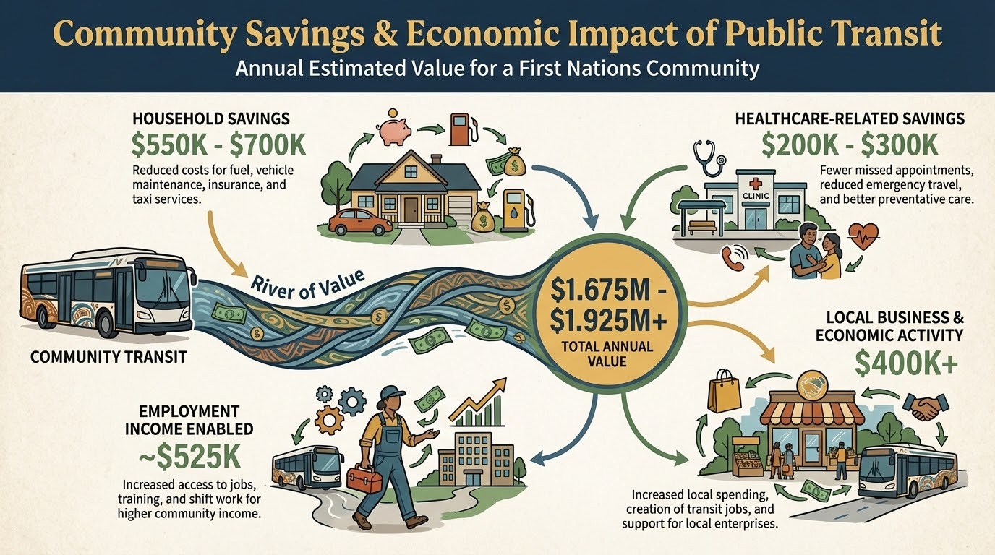
Notes:
Four stories, set up frank first, health care is one that most communities already have covered but it is also the most resource constrained and it really is life or death, employment,, the power that reliable transit has is to unlock this chicken or egg, which we herald time after time especially from ecdev people, it is also a way to generate rev, getting employers to pay for the service, many northern communities do that for mines, or for factories. Local business example of southern ontario nation trying to get people to its businesses wants to provide transit to and from the nearby town…
Lower use: 0.5 rides per person per week (26,000 rides/year)
Annual operating investment: $442K gross
At a realistic middle-use level, each $1 invested can unlock about $2 of community value per year, before counting longer-term health and workforce impacts.”

Slide 6
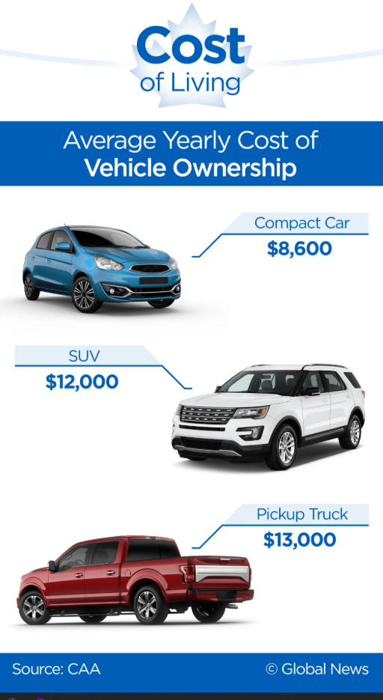
What lack of transportation is costing the community
Programs that provide rides to medical visits were associated with about 37% fewer missed appointments in a meta-analysis.
In Canada, about 65% of fatal collisions happened on rural roads (2011-2020).
In 2017, nearly 25% reported difficulty finding work because they lacked transportation to the job site.
In 2024, 45% of First Nations people living off reserve, reported it was difficult to meet basic financial needs, including transportation.
41% of First Nations people living off reserve said food prices were the area they were most impacted by.
Notes:
Communities are in competition to get people to people to live there. I want to highlight that cost goes beyond just people needing to buy a car, we spoke to many communiuties worried about the safety of their women and children who have no other option but hitchhiking. Or even bear attacks. Access to food, especially fresh food, leads to health outcomes, access to cultural events leads to better mental health. Overall competition for people to live in the community.
Furthermore there is the environmental cost…
https://www.nutritionnorthcanada.gc.ca/eng/1745933919234/1745947912822
https://www150.statcan.gc.ca/n1/daily-quotidien/250521/dq250521a-eng.htm
https://tc.canada.ca/en/road-transportation/statistics-data/road-safety-canada/2020/road-safety-canada-2020

Slide 7

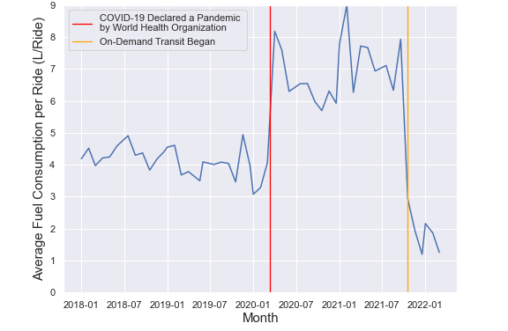
Sustainability with Transit
Efficiency of on-demand in rural transportation
Fixed-route buses vs on-demand minivans case study:
CO2 per ride dropped from 10.80 kg to 3.96 kg (about 63% lower)
Total emissions over the 6-month comparison period: 213,590 kg CO2 (fixed-route) vs 72,785 kg CO2 (on-demand)
Smaller, more fuel-efficient vehicles mean emissions per km were more than 2x lower than the fixed-route bus system
Fuel per passenger-km reduced by nearly 52%
Additional reductions with hybrids and ZEVs
Hybrid minivans: CO2 per ride reduced 44% vs the gasoline minivan baseline
Plug-in hybrid minivans: CO2 per ride reduced 68% vs the gasoline minivan baseline
Average fuel consumption per ride before and after the on-demand system was instituted (October 1, 2017 to May 1, 2022) NREL
Notes:
First nations are on the front line of climate change, they are some of the most exposed, and they are leaders when it comes to sustainability, when we speak to them, they get it. And thats one of the key reasons public transit is so important, we could solve transportation problems by just getting everyone a car, but that is one of the least efficient means of transport. What all these numbers are talking about is how public transit, can reduce the energy used per person moved, and further more how certain types of transit can be more efficient than others. Especially in low density, long distance areas. The key is shared rides. That is the most important for both environmental and financial sustainability. So think smaller vehicles with more people in them.

Slide 8
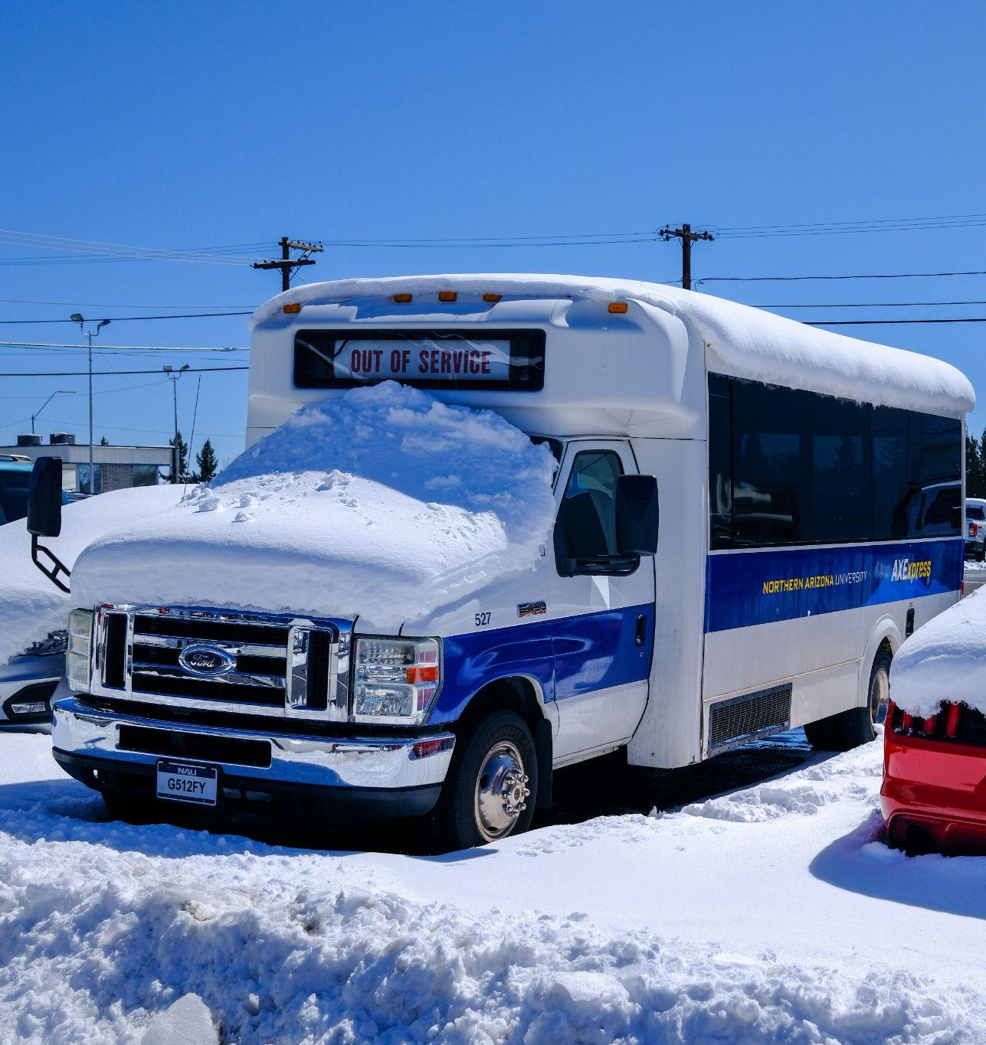
Potential transit vehicles
Map all vehicles and who controls them today, many community vehicles are kept in silos
Community vans and school buses
Medical travel vans and program vehicles
Identify where seats are empty and where demand is highest
Notes:
Are there already assets to be used, are they in silos, are they maintainable, are there people who can drive them.

Slide 9
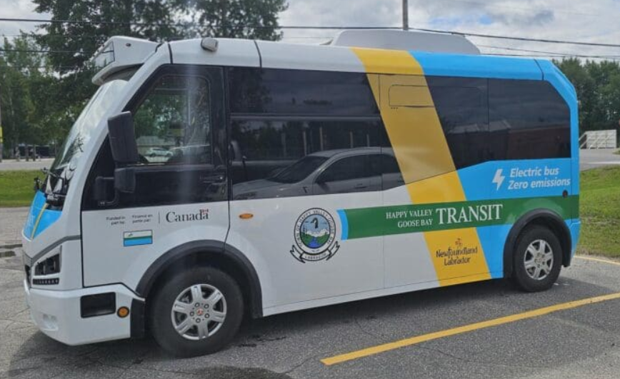
Zero Emission Vehicles (ZEV)
For zero-emission vehicles key considerations include:
Charging infrastructure
Electrical capacity
Fleet suitability
Cold-climate range
Maintenance and training
Procurement timelines
Supplier relations
Notes:
Its the future, its hard, theres was to reduce by just sharing rides.

Slide 10
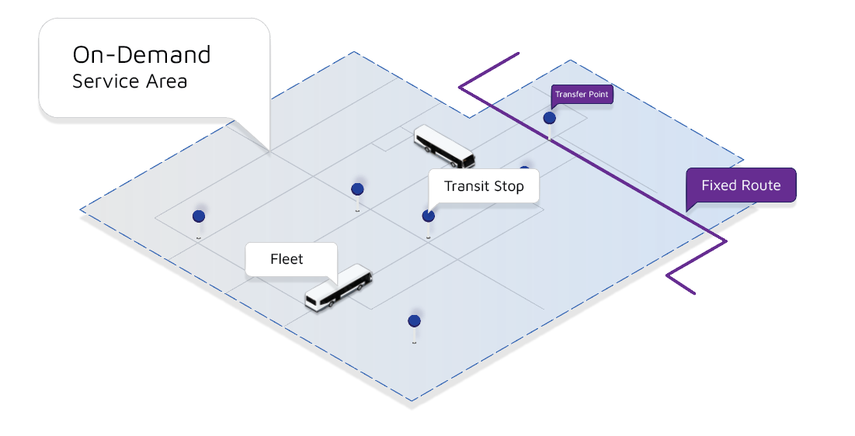
What transit models can work in rural and remote Nations?
Fixed route service for predictable travel like work and school peaks
On-demand shared rides booked by phone or app, good for low density areas and Elders
Hybrid service with fixed routes at peak times and on-demand in between
Community shuttle vans for planned trips like groceries, service hubs, events, and group day trips for long distance travel
Notes:
Uber… control over the model is important, lots of different models but not each one is right, example metrolinx fixed route into six nations, no first last mile, means no one uses it.

Slide 11
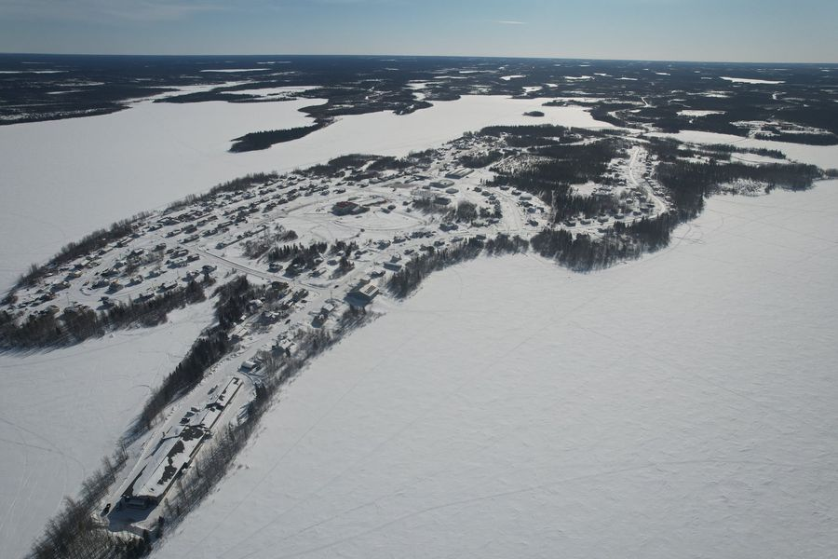
Geographic Challenges: Remote Areas, Water, And More
Winter access and extreme weather change impact service design and vehicle choice
Remote infrastructure gaps can slow EV transition
Road transport must integrate and support air travel, water travel for remote communities
Kasabonika First Nation, Ontario
Notes:
We heard from the north, we want to work with them, they have other challenges but even they can use some local transport in many cases.

Slide 12
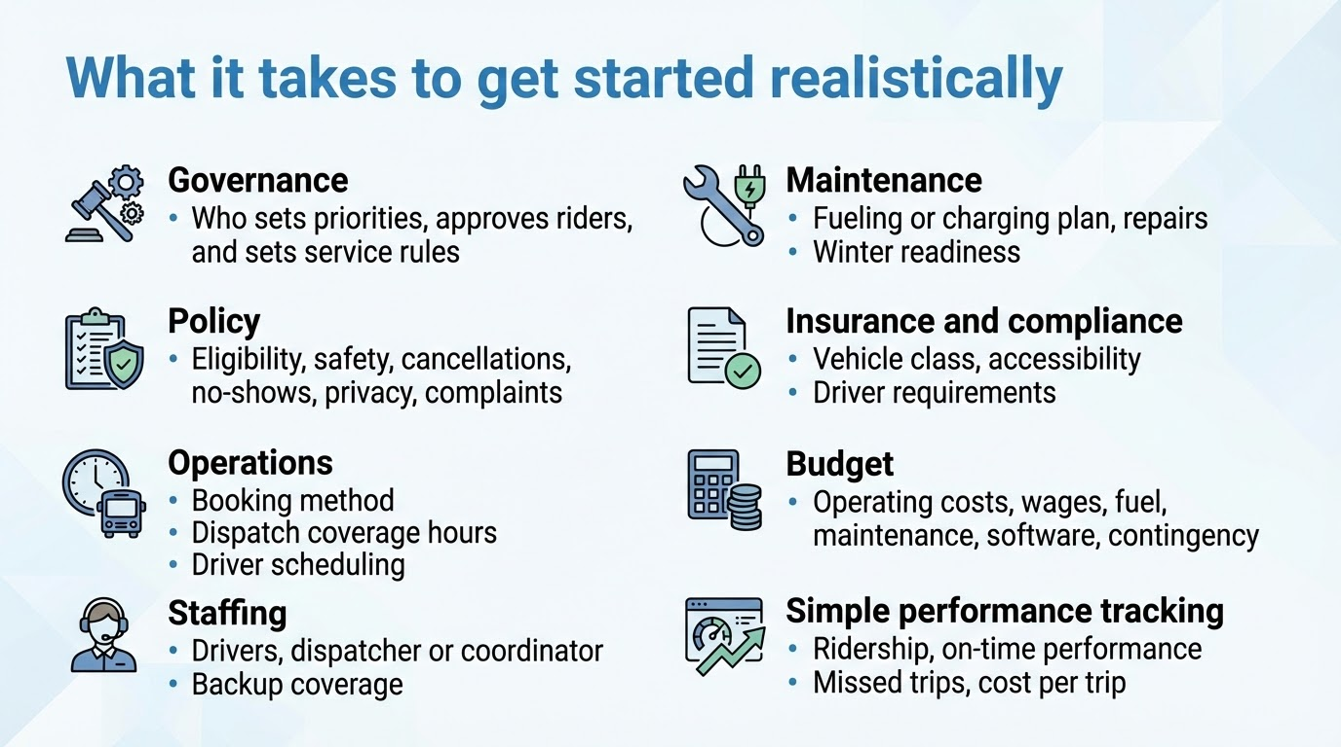
Notes:
Looks complicated and overwhelming but to get started you only need to really think hard about two of these, your operations, how many people you want to move and where, and how much will it cost to do that. We can help simulate it all out before you even start to test.

Slide 13



What First Nations have already done
Old Massett Village Council, Haida Gwaii Problem: Region-wide access gaps for health, food, and inter-community trips across a large island geography. Approach: Built a hybrid plan with fixed plus on-demand service, mapped priority destinations, built capital and operating budgets, and tested options including a passenger-only ferry link. Outcome: A council-ready service plan and funding-ready package with clear phases, costs, and EV transition steps.
Nuxalk Nation, Bella Coola Problem: Limited reliable travel options in a remote coastal context with seasonal risks and long-distance needs. Approach: Designed a community-run transit model with governance, staffing, and maintenance planning, then compared vehicle options including EV and hybrid scenarios. Outcome: A complete feasibility package that supported successful RTSF funding and a clear implementation path.
Kapawe’no First Nation Problem: Need for local transit that works in winter and fits a small fleet and limited staffing capacity. Approach: Tested EV readiness against local climate and routes, scoped charging and operations requirements, and set a phased plan that starts with reliable service first. Outcome: A risk-managed plan that avoided overcommitting to technology before infrastructure and operations are ready.
Notes:
Transit is a problem, but regardless of size its easy to do its being done across the country, all these nations engaged with their communities and stakeholders, identified issues, build a plan, requested funding and are now getting started deploying transit

Slide 14
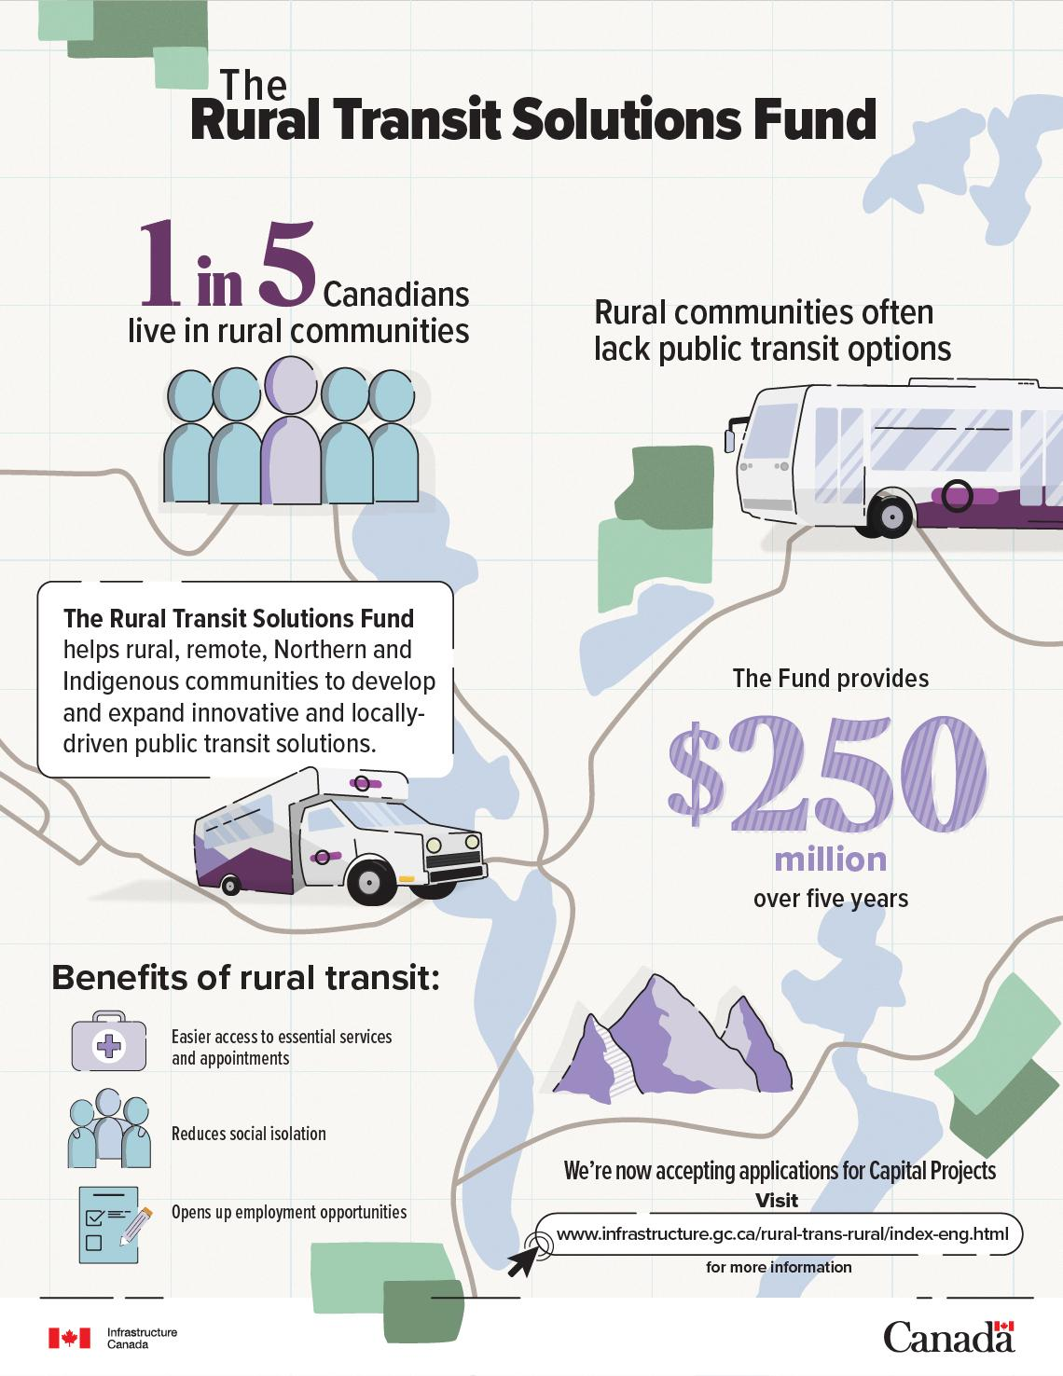
Funding Programs
Canada Public Transit Fund
Rural Transit Solutions Fund
Zero Emission Transit Fund
Investing in Canada Infrastructure Program, Public Transit Infrastructure Stream
Public Transit Infrastructure Fund
Canada Infrastructure Bank, Public Transit investments
Green Municipal Fund (Federation of Canadian Municipalities)
Notes:
From what we’ve seen, the government wants to help, it recognizes transportation for people is critical infrastructure that needs investment and there are billions coming online in the near future to actualize this, also local provincial funding as well. But knowing what you need and having your own story to tell is critical
“A feasibility study takes this same logic and applies it to your Nation’s actual geography, population, services, and priorities — so leadership can make informed decisions using local data.”

Slide 15
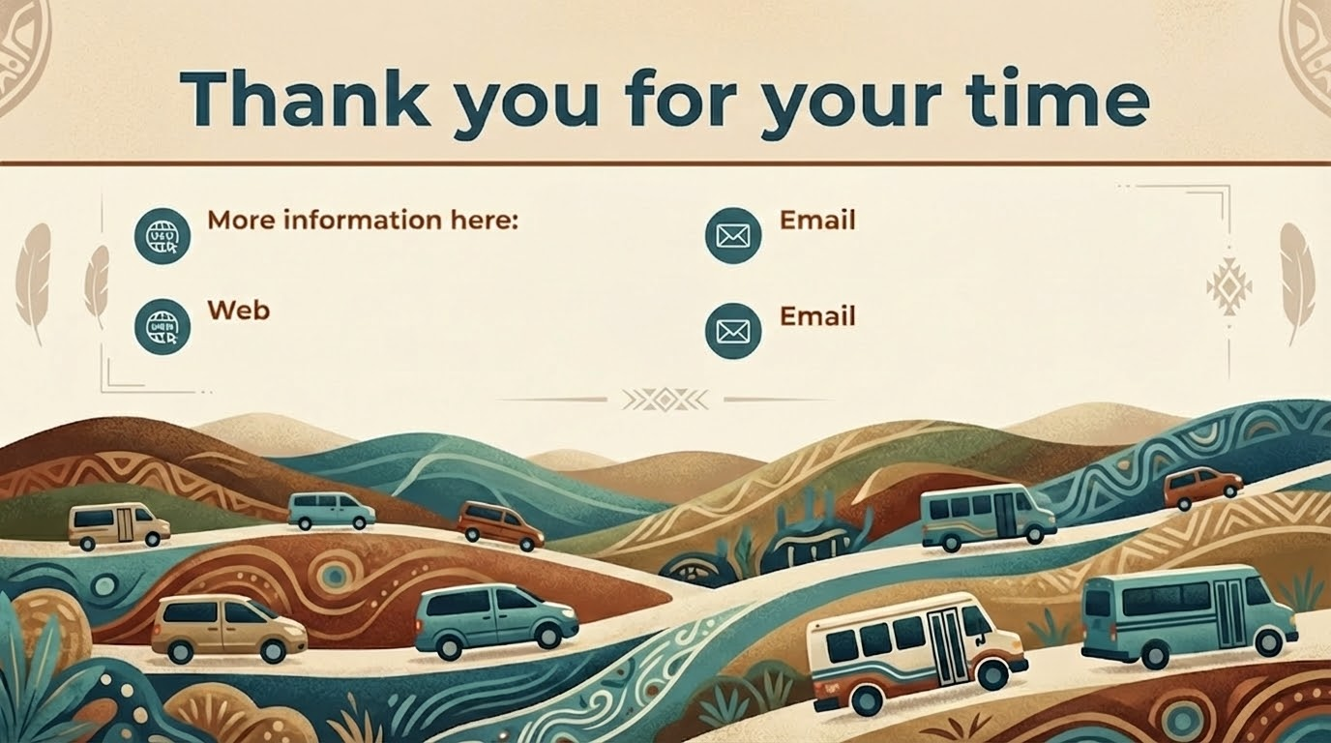
https://www.connectedge.ca/zev
frank@indigi-solutions.ca
https://pantonium.com/
luke.mellor@pantonium.com
Notes:
https://www.connectedge.ca/zev
https://pantonium.com/
frank@indigi-solutions.ca
luke.mellor@pantonium.com

