Slide 1


Slide 2


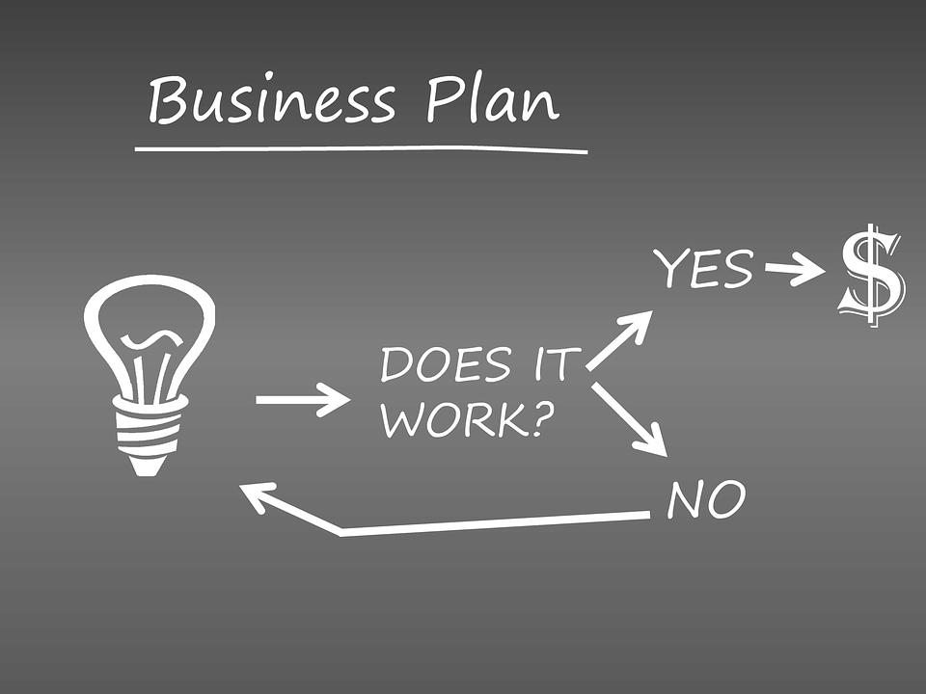
Welcome and Acknowledgment of the Land
"We acknowledge the lands that the Town of Wasaga Beach is located on are the historical territory of the Tionontati people and are within the boundaries of Treaty 18, signed with the Anishinaabe. We recognize the enduring presence of the Anishinaabe, Haudenosaunee, and Wendat Nations." In addition, for Sothern Ontario we also acknowledge the Attawandaron and Tionantati, nations.
We are thankful to be welcomed on these lands in friendship. The lands we are situated on are covered under the Williams Treaties and the traditional territory of the Mississaugas, a branch of the greater Anishinaabe Nation, including Algonquin, Ojibway, Odawa and Pottawatomi.

Slide 3
Strengthening Your Role in Community Economic Development
As an advisor, your role is more than just helping a single business succeed; it's about strengthening the entire community's economic development.
This means understanding the broader economic landscape of the community, identifying gaps, and helping to create a network of interconnected businesses that support each other.
You can play a vital role in capacity-building by providing workshops on business and financial topics.
Your work helps to build a more resilient and self-sufficient community. By focusing on the collective good, you contribute to a future where economic growth is a tool for cultural revitalization and community empowerment.

Slide 4
Indigenous Business Plans
Hello and welcome.
Today, we'll delve into the unique aspects of Indigenous business planning.
I'm excited to share some insights with you on how to approach this field with cultural awareness and strategic foresight.

Slide 5
Cultural & Community Elements in Indigenous Business Planning
Indigenous business planning is not just about profit; it's deeply rooted in the cultural and community values of the people involved.
The business must be a part of the community, not separate from it. This means incorporating traditional knowledge, language, and spiritual beliefs into the business model.

Slide 6
Cultural & Community Elements in Indigenous Business Planning
For many Indigenous communities, success is measured not only in financial terms but also by its contribution to social well-being, cultural preservation, and environmental stewardship.

Slide 7
Cultural & Community Elements in Indigenous Business Planning
A good business plan will reflect the community's vision and respect the relationship between the people and the land.
For example, a business might prioritize using traditional materials or employing community members to preserve skills and knowledge. The decision-making process is often communal, reflecting a collective approach rather than an individualistic one.

Slide 8
What is a Business Model?
A business model describes how a business organization creates, delivers, and captures value, in economic, social, cultural or other contexts.
The model describes the specific way in which the business conducts itself, spends, and earns money in a way that generates profit.

Slide 9
What is a Business Model?
The Business Model Canvas (BMC) is a strategic management tool that allows you to quickly and visually map out your business idea on a single page.
It's an excellent tool for Indigenous entrepreneurs as it helps to clarify the core components of the business while also providing a framework for incorporating cultural and community values into each section.
The canvas is made up of nine building blocks, each representing a key area of your business. They are typically organized into four main groups: customer, offering, infrastructure, and finances.

Slide 10
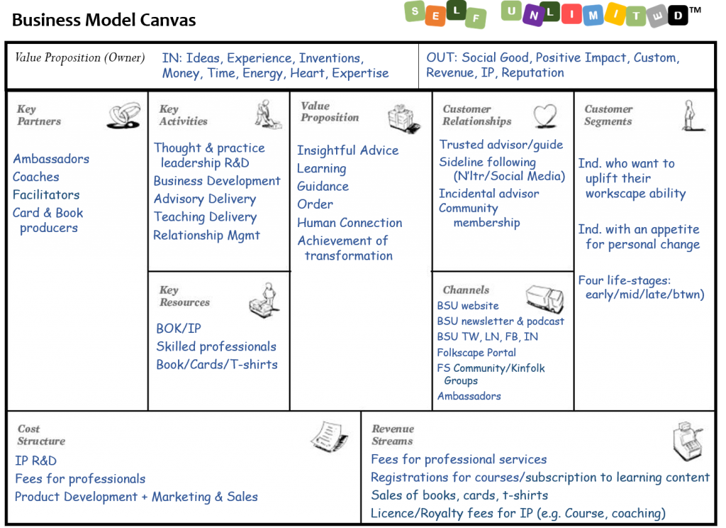
What is a Business Model?
This Photo by Unknown Author is licensed under CC BY-SA-NC

Slide 11
Business Model Canvas
The business model canvas (BMC) is a strategic tool that captures your entire business model on a single page. This visual framework helps you map out nine essential components: Customer segments. Value propositions. Channels.
The nine essential components of the BMC: Customer Segments, Value Propositions, Channels, Customer Relationships, Revenue Streams, Key Resources, Key Activities, Key Partners, and Cost Structure.

Slide 12
Business Model Canvas
1. Customer Segments
What it is:
The specific groups of people or organizations a business aims to reach and serve.
What it explains:
Who are the target customers, what are their needs, and what problems does the business solve for them?
For Indigenous Businesses:
Go beyond simple demographics. Consider the various segments within the community (e.g., youth, Elders, local families) as well as external markets. Think about who your business will serve and how it will meet their specific needs, both economically and culturally.

Slide 13
Business Model Canvas
2. Value Propositions
What it is:
The bundle of products and services that create value for a specific Customer Segment.
What it explains:
The unique value, benefits, or solutions the business offers to satisfy customer needs, wants, and problems.
For Indigenous Businesses:
This is where you highlight your unique cultural value. It's not just about the product; it's about the story, the traditional knowledge, the social impact, and the environmental stewardship that sets your business apart from competitors.

Slide 14
Business Model Canvas
3. Channels
What it is:
The ways a company communicates with and delivers its Value Proposition to its Customer Segments.
What it explains:
How the products and services are sold, marketed, and delivered to customers.
For Indigenous Businesses:
Consider community-specific channels, such as local community events, word-of-mouth networks, or partnerships with the Band Council. You might also focus on e-commerce to reach a broader market while maintaining your local base.

Slide 15
Business Model Canvas
4. Customer Relationships
What it is:
The type of relationship a company establishes and maintains with its customers.
What it explains:
How the business gets, keeps, and grows customers over time, fostering loyalty and engagement.
For Indigenous Businesses:
Relationship-building is often a core value. Your business model may emphasize personal relationships, community engagement, and a focus on long-term trust, rather than a purely transactional relationship.

Slide 16
Business Model Canvas
5. Revenue Streams
What it is: The ways a business generates cash from each Customer Segment.
What it explains: How the business makes money, which can include asset sales, usage fees, subscriptions, licensing, or advertising.
For Indigenous Businesses:
In addition to standard revenue streams, you might consider revenue from government grants, community contracts, or partnership agreements that include a community benefit component. The business plan should clarify how profits will be reinvested into the community.

Slide 17
Business Model Canvas
6. Key Resources
What it is: The most important assets a business needs to make its model work.
What it explains: These can be physical, intellectual, human, or financial assets required to create, deliver, and capture value.
For Indigenous Businesses:
This section should highlight unique resources such as traditional knowledge, cultural expertise, access to specific land or resources, and the skills of community members.

Slide 18
Business Model Canvas
7. Key Activities
What it is:
The most important strategic actions a business must perform to create and deliver its Value Proposition.
What it explains:
These are the core activities, such as production, problem-solving, or platform management, that are crucial to the business's success.
For Indigenous Businesses:
Key activities might include a focus on community engagement, cultural workshops, or traditional harvesting, in addition to standard business operations like production, marketing, and sales.

Slide 19
Business Model Canvas
8. Key Partners
What it is:
The network of suppliers and partners that help the business leverage its model.
What it explains:
External parties like strategic alliances, joint ventures, or buyer-supplier relationships that help the business focus on its core activities and reduce risks.
For Indigenous Businesses:
This section is vital for outlining partnerships with other Indigenous businesses, AFIs, government agencies, and community organizations. These partnerships are often built on mutual respect and shared goals.

Slide 20
Business Model Canvas
9. Cost Structure
What it is: All the costs incurred to operate the business.
What it explains: The major costs associated with key resources, key activities, and the value proposition itself, including fixed and variable costs.
For Indigenous Businesses:
The cost structure may include investments in community training, cultural protocols, and environmental protection, which are often considered integral to the business model rather than just external costs.

Slide 21
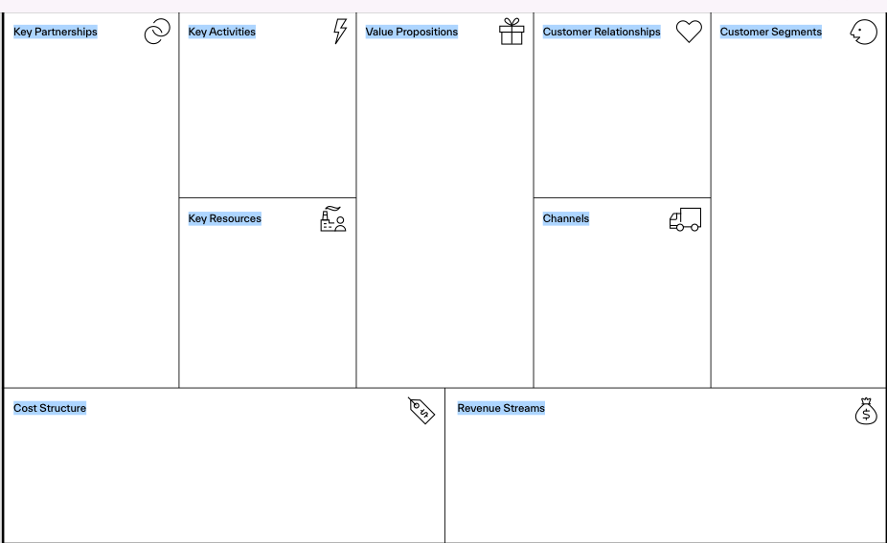

Slide 22
What is a Business Plan?
A business plan is an important document because it acts as a roadmap, guiding decision-making, identifying potential problems, and improving the chances of success by forcing thorough research and strategic planning.
It is essential for securing funding by convincing lenders and investors of a viable opportunity, and it helps to set clear objectives, define a marketing strategy, and establish a framework for operations and growth.

Slide 23
Why Business Plans Matter in Indigenous Economic Development
Business plans are essential in Indigenous economic development for several reasons:
they support sovereignty and self-reliance by providing a strategic roadmap for Indigenous-led growth and control over their economic future; and
they attract partnerships and funding by demonstrating viability to investors and governments, enabling access to critical capital for business expansion and community infrastructure.
By providing a clear plan, these documents help solidify long-term economic sustainability and foster a stronger connection between economic prosperity and cultural preservation.

Slide 24
Culturally-Rooted Entrepreneurship and Nation Building
Culturally-rooted entrepreneurship builds economies that sustain Indigenous communities by integrating traditional knowledge, values, and practices into business ventures, fostering community identity and self-determination.
These businesses, often rooted in unique cultural expressions like art and craftsmanship, contribute to local economic development, uphold Indigenous sovereignty, and promote the preservation and revitalization of culture, aligning with initiatives like the United Nations Declaration on the Rights of Indigenous Peoples(UNDRIP).

Slide 25
Elements of a Strong Community-Based Business Idea
A strong community-based business idea integrates local needs, leverages local resources (including culture), ensures scalability to grow without losing local roots, and fosters sustainability for long-term impact and viability.
Key elements include addressing a clear unmet need within the community, utilizing cultural assets to create unique value, building strong community relationships, and establishing a model that can expand its reach and impact over time while maintaining its commitment to the local area.

Slide 26
Types of Indigenous Businesses
Indigenous businesses operate across for-profit, cooperative, social enterprise, and land-based models, leveraging cultural strengths and community ties to create economic and social value.
*For-profit businesses aim for growth and profit, often integrating social goals.
* Cooperatives, like those in fishing or artisan work, focus on member benefits, shared ownership, and sustainable practices.
* Social enterprises prioritize social, cultural, or environmental missions, reinvesting profits to achieve their objectives.
* Land-based businesses, such as eco-tourism or traditional crafts, directly connect economic activity to cultural heritage and the natural environment, fostering sustainability and community well-being.

Slide 27
Indigenous Success Stories
Indigenous success stories in Ontario's First Nations highlight progress in economic development, like Aamjiwnaang First Nation’s (aka Chippewas of Sarnia), commercial plaza and industrial park, and entrepreneurship, seen in Supercom Industries (6 first nations working together) manufacturing initiatives.
Successes also include cultural revitalization through initiatives like Pindigen Park and educational programs like the First Nation Student Success Program. Other examples include achievements in advocacy, such as the Modoc Nation's wildlife fence removal, and personal triumphs in health and resilience, exemplified by individuals overcoming trauma to find renewed spiritual and physical well-being.

Slide 28
Group Activity:
Brainstorm Exercise – Participants brainstorm one business idea rooted in:
* Local community values
* Environmental stewardship
* Cultural heritage or traditional knowledge

Slide 29

The Core Parts of a Business Plan
Table of Contents
Executive Summary
General Company Description
Products or Services
Marketing Plan
Operational Plan
Management and Organization
Personal Financial Statement
Startup Expenses and Capitalization
Financial Plan
Appendices

Slide 30
Objective – Breaking down each of the sections of a practical business plan
Executive Summary
  Who, What, Why (quick snapshot)
  The executive summary is the elevator pitch for the rest of your business plan.
  Use it to highlight what you do, why you do it and how you'll succeed.
  It's often the first section that a person will read in your business plan, so this is your opportunity to “sell” your idea and its potential for success.
  Prepared after you have completed the rest of the business plan.

Slide 31
Objective – Breaking down each of the sections of a practical business plan
Business Description
  Vision and Mission statements
  Connection to Indigenous culture and community needs
* An Indigenous business's description should articulate a purpose beyond profit, weaving Indigenous values, culture, and community needs into its core vision and mission.
* This includes crafting unique vision and mission statements that reflect cultural authenticity, demonstrating respect for community protocols, and identifying tangible ways the business will benefit the Indigenous community and environment.
* The description must also show how the business's activities and products are deeply connected to Indigenous heritage and address specific community needs or gaps.

Slide 32
Objective – Breaking down each of the sections of a practical business plan
Market Research
  Understanding your audience
  Sources: Elder interviews, community meetings, government data
  * When conducting market research for an Indigenous business plan, it's crucial to deeply understand your target audience by utilizing various sources like elder interviews, community meetings, and government data to gain insights into their needs, values, and cultural context.
  * This understanding informs the development of a vision, mission statement, and business strategies that are aligned with the community's priorities and fosters a genuine connection to Indigenous culture.

Slide 33
Objective – Breaking down each of the sections of a practical business plan
Products and Services
  What are you offering and why it matters
Detailed Description:
Clearly explain the specific goods or services you intend to sell, using simple, easy-to-understand language.
Problem/Solution:
Describe the problem your product or service solves for your customers or community.
Unique Selling Proposition (USP):
Explain what makes your offering different and superior to your competitors.

Slide 34
Objective – Breaking down each of the sections of a practical business plan
Products and Services
  What are you offering and why it matters
Detailed Description:
Cultural Significance:
Weave in the cultural context, history, and values behind your products or services to create an emotional connection with customers.
Market Niche:
Detail how your offering addresses an unmet need, fills a gap in the local market, or provides something that is not currently available.

Slide 35
Business plan – Operations – How the Business Runs
Operations Plan
  How will daily activities be managed?
  Roles, responsibilities, and logistics
An operations plan for an Indigenous business should outline the daily activities, roles, responsibilities, and logistics required to achieve business goals, integrating Indigenous principles and community needs.
It details the workflows for product/service delivery, including who is responsible for what tasks and when, and how success will be measured.
Key elements include establishing clear roles, managing daily operations, handling logistics like supply chains, and ensuring all activities align with the business's strategic goals and community values.

Slide 36
Business plan – Operations – How the Business Runs
Operations Plan
Daily Activity Management
Workflow Definition:
Clearly define the day-to-day processes for producing goods or delivering services.
Task Management:
Break down overall goals into specific, actionable tasks and assign them to individuals or teams.
Performance Indicators:
Establish metrics to track progress and measure the success of daily operations.

Slide 37
Business plan – Operations – How the Business Runs
Operations Plan
Flexibility and Adaptation:
Build in mechanisms to adapt to changing circumstances, as successful operational planning requires flexibility.
Roles and Responsibilities
Clear Assignments: Define the specific roles and responsibilities of each team member or department involved in operations.
Accountability: Ensure clear lines of accountability for each task and operational stage.
Skill Assessment: Align roles with the skills and expertise of team members.

Slide 38
Business plan – Operations – How the Business Runs
Operations Plan
Team Alignment: Foster collaborative communication across departments to ensure everyone is working toward common goals.
Logistics
Supply Chain Management:
Detail the processes for sourcing materials, managing inventory, and ensuring timely delivery of products.
Equipment and Technology:
Identify the necessary equipment, technology, and facilities required for day-to-day operations.

Slide 39
Business plan – Operations – How the Business Runs
Operations Plan
Facility Management:
Outline how physical workspaces and resources will be managed to support operational efficiency.
Indigenous Community Integration:
Ensure logistics consider community resources, local suppliers, and potential partnerships with other Indigenous businesses or organizations.
Extra Considerations for an Indigenous Business Plan
Self-Determination:
Incorporate the principles of Indigenous self-determination and self-government into the operational framework.

Slide 40
Business plan – Operations – How the Business Runs
Operations Plan
Extra Considerations for an Indigenous Business Plan
Community Impact:
Consider how operations will impact and benefit the Indigenous community, potentially creating employment opportunities or supporting local economies.
Cultural Values:
Integrate Indigenous cultural values and traditional practices into business operations where appropriate.

Slide 41
Business plan – Operations – How the Business Runs
Operations Plan
Extra Considerations for an Indigenous Business Plan
Partnerships:
Explore partnerships with other Indigenous businesses and organizations to strengthen economic opportunities within the community.
Procurement Strategies:
Leverage government procurement strategies designed to increase opportunities for Indigenous businesses, such as the Procurement Strategy for Aboriginal Business (PSAB). Although it was replaced by the Procurement Strategy for Indigenous Business (PSIB) in 2021, the legacy of PSAB remains, as the modern strategy builds upon its goals to foster economic growth, create opportunities, and build capacity within Indigenous businesses through federal purchasing.

Slide 42
Business plan – who are your management and key workers
Management and Team
  Who's involved?
  Elders, youth, leadership, and external partners
* In an Indigenous business plan, the Management and Team section should include Elders for cultural guidance, Youth for new perspectives and innovation, Leadership for strategic vision and governance, and External Partners such as community members, governments, or other businesses for support and resources.
* This integrated approach ensures the business is grounded in cultural values, sustainable, and responsive to community needs, while also leveraging external relationships for growth and success.

Slide 43
Business plan – who are your management and key workers
Management and Business Team
1. Elders:
Role:
Provide wisdom, traditional knowledge, and cultural protocols to ensure the business operates in alignment with Indigenous values and community well-being.
Involvement:
They can act as advisors, cultural mentors, or members of a cultural advisory board, offering guidance on long-term vision and decision-making processes.

Slide 44
Business plan – who are your management and key workers
Management and Business Team
2. Youth:
Role:
Bring fresh perspectives, digital literacy, and entrepreneurial drive, ensuring the business remains innovative and relevant to future generations.
Involvement:
They can be involved in operations, technology, marketing, or as part of a mentorship program, fostering future leaders and developing new business opportunities.

Slide 45
Business plan – who are your management and key workers
Management and Business Team
3. Leadership:
Role:
Consists of individuals with proven business acumen and community standing, responsible for strategic planning, operational management, and financial oversight.
Involvement:
This includes executive management, board members, and project managers who translate cultural and community vision into tangible business goals and outcomes.

Slide 46
Business plan – who are your management and key workers
Management and Business Team
4. External Partners:
Role:
Provide crucial support through financial investment, technical expertise, market access, and broader community connections.
Involvement:
This can include government agencies, non-profit organizations, other Indigenous businesses, or community organizations, all contributing to the business's sustainability and growth.
.

Slide 47
Business plan – who are your management and key workers
Management and Business Team
Key Considerations for Integration:
Intergenerational Collaboration:
Foster an environment where Elders and youth can collaborate, sharing their knowledge and skills to the benefit of the business.
Governance:
Establish a governance structure that reflects Indigenous governance models, empowering the community and ensuring accountability.
Capacity Building:
Invest in training and development for all team members, ensuring they have the skills needed to contribute to the business's success.
Cultural Alignment:
Ensure the business's operations, mission, and values are rooted in and respectful of Indigenous culture.

Slide 48
Business plan – what are our financial expectations?
Financial Plan
  Budgeting basics
  Revenue projections
  Funding sources
  Grant vs. investment models
An Indigenous business financial plan requires a clear budgeting basics to project revenues, identify funding sources like grants and investments from Indigenous Financial Institutions (IFIs), and to differentiate between non-repayable grants and repayable investments.
Focus on creating realistic revenue projections, exploring the unique benefits and conditions of various Indigenous-focused funding programs, and clearly articulating your business's alignment with community needs and economic development goals to secure the necessary capital for your plan.

Slide 49
Business plan – what are our financial expectations?
Financial Plan
  Budgeting basics
  Revenue projections
  Funding sources
  Grant vs. investment models
An Indigenous business financial plan requires a clear budgeting basics to project revenues, identify funding sources like grants and investments from Indigenous Financial Institutions (IFIs), and to differentiate between non-repayable grants and repayable investments.
Focus on creating realistic revenue projections, exploring the unique benefits and conditions of various Indigenous-focused funding programs, and clearly articulating your business's alignment with community needs and economic development goals to secure the necessary capital for your plan.

Slide 50
Business plan – what are our financial expectations?
Financial Plan
Purpose:
A financial plan demonstrates the viability of your business and how it will generate profit, which is crucial for attracting lenders and investors.
Budgeting:
This is the process of making assumptions about the future to project both your revenues (money received) and expenses (money spent). A well-prepared budget serves as a base for making sound decisions and adjusting to unforeseen changes.
Key Components:
Your budget should include operating and capital expenditures, covering costs for personnel, operations, and physical resources.
Revenue Projections

Slide 51
Business plan – what are our financial expectations?
Financial Plan
Cash Flow:
Create a cash flow projection showing monthly inflows and outflows of money for the first 12 months, and quarterly or yearly thereafter.
Timing:
Do not assume sales equal immediate cash in hand. Enter revenues only when you expect to receive the payment, based on industry averages and your team's experience.
Supporting Documents:
Your projections should be detailed and supported by industry data and your understanding of your market.
Funding Sources

Slide 52
Business plan – what are our financial expectations?
Financial Plan
Funding Sources
Indigenous Financial Institutions (IFIs):
These are key partners for Indigenous entrepreneurs, offering access to capital through programs like the Aboriginal Entrepreneurship Program.
Government Programs:
Various levels of government offer funding for Indigenous economic development. Examples include the Aboriginal Business Investment Fund (ABIF) and the Aboriginal Business Financing Program (ABFP).
Partnerships:
Collaborating with other organizations and securing contributions from various funding sources can strengthen your application.
Grants vs. Investment Models

Slide 53
Business plan – what are our financial expectations?
Financial Plan
Funding Sources
Grants vs. Investment Models
Grants:
These are typically non-repayable contributions, often tied to specific programs that support Indigenous businesses. Eligibility criteria and available funding levels depend on the specific program and the project's scope.
Investments:
These are repayable funds provided by lenders or investors who expect a return on their money. Investment models are less common for startup capital in many Indigenous entrepreneurship programs, but are a standard component of general financing.

Slide 54
Business plan – what are our financial expectations?
Financial Plan
Funding Sources
Applying to Indigenous-Focused Programs
Demonstrate Need:
Clearly articulate the need for funding, aligning it with community development and program priorities.
Show Viability:
Provide a strong business plan with realistic financial projections and an explanation of how your business will generate profit.
Align with Indigenous Goals:
Highlight how your business contributes to economic development and serves the interests and needs of the Indigenous community.

Slide 55
Hands-On Exercise:
Small Group Activity: Teams fill in a simplified business plan template for a mock business using:
Community values
Sample data and assumptions
Oral and written components

Slide 56
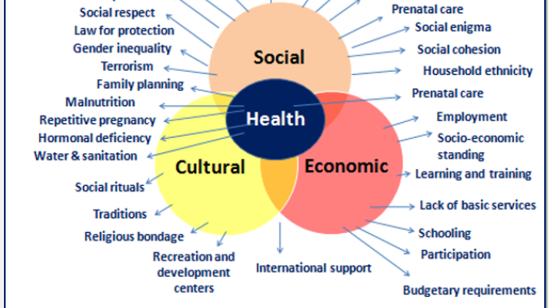
Community-Centered Implementation & Funding
Economic Development Plans

Slide 58
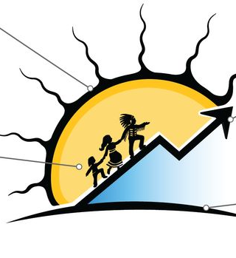
Objective – Learn how to finalize and fund a business plan that supports community values.
Aligning with Community Economic Development Plans
  Making sure the business fits local goals and needs
To align a business with Indigenous Community Economic Development Plans, you must prioritize self-determination, cultural sensitivity, and community well-being as defined in the plan, rather than solely focusing on profit.
A successful business plan will incorporate performance measures for community benefit, demonstrate how the business supports specific local goals and needs like infrastructure or workforce development, and foster mutually beneficial partnerships.
Actively engaging with Indigenous partners, understanding community priorities, and building a business that contributes to social impact are crucial for achieving economic reconciliation and enduring success.

Slide 59
Objective – Learn how to finalize and fund a business plan that supports community values.
Ethical Leadership and Cultural Protocols
  Respecting local traditions and community consent
Ethical leadership involves incorporating cultural protocols and obtaining community consent by building respectful relationships, understanding community-specific traditions, and seeking free, prior, and informed consent (FPIC) for business activities that impact a community.
For businesses, this means adapting plans to align with local Indigenous rights and cultural knowledge, such as the OCAP® Principles of Ownership, Control, Access, and Possession of Indigenous data, ensuring the community benefits and its cultural integrity is preserved.

Slide 60
Ethical Leadership and Cultural Protocols
Respect and Relationship Building:
Ethical leadership requires a deep understanding of and respect for local traditions, which can be achieved by building trusting, long-term relationships with community members.
Understanding Protocols:
Cultural protocols vary by community and reflect deeply held ethical systems. Learning and practicing them, such as through land acknowledgements, Elder protocols, or the use of a talking stick protocol, demonstrates respect and awareness.

Slide 61
Ethical Leadership and Cultural Protocols
Free, Prior, and Informed Consent (FPIC):
The principle of FPIC is essential for obtaining approval on projects that affect Indigenous communities. This means that the community has the right to decide on the development and use of their lands and resources, which requires authentic dialogue and mutual agreement.
Cultural Sensitivity:
Be mindful of how cultural elements are incorporated. For example, if incorporating aspects of a culture, ask for permission rather than taking without consent, and prioritize the use of the community's preferred language for respectful communication.

Slide 62
Ethical Leadership and Cultural Protocols
Integrating Business Plans
Community-Centric Business Models:
Business plans should be co-created or adapted to align with community-identified priorities, incorporating Indigenous self-determination.
Knowledge Protection:
Acknowledge that traditional knowledge shared is not public property. Respect intellectual property rights and protect community data, for example, through the OCAP® Principles, ensuring communities have control over how their knowledge is used and from which it profits.

Slide 63
Ethical Leadership and Cultural Protocols
Integrating Business Plans
Benefit Sharing:
Business activities should aim to create shared benefits with the community, promoting ethical, respectful, and sustainable outcomes.
Reconciliation:
In Canada, this framework aligns with the Truth and Reconciliation Commission's Calls to Action for business. Companies can foster reconciliation by building partnerships and ensuring that their economic activities are sustainable and respectful.

Slide 64
Ethical Leadership and Cultural Protocols
How to Start
Ask, Listen, and Learn:
When engaging with a community, always ask for permission, listen deeply to their concerns, and take their lead in all engagements.
Find Local Support:
Seek assistance from within the community for translations and cultural guidance to ensure accurate and respectful engagement.
Training and Resources:
Ensure all professionals are trained on the relevant protocols, and utilize resources like the Business Reconciliation in Canada guidebook to support respectful and sustainable partnerships.

Slide 65
Objective – Learn how to finalize and fund a business plan that supports community values.
Identifying Local Assets and Barriers
  Mapping strengths and potential obstacles
  Identifying local assets (strengths) and barriers (weaknesses/threats) involves performing a SWOT analysis, which maps internal factors (strengths, weaknesses) and external factors (opportunities, threats) within a community or business.
  A business plan integrates this analysis by using the identified strengths to seize opportunities, addressing weaknesses to mitigate threats, and developing strategies to leverage local resources and overcome obstacles, thereby creating a realistic and achievable path for growth.

Slide 66
Identifying Local Assets and Barriers. – SWOT Analysis
Identifying Local Assets and Barriers
This process is best done using a SWOT analysis, which helps categorize factors into four key areas:
Strengths (Assets):
These are internal positive qualities that provide a competitive advantage or contribute to success.
Examples: A strong online presence, a positive company culture, valuable intellectual property, or a solid financial foundation.

Slide 67
Identifying Local Assets and Barriers. – SWOT Analysis
Identifying Local Assets and Barriers
Weaknesses (Barriers):
These are internal limitations or areas where the organization is lacking or could improve.
Examples: High levels of debt, outdated equipment, poor customer satisfaction, or gaps in expertise.
Opportunities:
These are external factors or trends that a business could exploit to its advantage.
Examples: Emerging markets, new technologies, positive changes in customer needs, or favorable government policies.

Slide 68
Identifying Local Assets and Barriers. – SWOT Analysis
Identifying Local Assets and Barriers
Threats:
These are external challenges or obstacles that could negatively impact the business.
Examples: Intense competition, evolving market demands, negative publicity, or supply chain disruptions.
How Business Plans Fit In
A business plan utilizes the information gathered from a SWOT analysis to create actionable strategies:
1. Leverage Strengths and Opportunities:
The business plan outlines how the company will use its internal strengths to capitalize on external opportunities.

Slide 69
Identifying Local Assets and Barriers. – SWOT Analysis
How Business Plans Fit In
Address Weaknesses and Mitigate Threats:
It details strategies to overcome internal weaknesses and develop plans to counter or avoid external threats.
Strategic Decision-Making:
The SWOT analysis provides a fact-based foundation for making critical decisions about the business's future, helping it to define its competitive position and set realistic goals.
Resource Allocation:
The business plan allocates resources, such as capital, training, and technology, to develop strengths, improve weaknesses, and adapt to external conditions, ensuring the company remains agile and competitive.

Slide 70
Objective – Learn how to finalize and fund a business plan that supports community values.
Community Engagement and Consensus-Building
  Tools for inclusive decision-making
Indigenous community engagement and consensus-building are crucial for respectful and sustainable decision-making. These processes differ from traditional corporate models by prioritizing relationship-building, cultural protocols, and the recognition of Indigenous rights and knowledge systems.
Business plans serve as a key tool within this framework, but they must be developed collaboratively to ensure they reflect community values and goals

Slide 71
Indigenous Community Engagement and Consensus-Building Tools
Effective engagement and consensus-building with Indigenous communities are founded on principles of respect, trust, and mutual understanding.
Here are some of the key tools and approaches:
Relationship-Building:
Before any business is discussed, it's essential to establish a genuine relationship. This involves investing time, listening to Elders and community leaders, attending community events, and understanding local history, culture, and protocols. Avoid a transactional approach and prioritize building long-term, lasting connections.

Slide 72
Indigenous Community Engagement and Consensus-Building Tools
Here are some of the key tools and approaches:
Consensus-Based Decision-Making:
Many Indigenous cultures traditionally use consensus-based models where all voices are heard and everyone agrees on a decision. This differs from majority-rule voting, which can create a "winners and losers" dynamic.
Tools used to facilitate this include:
Talking Circles: A traditional practice where a physical object, like a talking stick, is passed around to give each person an uninterrupted turn to speak. This ensures every individual's perspective is considered.

Slide 73
Indigenous Community Engagement and Consensus-Building Tools
Tools used to facilitate this include:
Patience and Time: Allow sufficient time for the community's internal decision-making processes. Rushing can be seen as disrespectful and can erode trust.
Free, Prior, and Informed Consent (FPIC): As outlined in the United Nations Declaration on the Rights of Indigenous Peoples (UNDRIP), FPIC is a fundamental principle. It means that consent is sought well in advance, without coercion, and with all relevant information provided in an accessible format and language.

Slide 74
Indigenous Community Engagement and Consensus-Building Tools
Tools used to facilitate this include:
Cultural Protocols and Knowledge: Acknowledge and respect Indigenous protocols, which can include land acknowledgements, gifting, and showing deference to Elders and Knowledge Keepers. Integrate Indigenous Knowledge into planning and decision-making, as this traditional wisdom can offer valuable insights into environmental stewardship and sustainable practices.
Transparent Communication: Establish a clear, honest, and continuous two-way communication channel. This includes providing regular updates, being responsive to questions, and being transparent about project goals and potential impacts.

Slide 75
Objective – Learn how to finalize and fund a business plan that supports community values.
Business Plan Checklist and Red Flags
  What to double-check before finalizing
  Common mistakes to avoid
Business Plan Checklist for Indigenous Ventures
Before finalizing your business plan, double-check that you've addressed all the key components, with a specific focus on community and cultural elements.
Cultural & Community Alignment:
Vision & Values: Does the plan clearly state how the business aligns with the community's long-term vision and values (e.g., the Seven Generations Principle)?

Slide 76
Business Plan Checklists & Red Flags
Potential Red Flags & Common Mistakes
Look out for these common missteps that can damage trust and undermine the success of an Indigenous business plan.
Lack of Genuine Engagement: A common mistake is treating community consultation as a transactional "check the box" requirement rather than a continuous, relationship-building process. If the business plan was written forthe community instead of with them, it's a major red flag.
A "One-Size-Fits-All" Approach: Assuming that what works for one Indigenous community will work for another is a critical error. Each Nation has a unique history, culture, and governance structure that requires a tailored approach.

Slide 77
Business Plan Checklists & Red Flags
Potential Red Flags & Common Mistakes
Ignoring Traditional Knowledge: Failing to recognize and incorporate the value of traditional knowledge, especially concerning environmental practices or sustainable resource management, is a missed opportunity and shows a lack of respect.
Unrealistic Timelines: Indigenous decision-making often involves significant time for consensus-building and community discussion. A business plan with aggressive, inflexible deadlines that doesn't account for this can be a sign of a misunderstanding of cultural processes.
Overlooking Infrastructure & Skills Gaps: Assuming that all the necessary infrastructure (e.g., high-speed internet, reliable roads) and skilled labor are readily available is a common mistake. The plan should include a realistic assessment of these challenges and a strategy to address them.

Slide 78
Business Plan Checklists & Red Flags
Potential Red Flags & Common Mistakes
Inadequate Community Benefits: If the plan focuses only on profitability for external partners and provides minimal, short-term benefits to the community, it signals a lack of a true partnership and is a major red flag for investors and the community alike.
What to Double-Check Before Finalizing
Before the final signature, review the following to ensure the business plan is a robust and respectful document:
Read it Aloud: Have a community representative read the plan to ensure the language is accessible, respectful, and free of corporate jargon.
Verify the Benefits: Confirm that the community benefits outlined in the plan are in line with the community's priorities, not just what the business thinks they need.

Slide 79
Business Plan Checklists & Red Flags
What to Double-Check Before Finalizing
Cross-Reference with Community Agreements: Ensure that every commitment made in the business plan aligns with any pre-existing agreements, like Memorandums of Understanding (MOU) or Impact Benefit Agreements (IBA).
Confirm the Story: Does the business plan tell a coherent story that clearly connects the business idea to the community's long-term well-being? It should feel like a shared narrative, not just a financial document.

Slide 80
Business Plan Checklists & Red Flags
Cultural & Community Alignment:
Governance & Decision-Making: Is the governance structure for the business clearly defined? Does it respect and integrate traditional decision-making processes, such as the authority of Elders or a community-led committee?
Shared Benefits: Are the tangible benefits for the community explicitly outlined and quantified? This should go beyond employment and include things like revenue sharing, training programs, and infrastructure development.
Cultural Protocols: Does the plan acknowledge and respect local cultural protocols and traditions? This can include land acknowledgements, using the local language, or integrating Indigenous knowledge into operations.

Slide 81
Business Plan Checklists & Red Flags
Operations & Logistics:
Resources & Infrastructure: Have you accounted for potential logistical challenges in remote or rural communities, such as limited access to reliable internet, transportation, or skilled labor?
Supply Chain: Does the plan prioritize and create opportunities for partnerships with other Indigenous-owned businesses and suppliers?
Human Resources: Is there a clear plan for recruiting, training, and retaining local community members? Does it include mentorship and succession planning?

Slide 82
Business Plan Checklists & Red Flags
Financial & Legal:
Funding: Have you explored Indigenous-specific funding sources and capital corporations, in addition to traditional lenders?
Legal Structure: Have you considered a legal structure that respects the unique status of the business, especially if it operates on-reserve land?
Transparency: Are the financial and reporting mechanisms transparent and accessible to the community? How will the business report back on its progress and financial performance?

Slide 83
Objective – Learn how to finalize and fund a business plan that supports community values.
Funding Options
  Indigenous Services Canada (ISC)
  National Aboriginal Capital Corporations Association (NACCA)
  Aboriginal Financial Institutions (AFIs)
  CMHC (housing/business mix)
  Business Development Bank of Canada (BDC)
  Social enterprise and innovation funds

Slide 84
Funding Sources for Indigenous Business in Ontario
Securing capital for an Indigenous business often involves a mix of grants, loans, and equity from a variety of sources. Unlike traditional financing, many of these options are specifically designed to address the unique challenges and opportunities faced by Indigenous entrepreneurs.
The Synergistic Approach
The most successful Indigenous business plans often utilize a combination of funding sources. An entrepreneur might approach their local AFI for a business plan grant and a micro-loan, while simultaneously applying to a government program for a grant to cover training costs. For a larger-scale project, they might work with a mix of an AFI, BDC, and a social impact fund to assemble a complete financial package. This diversified approach demonstrates a strong, well-researched plan to all potential funders.

Slide 85
Funding Sources for Indigenous Business in Ontario
1. Aboriginal Financial Institutions (AFIs)
AFIs are the cornerstone of the Indigenous business financing ecosystem. They are Indigenous-controlled, community-based, and understand the specific needs and cultural context of their clients. They are often the first point of contact for an Indigenous entrepreneur.
Who they are: A network of over 50 organizations across Canada, several of which are in Ontario. Examples in Ontario include the Nishnawbe Aski Development Fund (NADF), Waubetek Business Development Corporation, and Two Rivers Community Development Centre.
What they offer: They provide business loans, non-repayable contributions (grants), business advisory services, and aftercare support. They can finance business startups, acquisitions, and expansions, and are often more flexible than conventional banks.

Slide 86
Funding Sources for Indigenous Business in Ontario
1. Aboriginal Financial Institutions (AFIs)
Key Advantage: AFIs are experts at risk mitigation in a way that conventional lenders are not. They are embedded in the community, understand the local economy, and can provide culturally appropriate support.
2. National Aboriginal Capital Corporations Association (NACCA)
NACCA is the national association that supports and represents the AFI network. While it doesn't provide direct financing to individuals or businesses, it plays a vital role in the system.
Who they are: An umbrella organization that works to increase the availability of capital for Indigenous entrepreneurs by strengthening the AFI network.

Slide 87
Funding Sources for Indigenous Business in Ontario
2. National Aboriginal Capital Corporations Association (NACCA)
What they offer: They manage national programs and initiatives, such as the Indigenous Growth Fund, a new and innovative fund that leverages government investment to raise additional capital for Indigenous businesses. They also offer programs for specific groups, such as the Indigenous Women's Entrepreneurship Initiative.
How they help: Your local AFI is often the entry point for accessing the larger funds and resources that NACCA helps to manage.
3. Indigenous Services Canada (ISC)
ISC is a federal government department that provides a range of programs and services to Indigenous peoples, including business and economic development support.

Slide 88
Funding Sources for Indigenous Business in Ontario
3. Indigenous Services Canada (ISC)
What they offer: ISC's Strategic Partnerships Initiative (SPI) and the Aboriginal Entrepreneurship Program (AEP) provide funding and support for economic development. The AEP, for example, is designed to enhance the growth of small and medium-sized Indigenous-owned businesses.
Key Advantage: ISC funding is often non-repayable (grants) and is intended to cover a portion of eligible costs, which can reduce the amount of loan financing required.

Slide 89
Funding Sources for Indigenous Business in Ontario
4. Government of Ontario Programs
The provincial government also has dedicated funding to support Indigenous economic development.
Indigenous Economic Development Fund (IEDF): This fund provides grants and financing to Indigenous entrepreneurs, businesses, and communities. It supports projects that diversify Indigenous economies, increase access to employment, and provide startup and expansion financing.
New Relationship Fund (NRF): This fund supports First Nations, Métis communities, and Indigenous organizations in building their capacity to engage in economic development activities.
FedDev Ontario: The Federal Economic Development Agency for Southern Ontario (FedDev Ontario) has dedicated funding for Indigenous businesses and organizations in its service area, with a focus on supporting economic development and community projects.

Slide 90
Funding Sources for Indigenous Business in Ontario
5. Business Development Bank of Canada (BDC)
BDC is a federal Crown corporation that provides financing and advisory services to Canadian businesses. They have specific offerings for Indigenous entrepreneurs.
What they offer: BDC's Indigenous Entrepreneur Loan provides financing of up to $350,000 to start or grow a business. This loan comes with flexible repayment terms and preferred rates. They also offer advisory services and resources tailored to Indigenous businesses.
Key Advantage: BDC is a major national player and can provide larger loans than many AFIs, often in partnership with them. They are a good option for Indigenous businesses ready to scale up.

Slide 91
Funding Sources for Indigenous Business in Ontario
6. Canada Mortgage and Housing Corporation (CMHC)
While primarily focused on housing, CMHC has programs that can be relevant for Indigenous businesses, especially those that are integrated with community infrastructure.
What they offer: CMHC provides funding and financing for housing construction and renovation, which can include mixed-use developments that feature both housing and business space (e.g., a community store or a health centre).
How it can be used: A business plan might include a request for CMHC funding to build a community-owned building that houses a business, an essential service, or a mix of both.

Slide 92
Funding Sources for Indigenous Business in Ontario
7. Social Enterprise and Innovation Funds
A number of funds are emerging that specifically target Indigenous social enterprises and innovative ventures that have a strong community benefit.
Indigenous Innovation Initiative: This fund supports Indigenous-led ideas and solutions that address complex health, social, and economic challenges. It is a good fit for businesses with a clear social mission and an innovative approach.
Other Social Impact Investors: Various private foundations and social impact investors are increasingly looking to invest in Indigenous-led ventures that create a positive social and environmental impact. These are often not for-profit or for-benefit organizations that prioritize community well-being over pure profit.

Slide 93
Objective – Learn how to finalize and fund a business plan that supports community values.
How to Pitch Your Plan
  Structuring a short presentation
  Tailoring for different audiences (funders, councils, banks)
* A successful pitch for an Indigenous business plan goes beyond financial metrics. It's about weaving a compelling narrative that respects the community's vision, highlights the cultural significance of the venture, and demonstrates the social and economic returns.
* Tailoring this story to different audiences is key.

Slide 94
Structuring Your Pitch Presentation & Deck
Your presentation should be concise, memorable, and tell a complete story. A good structure for a 10-15 minute pitch is:
Opening: The Story and the "Why" (1-2 minutes)
  The Hook: Start with a personal story or a brief, impactful statement about the business's purpose. This immediately connects your audience to the heart of the project.
  Land Acknowledgment: Begin with a sincere land acknowledgment, showing respect for the traditional territory you are on and the people who have stewarded it for generations.
  The "Why": Clearly articulate the problem you are solving and why this business is important for the community. Is it creating jobs, revitalizing culture, or providing a much-needed service?

Slide 95
Structuring Your Pitch Presentation & Deck
Your presentation should be concise, memorable, and tell a complete story. A good structure for a 10-15 minute pitch is:
The Business Opportunity (2-3 minutes)
  The Idea: Describe your product or service in simple, clear terms.
  The Market: Who is your target customer? What is the size of the market? Be specific.
  The Competitive Advantage: What makes your business unique? This is where you can highlight Indigenous knowledge, cultural authenticity, or a unique community-based approach that a competitor can't replicate.

Slide 96
Structuring Your Pitch Presentation & Deck
The Social & Cultural Impact (2-3 minutes)
  Community Benefits: This is the most crucial part of an Indigenous business pitch. Don't treat it as an afterthought. Detail how the business will benefit the community:
    Job creation (number of jobs, type of training)
    Revenue sharing or profit distribution
    Skills training and capacity-building
    Cultural preservation and language revitalization
    Environmental stewardship
  Key Partners: Acknowledge the support of key community leaders, Elders, or organizations. This demonstrates that you have community buy-in.

Slide 97
Structuring Your Pitch Presentation & Deck
The Financials (2-3 minutes)
  Ask: Clearly state how much money you are seeking and what you will use it for (e.g., equipment, marketing, salaries).
  Projections: Provide a high-level overview of your financial projections (revenue, expenses, profitability). Focus on a few key numbers that show the business is viable.
  Return on Investment (ROI): Go beyond just financial returns. Frame the ROI in terms of social, cultural, and economic benefits.

Slide 98
Structuring Your Pitch Presentation & Deck
The Team & The Ask (1-2 minutes)
  The Team: Introduce your team, highlighting their skills and connection to the community. Emphasize their commitment and passion.
  The Ask (revisited): Reiterate your request and open the floor for questions. End on a powerful, forward-looking statement about the partnership you wish to build.

Slide 99
Tailoring Your Pitch to Different Audiences
The core of your pitch remains the same, but you will need to adjust the emphasis and language for each audience.
Audience 1: Potential Funders (Banks, AFIs, Government Programs)
Focus: This audience wants to see a balance between your cultural mission and business viability. They are looking for a return on their investment—which can be financial or social.
Emphasis in Pitch:
Financials: Spend more time on your financial projections, showing a clear path to profitability and how their investment will be repaid.
Risk Mitigation: Address potential risks head-on and explain how you will mitigate them. For example, if on-reserve land is a factor, explain your legal and governance structure.
Social ROI: Clearly articulate the social and community benefits, framing them as a unique competitive advantage and a reason for their investment.
Pitch Deck Tips: Include detailed financial charts, a team slide that highlights business and technical expertise, and a clear "Use of Funds" slide.

Slide 100
Tailoring Your Pitch to Different Audiences
Audience 2: Band Council or Community Leaders
Focus: This audience wants to ensure the business aligns with the community's vision and will create long-term benefits. Trust and transparency are paramount.
Emphasis in Pitch:
Community Benefits: This is your main focus. Dedicate a significant portion of your pitch to detailing exactly how the business will improve the lives of community members.
Relationships: Talk about the process of collaboration and how you've engaged with Elders, Knowledge Keepers, and community members throughout the business planning process.
Shared Vision: Use language that reflects a shared journey and a collaborative partnership, rather than a top-down business plan.
Pitch Deck Tips: Use images that show community members, local landmarks, and cultural activities. Keep the language accessible, avoiding corporate jargon.

Slide 101
Tailoring Your Pitch to Different Audiences
Audience 3: Social Impact Investors or Philanthropists
Focus: This audience is driven by social and environmental impact. They are less concerned with a traditional financial return and more interested in the project's ability to create lasting, positive change.
Emphasis in Pitch:
The "Why": Spend more time on the social problem you are solving and the deeper, systemic change your business aims to create.
Impact Metrics: Go beyond simple job numbers. Talk about how the business will improve community health, well-being, or cultural pride.
Storytelling: Tell powerful stories about the community members who will be impacted by the project.
Pitch Deck Tips: Use infographics and data points to illustrate the social problem and the impact you plan to have. Include testimonials or quotes from community members.

Slide 102
Objective – Learn how to finalize and fund a business plan that supports community values.
Supporting Entrepreneurs in the Community
  Mentorship
  Business incubators
  Peer support
  * Indigenous entrepreneurs can access a wide array of support within their communities and beyond, which is crucial for building successful and sustainable businesses.
  * This support often goes beyond standard business advice, incorporating cultural values, peer networks, and holistic development.

Slide 103
Support for Entrepreneurs in the Community
Many Indigenous entrepreneurs find their most valuable support directly within their own communities or from Indigenous-led organizations.
Mentorship: Experienced Indigenous business leaders and Elders often provide guidance to emerging entrepreneurs. This mentorship is unique because it's not just about financial advice; it's about passing on traditional knowledge, navigating community protocols, and balancing business goals with cultural values. Programs like Futurpreneur's Indigenous Entrepreneur Startup Program and Indigenous Tourism Ontario's Business Advisors Program specifically offer one-on-one mentorship from Indigenous professionals.
Peer Support Circles: Entrepreneurship can be a solitary journey. Peer support circles, often organized by local community groups or Friendship Centres, allow entrepreneurs to connect with one another. This creates a safe space to share challenges, celebrate successes, and exchange resources. These networks help build a sense of community and combat feelings of isolation.

Slide 104
Support for Entrepreneurs in the Community
Business Incubators and Accelerators: These programs provide a structured environment for new businesses to grow. Indigenous-focused incubators, like the Indigenous Centre for Innovation & Entrepreneurship (ICIE) in Toronto, offer culturally relevant workshops, advisory services, shared workspaces, and a network of other Indigenous entrepreneurs.
Organizational Support
Beyond the immediate community, various organizations provide structured support and resources tailored to Indigenous entrepreneurs.
Aboriginal Financial Institutions (AFIs): As mentioned in a previous response, AFIs like the Nishnawbe Aski Development Fund (NADF) are key. Beyond providing financing, they offer essential business advisory services, help with business plan development, and provide ongoing aftercare support.

Slide 105
Support for Entrepreneurs in the Community
Business Development Bank of Canada (BDC): BDC has dedicated loan products and resources for Indigenous entrepreneurs. They also collaborate with Indigenous organizations to deliver training and networking events, like the SOAR Accelerator, which is a program for high-growth Indigenous businesses.
Canadian Council for Aboriginal Business (CCAB): The CCAB offers valuable resources, research, and networking events for Indigenous businesses and their partners. Their programs, like the Procurement Strategy for Aboriginal Business, can help entrepreneurs secure contracts and expand their market reach.
Pow Wow Pitch: This is a major competition for Indigenous entrepreneurs across Canada. It provides a platform to pitch business ideas, receive mentorship from industry leaders, and win prize money. It's a great opportunity for visibility, validation, and connecting with a large network of supporters.

Slide 106
Support for Entrepreneurs in the Community
Self-Guided Learning & Resources
In addition to structured programs, there are many self-guided resources available.
Online Toolkits and Workshops: Many organizations, including the National Aboriginal Capital Corporations Association (NACCA) and Futurpreneur, provide online resources, workshops, and business planning tools that are designed with an Indigenous perspective.
Indigenous-Owned Consulting Firms: Many Indigenous-owned consulting and professional services firms specialize in assisting Indigenous entrepreneurs with legal, financial, and strategic planning. These firms are well-versed in navigating the unique legal and cultural landscape.

Slide 107
Tools for Eco-Tourism, Crafts & More
Advising entrepreneurs in sectors like eco-tourism, crafts, and hospitality requires a unique toolkit.
For eco-tourism, this means focusing on authentic cultural experiences that educate visitors about the local history and traditions. The business plan should include elements like cultural sensitivity training for staff and protocols for respecting sacred sites.
For craft businesses, the focus should be on fair trade practices, protecting intellectual property rights for traditional designs, and ensuring artisans are paid fairly for their work. The business plan should also include a way to tell the story behind the crafts, connecting the product to its cultural significance.
In any sector, a business plan should not be a static document but a living guide that can be adapted to changing circumstances while remaining true to the business's foundational principles.

Slide 108
Objective – Learn how to finalize and fund a business plan that supports community values.
Wrap-Up Group Exercise:
Pitch Practice – Each group presents a 2-minute pitch of their mock business plan.
Peer and facilitator feedback
Celebration of ideas

Slide 109

Questions Please ??

