Slide 1

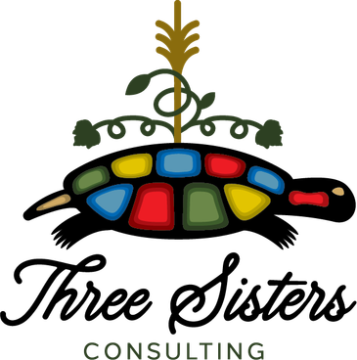
SESSION 01
2026
ENTREPRENEUR
DEVELOPMENT
PRESENTATION
WWW.THREESISTERSCONSULTING.COM

Slide 2
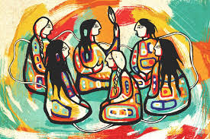
SESSION 01
2026
01
INTRODUCTION
02
OBJECTIVES
03
ENTREPRENEUR PROFILE
04
GROUP INTRODUCTIONS
05
MYTHS & MISCONCEPTIONS
06
BUSINESS STRUCTURES
Table of Contents
07
SUPPORTING ORGANIZATIONS

Slide 3
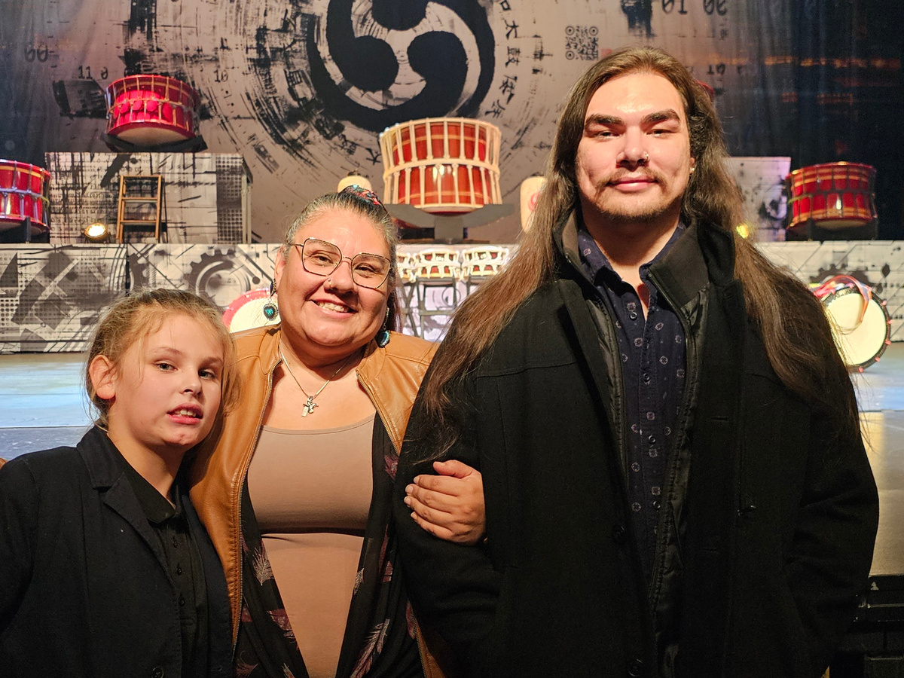
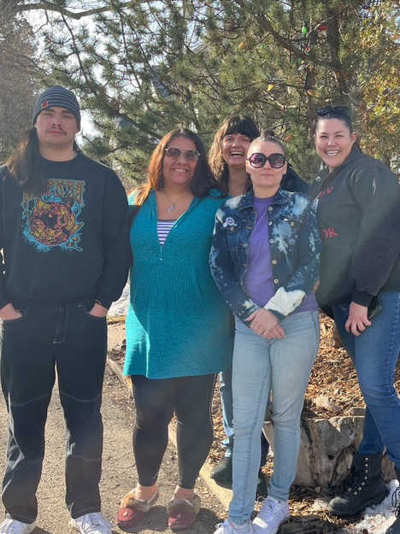
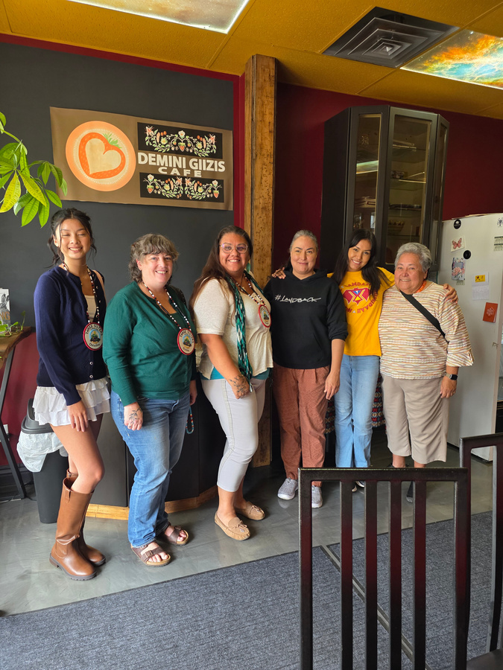
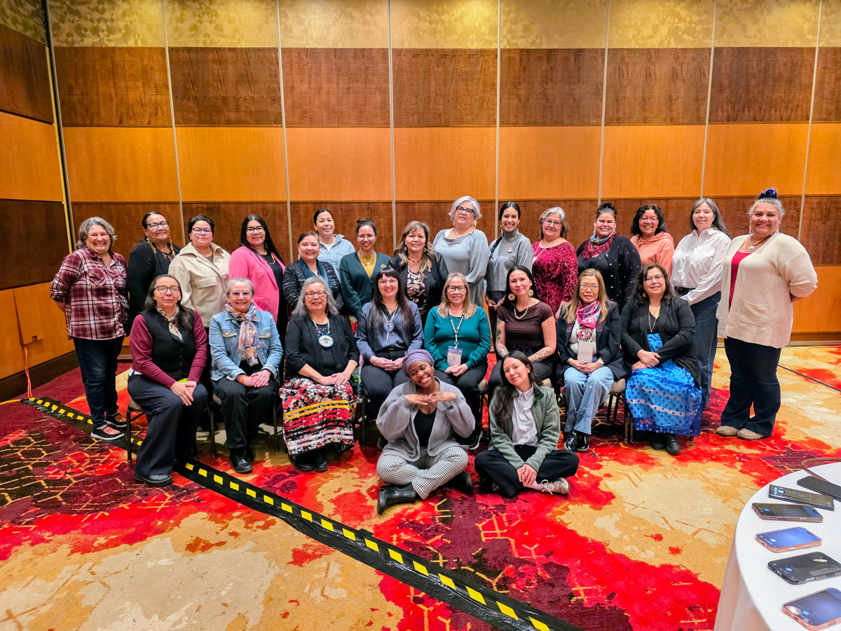
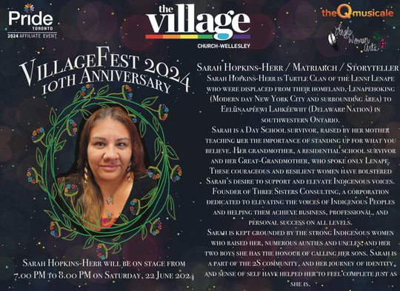
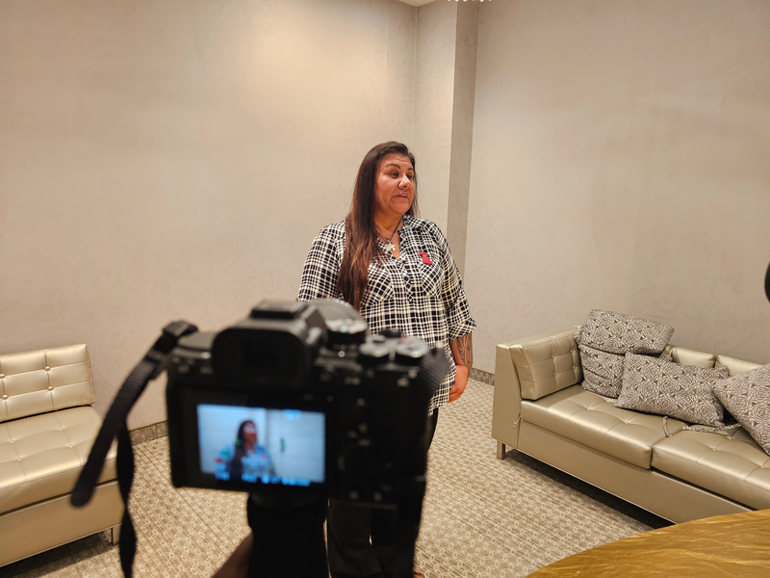
SESSION 01
INTRODUCTION
  Lenape mother of 2
  Three Sisters Consulting has been in operation since 2018
  Consulting - largely strategic planning, facilitation & engagement, training, coaching
TRAINING AND DEVELOPMENT IS A VITAL COMPONENT OF ORGANIZATIONAL GROWTH
WWW.THREESISTERSCONSULTING.COM

Slide 4
SESSION 01
PRIMARY OBJECTIVES
01
SHARING EXPERIENCES
02
LEARNING FROM EACH OTHER
OBJECTIVES
this year, OFNEDA is looking to grow entrepreneurial membership and provide supports to entrepreneurs by entrepreneurs. We learn from experiences and can support each other’s growth along the way. This helps us to stay grounded and empowers us to incorporate our identity into our business.
Participants are encouraged to share their journey and learning moments. How can we help each other?
There’s always opportunity to learn something that can help you in your entrepreneurial journey.

Slide 5
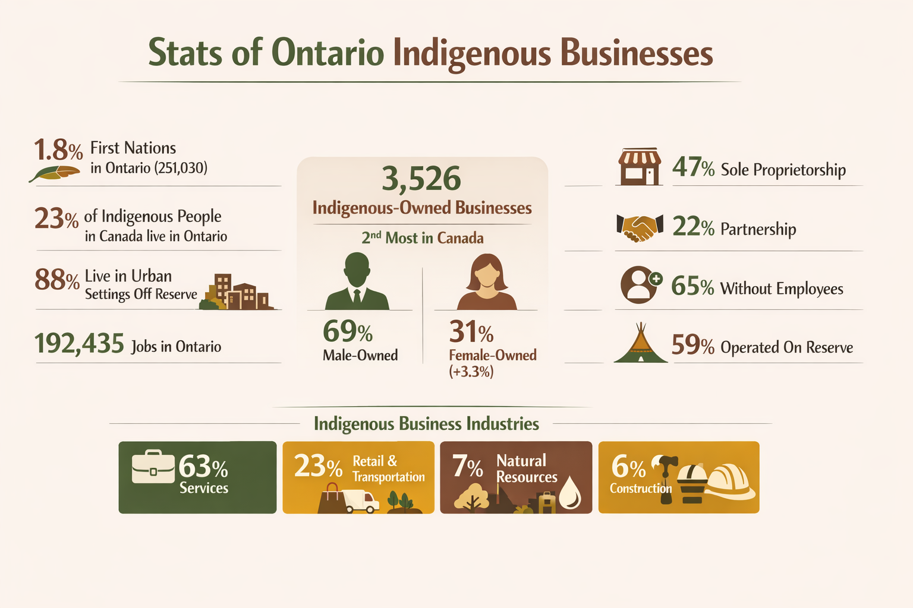
(+2.2%)

Slide 6
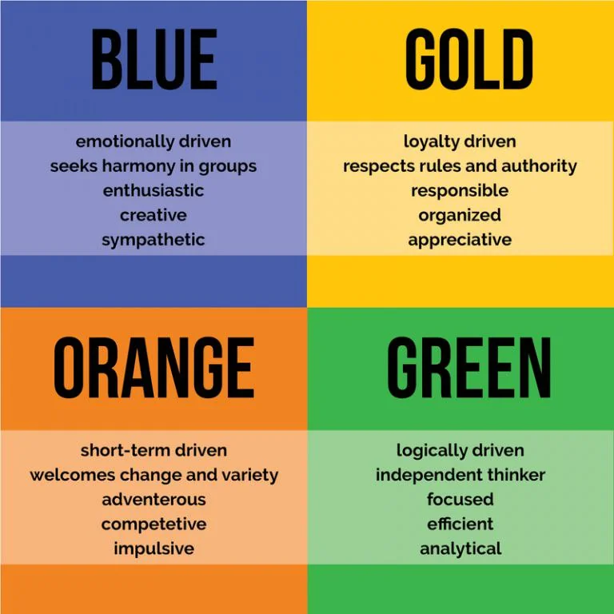
SESSION 01
TRUE COLOURS
BENEFITS:
  UNDERSTANDING YOUR STYLE OF LEADERSHIP
  LEARNING HOW TO COMMUNICATE WITH THOSE AROUND YOU
  SURROUND YOURSELF WITH A VARIETY OF PERSONALITIES TO FIND BALANCE

Slide 7

01
WE DON’T PAY TAXES
We still pay HST when taking on off reserve clients, payroll taxes and corprate taxes.
SESSION 01
02
ECONOMIC SUCCESS UNDERMINES INDIGENOUS IDENTITY
MYTH
COMMON MYTHS ABOUT FIRST NATION BUSINESS
When we’re successful, this is often accompanied by imposter syndrome and a feeling of “selling out”
03
SMALL BUSINESS IS INEXPERIENCED
We typically operate small businesses but with a deep level of expertise accompanied by cultural grounding & understanding.
Some of these myths come from the outside out, some come from within us. All should be addressed. Sometimes saying the words out loud allow us to move past the myths that stop us, slow our progress or cause us to overthink our direction.
04
WE RELY ON GOVERNMENT FUNDING
The assumption is that because there’s set aside funding that we’re “cashing in” however, the reason there is set aside funding is because of the generations of lack of support.

Slide 8

SESSION 01
2026
01
COMMON STRUCTURES
02
COMMUNITY - OWNED MODELS
  Sole Proprietorship
  Partnership
  Joint Venture
  Corporation
  Economic Development Corporation
  Band-Owned Enterprise
  Non-Profit
BUSINESS STRTUCTURE
THERE IS NO ONE WAY
The structure can change over time as your business, focus, and area of operation changes. It’s important to know the structures up front to be prepared in advance of change to allow time to create and adapt to the new structure.

Slide 9
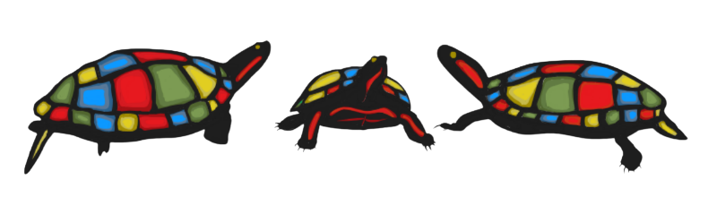
SESSION 01
BUSINESS SUPPORTS
The first outreach I recommend is to your Economic Development Officer. They have contacts to all the options below and more. Often, as entrepreneurs, our needs are in many areas and they can help to find the best fit.
01
IFI’S & CFDC’S
02
BANKS
02
MEMBERSHIP
Loans, some grants, workshops, specific areas of focus including women in business. Some mentorship - regional focused.
Major banks have an Indigenous-focused department. It’s important to develop a relationship with your bank.
CCIB and CAMSC are national organizations that provide workshops and self-guided training. They also provide verification of Indigenous Businesses and promote our business with corporate clients.

Slide 10
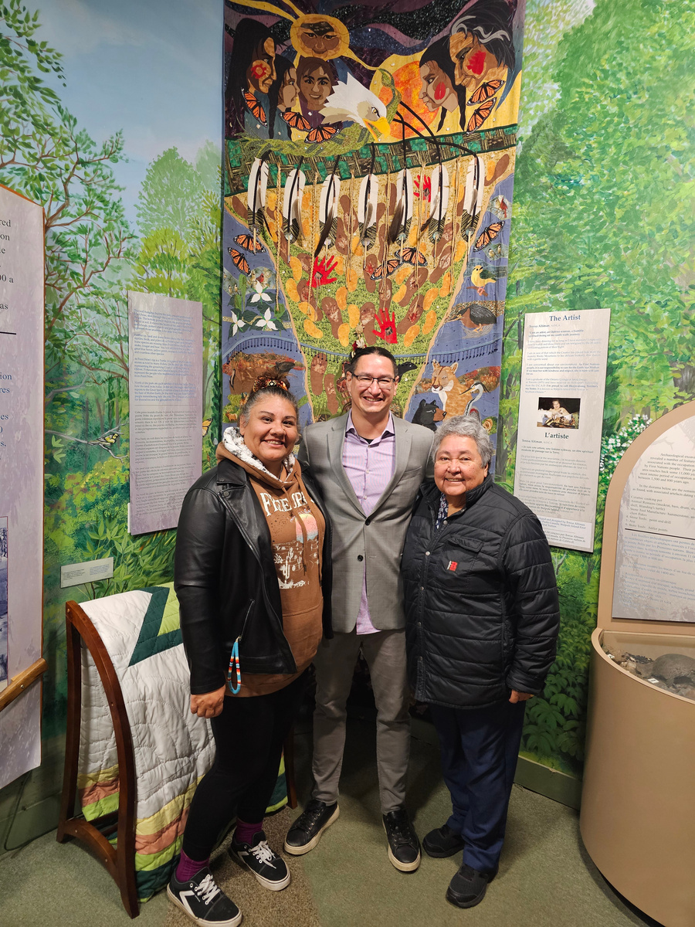
SESSION 01
2026
ANUSHIIK
FEEDBACK IS A GIFT, PLEASE CONSIDER SHARING YOUR EXPERIENCE WITH US.
WWW.THREESISTERSCONSULTING.COM

