Slide 1

Personal Finance & Your Business
Entrepreneur Development Presentation Session 02

Slide 2
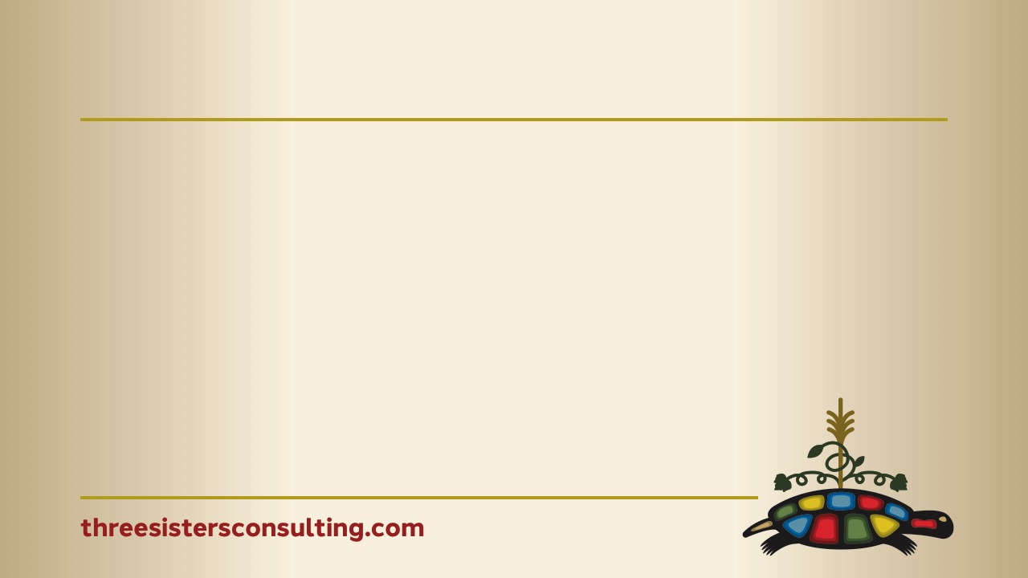
SESSION 02
Primary Objectives
Understand the impact of personal finances on your business
Learn some common financial habits that hold entrepreneurs back and how to prepare/avoid them
Learn to use tools that will help personal and business finances
Share Something, Learn Something. We’ve all had different experiences, and the benefit is that we can all sit together and share those experiences to help each other grow stronger businesses.

Slide 3
Table of Contents
Introduction & Objectives
Why Personal Finance Matters
The Reality: First Nation Business Stats
How Credit Impacts Your Business
Common Financial Mistakes
Myths About Credit
Tips to Improve Your Credit Score
Separating Personal & Business Finances
Building Financial Habits That Last
Tools & Resources
www.threesistersconsulting.com

Slide 4
SESSION 02
Roundtable Introductions
Money doesn’t need to be an uncomfortable topic. It is a tool for self-determination

Slide 5
SESSION 02
First Nation Business Stats in Ontario
8% of Indigenous Businesses used bank loans compared to 31% of non Indigenous small businesses in Canada
First Nations firms access roughly one tenth of the financing available to comparable mainstream businesses.
47% are sole proprietorships | 65% operate without employees on par with Canada
59% are operated on-reserve
47% of Indigenous women-owned businesses have NO lending relationship with any financial institution
Indigenous people earn 70 cents for every dollar non-Indigenous Canadians earn (national stat)
Access to capital is the #1 barrier for Indigenous entrepreneurs

Slide 6
SESSION 02
Why Personal Finance Matters
Your personal finances and your business are more connected than you may know
Banks look at your personal credit when you apply for a business loan
A low personal credit score can block access to startup capital
Personal debt can bleed into your business cash flow
Financial stress impacts decision-making and leadership
Your financial health is your business health — especially in the early years

Slide 7
SESSION 02
What Makes Up Your Credit Score
35% Payment History — do you pay on time? This is your biggest lever
30% Credit Utilization — how much of your available credit are you using? Aim below 30%
15% Length of Credit History — how long have you had credit?
10% Types of Credit — mix of credit cards, loans, lines of credit
10% New Credit Inquiries — how often are you applying for new credit?
Note: Payment history and utilization are the two biggest levers you can control — focus here first

Slide 8
SESSION 02
How Your Credit Score Affects Your Business
Banks review personal credit when approving business loans — especially for new businesses
Low score = higher interest rates or outright rejection before your business opens its doors
37% of Canadian small business owners use personal savings to fund their business
34% use personal credit cards for business expenses

Slide 9
SESSION 02
Common Financial Missteps
Mixing personal and business finances — using one account for both
Ignoring your credit report until you need a loan
Carrying high credit card balances (high utilization)
Making minimum payments only
Co-signing loans without understanding the risk
Not tracking monthly expenses (sometimes weekly is needed)
Letting bills go to collections
Using payday loans — high interest traps

Slide 10
SESSION 02
Myths About Credit — Let's Break Them Down
MYTH
FACT
Checking my own credit score hurts it
I have to carry a balance to build credit
Closing old accounts improves my score
Bad credit is forever
I only need good credit for a mortgage
Soft checks do NOT affect your score — check it for free anytime
Paying in full every month HELPS your score
Closing old accounts can HURT your score by reducing credit history
With the right habits you CAN rebuild — it takes time but it works
Lenders check it for business loans, leases, and supplier agreements too

Slide 11
SESSION 02
Tips to Improve Your Credit Score
Pay bills on time — set up automatic payments today
Pay down credit card balances — aim to use less than 30% of your limit
Do NOT close old credit accounts
Avoid applying for multiple credit products at once
Check your credit report for errors — free through Equifax (equifax.ca) and TransUnion (transunion.ca)
Ask suppliers to report your payments to credit bureaus
Start small — a secured credit card or small line of credit can help build history

Slide 12
SESSION 02
Separating Personal & Business Finances
Open a dedicated business bank account ideally from Day 1
Apply for a business credit card — separate from personal spending
Keep your business receipts and expenses tracked
Pay yourself a salary rather than spending business revenue directly
This protects your personal credit AND builds a business credit history
Your future self will thank you at tax time

Slide 13
SESSION 02
Building Financial Habits That Last
WEEKLY — Review your account balances. Know where you stand.
MONTHLY — Track income vs. expenses. Are you ahead or behind?
QUARTERLY — Review your credit report. Catch errors early.
ANNUALLY — Set a financial goal: savings target, debt reduction, or investment.
Use a simple budget tool — even a spreadsheet works
Talk to your Economic Development Officer — they can connect you to other resources specifically designed for First Nations Entrepreneurs i.e. IFI’s, Indigenous Departments of conventional banks.

Slide 14
SESSION 02
Tools & Resources
Free Credit Reports — Equifax Canada (equifax.ca) and TransUnion Canada (transunion.ca) or Credit Karma to help learn the impact of your financial decisions
Indigenous Financial Institutions (IFIs) & CFDCs, NACCA — loans, coaching, and workshops
Canadian Council for Indigenous Business (CCIB) — business supports and verification, financial tools and workshops
Your local Economic Development Officer — your first call for all of the above

Slide 15
SESSION 02
Your Financial Starting Point
This is a judgment-free zone — we all start somewhere
Reflection questions for the group:
→ Do you know your current credit score?
→ Do you have a personal budget?
→ Do you have separate personal and business accounts?
→ What is one financial habit you want to build this month?
Share only what you are comfortable sharing
Learning from each other is part of the journey

Slide 16
SESSION 02
Your Action Plan
Before you leave today, write down 3 things:
ONE thing you will do THIS WEEK — e.g., check your credit report for free
ONE habit you will build THIS MONTH — e.g., set up automatic bill payments
ONE goal for the next 6 MONTHS — e.g., reduce credit utilization below 30%

Slide 17

SESSION 02
Anushiik
Your financial health is part of your sovereignty.
Managing your money is an act of self-determination.
You are not alone in this journey.
Feedback is a gift — please consider sharing your experience with us.

