Slide 1
OFNEIDA
Intro to
Communications
for Community
Economic Development
Presented by
Locality
Consulting
localityconsulting.com
Communications Training

Slide 2
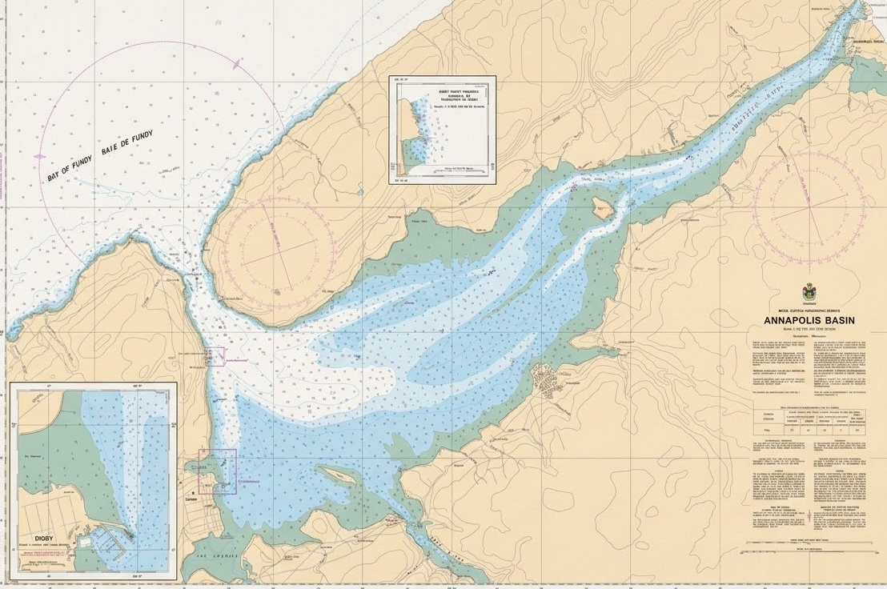
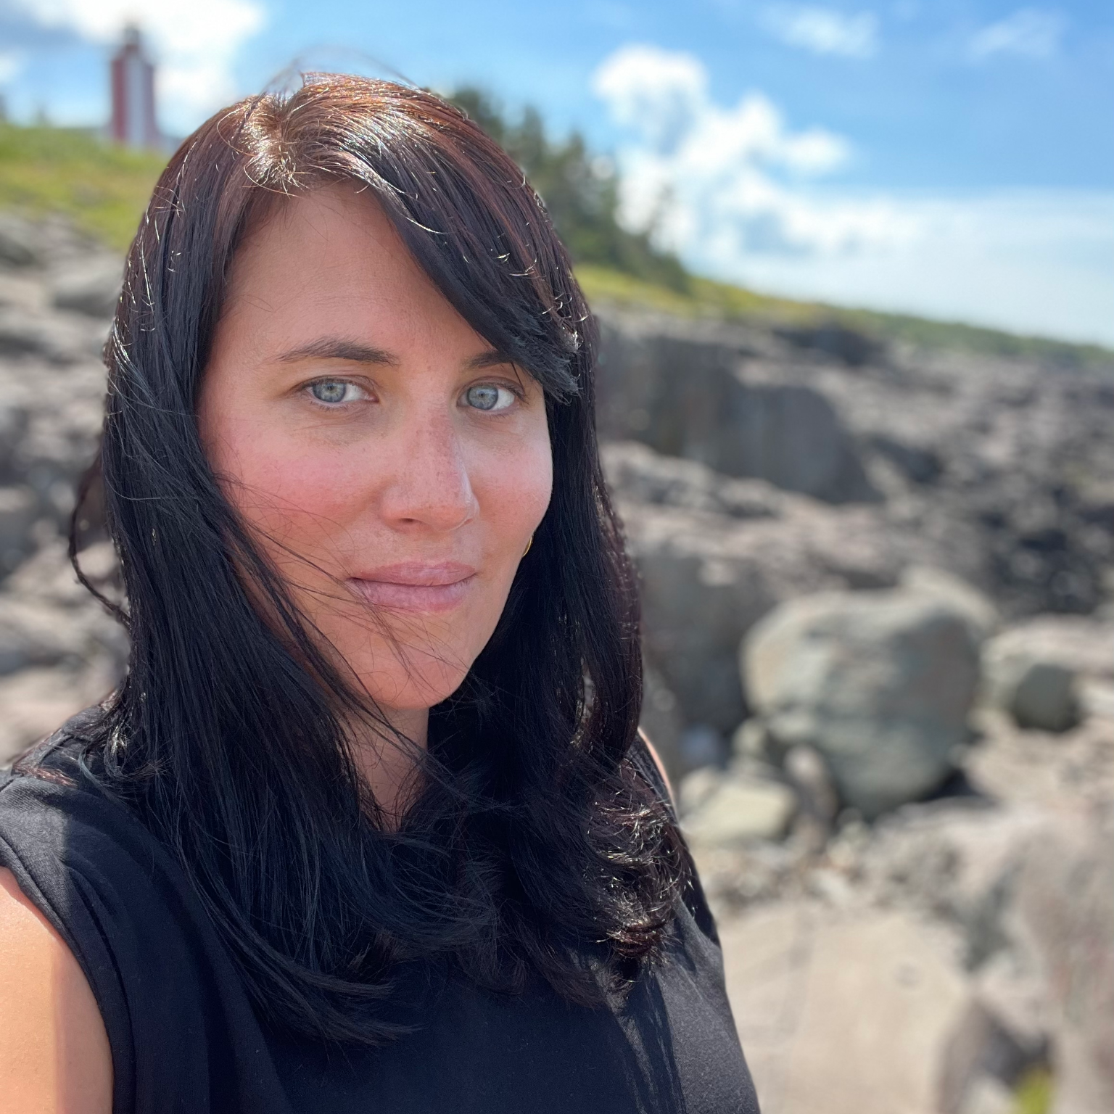
Who Are We?
Caroline Starr
Economic Development + Communications
Locality Consulting
Economic development consultant: I work with private and public sector partners, in a range of industries
Masters of Economic Development and Innovations: U Waterloo, Member of EDCO
Invested in community-led economic development
Interested in small communities and rural economic development
Background in communications, marketing, entrepreneurship
From: Digby in Southwest Nova Scotia
Kespukwitk (lands end, or end of flow in Mi’kmaq)
Nearest community: Mi’Kmaq - L’Sitkuk (Bear River FN)
About 380 members on/off res; 2000-4000 year history in that location
Traditional meeting place for Wabanaki Confederacy
First FN to have continuous contact with settlers (1605)
Own majority share of The Pines, an old CN Railway resort
Involved in fisheries & traditional crafts (birch canoes, baskets, wooden flowers)
localityconsulting.com

Slide 3
About Your Facilitators
Locality Consulting
What We Do
1
Brand Strategy & Design
We help communities bring their economic development plans to life.
2
Destination Development
Locality is a Canadian consulting group specializing in economic development strategy, place branding, and destination marketing.
We partner with municipalities and regions to uncover their unique strengths, share their story, and drive sustainable local growth.
We also love to partner with people from our amazing network!
3
Economic Development Strategy
4
Campaign Strategy & Creative
5
Fractional Ec Dev, Marketing, and Comms Support
localityconsulting.com
Notes:
CS

Slide 4
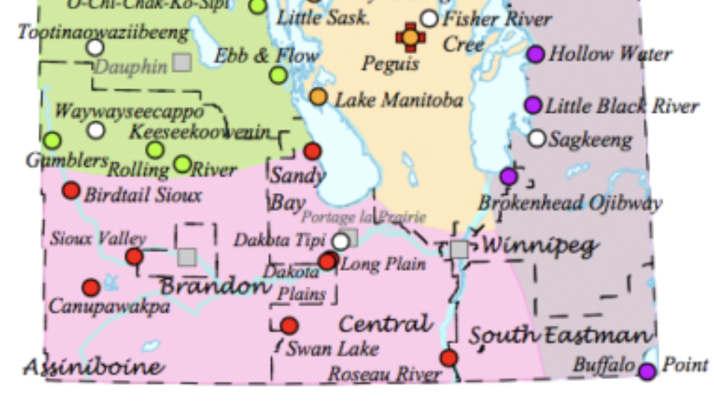

Who Are We?
Katherine Skene
Vice President, Marketing & Communications (Interim)
Crohn’s & Colitis Canada
Communications, government relations, and strategy consultant
I am most passionate about work that serves a public good: non-profit; government; post-secondary; community organizations
Invested in building strong team dynamics and productive relationships
From: Brandon, Manitoba, Treaty 2 Territory
Nearest community: Sioux Valley Dakota Nation
The largest Dakota Nation in Canada, with approx.2,500 members
Never a signatory to Canada's numbered treaties; achieved full self-government effective July 1, 2014,
Recently reopened Grand Valley Park, one of Manitoba's most significant bison-kill sites, with a history of 1,000+ years
localityconsulting.com

Slide 5
Agenda
01
Internal Communication 101
02
External Communications
03
Workshop
04
Using AI Without Losing Your Voice
05
Wrap-Up
localityconsulting.com

Slide 6
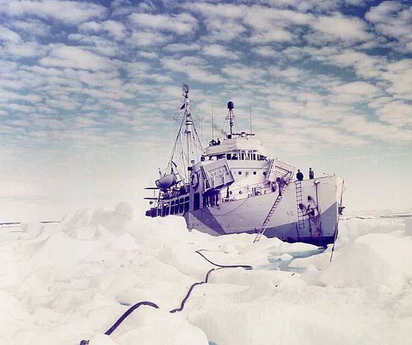
Notes:
KS
Icebreaker! Tell us why you’re here!
OR
When was a time when you felt something was poorly communicated to you?

Slide 7


SECTION 01
Internal Communication 101
Communicating with Colleagues and Community
localityconsulting.com
Notes:
CS I’ve put a phone here because I’m old school. I like picking up the phone after an email. Today, picking up the phone isn’t done all that often, so it kind of stops people in their tracks and usually it ends up resulting in a better conversation than I’d have over email.
This presentation mostly talks about written communication, but I wanted to note upfront that the principles still apply on the phone, or on zoom or teams or whatever you use.

Slide 8

communications is an exercise in trust.
localityconsulting.com
Notes:
KS Communication and trust are inextricably linked. You cannot have meaningful, effective communication without trust, and trust cannot be established or maintained without communication. When people feel they can express themselves safely, they are far more likely to collaborate and share valuable feedback.
Because strong relationships require a balance of both, you can approach this dynamic in many practical ways:
Radical Transparency: Be open about successes, failures, and the "why" behind your decisions to build credibility.
Consistent Delivery: Ensure that your words consistently align with your actions over time.

Slide 9
Writing with Purpose
Before you write, some questions:
Why am I writing this?
Who needs to read this? What do I know about them (role +capacity)?
What do I need them to do in response?
Structure follows purpose:
Lead with the ask or conclusion, then provide context
Keep it tight! Everyone is busy
Use subject lines, headers, and bullets to aid scanning when it makes sense
localityconsulting.com
Notes:
CS I’m looking for some help with a request I got about a CBA. Who is the best person to help with this?

Slide 10
Internal Communication: An inquiry
Subject: CBA update request from the gold mine
Hi John,
I got a request to discuss updates to the CBA from the new mine manager. Can you tell me who the best person is to handle this request?
Thanks,
Jane
localityconsulting.com
Notes:
CS This feels like a simple email, but anyone who has received one of these emails knows that it’s not. CBAs are relationship documents, and often have high stakes for communities, so asking for the best person implies a lot of trust to make that connection, and handle this request on behalf of community.

Slide 11
Reaching a Range of Internal Audiences
trending_upLeadership & Decision-Makers
•Lead with the recommendation or ask, in the subject line when possible
•Summarize the need to know information
•Frame impact in terms of relevance and importance
groupsFrontline Staff & Colleagues
•Be specific about what you need from them
•Give context: the 'why' matters for buy-in
•Use straightforward language
•Acknowledge workload and constraints
•Invite questions and feedback explicitly
localityconsulting.com
Notes:
KS

Slide 12
SECTION
02
External Communications
Speaking for community to partners and beyond.
localityconsulting.com

Slide 13
Writing for Specific Audiences
Know Your Audience First
Adapting Your Message
What do they already know about you?
What do they care about? (outcomes vs. process) How do you want them to feel?
What action do you want them to take?
What tone matches your relationship with them?
Government vs. partner vs. media vs. community member
Partner: align to their priorities and language
Government: formal, precise, evidence-based
Media: clear hook, short sentences, quotable lines
Community: accessible, warm, action-oriented
Always define acronyms; even familiar ones
localityconsulting.com
Notes:
KS

Slide 14
Set Expectations.
localityconsulting.com
Notes:
CS If you need to take an external request to your council, or other stakeholders, or anywhere and this takes X amount of time, tell them that. If you don’t work on Friday, stick it in your signature.
If summer is a slower season for you (which should be the goal for all of us), make that clear. You don’t owe anyone a response under some capitalist construct of a response time. You do yourself a service by setting an expectation that the response will come when it comes.
If things work a certain way in your community, then they work a certain way in your community. Share as much as you feel you need to, as clearly as you can to ensure people understand how the relationship will work

Slide 15
External Communication: Responding to an inquiry
Subject: engaging with consultants about mine
An in-person meeting is preferred, ideally in the morning, as this is the most appropriate way to begin meaningful dialogue with First Nation communities. This format would allow for proper introductions, a clear understanding of the study's purpose, scope, methodology, and intended data use, and an initial discussion of how X First Nation may wish to participate.
Before confirming participation, I will review this internally and seek direction from Lands and Resources and X, including in relation to the existing IBA and original covenants.
Prior to any engagement proceeding, please provide:
Proposed scope of work, methodology, and engagement plan;
Any interview, survey, or session materials;
Clarification on how FN citizen, staff, and community information will be stored, used, reported, and protected;
Confirmation of FN's opportunity to review findings before finalization;
Clarification on whether this study connects to ESG reporting, permitting, IBA implementation, or other company purposes.
Once internal direction is received, I will follow up with FN's preferred next steps.
localityconsulting.com
Notes:
CS This is based on a response I received from a FN around consulting on behalf of a mine. It’s very clear, and sets expectations around how engagement might be conducted, and provides the FN’s expectations.
This was a really great email. It set clear expectations for engagement, and boundaries. It doesn’t make things easy, but it is authentic, and to be expected, given past relationships.

Slide 16
Writing Impactfully: Two Core Principles
Active voice. Fewer words. Every time.
1. Prioritize Active Voice
Direct Action: 'The committee approved the plan' vs passive construction.
Intentionality: Passive voice creates distance; can be used but be deliberate about when and why.
Strong Verbs: Use 'secured', 'launched', or 'delivered' to drive momentum.
2. Practice Economy
Cut the Clutter: If a sentence still makes sense without a word, cut it. Less is more.
Focused Paragraphs: Limit each paragraph to one core idea for clarity.
Clear Requests: Maintain a high response rate by sticking to one ask per email.
localityconsulting.com
Notes:
KS

Slide 17
Active Voice vs. Passive Voice
Active Voice
What it is:
The subject of the sentence performs the action. It is direct, clear, and takes responsibility.
Example:
"The committee approved the plan."
Benefit:
Creates momentum and demonstrates leadership.
Passive Voice
What it is:
The subject receives the action. It can be wordy and sometimes obscures who is acting.
Example:
"The plan was approved by the committee."
Use case:
Use intentionally to create distance between something or when downplaying the action..
localityconsulting.com
Notes:
KS CS Let’s pause here for a minute and come up with some examples of each!

Slide 18
KEEP IT TIGHT.
localityconsulting.com
Notes:
CS I am the person in every ec dev consulting conversation saying this report is too long. No one will read this if it’s too long. No one will execute if if they don’t read it. It needs to written at a level that your audience can access.
This week, I cut a 100 page report for community stakeholders down to 35, and firmly made a case for it. As an economic developer, I don’t want to work on reports that stay on the shelf. I want to create things that communities can sell to their stakeholders and execute.
This is a value I bring to my work, and it comes from taking a comms lens to my work. If you want people to buy into your work, they need to understand it.

Slide 19
External Document Types: Overview
Correspondence
Email: requests, responses, follow-ups, setting timelines
Crisis and urgent communications
Formal Documents
Press releases
Memoranda of Understanding (MOUs)
Partnership & Funding
Working with partners through communications
Report writing | Grant writing
localityconsulting.com
Notes:
KS

Slide 20
Email: Getting It Right
Request & Response
Follow-Up Etiquette & Timelines
Subject line = a complete summary, not a topic
Open with the ask or the answer -- not background
State what you need, by when, and why
One email, one ask where possible
If responding: restate the question briefly, then answer
Acknowledge if you can only partially respond
Set expectations upfront: 'I'll have this to you by Friday'
If you miss a deadline, acknowledge it before they ask
Follow-up rule: wait 3-5 business days before nudging
Frame follow-ups as check-ins, not pressure
Always confirm next steps at the end of a thread
Use 'no reply needed' when appropriate
localityconsulting.com
Notes:
KS

Slide 21
Don’t be afraid to say the wrong thing. Everyone does.
localityconsulting.com
Notes:
KS

Slide 22
Crisis Communications.
localityconsulting.com
Notes:
CS

Slide 23
Crisis & Urgent Communications
Balancing clarity and speed
1. Acknowledge Something Has Happened
Confirm you are aware of the situation immediately to build trust.
2. Be Transparent
Share what you know, what you don't know, and what you're doing.
3. Don’t Say it if it isn’t True
‘We are investigating' is honest and appropriate. Stick to the facts.
4. Keep it Tight.
Short, direct messages are more effective in a crisis.
localityconsulting.com
Notes:
CS

Slide 24
Crisis & Urgent Communications
Crisis communication checklist
Internal Awareness
Who needs to know internally first? Establish a clear chain of communication.
Public Dimension
Determine the public-facing dimension and prepare a holding statement.
Core Message
What is the single most important message that needs to be shared right now?
Timeline Commitment
Commit to a timeline for updates, even if the next update isn't immediate.
Tone: Calm, direct, empathetic — not defensive
localityconsulting.com
Notes:
KS

Slide 25
Communicating about communications.
localityconsulting.com
Notes:
KS

Slide 26
Press Release: Structure and Purpose
When to use it
A major announcement, funding win, new partnership, event, or milestone
Standard structure
Headline: newsy, specific, active voice
Lead paragraph: who, what, when, where, why (1-2 sentences)
Body: supporting detail, context, data
Quote: from a leader or community member. Make it genuine and in their voice!
Boilerplate + contact information
Key rule
Journalists rewrite press releases; give them good raw material but don’t be surprised if they pull material directly from the release
localityconsulting.com
Notes:
KS

Slide 27
Partnership to focus on Indigenous-led procurement and support community-driven economic growth
Ohsweken, ON, April 29, 2025 – Six Nations of the Grand River Development Corporation (SNGRDC), the economic development arm of the Six Nations community, and MSS Ltd. (MSS), and Indigenous-led procurement company based in the Northwest Territories, agreed to terms on March 18, 2025 to form a Joint Venture (JV) to leverage Indigenous procurement opportunities to drive economic growth and sustainability. SNGRDC holds a majority interest of 51%, with MSS holding a 49% interest.
“We are excited to partner with MSS, an organization that aligns with our values of promoting Indigenous economic prosperity and community development,” said Matt Jamieson, President & CEO of Six Nations of the Grand River Development Corporation. “This Joint Venture represents a major step forward in enhancing Indigenous participation in national markets, and SNGRDC is proud to be at the forefront of these transformative efforts.”
The Joint Venture will serve as a platform to supply a range of products, including healthcare supplies and equipment, occupational health and safety products, office and institutional furniture, and more. The JV will also provide specialized services, including supply chain solutions, logistics management, and procurement advisory services to public and private sector customers. The Joint Venture will serve as a transformational initiative for Ontario governments, institutions and businesses to accelerate and advance the journey towards economic reconciliation.
This partnership expands MSS Ltd.’s Canada-wide network of Indigenous partners, creating new opportunities for the Six Nations community through the generation of sustainable own-source revenue. This collaboration underscores the power of Indigenous-led businesses to promote economic growth and long-term self-sustainability, demonstrating their ability to thrive in a rapidly changing global market.
“Our team at MSS Ltd. is committed to working alongside the Six Nations Development Corporation to co-develop initiatives focused on design, economic growth, and socio-economic advancement that will generate lasting benefits for the Six Nations community,” said James Hiebert, President of MSS Ltd. “Together, we aim to champion social benefit procurement practices that promote health equity, shared prosperity, and economic reconciliation across Ontario for generations to come. As a proud member of Six Nations, I’m honoured to reconnect with my community and collaborate on delivering industry-leading solutions that serve Indigenous and non-Indigenous businesses, governments, and municipalities alike.”
To learn more about MSS and their mission of fostering health equity and social prosperity, visit www.mssltd.com.
Notes:
KS

Slide 28
FOR IMMEDIATE RELEASE October 29, 2025
WEBEQUIE FIRST NATION AND THE PROVINCE OF ONTARIO SIGN COMMUNITY PARTNERSHIP AGREEMENT TO ADVANCE CRITICAL INFRASTRUCTURE AND ECONOMIC DEVELOPMENT
WEBEQUIE FIRST NATION, ON -- Webequie First Nation (WFN) and the Province of Ontario have entered into a new Community Partnership Agreement that advances planning for the proposed Webequie Supply Road (WSR) and provides new investments in priority community infrastructure and economic development initiatives. This Agreement reaffirms a government-to-government relationship grounded in mutual respect, partnership, and shared benefit. It supports ongoing efforts to enhance community well-being and prosperity, the protection of WFN's way of life, critical infrastructure and economic development, including opportunities in the Ring of Fire.
The planning for critical infrastructure is being undertaken in alignment with Webequie First Nation's three-tier model (Kanisso Pittawa Attayk Onakoooniskin), which protects traditional areas and ways of life while guiding responsible, sustainable, and equitable development.
Says Chief Cornelius Wabasse, Webequie First Nation: "For over a decade, we've worked to build cooperative relationships with industry and government, strengthening understanding of our community's priorities and shaping more principled, respectful approaches to development in our territory. While this work continues, we remain proactive and ready to partner in good faith. This Agreement with Ontario establishes an important foundation for cooperative planning, respectful decision-making, and meaningful participation in shaping the future of our lands and our community."
Ontario's $39.5 million investment will address urgent community priorities identified by Webequie First Nation, including resources for mental health and social supports and a new indoor multipurpose facility for sports, recreation and social gathering. In addition, funding will support local jobs and the procurement of materials and equipment needed to begin early work for the road to the Ring of Fire. The agreement will also rebuild and upgrade the community airport, which will serve as a regional transportation hub, and explore additional all-season road links for Webequie First Nation to the rest of the province.
Media contact: Michael Fox, michael.fox@indigenousengagement.ca, 807-472-6147
Notes:
KS

Slide 29
Writing With And About Partners.
localityconsulting.com
Notes:
CS

Slide 30
Memoranda of Understanding (MOUs)
What is an MOU?
A formal agreement outlining the terms of a partnership or collaboration
Not legally binding in most cases but sets shared expectations
There are many templates for MOUs available, but they require modification to meet objectives
Core elements
Purpose and scope | Roles and responsibilities of each party
Resources contributed (funding, staff time, in-kind)
Duration, renewal, and exit terms | Decision-making protocols
Practical tip
Negotiate the MOU before the relationship starts, not after tension arises
localityconsulting.com
Notes:
CS

Slide 31
MOU Examples
Six Nations: Tiny Homes MOU (2024)
A partnership between the development corporation and housing authority to enable affordable homeownership. It created a clear purchase pathway for community-built tiny homes through existing loan programs—a practical model for internal economic development.
Matawa & Lakehead: Education MOU (2025)
Formalized a partnership between a First Nations education authority and a public school board. Signed on-territory, it expanded student opportunities and showed how MOUs bridge institutional partners on community terms.
Kahnawà:ke & Canada: Governance MOU (2024)
Established a framework for exploring inter-governmental agreements across governance, land, and economic development. This serves as a relationship-building tool rather than a transactional deal.
Fort McKay & Suncor: Resource MOU (2024)
Explores oil sands development on reserve lands with the Nation as the landowner and lead voice. It aims for "sustainable prosperity" while upholding environmental stewardship and economic sovereignty.
localityconsulting.com
Notes:
CS

Slide 32
Working with Partners Through Communications
Communications is relationship infrastructure
Define communication norms at the start: frequency, channel, tone
Agree on who speaks externally on behalf of the partnership
Common partnership communication challenges
Misaligned timelines: build in buffer and check-ins
Jargon mismatch: learn each other's language
Credit and attribution: clarify upfront in writing
Conflict escalation: agree on a process before you need it
Practical habit
Shared decision log or meeting notes sent within 24 hours
localityconsulting.com
Notes:
CS

Slide 33
Report Writing
Purpose first: who reads it and why?
Progress reports: funders want outputs, outcomes, and issues
Internal reports: leadership wants decisions and resource implications
Community reports: stakeholders want stories, plain language, and impact
Structure that works
Executive Summary (always first, always standalone)
Context -- activities -- outcomes -- challenges -- next steps
Writing discipline
Tables and visuals over walls of text
Every section earns its place. Cut what doesn't serve the reader.
localityconsulting.com

Slide 34
Grant Writing
Read the guidelines like a contract
Funders use rubrics: answer every question they actually ask
Use the funder's language and repeat priorities back to them
Common sections
Statement of need should be grounded in data and community voice
Goals and objectives: SMART, measurable, time-bound
Activities, evaluation, and organizational capacity
Budget narrative: justify every line and show value for money
Grant writing discipline
Write the budget and work plan first. The narrative should match them
Always get a fresh reader before you submit
localityconsulting.com

Slide 35
SECTION
03
Workshop
Hands-on practice with two document types of your choice
localityconsulting.com

Slide 36
WORKSHOP ACTIVITY
Workshop: Choose Your Two Document Types
1
2
3
Choose
Draft
Debrief
Select two document types from the day: Email, Crisis Communication, Press Release, MOU, Report, or Grant Writing
Using a real or realistic scenario from your community work, draft a short version of each document type (15 min each)
Share your drafts with a partner or the group. What was hard? What choices did you make? What would you do differently?
localityconsulting.com

Slide 37
Responding to an environmental situation.
Sharing a community art project.
Introducing a new entrepreneurship program.
localityconsulting.com

Slide 38
SECTION
04
Using AI Without Losing Your Voice
Tools, skepticism, and your community's identity
localityconsulting.com
Notes:
CS

Slide 39
Intro to AI and Large Language Models (LLMs) in Communications
What AI Tools Can Do FOR YOU
What AI Tools Cannot Do
Draft and revise text quickly
Summarize long documents
Suggest structure and format
Brainstorm ideas and alternatives
Check grammar and readability
Translate between registers (formal / plain)
Do initial research / pull sources (be specific)
Cut length and condense material
Know community history & relationships
Verify facts or access live data (usually)
Replace human judgment on tone and trust
Speak for lived experience
Take accountability for errors
Build relationships or navigate conflict
Make decisions about a response
Understand and account for human dynamics
localityconsulting.com
Notes:
KS

Slide 40
handyman
AI is a tool.
It’s not a strategy.
localityconsulting.com
Notes:
CS You risk losing legitimacy with overuse.

Slide 41
A Healthy Dose of Skepticism
AI is a tool. Your community's voice is not a feature to outsource.
AI models reflect the data they were trained on, including its biases
Generic AI outputs often flatten the specificity that makes community communications powerful
Always read AI-generated drafts critically: would your members recognize this as coming from you?
Fact-check anything that sounds like a statistic; AI can confabulate convincingly
AI cannot be accountable for errors in a funding proposal or press release, you are.
Paid versions protect your information, free ones do not. Some versions are more are more ethical than others. Do your research before subscribing to one, and then do it again in six months.
localityconsulting.com
Notes:
CS Acknowledge when biases have been/are problematic for FN communities.

Slide 42
Dear X,
This is presented as a strong, well-structured report that clearly positions X SITE as a future aerospace and defence hub rather than just a regional airport. Its biggest strengths are the integrated ecosystem approach, strong alignment with federal defence priorities and UAV demand, and a clear phased strategy that balances quick wins with long-term, high-impact opportunities. The differentiation—especially the air–sea testing capability and uncongested airspace—is particularly compelling and well articulated.
To strengthen it further, the report could be more concise by reducing repetition and would benefit from clearer financial details, a more defined anchor tenant strategy, and a stronger governance model. Overall, it is a highly credible and investment-ready plan with clear potential to attract funding and drive long-term regional growth.
Hopefully, the report will serve as a guide into the new future of the facility.
I did notice a couple spots that were xxx’d out on page 6. Not sure if that was intentional or an oversight.
localityconsulting.com
Notes:
CS This is an actual response I got from a federal funding officer who was asked by his superior to review a confidential report that the federal funding agency commissioned. I asked for feedback on the strengths of the plan, it’s viability, and any material that the funding agency would need to see to meet the terms of the funding and to receive further funding.
The officer put the report through Chat GPT, and probably an unpaid version, since the federal government notes:
AI cannot be the only source of information for important business decisions.
Attention!
Never input protected, classified or personal information into public generative AI tools. Use these tools only for suitable unclassified information.
It’s also completely not helpful to the exercise (if he was better at querying, it could have been helpful, to a point, but it still didn’t meet the federal government’s terms of AI use).
Anyone want to pick out the CHAT GPT specific tells in this email?

Slide 43
Using AI Without Letting AI Use You
Productive uses in your communications workflow
Give AI a first draft to react to. it’s easier than starting cold
Ask it to simplify, tighten, or translate a section you've already written
Use it to brainstorm headlines, subject lines, or report titles
Have it generate questions a funder might ask, then answer them
Be as specific as possible in your prompts
Guardrails to protect your voice
Always rewrite AI output in your own words before using it
Feed it your organization's actual documents so it can learn your style IF you have a paid version
Never submit AI-generated text without reading every sentence aloud
Create a 'voice guide': words you use, words you don't, values language
You should spend more time editing AI output than it took to generate it.
localityconsulting.com
Notes:
KS

Slide 44
Wrap-Up
lightbulb
Key Takeaways
Reviewing the core principles of effective communication and AI usage.
help_outline
Questions & Discussion
An open floor for clarifying concepts and sharing specific organizational challenges.
trending_up
Next Steps
Implementing your new communication infrastructure and relationship expectations.
localityconsulting.com
Notes:
CS

Slide 45
Key Takeaways
groups
Internal communications
Lead with purpose. Know your audience. Make it easy to act.
public
External communications
Active voice, fewer words, and document types are tools. Use the right one!
handshake
Working with partners
Communication expectations are relationship infrastructure. Set them early.
psychology
AI and your voice
AI can help you work faster. It cannot replace your community's story.
star
The most important communication skill
Knowing when to pick up the phone instead
localityconsulting.com
Notes:
KS - Be yourself in your communications and you can’t go wrong–authentic, transparent, honest, tailored to your audience. Leverage tools and channels as appropriate.

Slide 46
Thank You!
Hello@localityconsulting.com
OFNEIDA
Locality Consulting | localityconsulting.com

