Slide 1
What Planners Miss About Accessibility
(And How to Fix It) | APA Nevada Conference
Section 508, ADA Title II, and WCAG 2.1 AA in planning deliverables
Devin Crowley | Eric Hasty
October 2026
Notes:
So what is accessibility?
Let me ask you this. What happens when you send a PDF to someone who cannot see?
Will they be able to read it? What if the PDF is filled with photos and figures?
What happens if they are immobile and can’t move a mouse. Can they navigate it?
It’s the same with a website. These same questionss should be asked.

Slide 2
It Started With Our Own Documents
I audit our website every year. Then I looked at our documents.
1 color
Dozens
April 2027
behind most of the 1,500+ failures a PDF checker flagged in one of our proposals
of headings and text elements used it, so the same problem repeated everywhere
deadline for agencies serving 50,000 or more
One early choice showed up everywhere that color did.
Notes:
After rebuilding the company website and running accessibility audits, I noticed there were a lot of “invisible” issues.
Twice a year, or after any website change, I run an audit. First with automated checkers, then a keyboard, and then finally a screen reader. The checkers miss a lot. I found a set of tabs on our news page that someone using a keyboard couldn't reach, and it only showed up because I tried to navigate the page without a mouse.
Then I looked at our PDF documents. A single color was causing text contrast issues in over 1,500 locations in the document. This single color was used on dozens of headings and text elements, with a contrast ratio too low to read. One bad choice showed up everywhere that color did.
I'm here because one of our head planners thought this room should hear it. He knows how much I care about this topic, and he saw a chance to help the clients we work with get ready for what's coming and know what to expect when it arrives. The April 2027 deadline for larger agencies is close, and the work lands on the people who produce the documents.
My co-presenter, Eric, learned what that looks like in practice, on a set of handbooks that cost us far more than anyone expected. I'll let him tell it.

Slide 3
Our Workflow
The specialist
Devin remediates the documents: plans, PDFs, forms.
What he sees: the same mistakes on almost every project, made by people nobody ever told.
The planner
Eric produced an accessible plan set on a live project, on a deadline.
What he sees: which fixes are realistic when the plan is due Friday, and which ones had to be scoped months earlier.
Today you get both views.
Notes:
Eric and I are at opposite ends of the same document. I'm usually the one who gets it after it's finished and has to make it work. Eric's the one who had to produce it with a due date bearing down on him. So when I say "do this early," he's the check on whether that's realistic.

Slide 4
ADA Title II, Section 508, and WCAG 2.1 AA
ADA Title II: the obligation. Public entities may not exclude people with disabilities from their programs or information.
Section 508: the procurement standard. Applies to federal agencies and flows down through federally funded work.
WCAG 2.1 Level AA (Web Content Accessibility Guidelines): the technical test. What an auditor measures your document against.
Title II requires accessibility, WCAG defines it, and Section 508 carries it into your contract.
Notes:
These three get lumped together as "ADA stuff," and they're not the same thing.
Title II is the reason.
It's the law that says a public agency can't shut people out of its programs or information.
WCAG is the yardstick, a long list of specific rules that someone can actually test a document against.
And 508 matters because it's how all of this ends up in your contract, especially when federal money is involved.
WCAG has been updated to version 2.2 so realistically, you should be targeting that.
I'm not a lawyer, so take the legal fine print to your agency's counsel. For the day-to-day work, WCAG is the one you'll hear about.

Slide 5
The Deadline Moved One Year
The April 20, 2026 interim final rule pushed WCAG 2.1 AA conformance back one year. The requirements did not change.
April 26, 2027
April 26, 2028
Public entities serving 50,000 or more
Entities under 50,000, and all special districts
DOJ says it “fully anticipates implementing the regulation at the new deadline.” Nothing about your 2026 projects gets easier, because the documents you are scoping now will still be live in 2027.
In Nevada: NDOT requires contractors’ public-facing PDF deliverables to be accessible, and the State of Nevada ADA Technology Accessibility Guidelines require WCAG 2.1 AA for all electronic media and downloadable files which State entities publish.
Source: DOJ Interim Final Rule, 91 Fed. Reg. 20902 (Apr. 20, 2026); ADA.gov; State of Nevada ADA Technology Accessibility Guidelines.
Notes:
Don't let this slide relax you. It's a one-year delay, and only 6 months remain; that's all. The requirements are exactly the same. The dividing line is 50,000 people: larger entities have April 2027, smaller ones and special districts get 2028.
The City of Las Vegas and the City of Reno would fall under the 2027 deadline. Smaller towns like Mesquite, Boulder City, or Gardnerville would fall under the 2028 deadline.
Think about how long a plan stays on an agency's website. Whatever you're scoping this fall will still be posted when that first deadline hits.
On the Nevada side, NDOT and the state's own guidelines already expect this for PDFs.
You should be aware there is a lawsuit currently going through the system that is trying to reverse the date extensions, but nothing has come from it yet.

Slide 6
Who Is Responsible?
The scope of work you wrote: accessibility should be included in the scope.
The Word file you drafted: heading styles, table structure, and alt text are decided here. A PDF cannot be fixed later without redoing this.
The maps and exhibits you commissioned: a rasterized CAD sheet cannot be made accessible. That decision happened at the subconsultant.
The deliverable you accepted: once you sign off, the agency owns the compliance problem, not the consultant.
The public entity carries the legal exposure, and planners make the decisions that create it.
Notes:
The legal risk sits with the agency, but look at who makes the choices. The scope of work, the Word file, the maps, and the sign-off. Those are planner decisions, every one of them, and nobody downstream can undo them cheaply.
The last one is the one I'd underline. When you accept a deliverable, you've told the agency it's fine.

Slide 7
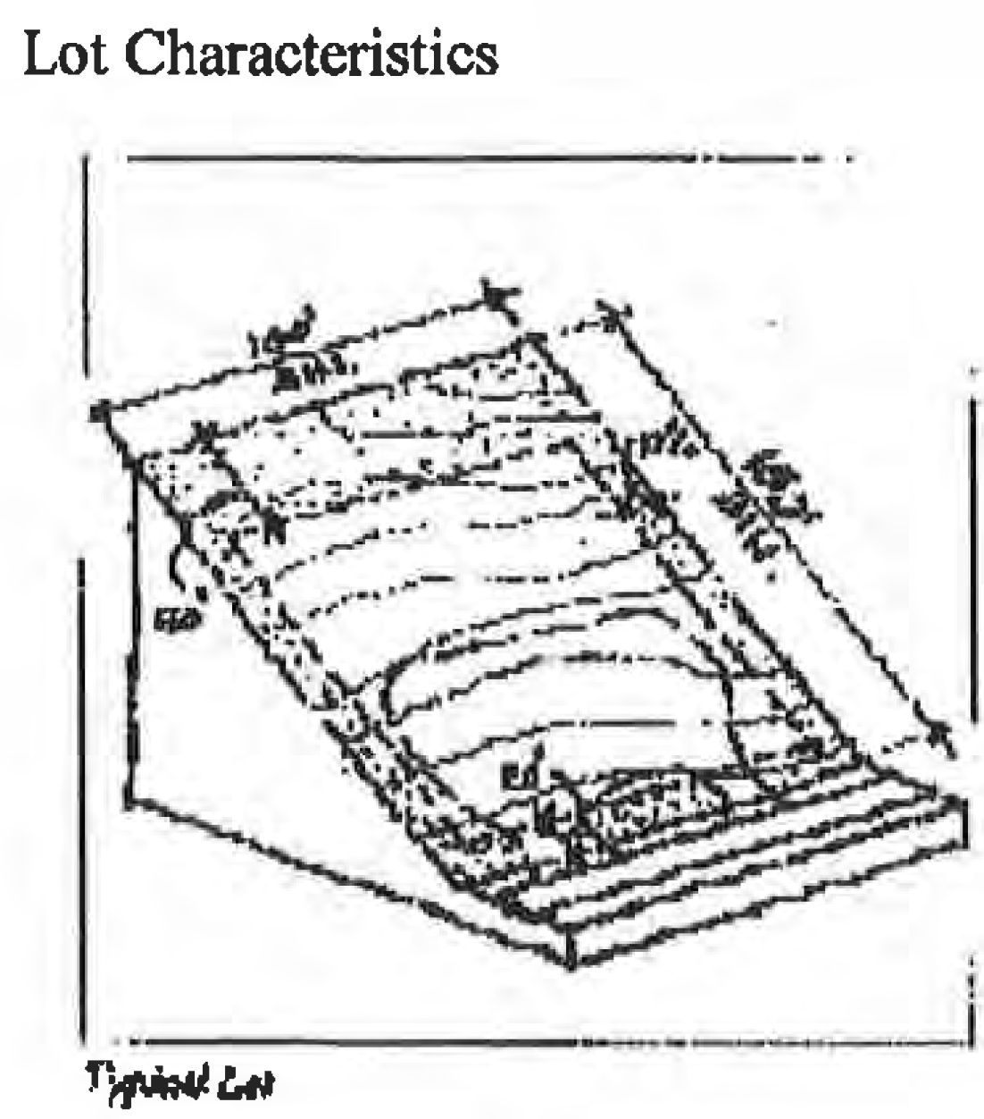
Case Study: City Design Handbooks
The document: two 1997 design handbooks still governing entitlements today.
The condition: scanned at 90 DPI. No text layer, no tags, no headings. A picture of a document.
The argument: legacy content, so Safe Harbor should cover it.
Why that failed: the handbooks are still actively used to make decisions, and they were being referenced and reissued. Safe Harbor protects content you leave alone.
The fix: rebuild the documents instead of remediating them. OCR on a 90 DPI scan only guesses at the text.
An example of an “Exhibit” that would have to be rebuilt (without source material)
Notes:
Here's a good example of a reasonable-sounding argument being wrong. Two design handbooks from 1997, scanned. To a screen reader, that's a blank page. The argument was that they're old, so they're covered. But Safe Harbor protects content you haven't touched, and these were still being used to decide entitlements, and still being reissued.
So we rebuilt them. OCR on a scan that rough gives you a guess, and a guess in a document that governs entitlements isn't something I'd sign off on.

Slide 8
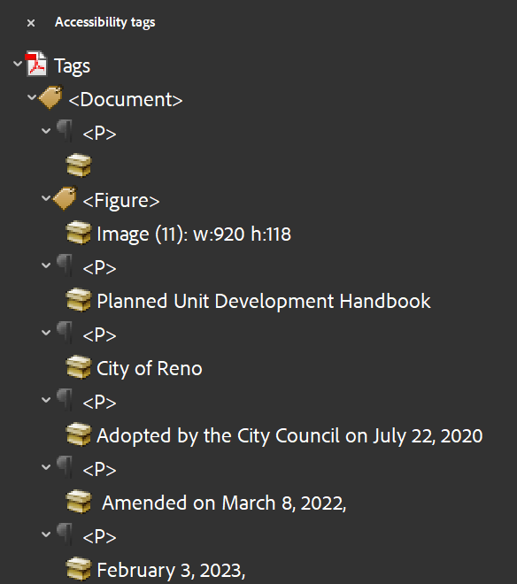
Case Study: Talus Valley
The document: large land development plan with a PUD Amendment, about 50 maps.
The condition: complex maps without alt text and no data tables, contrast issues, floating figures, and line breaks to position elements.
What was asked for: “make it an accessible PDF.”
The fix: added structure tags, corrected the reading order, add proper spacing between paragraphs, wrote alt text for each map, and moved the detailed map content into text or tables where it was too much for alt text.
Notes:
The request was to “make the PDF accessible." At first, it might sound like an easy task. Add alt text to a few figures, make sure there are proper headings, and no floating graphics or text boxes. Easy, right? Well, with Talus Valley, there were over 50 maps, the majority of which were too complex for alt text alone. We had to locate the data for each exhibit and generate tables based on their data. Maps with contrast or legibility issues had to be rebuilt.
Tags are labels hidden inside the PDF that say what each piece of content is, such as a heading, a paragraph, a list item, a table cell, or a figure. A screen reader can’t see the page. It reads the tags, in order. A page can look perfect and have no tags at all, which means a screen reader user hears nothing useful.

Slide 9
The Same Eight Failures, Almost Every Time
1. Contrast nobody measured
Agency brand colors at 3.1:1. It passed a design review, not a contrast check.
2. Alt text that says nothing
Blank, or “Figure 4-2.jpg.” The reader learns a figure exists and nothing else.
3. PDFs with no tags
The most common one, and the one that takes the longest to undo after the fact.
4. Headings faked with formatting
Bold 16pt text is not a heading. Without real styles there is no navigation and no table of contents.
5. Tables built from tab stops
Looks like a table, reads as one long run-on sentence.
6. Meaning carried by color alone
Red for constrained, green for available. Those are the same swatch to a lot of your audience.
7. Floating figures
Wrapped figures are tagged where they are anchored, often pages away from their caption.
8. Spacing made with the Enter key
Every extra return is an empty paragraph, read aloud as “blank.” Use Spacing Before and After.
Every one of these is cheap to prevent and expensive to fix.
Notes:
I'll go through these fast, because most of you will recognize your own files in here. None of them take special software or training. The last two, floating figures and the Enter key, are on the list because I see them constantly.

Slide 10
Live Demo: The Same Document, Twice
Before
NVDA on the untagged plan set.
“Graphic. Graphic. Graphic.”
No headings list. No page titles. Tab order jumps across columns. The land use table reads as a single paragraph of numbers.
After
The same content, tagged and structured.
“Heading level 2. Land Use and Zoning.”
Headings list navigates the document. The table reads row by row with its headers. The constraint map has a text equivalent.
Same information, same authors, and the only difference was how the file was built in Word before export.
Notes:
Okay, so this is the part where you hear what I've been describing. This is NVDA, a free screen reader. Don't watch the screen, listen. First pass is the untagged plan set. Pay attention to what you can't find, not just what it says. Then the same file after it was fixed in Word.

Slide 11
The Four WCAG Principles: POUR
P
O
U
R
Perceivable
The content must be available to users via sight, hearing, and/or touch.
In a plan set: Every map and exhibit has alt text or a text equivalent.
Operable
The product must be keyboard-accessible, navigable, and compatible with different input methods.
In a plan set: Bookmarks and a logical reading order through every sheet.
Understandable
The content must be readable and predictable, with clear labels and instructions.
In a plan set: Plain-language headings and labeled form fields.
Robust
The product must work with a variety of assistive technologies, browsers, and devices.
In a plan set: Tagged PDFs a screen reader can parse.
Notes:
POUR is how WCAG sorts everything it asks for, so when you see the acronym, that's what it means. I won't read the definitions. The plan set examples are the useful part. Perceivable, for instance, is the exhibit someone can't see: does a text version exist? Robust is the one that sounds odd. It just means the file works with the tools people actually use to read it.

Slide 12
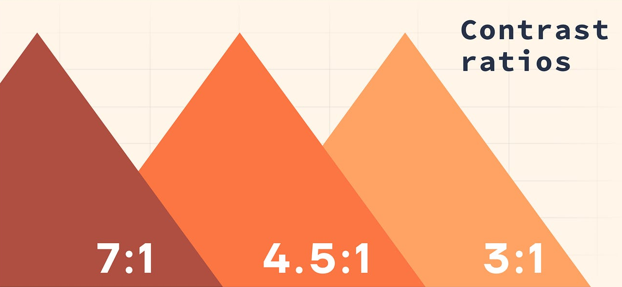
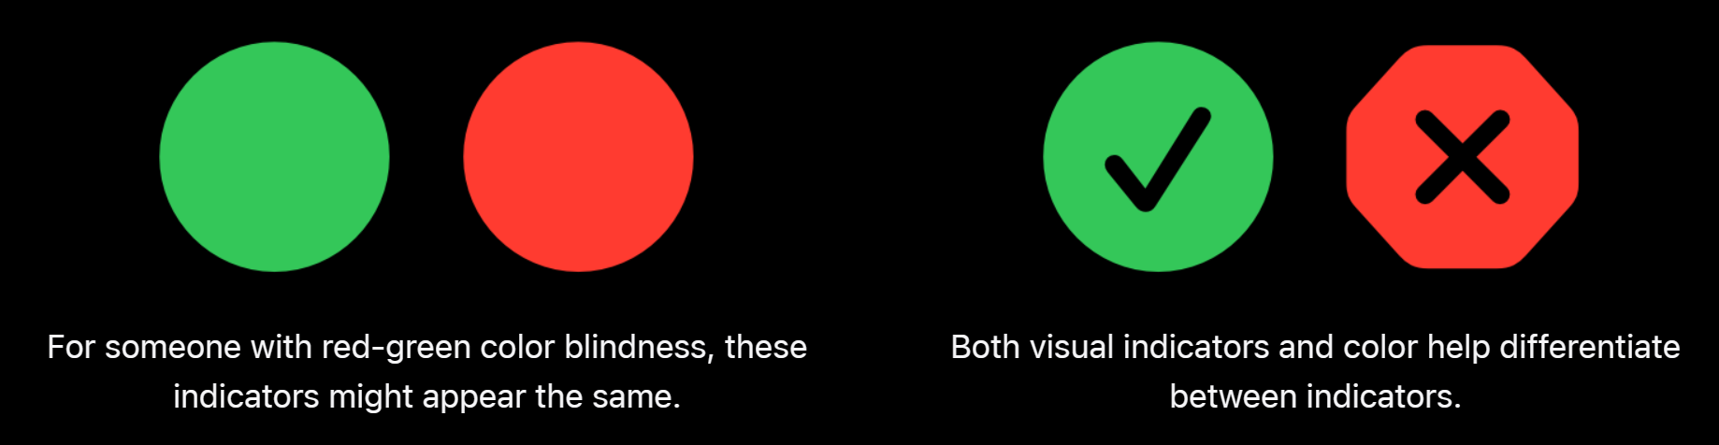
Contrast and Color
Minimum Requirements:
Normal text (under 18pt): 4.5:1 contrast ratio
Large text (18pt+): 3:1 contrast ratio
Never use color alone to convey information
Notes:
Contrast takes ten seconds to check with a free tool, so there's really no reason to guess. Agency brand colors are a common place for it to go wrong, because they get approved on how they look, not on a ratio.
The color-alone point matters just as much for maps. Think of a constraints map where red means one thing and green means another.

Slide 13
Document Structure
Build structure with Styles and captions
Use the Styles gallery. Heading 1, 2, 3, in order, no skipped levels. Bold 16pt text creates nothing a reader can navigate.
Use Insert Caption and Insert Cross-reference. A caption typed in a text box drifts from its figure, and a typed “see Figure 4-2” links to nothing.
Notes:
If you only change one habit, make it this one. When you pick Heading 2 from the Styles gallery, Word records that this is a section. That carries into the PDF, and a screen reader user can jump from heading to heading. Bold 16-point text looks the same and does none of that.
Captions work the same way. Use Insert Caption and the figure and its number stay together, and Word can build the list of figures for you.

Slide 14
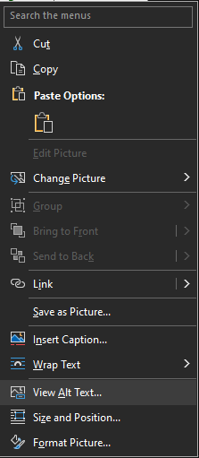
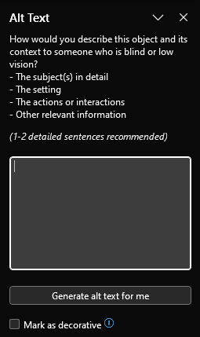
Alt Text for Things That Are Not Photographs
For a planning exhibit, write what it tells the reader, so the alt text carries the information.
A typical description: “Aerial photograph of the project site.”
What the reader needs: “Project site, 42 acres, bounded by Pyramid Way on the east and the Truckee River on the south.”
Site plans and complex exhibits: alt text cannot hold it all. Give the graphic a short alt text that points to the description, and put the substance in the body text or a table.
GIS story maps: every layer needs a text equivalent, and the map itself needs a summary of what it shows.
Charts: alt text states the takeaway. The underlying numbers go in a real table nearby.
Decorative images: if removing it loses nothing, mark it decorative. Do not write alt text for a divider line.
Notes:
Most people hear "alt text" and think "describe the photo." For a planning exhibit, that's the wrong job. Try this instead. If you were reading the exhibit to someone over the phone, what would you tell them? That's what the alt text or the body text needs to say. And for a big site plan, the answer is more than alt text can hold, so it goes in the document itself.

Slide 15
What About Complex Maps and CAD Sheets?
Maps
Short alt text: what the map is and where the full description is.
Text summary: what the map shows and what it means for the decision.
Feature table: the parcels, zones, constraints or acreages that matter.
Color is never the only signal. Add labels or patterns.
CAD sheets
Keep text as text: sheet index, title block, notes, legends and schedules.
Describe the purpose, not every line.
Check export settings early. A rasterized export loses the text.
Offer the data or a way to request an alternate format.
The requirement is that the information is available, not that every line of the drawing is described.
Notes:
This question comes up at almost every meeting I'm in. Part of the objection is fair. A big site plan or a CAD sheet can't be made fully accessible as a picture, and the goal isn't describing every line. What you owe the reader is the information in it.
For a map, that's a short alt text, a summary of what it shows, and a table of the features that matter. For a CAD sheet, it's keeping the text as text and describing what the sheet is for. Ask what decision the reader needs to make from it. That's what you describe.

Slide 16
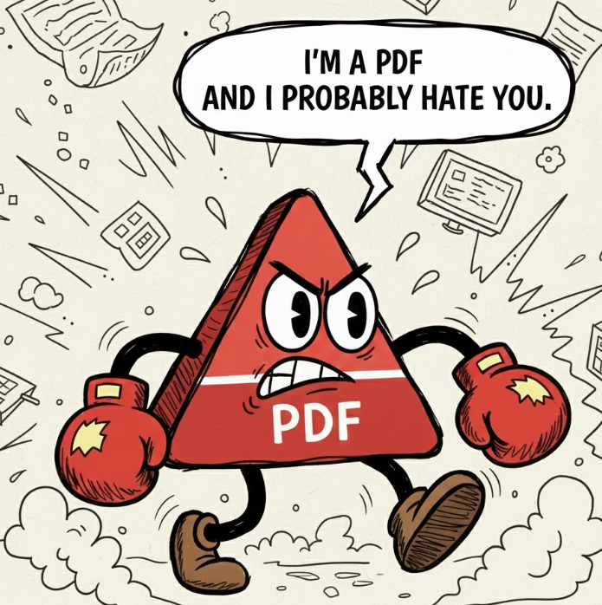
Tagged PDFs Start in the Source File
Tagged PDF: a real document. Text is text, headings are headings, tables have header rows, reading order is defined.
Scanned PDF: an image of a document. Nothing to read, nothing to navigate, and OCR only guesses at it.
Word and InDesign can both produce tagged output, but only if the source file was structured properly first. Export cannot invent structure.
PUD Handbook: a client asked for a “508-compliant PDF with Tracked Changes shown.”
Those two things cannot coexist. Track Changes markup is editorial metadata; a compliant PDF needs a single resolved reading order. Nobody involved was being unreasonable, and the request had already been priced.
This is a scoping problem. If somebody promised a deliverable that does not exist, in a contract, before anyone asked whether it was possible, what now?
Ask early. “What exactly does compliant mean for this deliverable, and who signs off on it?”
Notes:
A tagged PDF and an untagged one look identical on screen. That's why this gets missed. The difference is underneath, in the structure a screen reader actually reads. A scan is just a photograph of paper. And exporting doesn't fix a bad Word file, it carries the problems straight into the PDF.
The PUD Handbook story is about asking what someone means before you agree to it. The request was a 508-compliant PDF with Track Changes, which can't exist as one file. In the end they wanted two separate documents.

Slide 17
Scope It, or Pay for It Twice
1. Scoping
Name the standard, the deliverable formats, who remediates, and who accepts. One paragraph in the Scope of Work.
Cost: minutes
2. Production
Styles, alt text, real tables, text kept as text in CAD and GIS exports. Done while writing.
Cost: hours
3. After delivery
Remediate a finished plan set. Rebuild tables, retag every sheet, chase authors who moved on.
Cost: days, sometimes weeks
Treat accessibility as a specification and put it in the scope with the page count and the deadline.
Put the standard in writing: WCAG 2.1 Level AA, tagged PDF deliverables, native source files delivered alongside the PDF.
Notes:
Same work, three different moments, and the cost climbs each time. The scoping paragraph is the cheap one, and it's the only one you control directly.

Slide 18
What to Ask Your Consultant, Before You Hire Them
Which standard will you conform to, and at what level?
“We follow best practices” is not an answer. You want WCAG 2.1 Level AA in writing.
Who on your team does the remediation, and have they done it on a plan set?
Accessibility on a website is a different job from accessibility on 200 pages of CAD sheets.
Will you deliver native source files with the PDF?
Without the Word or InDesign file, the PDF cannot be fixed later, only rebuilt.
How will map and exhibit content be made available to a reader who cannot see it?
If the answer is “alt text,” they have not thought about it.
Who checks the deliverable, with what tool, before I accept it?
Name the check and put it in the acceptance criteria.
Notes:
These work in an interview or in an RFP. You don't have to know the technical answer. You just need to recognize a vague one when you hear it.
If they can't name the tool they'll use to check the work, that tells you something.

Slide 19
Free Tools That Do Most of the Work
WebAIM Contrast Checker: paste two hex values, get the ratio. Ten seconds, browser based.
WAVE: browser extension that audits a live page, including your agency site and story maps.
NVDA: free screen reader for Windows. Install it and listen to one of your own PDFs.
Office Accessibility Checker: built into Word, PowerPoint, and Excel. Review tab. Catches missing alt text and bad structure before export.
PAC: free PDF accessibility checker that tests a tagged PDF properly, which Acrobat's own check does not.
The Office checker is already on your machine if you use Microsoft Office.
Notes:
Everything here is free. If you only do one, install NVDA and open one of your own PDFs. Listening to your own document is a different experience from reading about it. PAC is the one most people haven't heard of.
The links are available at the web URL on the final slide.

Slide 20

Six Things You Can Start Today
​Use the Styles gallery for every heading. Stop bolding text.
​Run the Office Accessibility Checker before you send anything.
​Check your agency's brand colors against 4.5:1. Fix the ones that fail.
​Write alt text that carries the information, or mark the graphic decorative and put the content in the text.
​Add one paragraph on accessibility to your next scope of work.
​Install NVDA and listen to a document you wrote.
You do not have to become the expert to stop passing the problem along.
Notes:
Don't try to do all six. Pick one. The Styles gallery is the easy place to start, and it changes what lands on the next person's desk. Number five, the scope paragraph, takes a conversation, but it changes what everyone downstream does.

Slide 21
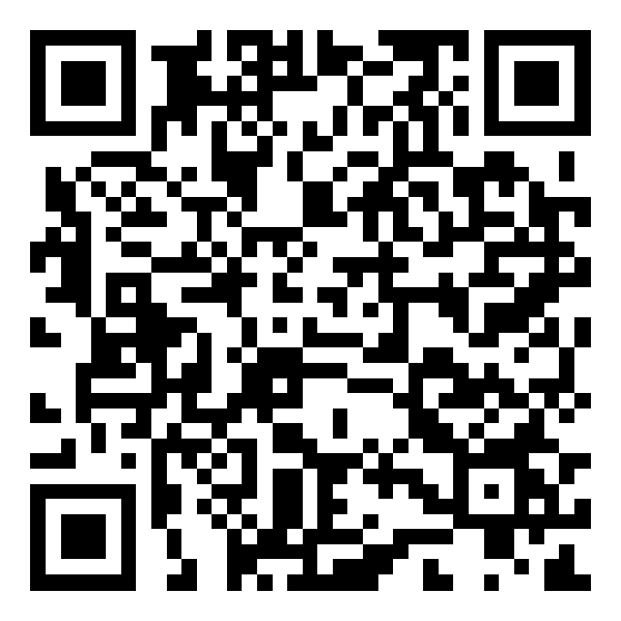
Questions
Devin Crowley
Section 508 / ADA Title II / WCAG 2.1 AA
Wood Rodgers | dcrowley@woodrodgers.com
Eric Hasty, AICP
Wood Rodgers | ehasty@woodrodgers.com
Slides and the tool links are available by scanning the QR code or visiting:
www.woodrodgers.com/apa2026
Notes:
That's it from us. Ask anything, including the awkward ones. If you've got a document you're not sure about, describe it and we'll tell you where we'd start.

