Slide 1


Hierarchical Taxonomy of Psychopathology Model in Clinical Research and Practice
Monika A Waszczuk, PhD
Associate Professor, Department of Psychology
Rosalind Franklin University of Medicine and Science
she/her/hers
October 2024
@MAWaszczuk

Slide 2


Plan
Introduction to the model
Clinical Research
Clinical translation:
  Assessment
  Treatment
  Feasibility
https://www.hitop-system.org/
@HiTOP_system

Slide 3
HiTOP
Consortium of nosologists from various mental health disciplines
Integrate evidence
Propose a system
Refine it as new data become available
Translate findings to research and clinical practice
190+ members globally, 11 Workgroups
30+ consortium papers
https://www.hitop-system.org/key-papers

Slide 4
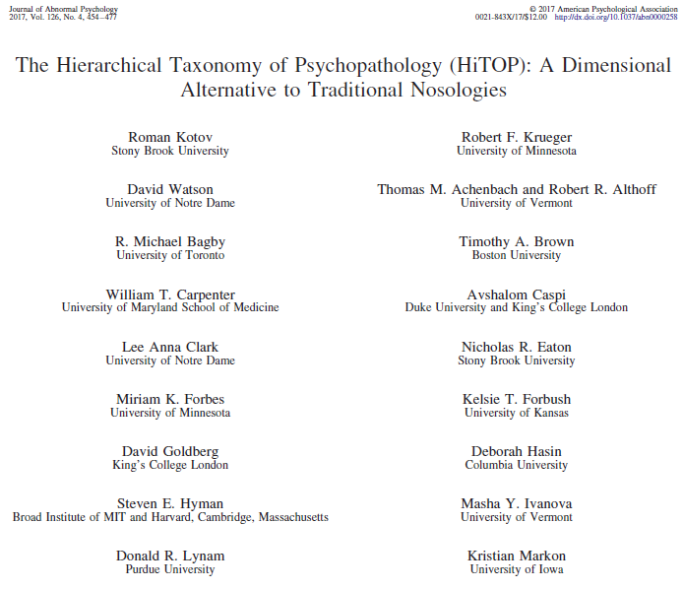
Notes:
The Hierarchical Taxonomy of Psychopathology (HiTOP) consortium proposed a data-driven classification system for a wide range of psychiatric disorders—based on a comprehensive review of existing nosologic and psychometric research

Slide 5
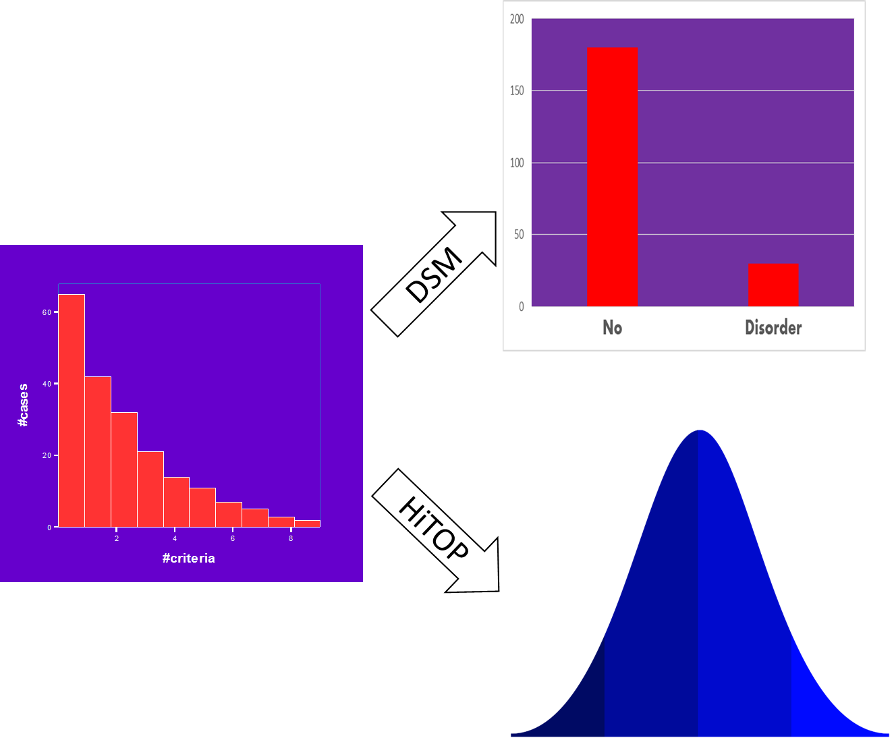

Slide 7
Advantages of Dimensions
Reliability: highly reliable and stable
NOS, subthreshold: everyone is described
Empirically-derived thresholds can be applied
Notes:
HiTOP frames mental health problems as continua, addressing many limitations of categorical classification, which include arbitrary boundaries between psychopathology and normality, diagnostic instability, and inability to account for subthreshold cases

Slide 8
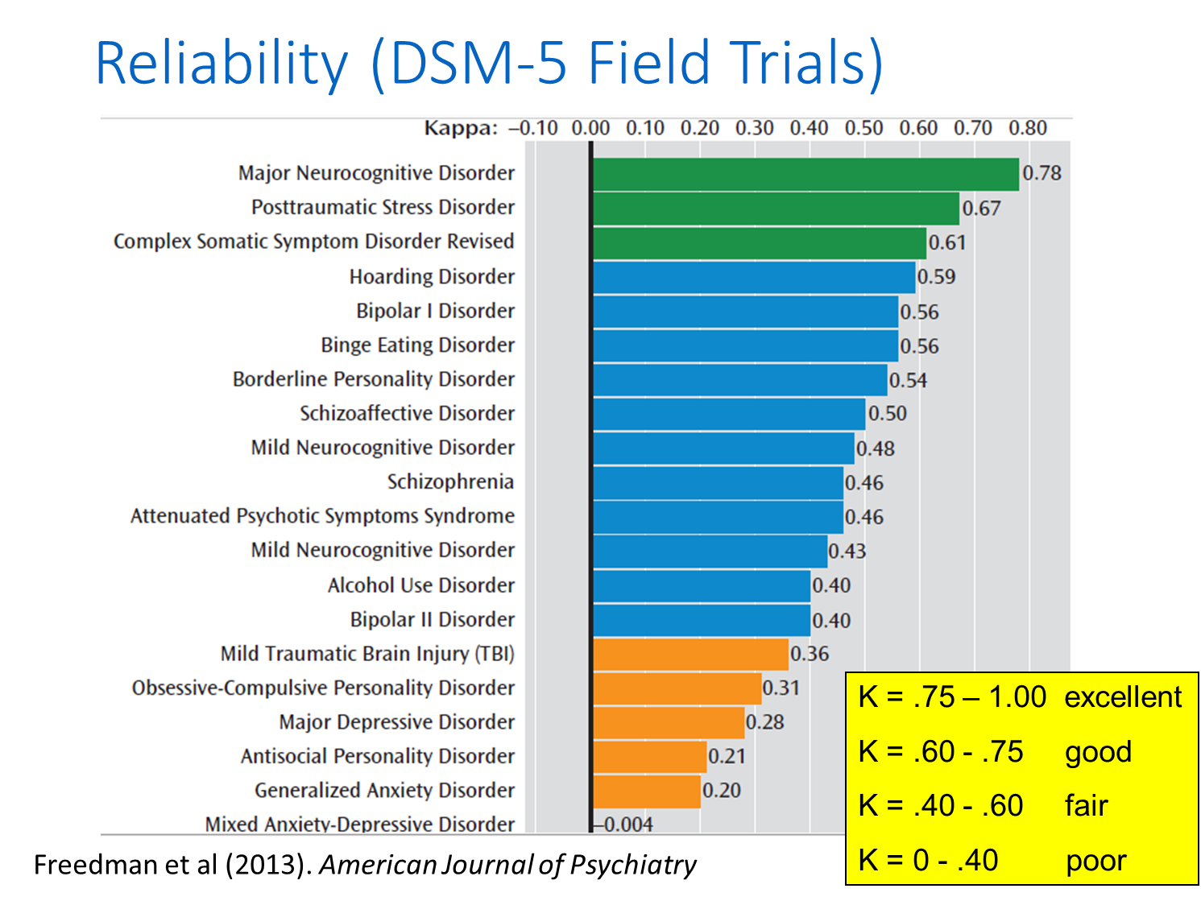
Notes:
Measurement of the extent to which data collectors (raters) assign the same score to the same variable is called interrater reliability.
0 represents the amount of agreement that can be expected from random chance, and 1 represents perfect agreement between the raters.

Slide 9


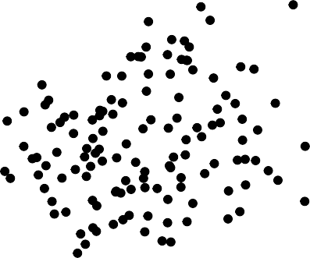
Frequency
5
4
Depression
3
2
1
0
2
3
4
5
Frequency
Kotov et al. (2022) Psychological Medicine
Psychosis

Slide 10


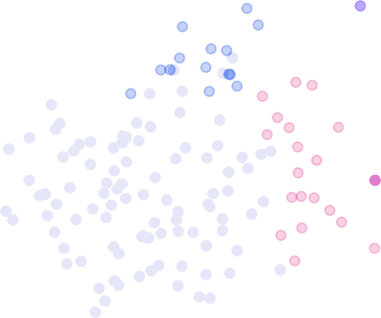
Frequency
5
Schizoaffective disorder
4
Major depressive disorder
with psychotic features
Major depressive
disorder
Depression
3
Schizophrenia
2
Schizotypal personality disorder
Delusional
disorder
1
No relevant dx
0
2
3
4
5
Frequency
Kotov et al. (2022) Psychological Medicine
Psychosis
Notes:
Faded = no relevant diagnosis; blue = major depressive disorder; violet = major depressive disorder with psychotic features; purple = schizoaffective disorder; pink = schizotypal personality disorder; magenta = delusional disorder; red = schizophrenia.

Slide 11
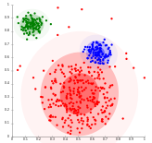
Data-driven
Negative
Use patterns of co-variation
Place related together, place unrelated separately
Heterogeneity: homogeneous components
Comorbidity: feature of the system
Disorganized
Psychotic
Notes:
resolves heterogeneity by grouping related symptoms together and assigning unrelated symptoms to different components, while also making comorbidity an explicit and predictable feature of the model by classifying related components together.

Slide 12
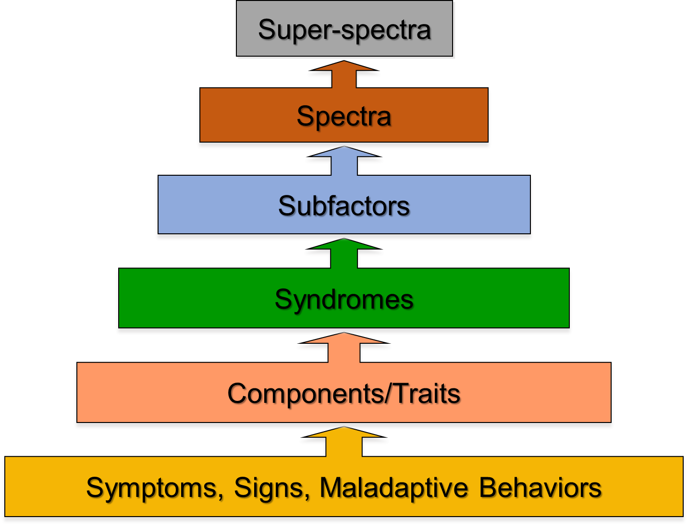
Hierarchical
P-Factor
Notes:
The HiTOP model organizes psychopathology into a hierarchy, in which each level captures a different degree of specificity with which mental illness is described
a syndrome (e.g. obsessive-compulsive disorder, OCD)
homogenous components (e.g. checking, cleaning, and rituals compulsions),
Subfactor: Fear subfactor
Inernalizing
General psychopathology factor

Slide 13
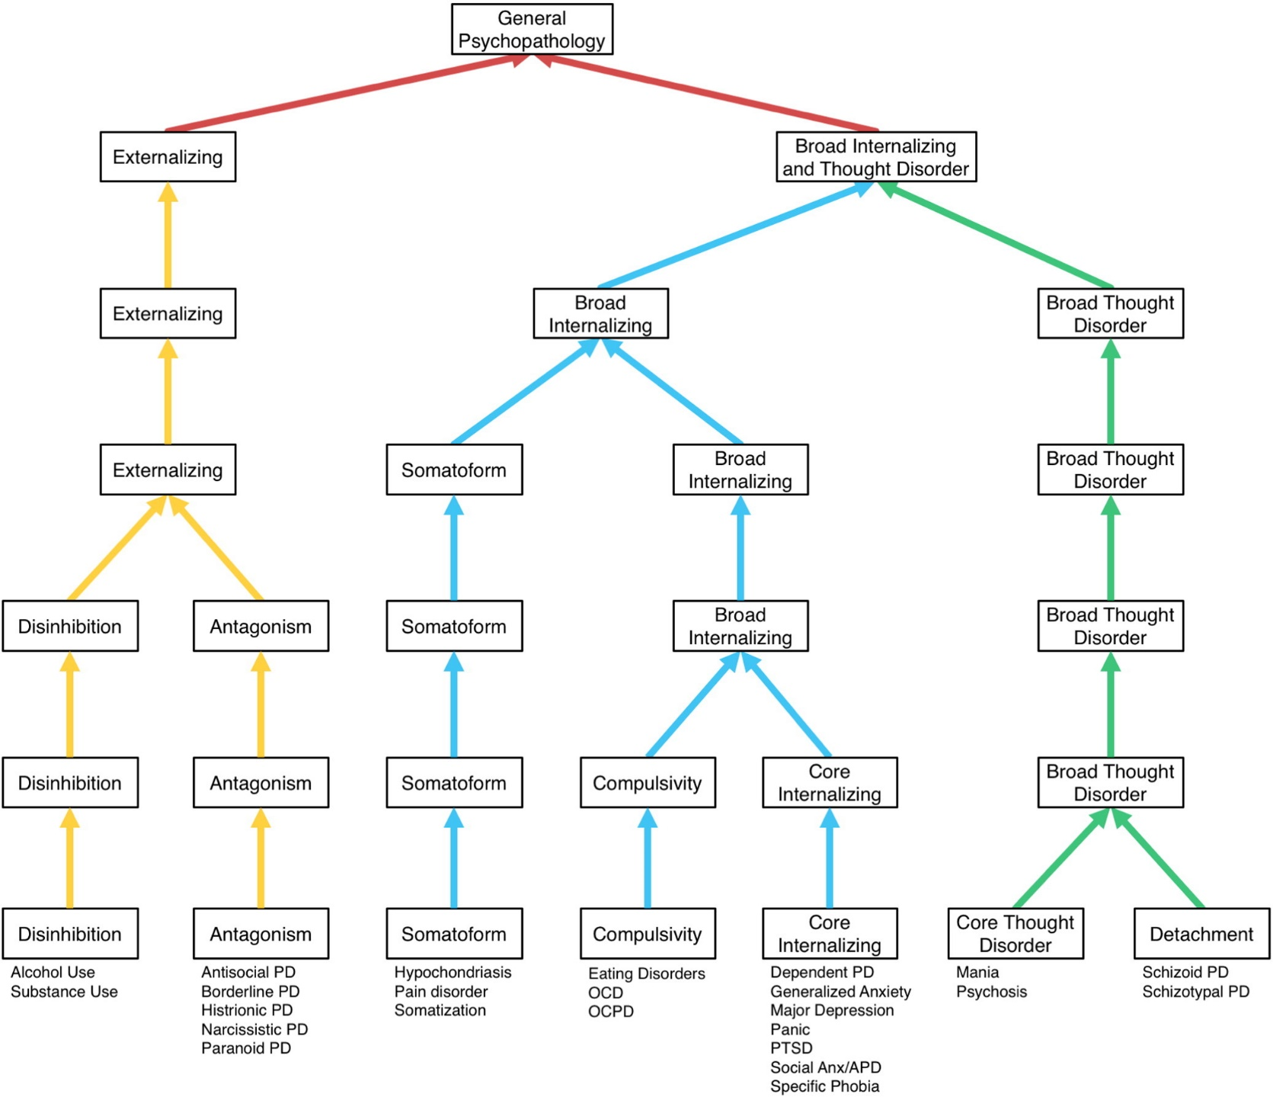
Hierarchical
Forbes et al., 2017

Slide 14
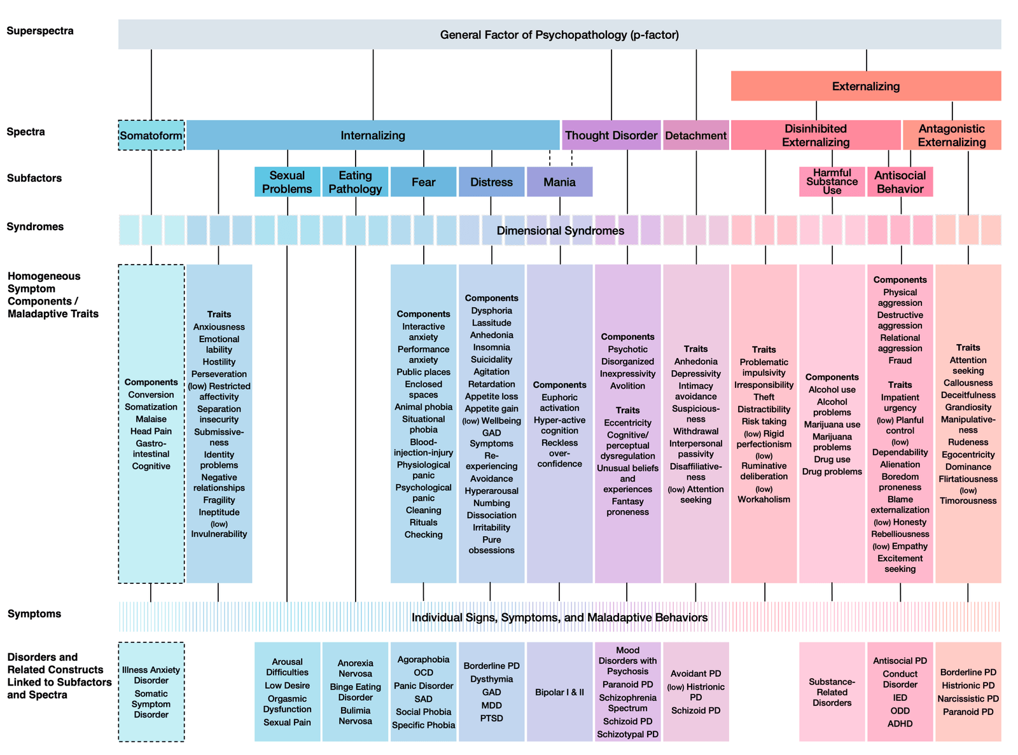
Notes:
HiTOP does not differ largely from the DSM in what constitutes signs and symptoms of mental illness; instead, HiTOP represents an evidence-based reorganization of these lower-level constructs. This reorganization is designed to increase specificity of diagnostic identifiers while reducing artifactual comorbidity across diagnostic groups and heterogeneity of symptoms within them.

Slide 15

Questions?

Slide 16
Clinical Research
Causes and outcomes of mental illness can have effects on broad higher order dimensions, the syndromes, or specific lower order dimensions
Two common research designs:
  Empirically delineate associations between a construct of interest and various levels of the HiTOP hierarchy
  Empirically test incremental predictions (exploratory potential) of a construct of interest by HiTOP

Slide 17
Clinical Research
Causes and outcomes of mental illness can have effects on broad higher order dimensions, the syndromes, or specific lower order dimensions
Two common research designs:
  Empirically delineate associations between a construct of interest and various levels of the HiTOP hierarchy
  Empirically test incremental predictions (exploratory potential) of a construct of interest by HiTOP

Slide 18
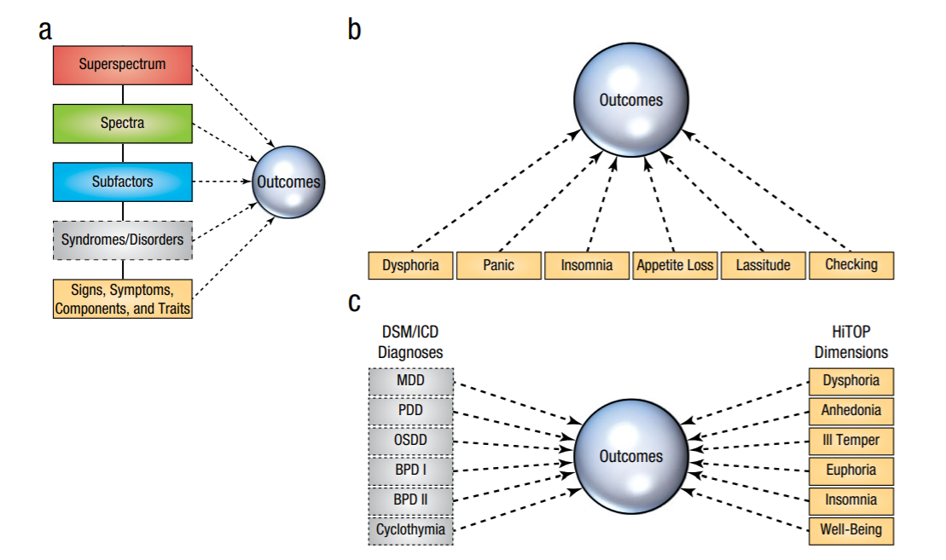
Research designs
Within HiTOP levels
Across HiTOP levels
Conway et al., 2019
Comparison of categorical diagnoses to HiTOP dimensions

Slide 19
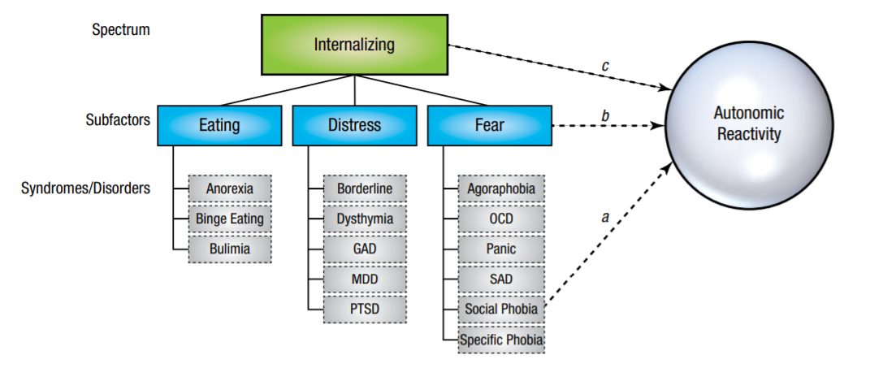
Conway et al., 2019

Slide 20
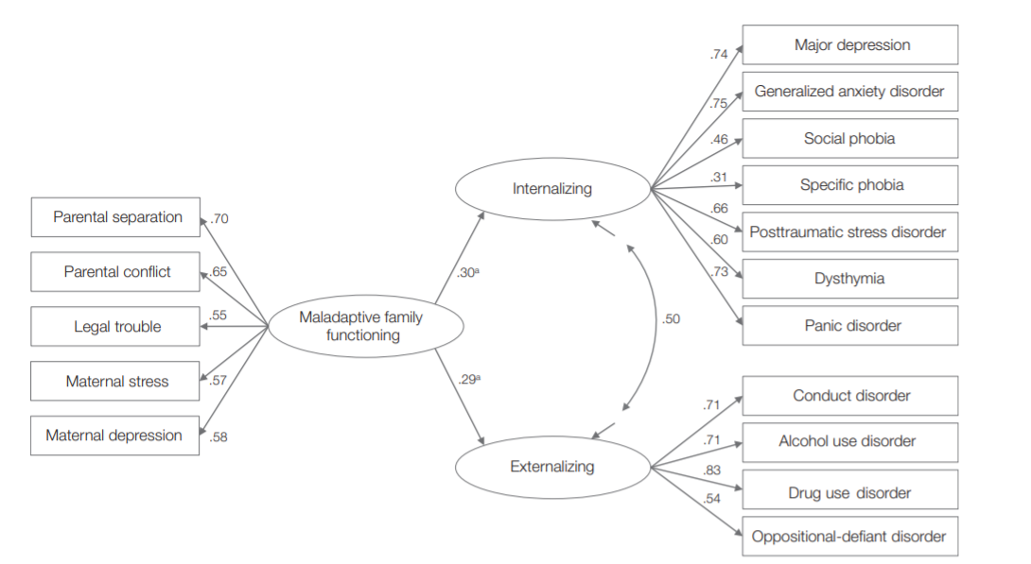
Maladaptive family functioning
20-year follow up
High-risk sample of 815 mother-offspring pairs
Prospective 20-year follow up
The same impact on INT and EXT
No symptom-specific effects
Perinatal to age 5
Conway et al., 2017

Slide 21
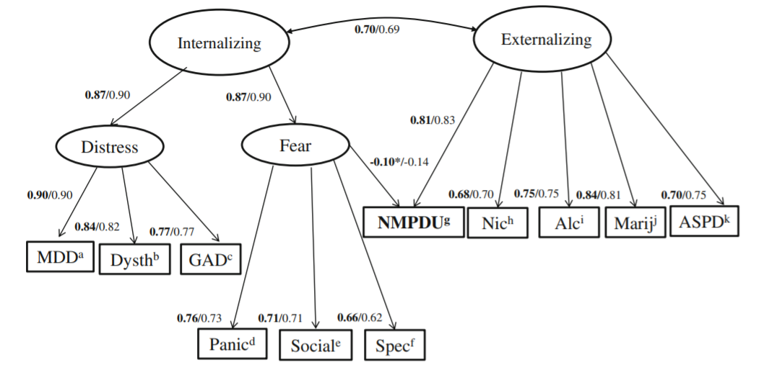
Nonmedical prescription drug use (NMPDU)
NESARC, N=43,093
NMPDU was strongly associated with EXT
A very small secondary association with the fear subfactor
Expand clinical risk assessment beyond SUD to include other indicators of EXT
Ofrat et al. 2014
Notes:
without a prescription, or (2) in greater amounts, more frequently, or for longer than recommended by a prescribing professional
National Epidemiological Survey on Alcohol and Related Conditions
Expands clinical risk assessment beyond the standard indicators of externalizing liability, e.g., patients’ past history of illicit or other substance abuse, to include other externalizing indicators that clinicians may be less likely to consider when evaluating risk, such as antisocial personality disorder or traits

Slide 22
Clinical Research
Causes and outcomes of mental illness can have effects on broad higher order dimensions, the syndromes, or specific lower order dimensions
Two common research designs:
  Empirically delineate associations between a construct of interest and various levels of the HiTOP hierarchy
  Empirically test incremental predictions (exploratory potential) of a construct of interest by HiTOP

Slide 23
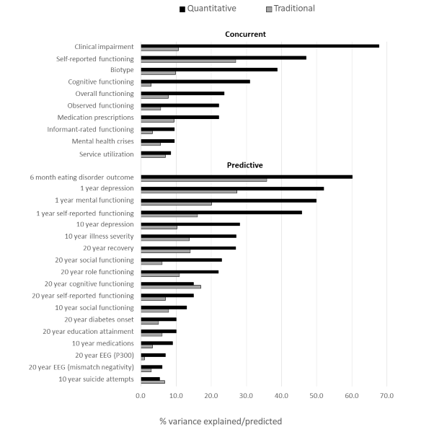
Kotov et al. (2022) Psychological Medicine

Slide 24
Kotov et al. (2022) Psychological Medicine

Slide 25
Clinical Research Implications
Transdiagnostic impact of common risk factors (e.g. trauma)
Piecemeal one-disorder-at-a-time approach not efficient
Measure and investigate a full range of mental health symptoms and disorders
Transdiagnostic factors may be a key level of focus for prediction, intervention, assessment, and prevention efforts

Slide 26
Questions?

Slide 27
Case vignette illustrating the clinical application of HiTOP
<sent via email>

Slide 28
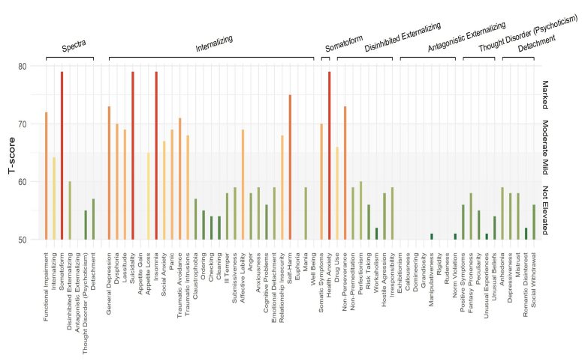

Slide 29
Clinical Translation
In HiTOP, the diagnosis is the patient’s profile on psychopathology dimensions
Spectra and subfactors -- the main difficulties the patient experiences
Components and traits -- specific issues
Symptoms -- current problems
Traits -- chronicity
Functional impairment assessed separately (ICD-11 distinction between disorder and disability)

Slide 30
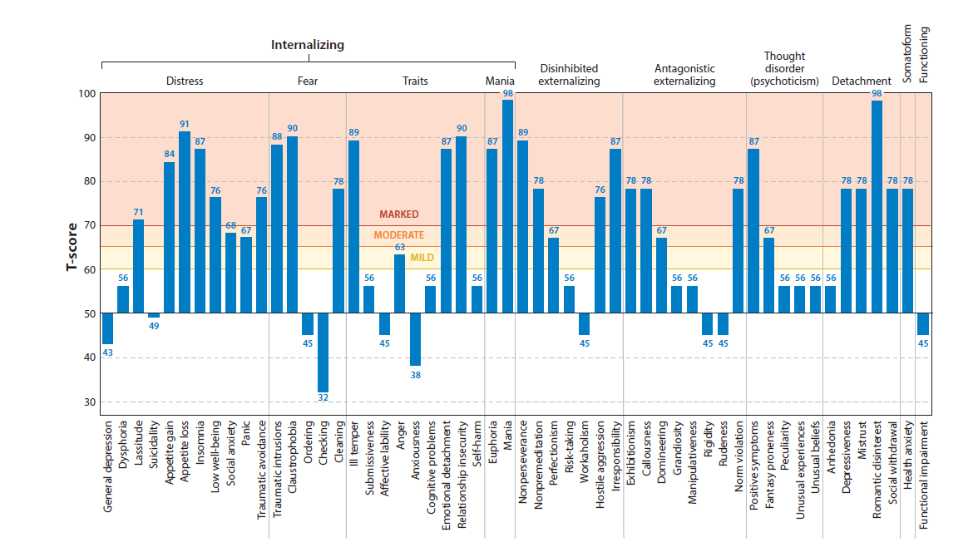

Slide 31
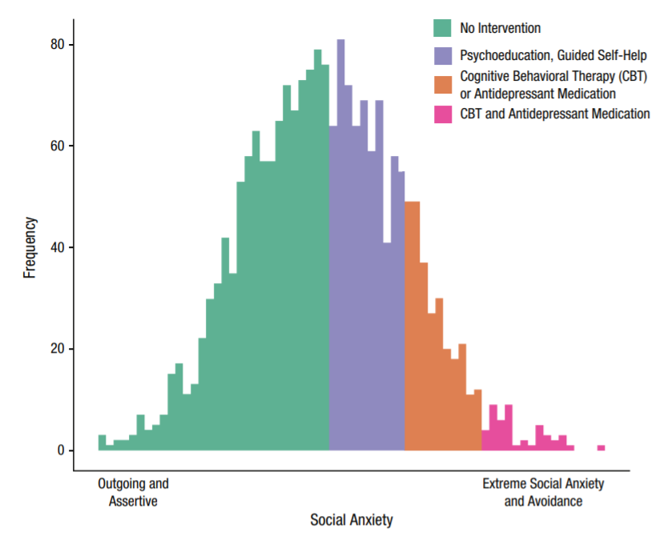
Patient’s score on psychopathology dimension

Slide 32
Patient’s score on psychopathology dimension
Empirical and multiple ranges for decision making
Intelligence, neuropsychology, MMPI, CBCL…
DSM-5 & ICD-11 starting as well (intellectual disability, substance use disorder, cross-cutting measures etc.)

Slide 33
Treatment (I)
Treatment targets can be both:
  At higher levels, where treatment can affect multiple problems simultaneously (e.g. Unified Protocol)
  At lower levels, when a specific behavior is particularly significant (e.g., suicidality, opioid use) or requires a specialized intervention (e.g., hypnotic drug for insomnia)

Slide 34
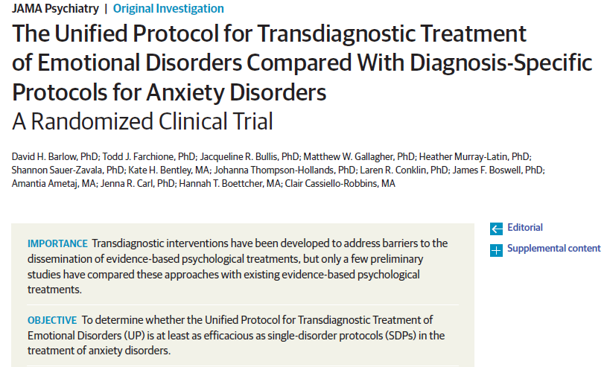
Treatment for Internalizing
Notes:
Among the 223 patients (124 women and 99 men; mean [SD] age, 31.1 [11.0] years), 88 were randomized to receive the UP, 91 to receive an SDP, and 44 to the waitlist control condition.
Patients were more likely to complete treatment with the UP than with SDPs (odds ratio, 3.11; 95% CI, 1.44-6.74). Both the UP (Cohen d, −0.93; 95% CI, −1.29 to −0.57) and SDPs (Cohen d, −1.08; 95% CI, −1.43 to −0.73) were superior to the waitlist control condition at acute outcome. Reductions in clinical severity rating from baseline to the end of treatment (β, 0.25; 95% CI, −0.26 to 0.75) and from baseline to the 6-month follow-up (β, 0.16; 95% CI, −0.39 to 0.70) indicated statistical equivalence between the UP and SDPs.

Slide 35
Treatment (II)
Dimensional case formulation highlights provision of care along the continuum of severity
  Multiple action thresholds
Comprehensive assessment identifies patient’s strengths (i.e., traits in adaptive range) and weaknesses beyond the current treatment target
Traits provide valuable prognostic information

Slide 36
Clinical Utility of DSM-5/ICD-10
N = 1,764 clinicians (mostly psychiatrists)
60% in developed countries
Educating patient or family: 44%
Selecting treatment: 34%
40% of prescriptions off-label
Meeting administrative requirement: 75% - diagnostic codes are useful
First et al. (2018). World Psychiatry Hodgson & Belgamwar (2006). Psychological Bulletin

Slide 37
Feasibility
Surveys show that clinicians often diverge from diagnostic criteria in their practice, and are open to dimensions, especially in treatment formulation and communication with patients
Dimensional assessments are commonly used: neuropsychological and intelligence testing, medical lab tests etc.
HiTOP favored over DSM for utility for formulating effective interventions, communicating clinical information to the client, comprehensively describing psychopathology, describing global functioning, and ease of application.
Raskin et al. (2022). Professional Psychology: Research and Practice
Ballinget al (2023). Clinical Psychological Science

Slide 38
HiTOP Digital Assessment and Tracker
(HiTOP-DAT)
Empirically-based symptom assessment that covers most of the HiTOP traits and components
Standardizes battery for intakes (45min)
Adaptable/modular
Give providers overview of symptoms prior to interview
Digitize and automate intake paperwork
Automatically monitor outcomes

Slide 39

Summary
HiTOP model differs from traditional classification of mental illness
  Dimensional
  Hierarchical
  Data-driven
Clinical research utility
Clinical translation includes transdiagnostic assessment and patient profiles
HiTOP profile is only one element of a psychiatric evaluation and case formulation

Slide 40



HiTOP Trainee Listserv:
https://www.hitop-system.org/trainees
HiTOP Clinical Network:
https://www.hitop-system.org/the-clinical-network

Slide 43
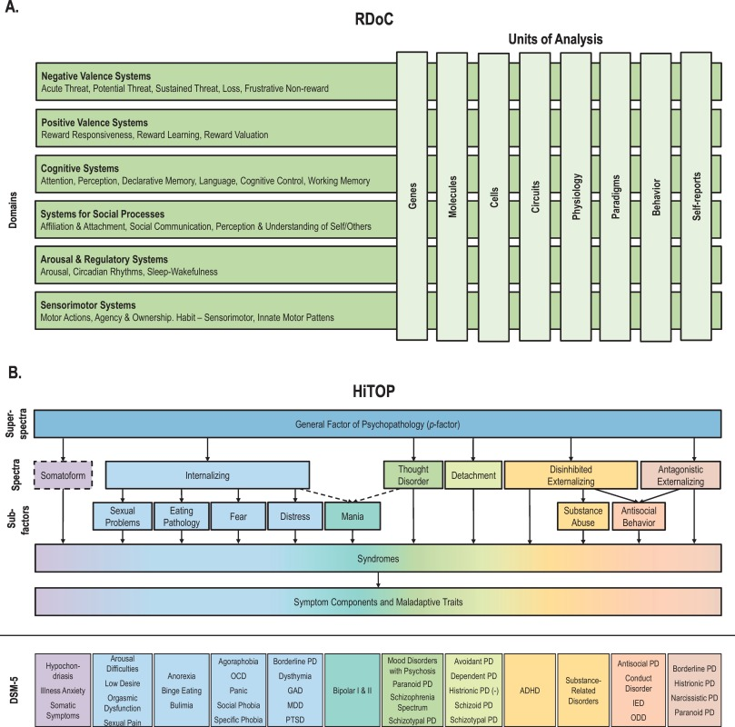



Slide 44
Dimensional Dimensional
Deductive (start with concepts) Inductive (patterns in data)
Circuits, no symptoms Symptom, no circuits
No clinical application Clinical application

Slide 45
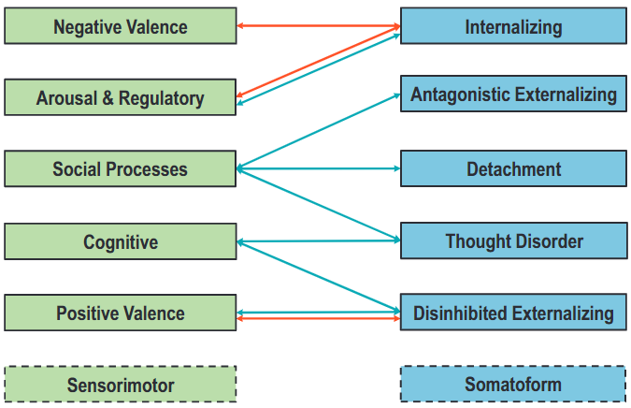
Red = positive association; Blue = negative association
Michelini et al. (2021). Clinical Psychology Review.

