Slide 1

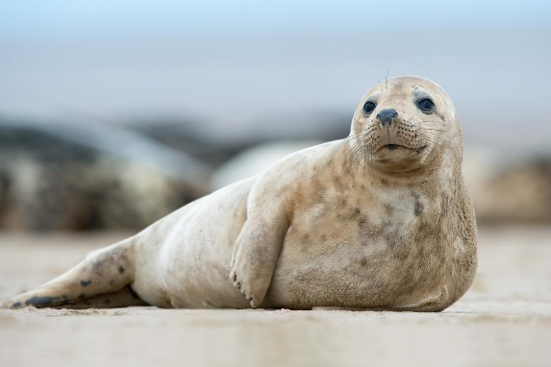
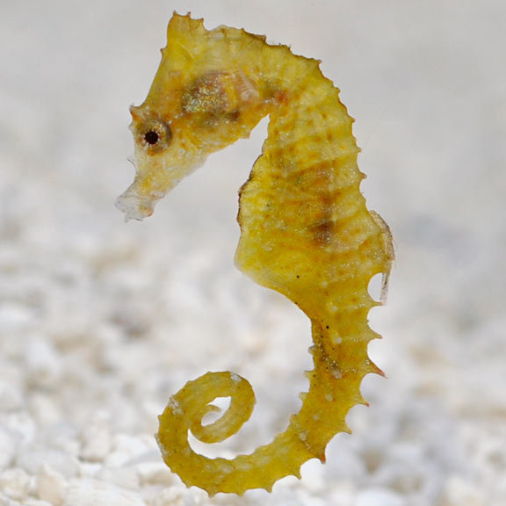
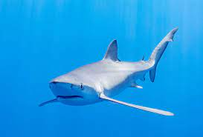
Welcome to Year 2
Seal Class
Seahorse Class
2025-2026
Shark Class

Slide 2
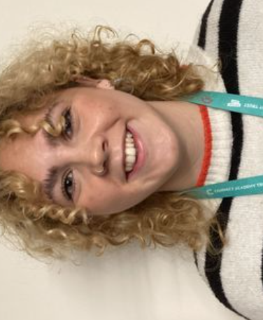
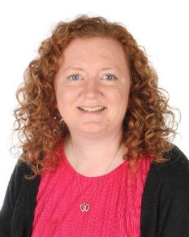
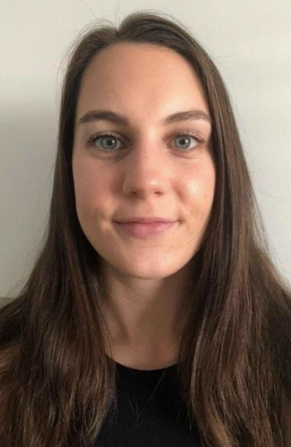

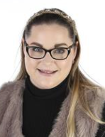
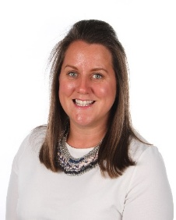
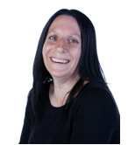

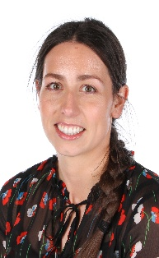

Year 2 Team
Miss Cottenham
TA- Miss Taylor (AM)
TA- Miss Slade (PM)
Y2 HLTA & PPA cover
Miss Williams
(Monday-Wednesday)
Mrs Marshall (Wednesday-Friday)
TA- Mrs Wiffen
Year Leaders
Mr Coombs
TA- Miss Harrison

Slide 3
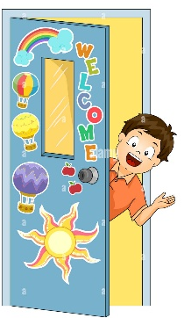


Communication
Email
hmarshall@wideycourt.Plymouth.sch.uk
rwilliams@wideycourt.Plymouth.sch.uk
hcoombs@wideycourt.Plymouth.sch.uk
gcottenham@wideycourt.Plymouth.sch.uk
Dojo!
Before or after school

Slide 4
The School Day
8.40am | Doors open Later than 8:55 – sign in at the office
3:15pm | End of the day
Drop off / pick up | Seal and Shark classes are dropped off and collected through the classroom doors Seahorse class are dropped off and collected from the door in the alley between Seahorse and Shark classes.
Free snack is provided, or children are welcome to bring their own healthy snack. Packed lunches or school meals as normal.

Slide 5
Games and PE
Please wear PE kits to school
Seal | Seahorse | Shark
Monday Wednesday | Monday Wednesday | Wednesday Thursday

Slide 6
PPA Cover – Wednesday AM
Miss Slade | Games Coaches | Class TA
Music, RE, Computing | District Sports Coaches | School library

Slide 7
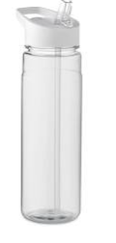
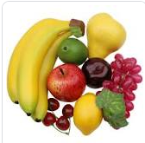
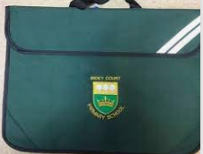




Needed Daily please…

Slide 8
Our Topics (see knowledge organiser)
Autumn 1 | Autumn 2 | Spring 1 | Spring 2 | Summer 1 | Summer 2
How do animals survive and thrive? | How has Crownhill changed since the 1950s? | What human and physical features can we find in our environment? | What impact did Sir Francis Drake have on Plymouth? | How do we keep plants alive? | What are the similarities and differences between Plymouth Sound and The Great Barrier Reef, Cairns?

Slide 9
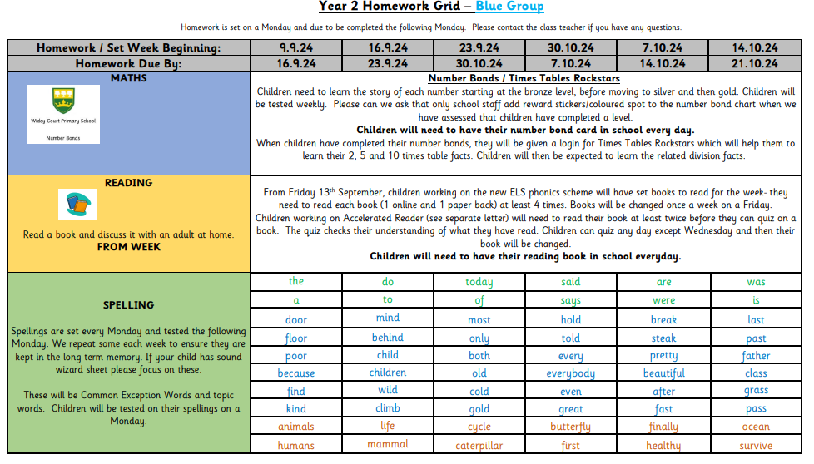

Homework – spellings, number bond, reading.
Set on a Monday. Hand in the following Monday.
Can be found on the website and inside your child’s homework book. A new grid for each half term.
Notes:
Children are expected to read daily, and each book should be read at least 4 times on the ELS phonics scheme and at least 2 times on the Accelerated Reader scheme. Children should read at least four times a week (this doesn’t need to be their school reading book).

Slide 10

Reading Books in Year 2
ELS- Essential Letters and Sounds – following our phonics scheme in line with your child's phonics attainment.
Weekly book, and a weekly e-book.
Notes:
Children are expected to read daily, and each book should be read at least 4 times on the ELS phonics scheme and at least 2 times on the Accelerated Reader scheme. Children should read at least four times a week (this doesn’t need to be their school reading book).

Slide 11

Reading Books in Year 2
AR- Accelerated Reader . When children come up to Year 2, the reading focus changes slightly. We still encourage children to use their phonic skills, but the focus moves towards fluency and comprehension, not word reading. You should have / will receive a letter about this. *We ask that you read this carefully to avoid any confusion or worries.*
Read 2/3 times at home Sign Quiz in school Change book.
Quiz any day (not a Wednesday)
Sync with your child’s AR account to get updates and quiz results…
Notes:
Children are expected to read daily, and each book should be read at least 4 times on the ELS phonics scheme and at least 2 times on the Accelerated Reader scheme. Children should read at least four times a week (this doesn’t need to be their school reading book).

Slide 12

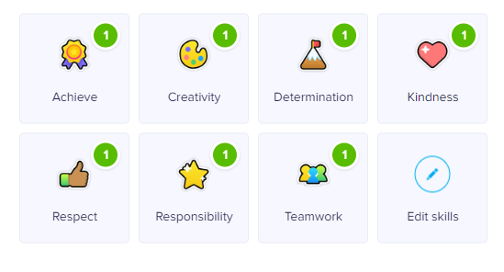


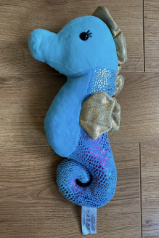


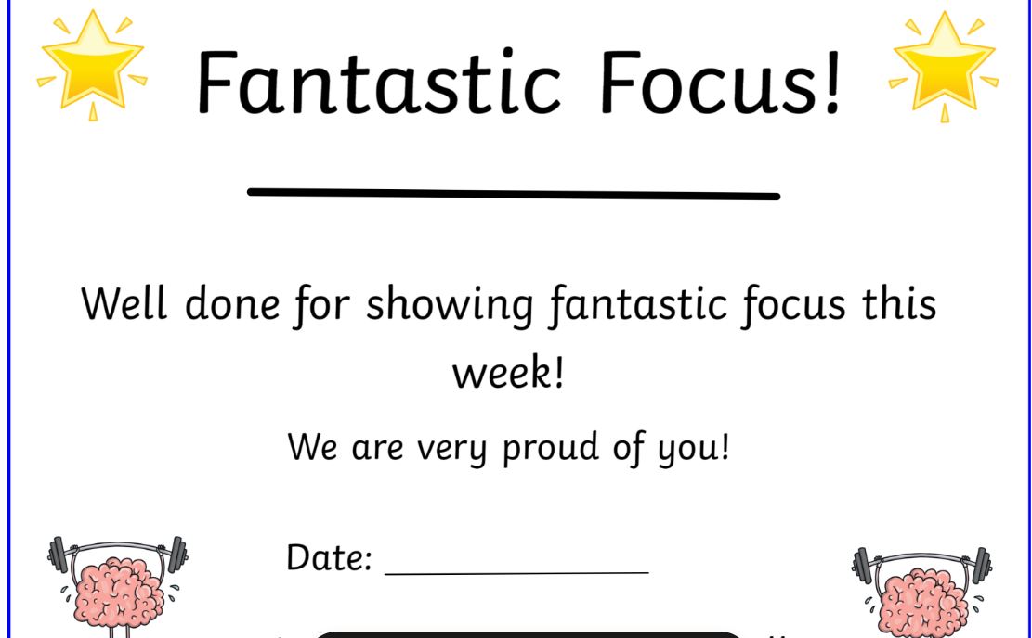
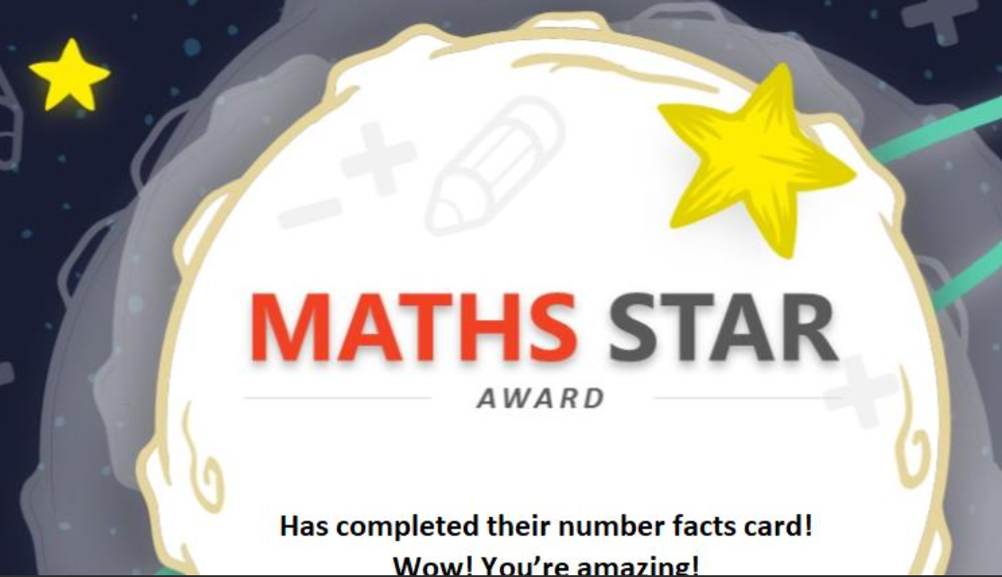

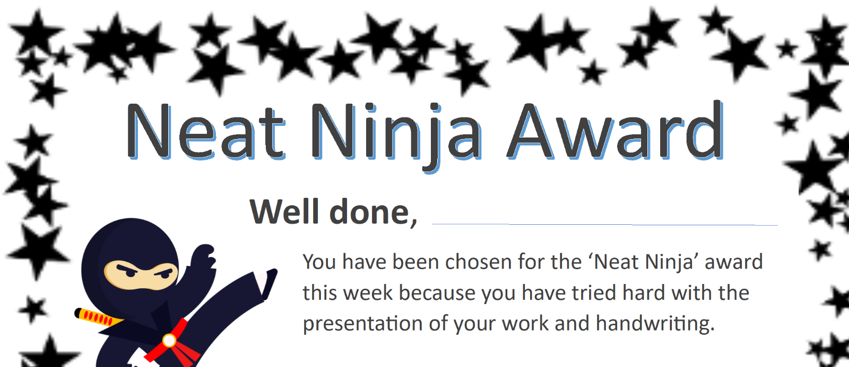
Seahorse Celebrating
Success!

Slide 13
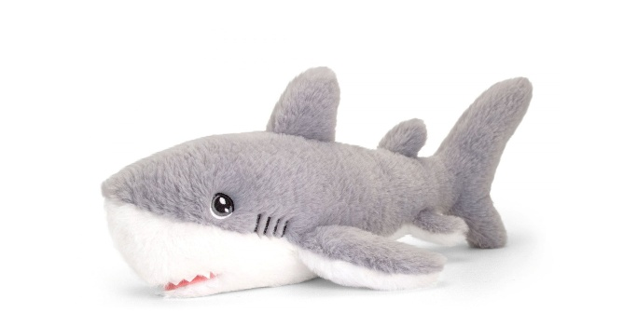

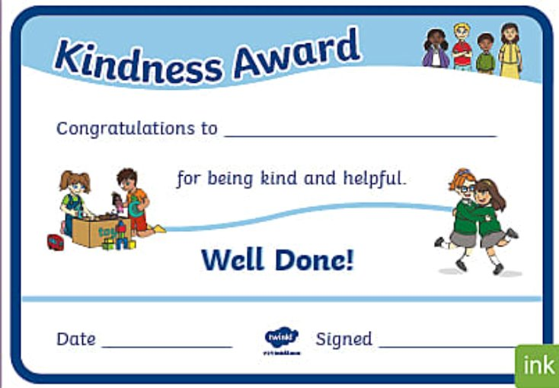
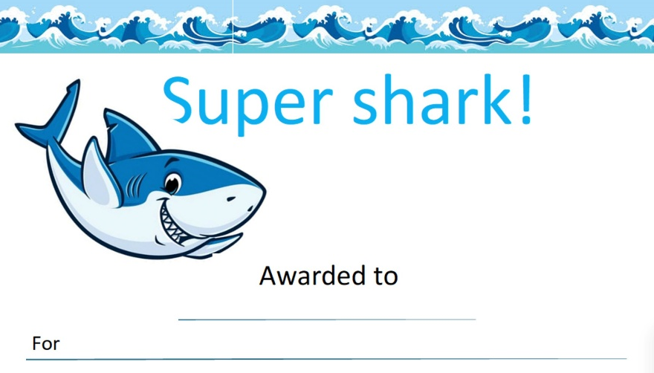
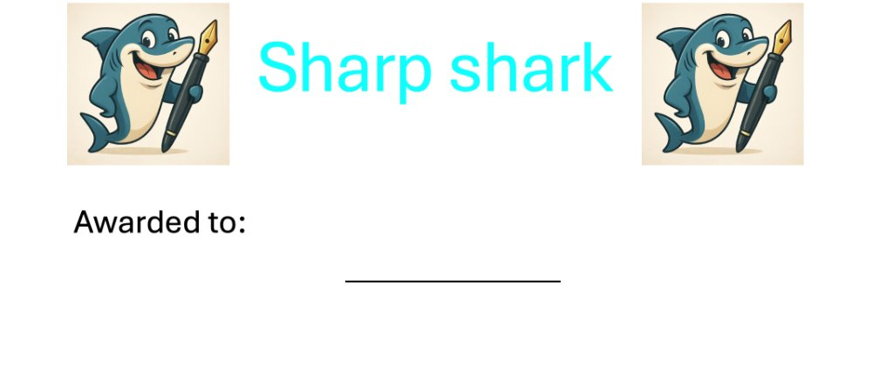
Shark Celebrating
Success!

Slide 14
Seal Celebrating
Success!

Slide 15
Attendance
The school target for attendance is 96.6%.
96.6% = 5 days absence across an entire school year
.

Slide 16
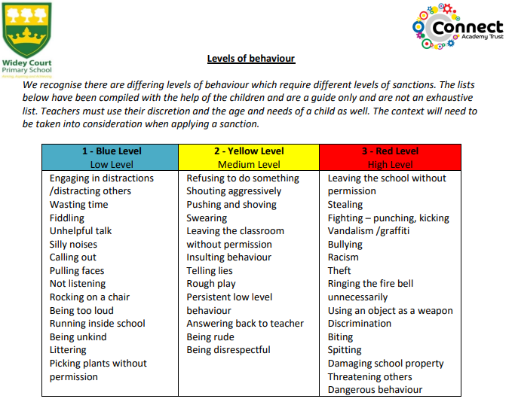
School Expectations
Negative Behaviour
As part of children’s recovery, they will fill out a reflection form with the class teacher where consequences are discussed.

Slide 17
Year 2 End of Year Expectations
Reading
- Read most words with 2 or more syllables
- Read most words containing suffixes (words ending ment, ness, less, ly, ful)
- Read most Common Exception Words (CEW)
- Read fluently, sounding out some unknown words
- Check their reading makes sense
- Answer questions, making some inferences
- Explain what has happened in the story so far

Slide 18
Year 2 End of Year Expectations
Writing
Write simple, coherent narratives (including real events)
Use capital letters and full stops, and use question marks correctly when required
Use present and past tense
Use co-ordination (e.g. or / and / but) and some subordination (e.g. when / if / that / because) to join clauses
Segment spoken words
Spell many Common Exception Words
Form capital letters and digits correctly (lower case letters Y1)
Using spaces between words

Slide 19
Year 2 End of Year Expectations
Maths
Read scales in divisions of twos, fives and tens
Partition any 2-digit number into different combinations of tens and ones. Eg, 34 = 30 + 4, 28 + 6, 12 + 22
Add and subtract two 2-digit numbers using an efficient strategy
Recall number bonds for 10 and give associated facts. For example, 6 + 4 = 10 , therefore 4 + 6 = 10 and 10 – 6 = 4
Count in 2s, 5s and 10s
Know the value of different coins
Name and describe the properties of 2D and 3D shapes.

