Slide 1

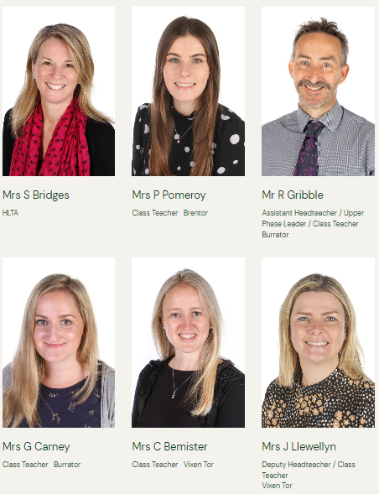


Welcome to Year 5 at
Widey Court
2025 - 2026
Year Leader

Slide 2

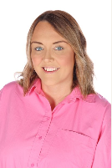
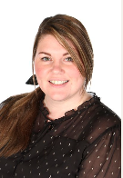
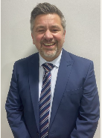
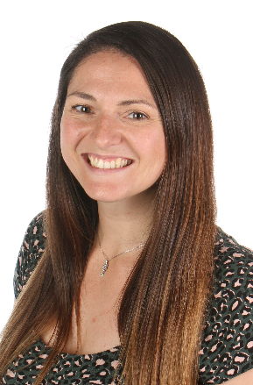
Teaching assistants GOVERNOR
Mrs Keach
Mr Spencer Tall
(Chair of Governors)
Mrs Omlo

Slide 3
SCHOOL DAY
Classroom doors are open from 8:40am. If your child needs to arrive at school before 8:30am, please book them in to breakfast club.
Register is taken at 8:50am
Break - 10:50 -11:05
Lunch - 12:15-13:15
ThURSDAY - PPA
(Sports coaches, Computing and Music on a rota system).
Class assemblies
BurratOR Autumn 2
BRENTOR Spring 2
VIXEN TOR Summer 2

Slide 4

Indoor PE and outdoor games
This Photo by Unknown author is licensed under CC BY-NC-ND.
Vixen Tor: Monday (outdoor) and Tuesday (indoor)
Brentor: Tuesday (indoor) and Thursday (outdoor)
Burrator: Tuesday (indoor) and Thursday (outdoor)
Please can children wear the correct kit: House Team colour
T-shirt + white/black shorts. Plain black tracksuit. Thank you!
*Mouth Guards

Slide 5
Topics
Please refer to the Year 5 Curriculum Overviews that are emailed each term. These overviews can also be found on the Year 5 webpage if you use this link: Year 5 at Widey Court Primary School
Autumn 1 – Where in the World? Europe
Autumn 2 – When the Romans left, how did the culture change?
Spring 1 – What’s out of this World? – Space!
Spring 2 – Would you rather live in Plymouth, England or Plymouth, New England?
Summer 1 – Why is Elizabeth 1st such an important person in history?
Summer 2 – Ocean plastics – what is the problem?

Slide 6
Behaviour
Policies | Widey Court Primary School
Behaviour expectations are high throughout the school we encourage all children to be independent and responsible for their own actions.
Behavioural reflection strategies are in place and may result in your child completing a reflection form. Your child's class teacher will contact you regarding any behaviour concerns, if necessary.
Positive behaviour, linked to our school values will be rewarded in a variety of ways on Dojo based on our 7 School Values: Respect, Determination, Teamwork, Kindness, Creativity, Responsibility, Achievement

Slide 7

HOW we can help our children IN A RAPIDLY CHANGING WORLD…
https://www.nspcc.org.uk/preventing-abuse/keeping-children-safe/share-aware/
Online safety is taught in school
Online activity at home can cause friendship issues and affect learning in school
It is recommended that children have time limits on their online activity and that under 12s should be monitored when using the internet
Please contact us if you are looking for advice or support

Slide 8

Communication…
We want the best for every child. Positive links and communication between home and school makes this happen.
Dojo – Please follow your child’s class page for updates, photos of our current learning and general messages.
Email - please contact your child's teacher via email if necessary. These can be found on the Year 5 welcome letter as well as your child's class page.
Facebook – please follow Widey Court Primary School on facebook.

Slide 9
HomeWORK
Please see this webpage for homework information each week
https://www.wideycourt.plymouth.sch.uk/year-groups/year-5
Year 5 at Widey Court Primary School
New spellings are set on a Monday and tested the following Monday.
Homework is set on a Monday.
Reading at least 4 times per week
Daily Timestable Rockstars
Autumn Term 1 Homework.pdf

Slide 10
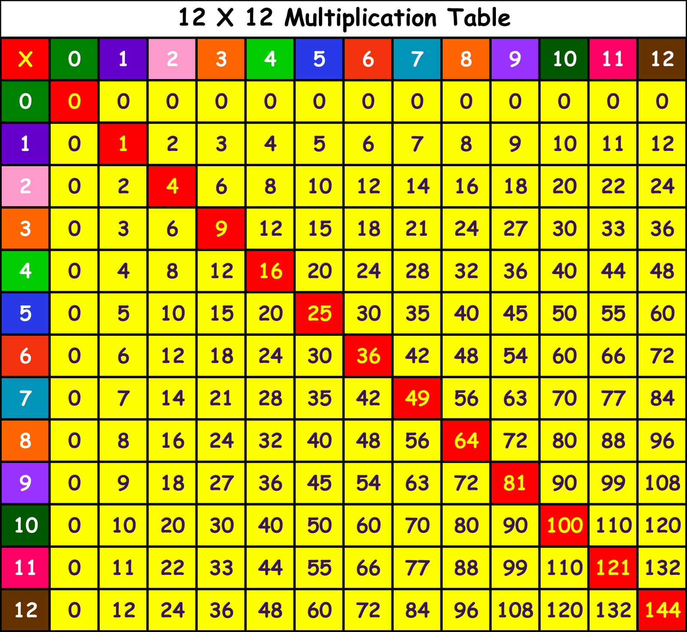
Learning number facts
Year 5 children completed the multiplication tables check (MTC) when they were in Year 4 but that is not the end of learning Number Facts!
In school and at home, children will be using Timestable Rockstars to help develop their:
Accuracy
Speed
Division facts
Recall

Slide 11

READING EXPECTATIONS
At Widey Court we value reading as an essential life skill that empowers children to reach their full potential.
Read or talk about a book they are reading at least four times per week.
Sign/date and comment in the Reading Record regularly (these will be checked by teachers/teaching assistances).
Read with your child when you can both take time to relax and enjoy their chosen book.
Children will have a range of reading material from school (AR book/library book/MyOn), you can also supplement these books with additional reading material from home.

Slide 12
READING EXPECTATIONS
At Widey Court we value reading as an essential life skill that empowers children to reach their full potential.
Research shows that hearing texts read aloud is a significant source of vocabulary acquisition.
Reading to your child allows them to hear what fluent and expressive reading sounds like.
Discussing books with your child helps them to develop opinions, preferences and make connections with other learning.
Reading together demonstrates the value of reading.
It can be fun and relaxing too!

Slide 13
If you have any questions or would like to arrange a meeting, please contact your child’s class teacher using the following email addresses:
Mrs Bemister (Vixen Tor)
cbemister@wideycourt.plymouth.sch.uk
Mr Gribble and Mrs Carney (Burrator)
rgribble@wideycourt.plymouth.sch.uk and gcarney@wideycourt.Plymouth.sch.uk
Mrs Pomeroy (Brentor)
ppomeroy@wideycourt.plymouth.sch.uk

