Slide 1
Year 5 Enrichment Week
From Monday 26th April
to Friday 30th April 2027
39 children at Nethercott Farm Residential Forest School Cooking Working with animals Tech-free! | 51 children at WCPS Day-trip to Deer Park Farm Farm Safari Den-building Sports Forest School Art activities Wellbeing

Slide 2
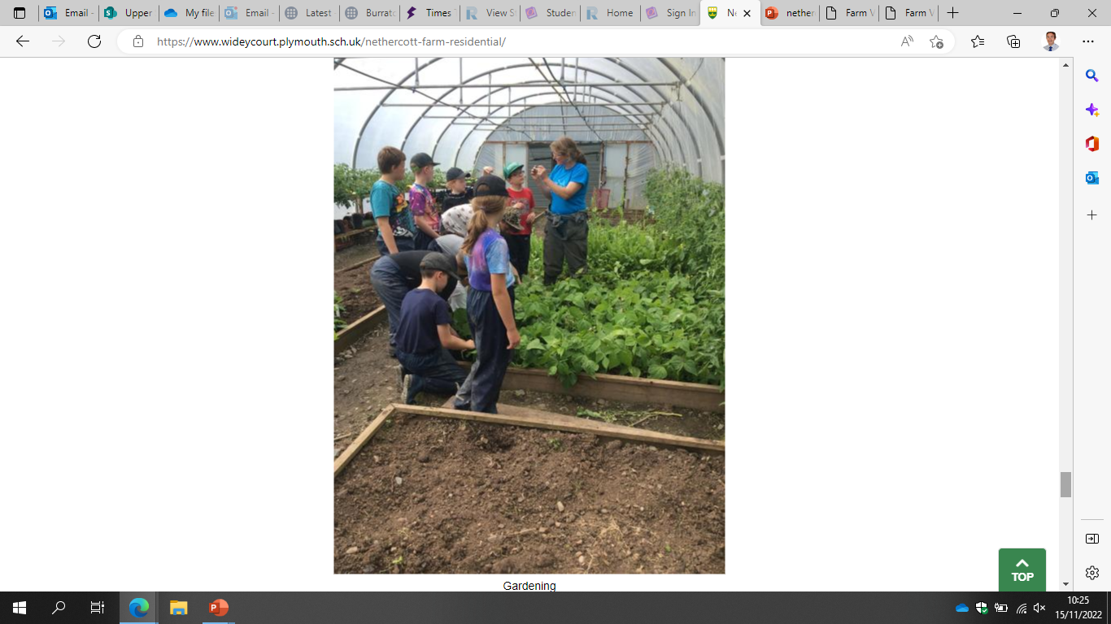
Nethercott Farm Residential for
Year 5 Children 2027
From Monday 26th April
to Friday 30th April
2027

Slide 3
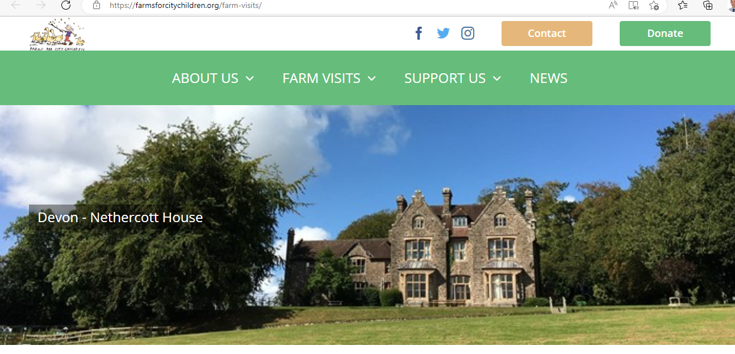
Nethercott Farm Residential
Farms For City Children - Our Life-changing Offer | Immersive Five-day Residential Stay - YouTube

Slide 4
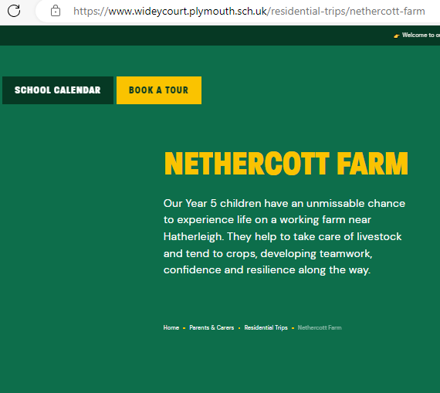

Slide 5

The Nethercott
Story
About us – Farms For City Children
Charity (FFCC)
Michael Morpurgo
Widey at Nethercott
Benefits to children
Sleeping arrangements
Dietary & Medical needs
Travel arrangements
Shopping!
Food & dining
Kit list

Slide 6
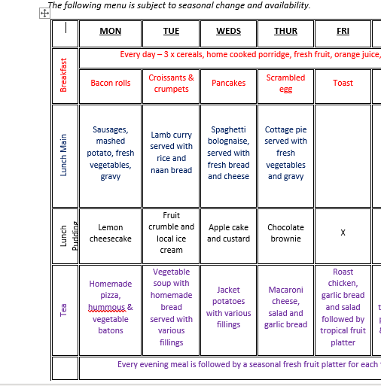

Slide 7
Information sharing
We will ask you to supply the following information in advance of the trip:
Dietary needs (allergy, intolerance, vegetarian etc)
Pastoral (anxiety, night-time issues etc)
Medical needs (non-food allergy, medicines, illness, conditions)
Permission to appear in FFCC photos and videos (FFCC online form)

Slide 8
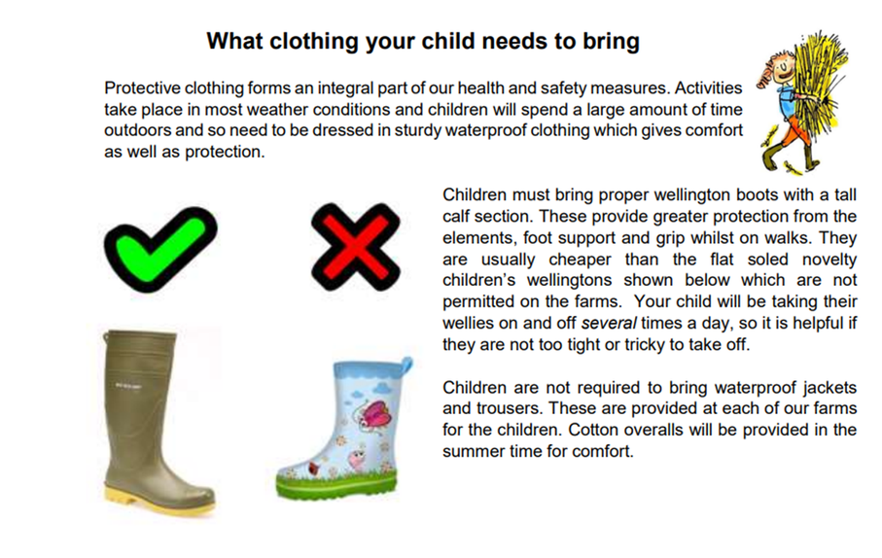

Slide 9

Kit List 2027 (part 1)

Slide 10

Kit List 2027 (part 2)

Slide 11
Securing a place for your child
There are 39 places on this trip
(because children are in 3 farm-work groups of 13 )
Widey office staff manage all payments and money-related enquiries
A deposit of £90 can be paid on Arbor
Full cost is £330
(discounts for FSM)
(spaces cannot be reserved in advance)
If/when the first 39 spaces have been filled, any additional deposit payments will be allocated a place on the waiting list

Slide 12
Any questions?
Please contact the school office for any payment enquiries:
admin@wideycourt.plymouth.sch.uk
Please contact Mr Gribble for all other enquiries about the trip:
rgribble@wideycourt.plymouth.sch.uk
Thank you.

