Slide 1
July 3, 2025
Science, energy, chemistry
The next chapter in a happy marriage

Slide 2
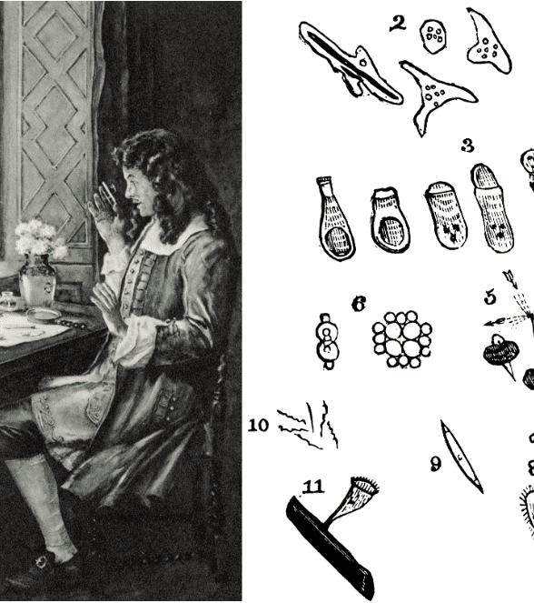
Optics reveal
Van Leeuwenhoek’s new world view
In 1674, Anthony van Leeuwenhoek used his new microscope to study a droplet of water. He saw lots of organisms — “animalcules” — in it and thus founded the science of microbiology.

Slide 3
Converging to hygiene
Bleaching and glass drive demand for potash
First soda factory in France
Coal gasifiers produce cheap ammonia
Solvay produces cheap soda
1700
1800
1900
2000
Doctors in cities start prescribing the use of soap
P&G Ivory soap
Lever soap
Maternal deaths slashed by washing with chlorine and soda
Pasteur’s germ theory, antisepsis in surgery

Slide 4
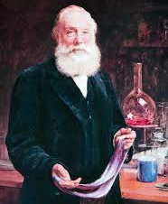
Perkin’s lab accident
Triggering the color revolution
In 1856, William Perkin wanted to cure malaria and accidentally found vibrant pigments for the textiles industry.

Slide 5
Light to fashion
Street and home lighting developed to run on coal gas
Gasifier tar creates a major waste issue
1700
1800
1900
2000
The cotton industry produces cheap textiles, creating a fashion industry
Perkin launches his synthetic dye, creating a fashion craze
Bayer and BASF founded to convert tar into pigments

Slide 6
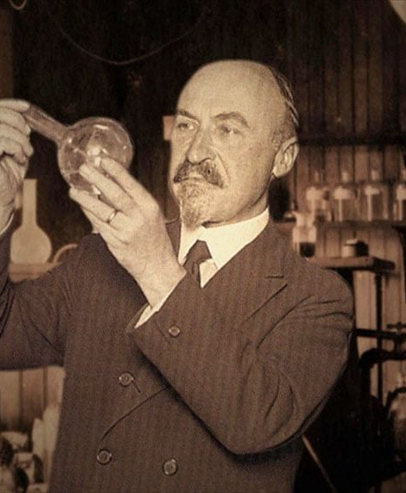
Brillant persistence
Baekeland creates a new class of materials
Bakelite, as the first synthetic material, created entirely new production methods and products.

Slide 7
Driving to prosperity
Refining creates lots of cheap waste hydrocarbons: naphtha and gasoline
Cracking provides cheap and large amounts of olefins
Car ownership explodes, leading to exponential growth of refining
Peak whale oil creates the refining industry
1700
1800
1900
2000
Electrification of homes and industry requires better insulator materials
Polyethylene (ICI) and Nylon (DuPont) discovered
Plastics enable mass-produced cheap durable goods (Tupperware)

Slide 8

What’s next?
Possible drivers for new products:
Biodegradability
Recyclability
Health impacts
Water / air purification
Conservation
Climate

Slide 9
THANK YOU

Slide 10
ABOUT LUX

