Slide 1
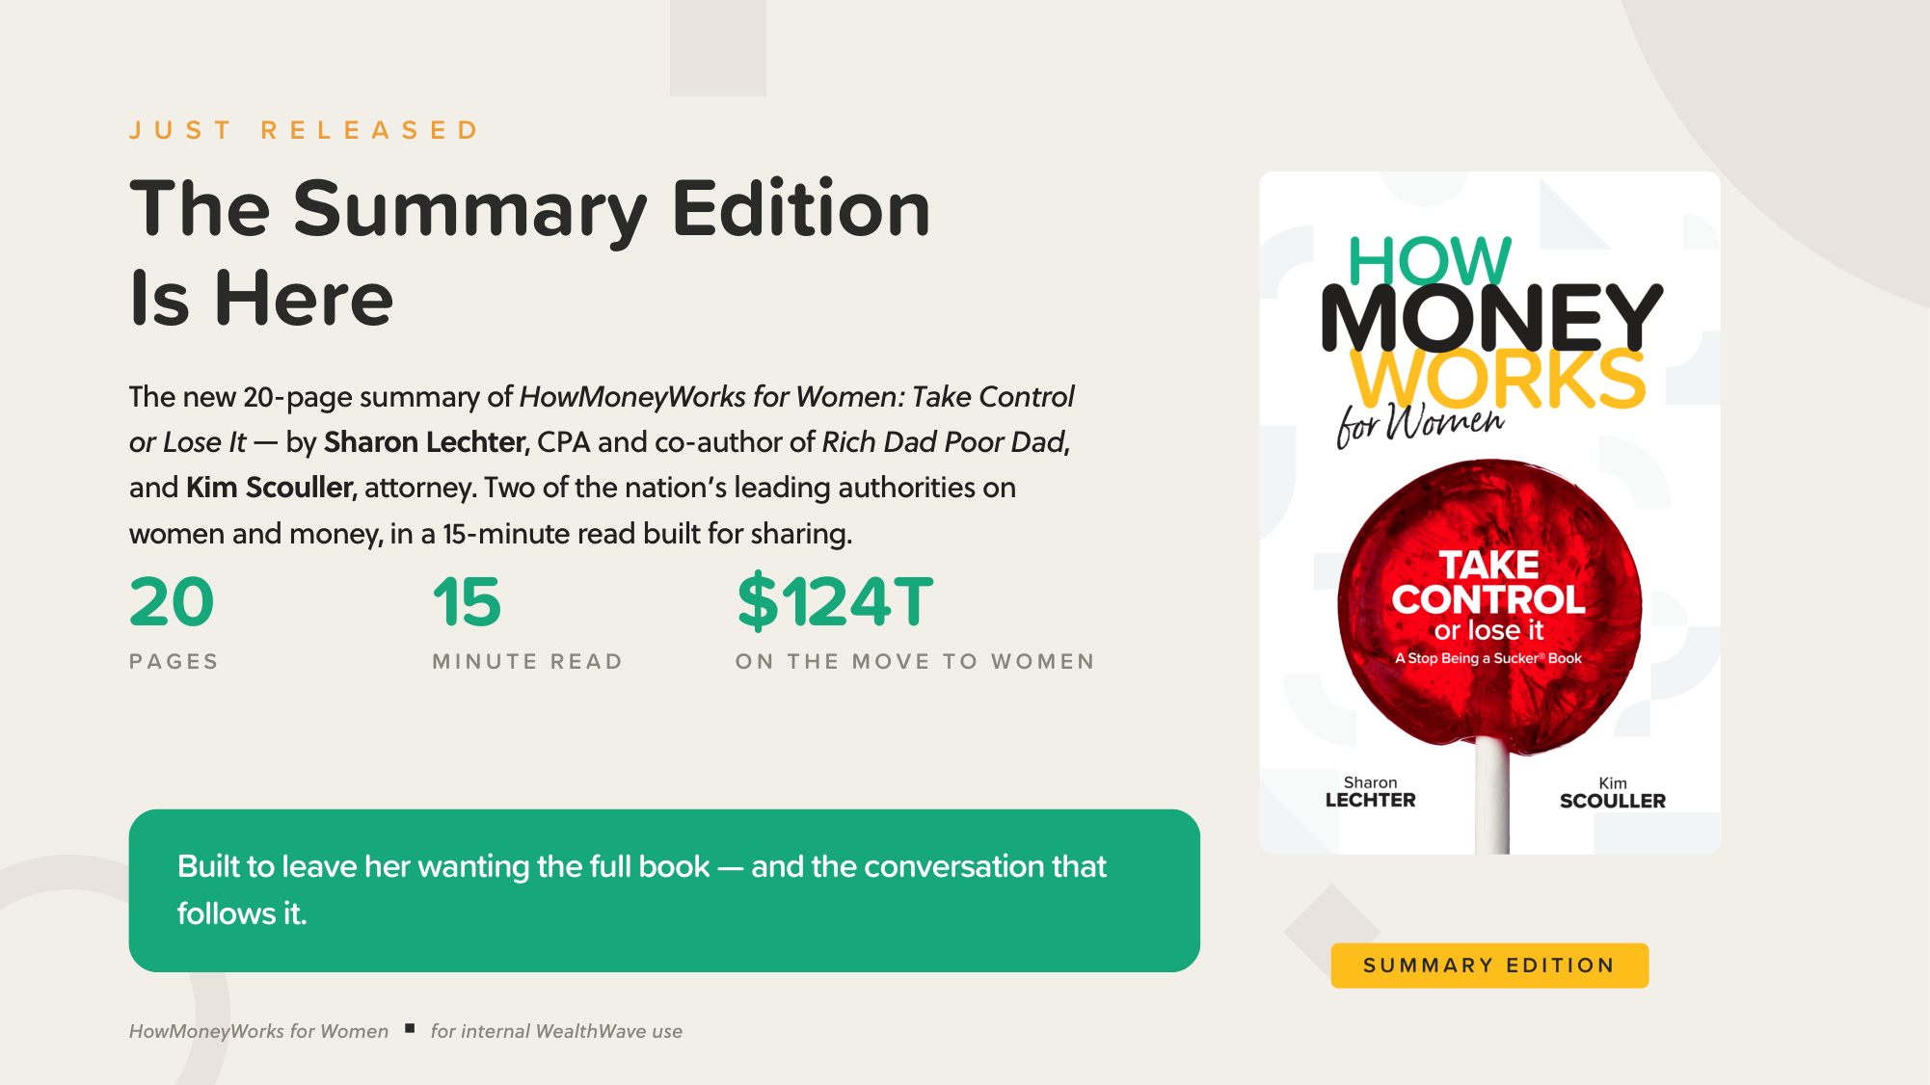
Notes:
Announce the Summary Edition: 20 pages, 15 minutes, by Sharon Lechter (CPA, co-author of Rich Dad Poor Dad) and Kim Scouller (attorney). The moment: $124T Great Wealth Transfer, most headed to women. Built to make readers want the full book.

Slide 2
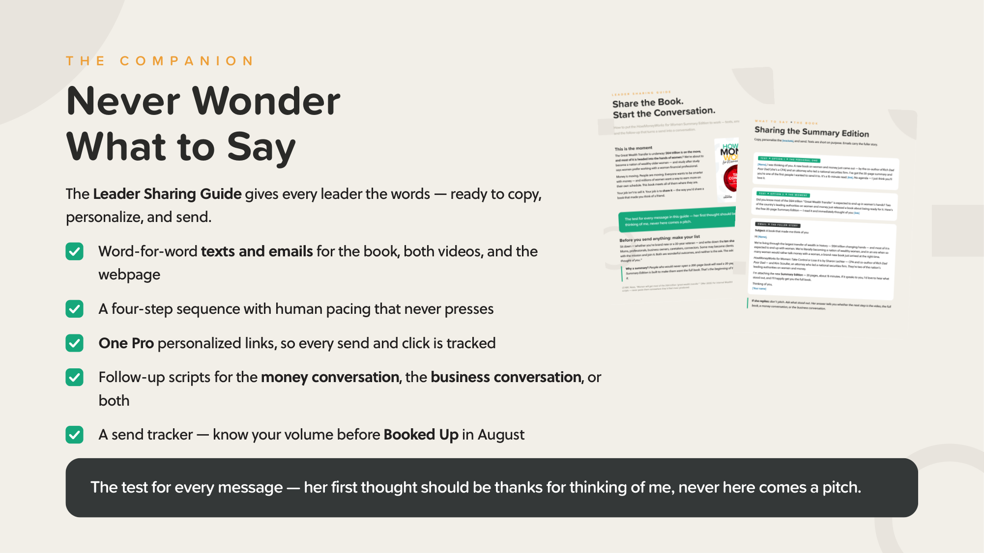
Notes:
The companion Leader Sharing Guide: word-for-word texts and emails for the book, the two women's videos, and the webpage; One Pro personalized links; follow-up scripts (money conversation, business conversation, or both); send tracker for Booked Up in August. The standard: her first thought should be 'thanks for thinking of me.'

Slide 3

Notes:
The ask tonight: list ten sharp women. Sequence: 1) send the summary with a personal line, 2) follow with a video a few days later, 3) share the webpage, 4) invite the conversation. Both files — where to find them: drop the link in chat.

