Slide 1

Equality, Diversity and Inclusion An intro to what the EDI Office can support you with at Trinity

Slide 2

What We Do
Your main point of contact is Joel McKeever, the Trinity Equality Officer at equality@tcd.ie
We are actively working to create a fair and equitable Trinity community
We lead local and national conversations that underpin Trinity’s responsibility to create a meaningfully equitable and inclusive society
Working at every level, from the daily life of students to the long-term future of the university, to create an intersectional, inclusive experience
We work in the understanding that more always needs to be done

Slide 3

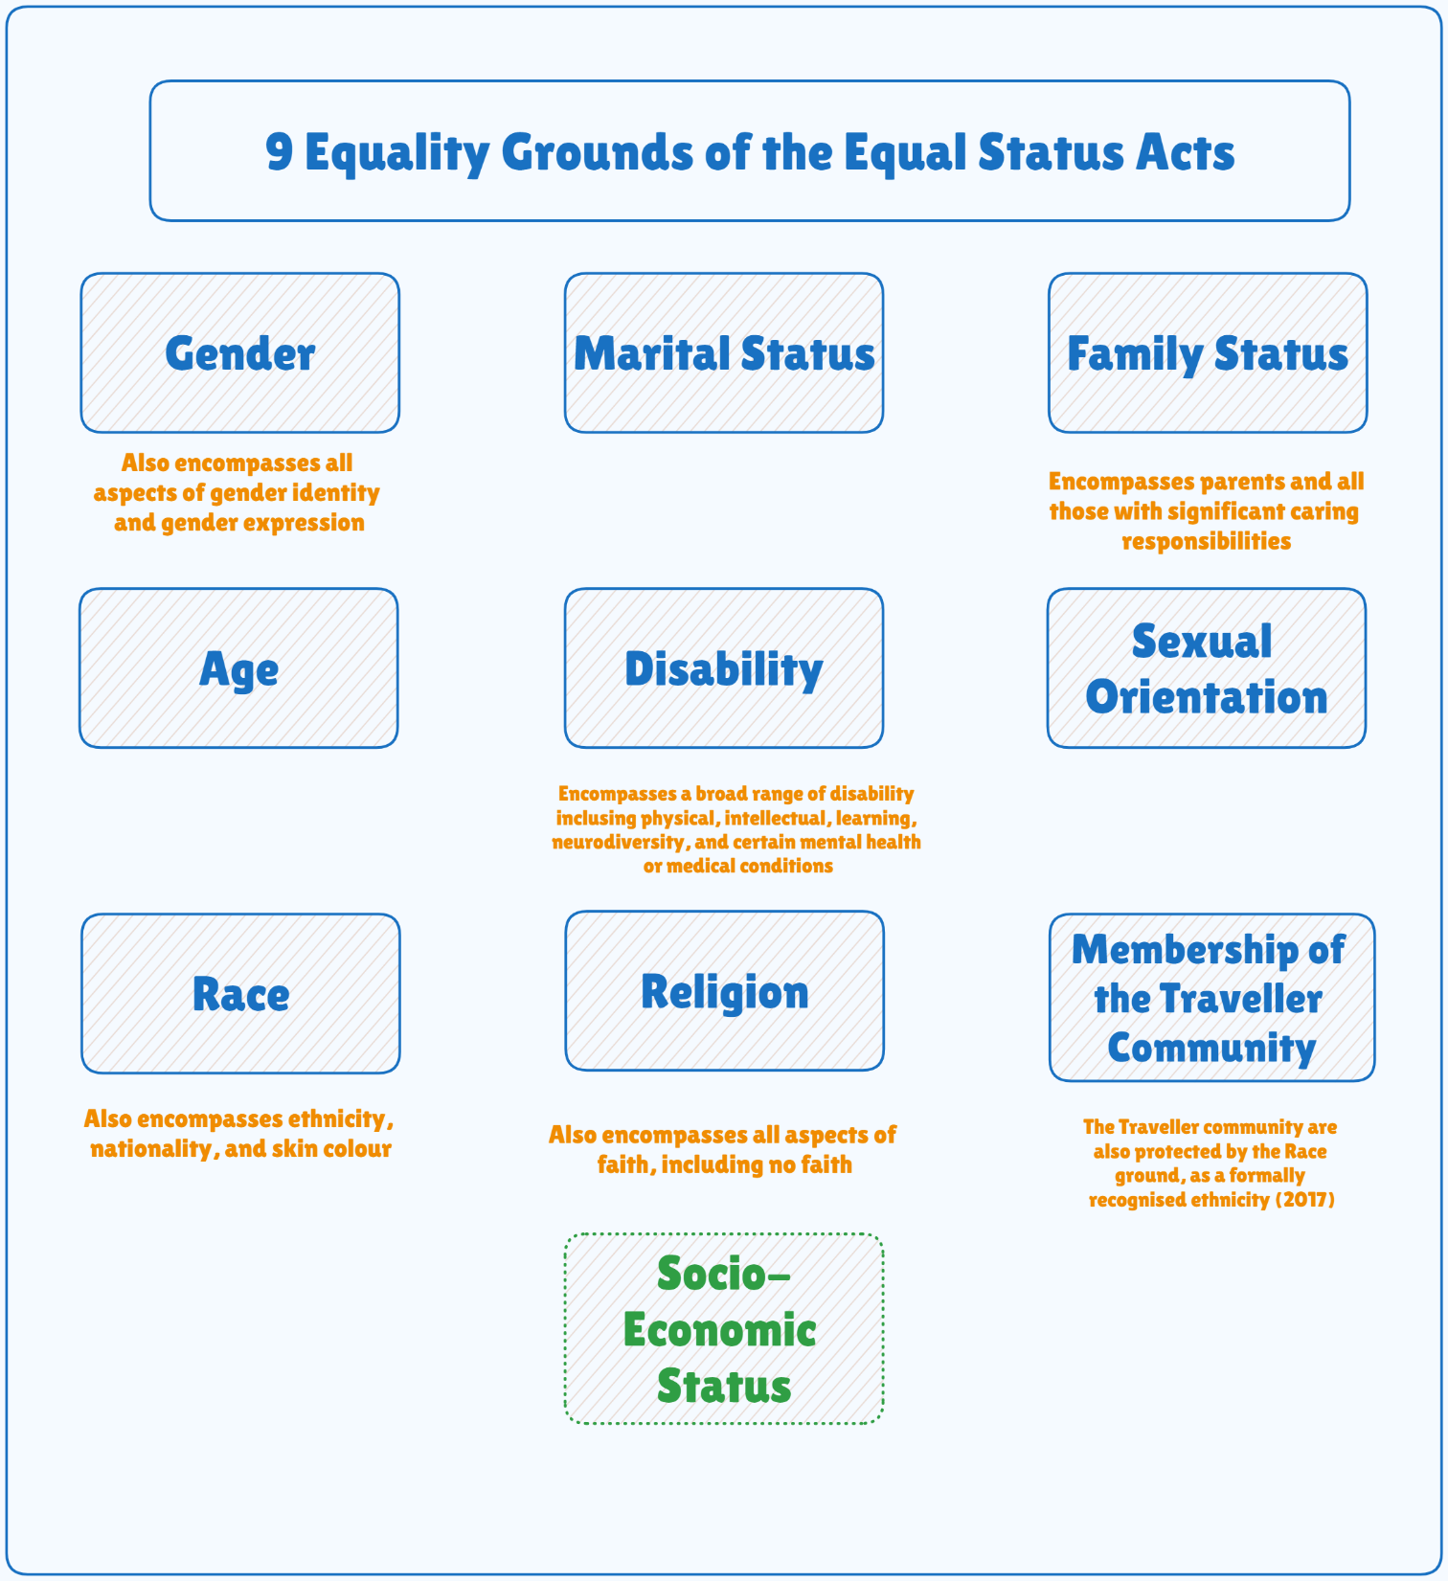
Equality areas we support with (including but not limited to…)
Not yet a specifically protected ground in equality law, but may be soon

Slide 4
What we support societies and students with?
See resources and FAQs on our website: www.tcd.ie/equality
How to make emails, social media, visual material accessible
How to organise events in an accessible and inclusive way
How to learn more about the different cultures and minority communities on campus
How to develop your own skills and knowledge on these topics as a society member
We offer guidance, resources, and good practice templates to support CSC, societies and individual students. This helps with:
Knowing your rights and who can give you advice
Making society events accessible, interesting, and inclusive for all kinds of students
Giving you clear steps to follow to resolve issues when they come up

Slide 5

Other Resources available
Training: recommended training options for Trinity students and staff including online modules:
Let’s Talk about Race in the Higher Education Sector
EDI in Higher Education
LinkedIn Learning available to staff and students:
Equity First: The Path to Inclusion and Belonging
How to Engage Meaningfully in Allyship and Anti-Racism
Bystander Training: From Bystander to Upstander
Cultivating Cultural Competence and Inclusion
Becoming a Male Ally at Work
Additional training and support from the EDI Office:
We will be working to make society specific training available in the near future – watch this space
In the meantime, if you have an area of particular importance or an EDI question we can support with, get in touch

Slide 6
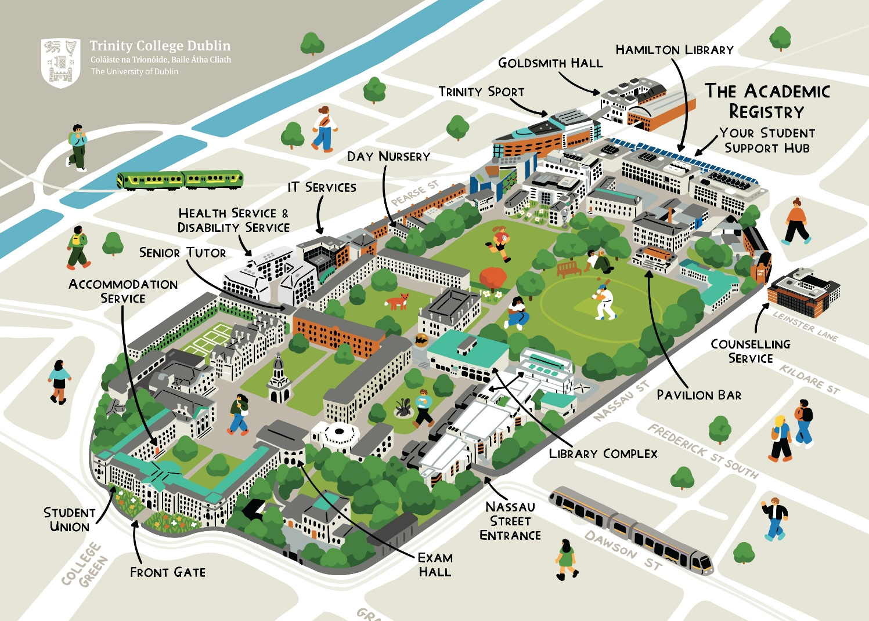

How to Find Us
Contact Us:
Email: equality@tcd.ie
Phone: 01 896 4034
Office: Room 2054, 2nd Floor, Arts Building

