Slide 1


(OTCPK: NACB)
2026 ANNUAL SHAREHOLDERS’ MEETING

Slide 2

chairman’s remarks
Richard B. (Randy) Anderson, Jr.

Slide 3
2025 highlights
Sustained Growth in Core Deposits and Client Relationships: Continued success in expanding deposits while deepening long‑term customer relationships.
Disciplined Execution of a Balanced Growth Strategy: Ongoing focus on funding loan growth through customer deposits, maintaining strong liquidity and low cost of funds while supporting earnings performance.
Expansion of SBA Lending Capabilities: Continued emphasis on SBA 7(a) and 504 lending as a strategic driver of commercial and industrial growth and net interest income.
Advancement of Innovation Initiatives: Exploration and expansion of innovation efforts, including evaluation of Microsoft Copilot to enhance productivity and operational efficiency.
Leadership Milestone: Recognition of Debra Keats for her 30‑year anniversary with NCB, celebrating her long‑standing leadership and contributions to the Bank and its communities.

Slide 4

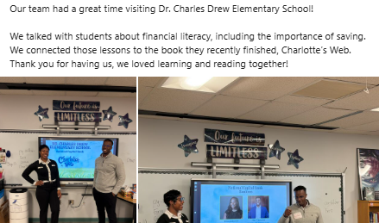
2025 Community Highlights
Community is at the core of everything we do.
This year, NCB continued supporting community organizations’ missions through the National Capital Bank Fund
  Charitable Giving – $128,018
  Volunteer Hours – 1,058
Follow us on LinkedIn, Facebook, and Instagram to see featured Bank activities and community highlights.

Slide 5
Q1 2026 Recap
Expanded commercial payment capabilities: Introduction of Zelle® for Small Business, providing faster and more flexible payment options for commercial clients.
Engaging the next generation of customers: Targeted efforts to attract younger customers through Next Gen Checking and Capitol Kids’ Club Savings Accounts, as featured on our website.
Community education and outreach: Hosted an in‑branch event for community members focused on online banking basics and digital banking tools.
Innovation and regulatory oversight: The Innovation Committee continues to evaluate emerging technologies while closely monitoring developments in Stablecoin regulation.

Slide 6

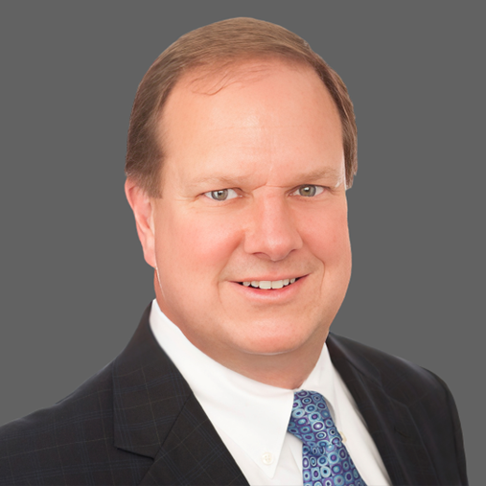
Retirement announcements
Randy Rabe
Chief Financial Officer
Richard Johnson
Chief Credit Officer

Slide 7
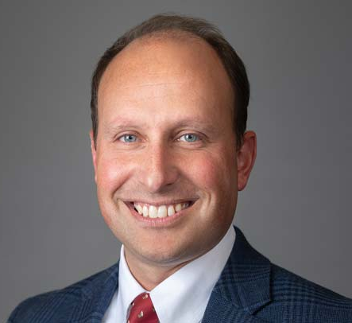

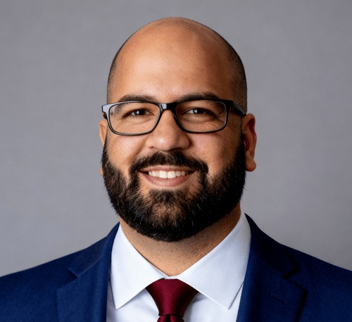

Management Announcements
Ryan McKinley
Chief Lending Officer
William Bauder
Chief Financial Officer
Shaun Ahmad
Chief Credit Officer
Ian Kilby
Risk and Innovation Director

Slide 8
2026 and moving forward
Operational Efficiency & Infrastructure
Enhancing internal reporting, analytics, and infrastructure to improve efficiency, scalability, and decision‑making in support of balanced asset growth and disciplined expense management.
Credit & Risk Management
Maintaining a strong focus on credit quality through enhanced monitoring and stress testing, ensuring the Bank remains resilient and well‑positioned amid economic uncertainty and changing conditions in the Washington, D.C. market.
Relationship Growth
Sustaining proactive client outreach and relationship management to identify risks, support client needs, and deepen relationships across retail and commercial customer segments. Advance strategic market expansion efforts through continued evaluation and pursuit of a future Tysons, Virginia location.
Shareholder Value
Continuing to execute on a balanced growth strategy focused on prudent asset growth, strong capital levels, liquidity management, and long‑term shareholder value creation.

Slide 9
Financial Highlights
$000’s except per share
Highlights
2025 Earnings of $7,033,000 and EPS of $6.12 improved 10%
Pre-provision earnings increased 23.8% as:
  Operating revenue increased 10.3%
  Operating expenses increased 3.5%
Balance sheet growth:
  Loans: $23 million (4.4%)
  Deposits $50 million (8.0%)
Strong deposit growth allowed for a decrease in borrowings of $9 million to $0
Capital levels remain stable and well above regulatory requirements

Slide 10
Earnings Growth trends
Analysis
5-Year CAGR:
  15.9% for Pre-tax pre-provision profit
  21.6% for Net income
Pre-tax pre-provision profit:
  favorably impacted by PPP loan fees in 2020 and 2021
  Improvement in 2024 & 2025 due to productivity improvements, cost reductions, deposit growth and a favorable funding mix
Net income in 2022 (and somewhat in 2021) was favorably impacted by a reversal of loan loss reserves booked in 2020 ($2.1 million) due to the uncertainty of the pandemic
CAGR 15.9%

Slide 11
Loan & deposit Growth trends
Analysis
Healthy and balanced growth over the past five years:
  Loans 4.2% CAGR (5yr)
  Deposits 5.0% CAGR (5yr)
Loan-to-Deposit ratio decreased in 2025 ending the year at 79.9% due to strong deposit growth and remains more conservative than our local DC peer bank median of 94%
Bank management continued to focus on more balanced growth in 2025 with customer deposit growth providing funding for loan growth

Slide 12
Valuable core deposits
Historical Deposit Growth ($000’s)
Deposit Composition (12/31/2025)
2025 Cost:
1.43%
CAGR: 5.0%
High quality deposit portfolio with cost of total deposits only 1.43% for 2025 which is low-cost relative to DC metro area competitors’ median (lower by more than 100 bps)
Robust core deposit base with less reliance on time deposits than DC metro area peer group
$5 million in brokered deposits

Slide 13
National Capital Financial Group
Record growth and income 2020-2025
CAGR 7.3%
CAGR 9.5%
CAGR 13.1%

Slide 14
Prudent credit culture drives asset quality
Credit Quality Highlights
Low historic nonperforming assets has been supported by conservative approach to provisioning reserves. Recent problem loans primarily originated from voucher-tenanted multifamily housing projects. The Bank is continuing to work multiple paths to cost-effectively resolve these problem loans.
Non-performing loans on December 31, 2025 was $13.8 million and was mainly from two borrowers in the multifamily housing space.
Asset Quality
Note: Nonperforming loans include loans on nonaccrual and 90+ days past due

Slide 15
Strong capital Levels
Tier 1 Leverage ratio remained strong at 11.34% in 2025
Total Risk-based Capital ratio remained very strong at 16.95% of risk-weighted assets

Slide 16
Focus on Productivity – 4Q25 vs. 4Q24
The post-pandemic economic conditions, including the rapid increase in interest rates beginning in 2022 caused the bank to shift its focus to cost efficiency and moderating growth to optimize ROA
Since 2Q22, we have been comparing ourselves against a 12-bank DC peer group ($300 mil - $8.0 bil) as well as a subset 7-bank DC peer group ($300 mil - $1.5 bil)
We measure using five important productivity metrics at the bank level
From 2Q22 to 4Q25, we have improved from the bottom quartile to the top quartile median performance
  At 4Q24 we were above median performance

Slide 17
1Q26 Financial Results
Highlights
1Q26 Earnings of $1,053,000 decreased 37.1% compared to 1Q25
Pre-tax pre-provision earnings increased 32.6% in 1Q26 compared to 1Q25 primarily due to net interest income growth
  Operating revenue increased by 10.3%
  Operating expenses decreased by 1.0%
  Efficiency ratio improved to 59.6%
Quarterly balance sheet fluctuations in 1Q26:
  Loans decreased $12 million
  Deposits decreased $28 million
Bank has very strong available funding sources with the Federal Reserve and FHLB with combined lendable collateral value of $226 million.

Slide 18
Per Share Trends
Stock price at 3/31/26 of $66.49 compared to book value at 3/31/26 of $59.47
2nd quarter dividend of $0.26 reflects a 23.8% increase over prior year
In addition to a $0.26 per share quarterly dividend, your Board approved a share repurchase program of up to $900,000 good until February 28, 2027
Per share data reflects the 4:1 stock split paid in the form of a dividend on November 26, 2024

Slide 19
Share Price-to-Earnings Trends
Price-to-Earnings (LTM EPS) has remained fairly stable in low double digits over the past four years
Increases in EPS have helped support an increasing share price
Per share data reflects the 4:1 stock split paid in the form of a dividend on November 26, 2024

Slide 20

Congratulations & Thank you
Please join us in thanking Kathy Didden for her 18 years of dedicated service (2008–2026) on the Boards of Directors of National Capital Bank and National Capital Bancorp, Inc.

Slide 21
Thank you for joining us
(OTCPK: NACB)

