Slide 1
Fluency Focus: Lesson 7 – the Railway Children

Slide 2
Vocabulary
flannel
furze bush
cuckoo
harsh

Slide 3
Vocabulary
oncoming
slackened
swiftly
feebly

Slide 4
The Railway Children by Edith Nesbitt
It seemed to her that they had been standing there for hours and hours, holding those silly little red flannel flags that no one would ever notice. The train wouldn't care. It would go rushing by them and tear round the corner and go crashing into that awful mound. And everyone would be killed. Her hands grew very cold and trembled so that she could hardly hold the flag. And then came the distant rumble and hum of the metals, and a puff of white steam showed far away along the stretch of line.
'Stand firm,' said Peter, 'and wave like mad! When it gets to that big furze bush step back, but go on waving! Don't stand on the line, Bobbie!' The train came rattling along very, very fast.
'They don't see us! They won't see us! It's all no good!' cried Bobbie.

Slide 5
The two little flags on the line swayed as the nearing train shook and loosened the heaps of loose stones that held them up. One of them slowly leaned over and fell on the line. Bobbie jumped forward and caught it up, and waved it; her hands did not tremble now.
It seemed that the train came on as fast as ever. It was very near now.
'Keep off the line, you silly cuckoo!' said Peter, fiercely.
'It's no good,' Bobbie said again.
'Stand back!' cried Peter, suddenly, and he dragged Phyllis back by the arm. But Bobbie cried, 'Not yet, not yet!' and waved her two flags right over the line. The front of the engine looked black and enormous. Its voice was loud and harsh.

Slide 6
'Oh, stop, stop, stop!' cried Bobbie. No one heard her. At least Peter and Phyllis didn't, for the oncoming rush of the train covered the sound of her voice with a mountain of sound. But afterwards she used to wonder whether the engine itself had not heard her. It seemed almost as though it had — for it slackened swiftly, slackened and stopped, not twenty yards from the place where Bobbie's two flags waved over the line. She saw the great black engine stop dead, but somehow she could not stop waving the flags. And when the driver and the fireman had got off the engine and Peter and Phyllis had gone to meet them and pour out their excited tale of the awful mound just round the corner, Bobbie still waved the flags but more and more feebly and jerkily.
When the others turned towards her she was lying across the line with her hands flung forward and still gripping the sticks of the little red flannel flags.

Slide 7
Discussion
What happened in the extract?
Who were the main characters?
Why do you think Bobbie kept waving the flags even though the train had stopped?
What sort of atmosphere was the writer trying to create in this extract?

Slide 8
Phrased Reading
It seemed to her / that they had been standing there for hours and hours,/ holding those silly little red flannel flags / that no one would ever notice. // The train wouldn't care. // It would go rushing by them / and tear round the corner / and go crashing into that awful mound. // And everyone would be killed. // Her hands grew very cold / and trembled so that she could hardly hold the flag. // And then came the distant rumble and hum of the metals, / and a puff of white steam showed far away / along the stretch of line.

Slide 9
Phrased Reading
Let’s do this part together!
'Stand firm,' said Peter, 'and wave like mad! When it gets to that big furze bush step back, but go on waving! Don't stand on the line, Bobbie!' The train came rattling along very, very fast.
'They don't see us! They won't see us! It's all no good!' cried Bobbie.
The two little flags on the line swayed as the nearing train shook and loosened the heaps of loose stones that held them up. One of them slowly leaned over and fell on the line. Bobbie jumped forward and caught it up, and waved it; her hands did not tremble now.

Slide 10
Phrased Reading
Let’s do this part together!
It seemed that the train came on as fast as ever. It was very near now.
'Keep off the line, you silly cuckoo!' said Peter, fiercely.
'It's no good,' Bobbie said again.

Slide 11
Your turn!
'Stand back!' cried Peter, suddenly, and he dragged Phyllis back by the arm. But Bobbie cried, 'Not yet, not yet!' and waved her two flags right over the line. The front of the engine looked black and enormous. Its voice was loud and harsh.
'Oh, stop, stop, stop!' cried Bobbie. No one heard her. At least Peter and Phyllis didn't, for the oncoming rush of the train covered the sound of her voice with a mountain of sound. But afterwards she used to wonder whether the engine itself had not heard her. It seemed almost as though it had — for it slackened swiftly, slackened and stopped, not twenty yards from the place where Bobbie's two flags waved over the line. She saw the great black engine stop dead, but somehow she could not stop waving the flags.

Slide 12
And when the driver and the fireman had got off the engine and Peter and Phyllis had gone to meet them and pour out their excited tale of the awful mound just round the corner, Bobbie still waved the flags but more and more feebly and jerkily.
When the others turned towards her she was lying across the line with her hands flung forward and still gripping the sticks of the little red flannel flags.

Slide 13
Echo Reading
'Stand firm,‘ / said Peter, / 'and wave like mad! // When it gets to that big furze bush step back, / but go on waving! // Don't stand on the line, / Bobbie!' //The train came rattling along very, very fast. //
'They don't see us! / They won't see us! / It's all no good!' / cried Bobbie.//
The two little flags on the line swayed / as the nearing train shook and loosened the heaps of loose stones that held them up. // One of them slowly leaned over / and fell on the line. // Bobbie jumped forward and caught it up,/ and waved it; // her hands did not tremble now. //
It seemed that the train came on as fast as ever. // It was very near now. //
'Keep off the line, you silly cuckoo!' / said Peter, / fiercely. //
'It's no good,' / Bobbie said again. //

Slide 14
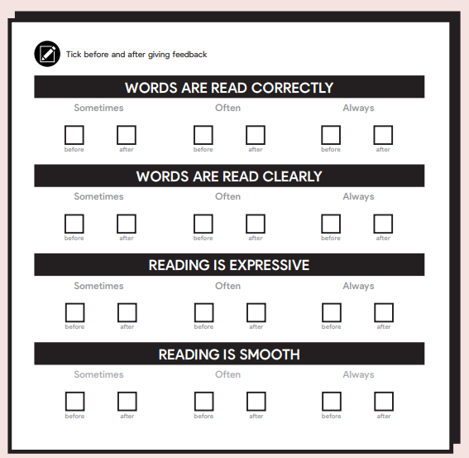
Paired reading

Slide 15
Performance reading
Time for you to show off your amazing reading!
In groups of four, divide the text into speech and narration. Two of you will deliver the speech and two the narration
The characters are Peter, Phyllis and Bobbie
Maybe you can make the train sound too!

Slide 16
Comprehension
1. What did the writer want the reader to feel? How did they achieve this?
The writer wanted the reader to…
They did this by…

Slide 17
Comprehension
2. Why do you think Bobbie fainted?
I think she fainted because…

Slide 18
Comprehension
3. Choose a key image or moment in the extract. Explain why it stood out to you.
A key image / moment is…
It stood out to me because…

