Slide 1
Fluency Focus:
Lesson 18 – Moons

Slide 2
Vocabulary
orbit
collision
accumulated

Slide 3
Vocabulary
asteroid
volcanic or geologic activity

Slide 4
Vocabulary
volcanic plumes
astronomer

Slide 5
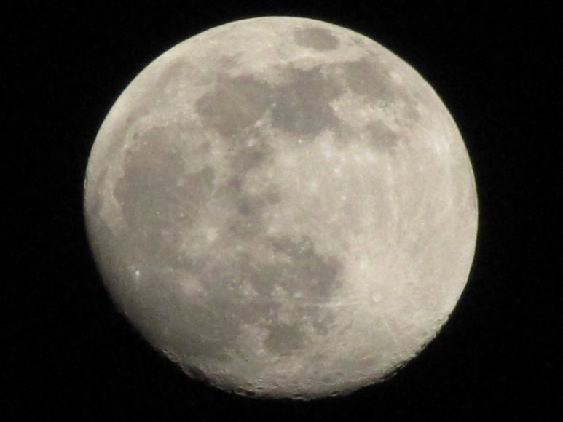
Moons
A moon is an object that orbits a planet or something else that is not a star. Objects that orbit other objects are also called ‘satellites’, so moons are sometimes called ‘natural satellites’. People have launched many artificial satellites into orbit around Earth, but these are not considered moons.
The planet or body that a moon orbits is called its ‘primary’. Just as gravity holds the planets in our solar system in orbit around the sun, gravity also keeps moons in orbit around their primaries.
Many moons formed at the same time as their primary. Gravity pulled bits of dust and gas together into larger and larger clumps of material. Eventually, the smaller clump of material (moon) began orbiting the larger clump (primary).

Slide 6
Some moons formed in other ways. Earth's moon may have formed when an object the size of Mars crashed into the planet. The collision sprayed a huge amount of material into orbit around Earth. This material slowly accumulated into one large body, our moon. Other moons in our solar system were once asteroids, chunks of rock that are too small to be planets. These asteroids came too close to their primary and were pulled into orbit by the force of gravity.
Most moons are made of rock, but many also contain a large amount of ice, gas, and other chemicals. Europa, a large moon orbiting Jupiter, has an icy surface that may cover a liquid ocean of water.
Some moons have volcanic or geologic activity. For example, scientists have observed volcanic plumes rising 300 kilometres from the surface of Io, another one of Jupiter’s moons. Other moons, including Earth's moon, show little or no signs of geologic activity, though they may have been more active in the past.

Slide 7
As of 2010, astronomers had discovered 166 moons circling planets in our solar system. Ninety-nine of these have been discovered since 2000. Jupiter has the most known moons, with 63. Saturn has 60 named moons, Uranus has 27, and Neptune has 13. Mars has just two, and Earth has only one. Venus and Mercury have no moons.
Because moons are relatively small, none have yet been discovered outside the solar system, but there are likely trillions of moons throughout the universe.
Fun Fact – Supermoon!
The largest moon in the solar system is Ganymede, which orbits Jupiter. Its diameter, or maximum distance across, is 5,262 kilometres (3,270 miles), larger than the planet Mercury. In 1610, Italian astronomer Galileo Galilei discovered Ganymede and three other planet-size moons circling Jupiter. They were the first moons discovered orbiting a planet other than Earth.

Slide 8
Comprehension
Did any information in the text surprise you?
What is the definition of a ‘primary’ in the context of this text?
Can you name two ways in which moons are formed?
Why has nobody discovered moons outside of our solar system yet?

Slide 9
Phrased reading
A moon is an object that orbits a planet/ or something else that is not a star.// Objects that orbit other objects are also called ‘satellites’,/ so moons are sometimes called ‘natural satellites’.// People have launched many artificial satellites into orbit around Earth,/ but these are not considered moons.//
The planet/ or body that a moon orbits/ is called its ‘primary’.// Just as gravity holds the planets in our solar system/ in orbit around the sun,/ gravity also keeps moons in orbit/ around their primaries.//
Many moons formed at the same time as their primary.// Gravity pulled bits of dust and gas together/ into larger and larger clumps of material.// Eventually,/ the smaller clump of material/ (moon)/ began orbiting the larger clump/ (primary).//

Slide 10
Let’s do this one together
Some moons formed in other ways. Earth's moon may have formed when an object the size of Mars crashed into the planet. The collision sprayed a huge amount of material into orbit around Earth. This material slowly accumulated into one large body, our moon. Other moons in our solar system were once asteroids, chunks of rock that are too small to be planets. These asteroids came too close to their primary and were pulled into orbit by the force of gravity.

Slide 11
Your turn
Most moons are made of rock, but many also contain a large amount of ice, gas, and other chemicals. Europa, a large moon orbiting Jupiter, has an icy surface that may cover a liquid ocean of water.
Some moons have volcanic or geologic activity. For example, scientists have observed volcanic plumes rising 300 kilometres from the surface of Io, another one of Jupiter’s moons. Other moons, including Earth's moon, show little or no signs of geologic activity, though they may have been more active in the past.

Slide 12
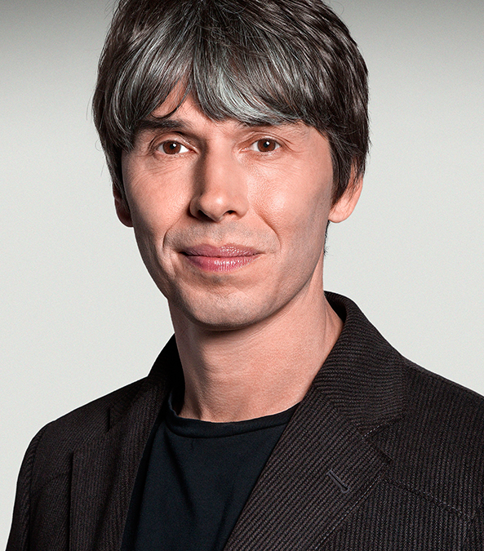
Echo reading
Imagine that you are a science TV presenter like Brian Cox
Let’s echo one section in that enthusiastic and informative style

Slide 13
Echo reading
Some moons formed in other ways. Earth's moon may have formed when an object the size of Mars crashed into the planet. The collision sprayed a huge amount of material into orbit around Earth. This material slowly accumulated into one large body, our moon. Other moons in our solar system were once asteroids, chunks of rock that are too small to be planets. These asteroids came too close to their primary and were pulled into orbit by the force of gravity.

Slide 14
Paired reading
Now you are going to listen to your partner reading in this science presenter style
Use the Fluency Scale to evaluate their reading
Tell your partner two things you liked about their reading and one thing they could improve
Then swap over!

Slide 15
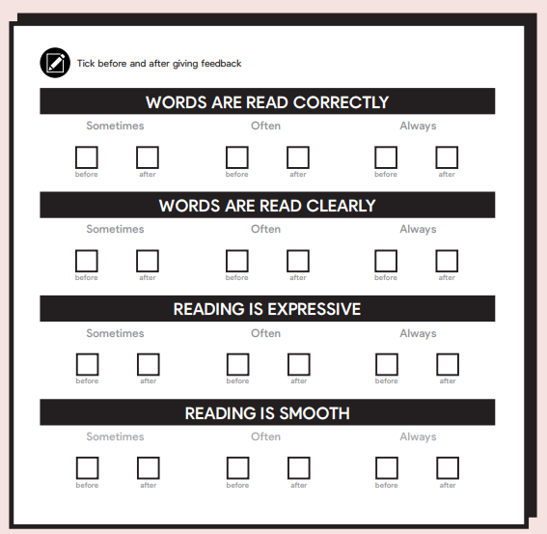
Paired reading

Slide 16
Performance reading
Time to show off your amazing reading!
Are there any volunteers who would like to present a section of the text to the class?
Remember to imagine you’re filming a science TV programme

