Slide 1
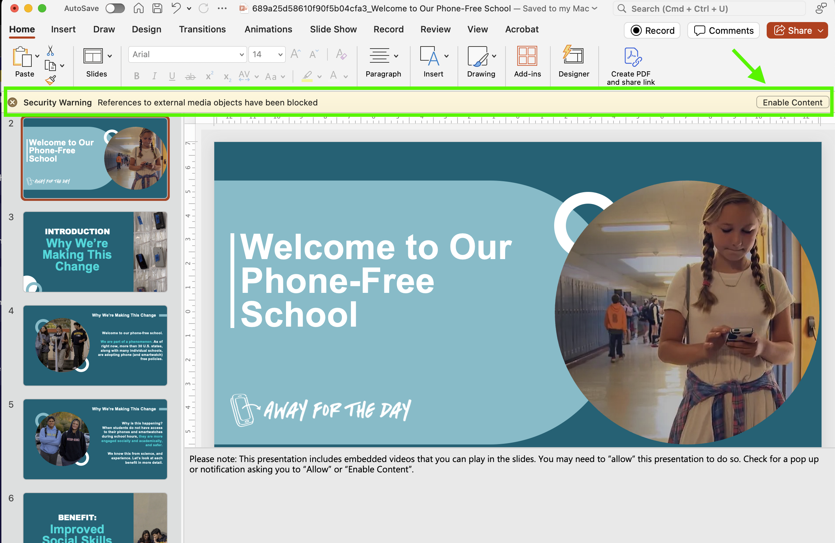
Note: This presentation includes embedded videos to play.
Depending on your school or district’s security settings, you may need to allow playback. If prompted, please select “Enable Content” (or a similar option).
Look for a security warning or similar popup and click ”Enable Content”
If the videos do not load, direct links are also provided in the speaker notes for each slide.

Slide 2
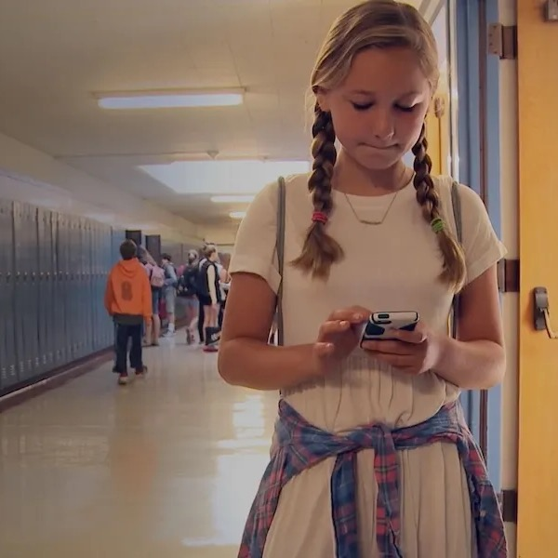

Welcome to Our Phone-Free School
Notes:
Please note: This presentation includes embedded videos that you can play in the slides. You may need to ”allow” this presentation to do so. Check for a pop up or notification asking you to “Allow” or “Enable Content”.

Slide 3
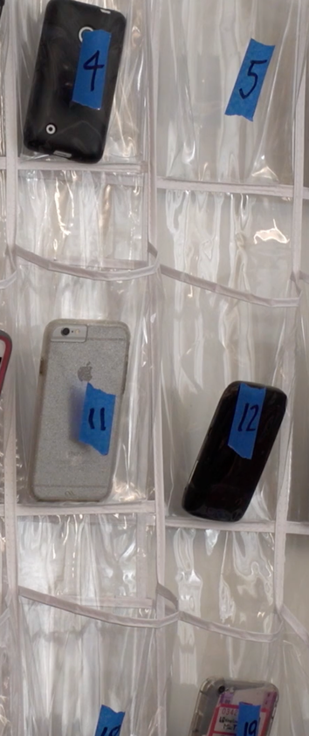
INTRODUCTION
Why We’re Making This Change

Slide 4
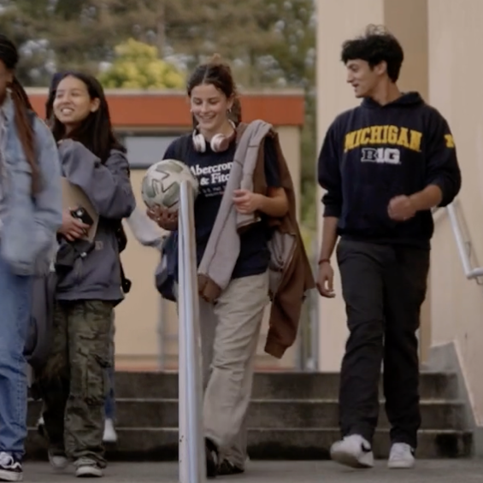
Why We’re Making This Change
Welcome to our phone-free school.
We are part of a phenomenon. As of right now, more than 30 U.S. states, along with many individual schools, are adopting phone (and smartwatch) free policies.

Slide 5

Why We’re Making This Change
Why is this happening?
When students do not have access to their phones and smartwatches during school hours, they are more engaged socially and academically, and safer.
We know this from science, and experience. Let’s look at each benefit in more detail.

Slide 6
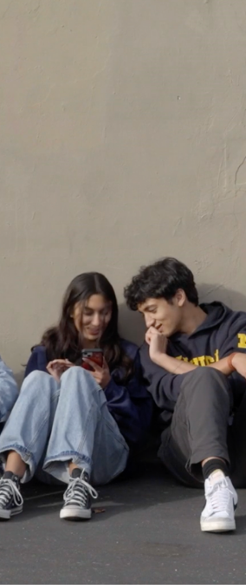
BENEFIT:
Improved Social Skills

Slide 7

Social Skills Will Improve
When our phones are out our social skills decline.
Click to play video
Notes:
Please use this link if video doesn’t play in-slide: https://player.vimeo.com/video/1105977368

Slide 8

Social Skills Will Improve
Schools with phone bans report an overall lift in morale, and deeper relationships between students, staff, and each other.
Click to play video
Notes:
Please use this link if video doesn’t play in-slide: https://player.vimeo.com/video/1105003404

Slide 9

Social Skills Will Improve
Improved social skills will last the rest of our lives, same as reading, writing and arithmetic.
Click to play video
Notes:
Please use this link if video doesn’t play in-slide: https://player.vimeo.com/video/1104697923

Slide 10
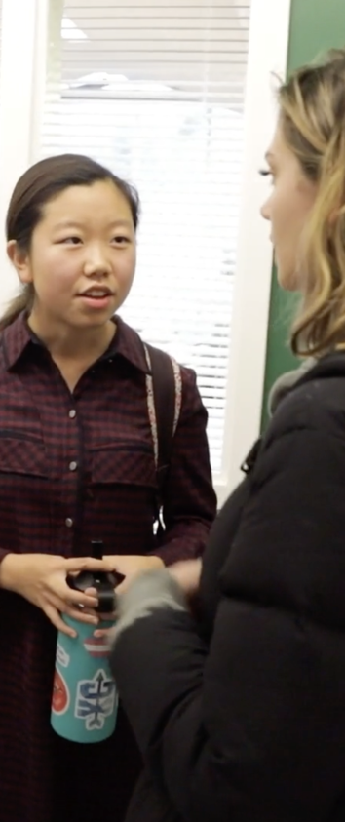
BENEFIT:
Improved Mental Well-Being

Slide 11
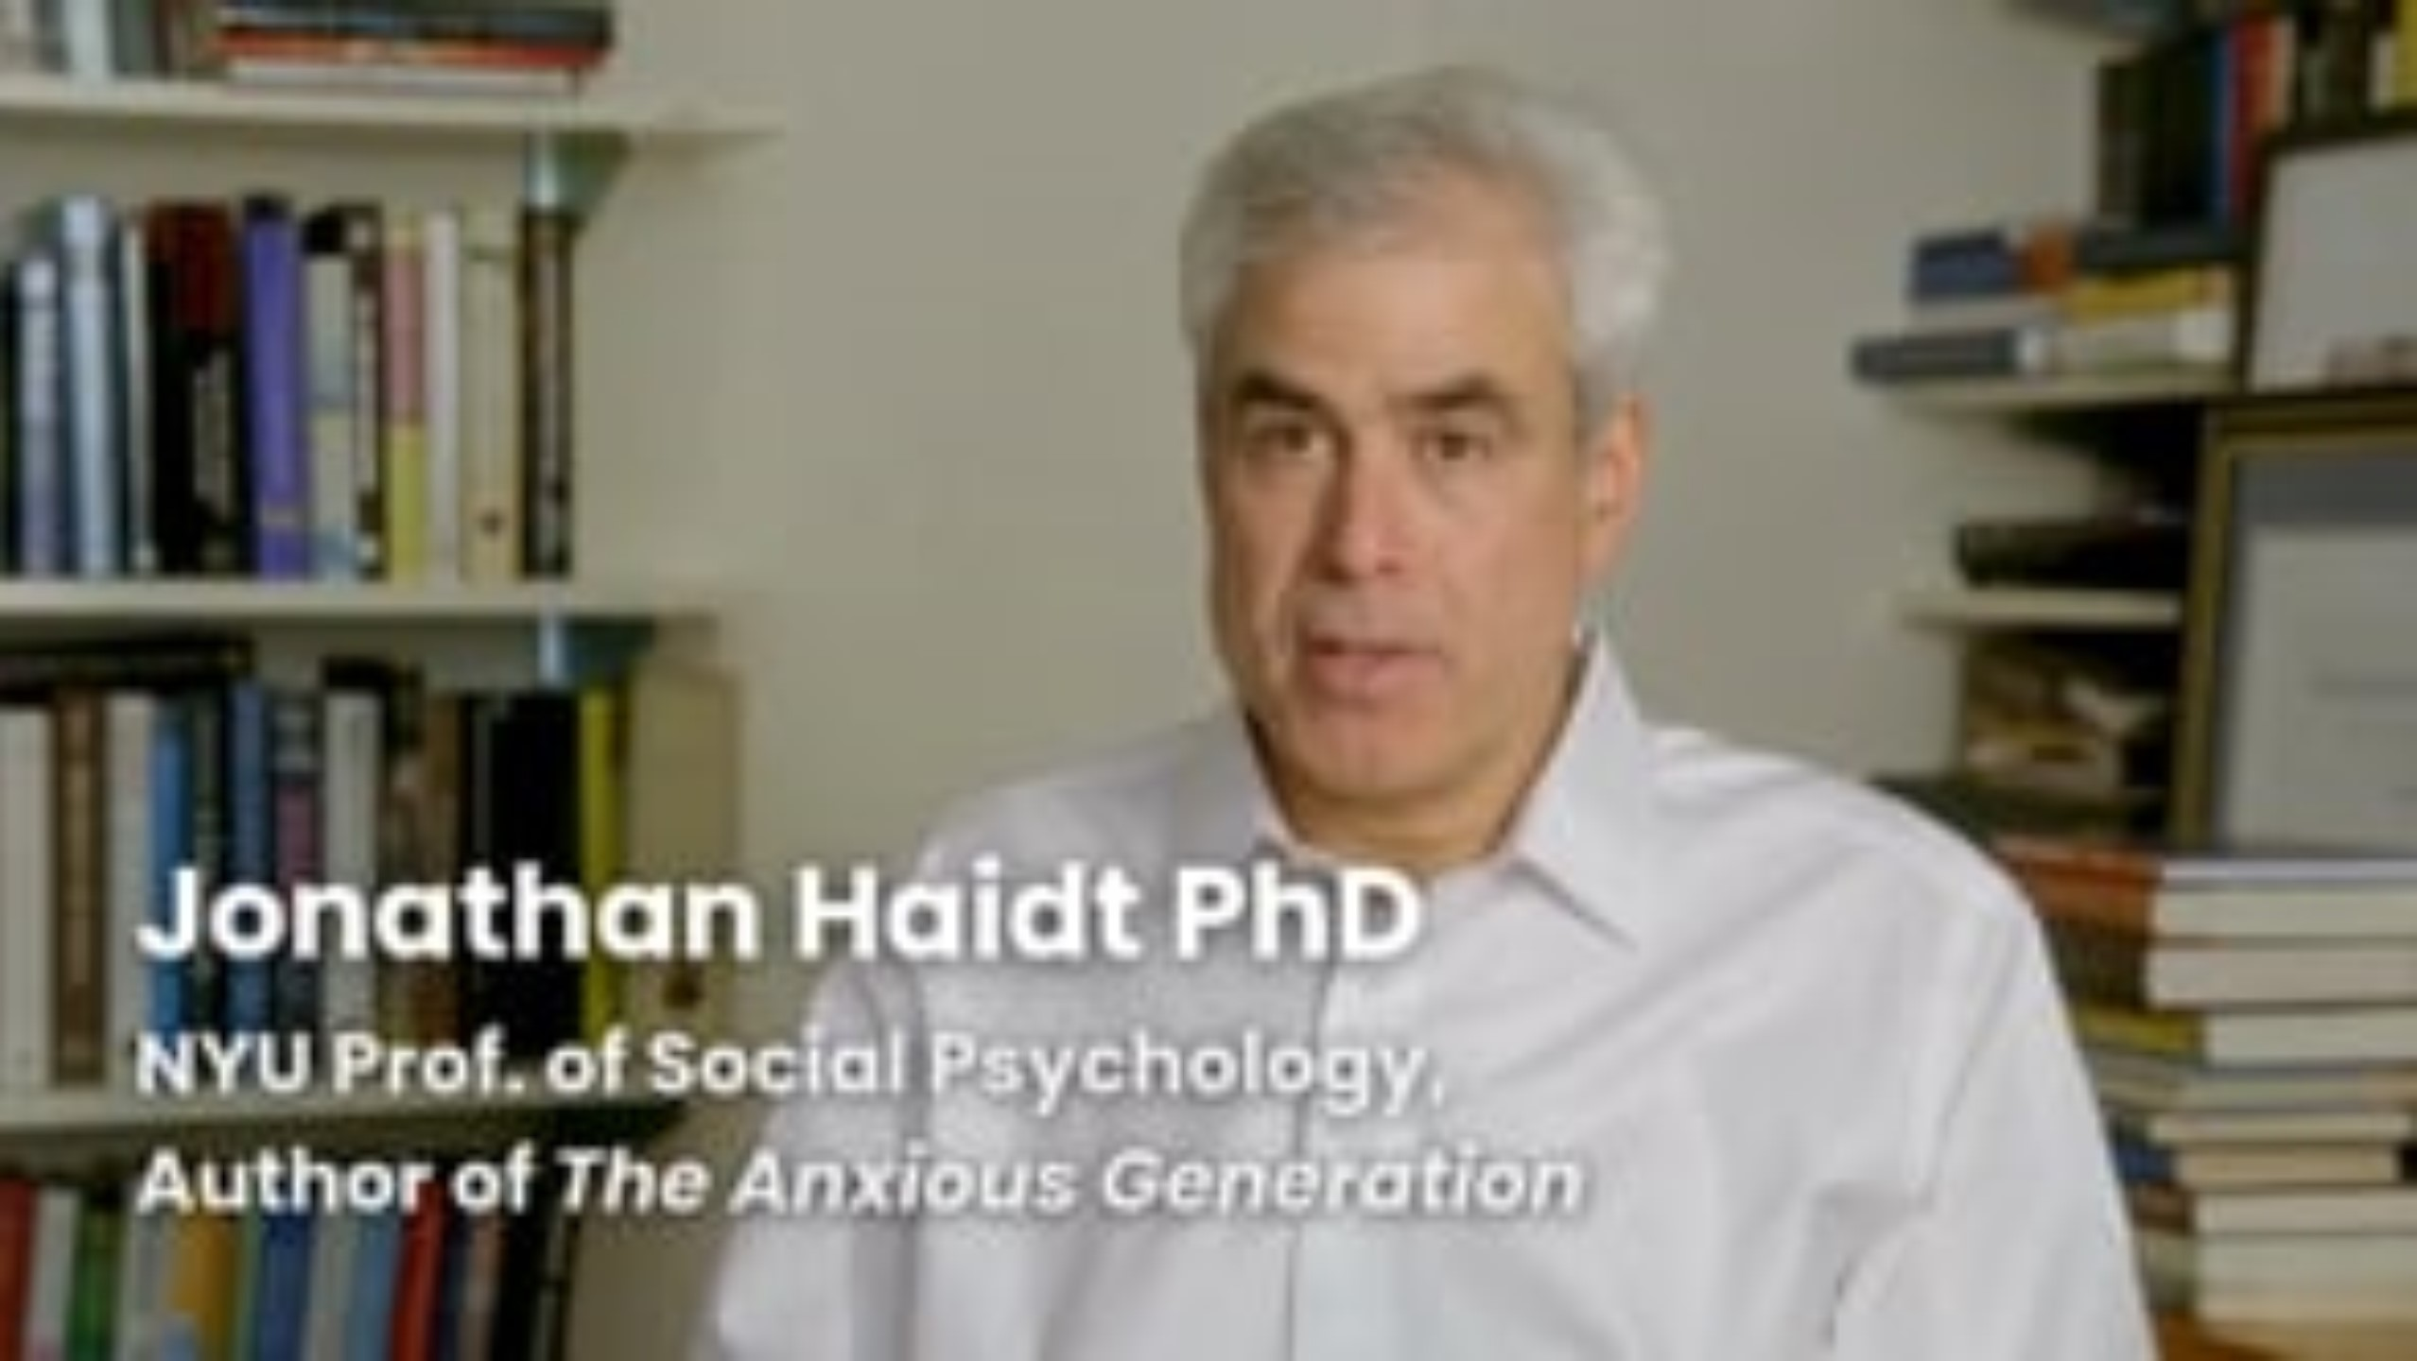
Mental Well-Being Will Improve
Strong relationships are important factors in mental health too.
Click to play video
Notes:
Please use this link if video doesn’t play in-slide: https://player.vimeo.com/video/1105977874

Slide 12
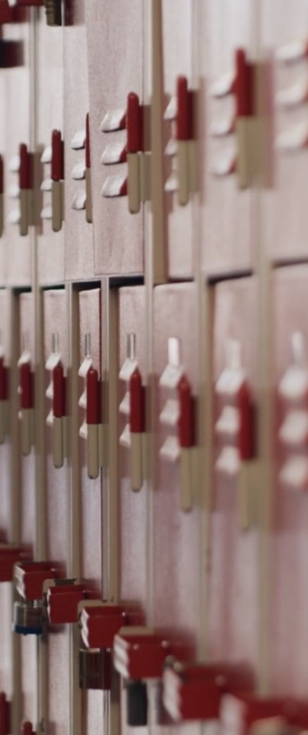
BENEFIT:
Safer Schools

Slide 13

Our School Is Safer
Though giving up our devices can feel like letting go of a life preserver in the ocean, experts agree that schools are safer without them.
Click to play video
Notes:
Please use this link if video doesn’t play in-slide: https://player.vimeo.com/video/1107129497

Slide 14

Our School Is Safer
Distracted students can’t hear announcements over the loudspeaker or urgent direction from adults.
Click to play video
Notes:
Please use this link if video doesn’t play in-slide: https://player.vimeo.com/video/1107129509

Slide 15
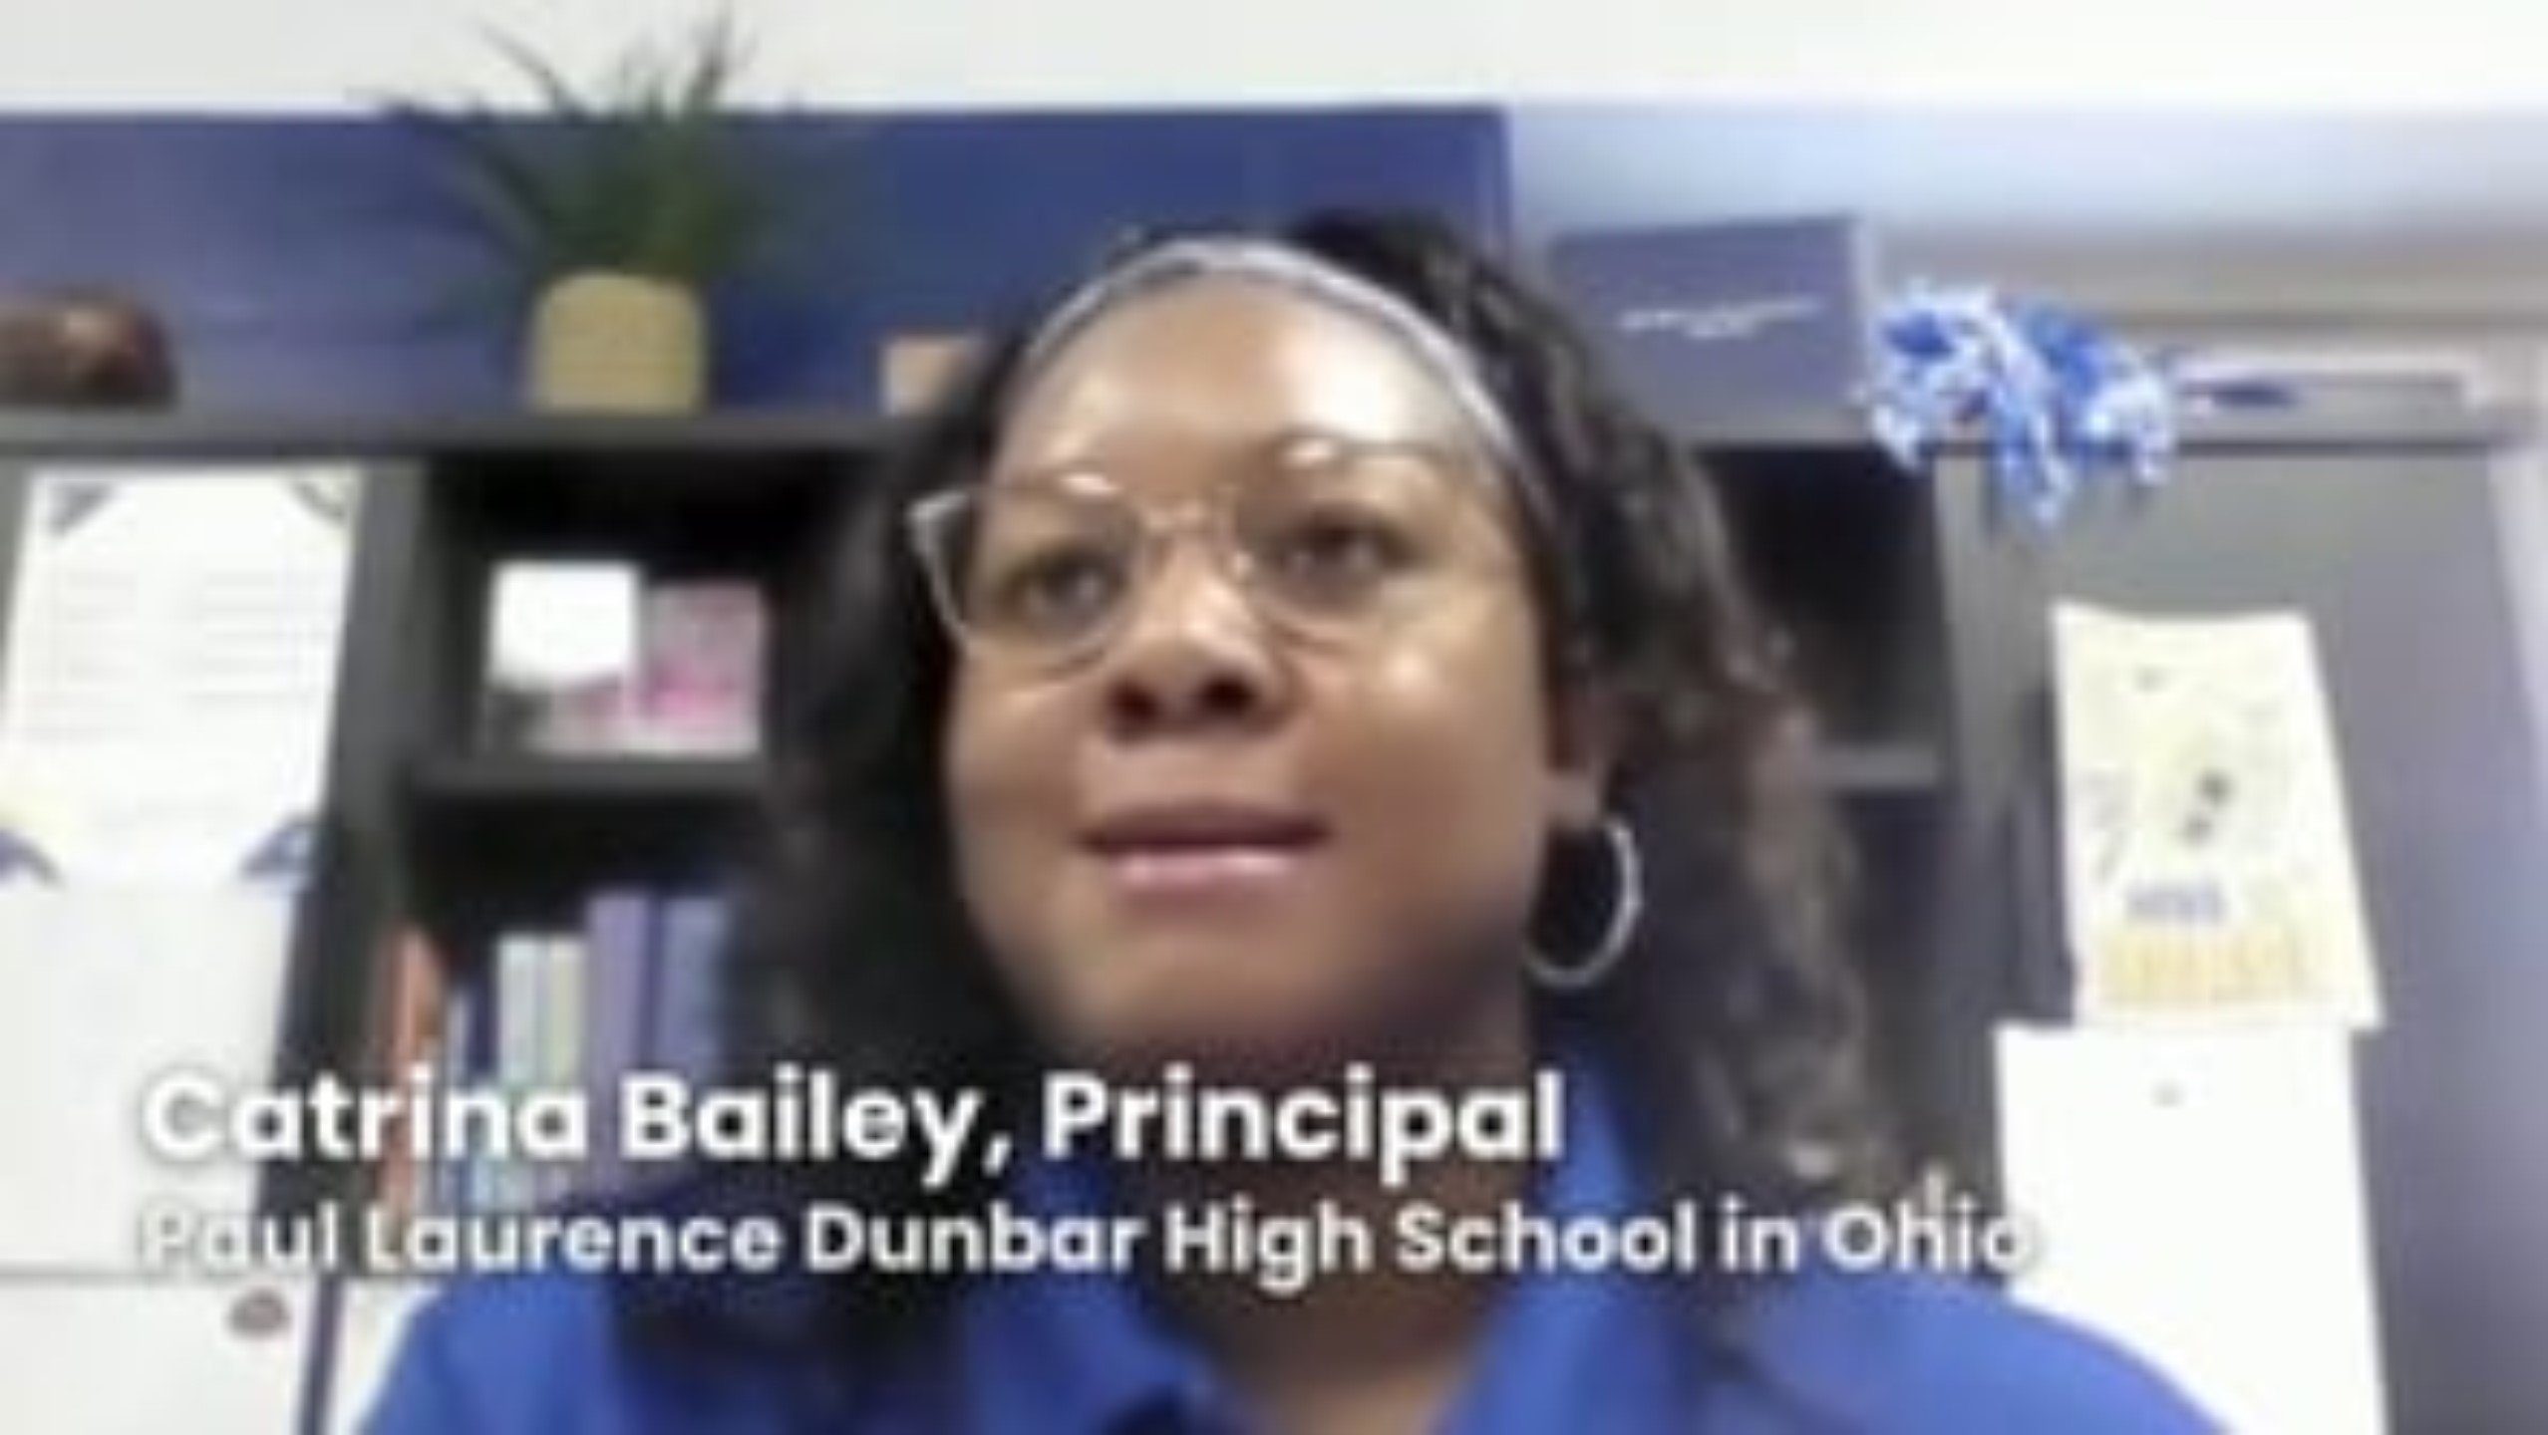
Our School Is Safer
Phone-free schools report a significant decrease in bullying, fights and associated cruelty from social media.
Click to play video
Courtesy of Smartphone Free Childhood U.S.
Notes:
Please use this link if video doesn’t play in-slide: https://player.vimeo.com/video/1105977501

Slide 16
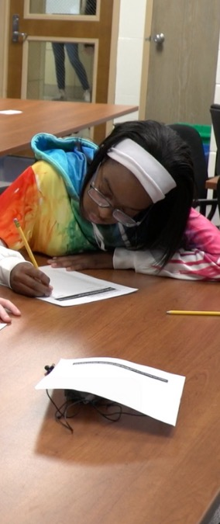
BENEFIT:
Improved Education

Slide 17

Our Education Will Improve
Ultimately, schools are where we go to gain knowledge and build habits that will serve us for life.
Bite-sized content is shortening our attention spans and undermining memory.
Click to play video
Notes:
Please use this link if video doesn’t play in-slide: https://player.vimeo.com/video/1107488698

Slide 18
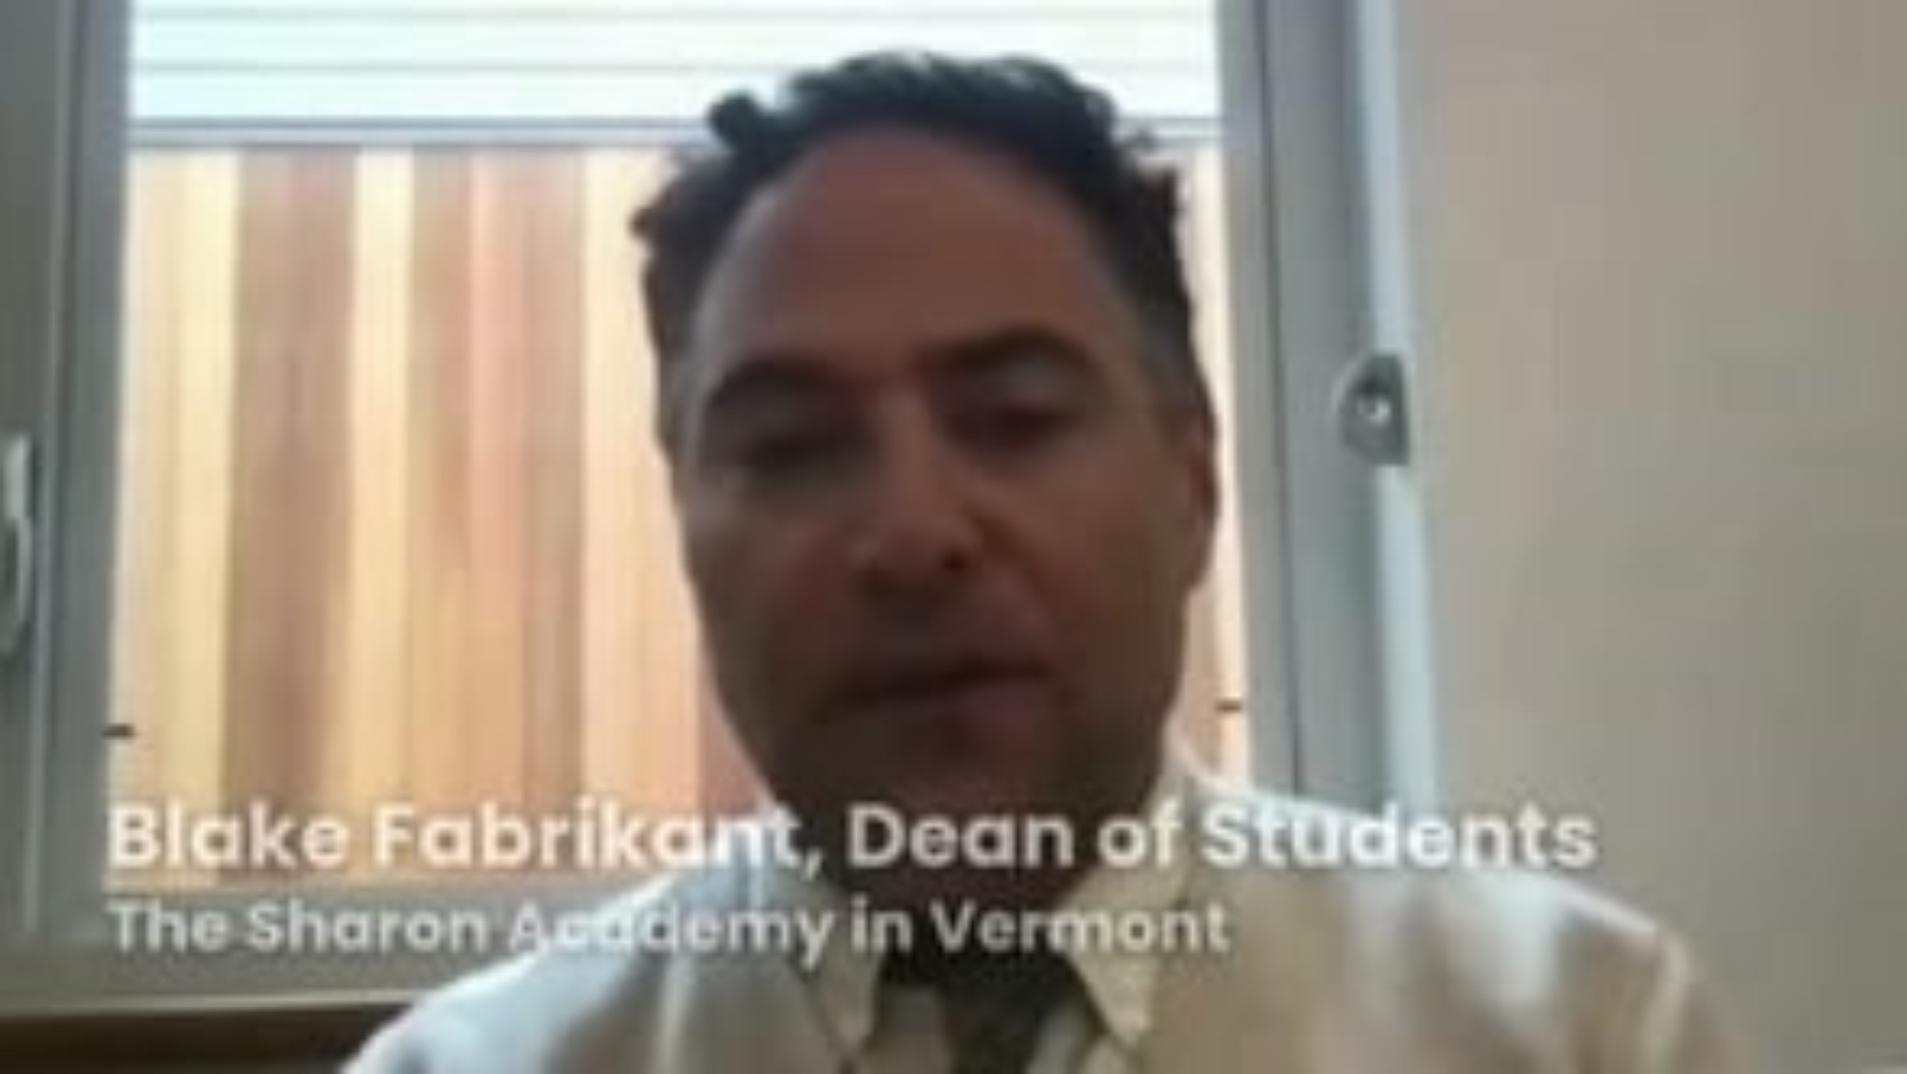
Our Education Will Improve
Distracted students interact less with their teachers and the topics they’re teaching.
Teachers in phone-free schools talk about their classrooms coming back to life!
Click to play video
Courtesy of Smartphone Free Childhood U.S.
Notes:
Please use this link if video doesn’t play in-slide: https://player.vimeo.com/video/1105977767

Slide 19
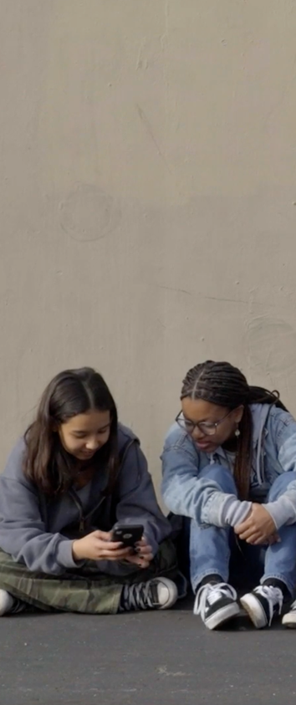
SUMMARY
Why We’re Making This Change

Slide 20

Why We’re Making This Change
Phone-free schools are happier, safer, and more social. They also produce better academic results.
It can be hard to adjust at first, but it's worth it. Welcome to our phone-free school, and the opportunity to learn without distraction.

Slide 21
LOCAL POLICY DETAILS
What is and isn’t allowed
How devices will be collected, stored and returned
What students should do when they need to contact their parents, and vice versa
Consequences of violating the rules
Does the policy apply to faculty and staff?

Slide 22
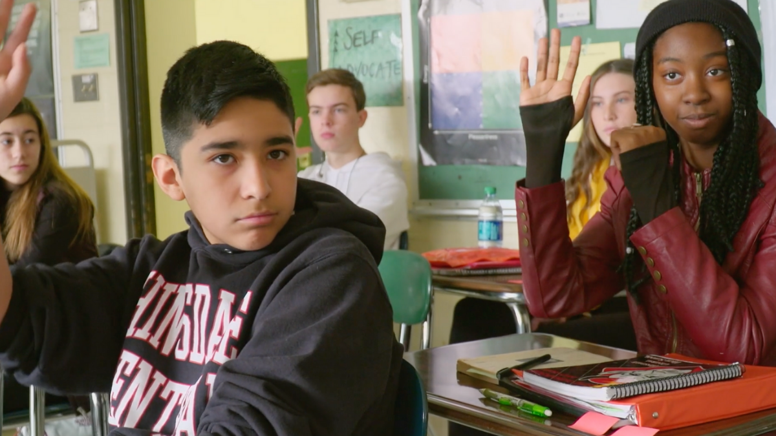
QUESTIONS?

