Slide 1

Unified Virtual Care
CCM/RTM Program Launch
Monday May 6, 2024

Slide 2
Program Overview
Patients that “initially” qualify for RTM/CCM are registered, insurance is verified, consent is acquired and a provider is identified to go through an initial new patient assessment.
The initial assessment is placed in the General Call Back Pool. All providers that are licensed in patient location and have been onboarded on patient insurance are notified.
Once a provider takes the case the following steps should be followed:
Patient must be called using Video – A video link is sent to the patient to join
The entire case, including video call and charting, should be at least 15 mins
If medical necessity is determined, patients is approved for RTM/CCM
Documentation must reflect that you spoke with patient about RTM/CCM enrollment – a CMS requirement
Unlike cash pays, provider needs to specify ALL ICD10 codes associated with patient chronic conditions a CMS approved list is attached.
Once approved for enrollment, a care managers contacts the patient and develops the care plan and sends it back to you for approval. You will have a monthly care plan to review.
As needed patient will submit a new encounter for questions, refills, and other common health issues.

Slide 3
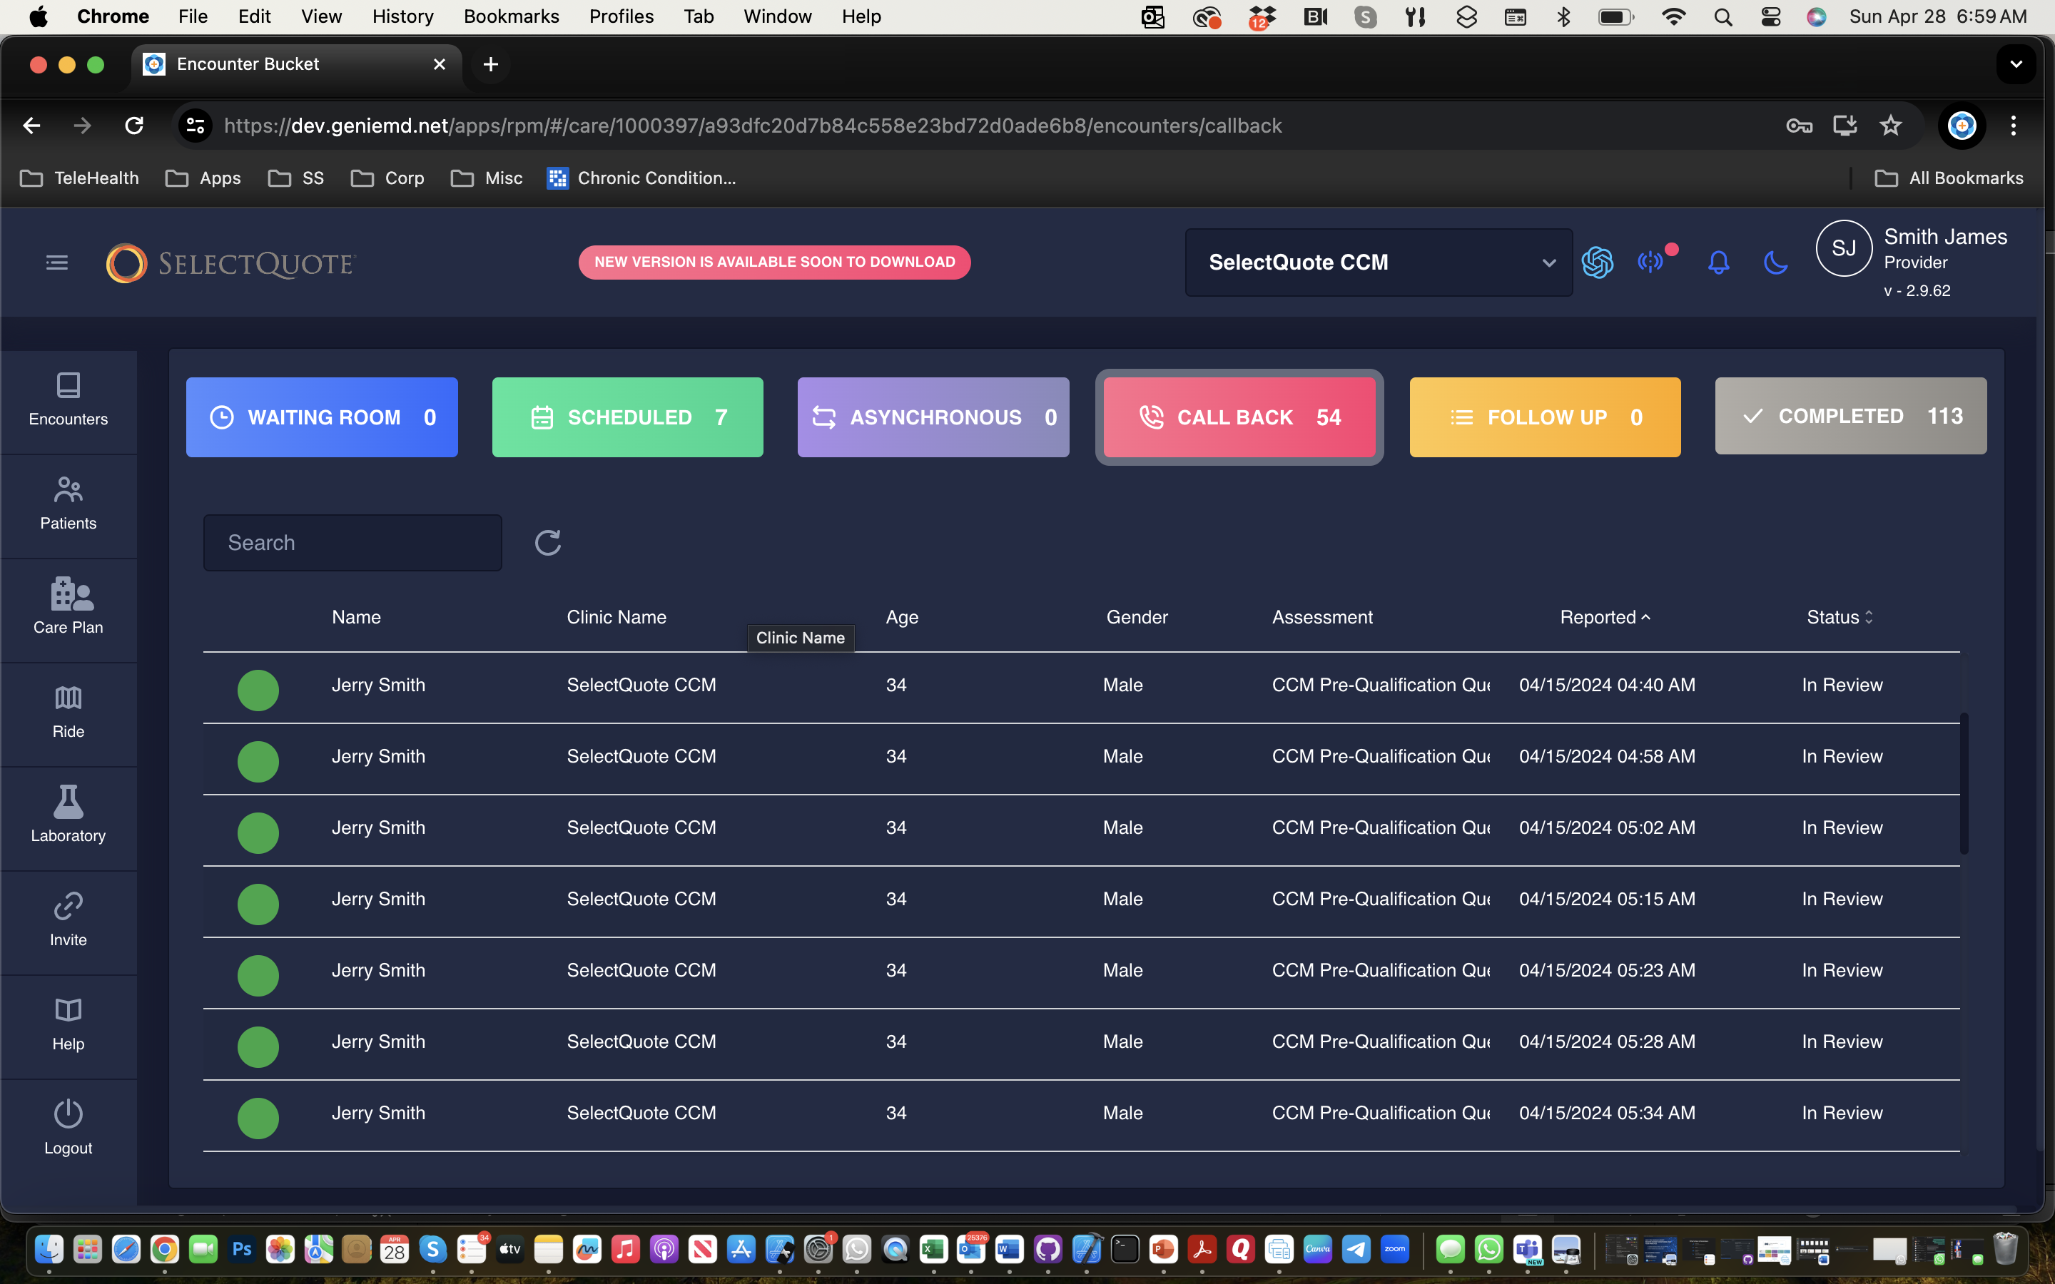
Patient Encounters
Matching Criteria
Provider licensed in patient state
Provider is credentialed with patient insurance
Care Plans
Cases will in Waiting Room
Bucket

Slide 4
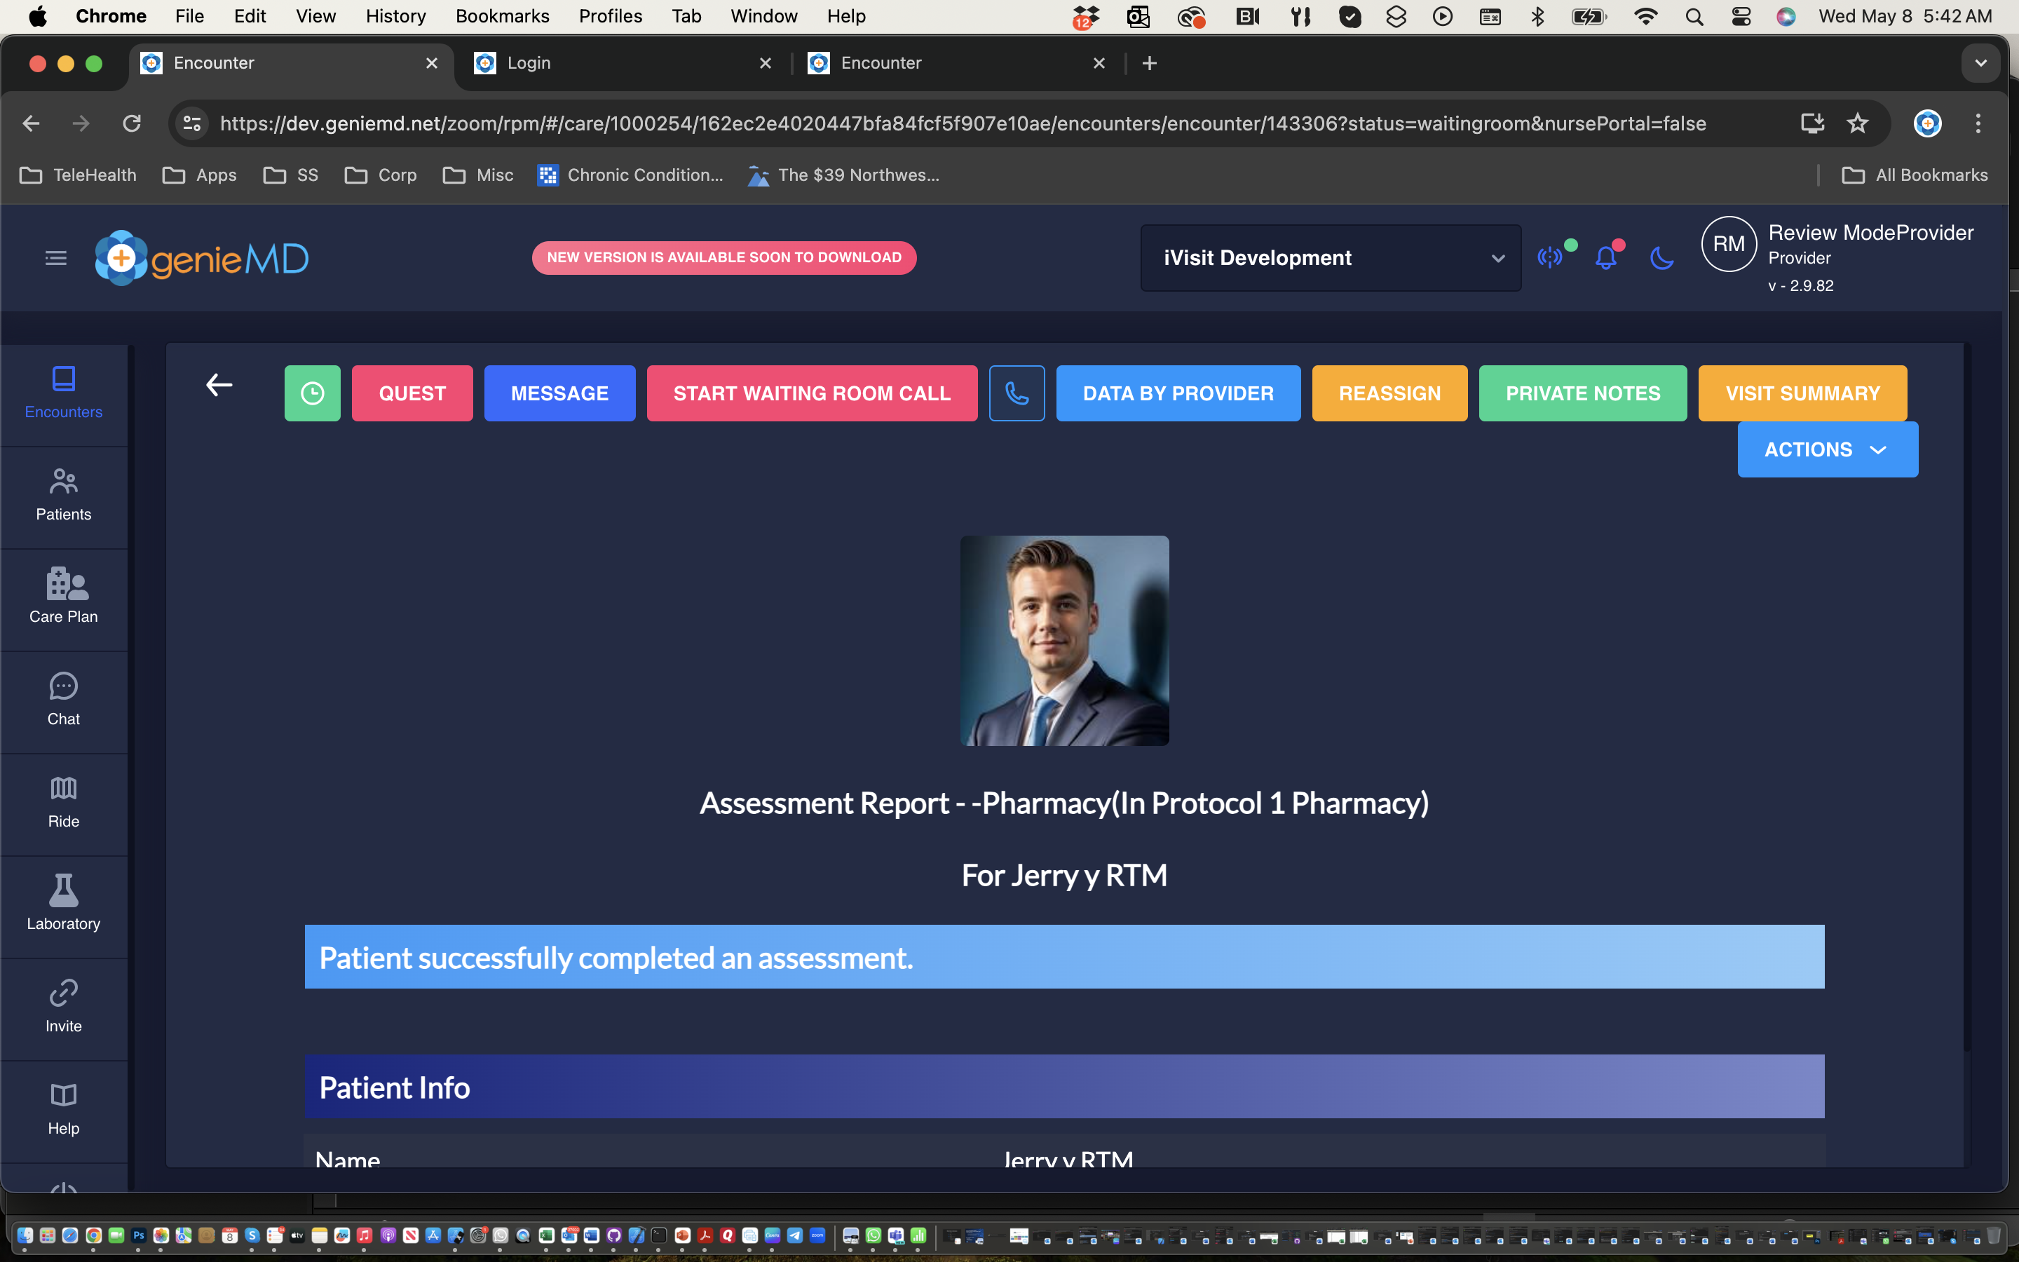
Encounter Information
Join Waiting Room

Slide 5
What to discuss with the patient & Document
Specifically speak about participation in the requested program
Validated that they are not currently in another RPM/CCM/RTM program
Establish what specific chronic conditions to be managed
Get verbal consent to enroll in the program and document
Mention & Document that there might be a copay
Mention & Document that patient can unroll at any time.
For RPM/RTM one chronic condition is required.
For CCM at least two chronic conditions are required.
A Care Manager will be contracting you to complete the enrollment process.

Slide 6
Common Chronic Condition based on History
Hypertension, Diabetes, Mental Health, COPD, Asthma, Obesity, Respiratory, Heart Disease/Heart Failure, Kidney Disease, Cancer, HIV, Depression, Chronic Pain and Fatigue, Hyperlipidemia, Rheumatoid Arthritis/Osteoarthritis, Anxiety Disorders. Fibromyalgia, Hypothyroidism

Slide 7
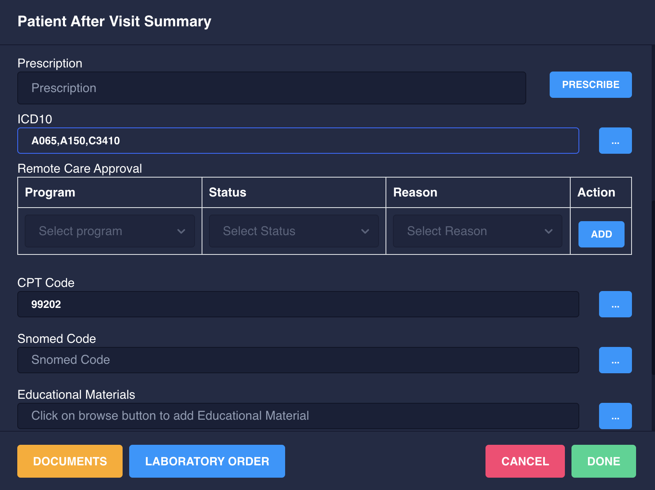
Completing the Case
ICD10 Codes: May us common codes.
Select Program
Approve or set other reasons
CPT Code
Preprogrammed

Slide 8

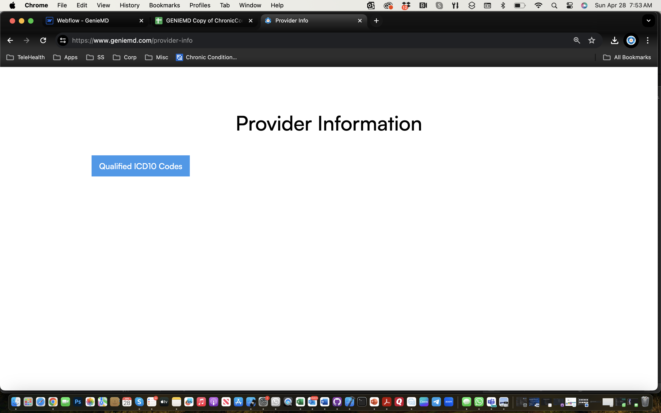
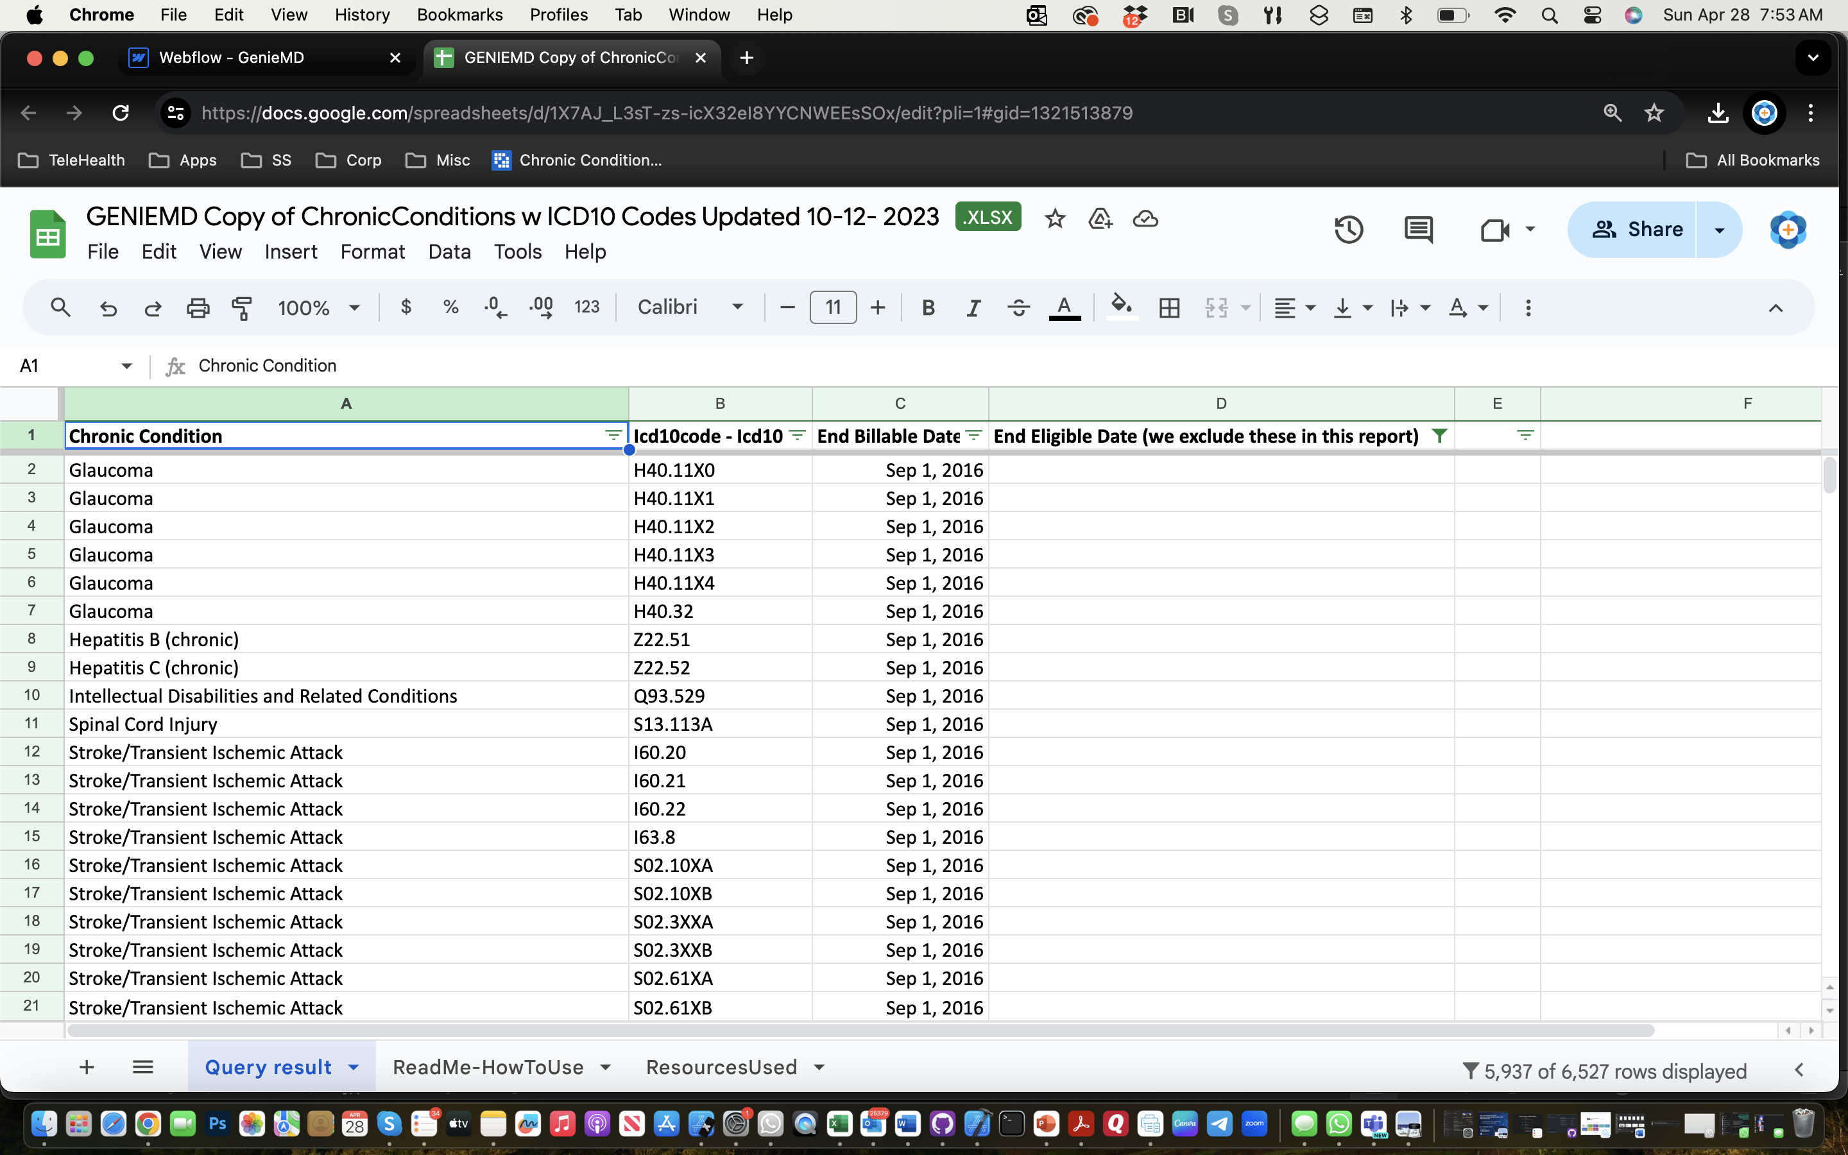
Approved Chronic Conditions (ICD10 Codes)
ICD10 Codes
Help

Slide 9
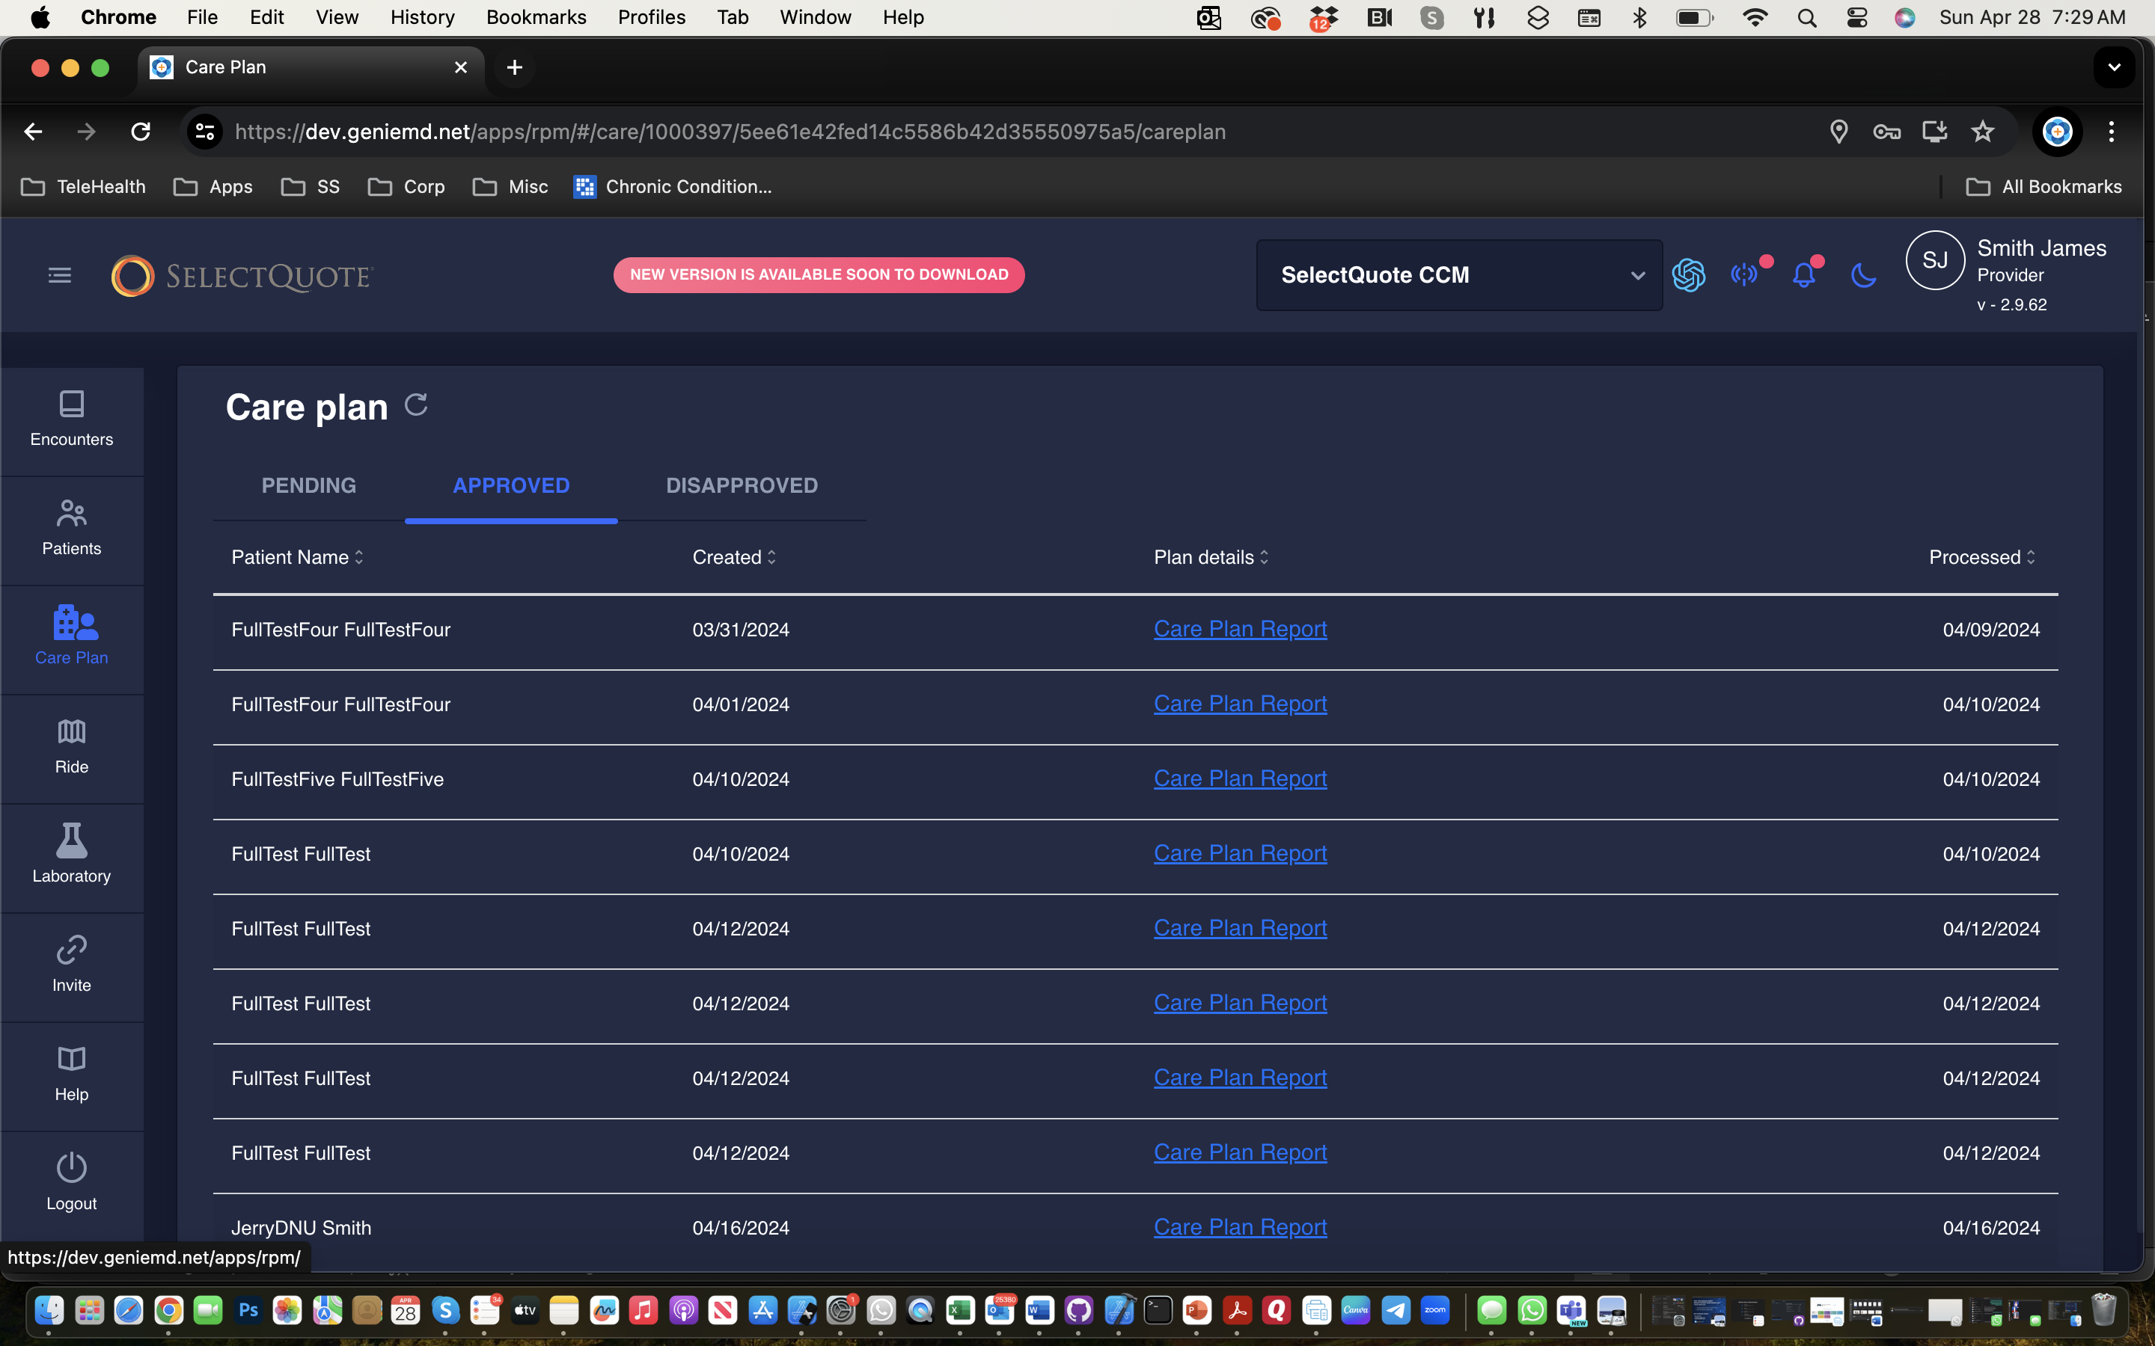
Care Plan Approval
View Care Plan
And Approve
Approved Care Plans are FAXed to PCP

Slide 10
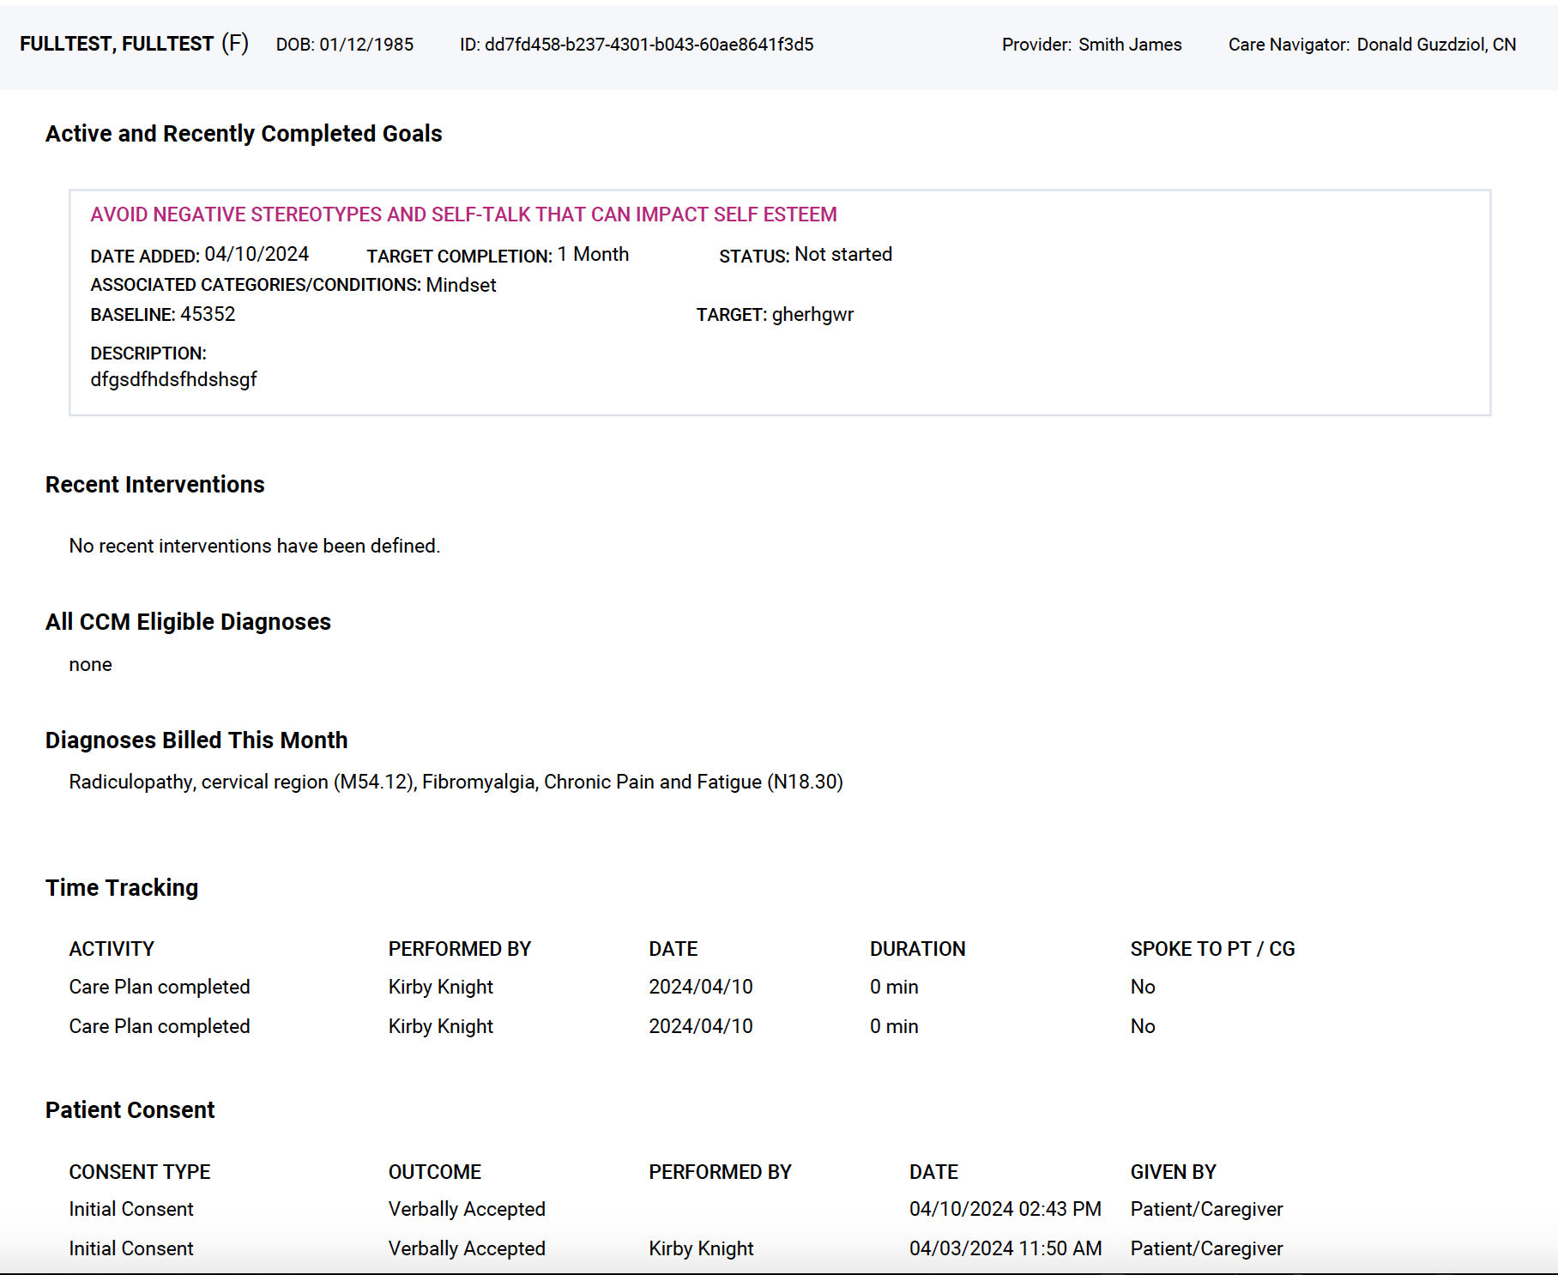
Typical Care Plan

Slide 11

Thank you!
(925) 460 - 9191
www.GenieMD.com

