Slide 1

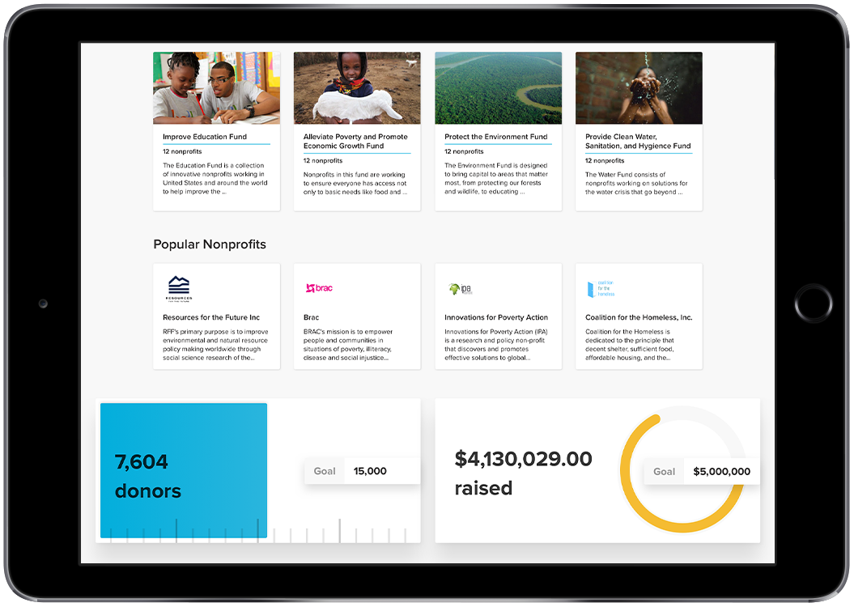
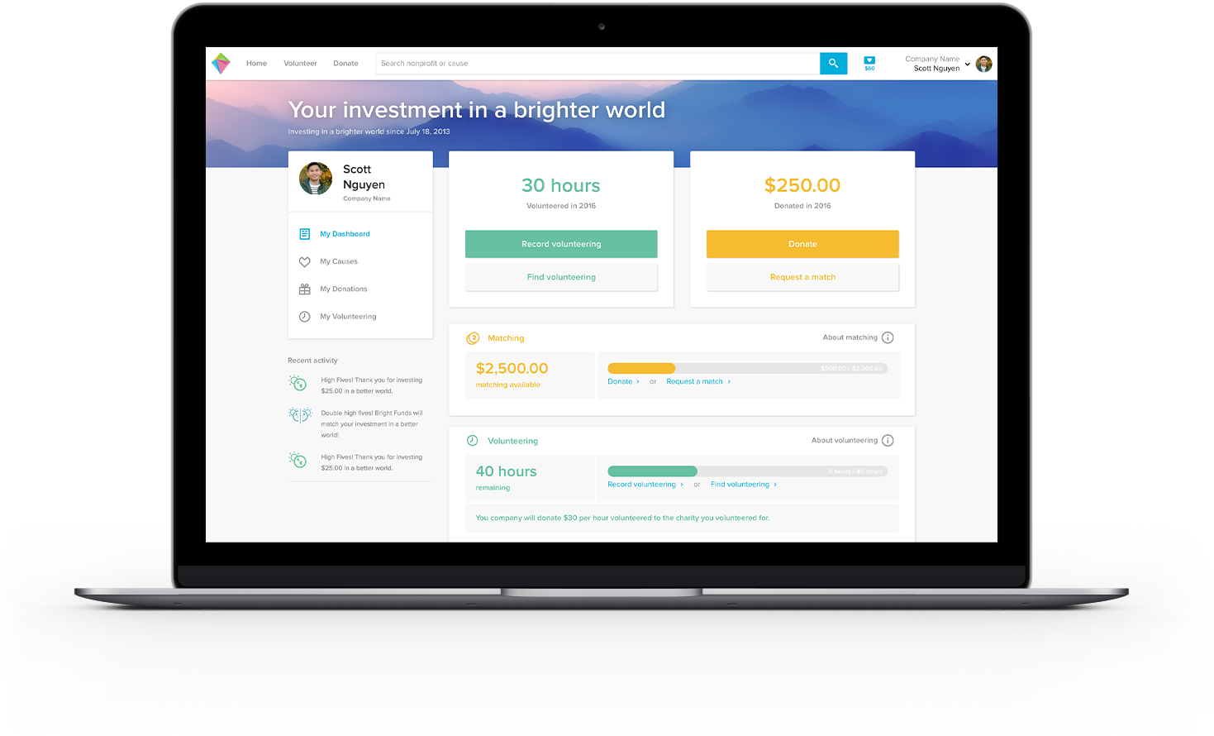
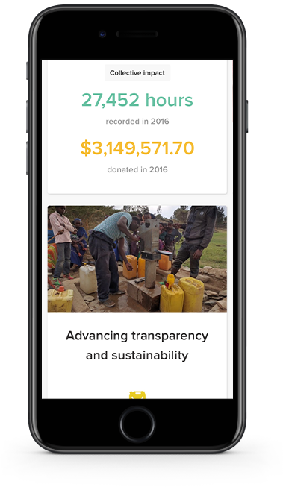
Unlocking Accenture’s Potential to Innovate & Improve the World
Bright Funds + [Company Name]
unlocking everyone’s potential to do good

Slide 2

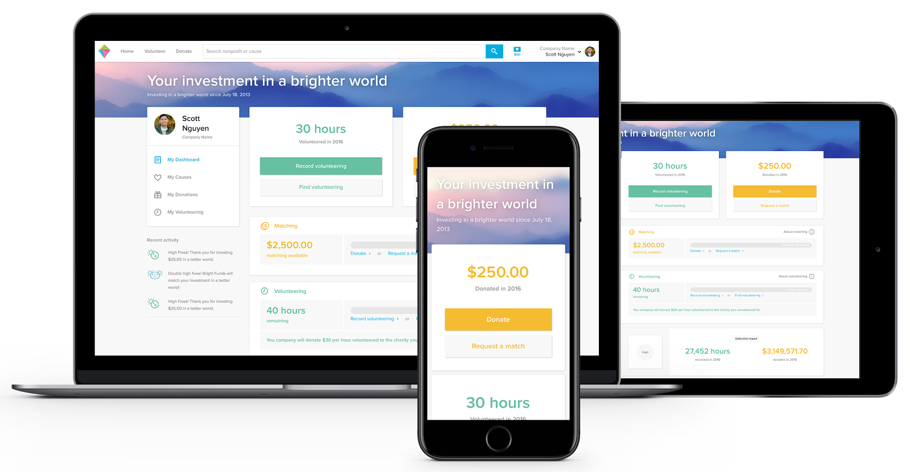
3
One home for every employee to do good
Easily support to your own causes and participate in [Company Name]’s signature programs through your personal Bright Funds account

Slide 3
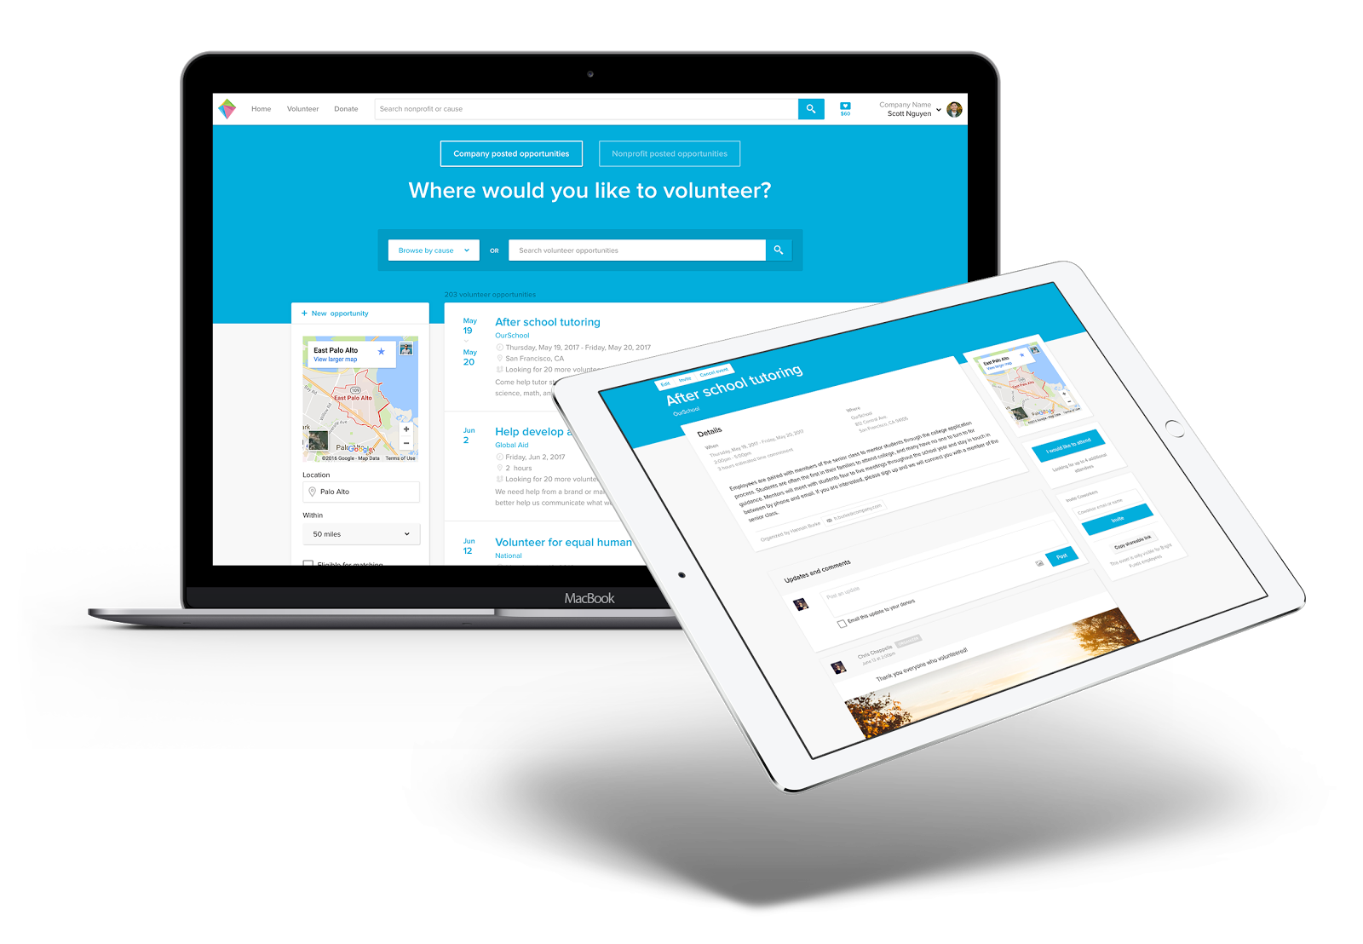
3
Organize and track volunteer activities at local offices and participate in [Company Name]-wide initiatives

Slide 4
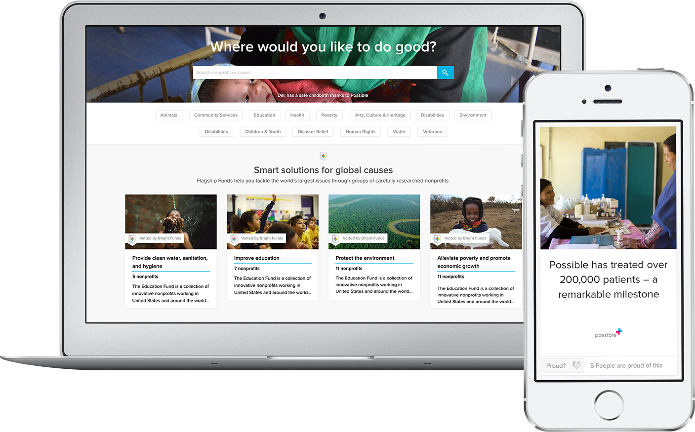
LOGO
4
Support causes that are important to the [Company Name]
community.
Give to your personal causes, colleagues’ causes, or key nonprofit partners at [Company Name].

Slide 5
Take advantage of [Company Name] employee perks
LOGO
5
$XXX in individual matching gifts available every year
Double your impact! Make your donation(s) directly on Bright Funds and automatically submit your donation for a matching gift
  (or easily upload a receipt if you made the donation directly to the nonprofit)

Slide 6
Take advantage of [Company Name] employee perks
LOGO
6
Make recurring donations so you can set it and forget it, providing consistent support to your favorite causes
Give to an existing Fund for strategic support to a curated list of nonprofits
Create your own custom Fund and share with your colleagues
Discover and sign up for volunteering events
Easily organize team volunteer events
Track your personal volunteering hours

Slide 7
Agenda for
November 15th,
2017
LOGO
7
Thank you!

