Slide 1


2025
ANNUAL REPORT

Slide 2

OBERLIN POLICE DEPARTMENT
ANNUAL REPORT
2025
On behalf of the Oberlin Police Department, I am honored to share our 2025 Annual Report with the community we proudly serve.
Every day, the men and women of this department work to ensure that Oberlin remains a safe, welcoming, and vibrant place for all. Behind every call for service, every patrol shift, and every community event is a dedicated professional committed not just to enforcing the law, but to serving people.
In 2025, we strengthened our relationships with residents, schools, businesses, and community partners. We continued expanding opportunities for dialogue, transparency, and collaboration because we understand that trust is earned through communication, presence, and consistency.
This report provides crime statistics and activity data from the past year, but it also reflects something more meaningful — the partnerships that make public safety possible. We believe that effective policing is built on mutual respect, shared responsibility, and open conversation.
As we move into 2026, our focus remains on listening, learning, and growing alongside our community. We are committed to expanding outreach efforts, enhancing transparency, and ensuring that every member of Oberlin feels seen, heard, and protected.
Public safety is strongest when it is shared. We are grateful for your continued support and partnership as we work together to keep Oberlin safe and united.
Respectfully,
C. Ryan Warfield
Chief of Police

Slide 3
OBERLIN POLICE DEPARTMENT
OUR MISSION
The Oberlin Police Department’s mission is to enhance the quality of life in our community
through the protection of life and property, fair and unbiased law enforcement,
and community partnerships.
CORE VALUES(T.R.I.P.)
  Teamwork – Oberlin Police Department recognizes its most important resources are the members of the department and the citizens of the community, and realizes that only through a true partnership can there be success.
  Respect – Oberlin Police Department will treat all persons in a dignified and courteous manner and demonstrate an understanding of their cultural diversity in dealing with the public in our public and private contacts.
  Integrity – Oberlin Police Department will uphold the highest moral and ethical standards. We serve with honesty and pride in maintaining the public’s trust and will accept responsibility for our decisions and actions.
  Professionalism – Oberlin Police Department is committed to ensuring those citizens who require the Department’s services will receive the quality and expertise of a true law enforcement professional.
VISION STATEMENT
To provide the best possible opportunity to live, work and raise a family in a safe
community, by preserving the peace and by reducing both the reality and perception of crime.

Slide 4
OBERLIN POLICE DEPARTMENT
CHIEF OF POLICE – C. RYAN WARFIELD
ADMINISTRATIVE LIEUTENANT – MICHAEL D. MCCLOSKEY
SERGEANTS
PATRICK L. DURICA MELISSA G. LETT JESSICA M. BEYER JACOB S.CROSSAN
DETECTIVE
BASHSHAR H. WILEY
FULL-TIME PATROL OFFICERS FULL-TIME DISPATCHERS
MARC ELLIS SUSAN C. WHITE WILLIAM J. FLESCH TAMARA S. STANLEY
MICHAEL KASTANIS ANETA MULLINS
ZACHARY R. NILES DAVID L. GALLETTI, JR.
JAKOB J. KOLESZAR ARIANNA TEVIS
MORGAN BYNUM-ROBINSON TENZELLA SHADID
TIMOTHY MCGLUGRITCH
BRANDON TOLLIVER
JOHN KUBICKI PART-TIME DISPATCHERS
GWEN S. GOUL
AUXILIARY OFFICERS
CAPT. MARK E. REYNOLDS
RECORDS COORDINATOR
SARA R. PODROSKY
ADMINISTRATIVE COORDINATOR
ANNETTE L. WEY

Slide 5
OBERLIN POLICE DEPARTMENT
# Adults Arrested

Slide 6
OBERLIN POLICE DEPARTMENT
Summary of Offenses Charged Upon Arrest (Adult)

Slide 7
OBERLIN POLICE DEPARTMENT
Charged Offenses by Type (Adult)

Slide 8
OBERLIN POLICE DEPARTMENT
# Juveniles Arrested

Slide 9
OBERLIN POLICE DEPARTMENT
Summary of Offenses Charged Upon Arrest (Juvenile)

Slide 10
OBERLIN POLICE DEPARTMENT
Charged Offenses by Type (Juvenile)

Slide 11
OBERLIN POLICE DEPARTMENT
Top 10 Crimes Reported
2025

Slide 12
OBERLIN POLICE DEPARTMENT
Domestic Violence

Slide 13
OBERLIN POLICE DEPARTMENT
OVI – Under the Influence Drugs/Liquor (Adult)

Slide 14
OBERLIN POLICE DEPARTMENT
Drug Offenses (Adult)

Slide 15
OBERLIN POLICE DEPARTMENT
Accidents

Slide 16
OBERLIN POLICE DEPARTMENT
Liquor Law Violations (Adults)

Slide 17
OBERLIN POLICE DEPARTMENT
Community Based Activity

Slide 18
OBERLIN POLICE DEPARTMENT
Traffic Stops
2025

Slide 19
Ohio Collaborative Demographics Report of Self-Initiated Traffic Stops 2025
(Standard 3.2017.6/D)

Slide 20
OBERLIN POLICE DEPARTMENT
Parking Citations

Slide 21
OBERLIN POLICE DEPARTMENT
USE OF FORCE
Category | 2024 Data | 2025 Data
Service Calls | 10,713 | 11,754
Incident Reports | 404 | 325
Total Force Reports | 6 | 3
Physical Force | 6 | 3
ECD (Taser) | 0 | 0
Chemical | 0 | 1
K-9 | 0 | 0
Impact Weapons | 0 | 0
Firearms | 0 | 0
Other | 0 | 0
The total number of force reports may not equal the sum of individual force categories noted, as a single force report may have involved application of multiple force options.
The use of force is dependent on a variety of factors and data can vary significantly from year to year as an officer’s force response is dictated by subject actions. However, the department data is in line with the expected trends nationally regarding police use of force, in that police use force in a small percentage of public contacts, and that when force is used, it is typically at the lower end of the force spectrum.

Slide 22
2025 TRAFFIC CRASHES
In 2025, there were a total of 116 crashes reported by the Oberlin Police Department through the State of Ohio’s OH-1 Crash Reports.
The breakdown of crashes is as follows:
  0 Fatal
  20 Injury
  96 Property Damage Only
  A further breakdown based on location and severity of damage:
  28 Private Property Crashes
  88 Reportable Crashes (on the roadway)

Slide 23
OBERLIN POLICE DEPARTMENT
VEHICLE REPORT
2025
Unit # | Year | Vehicle Description | Current Assignment | Odometer Year End | Mileage | Hours
915 | 2009 | Malibu | Surplus
922 | 2017 | Ford Explorer | Part-Time | 76,827 | 2,430
923 | 2017 | Ford Explorer | Patrol | 63,327 | 10,148
924 | 2017 | Ford Taurus | Auxiliary | 67,073 | 1,453 | 11,265
926 | 2019 | Ford Explorer | Patrol | 64,750 | 4,832 | 18,183
927 | 2019 | Ford Explorer | Patrol | 70,144 | 11,646 | 1,791
928 | 2020 | Ford Fusion | Detective | 35,664 | 8,981
929 | 2020 | Ford Explorer Hybrid | Patrol | 99,452 | 12,417 | 3,535
930 | 2021 | Ford Explorer Hybrid | Patrol | 41,461 | 9,401 | 2,522
931 | 2021 | Ford Explorer Hybrid | Patrol | 56,303 | 13,373 | 2,674
932 | 2022 | Ford Explorer | Chief | 33,763 | 21,477
933 | 2023 | Ford Explorer | Lieutenant | 9,670 | 5,280 | 112
934 | 2023 | Ford Explorer | Patrol | 16,861 | 13,078 | 3,126
935 | 2024 | Ford Explorer | Patrol | 12,580 | 12,473 | 3,164
936 | 2025 | Ford Explorer | Patrol | 2,612 | 2,612 | 1,041

Slide 24
OBERLIN POLICE DEPARTMENT
STAFF CHANGES
2025
NEW HIRES
Timothy McGlugritch, John Kubicki and Brandon Tolliver were hired in July 2025 as lateral patrol officers.
Tenzella Shadid was hired in November as a full-time dispatcher.
PROMOTIONS
Jacob Crossan was promoted to Sergeant on October 24, 2025.
Mark Reynolds was promoted to Auxiliary Captain on December 1, 2025.
RETIREMENTS
Sergeant Steve Chapman retired on July 4, 2025, after serving the Oberlin community for 25 years
James Vidovich retired as Auxiliary Captain on September 30, 2025, having worked in the Auxiliary Unit for 16 years.
.

Slide 25
OBERLIN POLICE DEPARTMENT
TRAINING
This department strives to ensure all employees are offered both in-service and outside training to maintain current skills and further professional development. Employees continue to meet annual Ohio training requirements including firearms qualification, Taser training, CPR/First Aid, LEADS certification and Intoxilyzer certification. Lexipol training bulletins continue to be issued monthly.
Training highlights for 2025 include:
The State of Ohio mandated 24 hours of Continuing Professional Training (CPT) for all sworn officers. Use of Force, Ethics Laws, Legal Updates and Search & Seizure are some of the required topics for training.
Some other covered topics included Officer Trauma & Wellness, Domestic Violence, Vehicle Dynamics, Report Writing and Leadership.
Officer Koleszar attended a Field Training Officer (FTO) course for 24 hours.
Officer Bynum-Robinson attended a School Resource Officer Basic training class for 40 hours.

Slide 26
OBERLIN POLICE DEPARTMENT
TRAINING HIGHLIGHTS
Sgt. Crossan and Detective Wiley attended online classes on Property & Evidence Management and Supervising Property & Evidence Rooms.
Detective Wiley attended a 3-hour Child Abuse Investigations class online and a 24-hour class on Reid Technique Investigations.
Officer Kastanis attended an 8 hour Drone Legal Update class.
Sgt. Lett and Officer Koleszar attended a 16-hour Virtual Reality Instructor class.
Officer McGlugritch attended a 20 hour class on Critical Evidence in Cell Phone Investigations.
Dispatcher White attended an Active Attack Integrated Response class for 16 hours.

Slide 27
OBERLIN POLICE DEPARTMENT
INVESTIGATIONS
2025
Bashshar Wiley is assigned to the Detective Bureau and is the primary investigator for the department for 2025. Detective Wiley investigated and/or was involved in 32 investigations in 2025. Thirty of these cases led to indictments and two have not yet been presented. This is in addition to several misdemeanor investigations leading to arrests.
In addition, Detective Wiley worked with several outside agencies regarding suspicious drug activity. A search warrant was executed and multiple drugs, firearms and currency were confiscated.
In May 2025, Detective Wiley spoke at Kendal-At-Oberlin regarding scams and frauds.

Slide 28
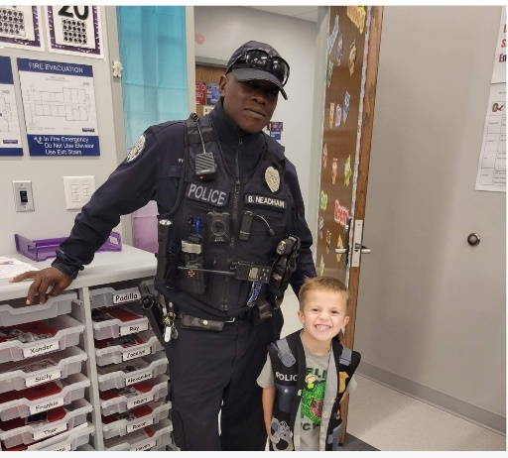
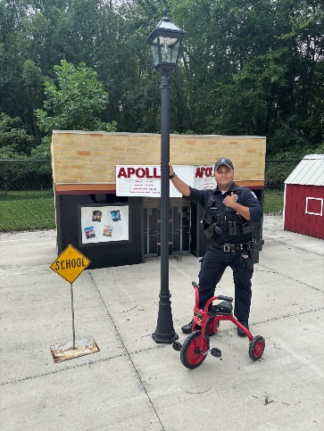
OBERLIN POLICE DEPARTMENT
SCHOOL RESOURCE OFFICER
Patrol Officer Billie Neadham was assigned as our School Resource Officer, dividing his time between all the Oberlin Public Schools. Officer Morgan Robinson replaced Officer Neadham in the fall of 2025 as the School Resource Officer.
SRO officers remain visible throughout the school district participating in many school activities. They monitor and interact with students during lunch, assist and monitor lock down drills and fire drills and attends counseling sessions with guidance counselors for students. SRO officers participate in safety presentations, attend Safety Coalition meetings and assist with regular calls for service.

Slide 29
OBERLIN POLICE DEPARTMENT
JUVENILE DIVERSION PROGRAM
The Oberlin Police Department’s Juvenile Diversion Program provides an informal and community-based program for delinquent and unruly juvenile offenders.
The goal of the program is to reduce juvenile recidivism by improving decision-making, enhancing self-esteem and strengthening familial and social relationships. This program serves as a child advocate for dependent, neglected and abused children.
Parents have been very receptive to the program and appreciate the fact that Oberlin Police Department has this program to give their child a second chance.
We are in the process of creating a community service hours project to add to the program. We currently refer juveniles to resources in reference to the crimes they committed.

Slide 30
OBERLIN POLICE DEPARTMENT
COMMUNICATIONS UNIT
The Communications Unit consists of seven Dispatchers and a Supervisor. Sergeant Jessica Beyer is the Unit’s Supervisor. The Unit is the primary public safety answering point for all emergency and non-emergency calls for service and the primary processing center for dispatching officers to calls for service. The Communications Center is staffed 24/7.
The Communication Center received 5,209 calls in 2025.
  All dispatchers participated in online training with PowerPhone and monthly training through Lexipol.

Slide 31
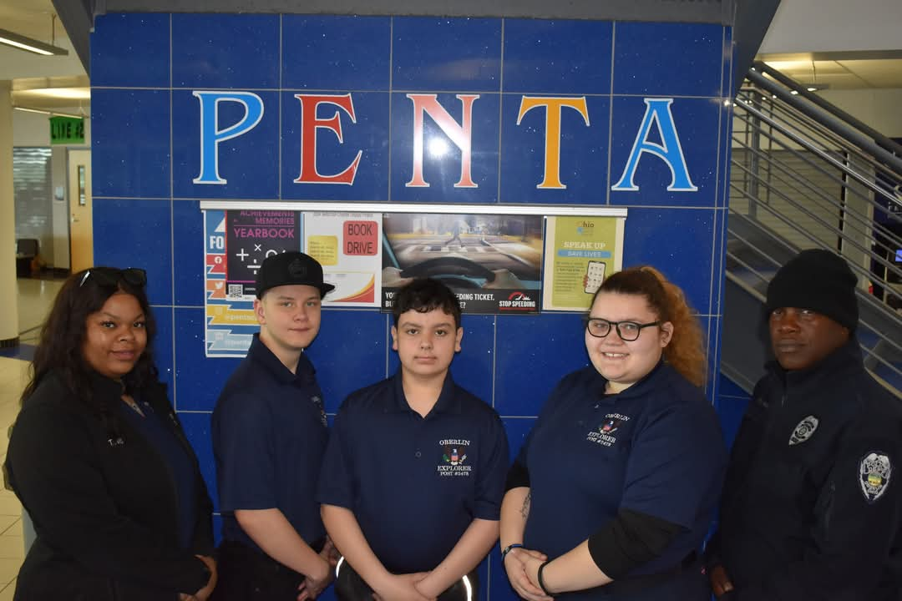
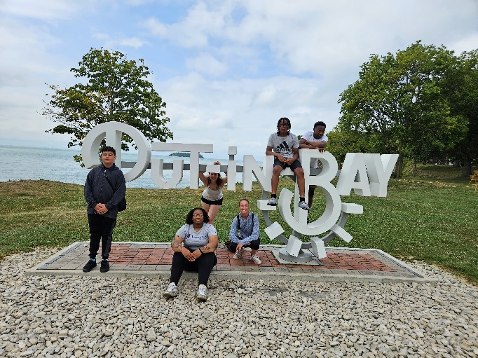
OBERLIN POLICE DEPARTMENT
EXPLORER POST #2478
The Oberlin Police Department Explorer Post 2478 has been in existence for 30 years. Explorers are open to males and females, ages 14-20, with interest in law enforcement and community service. In 2025, the department had 2 active Police Explorers. The Police Explorers Program was supervised and coordinated by Officer Billie Neadham, Officer Ilene Gonzalez and Dispatcher Arianna Tevis.
The Explorers participate in the Heart of Ohio Planning and Competition held in April every year. The Explorers have participated in the Big Parade, Safety Town, National Night Out, Halloween, the Christmas Parade and Shop With A Cop.

Slide 32
OBERLIN POLICE DEPARTMENT
JAIL OPERATIONS
A self audit of the Oberlin City Jail in 2025 was completed with no deficiencies noted. The inspection was subsequently approved by the Ohio Department of Rehabilitation and Corrections. The Oberlin City Jail also passed an annual fire inspection conducted by the Oberlin Fire Department and a health inspection conducted by the Lorain County Health Department.
At least 242 adult prisoners were temporarily held in the jail by our department and outside agencies. This includes new arrests and prisoners held for court appearances at Oberlin Municipal Court. One juvenile was temporarily held in the Oberlin City Jail or a secure room of the police department in 2025.

Slide 33
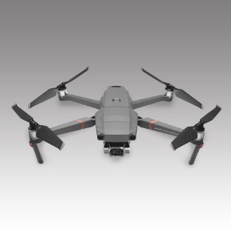
OBERLIN POLICE DEPARTMENT
DRONE UNIT
The Oberlin Police Department Drone UAV Unit consists of four trained officers:
Sgt. Jake Crossan
Ptl. Mike Kastanis
Ptl. Zachary Nilges
Ptl. John Kubicki
The Oberlin Police Department Drone Unit operates two drones/UAVs. For the year 2025, the department purchased a DJI Matrice 4 thermal which is used as the main/over watch drone. The Matrice has advanced thermal capabilities and a flight time of 47 minutes per battery. The Unit continues to use the small and versatile DJI Avata 2. This drone is used for interior buildings and training due to its easy learning capabilities.
The Oberlin Police Department’s Drone Unit has joined the Lorain County Joint Drone Initiative which is a partnership with County police & fire departments for quick deployment in case of emergencies.

Slide 34

OBERLIN POLICE DEPARTMENT
CRIME PREVENTION
National Night Out is celebrated the first Tuesday in August each year. This event gives residents an opportunity to interact with officers and discuss ways to prevent crime in neighborhoods in a relaxed setting.

Slide 35
OBERLIN POLICE DEPARTMENT
ANCILLIARY ASSIGNMENTS
Abandoned Bike Unit: Officer Robinson oversees the Abandoned Bike Unit in 2025 and continues to inventory the abandoned bicycles. Bicycles older than 90 days are either donated or scrapped. 17 bikes were transferred to the bike barn in 2025.
Project LifeSaver: Sgt. Durica is trained to operate Project Lifesaver equipment. The program is used to help locate individuals who are at risk of wandering away due to dementia, autism, etc. There is currently one Oberlin resident participating in the program.
Lost and Found: 75 items were turned in and entered into our Lost and Found; 35 items were returned to owner, 38 items were destroyed, one item was claimed by the finder after a 30-day hold, and one item was donated to Goodwill at the owner’s request.

Slide 36
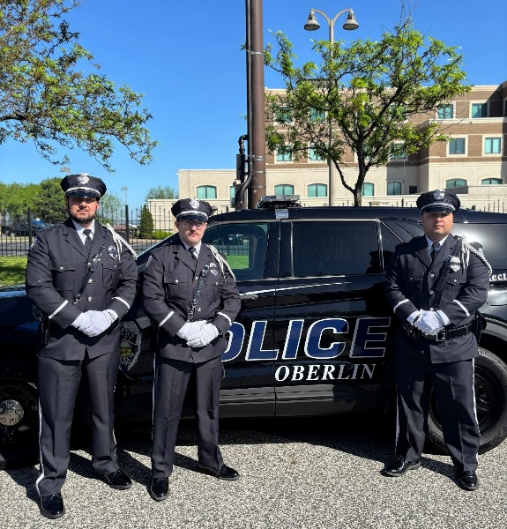
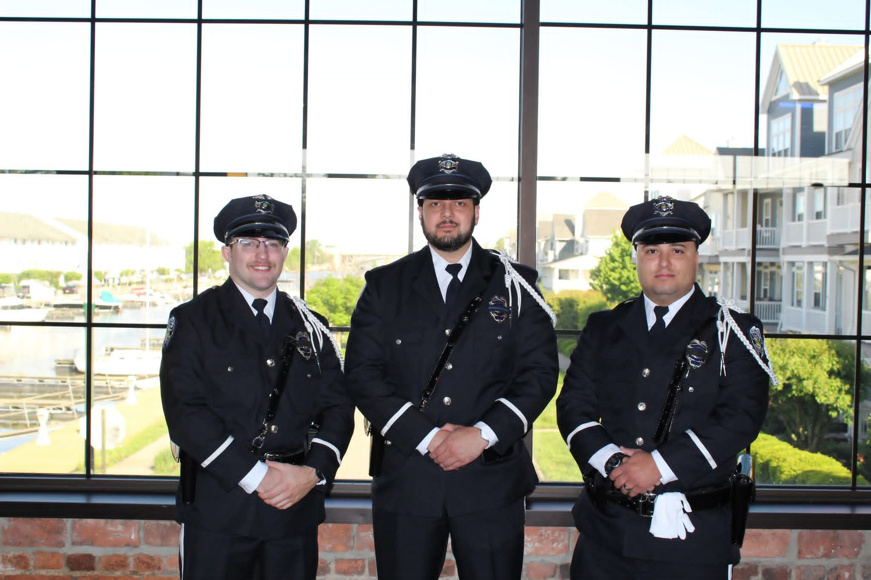
OBERLIN POLICE DEPARTMENT
HONOR GUARD
In 2025, members of the Oberlin Police Honor Guard attended the Lorain County Police Memorial and the Greater Cleveland Peace Officers Memorial.
The OPD Honor Guard participated in funeral events for Patrol Officer Neadham in May.
Oberlin Police Honor Guard attended the funerals for fallen Lorain Patrol Officer Phillip Wagner and Sheffield Village Police Lieutenant Aaron Bober.

Slide 37
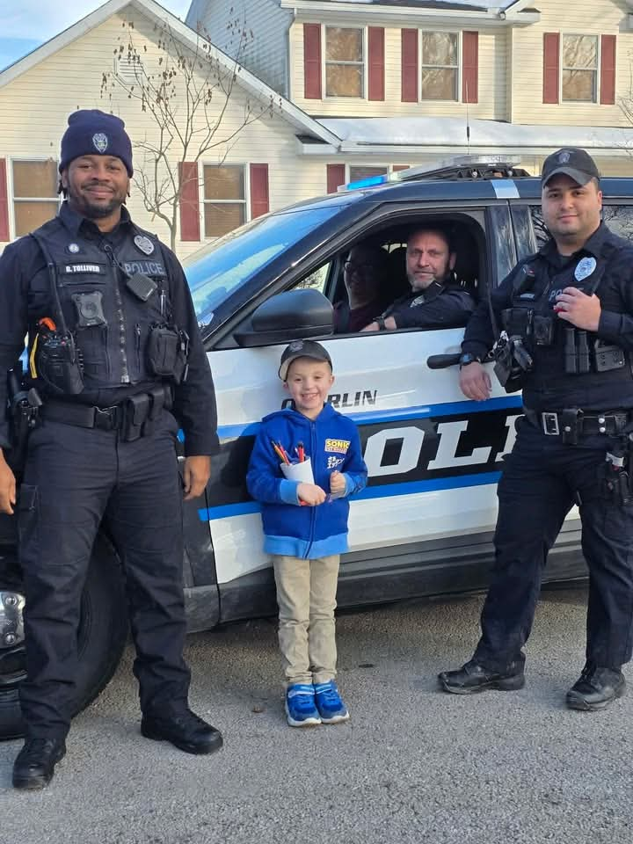
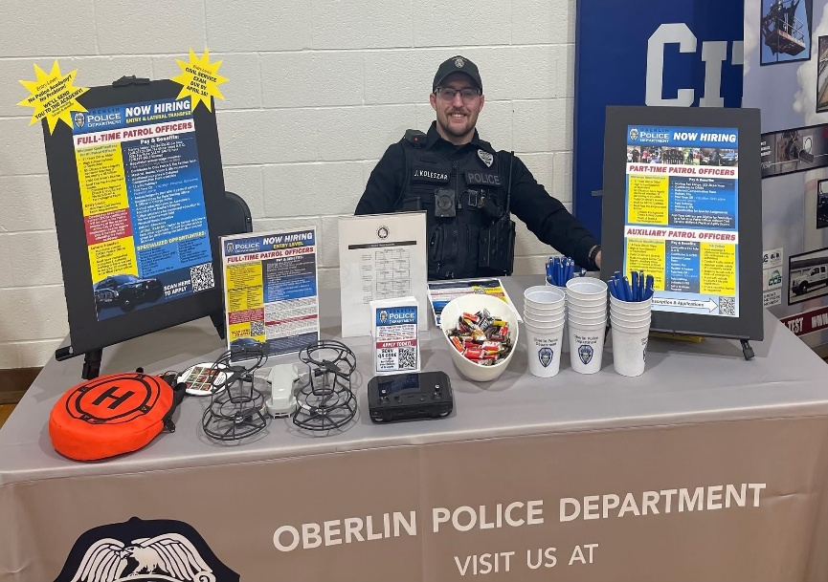
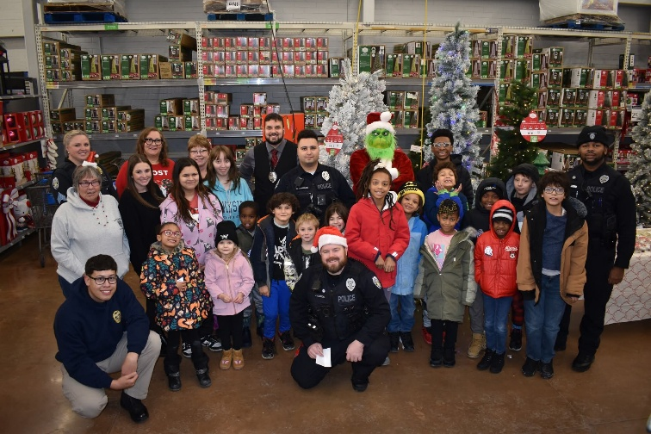
OBERLIN POLICE DEPARTMENT
COMMUNITY OUTREACH
The department continues to effort to enhance community policing, the department implemented the following strategies:
    Foot and Bicycle Patrol Areas
    Safety Town for Children Entering Kindergarten
      Shop With A Cop
      Lorain County Trunk or Treat

Slide 38
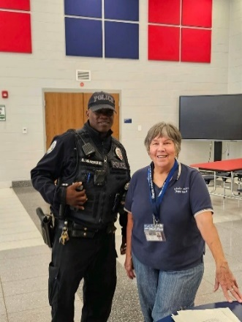
OBERLIN POLICE DEPARTMENT
COMMUNITY OUTREACH
2025
  Safety Town is held every year for children entering kindergarten. This program teaches safety in areas such as school bus safety, crossing streets, how to use 9-1-1 correctly, bicycle safety, stranger danger, water safety, staying safe around electricity and fire safety.
  This is a free program sponsored by the City of Oberlin with supplemental funding from Oberlin Rotary Club and Community Foundation of Lorain County. Oberlin Rotary Club’s generous donation paid for the materials and supplies for the buildings JVS has built for Safety Town. Community Foundation of Lorain County provides annual funding for
  T-shirts, supplies and refreshments.
  In 2025, Safety Town was suspended due to the unexpected loss of Officer Billie Neadham in May. Officer Neadham, along with Dispatcher Gwen Goul, planned and taught pre-k students every summer. This program is enhanced by student volunteers who donate their time.

Slide 39

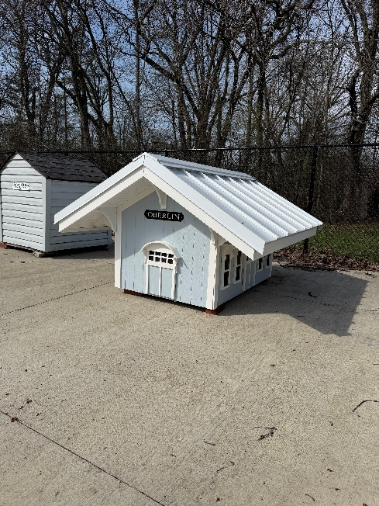
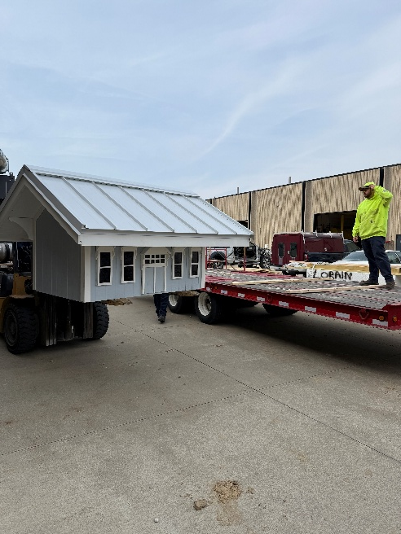
OBERLIN POLICE DEPARTMENT
COMMUNITY OUTREACH
In 2025, the Lorain County JVS carpentry program students built the Oberlin Depot building which was delivered to Safety Town in April. This continues to be an excellent opportunity for the JVS carpentry and masonry classes to apply their newly learned skills.
The materials for the building were purchased through a generous donation from Oberlin Rotary Club.

Slide 40

OBERLIN POLICE DEPARTMENT
MISCELLANEOUS
The regular duties of the Auxiliary Unit of Oberlin Police Department include parking enforcement, vacation home checks, animal calls, lockouts, and City Council security along with assisting with local events.
Our Department continues to reach out through social media. The Department posts items regarding criminal suspects, department and city events, awards, safety tips and other newsworthy items. The OPD social media pages continue to be used to help solve crimes along with being a tool for community policing.
The WebCheck fingerprint system continues to be utilized by the public. In 2025, we received $13,117.00 in revenues. We have paid $10,860.00 to the State of Ohio for processing electronic fingerprints, leaving a reimbursement of $2,257.00.

