Slide 1



AI Image Generation Workshop
www.brandience.com

Slide 2




Objective:
To demonstrate the importance of prompt engineering by comparing outputs across multiple groups. Participants will gain hands-on experience and develop a deeper understanding of crafting effective prompts to get the best results.
Prompt 1
Prompt 2
Prompt 3
www.brandience.com
Notes:
Don’t try to “fix” your prompt. It is OKAY if you mess up, that’s the point of this workshop.
Try to only have one image generate per prompt per group

Slide 3
Let’s get started!
Break into groups of 6 or less.
Decide on a generative AI tool to use (ChatGPT, Gemini, Copilot, etc) and start a new thread.
www.brandience.com

Slide 4
Prompt 1:
Within your groups, decide on a dog breed and generate an image of a puppy in that breed.
www.brandience.com

Slide 5
Group 1
Group 2
Group 3
[Place screenshot here]
[Place screenshot here]
[Place screenshot here]
Group 4
Group 5
Group 6
[Place screenshot here]
[Place screenshot here]
[Place screenshot here]
www.brandience.com

Slide 6
Prompt 2:
With your group, decide on a style for your image. Add specific detail to your prompt like environmental detail, mood/tone, art style, etc. to make your image unique.
www.brandience.com

Slide 7
Group 1
Group 2
Group 3
[Place screenshot here]
[Place screenshot here]
[Place screenshot here]
Group 4
Group 5
Group 6
[Place screenshot here]
[Place screenshot here]
[Place screenshot here]
www.brandience.com

Slide 8
Prompt 3:
With your group, decide on some text or messaging to make your image appear as an ad to help push the adoption of puppies. Be specific on placement of the text, what the copy will read, style, tone, etc.
www.brandience.com

Slide 9
Group 1
Group 2
Group 3
[Place screenshot here]
[Place screenshot here]
[Place screenshot here]
Group 4
Group 5
Group 6
[Place screenshot here]
[Place screenshot here]
[Place screenshot here]
www.brandience.com

Slide 10
Great work!
So, why did we go through each prompt?
www.brandience.com

Slide 11
Prompt 1 Goal:
Demonstrate how simple input (object or scene) generates a basic visual output using AI.
Prompt 2 Goal:
Demonstrate how adding visual style and descriptive detail to a prompt enhances the quality, tone, and clarity of the AI-generated image.
Prompt 3 Goal:
Demonstrate how incorporating specific text and messaging enables AI to generate functional, purpose-driven graphics—while also showcasing how these tools can support brainstorming, storyboarding, and creative ideation across projects.
www.brandience.com

Slide 12
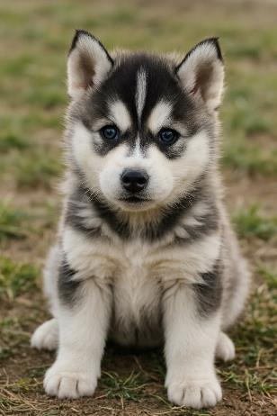
Round 1 Example
Prompt 1: Generate an image of a husky puppy
www.brandience.com

Slide 13
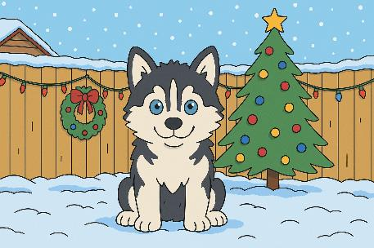

Round 2 Example
Prompt 2: I want to showcase a snowy backdrop to help show how cute he is. I want it to look like someone’s fenced backyard during the holiday season. I want the art style to be very similar to the animated show 'Bob's Burgers'. I want the tone to be happy, fun, and playful playing into the holiday spirit with decorations and snow.
https://www.brandience.com/

Slide 14
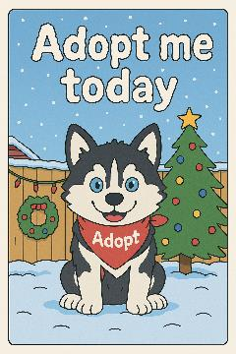
Round 1 Example
Prompt 3: I want to transform this into an advertisement to convince people to adopt. I want the image to be shown as an ad you would see online. Can you add the text "Adopt me today" spelled out in snow in the sky? I also want you to add a tiny bandana to the dog that says "Adopt“.
www.brandience.com

Slide 15
Takeaways
Prompt Precision Drives Quality Creative
Small changes in wording can drastically shift the tone, style, and effectiveness of AI-generated visuals—just like how intentional messaging drives campaign success.
AI is a Creative Partner, Not a Shortcut
This exercise demonstrates how AI can support the early stages of ideation, storyboarding, and creative development—freeing up time for deeper strategic thinking and brand alignment.
Consistency in Prompting Mirrors Consistency in Branding
Just as brand voice must remain consistent across channels, refining prompts with tone and detail leads to more coherent, on-brand creative outputs.
Cross-Disciplinary Applications Are Within Reach
From social posts to storyboards, this technology supports multiple Brandience departments—whether you're in creative, paid media, or strategy.
Human-Led, AI-Assisted Workflows Are the Future
These tools don’t replace creativity—they enhance it. The real power comes from marketers who know how to guide the tech with clarity and vision.
www.brandience.com

Slide 16
Thank you!
www.brandience.com

