Slide 1
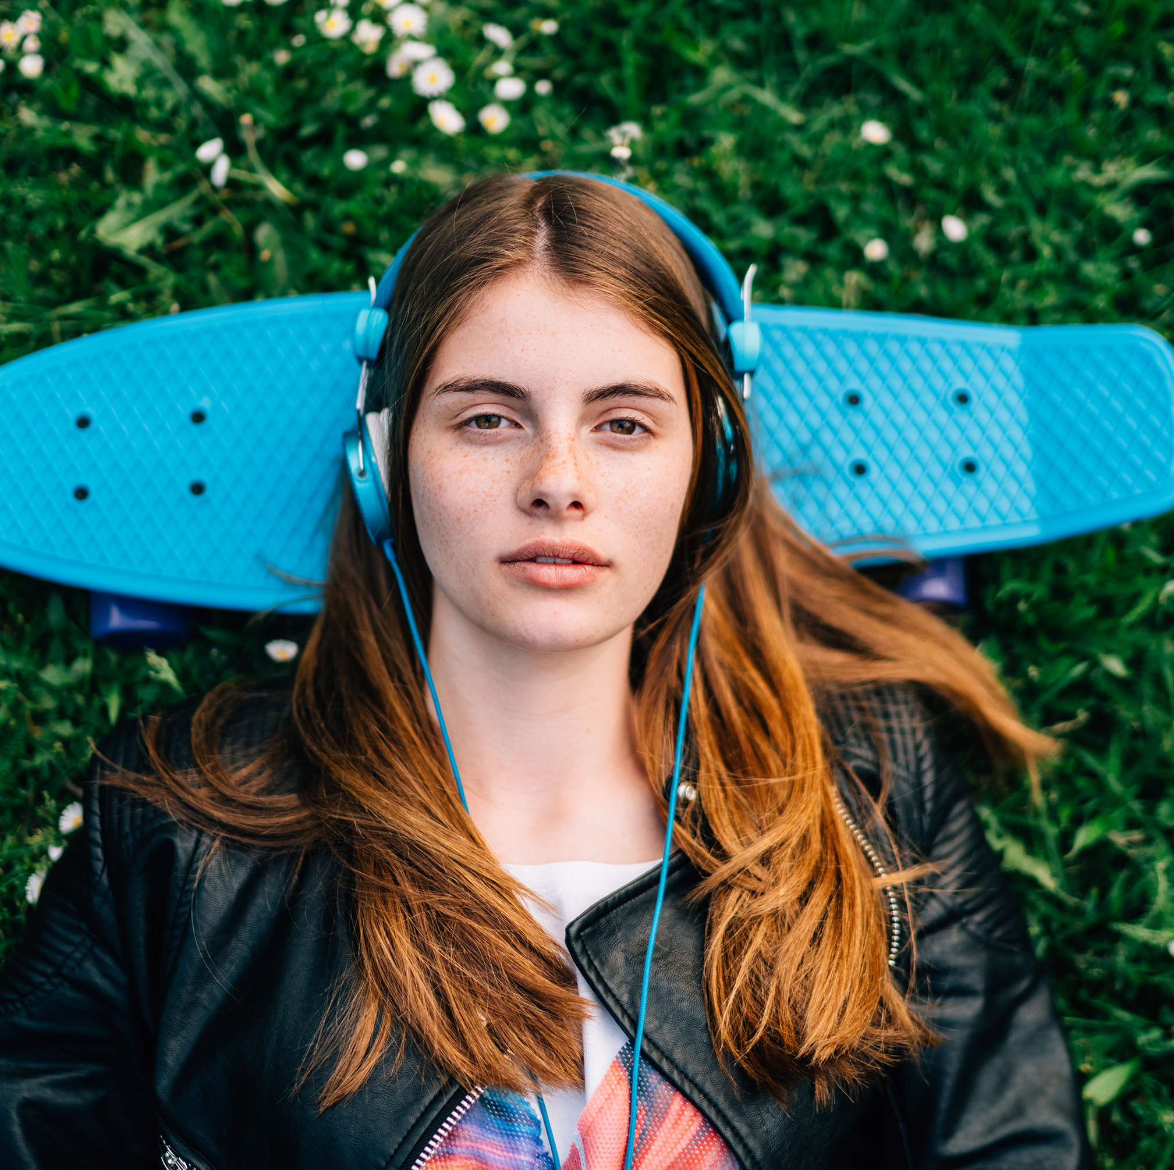


Activity One:
Change one thing for young people in your local area!
Pick one specific change you would make to improve the lives of young people in the area where you live…
…you’re in charge!

Slide 2
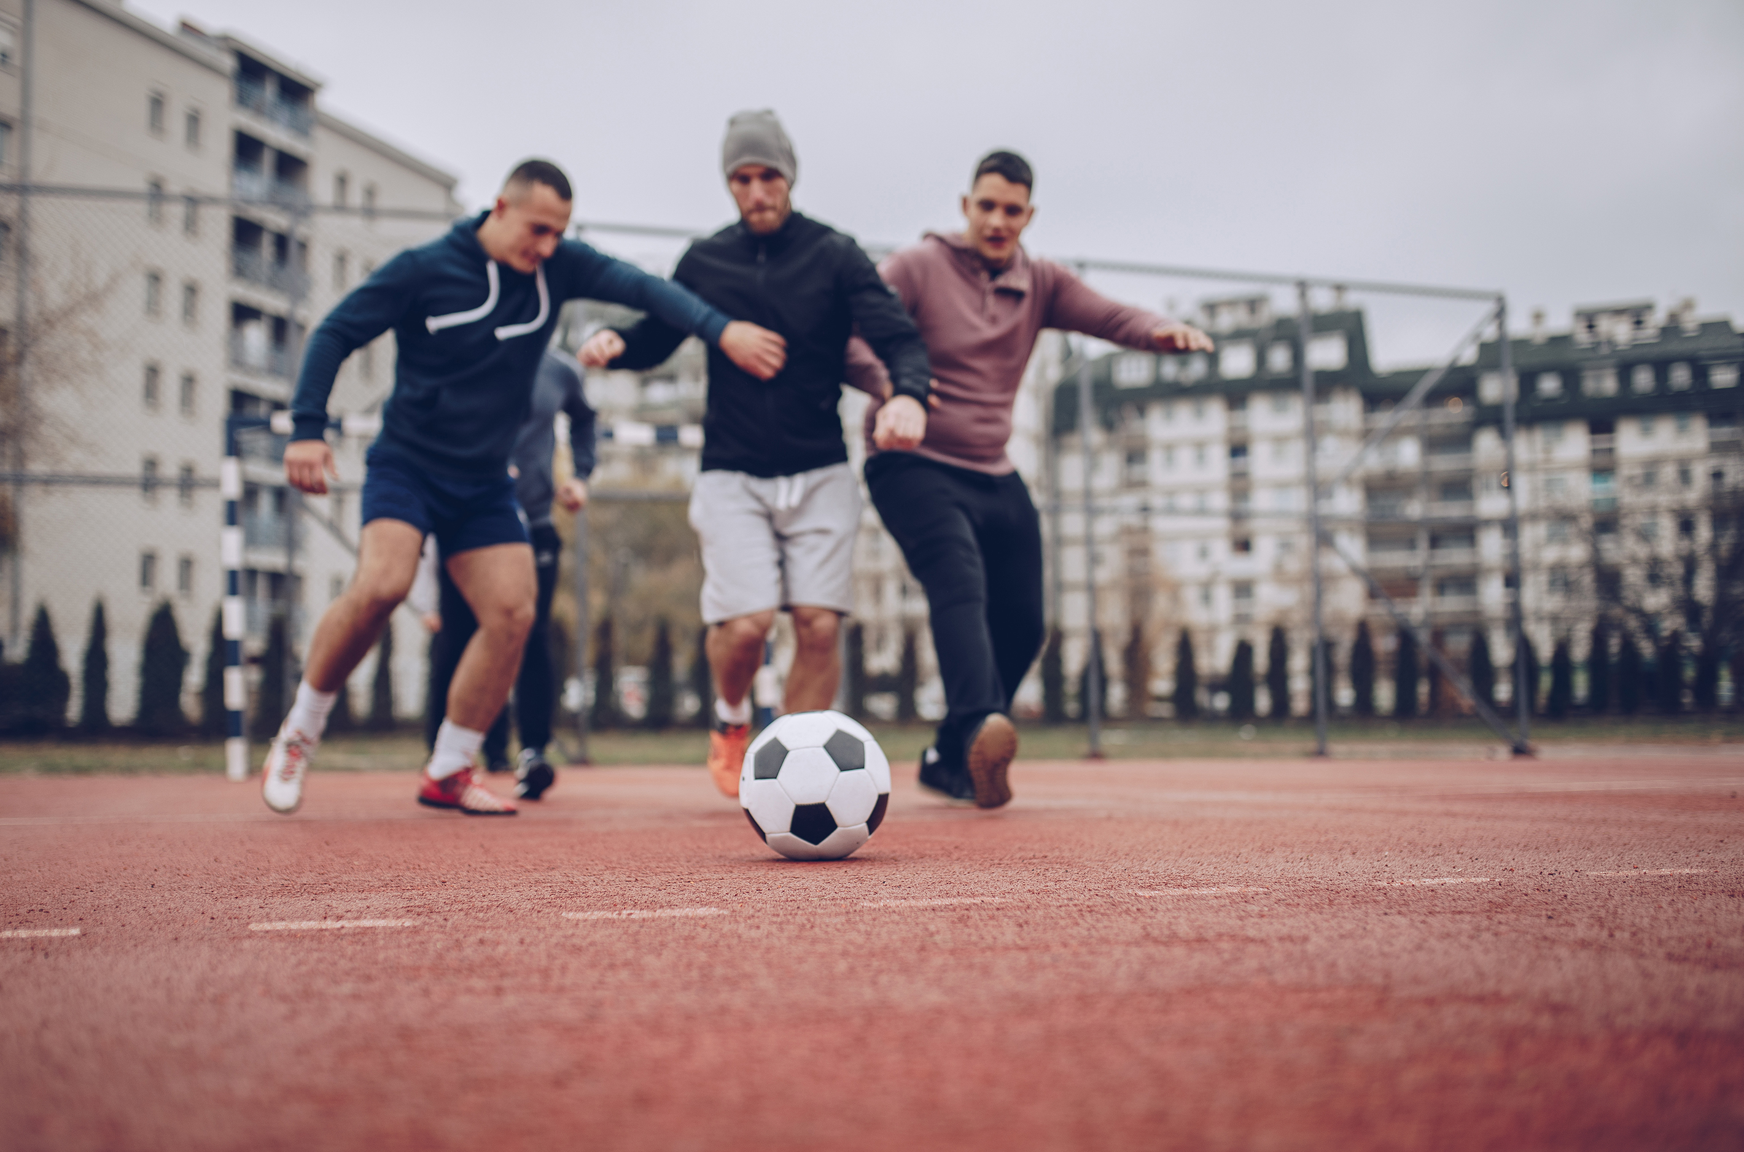
Tell a partner, or the group, what choice you’ve made and why it’s good for young people…try to keep to 1 minute…
Listen to others talk about their ‘one change’ too…
How do we decide which change gets made first if they’re different? Councils make these decisions all the time!
Passionate about your change?
  - Register to vote!
  Start a petition!
  Contact a councillor!
  Crowdfund a campaign!

