Slide 1

Media Literacy
Lesson: Science and misinformation

Slide 2


Media Literacy:
Why does it matter?
Being active in your local community; in decisions that impact you, your family and friends; being a part of civic life and democracy are all very important things. But so is the ability to know how politics works, what are the key issues facing London, Britain and the world, as well as developing the critical thinking necessary to evaluate different points of view and navigate the media.
You can find more education and social media resources on the London Voter Registration Hub.
>> https://registertovote.london/ <<

Slide 3
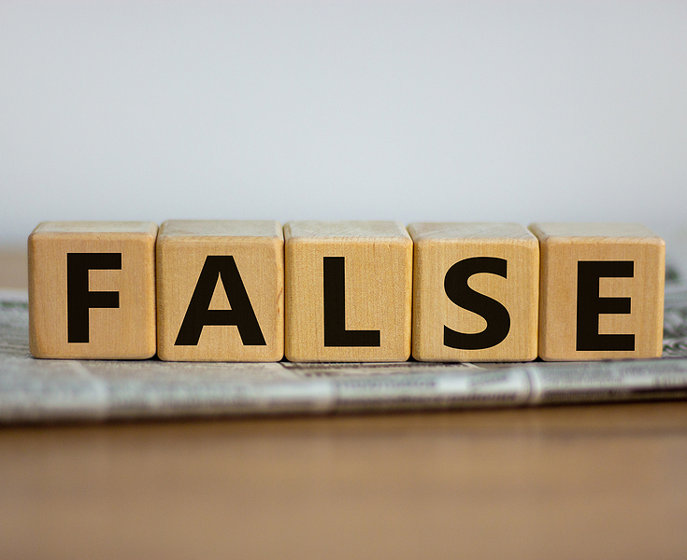
Misinformation/
Disinformation:
Science’s biggest villains
“Ignorance of the truth, or knowledge that is not acted upon, can be fatal.”
Computers, phones, the Internet and social media enable every individual to be a publisher, communicating true or false information instantly and globally.
'Misinformation' and 'Disinformation' undermine the credibility of science and the capacity of individuals and society to make evidence-informed choices in their best interests.

Slide 4
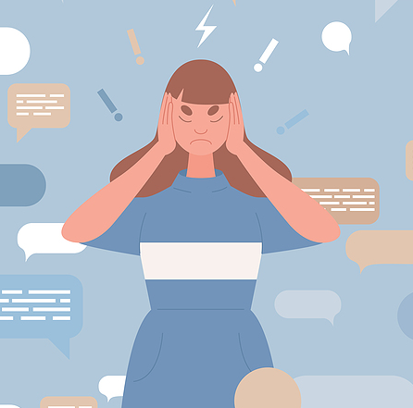
Terminology:
Disinformation is false information deliberately created to cause harm to a person, social group, organisation or country.
Misinformation is false information that is created and spread regardless of an intent to harm or deceive.
Both forms may be shared widely, regardless of whether or not the sharer knows the information is wrong.

Slide 5
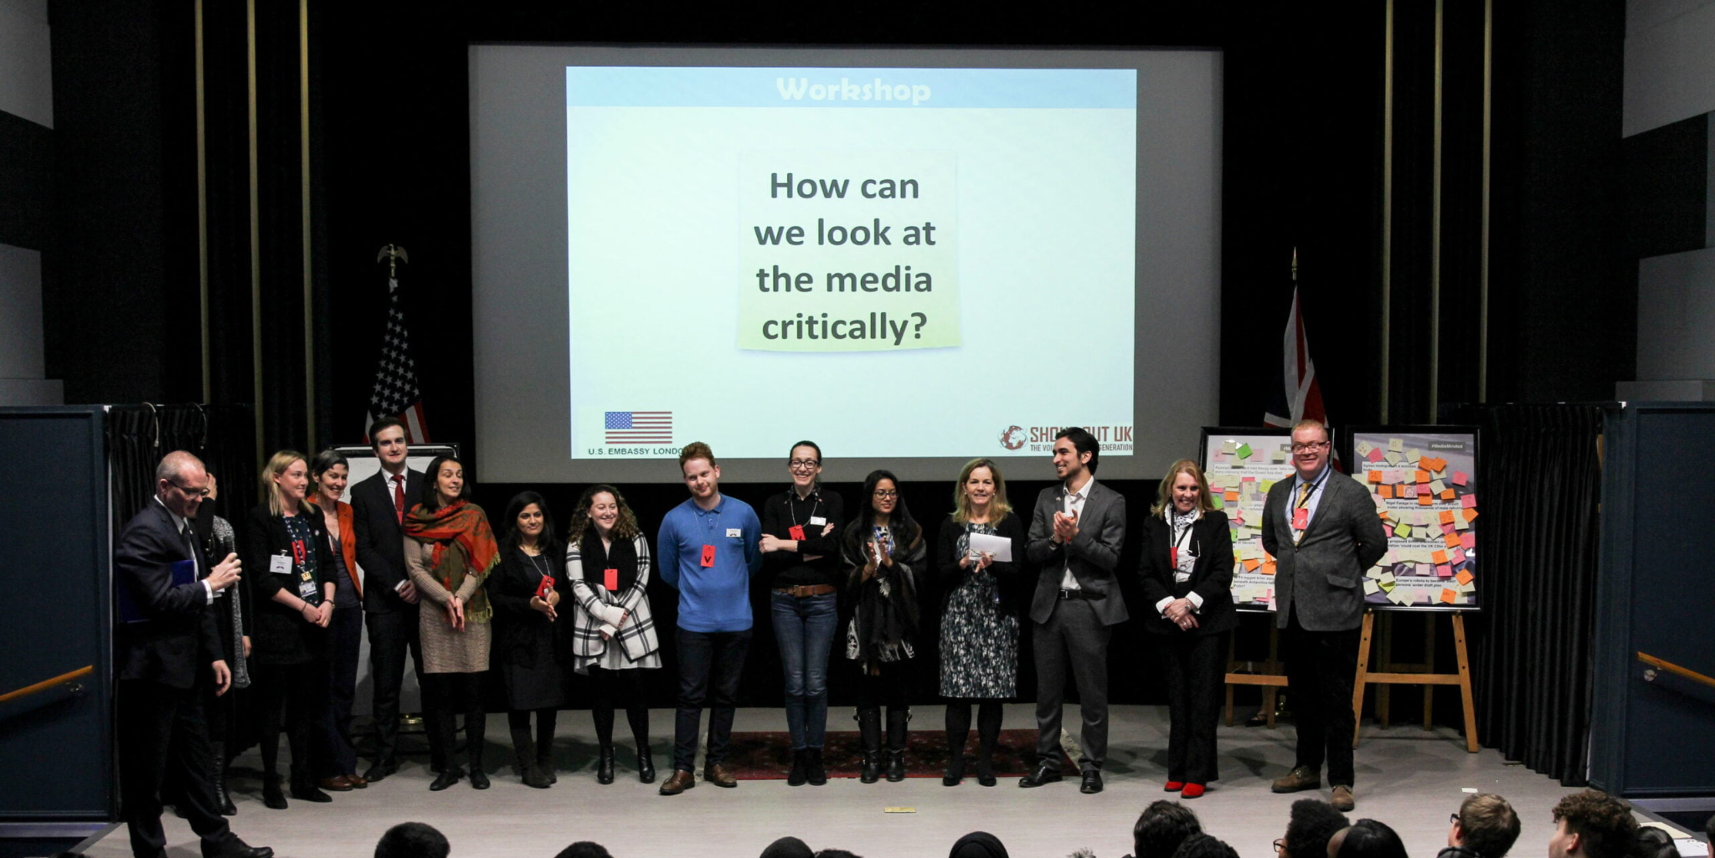
Discuss
Misinformation and Truth:
You will be shown three separate claims and will have to decide in groups whether these claims are truthful or misinformation.

Slide 6
Tobacco kills more than 8 million
people each year.
What do you think?
MISINFORMATION
TRUTH

Slide 7
Tobacco kills more than 8 million
people each year.
Source: World Health Organisation
TRUTH

Slide 8
TRUTH
The tobacco epidemic is one of the biggest public health threats the world has ever faced, killing more than 8 million people a year around the world. More than 7 million of those deaths are the result of direct tobacco use while around 1.2 million are the result of non-smokers being exposed to secondhand smoke.
All forms of tobacco are harmful, and there is no safe level of exposure to tobacco. Cigarette smoking is the most common form of tobacco use worldwide. Other tobacco products include waterpipe tobacco, smokeless tobacco products, cigars, cigarillos, roll-your-own tobacco, pipe tobacco, bidis and kreteks.
Source: WHO - World Health Organisation

Slide 9
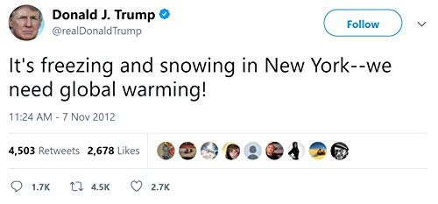
What do you think?
MISINFORMATION
TRUTH

Slide 10
Does a cold winter mean that global warming is over?
No. Scientists say that severe winter weather is still to be expected from time to time. That kind of weather happens even during a long-term warming trend for the planet.
(Source: NASA)
Weather refers to atmospheric conditions that occur locally over short periods of time, eg. rain, snow, clouds, winds, etc.
Climate, on the other hand, refers to the long-term regional or even global average of temperature, humidity and rainfall patterns over seasons, years or decades.
Global warming is the long-term heating of Earth’s climate due to human activities, primarily fossil fuel burning.
We are currently in a climate emergency and the United Nations says we could have just 11 years left to limit a climate change catastrophe.
MISINFORMATION

Slide 11

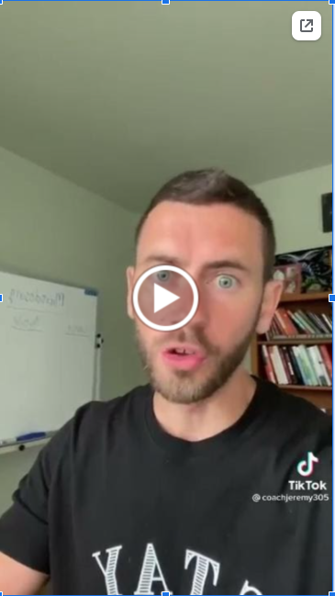
MISINFORMATION
TRUTH
https://vm.tiktok.com/ZSJbQNTjp/

Slide 12
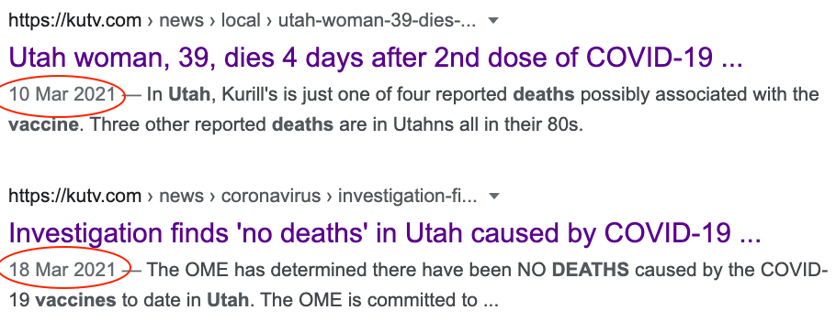
MISINFORMATION
Are healthy people at risk of dying from taking the Covid-19 vaccine?
No. Various studies across the world have investigated the side effects of vaccines and proven that only a VERY small percentage of individuals have had severe side effects, let alone died, from the vaccines. The news platform this individual uses to defend his argument, eventually discredits this information.

Slide 13

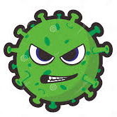
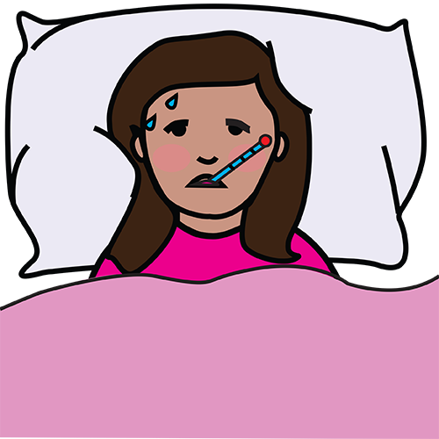
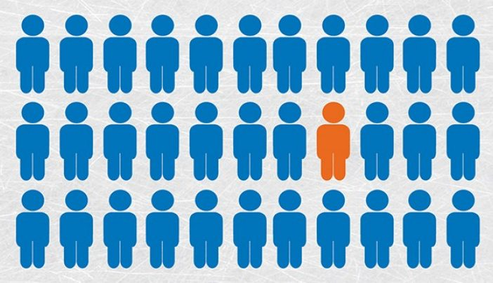
Covid-19 Vaccines - protecting everyone
Vaccines create collective
immunity through vaccination, NOT uncontrolled exposure, and thus reduce spread of viruses.
Vaccines stop us
getting ill
and dying
Vaccines protect others that
can’t be vaccinated.
Some people with weakened immune systems or with some medical conditions
can’t be vaccinated.
Vaccines reduce the chance
of mutations and
scary variants

Slide 14
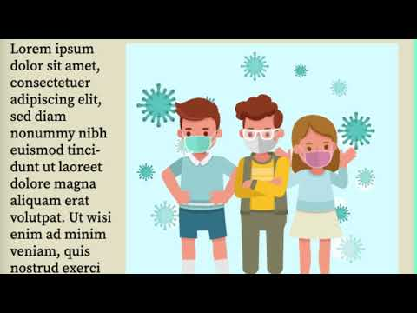
FAQ:
Watch the following video from
Shout Out UK on how to
REVIEW mis-/ disinformation
Reputation
Evidence
Verification
Intent
Emotions
Weight it up
https://www.youtube.com/watch?app=desktop&v=oqj3T3oxcrk

Slide 15
Looking to the future:
Disinformation is deliberately created with the intent to cause harm, while misinformation is incorrect information shared by people who believe it to be true.
Be aware that misinformation and disinformation are created and centered on big issues such as:
people's identities
climate change denial
voting and elections
Most fabricated content usually tries to play to your emotions. Always double-check images, social media posts and news articles before you react or share them.
When in doubt, remember to REVIEW.

Slide 16

The facts about WHO can and
HOW to register to vote:
1 in 3 young Londoners (16 to 25 year olds)
are not registered to vote
Black, Asian, ethnic minority and migrant
Londoners, private and social renters are
less likely to be registered to vote and, hence,
less likely to be heard
To register to vote in London, you have to
be aged 16 or over (you can vote at 18),
be a British, Irish, EU or Commonwealth
citizen, have a London address
Now you know the facts, get heard!

Slide 17
LONDON WON’T BE THE SAME WITHOUT YOUR VOICE.
Register to vote at:
www.gov.uk/register-to-vote
You can find more education and social media resources on the London Voter Registration Week Hub:
https://registertovote.london/

