Slide 1
Adoption Community Session
August 16th, 2023

Slide 2
Agenda
# | Topic(s) | Timing
3 – 7 | Adoption & Success Study Overview | 10 min
8 – 12 | Interview Findings & Common Themes | 15 min
13 | Panelist Questions | 25 min
15 – 18 | What’s Next? | 5 min

Slide 3
Adoption & Success Study

Slide 4

























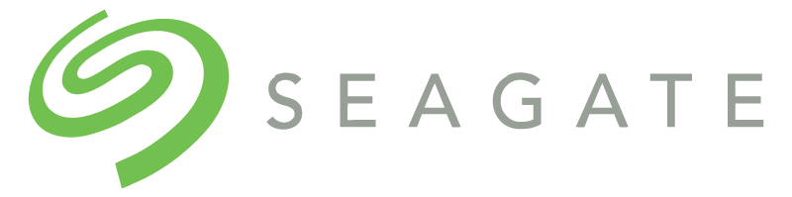














Who’s In The Community?

Slide 5



Adoption Study Overview
Why an adoption analysis…?
To better understand what drives success business success in the context of Gloat as a catalyst to career development, internal mobility, talent sharing, etc…
Approach
Focus: Three 1 hour interviews took place with core team members for: Schneider Electric, MetLife and Mastercard
Topics: Business case, driving leadership buy-in, success metrics, etc.
Outcomes: We analyzed responses across all three accounts and created a report of our findings regarding ‘why’ these accounts have seen success with the Talent Marketplace
3+ Years
2+ Years
2+ Years

Slide 6


All KPIs – August 2023
By The Numbers…
Onboarded User %: 73%
Monthly Atv. Users: 32%
Unlocked Hours: 599,585
Role Assignments: 9,835
Mentee Assigns: 9,395
Position Assigns: 2,221
Onboarded User %: 79%
Monthly Atv. Users: 36%
Unlocked Hours: 430,459
Role Assignments: 4,349
Mentee Assigns: 3,815
Onboarded User %: 60%
Monthly Atv. Users: 23%
Unlocked Hours: 353,013
Role Assignments: 8,164
Networking Assigns: 3,626

Slide 7
Measuring Adoption Success
Align & Integrate
Fitting Gloat Into Your Organization
Define Business Success
Building With The Future In Mind
Establish Your Foundation
Preparing Your People

Slide 8
Categories Analyzed
1
Case For Change
What business challenge are we solving?
Establish Your Foundation
Who/What level of leadership is bought in from a leadership perspective?
2
Leadership Buy-In
3
Change Network
How involved is the change network involved in driving business success?
Define
Success
4
Key Performance
Indicators
How do we define short and long term success through KPIs?
5
Rollout Strategy
What is the key to keeping people engaged after the initial rollout?
Align & Integrate
What people, process or policy changes occurred to drive Talent Marketplace success? (if any)
6
Existing Processes & Policies
7
Sourcing Projects
How were projects uncovered across the business?

Slide 9
Customer Themes

Slide 10
Establish Your Foundation
Case For Change | Leadership Buy-In | Change Network
Annual employee engagement surveys highlighted a need for…
  More experience(s)
  Internal mobility
  Skill development
Cutting external recruitment costs
Transition to skills based organisation
Market impacts/events (e.g. quiet quitting, COVID)
Position executives / sr leaders to build relationships and drive platform success through “walking the talk” (e.g. speaking about Gloat or posting a project)
Engagement and updates through regular SteerCo meetings
C-suite level calling out the platform as the hub career development tool
Set clear local goals for the network: registrations/OB%, HPC%, project to end user ratio, etc.
Monthly change network meetings led by the core team
Network made up of change champions and super users who know the platform and can articulate use cases/success stories

Slide 11
Define Business Success
Key Performance Indicators
Coaching/storytelling around reported KPIs is important to the ‘value’ conversation. Answering the ‘why’ in conjunction with Gloat benchmarks sets a good foundation for success
In addition to the Gloat self service dashboard, building an internal dashboard (PowerBI or Tableau) that the champions’ use to look at golden KPIs for their function/department/business unit
Conduct year over year analysis of how employee engagement scores are shifting due to Talent Marketplace
Lean into joint metrics - looking beyond your own platform, pull data from Gloat and connect it back to the business
  E.g. 33% of people who had a mentor or were on a project got promoted
Visibility of KPIs is highly important: user to opp ratio, NPS, MAU, etc. Regional leaders need to understand the impact to drive value at the ‘local’ level
Increasing the assignments KPI was a common thread in the interviews and important deriving value (e.g. unlocked hours)

Slide 12
Align & Integrate
Rollout Strategy | Existing Processes & Policies | Sourcing Projects
Build a strong brand that is recognized in person,
virtually, and on social media to create/sustain buzz
Leverage existing communication channels to rollout Gloat (ie. a natural flow into career dev, learning, etc.)
Tie Gloat platform to critical business objectives and initiatives (consider building a northstar that gets presented at the beginning of each planning/strategy session)
Use programs e.g. ‘Own Your Career’, ‘Grow Your Career’ to develop skills and give opp for action and open conversation (agency & access)
No major need for policy changes around talent sharing
Change management strategy is highly important to building confidence around Talent Marketplace…
  Mythbusters
  QRGs/Guidelines
  WIIFM
Conducting ‘work-breakdown’ exercises are critical
  ‘Projects’ is very new concept and collaborative sessions are a key driver
Projects don’t come from one specific source, facilitating the mindset shift around ‘what is a project’ is a game changer (job shadowing → business impact)
Dedicated champion network is important in 1st year to integrate into the culture/sets a good foundation

Slide 13

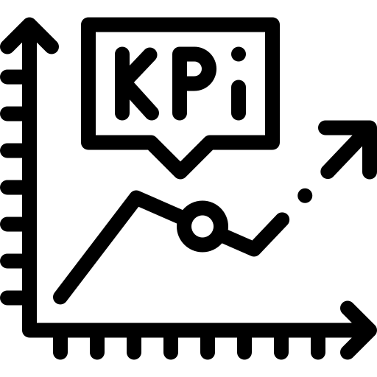


4 Actions To Help You Drive Adoption
Ask one senior leader to post a project to help them brainstorm and solve a problem they are struggling with
Build a KPI story on why adoption is key to success, and share with leaders + champions (reach out if you need support)
Review your talent marketplace brand and identify areas for improvement across materials (ie. how are benefits being articulated?)
Look at your marketing and HR calendar to see where you can embed Talent Marketplace to gain exposure (ie. Town Halls)
A Gloat customer success representative will follow up with you to see how these activities went, don’t hesitate to reach out with any questions!

Slide 14
Panelist Questions

Slide 15
What’s Next?

Slide 16
Customer Community Frame
Implementation Customers
0–12 Months
In Life Customers
13–36+ Months
The keys to a successful soft launch
Sustaining momentum and driving long term value
Driving a successful Global expansion
Building effective success stories
The key to sustaining adoption post launch
Strategies for managing talent hoarding
Setting your success metrics
Implementing behavioral models to drive
success

Slide 17
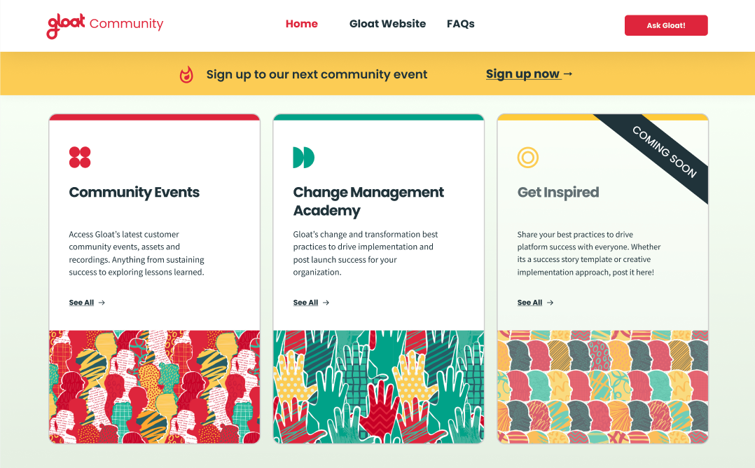
Coming Soon — Gloat’s Community Site!

Slide 18
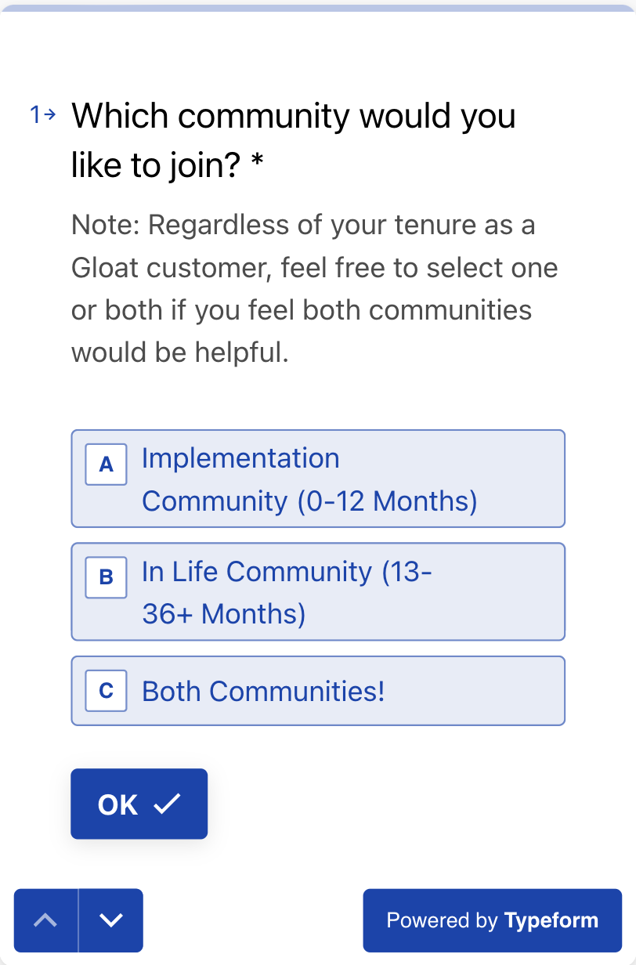
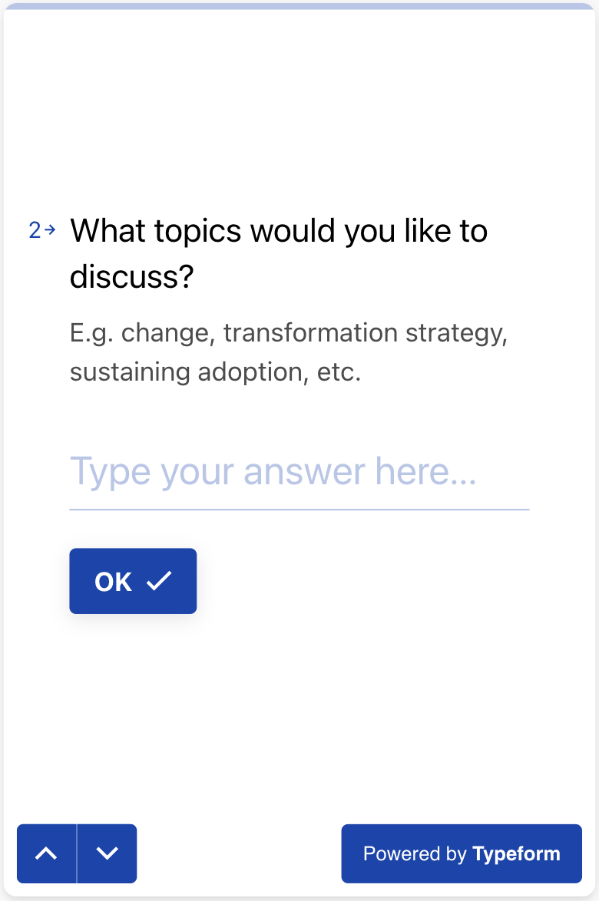
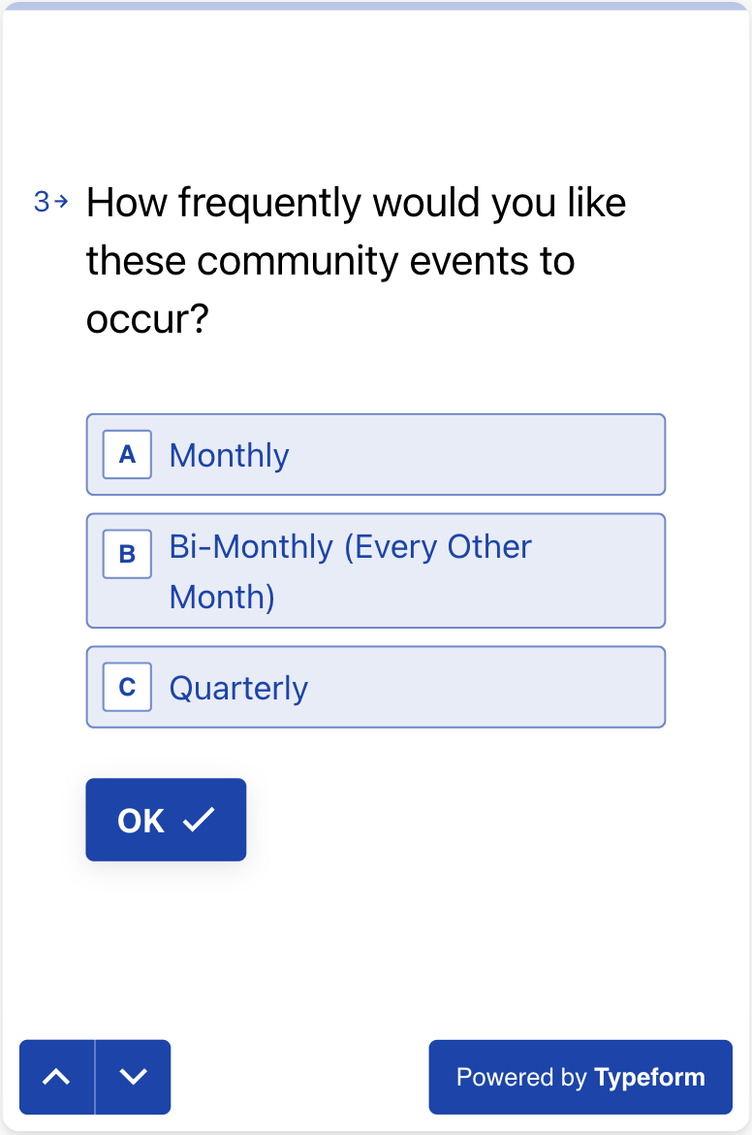
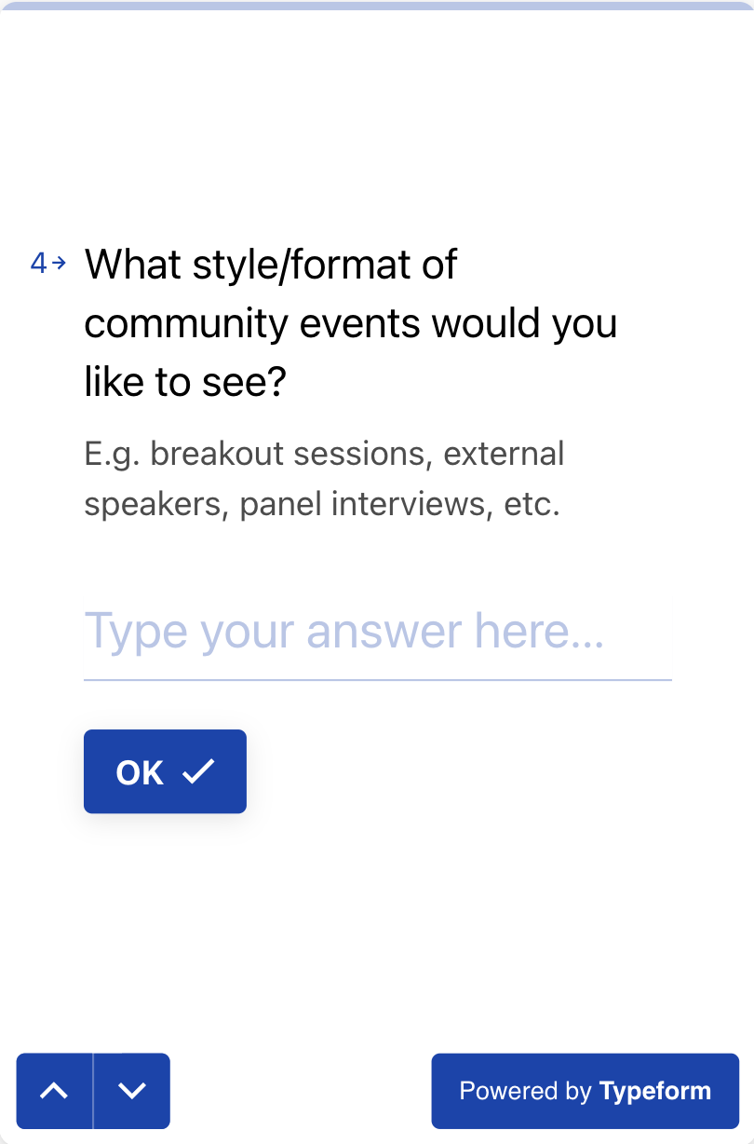
We want your thoughts!
Please fill out the community survey to help us better understand what you would like to see from Gloat – We will send the survey as a follow up after the session!

Slide 19
Appendix
Customer Specific Responses

Slide 20
Q&A – [Remove Before Session]
What metrics or indicators were monitored to gauge ongoing adoption, and how did you respond based on the data?
What strategies were employed to maintain user engagement and adoption following the initial launch?
Did you encounter any challenges in maintaining adoption levels after the launch, and how were they overcome?
What resources remained on the project after launch?
How did you keep communication channels open with users to address their needs and concerns after the initial launch?
What key lessons did you learn about sustaining adoption that you believe others could benefit from?
How did you ensure continued interest and usage among users after the launch phase?
How did you leverage feedback and insights from early adopters to inform your strategies for maintaining broader adoption?
Can you share examples of initiatives or campaigns that were implemented to sustain adoption over time?
Were there any specific tactics used to address potential drop-offs in adoption post-launch? If so, what were they?
Were there any unexpected factors or insights that played a significant role in sustaining adoption that you could share?

Slide 21
Case For Change
MetLife
Feedback from annual surveys
Need and desire for more career development opportunities
  Talent Marketplace as a catalyst for career development
On Feedback – Annual Surveys EEs requested
More experience
Mobility options
Skill development
Mission – Shifting Focus Towards Skills
Alignment on skills, including employee desired and business needs
Mastercard
Initiated Talent Marketplace (TM) due to CEO and customer collaboration during pandemic, addressing rapid partnership needs and skill gaps
Talent Marketplace addresses project needs and increases skill proficiency
Push for internal mobility to cut external recruiting cost, and facilitates transition to skills-based organization using Gloat data.
Schneider Electric
Exit surveys from employees that they didn't have a chance to develop in the company. Employee development is a huge focal point and talent marketplace as a catalyst to this was critical
Leavers reported not being able to find internal opps or feel like they were supported in terms of development
External trends around quiet quitting

Slide 22
Leadership Buy–In
MetLife
Engagement and updates through regular executive, business sponsor, and regional meetings, facilitating project progress and success sharing
  SteerCo
  Sr Executive Level POCs
  LOB Leaders
    Sessions occur on a monthly and bi-monthly basis depending on group
Mastercard
The Steerco is really important, and the data they present is quite significant. It gives us insights into how the projects are going and what outcomes we're achieving
Stories are critical to driving success. One of the biggest things MC is starting to lean into – opportunity now to lean into executives / most sr leaders to build relationships and drive platform success
Schneider Electric
Leaders consider this a career development tool and is the sole place to apply to open positions
C-suite (CEO and CHRO) level calls out the platform w/ the intention of benefiting the employees
Regional leads push this and SVPs are very supportive (even contribute to outside articles)

Slide 23
Change Network
MetLife
Monthly Change Network meetings encompass representatives from all LOBs and countries, overseen by the core team. Encouraging heightened engagement, including sharing success stories, best practices, and challenges.
Steerco members are also drawn from the Change Network, ensuring consistent channels and offering beneficial exposure to its members.
Mastercard
Started with a change champion network (200 people). Needed people to help drive success across the masses
Introducing a super user program focused on scaling the Gloat. Managers are enlisting individuals for super user roles, with collaborative curriculum development and credentialing in progress
Need to have change champions AND super users they know the platform and how to articulate the use cases/success stories
Schneider Electric
Global community made up of regional champions and a named person from each business unit
Set clear goals for the network: registrations/OB%, HPC%, project to end user ratio, etc.
Community is asked to run at least 3 training sessions per year: understanding skills, reflections on whats been accomplished and then best practices inside talent marketplace

Slide 24
Key Performance Indicators
MetLife
Power BI dashboard that has been created in house that is populated twice a week. All leaders and project team members and HR all has access to the tool. Able to get granular on certain areas of the business.
Main focus on overall KPI targets.... there is some LOB, Regional targets but not associated with performance goals
Mastercard
Coaching around data that needs to occur. Answer the ‘why’ behind what is being reported to key stakeholders to articulate value
Looking at usage of platform and connecting that to items such as promotions and employee engagement surveys
33% of people who had a mentor or were on a project got a promotion
Schneider Electric
Monthly metrics across Adoption, Actions, and Exploration categories (regs, adoption, HPC, my dev, assignments, applications, career planning, succession plans) reported to community network and HR leadership
Internal dashboard that the champions use and look at main KPIs + funnel for positions / projects
Sustainability metrics in annual report, amount of impact on employees with development actions

Slide 25
Policies & Ways Of Working
MetLife
Freeing up time to give them the opportunity to participate in short term projects. Similarly, very niche skilled roles also push back on being able to rotate through other areas of th ebusiness
Implemented a manager approval process – wanted to make sure the manager was aware of projects their employee wanted to particiapte in. Not necessiarly to block them but to support / help them balance their work load....
Mastercard
Internal application guidelines, getting input on all the policies. As more stakeholder weighed in, realization came that a shift needed to occur in the policy / languages
Leadership and global TA led the effort that everyone who needed to lead were present. Leadership, EE relations, legal, etc.
Schneider Electric
5 main cultural shifts that occured when OTM occurred: see the OTM cultural shift slide: Open to all, transparent, unbiased, borderless, allowed time to grow
Change management side of things is massive here. Mythbusters, guidelines, WIIFM, are all very important to building confidence around the foundation of Talent Marketplace

Slide 26
Sourcing Projects
MetLife
Don't have a specific source for projects. The idea of a project was very new to MetLife.... The initial effort was to get people outside the formal idea of a full time job. More and more projects that are higher quality are being added to the platform.
Project brainstorming, collaborative sessions and learning workshops to get people more and more used to the tool and what the capabilities were....
Right now working through a workshop they want to run to help with the brainstorming bit, including work breakdowns.
Mastercard
Not only saving the company money but delivering better solutions and providing career development for the employees that are present
Schneider Electric
Consistently promoting projects with support from various SE members, highlighting its effectiveness. It requires active project management rather than being low effort. Encouraging PMs to assign a dedicated PM role to alleviate project management burdens
Capturing testimonials is big from a promotion standpoint

Slide 27
Rollout Strategy
MetLife
Having constant communication with the change network / community. Regardless of language, start sharing details as soon as possible.
Learning bites, badging (4000 badges awarded in Q2). Continued engagement with every distribution
Incorporating messaging into other communications outside of mypath -- making the product 'BAU' as opposed to something bespoke.
Very strong branding that is recognized in each office, digital signage, etc.
Mastercard
When they first went out with general availability, tying projects to objectives and goals. Finding learning, mentoring, etc.
With career paths, tied in career development conversations. Became part of a natural cycle... Leveraging job architecture, moving from competencies to skills. M&A folks had no access to JA and P&C / HR people - helped understand who would help pilot this
Schneider Electric
No responses

