Slide 1
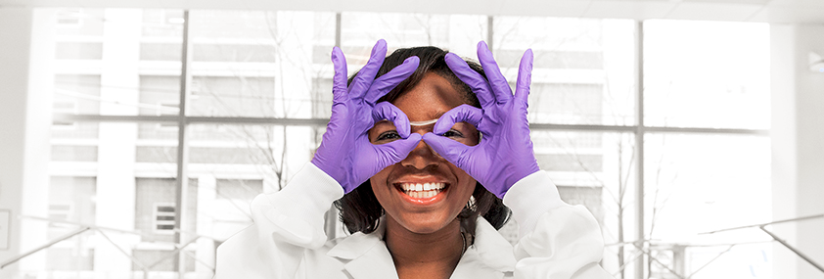
Gloat Community Call – Novartis’s Journey
People and Organization
Talent Management
Sara Steiner, Global Head Talent Marketplace + P&O ESG
Jan Štourač, Talent Marketplace Change Lead & PMO
June 30, 2022

Slide 2
Agenda
What and why: Building the overall narrative for Match
When: Our Talent Marketplace journey in Novartis
How: Engaging the audience after the launch

Slide 3
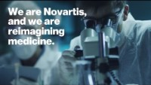
Novartis
Novartis is reimagining medicine to improve and extend people’s lives. As a leading global medicines company, we use innovative science and digital technologies to create transformative treatments in areas of great medical need.
In our quest to find new medicines, we consistently rank among the world’s top companies investing in research and development.
Novartis products reach nearly 800 million people globally and we are finding innovative ways to expand access to our latest treatments. About 108,000 people of more than 140 nationalities work at Novartis around the world.

Slide 4



Match is an AI powered resource consisting of two platforms
Talent
Learn
Talent Match
Easily see or post opportunities (roles, projects, etc.)
Find or be a mentor
Expand your experience and network
Match
Your go-to place for career growth and development
at Novartis
Match Learn
Learn in the flow of work and on the go
Connect with experts and peers
Spend less time searching and more time learning
powered by gloat
powered by Edcast
My Potential is an online questionnaire that increase self-awareness and help you focus your development by providing insights and tips on how to leverage strengths and enhance skills. My Potential influences and enhances your Match experience.
Notes:
In summary, Match gives associates the power to actively drive their development with an AI powered resource consisting of two platforms: Talent-Match (powered by Gloat) and Match-Learn (powered by EdCast):
Talent-Match (powered by Gloat) facilitates talent mobility, on-the-job learning, and career planning.
Match-Learn powered by EdCast allows for developing skills personalized learning recommendations and a social learning experience
Both platforms have been thoroughly tested in 2021 and will be launched enterprise-wide under the “Match” umbrella in April 2022.
We are introducing Match so that everyone at Novartis has boundless opportunity to discover, apply and grow their strengths and thus create a meaningful impact that furthers business objectives. So that:
everyone can easily see what career opportunities are available
Everyone is aware of what skills will be needed in the future
Everyone can easily find relevant learning opportunities
Everyone is visible to those who are looking for specific skills to staff projects or roles
Everyone can tap into the knowledge of others by posting projects or joining communities of practice
Now, let’s take a look at Talent Match

Slide 5





One Novartis Career & Development Journey
Emphasis on the end-2-end growth journey for all our talents rather than individual products, helping our people to grow and reach their full potential and for being a business enabler, not just another HR tool.
My Potential
Talent Match
Evolve - Performance
Match Learn

Slide 6
The plan: Implementing Talent Marketplace
Test Phase in 2021 focused on 5k active users using a pull approach. In 2022, we planned to launch to all of Novartis with a push campaign
2021 (Phase 1)
2022 (Phase 2)
Apr | May | Jun | Jul | Aug | Sep | Oct | Nov | Dec | Jan | Feb | Mar | Apr | May | June
Implementation
Test Phase 1
Test Phase 2
Go Live Preparation
Big Go Live
Rush to the finish line
Total of 8k by end of Q1
Add additional languages
Prepare final modules,
Preparing and launching PUSH comms, building excitement,
Populating platform, last early adopters
Technical Go Live
Pull approach with talent programs and innovative groups
Scaling up
Linked to large career fair in biggest units
Big Go Live
Full Novartis
Heavy global push
Leadership and business endorsement
Nudges
Configuration and implementation
Technical work being done prior go-live, HCM integration, SSO etc.
Modules
User Profile
Career Pathing
Jobs
Learning
Projects
Mentoring

Slide 7
The Reality: Launching while a Global Reorganization is announced
Adopting to new reality required alternative channels, amending messaging and extensive stakeholder rounds
 | Jan | Feb | Mar | Apr | May | June | Jul | August
Phase
Last Early adopters, finishing C&E assets, Mobilization of change network & Teasers
Local planning & engaging leadership
Awareness & engaging managers
“Soft” Go-live and reorganization announcement
On-Going engagement, embed Match & My Potential in processes, nudges, working with units and countries to drive
Feb: Jobs in Talent-Match
Q1: Talent-Match and Match-Learn integration

Slide 8

How do we engage: Leveraging the HR Change Network
Awareness and engagement activities led locally by Country and Unit Engagement Leads with the support from Global team
Direct
Multi-channel deployment
Match
Empowered by:
Regions and large countries
Business Units
L&D Community
Talent Management Community
Match Talent
Match Learn
My Potential
Associates and Managers
Global team to prepare plan, assets, behavioral interventions and
main messages to communicate.
Unit deployment leads, regional and country leads to modify the approach where necessary and communicate to associates.
Associates and manager understand the value of Match, context of it in Novartis and act upon main asks.

Slide 9
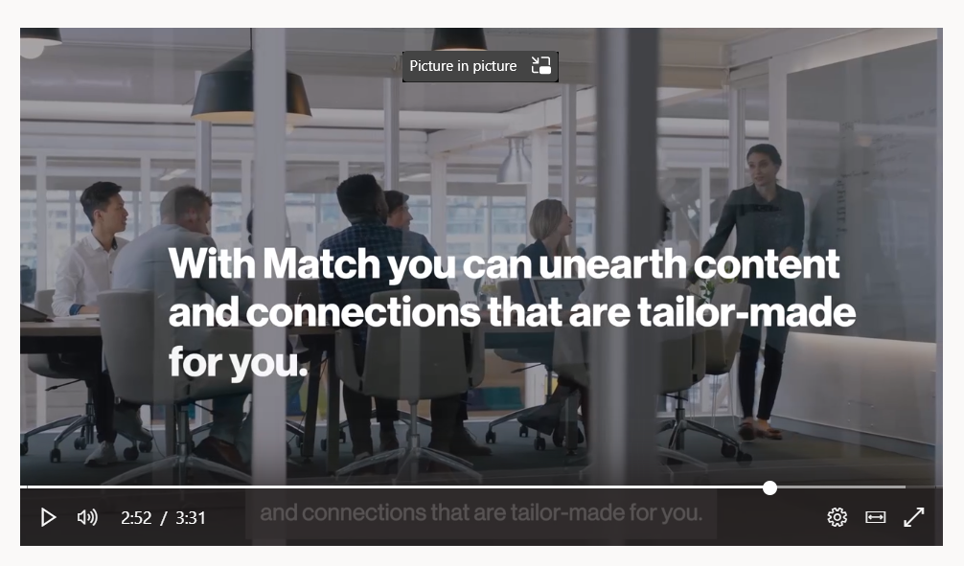
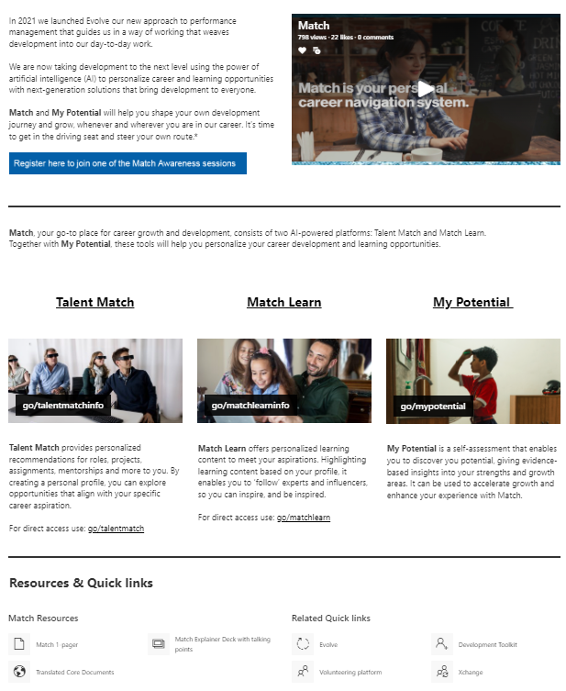
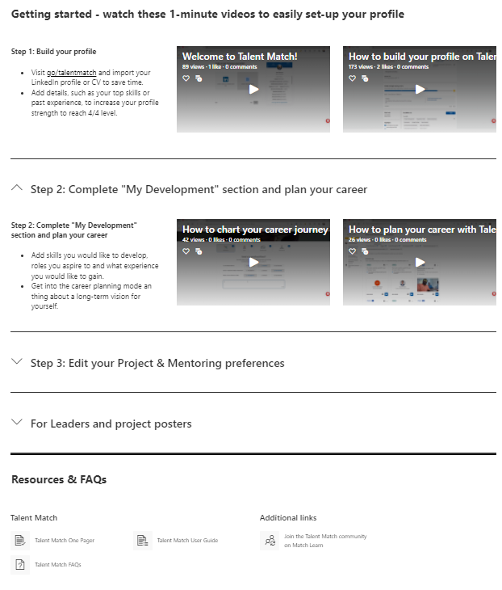
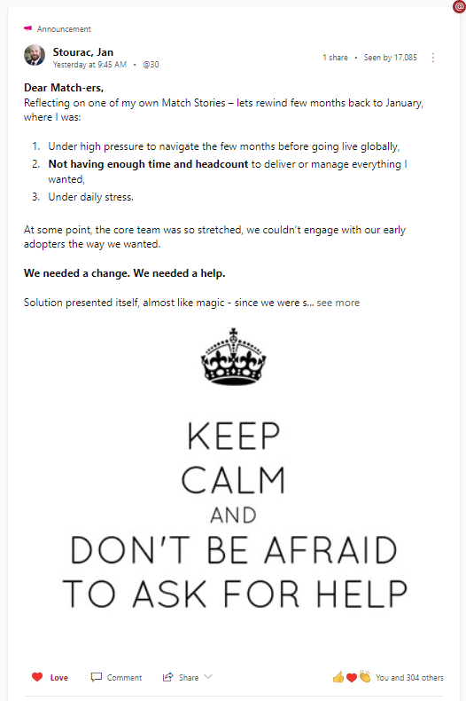
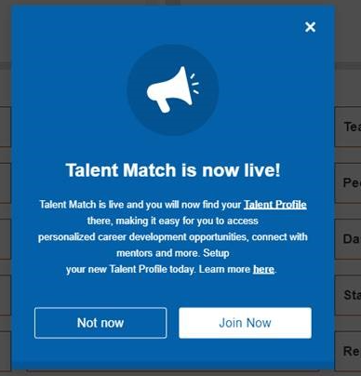
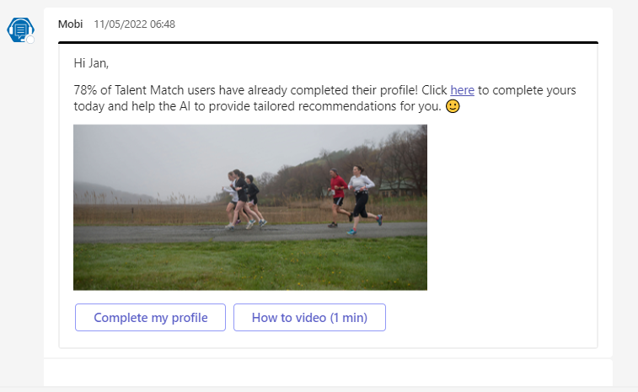
Examples
Novartis Intranet
Videos ¦ FAQ ¦ 1-Pager ¦ Guide
Yammer
Nudges

