Slide 1


Unleashing an Open Talent Market
Jean Pelletier
May 2021

Slide 2

Schneider Electric is leading the digital transformation of energy management and automation
Key figures for 2020
5%
of revenues spent on R&D
€25.2 bn
2020 FY revenues
72%
“Simplicity is the highest form of sophistication, and all design must be easily comprehensible and intelligible to the user.”
Jean Pelletier
VP, Digital Talent Transformation
Schneider Electric
Green Revenues*
128,500+
employees in over 100 countries
Page 2
© 2021 Schneider Electric. All Rights Reserved I
*Green Revenues definition: offers that bring energy, climate, or resource efficiency to customers, while not generating any significant harmful impact on the environment

Slide 3


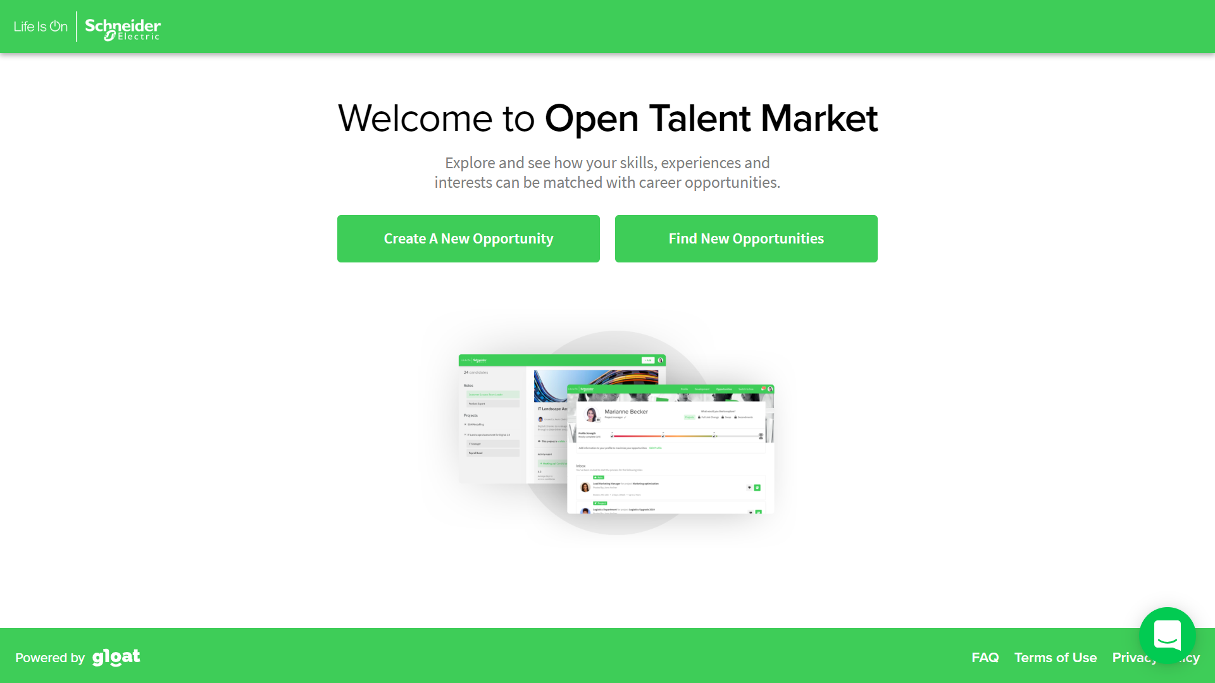
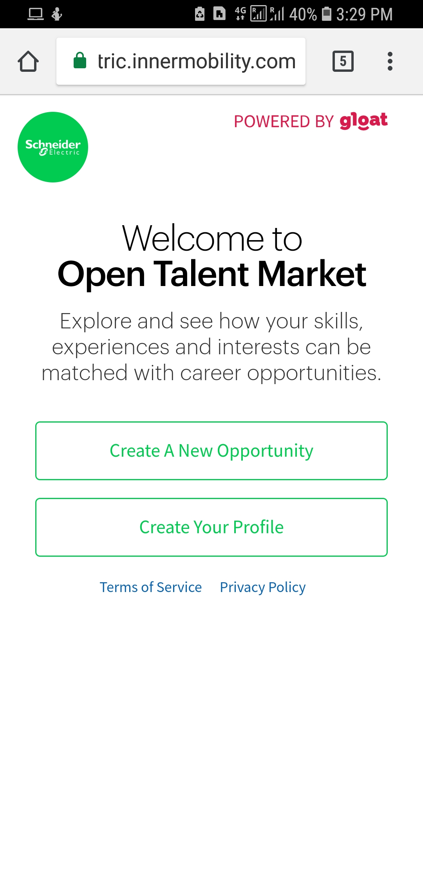
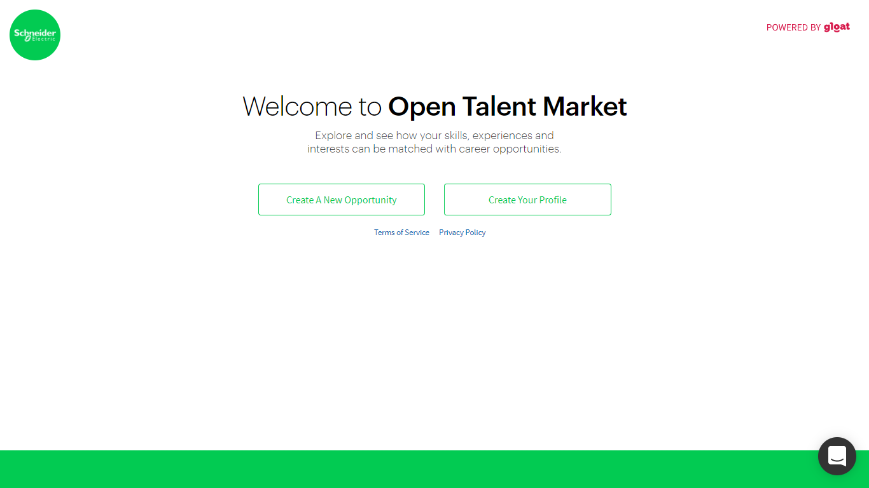

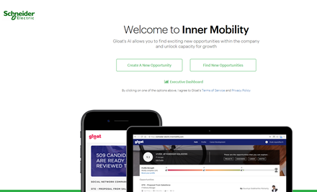

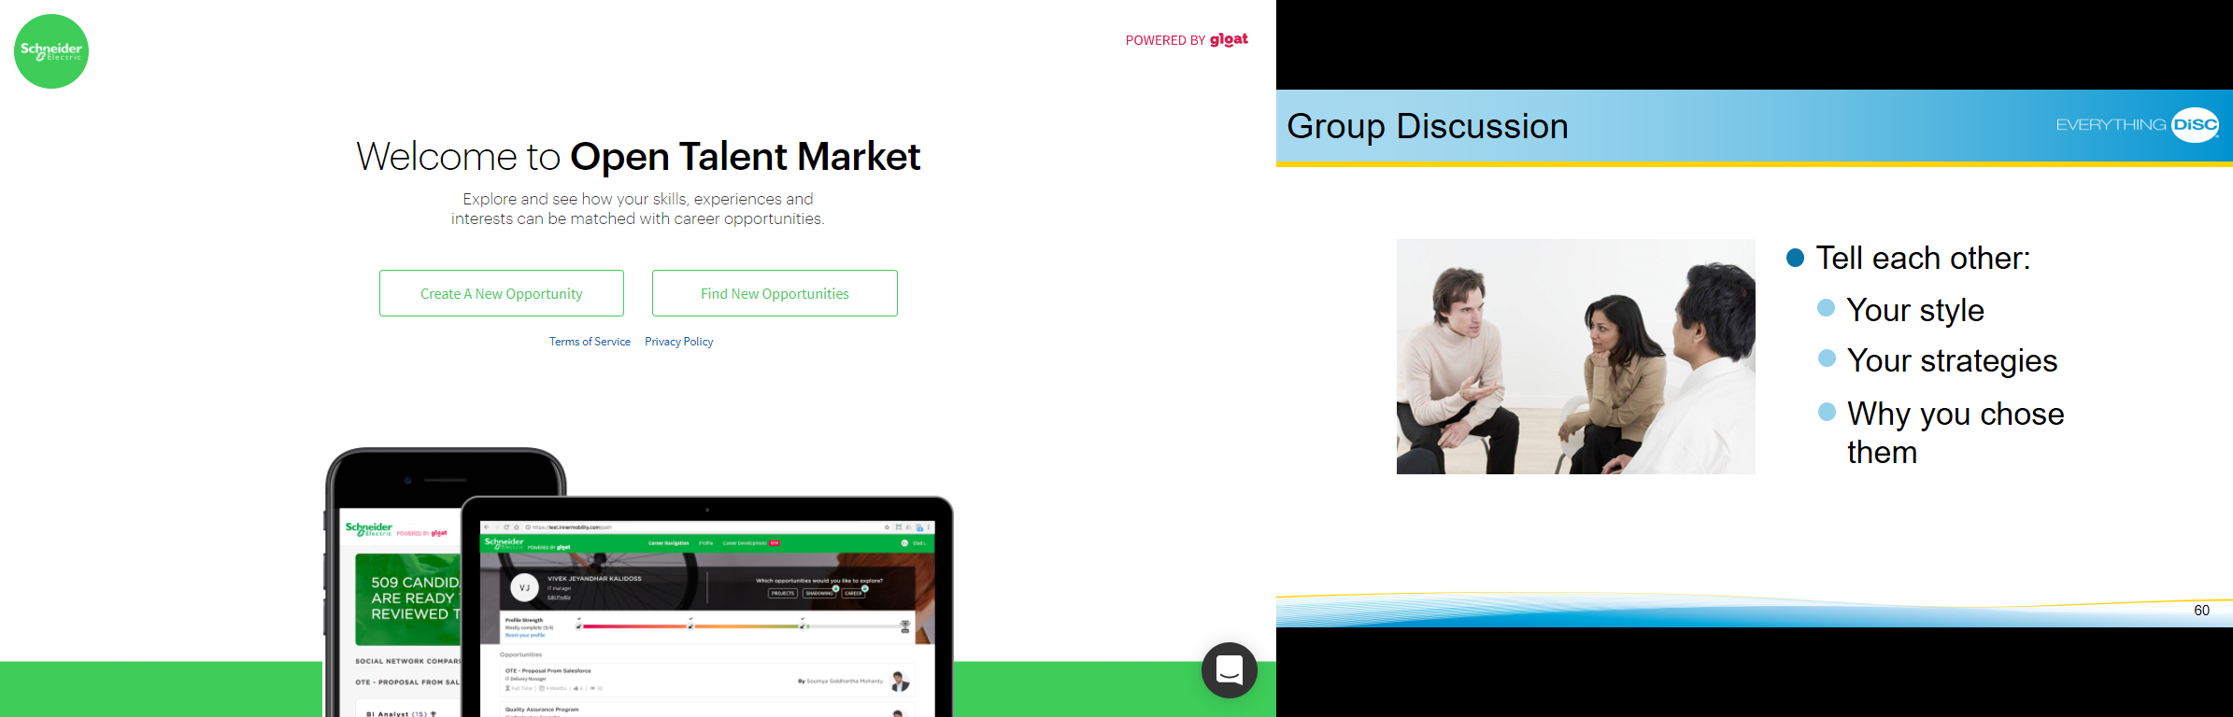


A digital, borderless, and transparent platform
Launched globally in May 2020, with versions in English, Spanish, French and Chinese.

Slide 4








OTM Journey
2019-2021
2019
March 2020
April 2020
May-Dec 2020
Q1 2021
Q2 2021
Q3 –Q4 2021
HR Community
Country based pilots
PIVOT To global Launch
Mandarin
Recruiter Role
Contract Negotiations
Global Change Network
Mobile App
Integrations
Skills Update & Analytics
Positions, Mentors, Projects
Career Planning & Succession Sourcing
Features Deployment
Confidential Property of Schneider Electric |
Page 4

Slide 5














AI is Changing the Landscape
By empowering employees to drive their career
Manager
HRBP
Job
Project
Peer
Mentor
TM
2 Weeks, 0 Matches
2 Mins, 3 Matches

Slide 6









OTM is disrupting the way we work for the better
PEOPLE
PROCESSES
SYSTEMS
Philosophy
You need to think about what this type of platform dos to your culture
Approvals
Adaption to no middle person. Links back to changes in roles.
Design rules
OTM is employee owned, customized for their needs.
No other access allowed, no validation actions. Consent needed for data to be moved.
Communications
Empower employees to drive their own careers; comms are blended to complement and support people strategy. Very rarely a stand-alone promotion;
Roles and responsibilities
These will change, for managers and HR
Architecture
OTM was architected for the employees. Not a campaign platform; not accessible to managers and HR
Registration
Key starting point to having the platform become part of your organization
Experiments
Think how to optimize the platform : Edison and Dare to disrupt innovation contest
Functionality
Leveraging all functionality. Positions, projects mentorship
Launching career planning

Slide 7
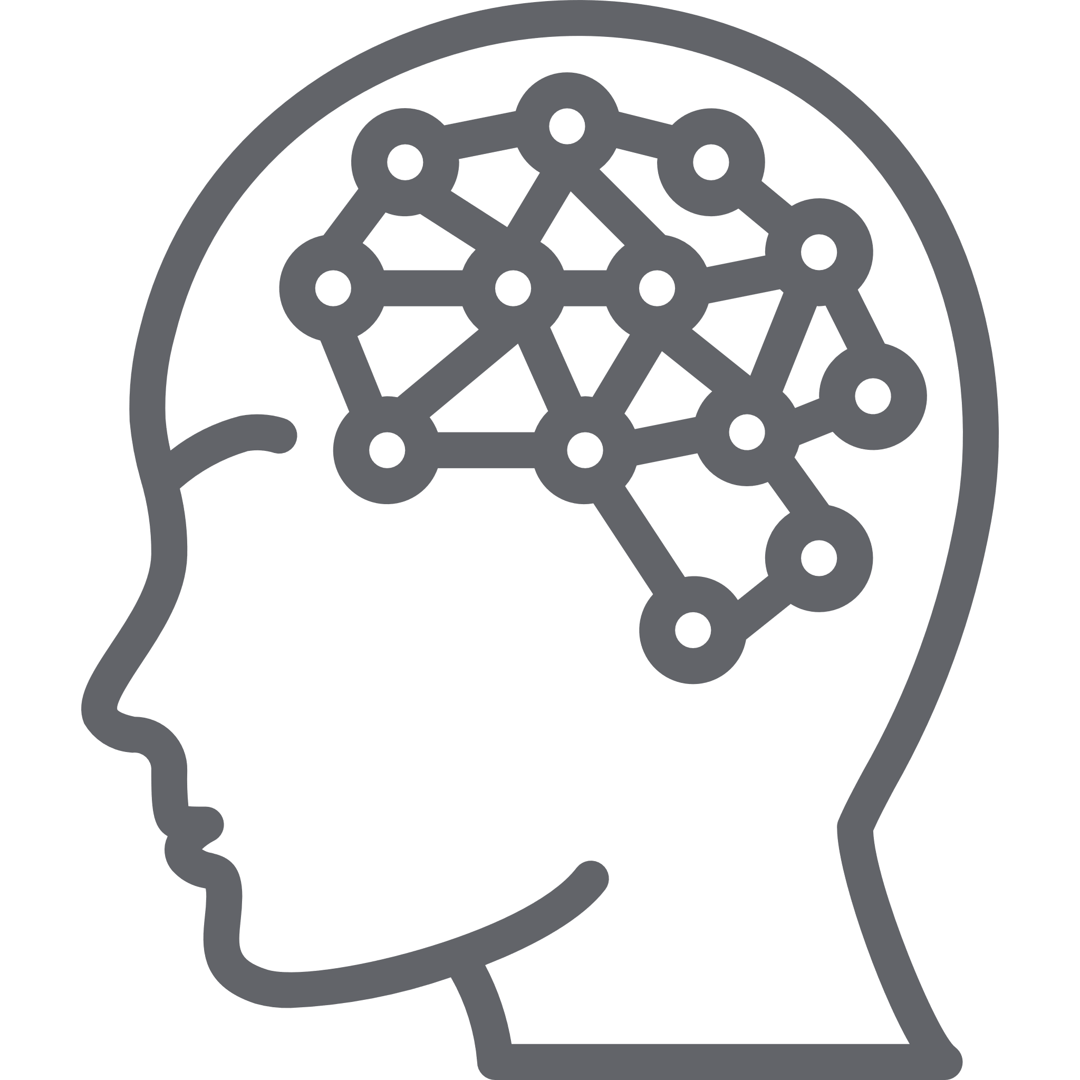



Lessons learned
jobs
projects
?
mentors
AI is a real game changer
AI can create connections and match employees to opportunities better and faster – while leveling the playing field.
OTM is a one-stop shop
OTM’s features (Positions, Projects, Mentorship) were key in its success. Next step will be career pathing and succession planning.
Employees are in the driver’s seat
Employees own their careers – through OTM, we have created a safe place for them to take charge and even experiment.
The role of HR is
evolving
As HR, we are rewriting our story to put the employee in the center of our design – creating a more agile workforce
More than a matchmaking tool, OTM is a mindset shift. We are putting employees in charge of their career development and creating our own gig economy in the process.

Slide 8
Questions & Answers

