Slide 1

Leveraging our Talent Marketplace to upskill our workforce
Andrea Korcekova, AD Strategic Workforce Planning & Insights
Sara Steiner, Gl. Hd Performance & Talent Development
November 29, 2023

Slide 2




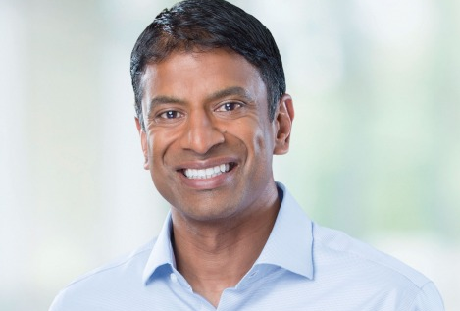
Novartis – we touch the lives of millions of people worldwide everyday
USD 40+ bn
NET SALES (2022)
140 COUNTRIES
where Novartis medicines are sold
250+ m PATIENTS
reached with Novartis medicines
70+ k EMPLOYEES
help to alleviate society's greatest disease burdens
We operate in a world where powerful forces are transforming healthcare
~ USD 10 bn
invested in research and development in 2022
(around 20% of group net sales)
Accelerating innovation in science & technology
Aging-related rise in chronic diseases
Increased demand for healthcare worldwide
CEO
Vasant (Vas) Narasimhan
ORGANIZATIONAL UNITS
International | US | Development | Biomedical Research | Operations | Supported by:
Global Functions
Talent Marketplace - Gloat Community Call

Slide 3

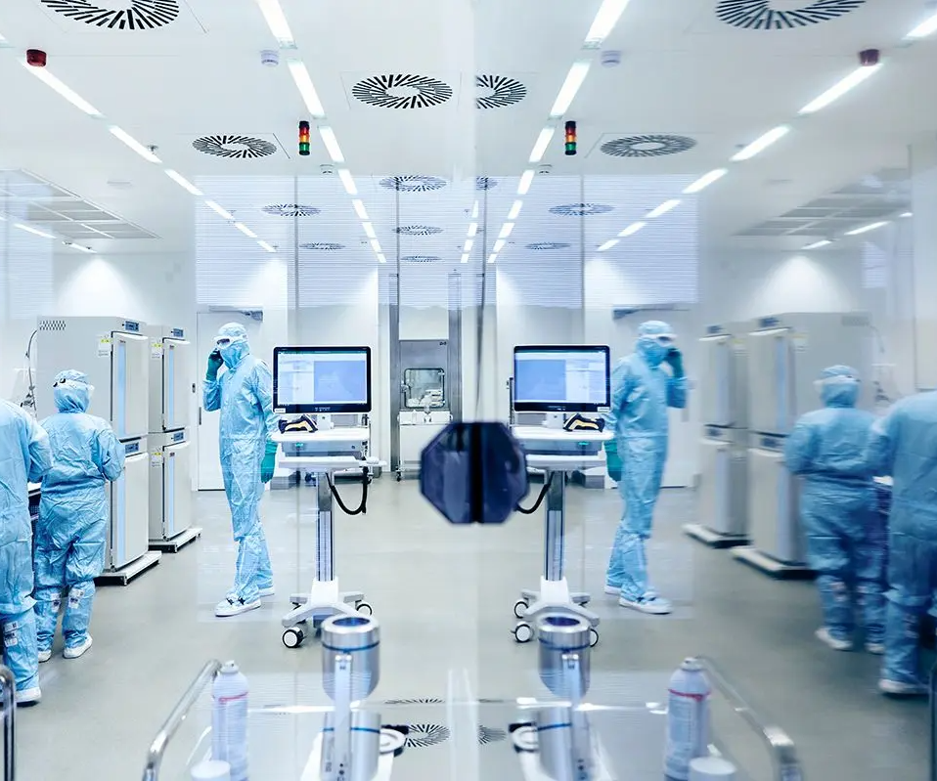

The Novartis Strategy is the starting point for our Talent Management Strategy
COMPANY STRATEGY
P&O STRATEGY
Where to play
OUR FOCUS
How to win
OUR PRIORITIES
Unleash the power of our people
to drive performance and deliver impact to reimagine medicine for our patients
5 core Therapeutic Areas
Cardiovascular, Renal & Metabolic (CRM); Immunology; Neuroscience; Oncology
Accelerate growth
Deliver high-value medicines (including launch excellence)
CULTURE
TALENT
2+3 technology platforms
Chemistry, Biotherapeutics
xRNA, Radioligand, Gene & Cell Therapy
Deliver returns
Embed operational excellence
TRANSFORMATION
4 priority geographies
US, China, Germany, Japan
Strengthen foundations
Unleash the power of our people
Scale data science and technology
Build trust with society

Slide 4



We are doubling down on our Novartis Talent Management Strategy to maximize talent impact
5 Big Bets ACCESS, GROW AND ENGAGE
Precision Talent
Leaders Of The Future
Talent Experience
Future-Ready
Workforce
Employer of Choice
Focus on the roles and teams that create the greatest value for Novartis
Assess and develop leaders with focus to accelerate performance today and tomorrow
Foster career & development for everyone to drive their careers and grow
Predict capabilities and skills needed in the future and build, buy, borrow them intentionally
Strengthen attractiveness as employer, both internally and externally, from early career to senior executives
Strategy Enablers
Talent
Intelligence
Skill Operating System
Data & Technology
Mindset & Capability
Talent Marketplace - Gloat Community Call

Slide 5
Why are we taking people development to the next level?
Inconsistent talent experiences create employee pain points:*
IN ORDER TO ADDRESS THIS, WE NEED TO:
80%
67%
50%
43%
Remove barriers between talent & opportunity
Future-proof our talent pipeline
Increase talent mobility
Leverage data and digital
Modernize employee experience
Personalize recommendations
Lack of visibility of career opportunities outside own domain
Career development depends on my manager
Unaware of future skills they need to develop
Struggle find personalized learning
Associates...
... leaving for lack of career opportunities is the highest reason within company control for Novartis!
... are dependent on their manager for career develop-ment conversations
...are unaware of future skills they need to develop
... are struggling to find personalized learning
* Employee Experience Survey 2020 & Exit Survey 2021
Talent Marketplace - Gloat Community Call

Slide 6
Creating impact through our Growth & Development journey
ONE END-TO-END GROWTH JOURNEY
for all our people, helping them to grow, take ownership of their career and unleash their potential
MY POTENTIAL
DISCOVER my foundational potential, objectively
IDENTIFY my strengths and opportunities
INCREASE my self-awareness and focus for development
MY DEVELOPMENT*
PLAN my development based on my aspirations and capture key development objective
CONSIDER growth opportunities recommended to me
CONNECT with my mentors and learn from others
MY IMPACT***
SETTING objectives that drive short-term deliverables and long-term aspirations
SEEK AND PROVIDE regular feedback in check-ins
RECEIVE recognition and rewards for my impact
MY LEARNING**
IDENTIFY interests for my skill building
FIND best learning resources
SHARE my unique knowledge with others
Internal names: * Talent Match, ** Match Learn, *** Evolve Reimagined Performance Management

Slide 7
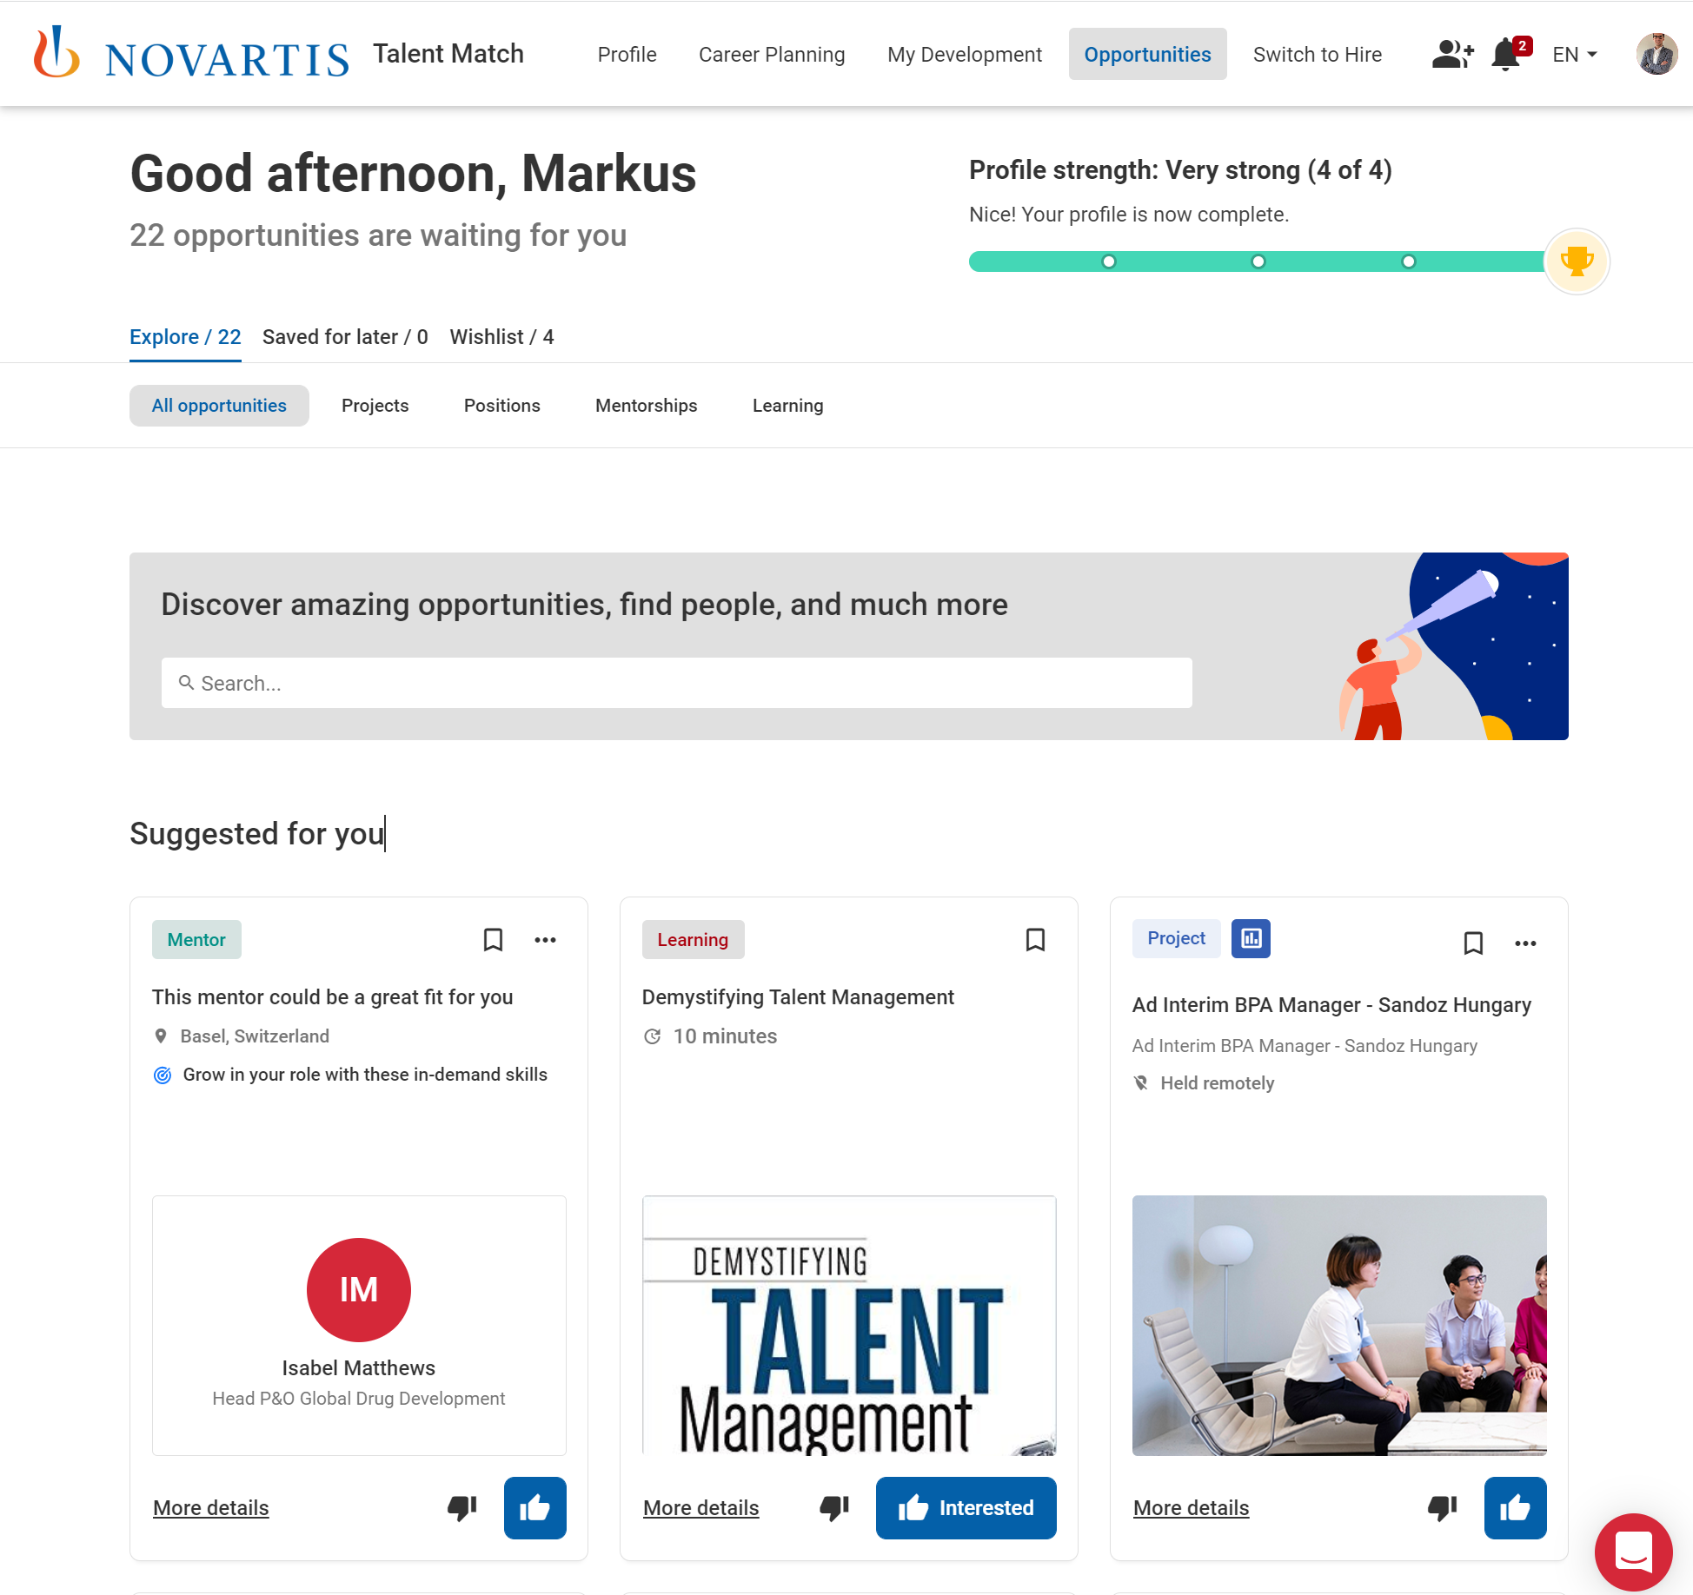
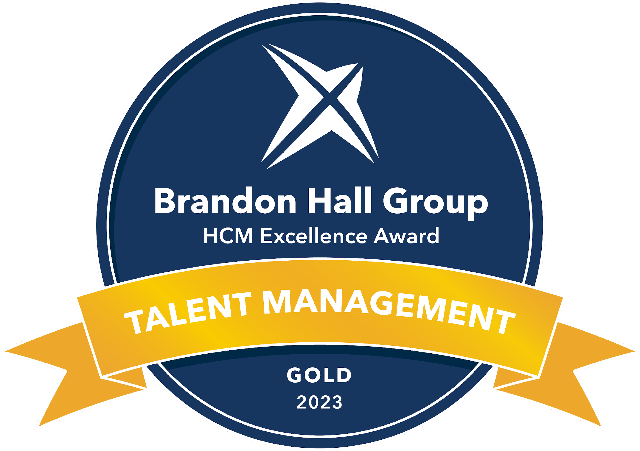
Our Talent Marketplace, Talent Match provides personalized recommendations to everyone, thanks to AI
Match provides personalized recommendations for new roles, projects, short-term assignments and mentoring, giving every associate at Novartis the opportunity to actively drive their career and ultimately unleash their power.

Slide 8
Change in mindset & practice is required
PRECISION TALENT
CRITICAL FOR SUCCESS...
SHIFTING MINDSETS
CLEAR MANAGER EXPECTATIONS
LEADERSHIP
SUPPORT
INTUITIVE TECHNOLOGY THAT DRIVES EXPERIENCE
DATA INTEGRITY & AI
INTEGRATION WITH LEARNING & REWARDS
Talent Marketplace - Gloat Community Call

Slide 9


Nearly two years of data show that Talent Match also relates to real-life outcomes
PROMOTION
Associates actively using Match and being assigned to projects are 51% more likely to be promoted. Associates using Match but not being assigned to projects are still 6% more likely to be promoted than a representative group of non-Match users.
PROMOTION
Lateral moves are 126% more likely for associates that actively use Talent Match and have been assigned to a project. Associates using Match but not engaged in a project are still 14% more likely to have a lateral move compared to non-Match users.
RETENTION
Match users engaged in projects are 73% less likely to leave Novartis and active Talent Match users not engaged in projects are 56% likely to leave, than the Novartis baseline.
VOLUNTARY ATTRITION, JAN 2022 - PRESENT
% OF MATCH USERS PROMOTED JAN 2022 – PRESENT VS REPRESENTIVE NVS PEERS
LATERAL MOVES JAN 2022 -PRESENT,
% OF MATCH USERS VS REPRESENTATIVE NVS PEERS
GENDER EQUALITY
Men and women benefit equally from the opportunities
Sources: Talent Match and Firstport, March 2023
Representative Sample consists of 10,000 associates stratified by age, country, and GJFA level, proportionality similar to the match study sample.
Note. Successful use of Match is correlated with promotions and lateral moves. Matched associates are promoted and/or have made lateral moves at higher rate than representative comparison group. This effect can also be attributed to multiple factors, such as motivation, activity and entrepreneur spirit. Data set for gender is limited.

Slide 10
Zooming in on Skills & our work with Finance

Slide 11
Skills are the key enabler to unlock talent centric P&O solutions
Skills as currency for all building blocks of HR solutions...
... to enable an integrated talent experience for our pepole
Job Architecture
Mentoring
Learning & Development
Rewards
Job Postings
Learning Content
Skills to Jobs
Skills to Growth
Strategic Workforce Planning
Talent Acquisition
Positions
SKILLS
Gig Work
Learning Analytics
TALENT
Precision Talent
Talent Analytics
Organization
Capability Building
Candidates
Skills to People
Associates
Career Pathing & Planning
Performance Management

Slide 12
In 2021, we sliced the “skills topic” to 5 areas which allowed us to progress in targeted and tangible way
Skill Taxonomy
Data Architecture & Skill Intelligence
Skills to People
Skills to Jobs
Skills to Growth
Provide one shared language for skills
Building an inter-operable skills data architecture, allowing for talent and skill insights
Understand the skills we have (includes skill assessment)
Sustainably link skills to roles
Curate the most meaningful skill-building portfolio
(in hands of our Learning team )

Slide 13
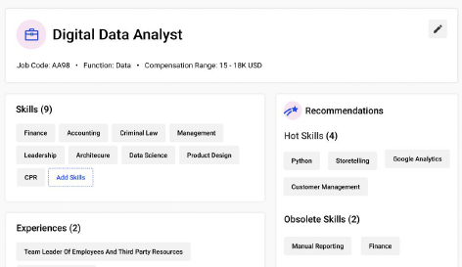
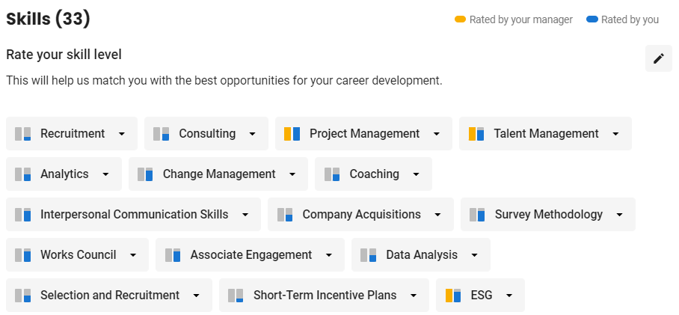
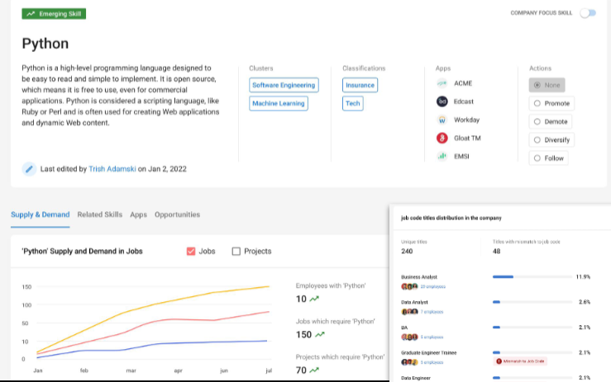
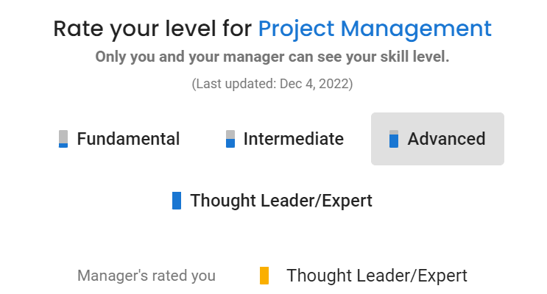
Match is centered around the capabilites, roles and skills needed to accelerate the transformation...
Job Architecture
Proficiency Levels
This module was deployed in parallel to running the Finance Use Case (see later slides)
Talent Marketplace - Gloat Community Call

Slide 14
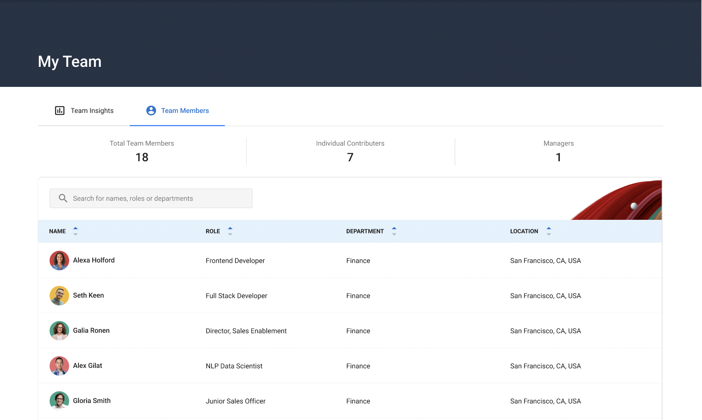
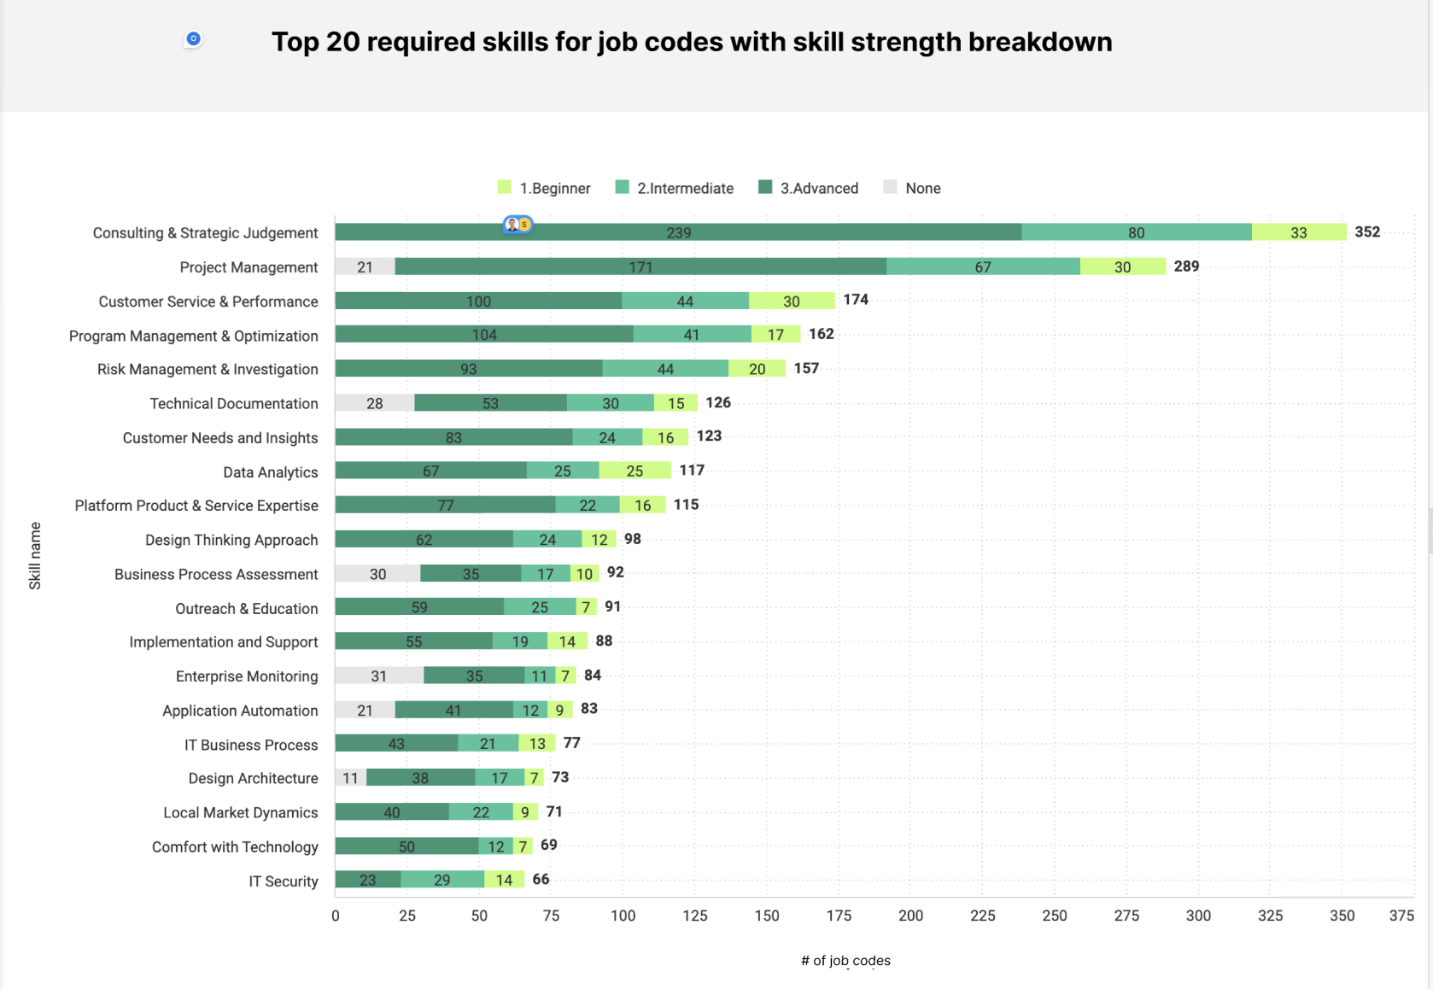
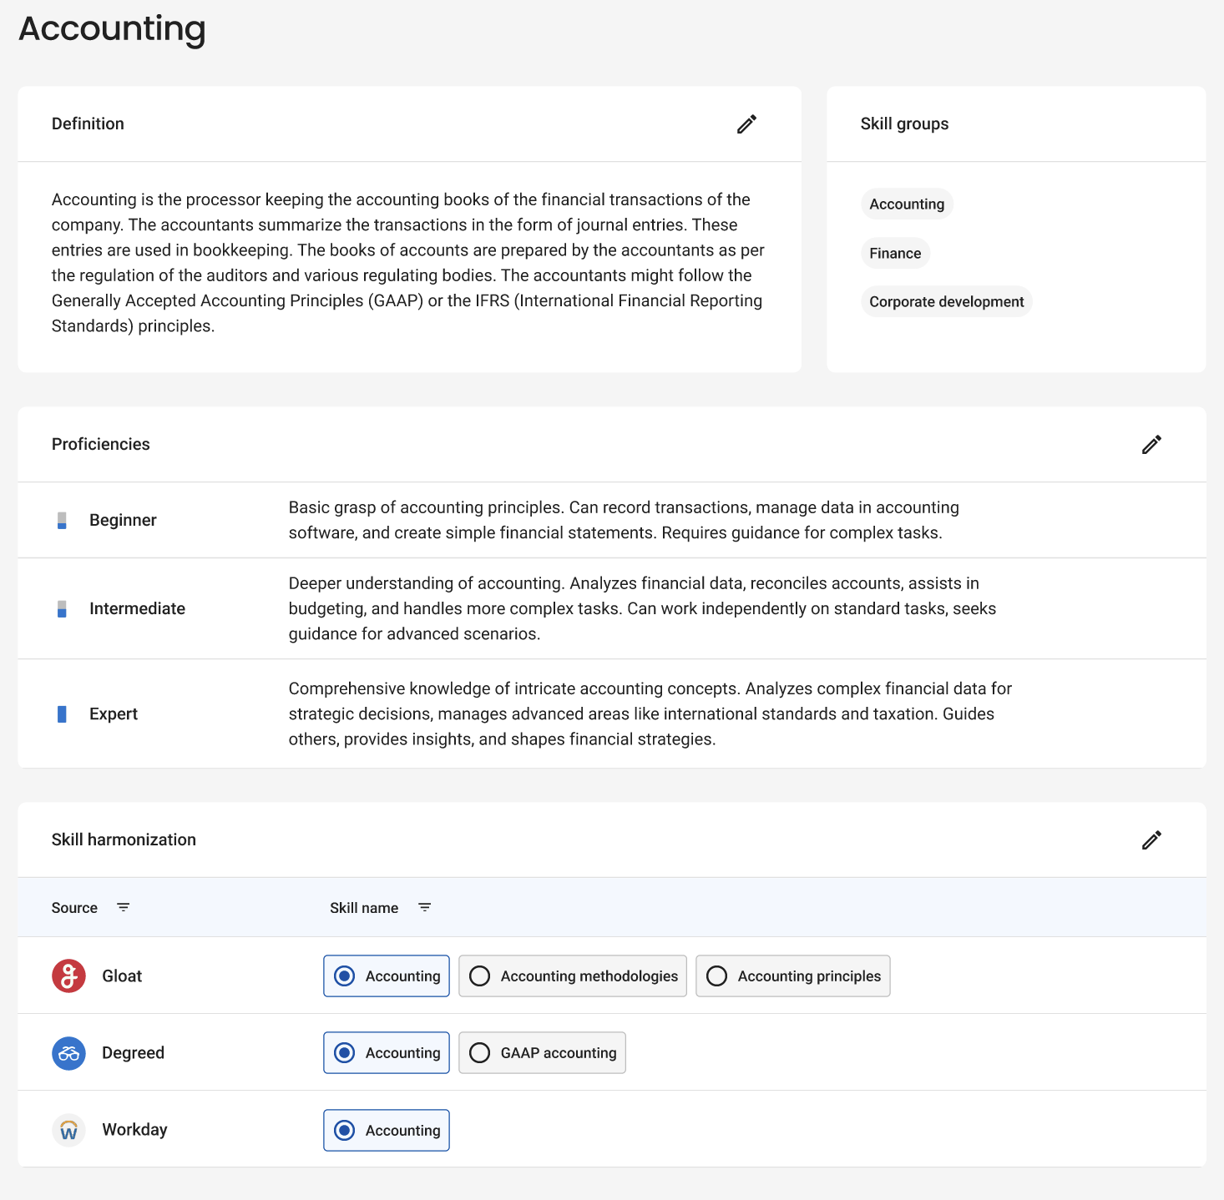
...and enables insights to make better, faster decisions to win in the marketplace
Manager Dashboard
Skills Foundation*
*currently being deployed
Talent Marketplace - Gloat Community Call

Slide 15
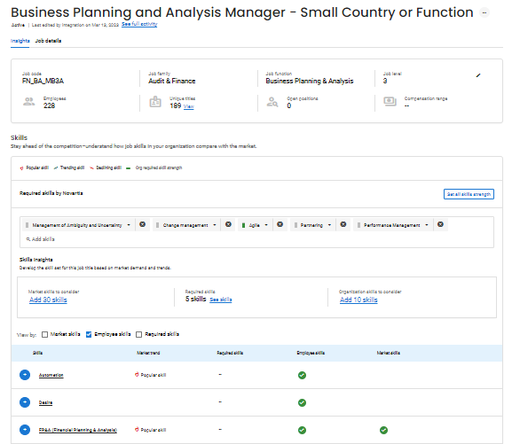

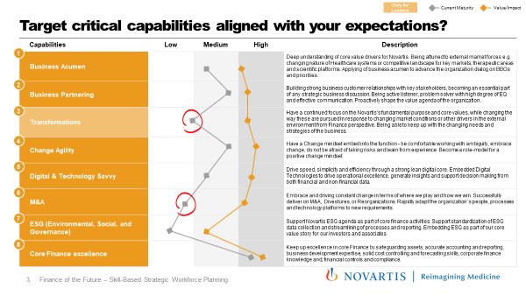
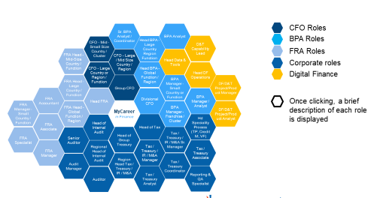
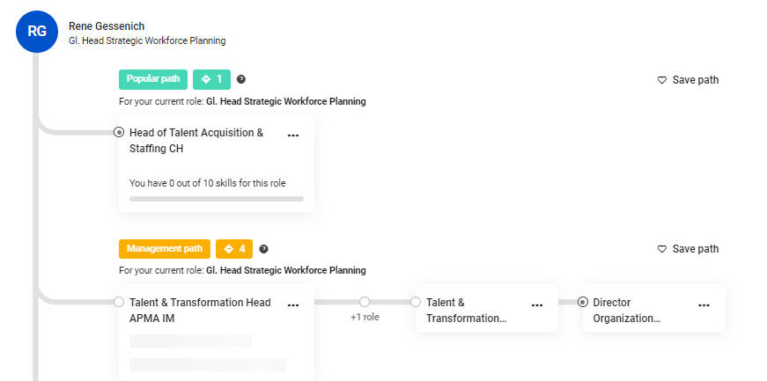

Example: My career in Finance project plan
1
2
DEFINE FUTURE CRITICAL SKILLS & CAPABILITIES AND CURRENT GAPS
DEFINE STRATEGIES ON HOW TO CLOSE THE GAPS (e.g. career pathing, career stories, etc..)
Capabilities
Career path / other strategies to close the gaps
January
February
March
April
May
GO LIVE
June onwards
A
B
C
D
E
D
Measurement Framework
Target Critical Capabilities
Capability & Skills to Role Mapping
High-level career pathing options and career stories
AI recommended paths in Match
CFO-led Communication to associates
Talent Marketplace - Gloat Community Call

Slide 16
Final list of Finance Capabilities and Skills
Capabilities | Description | Skills
Shareholder Value Creation | Shape the value agenda for the organization by possessing a strong analytical skills, understanding value drivers, value modeling, external orientation (healthcare systems, science/therapeutic areas, competition), making decisions and taking smart risks. | Strategic decision making Critical thinking Rapid problem solving Market understanding Understanding value drivers Planning & analysis Option analysis Decision support Resource allocation
Leading Change | Adapt the business and organization to changing external and internal conditions through a strategic thinking & vision, effective communication, resilience, stakeholder management, managing ambiguity and complexity. Have a Change mindset embedded into the function - be comfortable working with ambiguity, embrace change, do not be afraid of taking risks and learn from experience. | Managing Ambiguity Resilience Ability to influence key stakeholders Embracing Change Effective Communications
Operational Excellence | Drive organization and process simplification, continuous improvement and productivity through a strong lean digital core. Leverage data & digital to drive operational excellence, generate insights and support decision making from both financial and non-financial data. | Process Optimization E2E Process view Continuous Process Improvement AI driven insight generation Data Cleansing / Normalization Data visualization
People management | Develop talent, coach, provide constructive feedback, build and motivate high-performance teams, provide high challenge/high support climate where people grow. | Coaching Self-awareness Building Effective teams People development Employee engagement Giving And Receiving Feedback Interpersonal Savvy
Accounting, Financial & ESG reporting, Controls & Compliance | Keep up excellence in core Finance by safeguarding assets, accurate accounting and reporting, strong financial controls & compliance, and supporting standardization of ESG data collection and streamlining of ESG processes and reporting. | Financial Accounting Financial and management reporting Compliance and controls ESG data management ESG reporting
Corporate Finance | Keep excellence in Corporate Finance disciplines including Tax and Treasury, successfully deliver on M&A, Divestures, or Reorganizations. | Corporate governance Capital allocation Tax Treasury Mergers & Acquisitions (M&A) PMI (Post-merger integration)
1
2
3
4
5
6

Slide 17
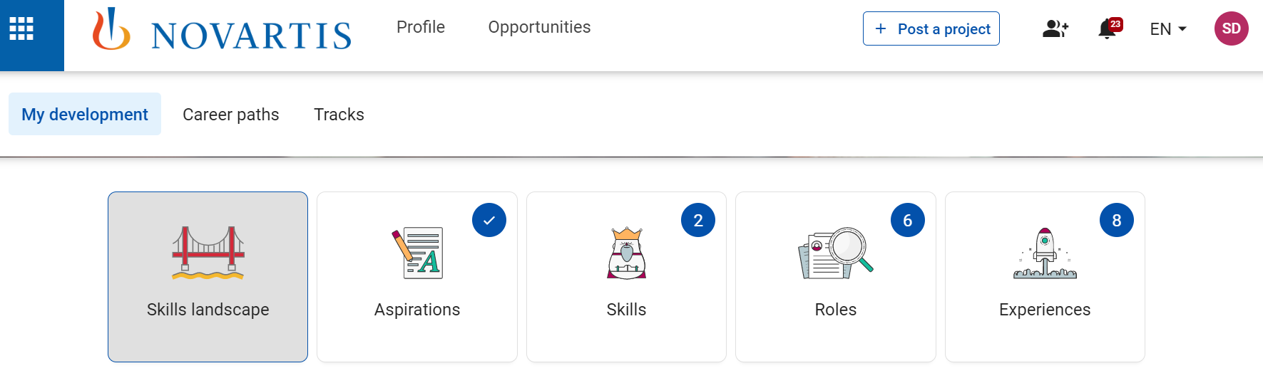
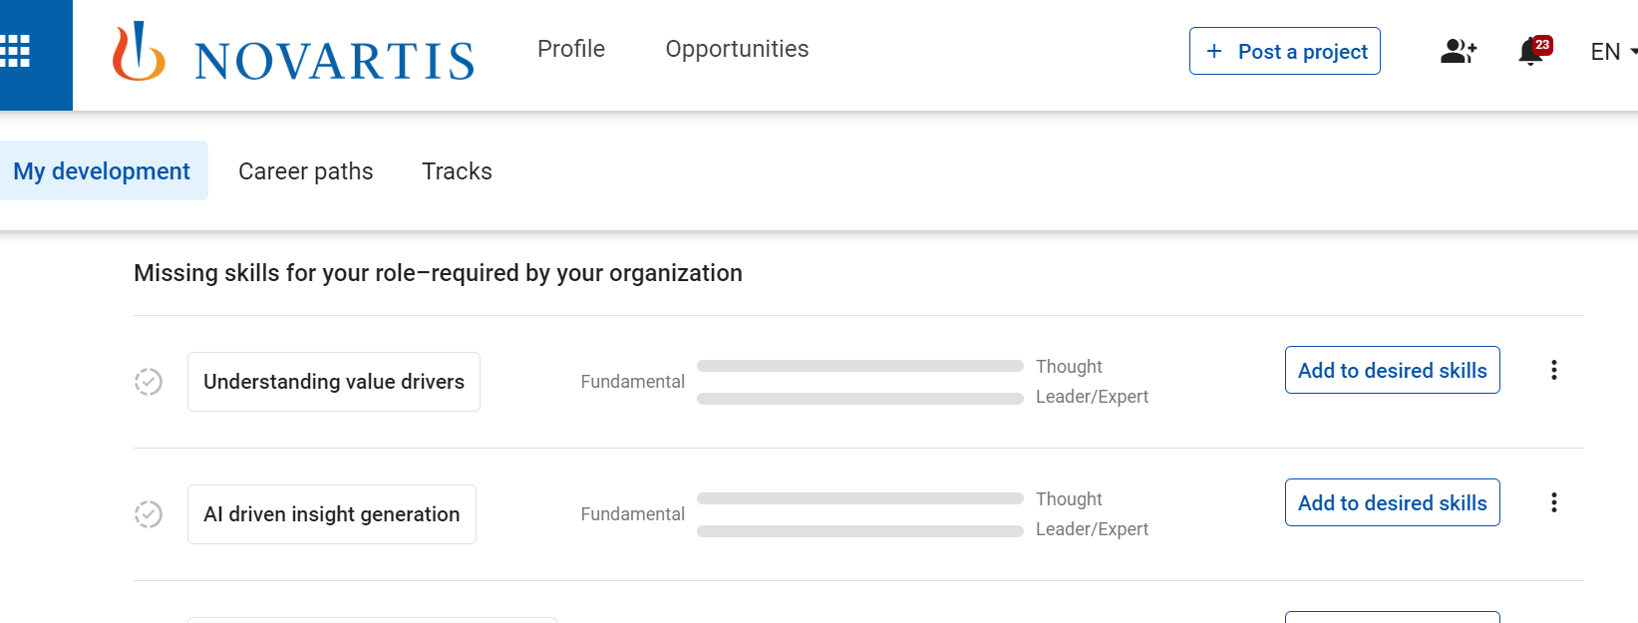
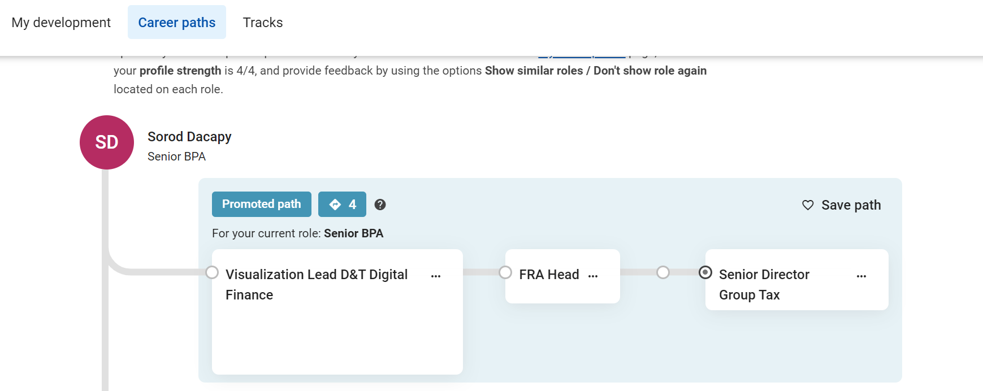
Embedding of My Career in Finance project’s deliverables into Talent Match
Results of My Career in Finance project are visible in Talent Match in 2 places:
1. Skills landscape: ability to see required skills for your role
2. Promoted paths: career pathing tailored manually only for Finance associates (on top of AI-driven paths)
Talent Marketplace - Gloat Community Call

Slide 18
Final list of roles for career pathing opportunities
CFO - Mid - Small Size Country / Cluster
Director Internal Audit Function / Region / Specialty
CFO - Large Country or Region
CFO
Senior Manager Internal Audit
Head Internal Audit Function / Region / Unit
CFO - Large / Mid Size Country / Cluster
BPA
FRA Head Function / Region / Process
Novartis CFO
Head BPA / Head Finance Mid-Size Function/Unit
FRA
Unit CFO
Associate Director / Senior BPA
Corporate
FRA Head - Mid-Size Country / Function / Process
Head FRA
Digital Finance
FRA Specialist
FRA Head - Large Country / Function / Process
MyCareer
in Finance
Head BPA
Unit / Head Finance Large Function
(Senior) Financial Analyst
Internal Audit
FRA Manager / Team Lead
Head Treasury
Head BPA & Digital Finance
(Senior) BPA Manager
FRA Manager - Small Country / Function / Process
Head Tax & Insurance
Head BPA / Director Finance Small Function/Unit
FRA Associate
Senior Manager Tax / Treasury & M&A
Head Tools / Operations / Hub
Team Lead Treasury/Tax
(Executive) Director IR / M&A
D&T Capability Lead
Manager Tax / Treasury / M&A
DF/D&T Project/Product Manager / Analyst
Talent Marketplace - Gloat Community Call

Slide 19

Final thoughts & Lessons Learned
Leadership support matters: great support from CFO; work addressed a business need
Joined ownership: Active collaboration between business & HR
Today: Opportunity to leverage Skills Foundation for future projects
Conscious decision to leverage Promoted Paths (high workload if you are using paths on a position level)

Slide 20
Thank you
Andrea Korcekova
Sara Steiner

