Slide 1

Sustaining Adoption & Building a Change Network
Internal Talent Marketplace
Gloat Customer Community April 18, 2024
Confidential Property of Schneider Electric |
Page 1

Slide 2
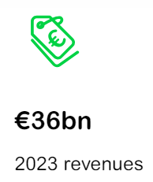
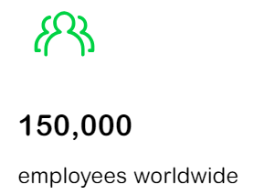

Who is Schneider Electric?
We are leading the digital transformation of energy management and automation.
We have operations in more than 100 countries
Our purpose is to empower all to make the most of our energy and resources, bridging progress and sustainability for all.
We call this Life Is On.​
NOTE: We only target 100k connected employees with our talent marketplace

Slide 3













Our Talent Marketplace Journey
May 2020
June 2021
Q1 2022
H2 2022
H1 2024
2019 – Q1 2020
H2 2020 / H1 2021
H2 2021
Q2 2022
H1 2023
Global HR Community
Global Dept and Country based pilots
Global Launch after Covid forced remote working
Training & Change Management
Career Paths (longer term)
Acceleration on adoption / usage
Succession Sourcing
Career Tracks (shorter term)
Access to Data
Employee Skills Proficiency &
Profile visibility
Learning Opportunities
Positions, Mentors, Projects Opps
Adoption, Career Planning & Succession Sourcing
Data
Skills
Learning
Platform available in English, French, Spanish, Chinese, Portuguese, German, Russian
Confidential Property of Schneider Electric |
Page 3

Slide 4


Managing your Internal Talent Marketplace
End of March 2024
Global adoption and Usage
Adoption
Lifetime Usage
90%
of connected employees registered
(~ 93k)
~ 35k
Total talent impacted
~11k
Assigned to part-time project roles
>23k
Visitors per month
57% Robust Profiles
(72% for “onboarded”)
47% My Development
Completions
~3k
Offered full-time positions
~ 730k
Unlocked hours by existing resources
~21k
Assigned to mentorship relationships

Slide 5
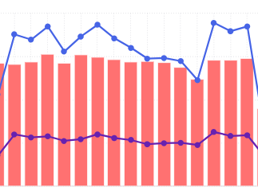


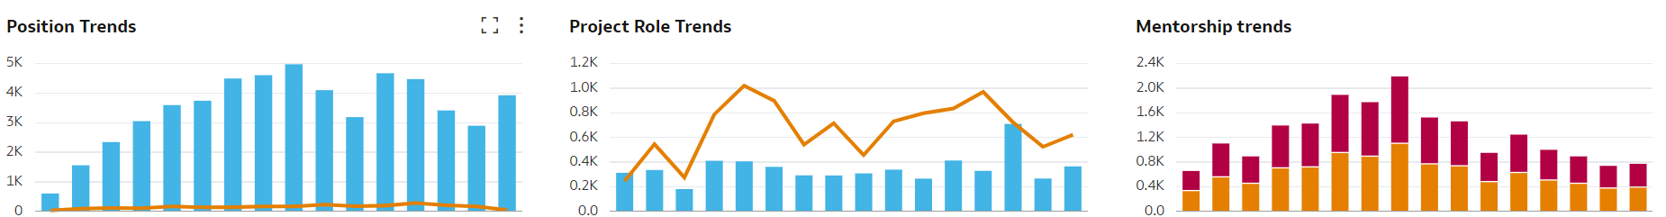
The Monthly “Heartbeat” of OTM Usage
ON
Career Development
Supporting Always
May 2023
Q1 2024
Monthly visits decreased after loss of internal comms (IC) support in May 2023 but reached all time high in Q1 2024 thanks to return of IC support and targeted campaign to non-registered
Visits
Assignments
Quarterly Trends
Blue = Created Orange / Red = Assigned
Q2
2020
Q1
2024
Q2
2020
Q1
2024
Q2
2020
Q1
2024

Slide 6








Managing your Internal Talent Marketplace
Tips for Sustaining Adoption
Remind users about the importance of visiting often
Keep Profile up-to-date
Complete / update My Development section
Opportunities available change daily
Teach the AI
Constantly Find New Ways to Use the Tool
Introduce New features
Innovative Project Use cases
Utilize Opportunity targeting
Cover extended leave of absences

Slide 7




Managing your Internal Talent Marketplace
Biggest Lessons Learned for Sustaining Adoption
jobs
projects
mentors
Implementing a Change Network is key
The introduction of a talent marketplace is more than just a short-term project
Having a dedicated person (team)
is essential to long term success
Never stop communicating
You can’t just “Build it and they will Come"

Slide 8
Formalize the Structure of your Change Network
OTM Global Community Network of Champions
Our ambition is to have a network of champions that animate and support the Open Talent Market who are closer to employees in the business, functions or regions to ensure they are aware of Schneider’s Talent Philosophy and how the tool (OTM) can assist with their career development efforts and help enable them to reach their fullest potential.
Global Support Team
TA, TM, Internal Communications, Learning, HRS/ASAE, People Analytics
GLOBAL ENTITIES
Required
Energy Management
Industrial Automation
Optional
Schneider Digital
Global Marketing
Global HR
Finance
GSC
Strategy & Sustainability
Innovation
Governance
NAM
Region Lead
China
Region Lead
France
Region Lead
Europe
Region Lead
International
Region Lead
Required
REGIONAL
Optional
Local Champions
Local Champions
Local Champions
*Local Champions
*Local Champions
* Regional lead may opt to assign local leads to support by Zone / Country

Slide 9
Ensure that the Purpose of the Change Network is clear
To achieve our targets around adoption and usage of the Open Talent Market (OTM) platform, we will need Global and Regional / Local teams to partner on rolling out enhancements/updates, communications as well as planning and completing training.
GLOBAL
REGIONAL / LOCAL
Overview
Through alignment of people, process and systems, the Global OTM Community will embrace Schneider’s global talent philosophy and ensure our employees are aware and empowered to drive their own career development.
Organization
Led by the Global OTM Lead to share knowledge, assets, best practices, and platform updates with the regions and business units
Comprised of the Global OTM Lead, Global OTM Support Team (product owner, internal technical support, change management lead), Global Entity Stakeholders and representatives from TA, TM, and Learning
Members will participate in monthly community call
Overview
Through guidance and support from the Global Team, the Local Community will help promote adoption and usage of the platform in alignment with the stated KPIs as well as remain informed of the plans for new features / functionality to ensure our employees are aware and empowered to drive their own career development.
Organization
Each Region Lead will own their local strategy to ensure OTM is adopted and supported within their area of responsibility
Regions can have additional local leads as needed
Regional leads will participate in monthly community call

Slide 10





Define the Roles and Responsibilities and Time Commitment
of Members in the Change Network
Point Of Contact (POC) for respective entity
Appointed by the HRC as the
main stakeholder for the entity
Entity Stakeholders
Be informed as stakeholders
Become SME in this space
Champion OTM within entity
Ensure partnership with all region leads
Influence local strategies as voice of the entity
Support regional / local OTM teams for their ongoing strategy
Support entity success against KPI targets
Capacity Needed: 1% of time
Support local team strategies on continuous improvement opportunities

Slide 11





Define the Roles and Responsibilities and Time Commitment
of Members in the Change Network
Point of contact for Region teams
(Connection to global)
Appointed by the HRC as the
main lead for the region
Regional Lead
Be informed
Become SME in this space
Manage and organize regional support including change management and communication
Champion OTM within region
Drive all things OTM in their regional scope
Act as the voice of the region
Keep global support team and entity stakeholders informed
Build and execute ongoing local initiatives around OTM
Identify regional success measurements aligned to overall strategy
Capacity Needed: 5% of time
Identify and share any continuous improvement opportunities

Slide 12


Define the Roles and Responsibilities and Time Commitment
of Members in the Change Network
Local point of contact supporting regional lead
Appointed by the regional lead
Local Lead
OTM sourced volunteers at the local level that the regional leads leverage to spread the word about OTM as well as cascade communications and change management or conduct training.
Help execute local initiatives around OTM
Support local success against KPIs
Capacity Needed: Dependent on
regional needs
Identify and share any continuous improvement opportunities

Slide 13

Managing your Internal Talent Marketplace
10 Tips for a Successful Change Network
Create a sense of community
Encourage friendly competition
Formalize Champion onboarding
Encourage them to create a team to support them via a Project various roles
Communications, Analytics, Training
Provide regular updates (we have a monthly meeting)
Establish communication channels (we use Teams)
Provide base content for them to localize as needed (FAQs, PPTs, how to videos)
Store the content in a place that is easy to find / navigate (we use Sharepoint)
Recognize their successes
Give them visibility to data so they can draw their own insights

Slide 14




Managing your Internal Talent Marketplace
Biggest Lessons Learned for Establishing your Change Network
Seek sponsorship from leaders to name champions champions
Set realistic expectations
Give them the chance to share best practices
Be willing to support their campaigns
Remember…
It is not their daily job but instead a development opportunity

Slide 15
Managing your Internal Talent Marketplace
Establishing your Change Network
Impact we have seen since launching a change network in Q4 2021
+ 40%
42k new Registrations
3.4k new Project Roles created
6.9 new Project Role assignments
+ 58%
Total Talent
Impacted!
+ 136%
1.8 new Position assignments
12.5 new Mentorship assignments
+ 51%

