Slide 1
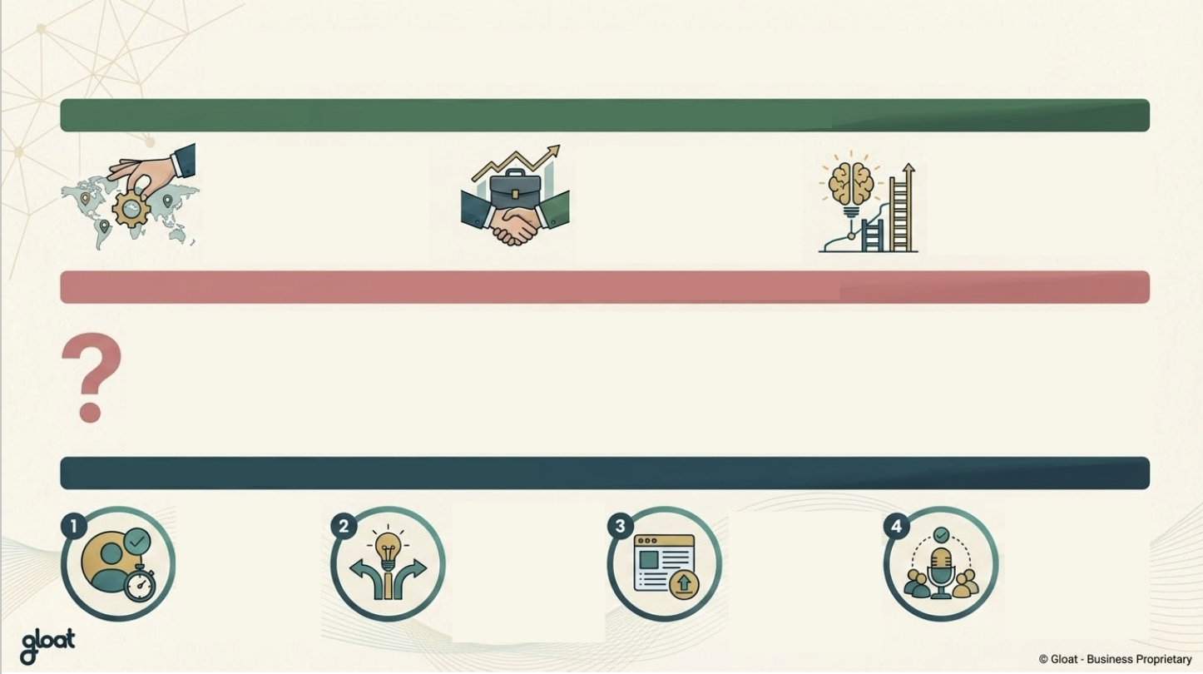
Using the Marketplace as a Manager
To Post Work
Instantly find people across the organisation with the skills & capacity you need with no extra budget required
To Advertise Positions
Internal candidates require less ramp up time so you can fill gaps more quickly
To Develop Your Team
Use AI to recommend relevant opportunities across the company for your team
I have a vacancy on my team:
I’m struggling with a problem:
I’m looking for a specific skill-set:
I’m looking for ways to develop my team:
Publish a piece of work to access resource in the meantime
Publish a piece of work to access diverse perspectives and understand global best practice
Search by skill on the Talent Marketplace to see in seconds where capability already exists
Encourage employees to create a profile and explore opportunities as part of their development plans
Register here (insert link) and validate your skills to create a profile in less than 5 mins
Shift away from tapping your ‘go-to’ roster of people and post a piece of work on the marketplace
Use Gloat’s AI to turn your idea into a project description & publish to find relevant candidates
Speak to your team members about the marketplace in 1-1s and/or in your next team meeting

