Slide 1
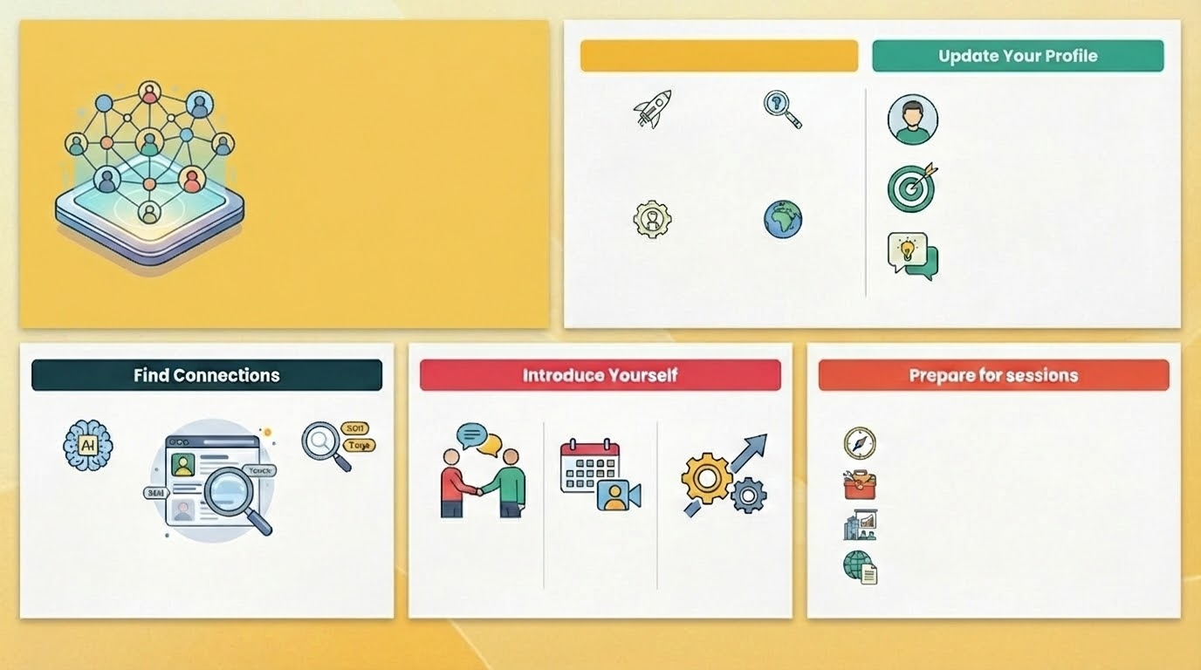
Why Network?
Step 1: Update Your Profile
Tell us about your career so far by completing your Gloat Profile
Networking on the Talent Marketplace
Building connections for your career journey
I want career advice from an employee who has my dream role
I want to find out more about different parts of the business
Share your career aspirations, the skills and experiences you would like to develop
Tell others what they can learn from you. Add a networking intro and pick one or two skills & experiences you can teach others
I am searching for an expert to provide advice for a specific task
I am seeking opportunities to learn about global best practice
Step 2: Find Connections
Step 3: Introduce Yourself
Step 4: Prepare for Sessions
Gain Career Advice: How did you get where you are today?
Gain Expert Advice: How would you deal with this problem/task?
Understand the Business: What are the main goals of your business unit?
Gather Global Best Practice: Have you dealt with this problem/task before? How did you approach it?
Explore connections recommended by the AI on your Opportunities page
Search for a connection by the skill you would like to develop
What is your story so far, how did you end up in your current role?
When and how would you like to meet e.g. once off on a virtual call?
What would you like to cover with your connection?
OR

