Slide 1

Work on the Talent Marketplace
When should I post ‘Work’?
Plan Work Faster
Connect with People
Access Tools & Upskill
Have a goal but not sure where to start? Break it into tasks with AI.
Want to validate your project plan? Sense-check with AI suggestions.
Unsure where automation fits? Highlight tasks suited to automation so you and your team can focus on impact.
Need an extra pair of hands? Create an opportunity in minutes and post it to the marketplace.
Want to check if your team has the right skills to deliver? Check skill match on your team first
Don’t have capacity on your team? Surface people across the company who could help
Spending too much time on repetitive work? Use AI prompts to automate and free up capacity.
Deadlines fast approaching? Discover tools and technologies to accelerate delivery.
Looking to grow on the job? Connect with mentors and learning to build new skills as you work.
Frequently asked Questions
1
2
Who can post ‘Work’?
Anyone! Managers, team leads, or employees can post.
Is there a formal process or budget approval required?
No, as the tool helps you access internal resources you can get started without any approvals.
3
4
5
Who can see the work I posted?
Work is only visible if you choose to click ‘Publish to the marketplace’, otherwise you can use the tool for your own planning.
Who can post ‘Work’?
Anyone! Managers, team leads, or employees can post.
Is there a formal process or budget approval required?
No, as the tool helps you access internal resources you can get started without any approvals.

Slide 2
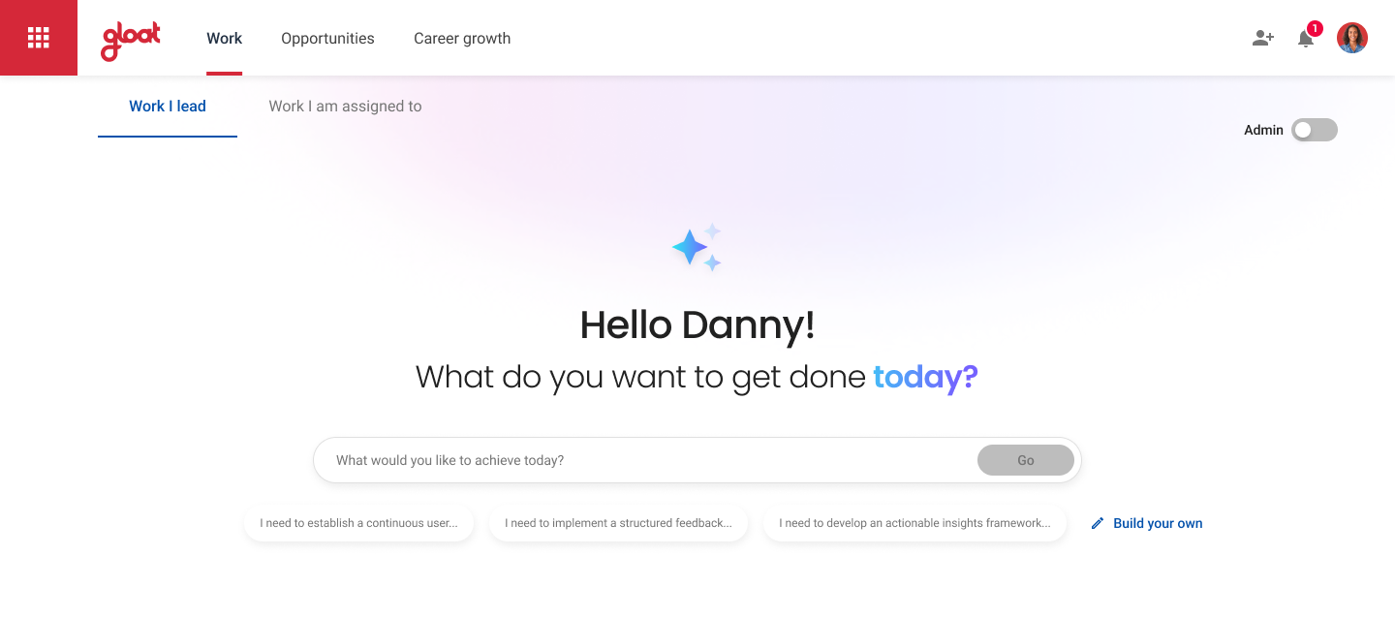
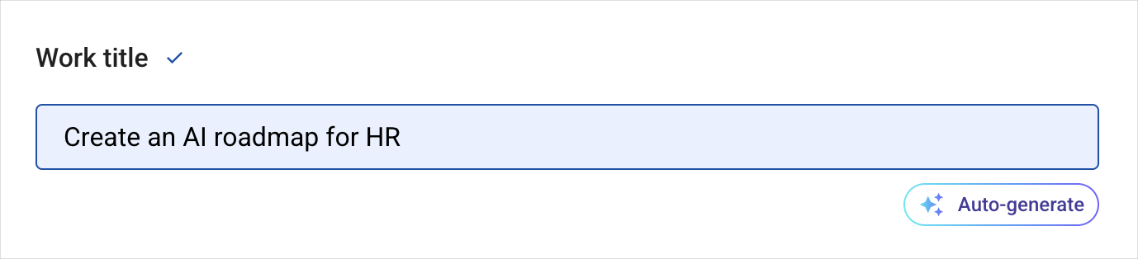

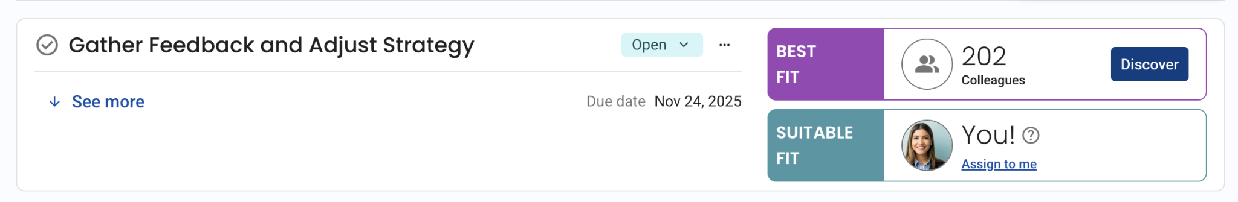
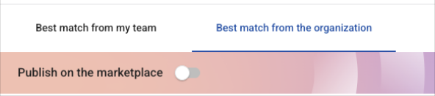
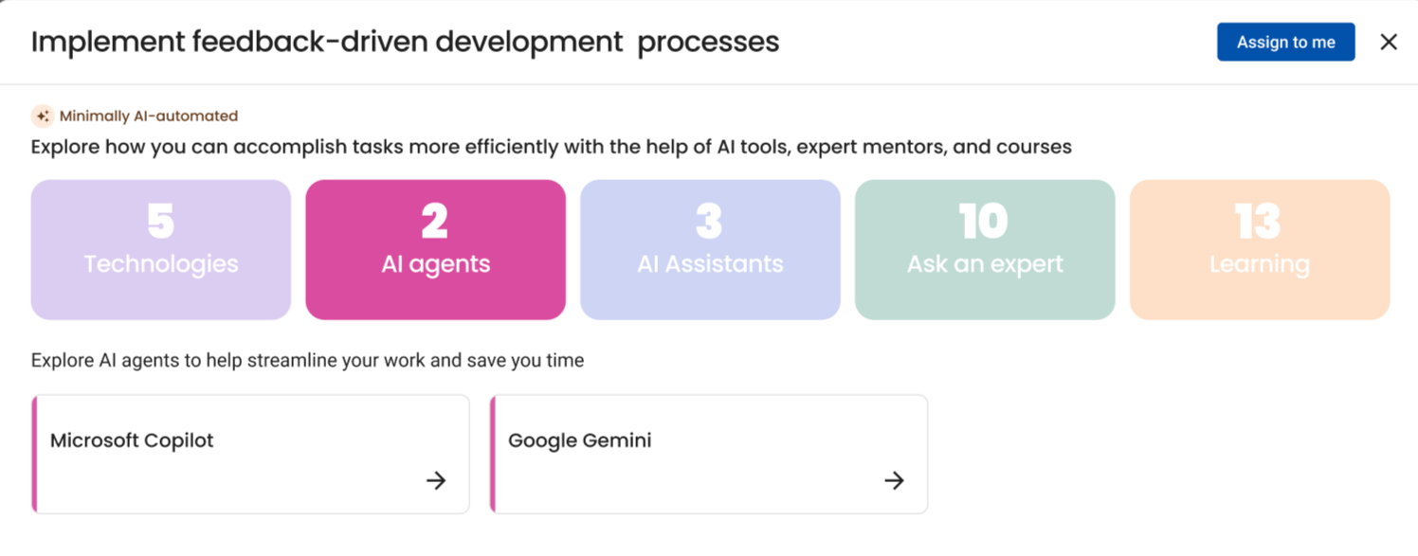
How to get started
Post Work
A
B
Know what you want to post, click here to create an opportunity in minutes using the new ‘Auto Generate’ feature.
Create work manually
Need help breaking down your work? Enter your goal here to receive an AI generated list of tasks
How can I refine work before posting?
Use the chatbot to add additional context & details e.g. co owners, deadlines or edit directly on the tasks if you want to refine any of the AI generated responses
Assign Work
What does best fit/suitable fit mean?
For each activity, the AI recommends who is the best fit for the task - it will suggest you if you have the skills required (you can review by clicking the question mark icon) otherwise it will recommend colleagues.
A
B
A
Select best skill match from your team or look across the organisation to find relevant talent. Remember to publish to the marketplace to make it visible to others.
B
Find ways to accelerate your work by:
Understanding the automation potential of each task
Finding relevant AI agents assistants or technologies that can help you automate the work
Upskilling using relevant experts in the business or learning content

Slide 3
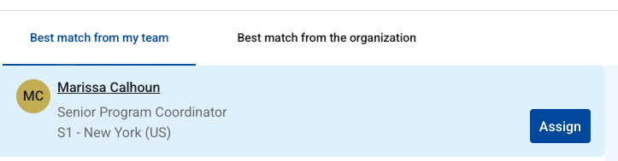
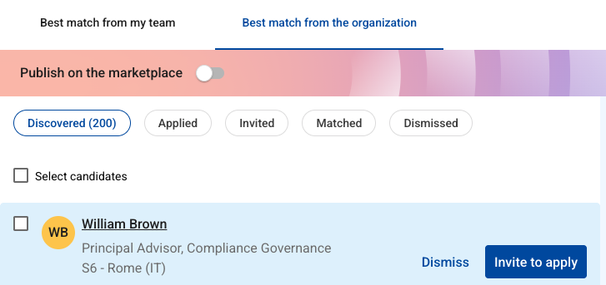

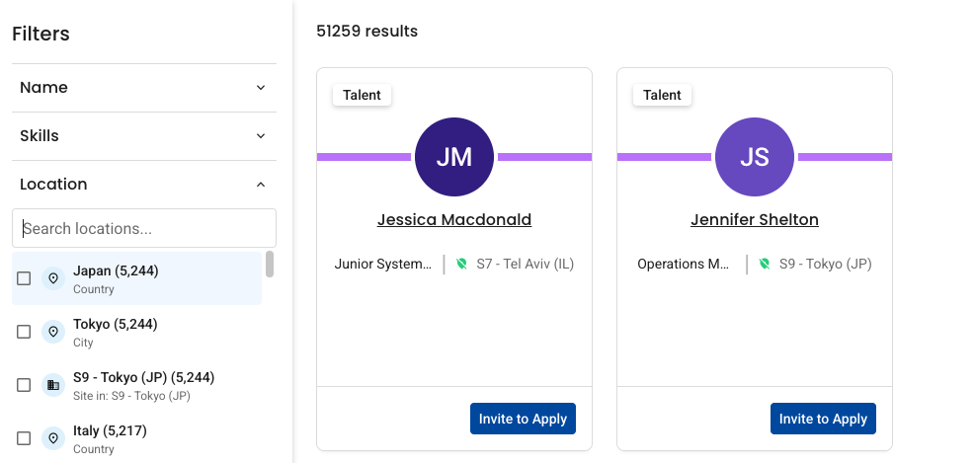
How can I find people to work with?
Assign work to your team
1
Speak to employees before clicking ‘Assign’ to check capacity/appetite
2
Click ‘Assign’ to send a confirmation email to the employee and automatically add the project to their profile upon completion.
For each activity, see the best skill match from your team
Note: This tab will appear for line managers & only team members with completed profiles will appear.
3
Remind team members who did not appear to complete their profiles
Let AI discover candidates across the organisation
1
Review AI suggested matches for your activity. Click into profiles to see full details on candidate experience, current role, location etc.
2
Click Invite to apply to ask candidate to review the Activity and apply if interested
3
If candidate responds, schedule a 15 min chat to validate suitability before assigning
Publish on the marketplace to encourage applications
1
Toggle “Publish to Marketplace” to promote your project to relevant candidates.
2
When candidates are a strong skill match, your project will appear in their weekly digest emails and on their Opportunities page.
Activities that are not published to the marketplace will remain visible only to you, your assigned team members, and discovered candidates you invite to apply.
3
Respond to all applications, even if you plan to decline. It’s always better for candidates to receive a response than no reply at all.
Use search to pinpoint the right candidates
1
Click Search candidates in the top-right to find a specific candidate you have in mind
2
Or use filters in the Search popup to narrow down results and find people with the right skills, location, business unit or grade level
3
Click Invite to apply to ask candidate to review the Activity and apply if interested

