Slide 1

Work on the Talent Marketplace
When should I apply for ‘Work’?
Seeking New Challenges
Exploring New Paths
Supporting Career Growth
Do you feel some of your skills aren’t being fully used? Are you looking for ways to make a bigger impact?
‘Work’ helps you discover part-time opportunities where you can take on new challenges, apply your strengths in different contexts, and continue learning across the organisation.
Are you unsure of your next career step?
‘Work’ helps you explore different areas of the business and discover what truly excites you.
Try out new roles, connect with different teams, and get clarity on where you want to take your career.
Have a clear goal in mind and want to build the experience to get there?
‘Work’ can help you gain hands-on experience, strengthen the right skills, and expand your network.
It’s a practical way to prepare for your next step — whether that’s a promotion, a new role, or a shift in direction.
Frequently asked Questions
1
2
Who can apply for ‘Work’?
Anyone! All you need to do is create a profile on the Talent Marketplace and the AI will start recommending relevant opportunities
Do I need approval from my manager?
No, but we recommend letting them know before applying for opportunities to give them visibility
3
4
5
Is there a maximum number I can apply for?
There’s no limit, provided that taking on multiple projects doesn’t impact your everyday work and objectives
Can I apply for projects outside my current business area?
Yes. One of the benefits is that you’ll be able to see openings in other business areas, that you might otherwise not be aware of
Will compensation be affected when taking on ‘Work’?
These opportunities are voluntary and don’t include additional pay. The reward is the chance to grow your skills and shape your career path

Slide 2
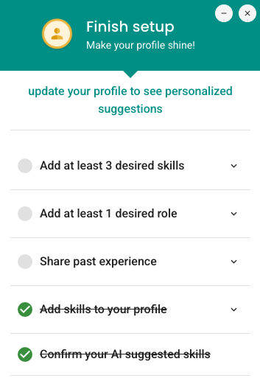
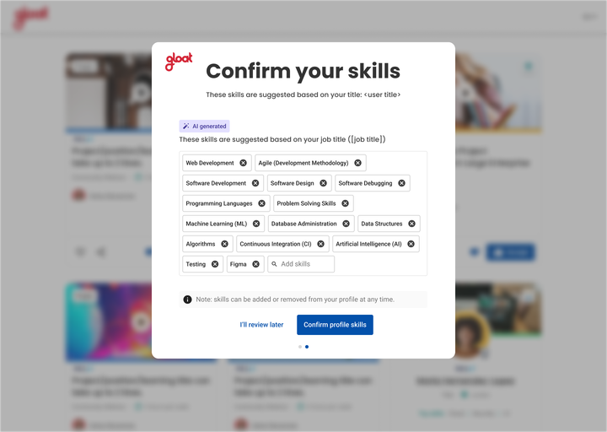

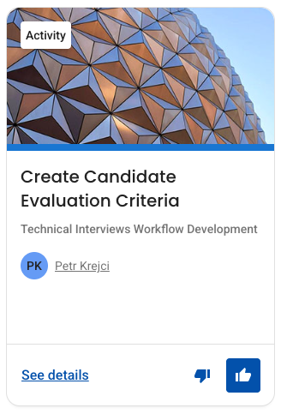
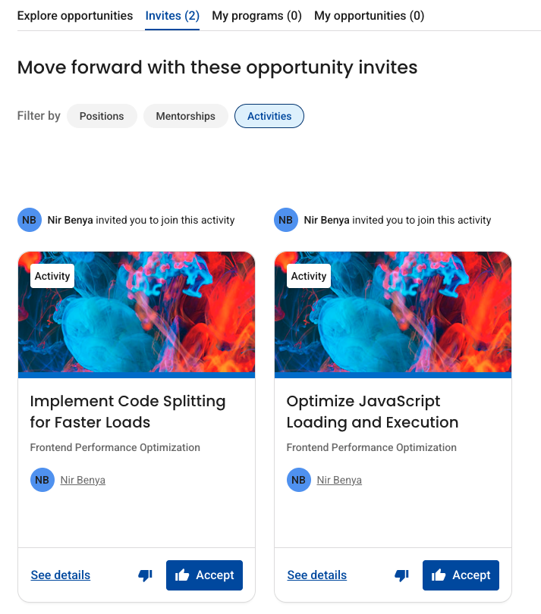
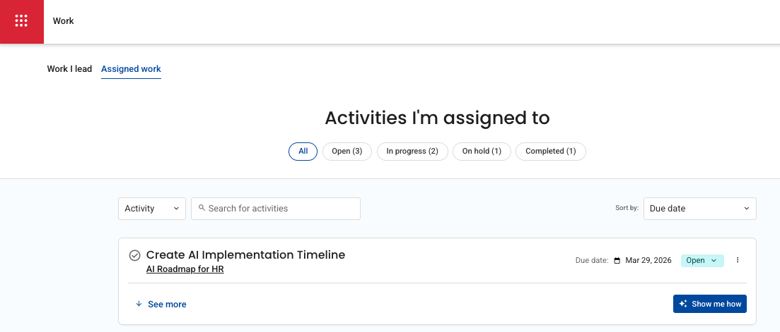
How to get started
Update your Profile
B
Already created a profile? Make sure your details are up to date. The more information you add, the better the matches you will receive
Know what you want to post, click here to create an opportunity in minutes using the new ‘Auto Generate’ feature.
A
Logging in for the first time? Review the AI inferred skills suggested based on your job title
How will I get notified of relevant opportunities?
Once your profile is set up, you can browse available projects anytime on the Opportunities page. You’ll also receive relevant updates in the Weekly Digest email and nudge emails from colleagues encouraging you to apply
Finding Opportunities
B
Respond: Opportunity owners can also reach out directly to you. In your ‘Invites’ tab you can review and accept or decline requests.
A
C
Manage Work: Once you and the opportunity owner have agreed to start working together, your activity will appear under the ‘Work’ tab. Here you can access tools to complete the work e.g. AI assistants and prompts, and track your progress
Apply: Look on your Opportunities page and review relevant suggestions. Click the thumbs up 👍 to apply & notify the owner. Click the thumbs down 👎 to remove from suggestions (no notification will be sent)

