Slide 1


Health Colorado Inc.
Conflict of Interest Legislation

Slide 2
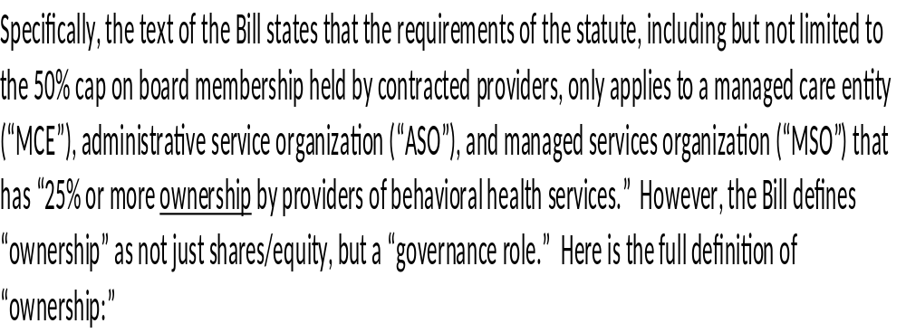

Slide 3


Slide 4
Governance
Option 5: Empower Community Board Members with Voting Rights and Remove Two
Provider-Directors
Under Option 5, HCI would grant the 2 community members on the board voting rights such that
they are true members of the governing body of HCI rather than merely spectators to board
activities and decision-making. In addition, HCI would also need to remove 2 (or more)
provider-directors from the board in order to achieve the 50% cap on provider-director
representation on the HCI board. Beacon’s appointee and the 2 community members would be
on the non-provider-director side of the equation, and the 3 remaining provider-directors would
make up the provider-director side of the equation.

Slide 5
Health Colorado Board of Directors
Old
  Beacon
  Valley Wide
  Health Solutions
  South East Health Group
  SolVista
  SLVBHG
  Community Board Member
  Community Board Member
New
  Beacon
  Valley Wide - FQHC
  Health Solutions - Urban CMHC
  ?? - Rural CMHC – will be chair
  Community Board Member
  Community Board Member

Slide 6
Ownership
Option 8: Partial-Sale by Provider-Shareholders and Exercise of HCI’s Right of First
Refusal
The above options contemplate all provider-shareholders retaining ownership in HCI. The HCI
Bylaws also provide for certain rights of first refusal (“ROFRs”) should any provider-shareholder
wish to redeem their shares in HCI. If that is the case, HCI could buy back the
shares from the redeeming shareholder(s) and simply retire those shares. It is not required that
those shares be resold to a non-provider party or otherwise. However, given this is a
sale/redemption option, we have not fleshed it out in detail here but would be happy to do so
upon request if any HCI shareholder wishes to be redeemed and the remaining HCI shareholders
would like to better understand the corporation’s options pursuant to such redemption.

Slide 7
Recommendation:
Governance
Ownership
Utilize option 5 to change board governance. This is the best of the options and all providers are leaning towards this option. This will meet the 50% cap on the board.
Only other option would be to add a community member for each provider to balance and have more non-provider votes.
Decrease shares from 17% to 5% to remain under the 25% ownership.
  One owner/provider will need to decrease 4.99%
Selling all shares and becoming a provider only does not meet our objectives.
The only reason to sell shares is if we are in agreement to move towards a RAE 3.0 bid.

