Slide 1
Colorado Health Partnerships
Durango
April 25th, 2015

Slide 2
What We Know
Health Care Policy and Financing RCCO Guidance
The RCCO regions will stay the same, with stakeholder meeting to be held to determine the fate of Larimer and Elbert counties.
The RCCO and BHO contracts will be combined – 7/1/2017
Behavioral Health services will MOSTLY remain capitated

Slide 3
What We Know
Health Care Policy and Financing Guidance
No physical health risk to start
Over five years there will be a glide path to physical health risk
Pace and structure for expanding risk may vary by region
Appropriate licenses will need to be in place

Slide 4
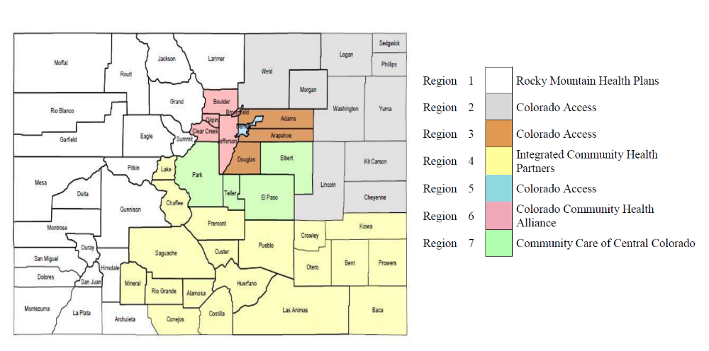
The Regions
Advantage or Disadvantage
Our BHO is the only one that is broken apart. Our BHO is in three RCCOs.
(Assuming that the Larimer – Elbert problem will be fixed)

Slide 5
Questions
What is HCPC looking for in a bid
How do we bid
What can CHP contribute to a bid
    Can we agree on a business model
What if we don’t win
Can behavioral health rates for the three RCCO regions be separately certified

Slide 6
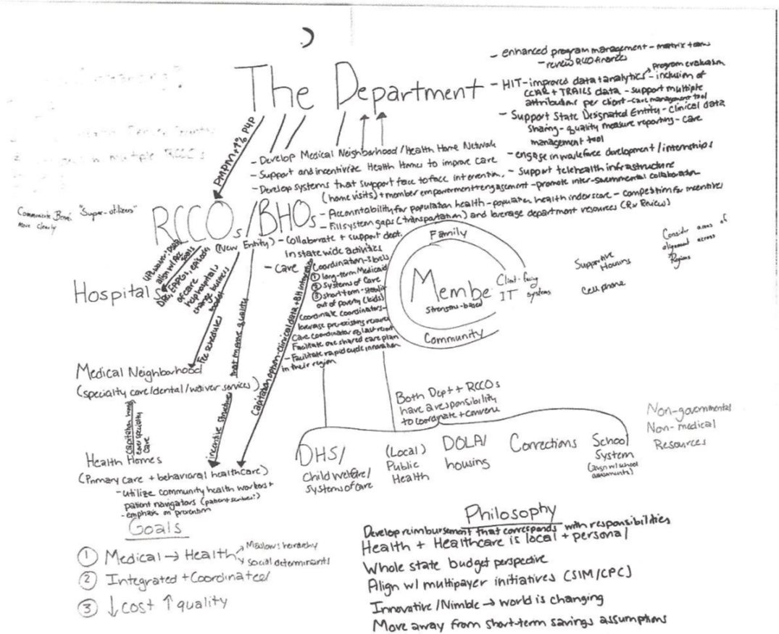
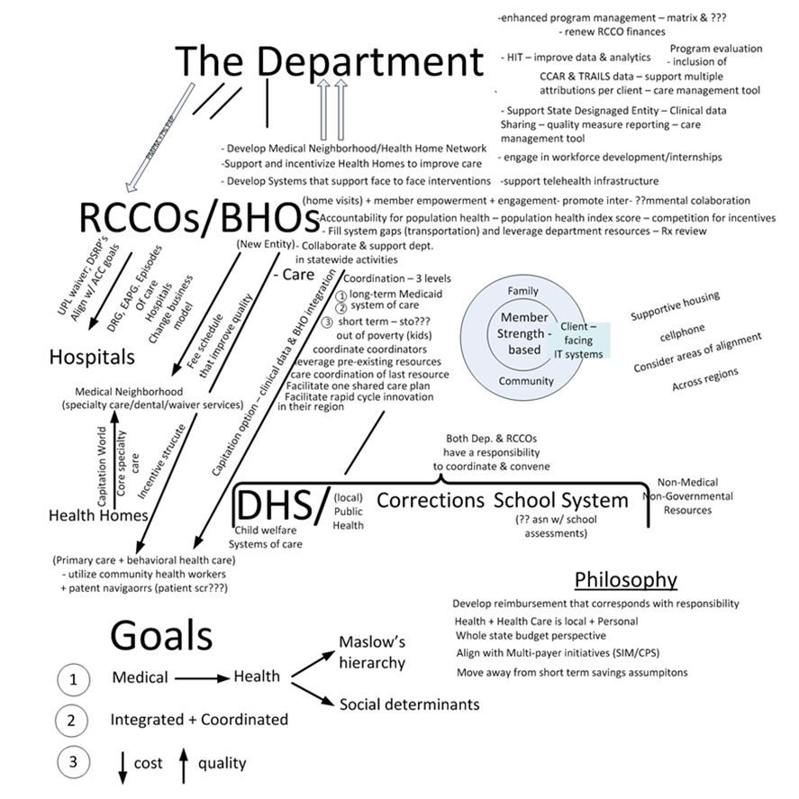
What is HCPC looking for in a bid

Slide 7
What is HCPC looking for in a bid
Interpreting the Hieroglyphics
A combined RCCO/BHO that can impact health care costs by integrating capitated behavioral health services into primary care fee for service structures, that will be evolving toward risk, with a focus of coordinating medical procedures and community services, that impact the social determinants of health, in order to reduce health care spending.

Slide 8
What is HCPC looking for in a bid
How many bidders do they want
          Will they award more than one region to a contractor
What is the value of our integrated sites
      If we win a region
      If we don’t win a region
  Behavioral Health, Care Coordination and Social Determinants of Health will be more important than primary care.

Slide 9
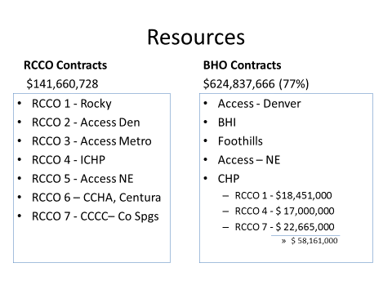
What is HCPC looking for in a bid

Slide 10
Health Authority
HCPF
Health
Authority
CDPHE
Population Health
Strategy and
Regulation
Direct Patient
Care
DHS
DOI

Slide 11
How do we bid
Is CHP the bidding entity
How many regions do we bid
Where are we the primary bidder
Where do we partner
Where do we contract for the behavioral health risk from other bidders

Slide 12
How do we bid
Where do we provide our network of services
Where do we provide back office admin service
What about RCCO regions outside of our BHO area

Slide 13
What can CHP contribute to a bid
Colorado Health Partnerships role as the BHO contracting entity will end 6-30-2017 – our operating agreement does not bind us together for the RCCO bid
7.6. Other Activities of Members or Affiliates; Additional Joint Investments Any Member or any Affiliate thereof may have other business interests and may engage in other business ventures of any nature or description whatsoever, whether currently existing or hereafter created; provided, however, such business may not compete, directly or indirectly, with the business of the LLC within the geographic region served by the LLC.

Slide 14
What can CHP contribute to a bid
CHP holds the LSLPN License
CHP has the insurance reserve to cover BH risk in three RCCO regions
CHP has an organized lobbying structure
CHP has experience organizing a bid effort
Proposed business mode
  Is it time to bring in other provider partners

Slide 15
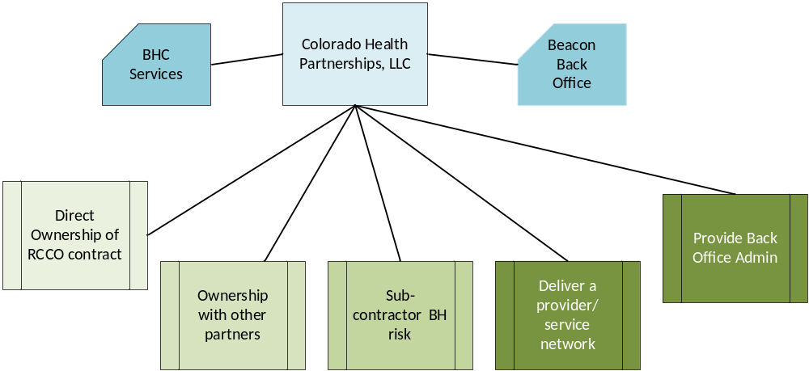
What can CHP contribute to a bid
Potential Business Structure

Slide 16
What if we don’t win
It’s likely that we won’t win all of the RCCOs within our BHO Area
Can we figure out how to work in other regions
  FBHP
  Northeast
  BHI
  Denver
What role can CHP play, post award, in organizing the efforts in each region

Slide 17
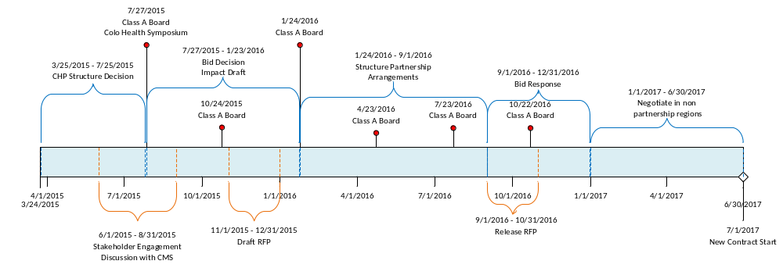
Draft Timeline

