Slide 1

Class A Board
10-24-2015
ACC 2.0 Back to the Future

Slide 2
HCPF Evolution in Thinking
ACC Model Details and Policy Decisions 4-21-15
  …the ACC will continue to pay most physical health through managed fee for service and most behavioral health through a capitated payment structure.
ACC Phase II-1 10-1-2015
  the ACC will continue to support payment methodologies for different regions and providers that promote value based purchasing.
ACC Phase II Concept Paper 10-20-2015
  Behavioral health services for all clients will be reimbursed by the State Agency either for encounters or for services rendered, rather than through capitation.
  The State Agency will retain all of the responsibilities related to administering benefits for clients and moving payment for those services toward a more value-based payment system.

Slide 3
ACC 2.0 Key Concepts
Value Based Payments
  Value-based payments will be layered on a fee-for-service platform.
Goal
  The goal of the next iteration of the ACC is to optimize health for those served by Medicaid through accountability for value and client experience at every level of the health system and at every life stage.
Principals
  Person- and family-centeredness
    WHO Def - "complete state of physical, mental and social well-being, and not merely the absence of disease or infirmity."
  Outcomes-focused and value-based
    Triple Aim
    aligns with the core commitments of the Hickenlooper Administration to operate programs with efficiency, elegance and effectiveness
  Accountability at every level
    They are going to keep an eye on the money

Slide 4
ACC 2.0 Key Concepts (cont)
Health Neighborhoods
  Team Based Care within PCMP Practice
  Specialists within the neighborhood
  RAE contracting authority
Client
  In ACC Phase II, the client and client’s family will be empowered and accountable for managing their own health and appropriately using the health care system.
  Onboarding, Client Engagement, Client Incentives
Contracting by the RAE
  The RAE must develop and maintain a formal, contracted network of PCMPs, specialty behavioral health providers, and home and community-based services case management agencies.
    RAEs will be expected to develop strategies to serve rural and frontier areas to ensure that all clients receive the same high-quality care and have adequate access to care.

Slide 5
ACC 2.0 Key Concepts (cont)
Behavioral Health System
  The RAE will be responsible for administering Colorado's Community Behavioral Health System to ensure the client care and service functions of the BHO are retained as appropriate. The RAE will be expected to develop systems of care for clients with behavioral health needs. Activities may include network development, quality-improvement, contracting and licensure activities, and helping clients to navigate the behavioral health system.
Benefit Managements
  State Agency will remove the covered diagnosis criteria for all behavioral health
  State Agency will work to define integrated care and find ways to reimburse for instances that involve both physical health and behavioral health in the same visit.
  State Agency will seek to resolve any other barriers to integrated care,
  State Agency will explore options for reimbursing multiple and new provider types for low acuity behavioral health services

Slide 6
ACC 2.0 Key Concepts (cont)
Client Incentives
  A defined, statewide scope is necessary for budgeting and assessing efficacy. Incentives will be between $50 and $250 per client per year. They can be either in-kind (e.g., gym memberships, nutrition or cooking classes, bicycle rentals, Fitbits, etc.) or financial incentives.
  To support RAE client incentive programs, the State Agency will make its first foray into utilizing clinical measures for program administration. The client incentive program success will be measured on both claims and clinical measures.
Transition
  The State Agency, in partnership with the new RAEs and the current RCCOs and BHOs, will develop a staged transition plan that ensures smooth handoffs.

Slide 7
Role of the RAE
One administrative entity
Will be paid an admin PMPM
Regional Accountable Entities – will be accountable for the outcomes of the clients enrolled in their region and will achieve those outcomes in four major ways:
  supporting clients in managing their own health
  developing and overseeing a coordinated delivery system and managing to value-based payments from the State Agency
  developing strategies for implementing their own value-based payments for delivery system participants
  identifying and addressing health inequities and population health issues.

Slide 8
Role of the RAE (cont)
The RAE will be responsible for contracting with the PCMPs, the Health Team providers, behavioral health practitioners, and LTSS case management agencies
The RAE will be responsible for creating a case management network that maximizes choice
The RAE will be responsible for ensuring access to specialty and hospital care and developing infrastructure that supports coordination between the Health Team and Health Neighborhood
the RAE will be responsible for promoting and supporting State Agency initiatives including those around electronic consultation and other telehealth programs

Slide 9
Role of the RAE (cont)
the RAE will be responsible for developing mechanisms to engage community partners across the RAE’s region on population health and non-medical community services
the RAEs will be responsible for a Primary Care Case Management (PCCM) system of care. Payments to the RAE will include value-based components such as payments tied to— Key Performance Indicators, shared savings, and a competitive pool
The RAEs will be responsible for making value-based administrative (PMPM) payments to Health Team providers with more than 1,000 attributed ACC clients

Slide 10
Role of the RAE (cont)
the RAE (or a delegated community provider) will begin the onboarding process by helping clients complete an eligibility-type-specific physical, behavioral, and social needs screening
the RAEs will trial and evaluate various client engagement strategies using a standardized tool to measure client activation/ engagement
RAEs will be required to develop a system to support clients who are seeking information or assistance and who are not engaged with their Health Team

Slide 11
Role of the RAE (cont)
The RAE will be required to offer evidence-based interventions and have methodologies for measuring the efficacy of their approach (for client incentives)
The RAE will be expected to support the PCMPs financially and operationally in utilizing lay health workers such as patient navigators, community health workers, promotoras (Latino/a community health workers), and peer specialists (including family, youth, and adult peer specialists)
RAEs will procure and offer an interoperable mobile-ready care coordination tool to support communication and coordination between members of the Health Team

Slide 12
Role of the RAE (cont)
As discussed previously, the RAE will have concrete requirements around ensuring access to this network and promoting engagement and coordination with this broader neighborhood or community of providers
  The RAE will maintain a list of the available medical providers (specialists) and non-medical services available to clients within the community
  The RAE will work to develop protocols, MOUs, and business processes to help the various members of the health neighborhood work together
  RAE will also be encouraged to work with other vendors; for example, creating an MOU with the Medicaid Dental Administrative Services Organization to promote coordination and collaboration on shared clients
  the RAE will be responsible for creating or supporting existing community forums that enable different providers to form personal relationships and facilitating the development of necessary relationships on an ad hoc basis

Slide 13
Role of the RAE (cont)
The RAE must develop and maintain a formal, contracted network of PCMPs, specialty behavioral health providers, and home and community-based services case management agencies.
The RAE will be responsible for ensuring the quality of services provided within the network and tracking how the network is meeting requirements such as access, person-centeredness, and others
RAEs will be expected to develop strategies to serve rural and frontier areas to ensure that all clients receive the same high-quality care and have adequate access to care

Slide 14
Role of the RAE (cont)
The RAE will be responsible for providing intensive support to contracted PCMPs
the RAE will be responsible for managing the network of Case Management Agencies (CMAs) that serve the LTSS population
the RAE will provide clients with open, informed, and conflict-free choice among CMAs by contracting with a diverse network of qualified CMAs and functioning as a neutral party to connect clients with a CMA that meets their needs
The RAE will be required to offer practice support to the Health Team, using strategies approved by a RAE Board of Directors (described in Oversight) and the community

Slide 15
Role of the RAE (cont)
The RAE will be able to offer grants to PCMPs and community partners to invest in rapid-cycle quality-improvement activities related to State Agency-directed priority areas
The RAE will be responsible for engaging and supporting the communities within its geographic region
RAE should also be familiar with and, to the extent possible, align its efforts with the community health improvement plan and nonprofit hospitals' community health needs assessments and implementation strategies
RAE will be required to retain BHO functionality by administering the Community Behavioral Health System to ensure individuals with serious and ongoing behavioral health needs receive the services and supports they need

Slide 16
Role of the RAE (cont)
The RAE will be responsible for administering Colorado's Community Behavioral Health System to ensure the client care and service functions of the BHO are retained as appropriate. The RAE will be expected to develop systems of care for clients with behavioral health needs. Activities may include network development, quality-improvement, contracting and licensure activities, and helping clients to navigate the behavioral health system
RAE will have specific requirements to develop systems of care to serve children with high behavioral health needs who are at-risk of an out-of-home placement and clients who are transitioning back into the community from Corrections

Slide 17
Role of the RAE (cont)
RAEs will be required to be a 24-hour resource
RAEs will be required to support Health Teams in using client engagement techniques such as motivational interviewing, chronic disease self-management, and health coaching

Slide 18
Role of the State
The State Agency serves as the foundation for the program, playing a crucial role in providing the infrastructure needed for success
The State Agency will administer a flexible benefits package, manage enrollment into the RAEs, and ensure cross-agency alignment
The State Agency will retain all of the responsibilities related to administering benefits for clients and moving payment for those services toward a more value-based payment system
  Two Functions
    Utilization Management
    Benefits Management
    Align Hospitals Incentives

Slide 19
Role of the State
The State Agency will work with stakeholders and conduct rigorous cost/benefit analysis to determine the best method for achieving physical and behavioral health integration
  State is considering
    Remove Covered Diagnosis
    Find ways to reimburse integrated care
    Resolve barriers to integrated care
    Explore reimburse multiple and new provider types
the State Agency will need to expand UM activities to include specialty behavioral health services

Slide 20
Role of the State
The State Agency seeks to better align hospitals with the ACC and incentivize them to promote whole-person health
the State Agency will mandatorily enroll clients into the ACC at the time of Medicaid enrollment
The State Agency is committed to ensuring that the ACC is aligned with internal benefits and with federal, state, and local health improvement efforts in order to maximize impact and minimize redundancies

Slide 21
Role of the State
the State Agency will work to create ACC Phase II alignment include:
  Comprehensive Primary Care Initiative (CPC)
  The State Innovation Model (SIM).
  Better Care, Better Costs, Better Colorado (“BC3”)
  The Colorado Opportunity Project

Slide 22
Overarching Direction
Converts the BHO from a program run by community providers to a state run program administered by state employees
Replaces the 2 community management information sysyems with a centralized state run information system
Removes risk and related cost control mechanisms and replaces them with encounter and claims based fee for services payments

Slide 23
Overarching Direction
Places the emphasis on primary care and dilutes aggressive behavioral health interventions

Slide 24
Provider Driven Managed Care
Aligns
  Administration
  Finances
  Services
Concept Paper – fractures and misalignment Incentives
  Admin to the RAE
  Finances back to the State
  Services Remain with the provider
Risk Contract Aligns Incentives

Slide 25
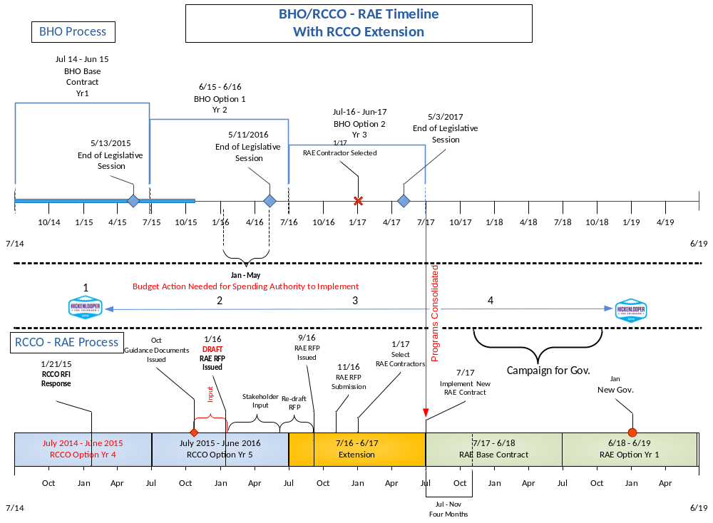

Slide 26
Discussion
RAE Bid Strategy
  Are providers necessary?
How do we prepare
  Role for CHP
  Beacon Health Options
  Behavioral Health Centers
    What is the value of our comprehensive care system
Do we go along or do we push back?
  CBHC – CCHN
  CHP alone

