Slide 1
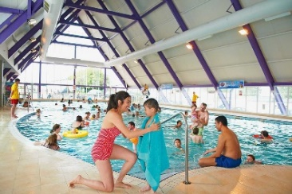
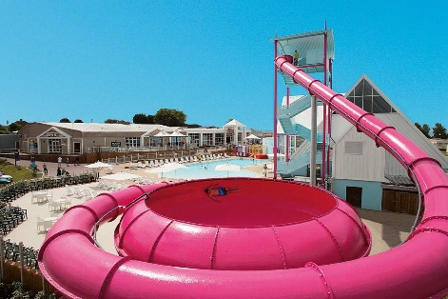
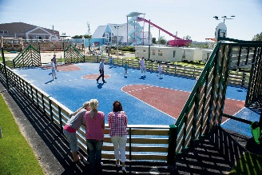
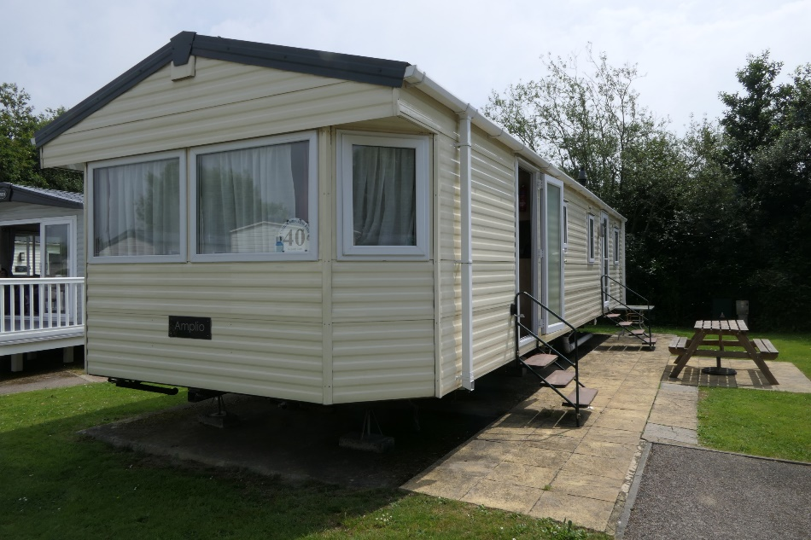
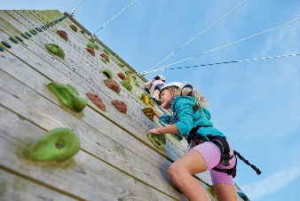
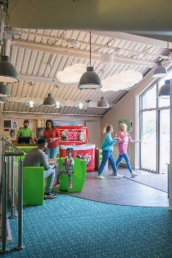
Combe Haven Holiday Park
St. Leonards, East Sussex
https://www.haven.com/parks/sussex/combe-haven
Registered Charity No. 1110644
Heated indoor and outdoor pools
with space bowl flume
Bar/Restaurant
Funworks amusement arcade
Launderette
On site shop/food outlets
Relaxed entertainment programme suitable for the whole family
Adventure playground
Pitch & Putt
Climbing wall
Indoor soft play area
Local buses into Eastbourne, Bexhill, Hastings and Pevensey Bay
Local supermarkets 5 mins drive, beaches & cinemas in Hastings 5-10 mins drive.
Welcome to our caravan at:
Combe Haven Holiday Park
St. Leonards, East Sussex
Available from April to October

Slide 2
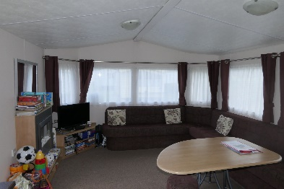
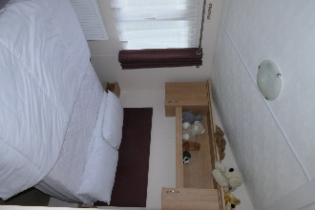
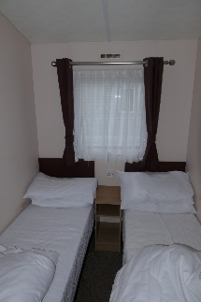
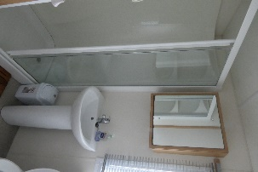
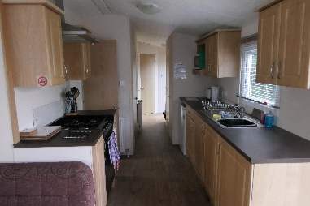
Caravan booking form (NC40/NC50)
Please return to:
Children with Cancer Fund
4 The Triangle
Willingdon
East Sussex
BN20 9PJ
Or complete, scan and Email to: holidays@childrenwithcancerfund.org.uk
Welcome to the Children with Cancer Fund caravan. CWCF is a small charity based in Polegate, East Sussex. We are here to help children with a diagnosis of cancer up until the age of 18 and their families by offering holiday breaks.
10 berth caravan with Central Heating
There are two hospitals in the area:
Eastbourne DGH, Kings Drive, Eastbourne BN21 2UD {30 mins drive}
Hastings Conquest, TN37 7RD (Kipling Ward) {10 mins drive}
Name:
Address:
 | Post Code:
Telephone:
Mobile:
Email
How did you hear about us?
Date: From | To
Please list ALL people who will be staying in the caravan |  |  | Age if under 18
1
2
3
4
5
6
7
8
9
10
Signed: |  | Date:
Large lounge with pull- out double bed
Double bedroom
2 toilets/1 shower
3 x twin bedded rooms
Fully equipped kitchen
The caravan is well equipped with oven, 4 ring hob, microwave, fridge, kettle and toaster.
There are 3 twin bedded rooms and 1 double room with a pull out double sofa bed in the lounge
Duvets are provided but you will need to take your own sheets, duvet covers, pillows, pillow cases, towels and tea towels.
Shower room with washbasin and toilet & a separate toilet room
There is a TV, DVD player, books and some games
Patio/grass area with a wooden picnic table. One car park space adjacent to the caravan, additional spaces nearby.
Please note: No smoking. No Pets in caravan.

